Slide 1
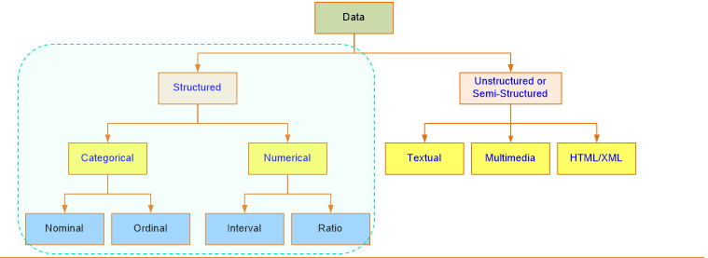

Slide 2
Nominal - used for labeling variables, without any quantitative value. “Nominal” scales could simply be called “labels.”
Gender , Color ,

Slide 3
Ordinal - the order of the values is what’s important and significant, but the differences between each one is not really known.
Very Unhappy , Unhappy, Happy , Very Unhappy

Slide 4
Interval - Scales in which we know both the order and the exact differences between the values.
They don’t have a “true zero.”
Temperature

Slide 5
Ratio : They tell us about the order, they tell us the exact value between units, AND they also have an absolute zero.
height, weight

Slide 6
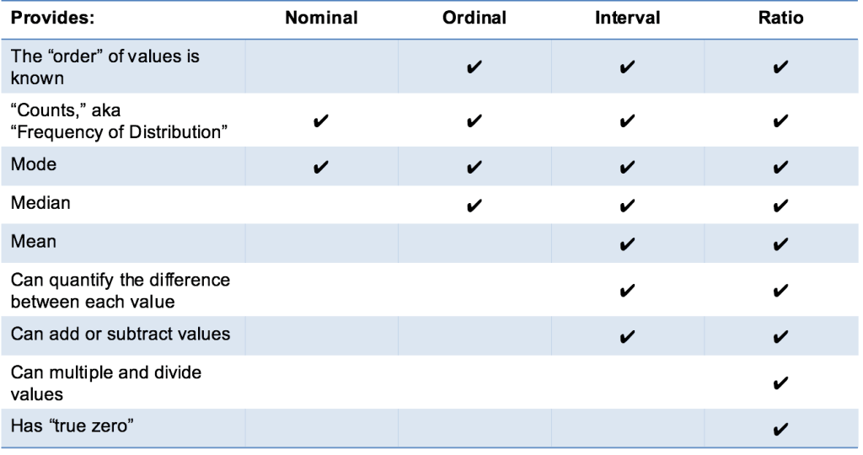
Notes:
In Ratio – GM Also

Slide 7
