Slide 1
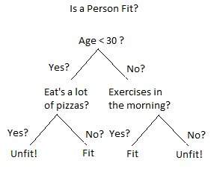


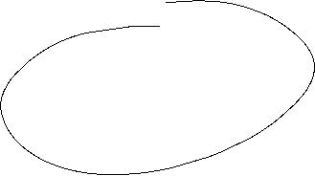


Slide 2
Will the customer leave big tip ?
great
Food
yuck
mediocre
Speedy
no
no
no
yes
yes
Price
high
adequate
yes
no

Slide 3
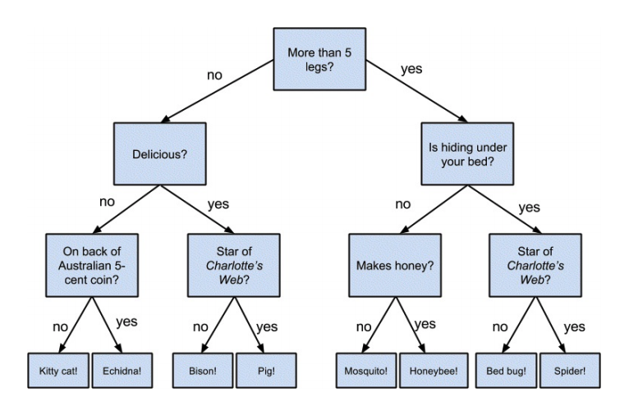
Animal Classifier

Slide 4
Decision tree is a type of supervised learning algorithm
Used in both regression and classification problems.
works for both categorical and continuous input and output variables.

Slide 5
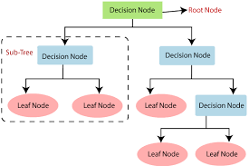
Root Node represents the entire population or sample. It further gets divided into two or more homogeneous sets.
Splitting is a process of dividing a node into two or more sub-nodes.
When a sub-node splits into further sub-nodes, it is called a Decision Node.
Nodes that do not split is called a Terminal Node or a Leaf.

Slide 6
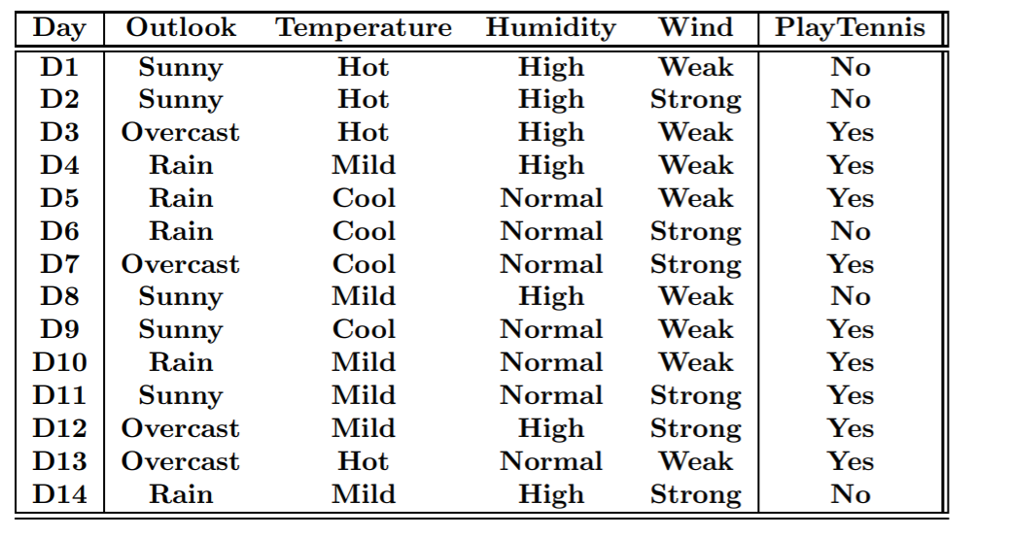

Slide 7
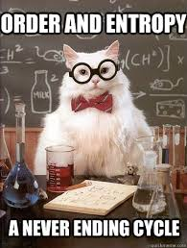

Slide 8

Entropy
also called as Shannon Entropy (Claude Shannon, the “father of information theory”)
is denoted by H(S) for a finite set S, is the measure of the amount of uncertainty or randomness in data.
it tells us about the predictability of a certain event

Slide 9
Entropy for coin toss
H(S)=P(heads)⋅log(1/P(heads))+P(tails)⋅log(1/P(tails)).
H(S)=1/2⋅log(2)+1/2⋅log(2)=1/2+1/2=1,

Slide 10
Calculate entropy for a coin which has heads on both the sides,

Slide 11
It’s 0
No randomness

Slide 13


Calculate initial entropy

Slide 14


Slide 15
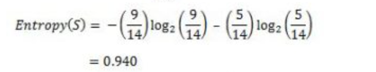
distribution is fairly random or not ?

Slide 16
Which attribute to choose to split ?
Wind, Outlook, Temperature , Humidity ?

Slide 17
choose the attribute that gives us highest possible Information Gain

Slide 18
Information Gain
also called as Kullback-Leibler divergence
Is denoted by IG(S,A) for a set S
is the effective change in entropy after deciding on a particular attribute A.
It measures the relative change in entropy with respect to the independent variables.

Slide 19

IG(S, A) is the information gain by applying feature A
H(S) is the Entropy of the entire set, while the second term calculates the Entropy after applying the feature A, where P(x) is the probability of event x.

Slide 20


Let’s choose attribute wind
where ‘x’ are the possible values for an attribute. Here, attribute ‘Wind’ takes two possible values in the sample data, hence x = {Weak, Strong} We’ll have to calculate:

Slide 21
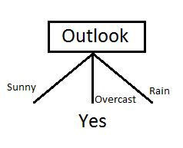

Slide 22
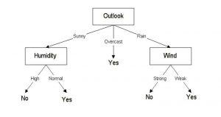

Slide 23
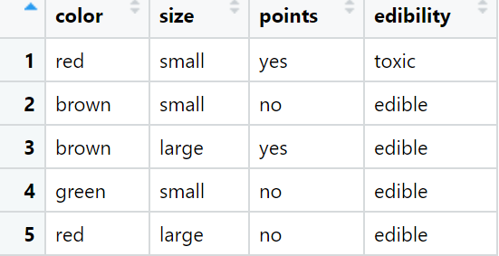

Slide 24
if the data-set is pure (e.g. all toxic), then
  construct a leaf having the name of the class (e.g. ‘toxic’)
else
  choose the feature with the highest information gain (e.g. ‘color’)
  for each value of that feature (e.g. ‘red’, ‘brown’, ‘green’)
    take the subset of the data-set having that feature value
    construct a child node having the name of that feature value (e.g. ‘red’)
    call the algorithm recursively on the child node and the subset

