Slide 1
Business Analysis & Valuation
By Yogesh Chauhan

Slide 2
Valuation
“Knows the price of everything, but the value of nothing” (Oscar Wilde).
Greater fool theory: there will always be a “greater fool” in the market who will be ready to pay a price based on higher valuation for an already overvalued security. Therefore, valuing assets are irrelevant.
The value is in the eye of beholder, possibly, bitcoin and gold.
However, most of financial investors do not buy financial assets based on emotional or aesthetic reasons. Therefore, the price paid for any asset should reflect the cashflows it is expected to generate.
Most of times, in the stock market, we follow the noise and we try to support the noise through our valuation (momentum effect).

Slide 3
Misconceptions about valuation
Myth 1: A valuation is an objective search for “true value.
  Truth: All valuations are biased. The only questions are how much and in which direction.
  Truth: The direction and magnitude of the bias in your valuation is directly related to who pays and how much you are paid?
Myth 2: A good valuation provides a precise estimate of value
  Truth: There are no precise valuation.
Myth 3: The more quantitative a model, the better the valuation
  Truth: If you use more variables to estimate the value, you must make more assumptions.

Slide 4
Valuing an asset is not same as pricing the asset
Drivers of value
Cashflows from existing assets
Growth in cashflows
Quality of Growth
Drivers of price (Demand and supply)
Market moods & momentum
Surface stones about fundamental
Accounting estimates
The GAP
Is there one?
If so, will it close?
If it will be close, what will cause it to close?
Intrinsic value
Value
Price
Price
Valuation estimates

Slide 5
Two approaches to valuation
Intrinsic valuation: The value of an asset is a function of its fundamentals – cash flows, growth and risk. In general, discounted cash flow models are used to estimate intrinsic value. Intrinsic valuation is designed to value assets that generate cashflows.
Relative valuation (pricing): The value of an asset is estimated based upon what investors are paying for similar assets. Therefore, it provides a value that is in build of investors’ sentiment. In general, this takes the form of value or price multiples and comparing firms within the same business.

Slide 6
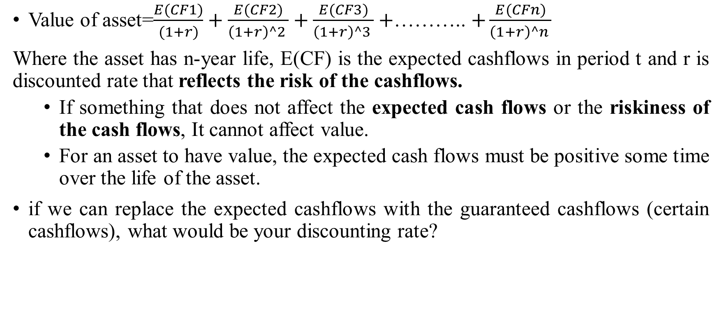
Discounted cash flow valuation
Value of asset=$\frac{E(CF1)}{(1+r)}+\frac{E(CF2)}{\left(1+r\right)^2 }+\frac{E(CF3)}{\left(1+r\right)^3 }+$……….. $+\frac{E(CFn)}{\left(1+r\right)^n }$
Where the asset has n-year life, E(CF) is the expected cashflows in period t and r is discounted rate that reflects the risk of the cashflows.
  If something that does not affect the expected cash flows or the riskiness of the cash flows, It cannot affect value.
  For an asset to have value, the expected cash flows must be positive some time over the life of the asset.
if we can replace the expected cashflows with the guaranteed cashflows (certain cashflows), what would be your discounting rate?

Slide 7
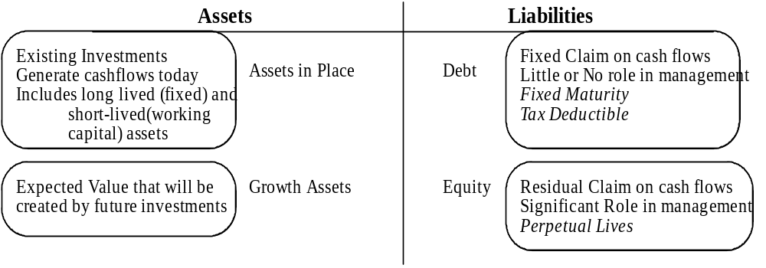
DCF Choices: Equity Valuation versus Firm Valuation
Firm Valuation: Value the entire business
Equity valuation: Value just the equity claim in the business
Notes:
A business and the equity in the business can be very different numbers…
A firm like GE in 2005 had a value of $ 500 billion for its business but its equity is worth only $ 300 billion - the difference is due to the substantial debt that GE has used to fund its expansion.
You can have valuable businesses, where the equity is worth nothing because the firm has borrowed too much….

Slide 8
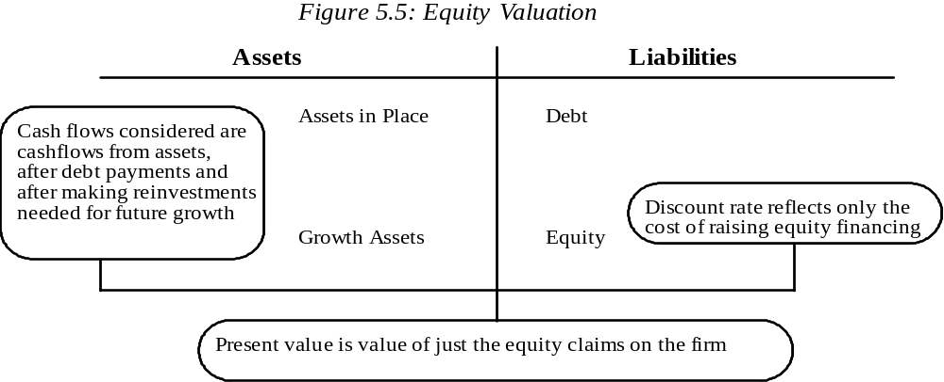
Equity Valuation

Slide 9
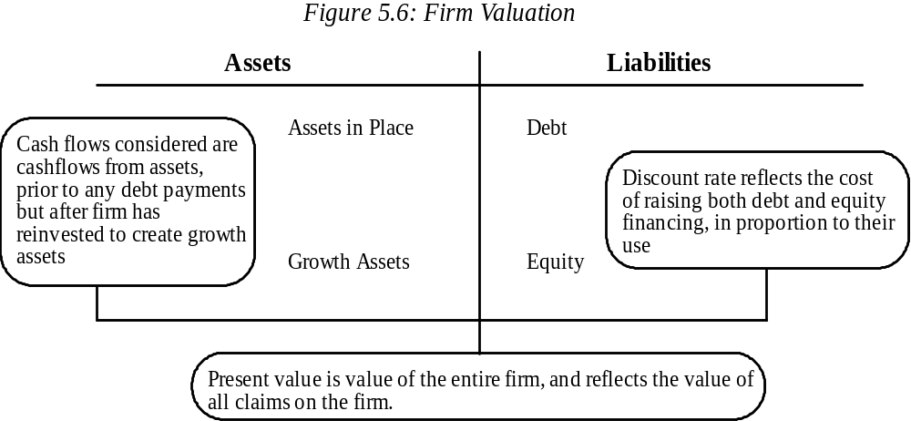
Firm Valuation
Notes:
A firm includes not just the equity, but all claim holders. The cash flow to the firm is the collective cash flow that all claim holders make from the firm, and it is discounted at the weighted average of their different costs.

Slide 10
Principles of valuation
Companies create value by investing capital from investors to generate future cash flows at rate of return exceeding the cost of that capital. (Combination of growth and Return on invested capital (ROIC) drives value).
Value is created for shareholders when companies generate higher cashflows, not by rearranging investors’ claims on those cash flows.
  When a firm substitutes debt for equity or issues debt to repurchase shares, it changes the ownership of claims to its cash flows. However, it doesn’t change the total available cashflows.
A company’s performance in the stock market is driven by changes in the stock market’s expectations, not just the company’s actual performance .
The value of a business depends on who is managing it and what strategy they pursue.

Slide 11
If you value something, you must believe it.
What valuation theory? I don't have any theories.
Do you believe? To act on your valuation, you must have faith:
  In your own valuation judgement
  In the market, the prices would move towards your value estimates.
That faith will have to be earned.

Slide 12
Process of valuation: Narrative versus Numbers
Step 1: Develop a story for the business you are valuing
In a story, you tell how you see the business evolving over time
Step 2: Test the narrative to see if it is possible, plausible, and probable.
There are lots of possible story, not all of them are plausible, and only a few of them are probable
Step 3:Convert the narrative into drivers of value.
Take the narrative apart and look at how you will translate it into valuation inputs, starting with potential market size and moving on to cash flows and risk. By the time you are done, each part of the narrative should have a place in your numbers, and each number should be backed up with a portion of your story.
Step 4: Connect the drivers of value to a valuation.
Create an intrinsic valuation model that connects the inputs to an end-value in the business.
Step 5: Keep the feedback loop open.
Listen to people who know the business better than you do and use their suggestions to fine-tune your narrative and perhaps even alter it. Work out the effects on value of alternative narratives for the company.

Slide 13
The story of a firm valuation
Firm A has total sales of $5000, which is expected to grow by 10% for the 3 years, and thereafter stable growth rate would be 5% forever. Operating cost (before depreciation) is 40% of total sales. Depreciation is 10% of sales. Capital expenditures equal 10% sales to keep the capital intensity constant. Tax rate is 30%. Working capital requirement is 5% of total sales. The firm is finance with 50% equity and 50% debt. The interest on debt is 10%. Equity beta of the firm is 1.2, risk-free rate=6%, and equity risk premium=4.77%
Please value the firm, and equity.

Slide 14
Estimation of cash flow (basic)
Free Cash flow to Firm | Free Cash flow to Equity
Sales - COGS (Operating cost) EBIT - Tax paid NOPAT Add deprecation -Capex -Change in Net working capital FCFF (Free cashflow to films) FCFF is the amount that is available to the suppliers of the capital (both equity and debt) | Sales - COGS EBIT -Interest paid EBT -Tax PAT Add deprecation -Capex -Change in Net working capital (New debt-Old debt) FCFE

Slide 15
Free cashflow to firm
 | Base year | 1 | 2 | 3
Sales | 5000 | 5500 | 6050 | 6655
Less COGS | 2000 | 2200 | 2420 | 2662
Less Depreciation | 500 | 550 | 605 | 665.5
EBIT | 2500 | 2750 | 3025 | 3327.5
Less Tax paid@ 30% | 750 | 825 | 907.5 | 998.25
NOPAT | 1750 | 1925 | 2117.5 | 2329.25
Add depreciation | 500 | 550 | 605 | 665.5
Less Capex |  | 550 | 605 | 665.5
NWC | 250 | 275 | 302.5 | 332.75
Less Change in NWC |  | 25 | 27.5 | 30.25
FCFF (free cashflow to firm) |  | 1950 | 2145 | 2359.5

Slide 16
Cost of capital
Cost of equity= Risk-free rate +Equity risk premium*equity beta
  =6% +4.77%*1.2=11.72%
Cost of debt=Interest rate*(1-tax rate)=10%*(1-30%)=7%
Cost of capital=0.50*11.72% +7%*0.50=9.36%

Slide 17
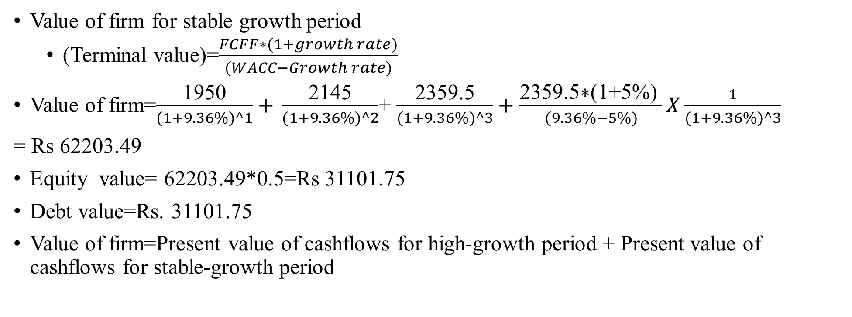
Firm valuation
Value of firm for stable growth period
  (Terminal value)=$\frac{FCFF∗(1+growth rate)}{(WACC−Growth rate)}$
Value of firm=$\frac{\text{1950}}{(1+9.36\%)^1}+$ $\frac{\text{2145}}{(1+9.36\%)^2}$+ $\frac{\text{2359.5}}{(1+9.36\%)^3}+$ $\frac{\text{2359.5}\text{∗(1+5\%)} }{(9.36\%−5\%)}X\frac{1}{(1+9.36\%)^3}$
= Rs 62203.49
Equity value= 62203.49*0.5=Rs 31101.75
Debt value=Rs. 31101.75
Value of firm=Present value of cashflows for high-growth period + Present value of cashflows for stable-growth period

Slide 18
You are willing buy the following firms. In order to discount the target’s cashflows, which discount rate would you use?
Year | 2016 | 2017 | 2018 | 2019
Revenues | 1200 | 1500 | 1875 | 2344
COGS | 684 | 855 | 1069 | 1336
Dep | 42 | 53 | 66 | 82
EBIT | 474 | 593 | 741 | 926
Less interest | 20 | 20 | 20 | 20
EBT | 454 | 573 | 721 | 906
Tax | 182 | 229 | 288 | 362
PAT | 272 | 344 | 432 | 543
Dep | 42 | 53 | 66 | 82
Capital spending | 75 | 94 | 117 | 146
Working Capital | 480 | 600 | 750 | 938
Change in NWC |  | 120 | 150 | 188
(Net debt-old debt) | 0 | 0 | 0 | 0
FCFE | 239 | 182 | 231 | 292
 | Acquirer | Target
Cost of equity | 16% | 14.75%
Cost of capital | 14% | 12%

Slide 19
Same ingredients, different approaches
Inputs | Dividend Discount Model | FCFE (Potential dividend) discount model | FCFF (firm) valuation model
Cash flow | Dividend | Potential dividends = FCFE = Cash flows after taxes, reinvestment needs and debt cash flows | FCFF = Cash flows before debt payments but after reinvestment needs and taxes.
Expected growth | In equity income and dividends | In equity income and FCFE | In operating income and FCFF
Discount rate | Cost of equity | Cost of equity | Cost of capital
Steady state | When dividends grow at constant rate forever | When FCFE grow at constant rate forever | When FCFF grow at constant rate forever

Slide 20
Estimation of cashflows

Slide 21
Steps in cashflow estimation
Estimate the current earnings of the firm
  If looking cashflows to equity, start with earnings after interest payment-i.e. net income.
Consider how much the firm invested to create future growth.
  If the investment is not expensed, it will be classified as capital expenditure. To the extent that deprecation provides cashflows, it will cover some of these expenditure.
  Increasing working capital needs, are also investment for future growth.
If looking at cashflows to equity, consider the cashflows from net debt issues (debt issued-debt paid).

Slide 22
Estimating free cash to firm
EBIT (Operating profit)*(1-tax rate) minus (Capex-dep) - change in working capital
EBIT*(1-tax rate) minus reinvestment (Capex-dep+ change in working capital)
EBIT*(1-tax rate)*(1-reinvestment rate).
Reinvestment rate=reinvestment /EBIT*(1-tax rate)

Slide 23
From reported to actual earnings
Operating leases
Convert into debt
Adjust operating income
R&D Expenses
Convert into assets
Adjust operating income
Firm’s history
Comparable firms
Cleanse operating items of
Financial expenses
Capital expenses
Non-recurring expenses
Normalized earnings
Update numbers:
Trailing earnings
Unofficial numbers
Measuring earnings

Slide 24
Updating earnings
When valuing firm, we often depend on financial statements for inputs on earnings and assets. Annual reports are generally outdated. We can update the numbers:
  Trailing 12 months data, constructed from quarterly earnings reports
Updating makes sense for smaller and more volatile firms, as well as growth firms (such as LinkedIn)
TTM (for now)=Sales (in the last annual report) + Sales for first qtr(April to Jun 2019)- Sales for first qtr(April to Jun 2018)

Slide 25
Updating earnings (TTM)
(Financial data in millions, except per share amounts) | Dec 1998 | Nine Months Ended September 30, 1998 | Nine Months Ended September 30, 1999 | Last 12 months
REVENUE
U.S. domestic package | 20,650 | 15,129 | 16,239 | 21760
International package | 3,237 | 2,342 | 2,562 | 3457
Non-package | 901 | 653 | 805 | 1053
TOTAL REVENUES | 24,788 | 18,124 | 19,606 | 26270
Operating expenses: |  |  |  | 0
Compensation and benefits | 14,346 | 10,587 | 11,226 | 14985
Other | 7,352 | 5,315 | 5,522 | 7559
Restructuring charge | — | — | —
TOTAL OPERATING EXPENSES | 21,698 | 15,902 | 16,748 | 22544
OPERATING PROFIT (LOSS) |  |  |  | 0
U.S. domestic package | 2,899 | 2,098 | 2,522 | 3323
International package | 56 | 19 | 147 | 184
Non-package | 135 | 105 | 85 | 115
Corporate | — | — | 104
TOTAL OPERATING PROFIT | 3,090 | 2,222 | 2,858 | 3726

Slide 26
Capital expenditure, operating expenses, and financial expense
The distinction between operating and capital expenditures is critical for tax calculations.
  Since, we consume the benefits of operating expenditure in the year in which it is incurred, we can subtract it from pre-tax operating profit, thereby reducing tax-liability
  The benefits of capital expenditure spread over multiple years. Therefore, we subtract it from pre-operating income over multiple years as deprecation.
Make sure that there are no financial expenses mixed in with operating expenses
  Financial expense: Any commitment that is tax deductible that you must meet no matter what is your operating result: Failure to meet its leads to loss of control of the business.
  Example: Operating leases: While accounting convention treats operating leases as operating expenses, they are financial expenses and need to be reclassified as such.
  We don’t subtract financial expenses when we calculate operating income.

Slide 27
Net capital expenditures
Net capital expenditures=Capital expenditure-Depreciation
  Depreciation is a cash inflow that pays for some or a lot the capital expenditure.
In general, the net capex is a function of how fast a firm is growing or expecting to grow. High growth firms require more capex than low growth firm.
Assumption about net capital expenditures can thus never be made independently of assumption about growth in the future.

Slide 28
Problems….
While, it is easy to find capital expenditure information in financial statements (cashflow), forecasting these expenditure can be difficult for three reasons.
  Firms often incur capital expenditure in chunks- a large investment in one year can be followed by small investments in subsequent years.
  Accounting definition of capital expenditure does not reflect true capital expenditure, such as R&D.
  The growth of the firms comes from two ways. First, firm prefers to invest in projects (organic growth). Second, a lot of firms (mostly techno firms) acquire another firms for future growth (inorganic growth). However, acquisitions are not classified by accountants as capital expenditures.

Slide 29
Lumpy capital expenditures and the need for smoothing
The simplest normalization technique is to average capital expenditure over a number of years. However, the above method has the following caveat.
  Firms with limited history.
  Change in business mix.
Industry average for capital expenditure (capex/sales) are an alternative method (Good for mature firms).

Slide 30
Issues with acquisitions in valuation
Firms generally do large acquisitions infrequently. Hence, it is not easy to predict them. If can, what should be the cost of acquisitions?
If you choose not to consider acquisition costs into consideration, the portion of growth due to acquisitions should not be considered in the valuation.
Analysts make a common mistake, i.e., they use the impressive historical growth, a portion due to acquisitions, is to extrapolate future growth, but ignore acquisition costs at the same time. This results in inconsistence, may lead to overvaluation.
To best place to find acquisitions is in the statements of cash flows when the firm is making cash payment.
What if the firm uses stock to finance acquisitions.

Slide 31
Sun pharma (revenue growth)
Year | Revenue | Growth Rate
2002 | 7392
2003 | 9722 | 27.40%
2004 | 11088 | 13.15%
2005 | 11853 | 6.67%
2006 | 16368 | 32.28%
2007 | 21321 | 26.43%
2008 | 33565 | 45.38%
2009 | 42723 | 24.12%
2010 | 38086 | -11.49%
2011 | 57216 | 40.70%
2012 | 80054 | 33.59%
2013 | 112389 | 33.93%
2014 | 160044 | 35.35%
2015 | 272451 | 53.20%
2016 | 275097 | 0.97%
2017 | 299939 | 8.65%
2018 | 260659 | -14.04%
2019 | 297520 | 13.23%
2020 | 335891 | 12.13%
Average Growth rate |  | 21.20%
Compounded Growth rate |  | 23.62%

Slide 32
Sun pharma (net capex)
Year | Acq of Fixed & Intang | Acq of Subs | Dep | Net Capex | %Revenue
2002 |  |  | 173.8 | 174 | -2.35%
2003 | -997 |  | 212 | -785 | 8.07%
2004 | -2884 |  | 282.4 | -2602 | 23.47%
2005 | -1699 |  | 406 | -1293 | 10.91%
2006 | -3406.2 |  | 610.2 | -2796 | 17.08%
2007 | -2365 |  | 813.3 | -1552 | 7.28%
2008 | -2023.5 |  | 968.6 | -1055 | 3.14%
2009 | -6101 | 0 | 1232.9 | -4868 | 11.39%
2010 | -2841.3 | -806.9 | 1533.1 | -1308 | 3.43%
2011 | -4218.5 | -4689.3 | 2048.5 | -2170 | 3.79%
2012 | -7129.1 | -2740.4 | 2911.6 | -4218 | 5.27%
2013 | -8454.5 | -16414.6 | 3361.7 | -5093 | 4.53%
2014 | -9060 | 0 | 4092.3 | -4968 | 3.10%
2015 | -23418.8 | -3194.6 | 11947.2 | -11472 | 4.21%
2016 | -34035.2 | -10255.5 | 10375.3 | -23660 | 8.60%
2017 | -36928.6 | -1671.8 | 12647.5 | -24281 | 8.10%

Slide 33
Sun pharma (acquisitions)
Announce Date | Target Name | Total value | Payment Type | Deal Status
8/9/2017 | Krystal Biotech Inc | N/A | Cash | Completed
7/31/2017 | Zenotech Laboratories Ltd | N/A | Undisclosed | Completed
3/16/2017 | Thallion Pharmaceuticals Inc | 1.73 | Undisclosed | Completed
1/4/2017 | scPharmaceuticals LLC | 45.6 | Cash | Completed
12/22/2016 | scPharmaceuticals LLC | 13 | Cash | Completed
11/23/2016 | Biosintez OAO | 60 | Cash | Completed
10/26/2016 | Ocular Technologies Sarl | 40 | Cash | Completed
3/29/2016 | Japanese branded drug portfolio | 293 | Cash | Completed
9/15/2015 | InSite Vision Inc | 50.84 | Cash | Completed
6/25/2015 | Zenotech Laboratories Ltd | 0 | Cash | Completed
3/3/2015 | GSK opiates business | N/A | Cash | Completed
9/17/2014 | Tildrakizumab rights | 80 | Cash | Completed
7/15/2014 | Pharmalucence Inc | N/A | Undisclosed | Completed
4/6/2014 | Ranbaxy Laboratories Ltd | 4122.09 | Stock | Completed
12/17/2012 | URL Pharma Inc | N/A | Undisclosed | Completed
11/8/2012 | Dusa Pharmaceuticals Inc | 165.86 | Cash | Completed
12/6/2010 | Caraco Pharmaceutical Laboratories Ltd | 46.8 | Cash | Completed
11/26/2008 | Chattem Chemicals Inc | N/A | Undisclosed | Completed
6/30/2008 | Taro Pharmaceutical Industries Ltd | 0.2 | Cash | Completed
5/21/2007 | Taro Pharmaceutical Industries Ltd | 18.65 | Cash | Completed
12/23/2005 | Able Laboratories Inc | N/A | Undisclosed | Completed
9/14/2005 | Manufacturing facility | N/A | Undisclosed | Completed
8/10/2005 | ICN Co Hungary Ltd | N/A | Undisclosed | Completed
4/5/2005 | Phlox Pharmaceuticals Ltd | 0.05 | Stock | Completed
9/25/2004 | 3 pharmaceutical brands | 5.4 | Undisclosed | Completed
2/4/2004 | Caraco Pharmaceutical Laboratories Ltd | 37.57 | Cash | Completed
5/27/2002 | MJ Pharmaceuticals Ltd | 0.25 | Stock | Completed
2/26/2001 | Pradeep Drug Co Ltd | 0.36 | Stock | Completed

Slide 34
Sun pharma (Adjusted net capex)
 | Adjusted of Net capex for 2014
 | Capital expenditures | 9060
 | Cash Acquisitions | 0
 | Less Depreciation | -4092.3
 | Net Capex (from financials) | 4967.7
 | Stock Acquisitions (Ranbaxy) | 4122
 | Add R&D expenditures | 20669.4
 | Less Amortization of R&D | -8983.87
 | Adjusted Net Capex | 25742.93
 | Revenue | 160044
 | Net capex/Revenue | 16.08%
 | EBIT*(1-t) | 44361
 | Net Capex/EBIT*(1-t) | 58%
 | ROIC | 25.46%
 | Implied Growth rate | 14.8%

Slide 35
Working capital investments
In accounting terms, working capital=current assets-current liabilities
A clearer definition of working capital from a cash flow perspective is the difference between non-cash current assets (inventory and accounting receivable) and non-debt current liabilities (account payable).
While some analysts consider operating cash into working capital, it should not be included if it earns fair returns.
For firms in some sectors, it is the investment in working capital that is the bigger part of reinvestment, such as retail store.
If your business is currency business, you may include (normal) cash in your working capital (retail businesses, Pan shop).

Slide 36
Working capital: General proposition
Working capital details: While some analysts break down working capital into details (inventory, deferred taxes, payable, etc.), it is pointless exercise unless you feel that you can bring some specific information that improves your forecast.
Working capital volatility: Changes in non-cash working capital from year to year tend to be volatile. Hence, building of the change in the most recent year is dangerous. It is a good idea to measure working capital as a percent of sales, while looking at industry average.
Negative working capital: Some firms have negative non-cash working capital. These firms use suppliers’ credit to finance their growth.

Slide 37
Classification of non-cash working capital (TCS)
Total Current Assets | Yes/No | Total Current Liabilities |  | Yes/No
Cash, Cash Equivalents & STI | No | Accounts Payable |  | Yes
Cash & Cash Equivalents | No | Accrued Taxes |  | No
ST Investments | No | Interest & Dividends Payable |  | No
Accounts & Notes Receiv | Yes | Other Payables & Accruals |  | Yes
Unbilled Revenues | Yes | ST Debt |  | No
Inventories | Yes | ST Borrowings |  | No
Other ST Assets |  | ST Capital Leases |  | No
Derivative & Hedging Assets | No | Other ST Liabilities
Taxes Receivable | No | Deferred Revenue |  | No
Misc ST Assets | No | Derivatives & Hedging |  | No
 |  | Deferred Tax Liabilities |  | No
 |  | Misc ST Liabilities |  | No

Slide 38
Noncash working capital: TCS
 | 2010 | 2011 | 2012 | 2013 | 2014 | 2015 | 2016 | 2017 | 2018
Current assets
Accounts & Notes Receiv | 58,554.1 | 81,949.7 | 115,203.5 | 140,955.8 | 182,304.0 | 204,399.1 | 240,730.0 | 226,170.0 | 249,430.0
Unbilled Revenues | 12,011.4 | 13,488.5 | 22,477.6 | 31,410.3 | 40,056.1 | 38,270.8 | 39,920.0 | 52,080.0 | 66,860.0
Inventories | 177.9 | 228.2 | 177.7 | 211.5 | 0.0 | 0.0 | 160.0 | 0.0 | 260.0
Current assets | 70,743.4 | 95,666.4 | 137,858.8 | 172,577.6 | 222,360.1 | 242,669.9 | 280,810.0 | 278,250.0 | 316,550.0
Current Liabilities
Accounts Payable | 29,777.3 | 25,723.3 | 32,507.8 | 42,697.1 | 0.0 | 0.0 | 0.0 | 49,050.0 | 50,940.0
Net working capital | 40,966.1 | 69,943.1 | 105,351.0 | 129,880.5 | 222,360.1 | 242,669.9 | 280,810.0 | 229,200.0 | 265,610.0
Revenue | 300,289.2 | 373,245.1 | 488,938.3 | 629,894.8 | 818,093.6 | 946,484.1 | 1,086,460 | 1,179,660 | 1,231,040
NWC/Revenue | 14% | 19% | 22% | 21% | 27% | 26% | 26% | 19% | 22%
Avg NWC | 21.58%

Slide 39
Global trend of NWC (computer services)
Emerging markets firms:
  Non-cash NWC/Sales=20.29%
Global
  Non-cash NWC/Sales==14.32%

Slide 40
Noncash working capital: Flipkart
Flipkart-working capital with cash
 | Mar 2018 | Mar 2017 | Mar 2016 | Mar 2015 | Mar 2014 | Mar 2013 | Mar 2012
Sundry Debtors | 1,235.59 | 892.81 | 224.64 | 358.71 | 109.19 | 47.39 | 15.51
Cash and Bank | 70.26 | 773.77 | 1,264.03 | 2,219.75 | 427.25 | 166.21 | 235.98
Current Assets | 1,235.59 | 1,666.58 | 1,488.67 | 2,578.46 | 536.44 | 213.60 | 251.49
Sundry Creditors | 2,870.57 | 2,287.66 | 1,472.49 | 1,607.59 | 590.17 | 102.95 | 35.8
Net working capital | -1,634.98 | -621.08 | 16.18 | 970.87 | -53.73 | 110.65 | 215.69
Net Sales | 21438.65 | 15264.42 | 12818.01 | 9032.18 | 2804.95 | 1180.07 | 204.82
WC % of net sales | -7.63% | -4.07% | 0.13% | 10.75% | -1.92% | 9.38% | 105.31%
Average | 15.99%
Flipkart-working capital without cash
 | Mar 2018 | Mar 2017 | Mar 2016 | Mar 2015 | Mar 2014 | Mar 2013 | Mar 2012
Sundry Debtors | 1,235.59 | 892.81 | 224.64 | 358.71 | 109.19 | 47.39 | 15.51
Current Assets | 1,235.59 | 892.81 | 224.64 | 358.71 | 109.19 | 47.39 | 15.51
Sundry Creditors | 2,870.57 | 2,287.66 | 1,472.49 | 1,607.59 | 590.17 | 102.95 | 35.8
Net working capital | -1,634.98 | -1,394.85 | -1,247.85 | -1,248.88 | -480.98 | -55.56 | -20.29
Net Sales | 21438.65 | 15264.42 | 12818.01 | 9032.18 | 2804.95 | 1180.07 | 204.82W
WC % of net sales | -7.63% | -9.14% | -9.74% | -13.83% | -17.15% | -4.71% | -9.91%
Average | -10.30%

Slide 41
Noncash working capital: Avenue Supermarts Ltd
 | 2017 | 2016 | 2015 | 2014 | 2013 | 2012 | 2011 | 2010 | 2009
Inventories | 933.16 | 660.2 | 529.92 | 363.98 | 257.81 | 185.26 | 117.91 | 71.77 | 47.3
Sundry Debtors | 21 | 8.38 | 7.07 | 9.5 | 13.12 | 4.48 | 1.57 | 3.07 | 1.43
Current assets | 954.16 | 668.58 | 536.99 | 373.48 | 270.93 | 189.74 | 119.48 | 74.84 | 48.73
Sundry Creditors | 266.76 | 200.47 | 133.66 | 127.77 | 97.2 | 64.24 | 46.56 | 18.54 | 13.17
Other Liabilities | 376.62 | 177.42 | 214.05 | 194.52 | 188.44 | 144.89 | 91.41 | 1.82 | 1.68
Current liabilities | 643.38 | 377.89 | 347.71 | 322.29 | 285.64 | 209.13 | 137.97 | 20.36 | 14.85
NWC | 310.78 | 290.69 | 189.28 | 51.19 | -14.71 | -19.39 | -18.49 | 54.48 | 33.88
Gross Sales | 12,816.12 | 9,245.18 | 6,433.52 | 4,680.60 | 3,334.62 | 2,202.60 | 1,688.71 | 1,095.29 | 623.68
%NWC | 2.42% | 3.14% | 2.94% | 1.09% | -0.44% | -0.88% | -1.09% | 4.97% | 5.43%
Average (%NWC) | 1.95%
Inventory/sales | 7.28% | 7.14% | 8.24% | 7.78% | 7.73% | 8.41% | 6.98% | 6.55% | 7.58%
Average (Inventory/sales) | 7.52%

Slide 42
Global trend
Retail (Online)
  Emerging market: -5.37%
  Global: -0.30%
  US: -1.18%
Retail (General)
  Emerging market: -1.51%
  Global: -0.45%
  US: 2.07%

Slide 43
The value of growth
When valuing a firm, most of analysts get caught up in view that higher growth means higher valuation.
Growth, however, is a double-edged sword.
  The good side of the growth is that increases future revenues and therefore future cash flows.
  The bad side of the growth is that you have reinvest current cash flows for future earnings.
  The net effect of growth is whether the good outweighs the bad (when ?)

Slide 44
Ways of estimating Growth in Earnings
Look at the past
  The growth in revenues and operating profits can be a first point for expected growth estimation.
  When earnings are negative, then its past growth rate does not make sense.
  It is easy for a smaller firm to grow at greater rate compared to a larger firm.
Look at what other estimates: Analysts, and Managers
Look at fundamentals
  How much firms reinvest, and the quality of investments.

Slide 45
Historical growth rates
Historical growth rates can be estimated in several different ways:
  Arithmetic versus Geometric averages
  Simple versus Regression models.
Historical growth rates can be sensitive to
  The period used in the estimation (starting and ending periods)
  The metric that the growth is estimated in

Slide 46
TCS: Arithmetic versus Geometric growth rate
Year | PBDITA | % Change | PBT | %Change | Sales | %Change
2010 | 92546 |  | 86059.3 |  | 299311.2
2011 | 145801.8 | 58% | 134013.2 | 56% | 412823.7 | 38%
2012 | 165504.2 | 14% | 156640.6 | 17% | 506573.5 | 23%
2013 | 250097.1 | 51% | 230768.5 | 47% | 685404 | 35%
2014 | 256068.2 | 2% | 239812.3 | 4% | 780829.5 | 14%
2015 | 308980 | 21% | 293070 | 22% | 896210 | 15%
2016 | 318830 | 3% | 301850 | 3% | 973800 | 9%
2017 | 341310 | 7% | 320190 | 6% | 1035870 | 6%
2018 | 419660 | 23% | 394340 | 23% | 1312550 | 27%
Arithmetic average |  | 22% |  | 22% |  | 21%
Geometric average |  | 13% |  | 14% |  | 18%
Std dev |  | 21% |  | 20% |  | 12%

Slide 47
Negative earnings
You are trying to estimate the growth rate in EPS at firm A from 2017 to 2018. In 2017, EPS is Rs. -10, whereas in 2017 EPS is Rs. 5. What is the historical growth rate?
  -150%
  150%
  300%
  Can’t be estimated
When earnings are negative, the growth rate (in earnings) is meaningless.
Can we have negative growth in revenue?

Slide 48
The effects of size on growth: Flipkart
Year | Net Sales | % Change
2012 | 204.82
2013 | 1180.07 | 476%
2014 | 2804.95 | 138%
2015 | 9032.18 | 222%
2016 | 12818.01 | 42%
2017 | 15264.42 | 19%
2018 | 21438.65 | 40%
Gematric average growth rate |  | 88%

Slide 49
Problem with historical growth rate: Flipkart
Year | Sales (in corers)
2019 | 40304.66
2020 | 75772.76
2021 | 142452.8
2022 | 267811.3
2023 | 503485.2

Slide 50
Analyst estimates
While the job of an analyst is to find under and over valued stocks in the sectors that they follow, a significant proportion of an analyst’s time (outside of selling) is spent forecasting earnings per share.

Slide 51
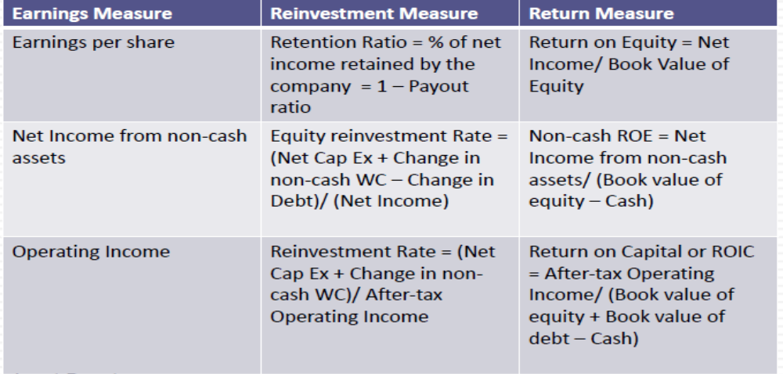
Estimating Fundamental Growth from new investments: Three variations

Slide 52
The value of growth
 | Firm 1 | Firm 2 | Firm 3
Reinvestment rate | 20% | 100% | 200%
ROIC | 50% | 10% | 5%
Expected growth rate | 10.0% | 10.0% | 10.0%
Assume that your cost of capital is 10%. As an investor, rank these firms in the order of
most value of growth to least value growth.

Slide 53
Estimating growth when operating Income is negative or margins are changing: Young and growth firms
When operating income is negative or margins are expected to change over time, we use a three-step process to estimate growth
  Estimate growth rates in revenues over time
    Determine the total market (given your business model) and estimate the market share that you think your company will earn.
    Decreases the growth rate as the firm becomes larger.
    Keep track of absolute revenues to make sure that the growth is feasible.
  Estimate expected operating margins each year
    Set a target margin that the firm will move towards
    Adjust the current margin towards the target margin
  Estimate the capital that needs to be invested to generate revenue growth and expected margins
    Estimate a sales to capital ratio that you will use to generate reinvestment needs each year.

Slide 54
Flipkart: Growth rate
Year | Sales | EBIT | Profit margin | Growth in sales | Total capital | Sales/Capital
0 | 1180.07 | -281.73 | -23.87% | 0 | 487.32 | 2.422
2014 | 2804.95 | -400.12 | -14.26% | 138% | 1161.92 | 2.414
2015 | 9032.18 | -817 | -9.05% | 222% | 6414.73 | 1.408
2016 | 12818.01 | -534.34 | -4.17% | 42% | 6205.63 | 2.066
2017 | 15264.42 | -234.69 | -1.54% | 19% | 6368.3 | 2.397
2018 | 21438.65 | -2041.46 | -9.52% | 40% | 9879.2 | 2.170
Geometrics growth in revenue=62% and average sales /capital ratio=2.146

Slide 55
Flipkart: FCFF
Year | Growth rate | Sales | Profit margin | Operating Profit | Sales/Capital ratio | Capital | Investment | NOPAT | FCFF | ROIC
2018 | 62% | 21438 | -9.52% | -2041 | 2.146 | 9990
2019 | 56% | 33509 | -6% | -1862 | 2.09 | 16053 | -6063 | -1862 | -7925 | -11.60%
2020 | 51% | 50464 | -2% | -805 | 2.03 | 24874 | -8821 | -805 | -9626 | -3.24%
2021 | 45% | 73122 | 2% | 1730 | 1.97 | 37114 | -12240 | 599 | -11642 | 1.61%
2022 | 39% | 101786 | 6% | 6441 | 1.91 | 53247 | -16132 | 2229 | -13903 | 4.19%
2023 | 34% | 135885 | 10% | 13983 | 1.85 | 73332 | -20086 | 4839 | -15246 | 6.60%
2024 | 28% | 173661 | 14% | 24750 | 1.79 | 96779 | -23447 | 8566 | -14881 | 8.85%
2025 | 22% | 212040 | 18% | 38621 | 1.74 | 122157 | -25377 | 13367 | -12011 | 10.94%
2026 | 16% | 246814 | 22% | 54733 | 1.68 | 147158 | -25002 | 18943 | -6058 | 12.87%
2027 | 11% | 273223 | 26% | 71415 | 1.62 | 168802 | -21644 | 24717 | 3073 | 14.64%
2028 | 5% | 286884 | 30.10% | 86352 | 1.56 | 183900 | -15098 | 29886 | 14788 | 16.25%
Growth rate for retail business
Profit margin for retail business
Sales/ capital for retail business

Slide 56
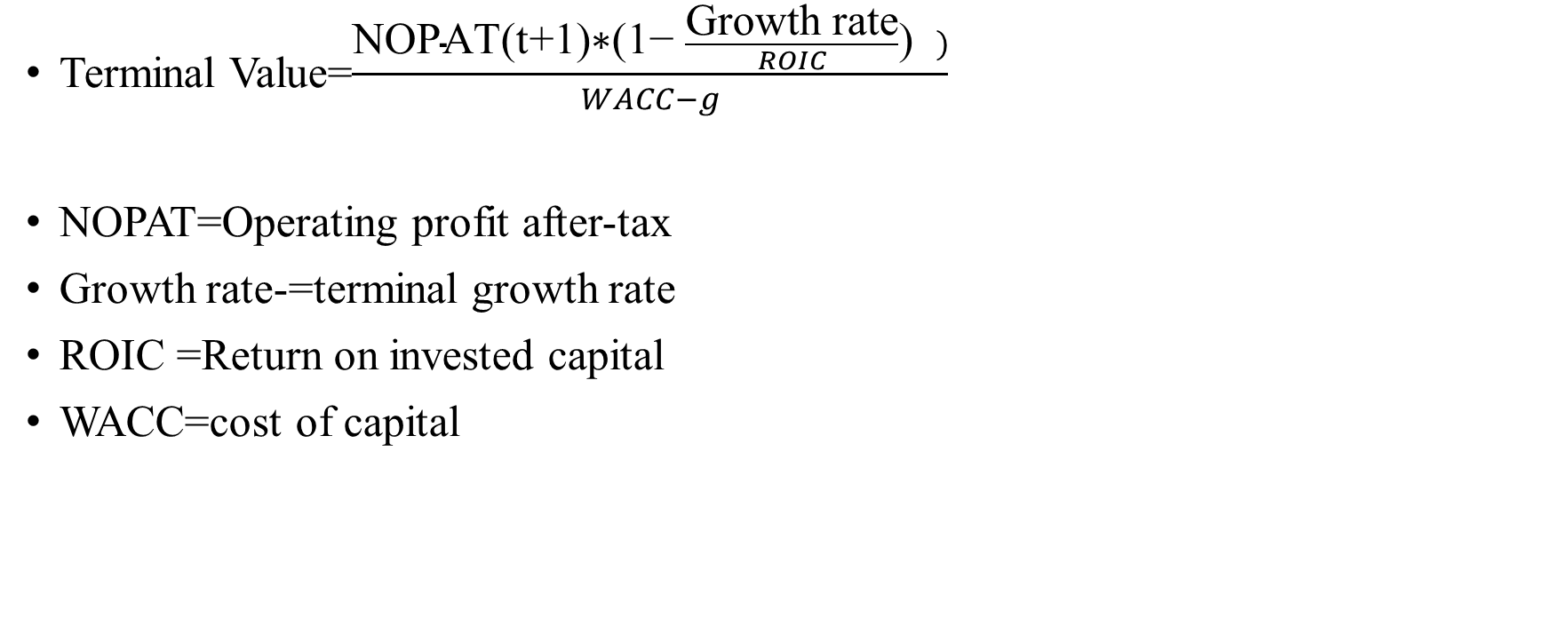
Terminal value
Terminal Value=$\frac{\text{NOPAT}\text{(}\text{t}\text{+1)∗(1− }\frac{\text{Growth} \text{rate}}{ROIC}\text{) })}{WACC−g}$
NOPAT=Operating profit after-tax
Growth rate-=terminal growth rate
ROIC =Return on invested capital
WACC=cost of capital

Slide 57
Don’t wait too long for terminal growth
Assume that you are valuing a young, high growth firm with great potential, just after its IPO. How long would you set your high-growth period.
  < 5 years
  5 years
  10 years
  >10 years

Slide 58
High growth period
Recapping a key lesson about growth, it is not growth per se that create value but growth with excess returns.
For growth firms to continue to generate value creating growth should have sustainable competitive advantage, more competitive advantages longer high growth period (LinkedIn, Facebook, Flipkart).

Slide 59
Valuation of TCS

Slide 60
TCS (NOPAT and Net investment)
 | 2010 | 2011 | 2012 | 2013 | 2014 | 2015 | 2016 | 2017 | 2018
Operating Income | 80551 | 104442 | 135386 | 171214 | 238036 | 226844 | 287890 | 303240 | 305020
Less tax (34.61%) | 27879 | 36147 | 46857 | 59257 | 82384 | 78511 | 99639 | 104951 | 105567
NOPAT | 52672 | 68294 | 88529 | 111957 | 155652 | 148333 | 188251 | 198289 | 199453
Net working capital | 40966 | 69943 | 105351 | 129881 | 222360 | 242670 | 280810 | 229200 | 265610
Change in NWC (a) |  | -28977 | -35408 | -24530 | -92480 | -20310 | -38140 | 51610 | -36410
Capex (b) | -3968 | -10914 | -10891 | -17205 | -22612 | -12819 | -1020 | -30 | 1520
Net Investment (a+b) |  | -39891 | -46299 | -41735 | -115091 | -33129 | -39160 | 51580 | -34890

Slide 61
TCS (ROIC and Net Investment rate)
 | 2010 | 2011 | 2012 | 2013 | 2014 | 2015 | 2016 | 2017 | 2018
Fixed Assets | 42708 | 54045 | 62671 | 78871 | 102033 | 121425 | 116410 | 115980 | 114940
Total Intangible Assets | 34846 | 35438 | 38413 | 38363 | 25095 | 22621 | 18030 | 16440 | 17570
Total Assets | 77554 | 89483 | 101084 | 117234 | 127128 | 144045 | 134440 | 132420 | 132510
Net working capital (NWC) | 40966 | 69943 | 105351 | 129881 | 222360 | 242670 | 280810 | 229200 | 265610
Invested Capital (TA+NWC) (a) | 118520 | 159426 | 206435 | 247114 | 349488 | 386715 | 415250 | 361620 | 398120
NOPAT (b) | 52672 | 68294 | 88529 | 111957 | 155652 | 148333 | 188251 | 198289 | 199453
ROIC (1) | 44.44% | 42.84% | 42.88% | 45.31% | 44.54% | 38.36% | 45.33% | 54.83% | 50.10%
Net Investment (C) |  | -39890.5 | -46299.2 | -41734.9 | -115091.2 | -33128.9 | -39160.1 | 51580 | -34890
Net Investment rate (C/b)=(2) |  | 58.41% | 52.30% | 37.28% | 73.94% | 22.33% | 20.80% | -26.01% | 17.49%
Growth rate (1*2) |  | 25.0% | 22.4% | 16.9% | 32.9% | 8.6% | 9.4% | -14.3% | 8.8%

Slide 62
TCS (ROIC and Net Investment rate)
Average ROIC | 45.40%
Average Reinvestment rate | 32.07%
Growth rate | 14.56%

Slide 63
TCS (FCFF for high growth period)
 | Growth rate for high-growth period=14.56%
 | 2018 | 2019 | 2020 | 2021 | 2022 | 2023
Operating Income (Loss) | 305020 | 349431 | 400308 | 458593 | 525364 | 601857
Less tax |  | 120938 | 138547 | 158719 | 181828 | 208303
NOPAT |  | 228493 | 261761 | 299874 | 343536 | 393554
Less Net Investment |  | 73273 | 83942 | 96163 | 110165 | 126205
FCFF |  | 155220 | 177820 | 203711 | 233371 | 267350

Slide 64
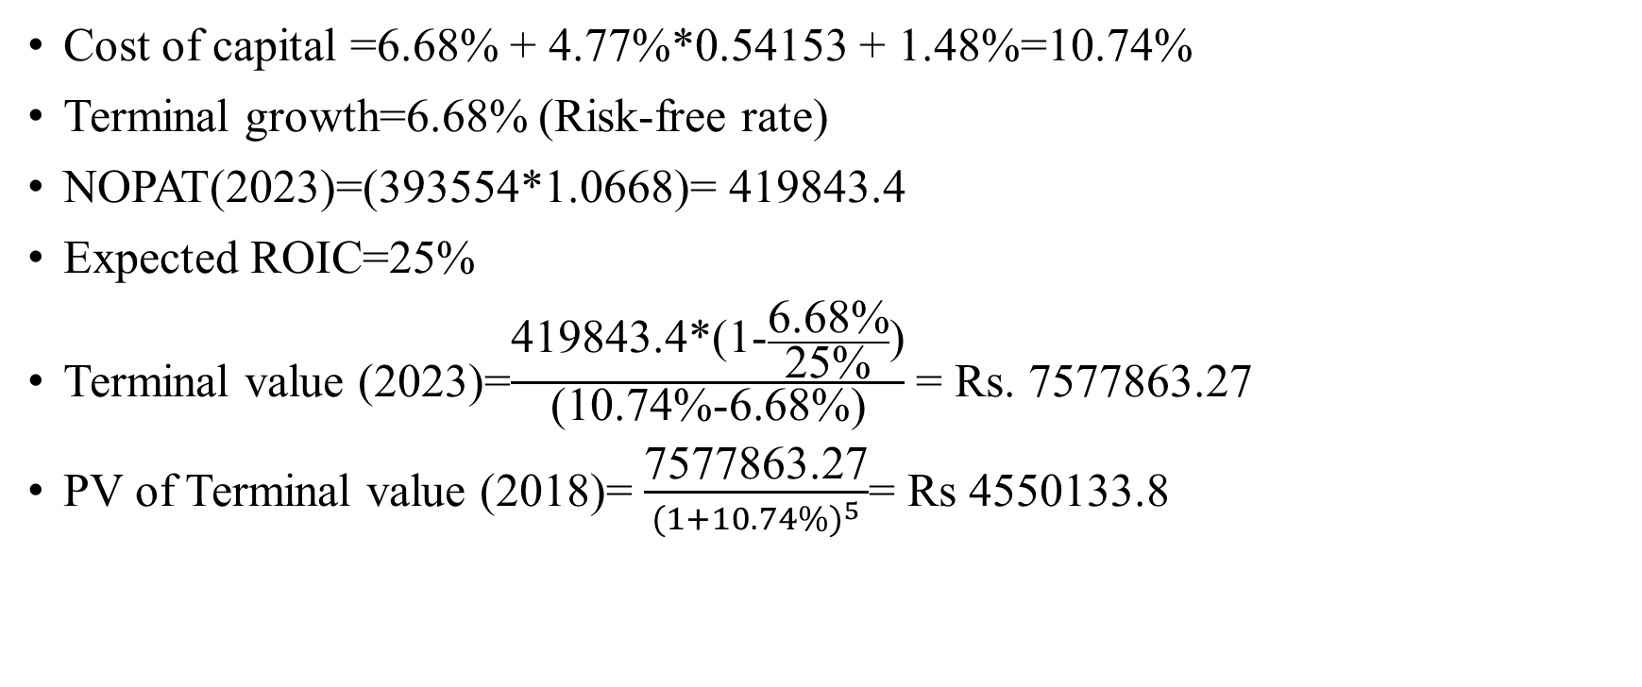
TCS (Terminal Value)
Cost of capital =6.68% + 4.77%*0.54153 + 1.48%=10.74%
Terminal growth=6.68% (Risk-free rate)
NOPAT(2023)=(393554*1.0668)= 419843.4
Expected ROIC=25%
Terminal value (2023)=$\frac{\text{419843.4∗(1−}\frac{\text{6}\text{.}\text{68}\text{\%}}{\text{25\%}}\text{)}}{\text{(10.74\%−6.68\%}\text{)}}$ = Rs. 7577863.27
PV of Terminal value (2018)= $\frac{\text{7577863.27}}{{(1+10.74\%)}^{5}}$= Rs 4550133.8

Slide 65
Present value of high-growth period cashflows
 | 2019 | 2020 | 2021 | 2022 | 2023
FCFF | 155220 | 177820 | 203711 | 233371 | 267350
Present value at 10.74% | 140166.2 | 145001.2 | 150003.3 | 155177.5 | 160530.5
Total Sum of present value of high-growth period cashflows=Rs. 750878.7
Value of operation= PV of cashflows for high-growth period+ Terminal value
Value of operation= 750878.7 + 4550133.8= Rs. 5301013

Slide 66
Other loosed value
Value of cash=425810*1.22=519488.2
Investments & receivables=360920+ 940=361860
Value of Minority/Non-Controlling Interest=6.09*4020=24481.8

Slide 67
Minority/Non-Controlling Interest (Comparable firms’ Pb ratio)
 | PB ratio
Oracle Fin Serv | 8.86
Infosys | 4.76
Persistent | 3.3
NIIT Tech | 5.31
L&T Infotech | 7.95
MphasiS | 5.72
Tech Mahindra | 3.24
TCS | 10.06
HCL Tech | 4.89
Cyient | 3.68
Mindtree | 5.47
Tata Elxsi | 11.77
Wipro | 3.21
Intellect Desig | 4.14
Hexaware Tech | 9.07
Average | 6.09
Value of minority Interest=6.09*4020=24481.8

Slide 68
TCS (Firm value)
Value of Operation | 5301013
Add Cash &Short-term Inv | 519488.2
Add Other ST Assets | 69880
Add LT Investments & Receivables | 361860
Add Other LT Assets | 131830
Firm value | 6384071

Slide 69
Firm value to per share
Firm value | 6384071
Less
ST Debt | 1930
Other ST Liabilities | 68260
LT Debt | 540
Other LT Liabilities | 28840
Total debt liabilities | 99570
Total Equity value | 6,284,501
Less Minority/Non-Controlling Interest | 24481.8
Value of Pure equity | 6,260,019
Outstanding stocks | 3828.6
Value per share | 1635

Slide 70
Sensitivity analysis
 | Terminal Growth
$1,560.66 | 5% | 6% | 7% | 8% | 9% | 10%
20% | 1253 | 1358 | 1519 | 1798 | 2398 | 4617
21% | 1266 | 1377 | 1547 | 1841 | 2474 | 4816
22% | 1278 | 1394 | 1572 | 1880 | 2543 | 4996
23% | 1288 | 1409 | 1595 | 1916 | 2606 | 5161
24% | 1298 | 1423 | 1616 | 1948 | 2664 | 5312
25% | 1307 | 1436 | 1635 | 1978 | 2717 | 5451
26% | 1315 | 1448 | 1653 | 2006 | 2766 | 5579
27% | 1323 | 1459 | 1669 | 2032 | 2811 | 5698
28% | 1330 | 1470 | 1684 | 2056 | 2854 | 5809
29% | 1337 | 1479 | 1699 | 2078 | 2893 | 5911
30% | 1343 | 1488 | 1712 | 2099 | 2930 | 6007
ROIC

Slide 71
Closing DCF: Value=Story
Let’s assume that you are looking at the valuation of a firm, where the analyst has estimated a CAGR of 50% for the next ten years, an operating margin of 20% in year 10 (twice the industry average), a low reinvestments (given growth), and cost of capital of 10% in year 10 (below the market average). On each of the following dimension, what is your implicit story:
  Company size: Small or Large
  Total market: Stable or Growing
  Competitive advantages: Strong or Weak
  Capital Intensity of business: Low or high
  Nature of product/Service: Discretionary or Non-discretionary.

Slide 72
Story changes?
Every valuation has an implicit story in it. What might cause this story to change?
  Earning reports from the firm.
  Macroeconomic changes (interest rates, inflation etc.)
  Regulatory changes
  Earnings reports from other firms
  All of above
  None of the above. A good story should be timeless.

Slide 73
Life Cycle, stores, and numbers
Valuation is a combination of a story with numbers. As companies move through the life cycle from young start-up to declining firms, which of the following statements would you agree with about the mix of stories and numbers?
  The mix should not change as companies age.
  The number are more important for young firms and stories for older firms.
  The stories are more important for young firms and numbers for older firms.

