Slide 1
BRAND MANAGEMENT
MDP-Product management for manager
MDP-Product management and Research
28th November, 2020
Notes:
A very Good evening to every one!!
I will be your resource person for this session. My name is Dr. Yukti sharma. Today I will be sharing some insights on Brand management

Slide 2
Dr Yukti Sharma
yukti.sharma@mdim.ac.in

Slide 3
Key Takeaway
Customers’ Brand knowledge
Brand architecture
Resources: Video cases

Slide 4
Customer’s brand knowledge
Customers’ brand knowledge refers to a consumer’s understanding and recall of a brand and its products.
Concerned with the consumer’s ability to remember, and associate a brand with the correct.
Notes:
.Brands are neither physical products, nor actual services. Brands live in the mind of the consumer.
brand knowledge refers to a consumer’s understanding and recall of a brand and its products

Slide 5
Keller’s Pyramid
Notes:
Lets now discuss the Keller’s Brand Resonance or CBBE Pyramid

Slide 6
Building a strong brand and brand knowledge - 4 steps
Identity: who are you?
Meaning: What are you?
Response: How do I feel about you?
Relationships: What about you and me?
Tangible and intangible attributes
Associate with particular product categorycategory
Notes:
According to the CBBE model by professor Kevin Lane Keller there are four major steps to build in a strong brand. These steps can be presented as questions to ask regarding the brand.
First, who are you? This establishes identity. The customers will be able to associate it with a particular product category or need.
Second, what are you? This establishes meaning. In other words, customers will be able to link the brand to tangible and intangible attributes.
Third, how do I feel about you? This is related to the kind of responses your brand seeks to achieve.
Fourth and finally, what about you and me? This question covers brand relationships. In other words, the brand response is converted into an intense and loyal relationship.
It is important to think of these steps as a ladder. You cannot achieve brand loyalty without the right brand response and you cannot achieve brand response without meaningful associations

Slide 7
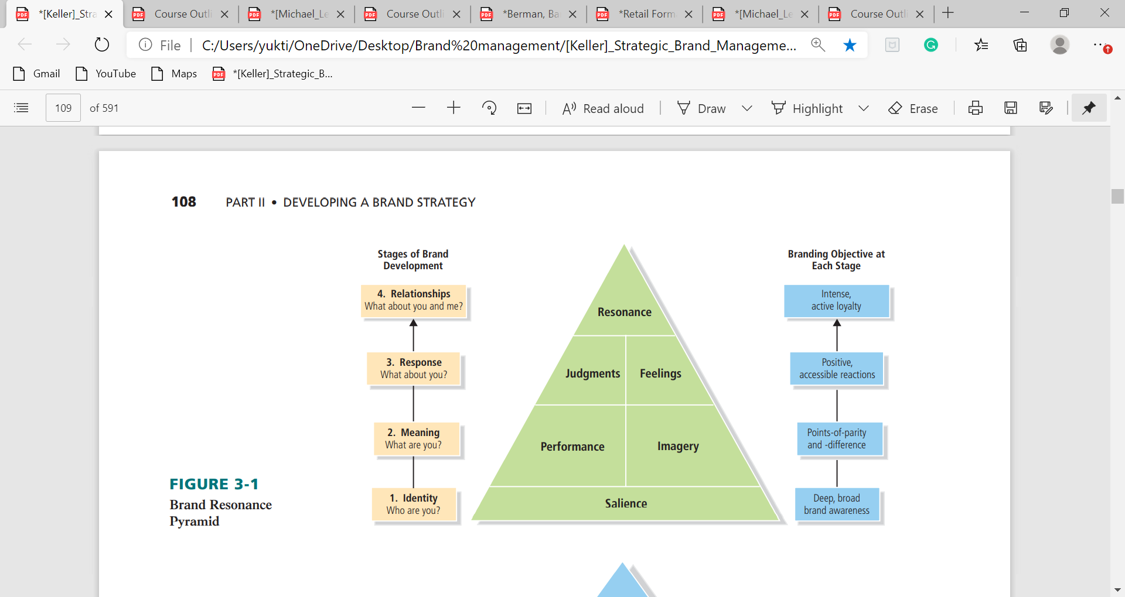
Keller’s Brand Pyramid
Customers logical side, rational side
Customers emotional side
Notes:
So, for a more solid structure CBBE can be drawn as a pyramid. The pyramid has 6 brand building blocks of positive brand equity.
Note here building blocks corresponds to the specific brand equity stage. CBBE or customer-based brand equity is achieved only when the brand makes it to the top of the pyramid and achieves Brand resonance. One side of the pyramid is made up of blocks that appeal to the customers logical side, rational side, which includes brand performance and judgement. And the other appeals to the customers emotional side, including feelings and imagery.
So, a strong brand goes up both sides of the pyramid. let us now explore these blocks in more detail.

Slide 8
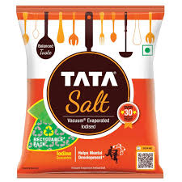
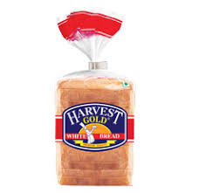
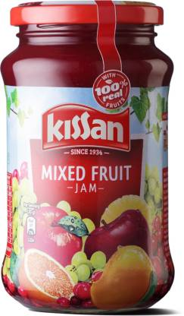
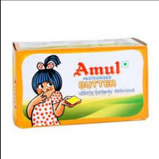
1. Brand Salience Or Brand awareness
Strength of the brand-related memory
Consumer’s ability to identify the brand
For instance, low-involvement decisions
Notes:
The foundation block of-course is brand salience or brand awareness.
Brand awareness is related to the strength of the brand-related memory,
It is the consumer’s ability to identify the brand under in different conditions or contexts. It relates to How often is the brands name evoked in various circumstances? How easily is it recognised? Is it at the top of the customers mind?
It is particularly relevant to create favorable consumer response in low-involvement decisions when consumers are willing to base their choices on mere familiarity
For instance, daily use FMCGs like tata salt, harvest bread, Amul, kissan.
Further, a brand with high salience is the one that has both high brand recognition and recall abilities.
Brand recognition is consumers’ ability to confirm prior exposure to the given the brand as a cue. In short, when you visit to grocery store, then if you are be able to recognize the brand as one to which you have already been exposed, then we may say you recognize the brand. If consumer decisions are mostly made at the Point of purchase then brand recognition will be important.
On the other hand, Brand recall is consumers’ ability to retrieve the brand from memory. Brand recall arises when a consumer is able to recall about the brand in the particular product category, the needs fulfilled by the category, or a purchase or usage situation. For instance, consumers’ recall of Kellogg’s Corn Flakes will depend on consumer’s ability to retrieve the brand when they think of the cereal category or of what they should eat for breakfast or a snack, whether at the store when making a purchase or at home when deciding what to eat.

Slide 9
2.a. Brand meaning: Brand Performance
Brand performance describes how well the product or service meets customers’ more functional needs.
How well the product or service meets customers’ more functional needs. It answers questions like, How well does the brand rate on objective assessments of quality?
  Primary ingredients and supplementary features.
  Product reliability, durability, and serviceability.
  Service effectiveness, efficiency, and empathy
  Style and design
  Price
Notes:
Now that the foundational block is established let us discusses the two blocks that constitute brand meaning.
Let us first have a look at brand performance.
Remember no matter how well constructed and creative your brand campaigns are, what matters at the core is the product itself.
If you want to build a loyal customer, you must first, ensure that they have a great experience with the product or service that you are offering.
So, brand performance is an objective measure of this aspect., Brand performance describes how well the product or service meets customers’ more functional needs. It answers questions like, How well does the brand rate on objective assessments of quality? To what extent does the brand satisfy utilitarian, aesthetic, and economic customer needs and wants in the product or service category.
It measures five different types of attributes related to your product or service.
• Primary ingredients, what are the building blocks of the product? Are there unique elements? Can they be customised?
• Reliability -How consistent is the quality of the performance of the product? What is the product economic life? How easy is it to repair when needed?
• Effectiveness of service - How responsive is the service? Does the product keep customers best interest in mind?
Style and design - Does your brand have an aesthetically appealing product? Can customers associate with different elements, such as colour, look and feel, sound or smell?
• Price - What price tier does the brand fall under; is it economy, is it premium? What are the discount policies etc?
< Can you identify a brand known for its performance>

Slide 10

Microsoft Surface Laptop 3
Notes:
Lets have a look at MS surface laptop to understand Brand equity based on Brand performance.
<can you tell me what are the Brand performance highlighted here>

Slide 11
2. b. Brand meaning: Brand Imagery
Imagery depends on the ways in which the brand caters to the customers psychological or social needs
Brand imagery is about the abstract ways in which the customers think about the brand.
It is primarily intangible customers
It can develop image related association by their own experience, word of mouth or advertising
Notes:
The Other block that makes a brand meaning is imagery. Now imagery depends on the ways in which the brand caters to the customers psychological or social needs. Unlike brand performance, Brand imagery is about the abstract ways in which the customers think about the brand. It is primarily intangible customers can develop image related association by their own experience, word of mouth or advertising. For instance, Amul, Asian paints.

Slide 12
Components of Brand imagery
User Imagery
Purchase and usage Imagery
Personality and values Imagery
History, heritage and experiences
Type of person or organization who uses the brand. Idealised users
Under what conditions or situations can or should buy and use the brand
. It can appear to be “modern,” “old-fashioned,” “lively,” or “exotic.”
Brands take on associations to their past and certain noteworthy events in the brand’s history
Notes:
Lets understand the several components of Brand imagery, i.e., kinds of intangibles can be linked to a brand, but four main ones are:
User Imagery 2. Purchase and usage Imagery3. Personality and values 4. History, heritage, and experiences
User Imagery. Under this brand imagery is visualized as the type of person or organization who uses the brand. This imagery may result in customers’ mental image of idealized users. For example in case of Blackberry ads, imagery was of white collar or business man.
Purchase and usage situations: It tells us consumers under what conditions or situations can or should buy and use the brand. Associations can relate to type of channel, such as department stores, specialty stores, or the Internet. Or, it can relate to the time of day, week, month, or year to use the brand. For instance, Dawat’e Basmati rice to be used on specific occasions.
Brand Personality and Values: brands may take on personality traits or values and, like a person. It can appear to be “modern,” “old-fashioned,” “lively,” or “exotic.” Brand personality is a static feature which remain with the brand. Five dimensions of brand personality (with corresponding subdimensions) are sincerity (down-to-earth, honest, wholesome, and cheerful), Adventurous (daring, spirited, imaginative, and up-to-date), competence (reliable, intelligent, successful), sophistication (upper class and charming), and ruggedness (outdoorsy and tough).
Brand History, Heritage, and Experiences: Hereby, brands take on associations to their past and certain noteworthy events in the brand’s history. It may lead to recall of distinct personal experiences and episodes or past events. They can be highly personal and individual, or more well-known and shared by many people.
<Can you think of a brand using these imagery>

Slide 13
3. A. Brand Response : Brand judgement
Customers personal opinions which are formed by putting together information from performance and imagery related association.
Four aspects
  Brand Quality
  Brand Credibility: Competence, dependability, and likeability
  Brand Consideration: Evoked set
  Brand Superiority: Brand stands out from its competitors that your brand is superior to comparative
Notes:
The third building block under brand response is called brand judgements. Like the name suggests these are customers personal opinions of the brand which are formed by putting together information from performance and imagery related association. Naturally customers form all sorts of judgements about a brand. However, four categories are especially important for the brand manager to take into consideration under Brand judgement are:
• Brand quality - Customers may have different types of attitudes towards the brand but the most important one is related to quality. Now in the eyes of the customer the brand should be able to deliver on a set of relevant criteria. For example, a smartphone should be able to deliver on certain parameters like;
battery life, storage, look and feel, and so on.
3• Brand credibility - Customers form opinions based on the organisation or company based behind the brand. Credibility measures three components,
competence, dependability, and likeability.
4. Third is Brand consideration, suggests that Even if the customer forms a positive association about the brand it doesn't matter if they don't actually consider the brand at the time of purchase. So, to ensure that your brand scores well on this front it is important that customers feel that the brand is actually relevant to their lives.
5. Brand superiority: • Brand superiority - This is the foundation on which brand loyalty rests. Do customers believe or perceive that your brand stands out from its competitors that your brand is superior to comparative. Do they believe that your brand offers benefits that others don't or better than what others offer?

Slide 14
3. Brand Response : Brand Feelings
Brand feelings are customers’ emotional responses and reactions to the brand.
Social currency evoked by the brand.
  Brands warmth: Soothing types of feelings and makes consumers feel a sense of calm or peacefulness
  Fun: Consumers’ feel amused, lighthearted, joyous, playful, cheerful.
  Excitement: Consumers feel energized and that they are experiencing something special
  Social approval: A belief that others look favorably on their appearance, behaviour
  Self-respect: sense of pride, accomplishment, or fulfillment
Notes:
The other side of brand responses is brand feelings. Brand feelings are customers’ emotional responses and reactions to the brand. It can be termed as the social currency evoked by the brand. It can be mild or intense and can be positive or negative.
Particularly, it encapsulates questions like: What feelings are evoked by the marketing program for the brand or by other means?
How does the brand affect customers’ feelings about themselves and their relationship with others?
The six important types of brand feelings.
Measure the brands warmth : soothing types of feelings and makes consumers feel a sense of calm or peacefulness. For example,
Sense of fun: Upbeat types of feelings make consumers feel amused, lighthearted, joyous, playful, cheerful. For example,
Ability to evoke excitement: consumers feel energized and that they are experiencing something special
Security it provides: feeling of safety, comfort, and self-assurance. For instance, LIC ad
Amount of social approval that it will bring to its users: a belief that others look favorably on their appearance, behavior, and so on. For example, Fair and lovely.
Self- respect: consumers feel a sense of pride, accomplishment, or fulfillment. For example, Sir utha ke jiyo

Slide 15
Brand resonance
Brand resonance describes the nature of this relationship and the extent to which customers feel that they are “in sync” with the brand.
Extent of intensity and level of activity
Examples of brands with high resonance include Harley-Davidson, Apple
Notes:
The final step of the CBBE pyramid is brand resonance.
It is the ultimate relationship that the customer has with the brand. Resonance refers to the depth of the psychological bond between the brand and its user
and the action that customers take because of this bond. Examples of brands with high resonance include Harley-Davidson, Apple
Resonance is characterized in terms of intensity and level of activity.
Intensity is the depth of the psychological bond that customers have with the brand.
level of activity includes, repeat purchase rates and the extent to which customers seek out brand information, and events

Slide 16
Components of brand resonance
Behavioral loyalty
Attitudinal attachment
Sense of community
Active engagement
The number of repeat purchases made
Assures that consumers see the brand as special in some way. Maybe it is their favourite position or a treat that they look forward to.
Extent to which customers identify with others who also purchase the brand
The extent to which the customer is willing to invest extra time or energy in the brand
Notes:
brand resonance comprise of four major categories.
• Behavioural loyalty -This aspect of resonance can be measured by the number of repeat purchases made. It answers, how often do customers purchase a brand and how much do they purchase? While a larger number of repeat purchases is good for the brand bottom line profit results. This alone cannot generate resonance. After all the customers may choose to make repeat purchases for many reasons. Maybe their local convenience stores talk only this brand, it falls within their price range or they have move to a different city and the brand that they love is no longer available so they another brand repeatedly. For example, do you buy a certain brand of toothpaste because you really love the brand or because you have always brought it. So behavioural loyalty is one of the dimensions that can be used to capture brand resonance.
• Attitudinal attachment - This category measures the extent to which customers view brands as part of something larger than just a purchase. It is beyond just positive attitude notion and assures that brand is important and consumers see the brand as special in some way. Maybe it is their favourite position or a treat that they look forward to. So attitudinal attachment is again an indicator of resonance. For instance, Kinderjoy
• Sense of community -This is the social side of resonance and it looks at the extent to which customers identify with others who also purchase the brand. A very popular example of this phenomenon is Harley-Davidson. The community of Harley Davidson are known e Harley Owners Group (HOG), Frequently, the fellow owners connect with each other based on their love to ride, go on long road trips and have fun.
• Active engagement - The strongest affirmation of brand loyalty lies in the extent to which the customer is willing to invest extra time or energy in the brand.
Now this is seen in their choice to visit the brands website, social media pages, more often form or join club centre on the brand and even become brand evangelist.

Slide 17

Brand community- Harley Davidson
Notes:
Similarly, lets consider an example of Apple. Apple encourages APPLE owners to form local Apple user groups. Over 800 groups exist worldwide, ranging in size from fewer than 25 members to over 1,000 members. Many groups arranges monthly meetings, member discounts, special interest groups, classes, and one-on-one support. The user groups provide Apple owners with opportunities to learn more about their computers, share ideas, friendships with fellow Apple users, as well as sponsor special activities and events and perform community service. A visit to Apple’s Web site helps customers find nearby user groups.

Slide 18
Brand architecture
1. Define the key components of brand architecture.
2. Outline the guidelines for developing a good brand portfolio.
3. Assemble a basic brand hierarchy for a brand.

Slide 19
Brand architecture
Blueprint of the structural framework or arrangement of all the brands within the organization.
Includes both the brand’s breadth or boundaries and its depth or complexity
Which different products or services should share the same brand name? How many variations of that brand name should we employ?
Role
To clarify brand awareness
To improve brand image

Slide 20
Four of the typical scenarios to re-look its brand architecture
Introduce brand into new market
Toyota’ European brand Yaris (1990)
Acquire or merge product portfolios
United merged with Continental Airlines → United Airlines
VI (Vodafone and Idea)
Sub-brands challenge the parent brand
Diary Milk sub-brand of Cadbury parent brand name. variances such as for Dairy Milk Silk, Dairy Milk Bubbly, etc.
Too many brands in your portfolio sub-brands
Leverage on your strongest brands
In 2012, Kellogg's company rationalise its Kellogg's brand portfolio; Kellogg's master brand umbrella into all of Kellogg's marketing campaigns.

Slide 21
Systems of brand architecture
Umbrella
Product
Endorsed
Monolithic

Slide 22
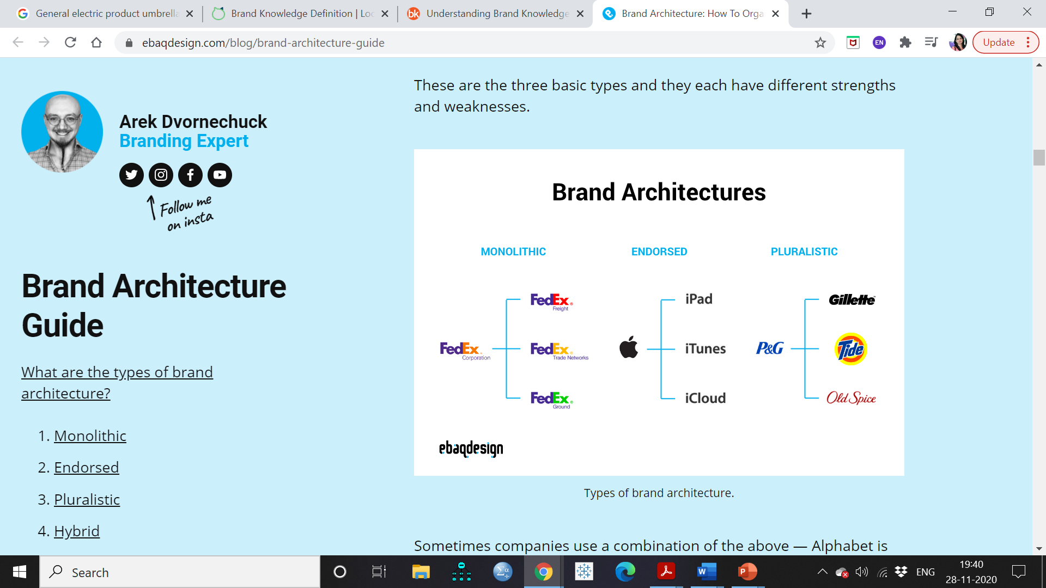
Umbrella brand architectural system
When a brand name spans across a range of sub-brands,
Typically, all sub-brands falling within the same product category
No need to run “name” research
No excessive spending on advertising to create recognition.
FedEx brand deals in several product category: courier, postage, shipping, logistics.
For instance, FedEx Express, FedEx ground, FedEx freight, etc.
Notes:
Can you think of such example ??
FedEx is an example of successfully incorporating the umbrella model.
FedEx is a brand in the product category of courier, postage, shipping, logistics.
This brand has other sub-brands catering to more niches within the same product category.
FedEx Express, FedEx ground, FedEx freight, etc.

Slide 23
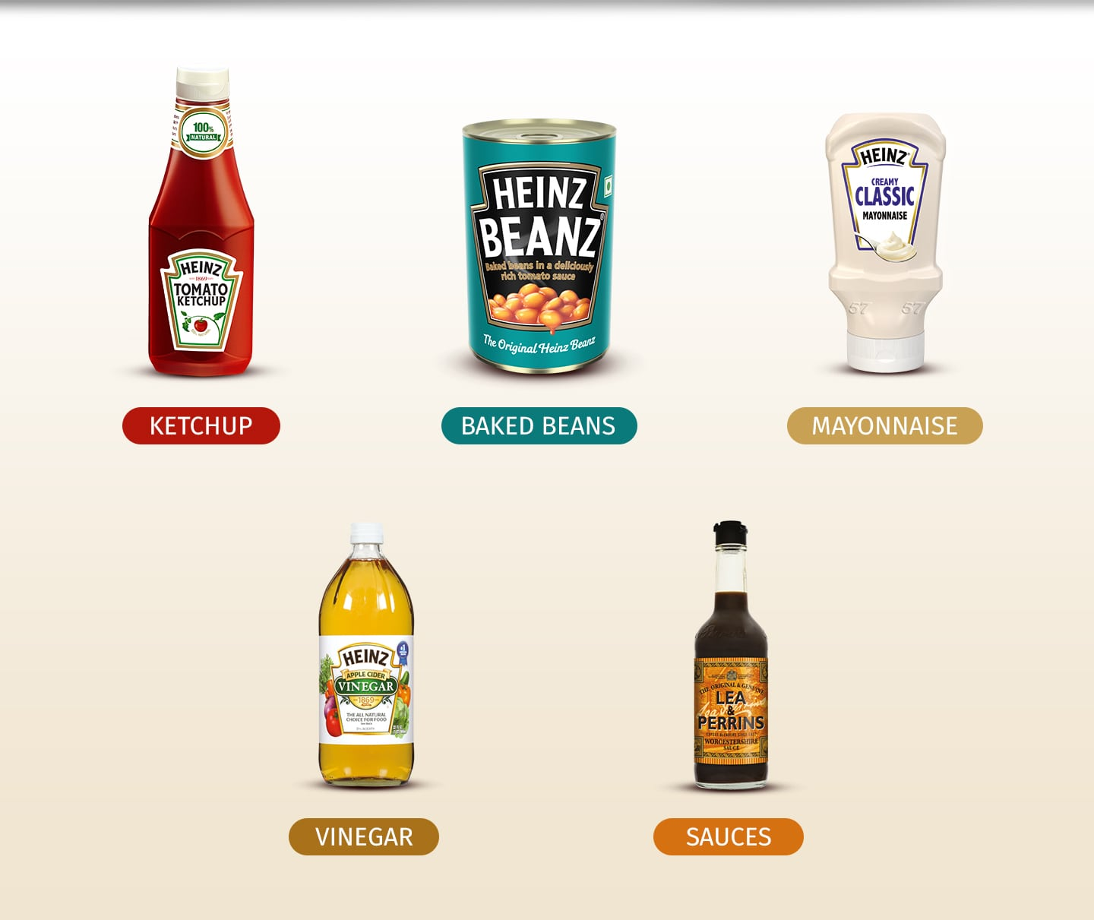
For instance: Heinz and General electric
Notes:
For instance, Heinz and GE, use their corporate brand as an umbrella brand across their entire range of products

Slide 24
Product brand architecture system
Each product or service is individually branded
In consumer packaged-goods companies
Hereby, Parent brand (i.e., organisation brand ) or the corporate brand is de-emphasised
For instance, Procter and Gamble and Unilever use this model.
This brand architecture system works for those that have sufficiently large resources and deep pockets
If a product fails or appears to be of low quality, the company has not tied its reputation to it.

Slide 25
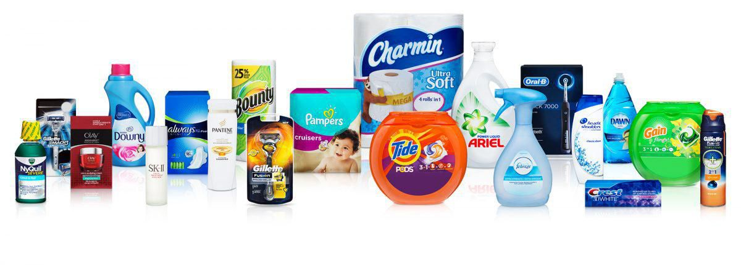
For instance: P & G

Slide 26
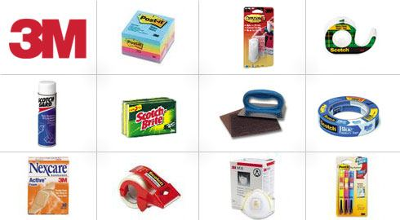
Endorsed brand architectural system
When sub-brands are linked to the corporate or organisation brand by verbal and visual endorsement.
In this system the sub-brand is the dominant brand, backed up by the strength of the parent corporate brand.
For instance, 3M uses this model for its brands, such as Post-it, Scotch, Thinsulate, Nexcare
Notes:
where the logo of 3M is printed on the packaging of these brands
in order to signal and transfer the association of 3M's reliability and quality to these brands.

Slide 27
Monolithic brand architectural system
Same corporate name across all the products and services of the company in all product categories.
This is most often found in big corporate brands, companies
Such as Mitsubishi, Virgin
Best suited for brands
Having optimal levels of recognition,
Delivering a brand promise
Extending into multiple un-related categories has minimal risk.

Slide 28
Hybrid brand architecture system.
Fifth type of architecture system
This system combines aspects of the four brand architecture systems
An example is the Marriott Group of hotels
Ritz-Carlton: is a stand-alone brand. does not even have a hint of the Marriott name in.
Fairfield Inn is a value hotel and is endorsed by Marriott.
Notes:
In the real world there is also the hybrid brand architecture system.
This is a fifth type of architecture system and as the name indicates this system combines aspects of the four brand architecture systems we have just discussed.
An example is the Marriott Group of hotels, one look at the brand portfolio of Marriott and the brand names demonstrate the adoption of hybrid system.
Marriott is not sticking to just one architecture brand, architecture system;
look at the Ritz-Carlton that belongs to the Marriott group but does not even have a hint of the Marriott name in. Why?
Because the value proposition of the Ritz-Carlton is luxury, absolute high-end hotel and the Marriott is not as high-end.
So, the Ritz Carlton is a stand-alone brand.
Similarly, in the contemporary quality hotels and resorts Marriott has two brands and only one of them uses the Marriott umbrella,
Renaissance hotels and resorts are standalone. Fairfield Inn is a value hotel and is endorsed by Marriott.
Having looked at these different formats of the brand architecture keep in mind that these are compiled based on best practices in the world and service guidelines in choosing your brands architecture system. The four big systems umbrella, product, endorsed and monolithic are robust enough to be successfully used as hybrid formats.

Slide 29
Branded house vs. House of brands
These two branding strategies represent two ends of a brand relationship continuum
Branded house | House of brands
A branded house follows the monolithic brand architecture system. | A house of brands follows the product brand architecture system.
For instance, Mitsubishi, Virgin. | For instance, Procter and Gamble, Unilever.
Include many business-to-business industrial firms, such as Siemens, Oracle, and Goldman Sachs. | Firms largely employing a house of brands strategy include consumer product companies

Slide 30
Steps in designing brand architecture
Brand portfolio
Brand hierarchy

Slide 31
BRAND PORTFOLIOS
Brand portfolio includes all brands sold by a company in a product category
Any one brand in the portfolio should not harm or decrease the equity of the others.
Procter & Gamble is widely recognized as popularizing the practice
Why an organization needs several brands in one product category??
  Enhance market coverage: Multiple brands allow a firm to pursue different price segments, different channels of distribution, different geographic boundaries
  To increase shelf presence and retailer dependence in the store
  To attract consumers seeking variety who may otherwise switch to another brand
  To yield economies of scale in advertising, sales, merchandising, and physical distribution
Notes:
A brand can only be stretched so far, and all the segments the firm would like to target may not view the same brand equally favorably. Marketers often need multiple brands in order to pursue these multiple segments.

Slide 32
specific roles as part of a brand portfolio
FLANKER
Attractive brands that they take sales away from their higher-priced comparison brands or referents
CASH-COWS
Low-End, Entry-Level
Create stronger points-of-parity with competitors’ brands
Qantas launched Jetstar airlines as a discount fighter brand
Notes:
Flankers or “fighter” brands be so attractive that they take sales away from their higher-priced comparison brands or referents.
create stronger points-of-parity with competitors’ brands so that more important (and more profitable) flagship brands can retain their desired positioning.
introducing discount brands as flankers, In Australia, Qantas launched Jetstar airlines as a discount fighter brand to compete with the recently introduced low-priced Virgin Blue airlines

Slide 33
specific roles as part of a brand portfolio
FLANKER
CASH-COWS
Have dwindling sales but still retained
Low-End, Entry-Level
Hold on to a sufficient number of customers and maintain their profitability with virtually no marketing support
For instance, Gillette still sells Mach3 in spite of Gillette Fusion

Slide 34
specific roles as part of a brand portfolio
FLANKER
CASH-COWS
Low-End, Entry-Level
line extensions or brand variants in a certain product category that vary in price and quality.
leverage associations from other brands
Bringing new customers into its brand franchise
BMW introduced certain models into its 3-series automobiles

Slide 35
BRAND PORTFOLIO STRATEGY
 | TARGET CUSTOMER SEGMENTS
 | S1 | S2 | S3 | …
Premium | BRAND A
Mid range |  | BRAND B | BRAND C
Value |  | BRAND D |  | BRAND E
To maximize market coverage so that no potential customers are being ignored, but minimize brand overlap so that brands aren’t competing among themselves to gain the same customer’s approval

Slide 36
BRAND Hierarchy
Brand hierarchy is a useful means of graphically portraying a firm’s branding strategy
Displays the number and nature of common and distinctive brand elements across the firm’s products
Revealing their explicit ordering
For instance, Dell Inspiron 17R
  DELL: corporate name to brand many of its products
  Inspiron: designates a certain type of computer (portable)
  17R: identifies a particular model of Inspiron

Slide 37
Levels of Brand Hierarchy
Corporate or Company Brand Level: highest level of the hierarchy
Family Brand Level: also called a range brand or umbrella brand. Used in more than one product category. For instance, Dairy milk
Individual Brand Level. restricted to essentially one product category, For instance, Frito-Lay offers Fritos corn chips, Doritos tortilla chips, Lays and Ruffles potato chips, and Rold Gold pretzels
Modifier Level. Designate a specific item or model type or a particular version or configuration of the product. Land O’Lakes offers “whipped,” “unsalted,” and “regular” versions of its butter. Yoplait yogurt comes as “light,” “custard style,” and “original” flavors.
Product Descriptor: what the product is and does and also helps define the relevant competition in consumers’ minds

