Slide 1
Customer Life Time Value

Slide 2
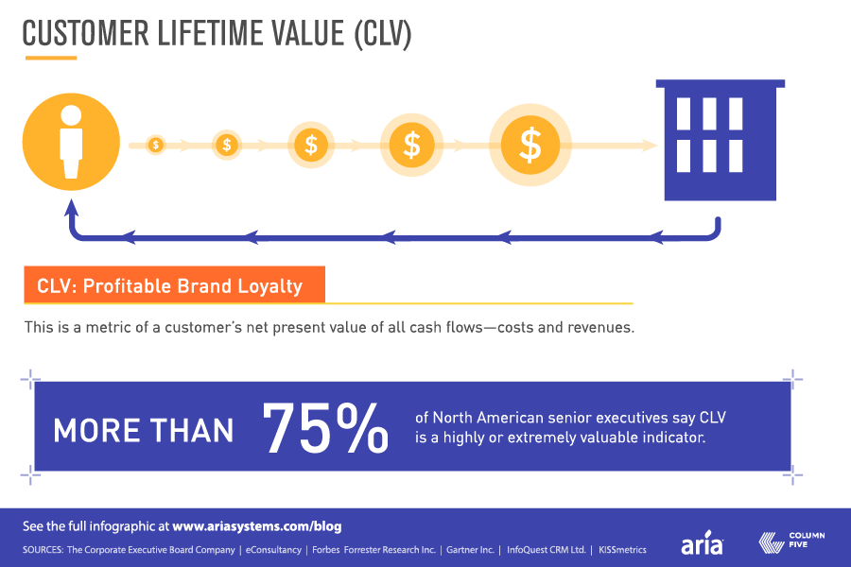

Slide 3
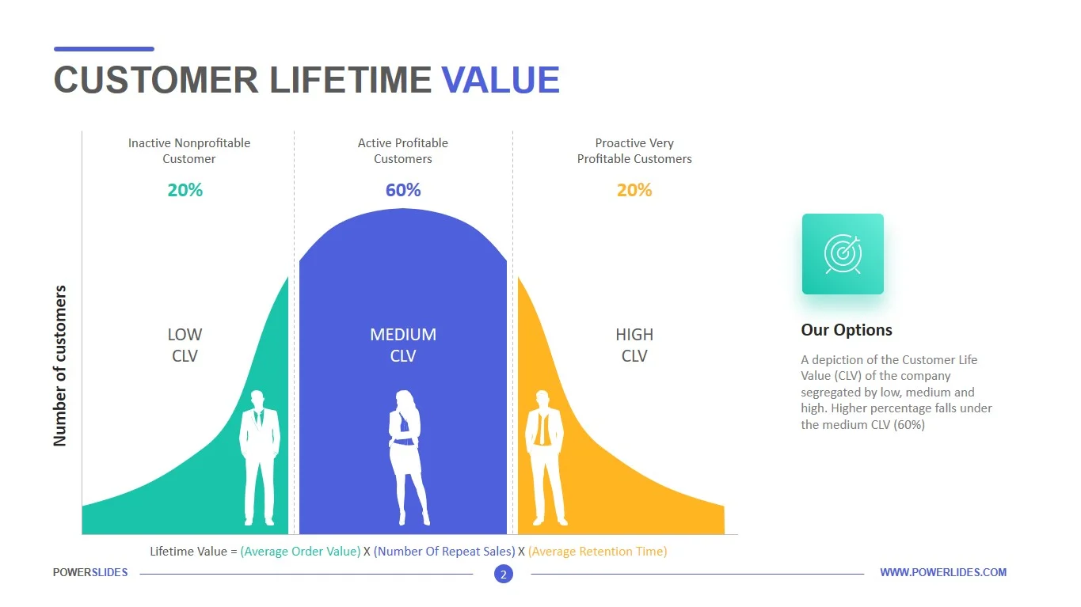

Slide 4
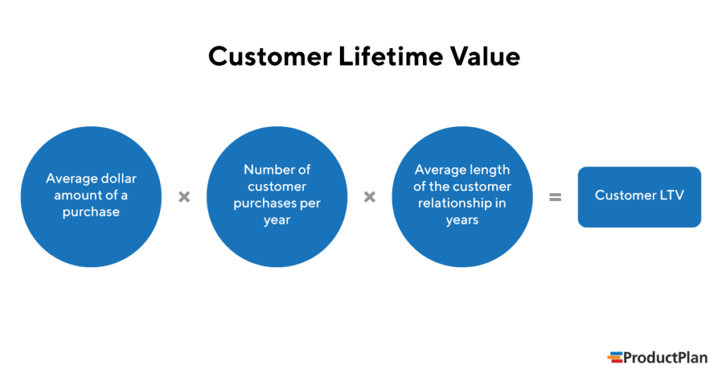

Slide 5
CLTV
The average sale for a shoe retailer, Zinga is $60, and the average customer shops with them two times per year for three years.
After calculating all the expenses Zinga’s profit margin is 15%.
  Calculate the CLTV?

Slide 6
How to increase CLTV
Optimize Onboarding
  First Impression is the last impression
Effective Communication
  Content
  Relevant
  Transparent
Loyalty Program
  Give first and expect second
Retargeting
  Re-engage
  Remind

Slide 7
How to increase CLTV
Impress first !
  That you are dedicated for your offerings
Engage
  How to do this??
Retain
  How it is helpful?

Slide 8
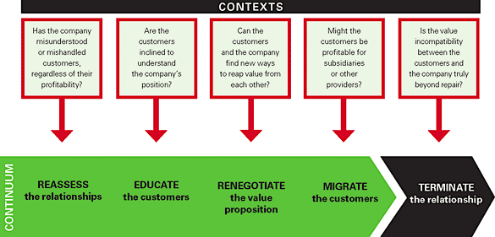
The Right Way to Manage Unprofitable Customers

Slide 9
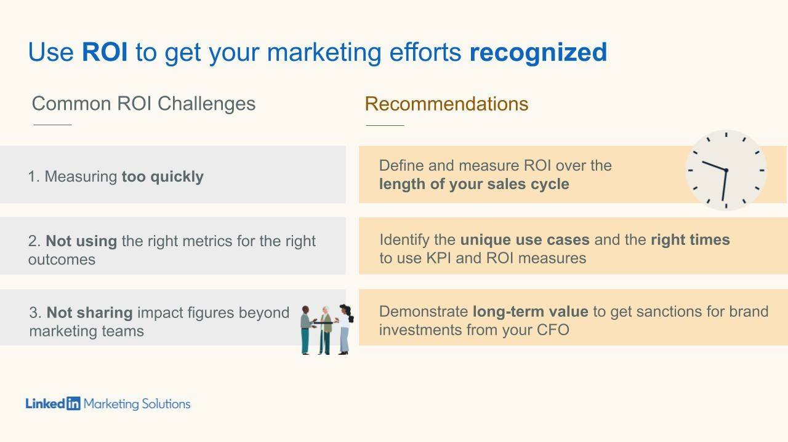

Slide 10
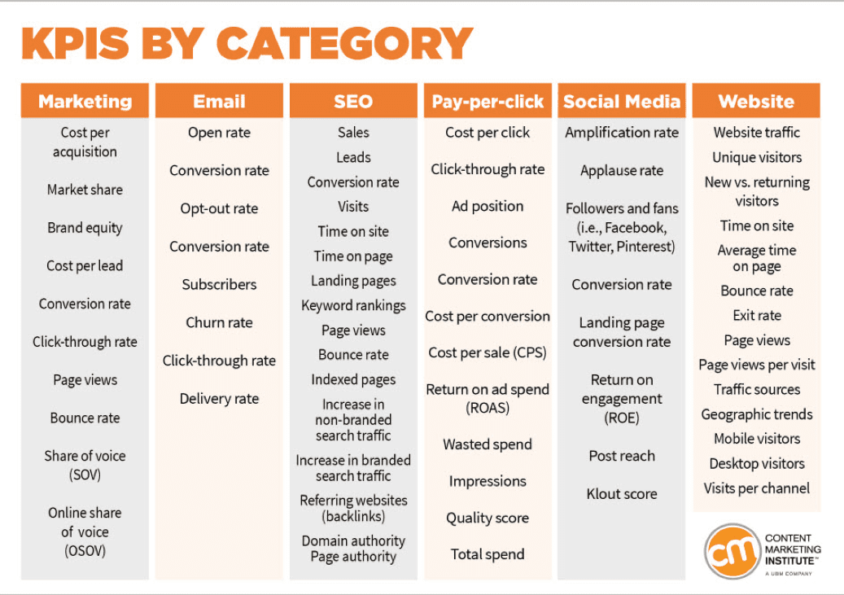

Slide 11
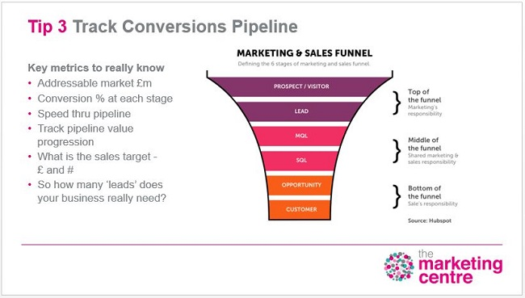

Slide 12


Slide 13
You are Ms. Lima
If you spend $ X on advertisement (fixed marketing cost) and total Y customer (all new customers) buy your product leading to a total of $Z revenue.
  What is your customer acquisition cost?
  How will you calculate it?

Slide 14
Return on Marketing (ROM)
Suppose you are Mr. Remo (Senior Marketing Analyst). Who has chosen - marketing (reaching out) to prospective customers through email medium?
What steps and data will you require to calculate the ROM through email method only?

Slide 15
ROM
[Revenue – Marketing Cost]/[Marketing Cost]

Slide 16
References
1. https://clevertap.com/blog/customer-lifetime-value/

