Slide 1
Corporate Finance
Yogesh Chauhan

Slide 2
A Dilemma
CCD has an opportunity to open a shop at IIM Raipur. At the same time, it has another opportunity at IIIT Raipur. Now, CCD comes to you to take your opinion.
We find that Govt bond and a corporate bond pay-off Rs 1000 after one year from now. We need to decide how much we should pay for both bonds and why?

Slide 3
Introduction to finance
Finance is the study of value.
Value creation is about two key components: Time and Uncertainty.
(Almost) everything can be valued with our framework.
It is a way of thinking and a set of tools that reflect this way of thinking.
Takeaway: It can improve your decisions making.

Slide 4
Don’t mistake accounting for finance
Accounting Balance sheet
Liabilities | Assets
Equity | Fixed assets (long-lived real assets)
Debt | Current Assets (Short-lived assets)
Other liabilities | Financial investment
Current assets | Intangible assets (Patents &trademarks)

Slide 5
The financial balance sheet
Liabilities | Assets
Equity (Residual Claim on cash flows, Perpetual lives) | Assets in place (Existing investments
Debt (Fixed claim on cash flows, Fixed life) | Growth assets (Expected value that will be created by future investments)

Slide 6
Corporate Finance: The Big Picture
Maximize the value of the business (firm)
The Investment Decision Invest in assets that earn a return greater than the minimum acceptable hurdle rate
The Financing Decision
Find the right kind of debt for your firm and the right mix of debt and equity to fund your operations
The Dividend Decision
If you cannot find investments that make your minimum acceptable rate, return the cash to owners of your business
The hurdle rate should reflect the riskiness of the investment and the mix of debt and equity used to fund it.
The return should reflect the magnitude and the timing of the cashflows as well as all side effects
The optimal mix of debt and equity maximizes firm value
How you choose to return cash to the owners will depend on whether they prefer dividends or buybacks

Slide 7
Time value of money
(Virtually) every decision involves time and uncertainty.
Time value of money is very important to understand the impact of just the passage of time on decision.
The time value of money (TVM) is the concept that money available at the present time is worth more than the identical sum in the future due to its potential earning capacity, such as interest rate you are going to earn on your money.
  Assume you have the option to choose between receiving $10,000 now versus $10,000 in two years. It's reasonable to assume most people would choose the first option

Slide 8
Time value of money: Some terminology
PV=present value (Rs): the value of money today
FV=future value (Rs): the value of money in future
t=# of periods (#)
r=Interest rate (%)>0 (assumption)
Remember, no uncertainty for now!

Slide 9
Time value of money: Interest rate
How much you need to be offered?
  How strong your preference for current consumption over future. consumption: the strong preference of current consumption leads to higher real interest rate.
  Once we add expected inflation with real interest rate, it is called nominal interest rate.
Economists and government officials have been motivating for current consumption that has led American families to save less and consume more of their income, even future income. Keeping everything constant, interest rate in US is expected be lower compared to India.

Slide 10
Important of Timelines!
100
100
100
0
1
2
3
n
At different points of time cash flows cannot be compared to each other.

Slide 11
Simple future value
Suppose a bank pays 10% interest rate per year and you are given a choice between two plans. Which option would you prefer?
  Receive Rs 100 Today
  Receive Rs 100 one year from now
  -Future value=Initial payment plus accumulated interest
  FV=P + r*P= P*(1+r)
  100=100 +10%*100=100*(1+10%)
Time period: 0
1
(A)
Rs 100
(B)
Rs 100

Slide 12
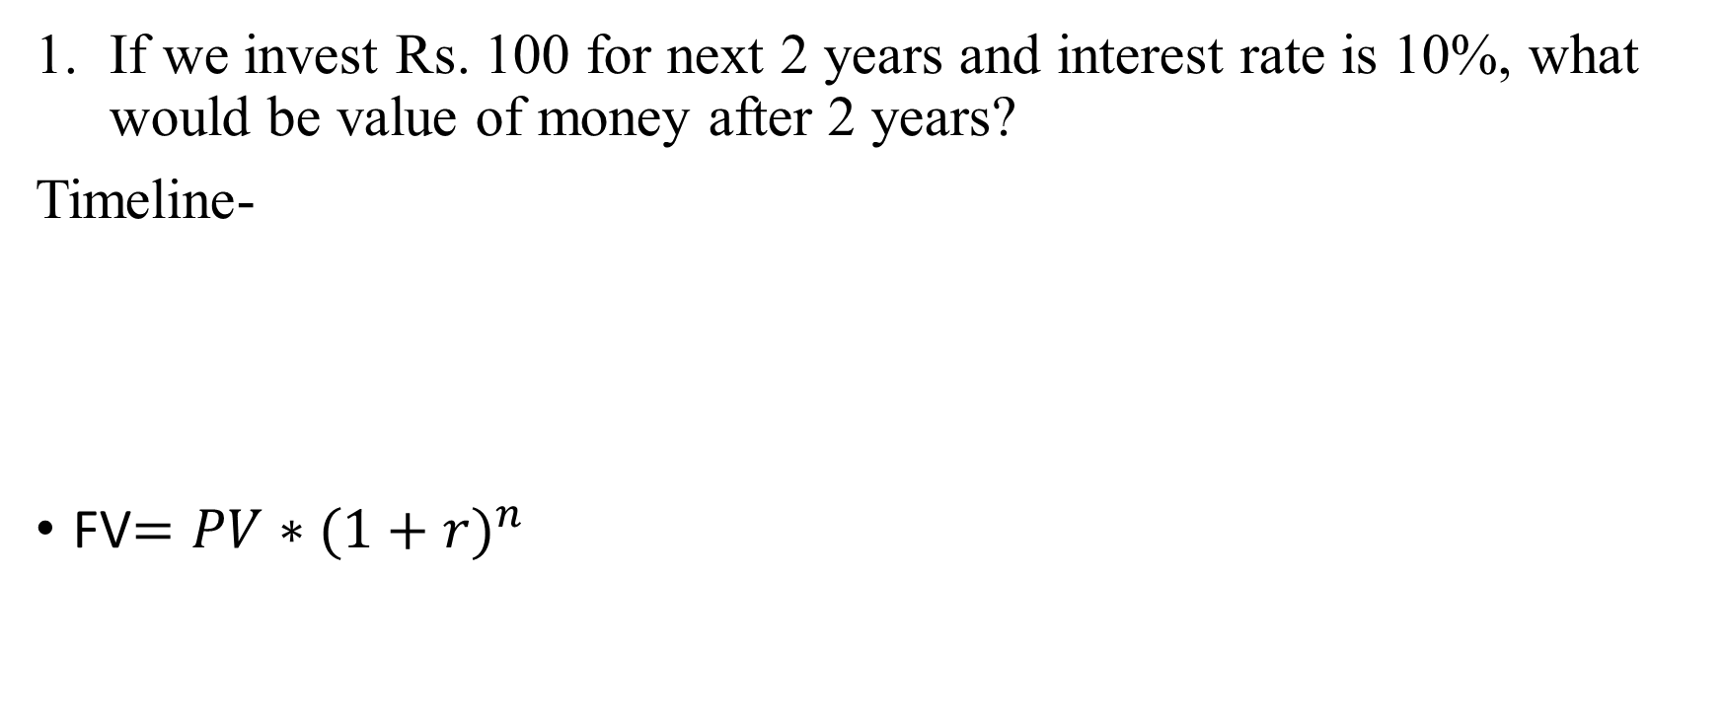
Simple future value
If we invest Rs. 100 for next 2 years and interest rate is 10%, what would be value of money after 2 years?
Timeline-
FV$={PV∗(1+r)}^{n}$
0
1
2
100
110
121
=100*(1+10%)
=110*(1+10%)
=100*(1+10%)*(1+10%)=100*(1+10%)^2

Slide 13
Power of compounding

Slide 14
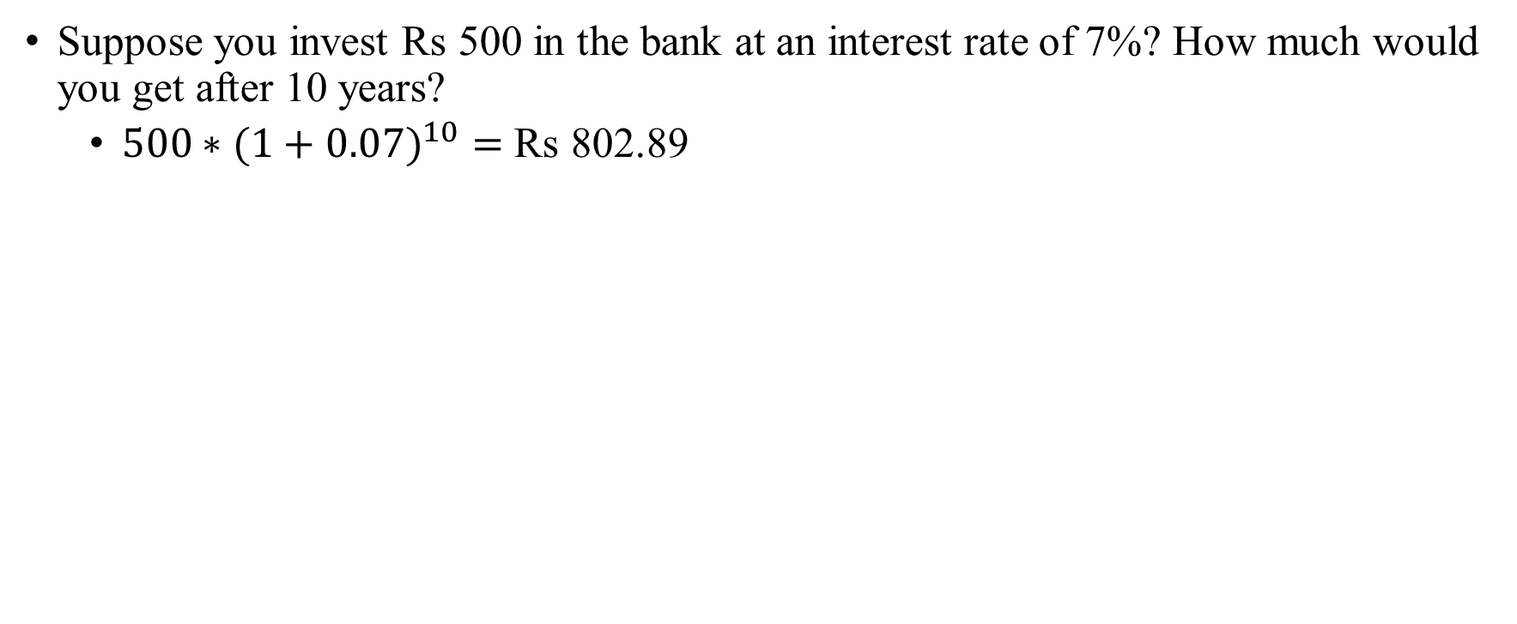
Future value: Example
Suppose you invest Rs 500 in the bank at an interest rate of 7%? How much would you get after 10 years?
  ${500∗(1+0.07)}^{10}=$ Rs 802.89

Slide 15
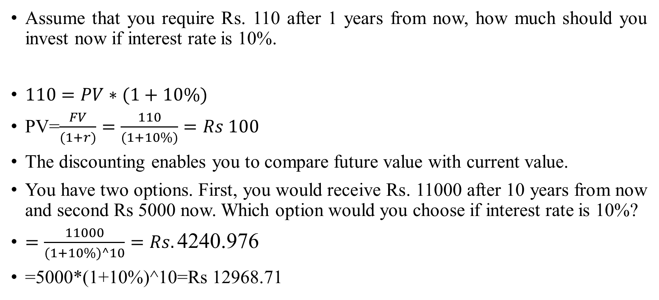
Simple present value
Assume that you require Rs. 110 after 1 years from now, how much should you invest now if interest rate is 10%.
$110=PV∗(1+10\%)$
PV=$\frac{FV}{(1+r)}=\frac{110}{(1+10\%)}=Rs 100$
The discounting enables you to compare future value with current value.
You have two options. First, you would receive Rs. 11000 after 10 years from now and second Rs 5000 now. Which option would you choose if interest rate is 10%?
$=\frac{11000}{(1+10\%)^10}=Rs.\text{4240.976}$
=5000*(1+10%)^10=Rs 12968.71

Slide 16
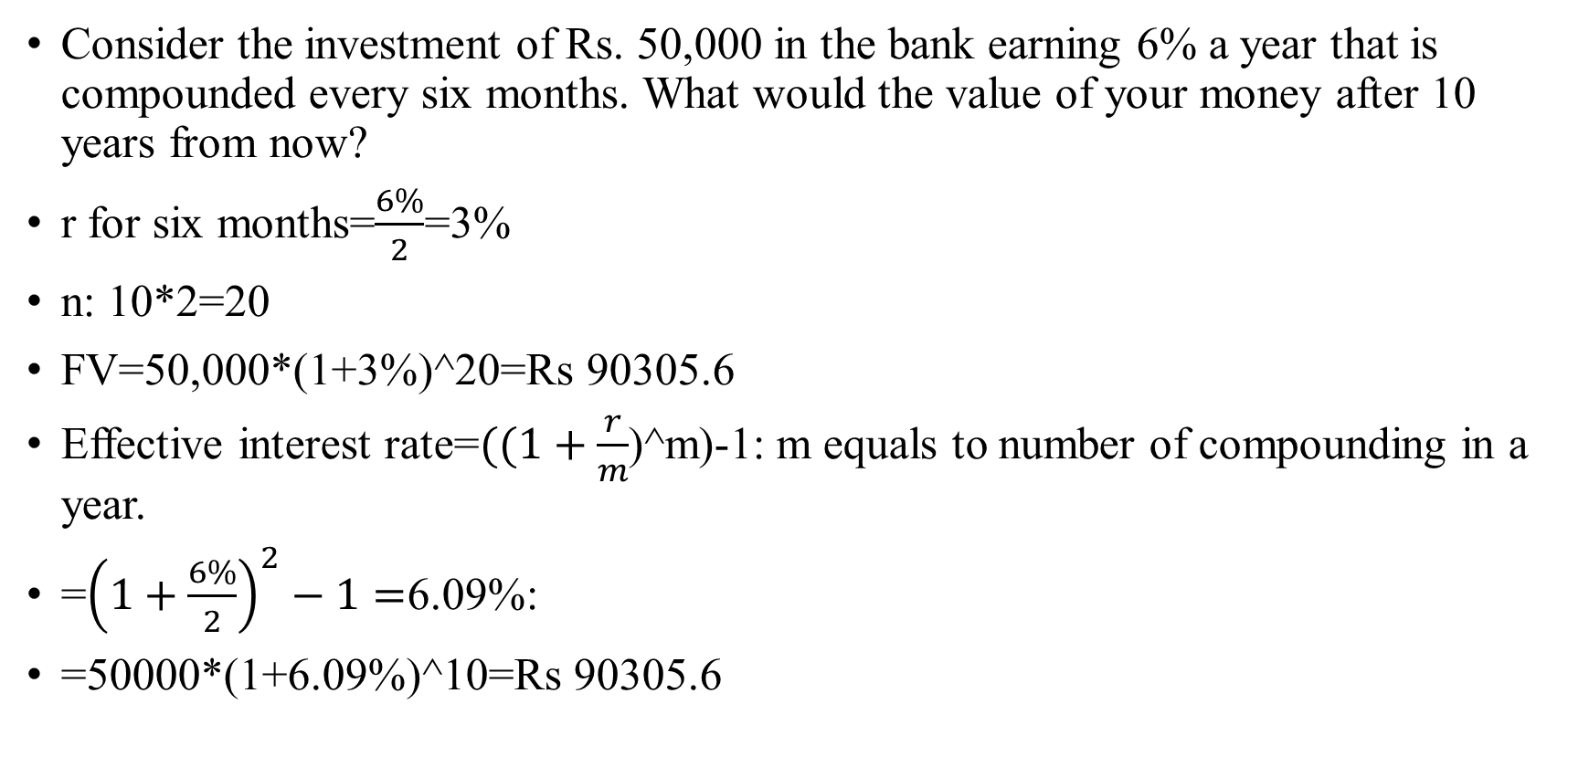
The frequency of discounting and compounding
Consider the investment of Rs. 50,000 in the bank earning 6% a year that is compounded every six months. What would the value of your money after 10 years from now?
r for six months=$\frac{6\%}{2}$=3%
n: 10*2=20
FV=50,000*(1+3%)^20=Rs 90305.6
Effective interest rate=$((1+\frac{r}{m}$)^m)-1: m equals to number of compounding in a year.
=${\left(1+\frac{6\%}{2}\right)}^{2}−1=$6.09%:
=50000*(1+6.09%)^10=Rs 90305.6

Slide 17
The frequency of discounting and compounding
Assume that you are comparing interest rates on several loans, with different banks. The first bank has 8% interest rate, with compounding occurring every month. The second bank has 7.98% interest rate, with compounding occurring every week. The third bank has 7.97% interest rate, with daily compounding. Which is the cheapest loan?
Interest rate | Number of frequency | Effective interest rate
8% | 12 | 8.30%
7.98% | 52 | 8.30%
7.97% | 365 | 8.30%

Slide 18
Time value of money: Annuities
An annuity is a steam of constant cashflows that occur regular intervals for a fixed period of time, such as bank recurring deposit (RD).
Consider you invest Rs 100 the end of every year for the next 3 years in the bank. The bank offers you 10% interest per year. What would be the value of your investment after 3 years
Year | Interest rate | Cash flow | Years to end n | Future value
0 | 10% | 0 | 3 | 0
1 | 10% | 100 | 2 | 121
2 | 10% | 100 | 1 | 110
3 | 10% | 100 | 0 | 100
 |  |  | Total | 331

Slide 19
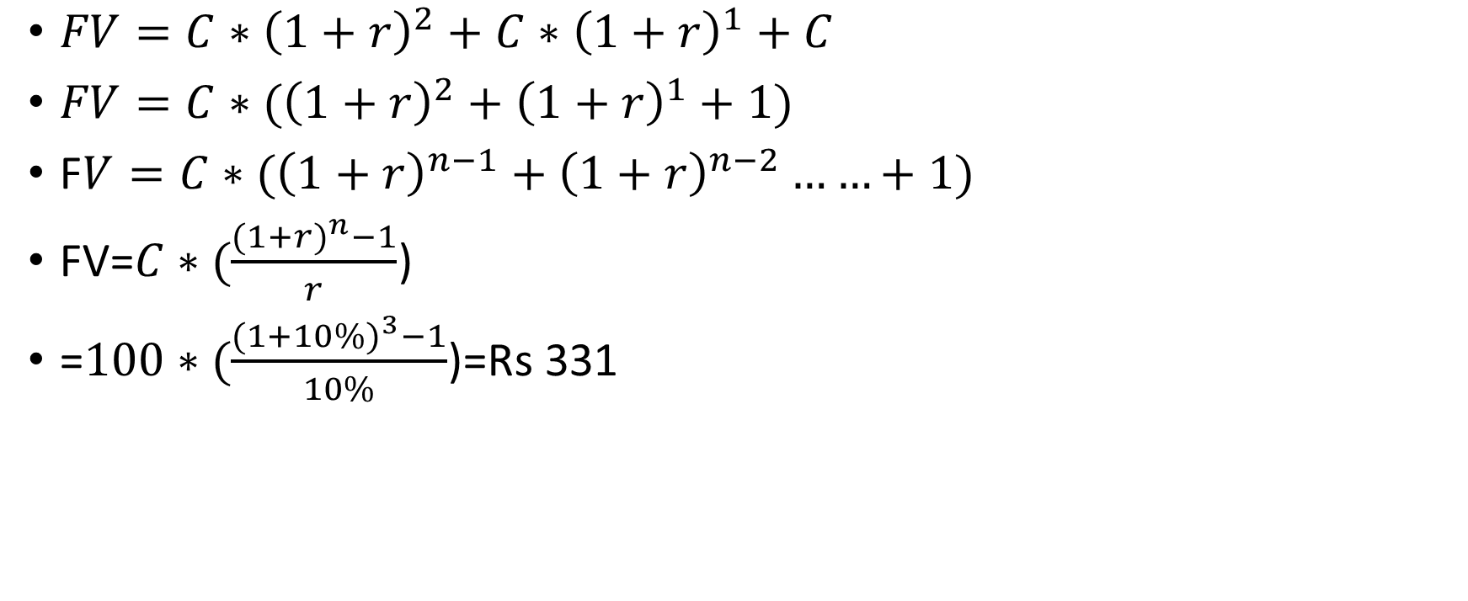
Future value of an annuity: Formula
$FV=C∗{\left(1+r\right)}^{2}+$ $C∗{\left(1+r\right)}^{1}+C$
$FV=C∗({\left(1+r\right)}^{2}+$ ${\left(1+r\right)}^{1}+1)$
F$V=C∗({\left(1+r\right)}^{n−1}+$ ${\left(1+r\right)}^{n−2}……+1)$
FV=$C∗(\frac{{(1+r)}^{n}−1}{r}$)
=$100∗(\frac{{(1+10\%)}^{3}−1}{10\%}$)=Rs 331

Slide 20
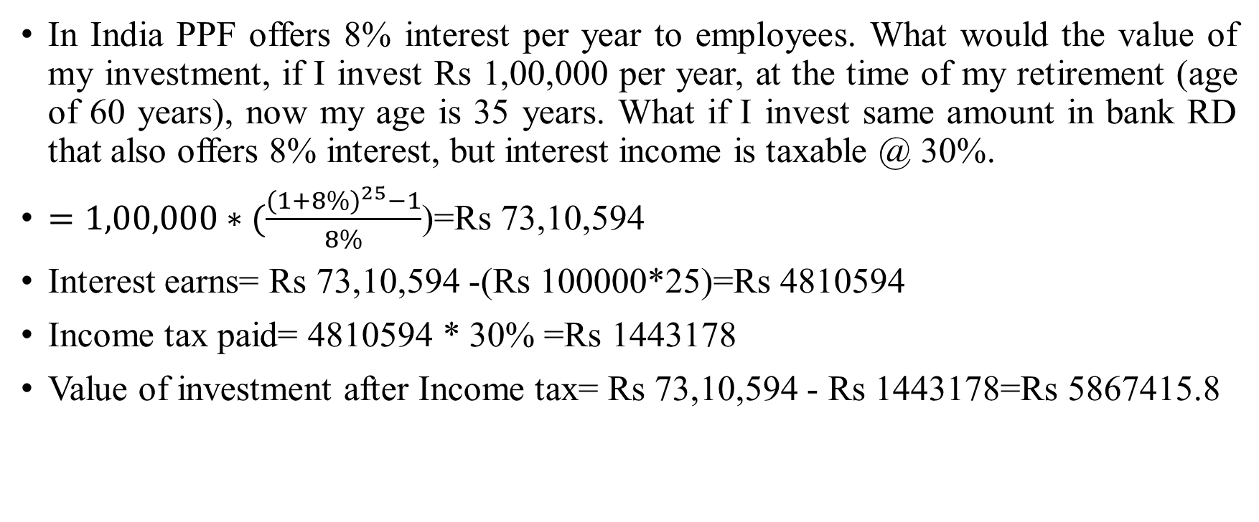
Retirement planning…
In India PPF offers 8% interest per year to employees. What would the value of my investment, if I invest Rs 1,00,000 per year, at the time of my retirement (age of 60 years), now my age is 35 years. What if I invest same amount in bank RD that also offers 8% interest, but interest income is taxable @ 30%.
$=1,00,000∗(\frac{{(1+8\%)}^{25}−1}{8\%}$)=Rs 73,10,594
Interest earns= Rs 73,10,594 -(Rs 100000*25)=Rs 4810594
Income tax paid= 4810594 * 30% =Rs 1443178
Value of investment after Income tax= Rs 73,10,594 - Rs 1443178=Rs 5867415.8

Slide 21
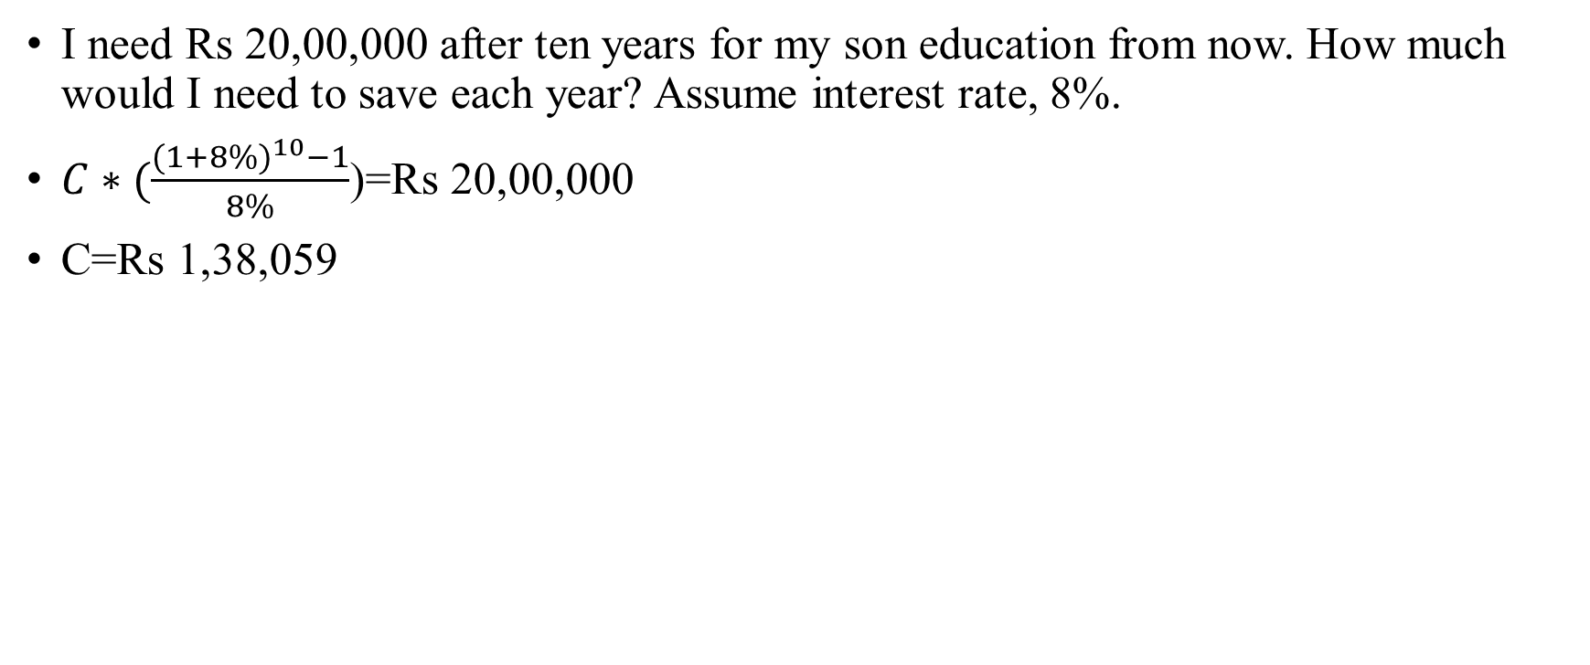
Son’s education plan…
I need Rs 20,00,000 after ten years for my son education from now. How much would I need to save each year? Assume interest rate, 8%.
$C∗(\frac{{(1+8\%)}^{10}−1}{8\%}$)=Rs 20,00,000
C=Rs 1,38,059

Slide 22
Time value of money: present value annuities
You are owner of Firm A and that you have a choice of buying a copier for RS 12000 in cash or paying Rs. 3000 a year for five year for the same copier. If the discount rate is 10%, which option would you rather do?
Year | Interest rate | Cash flow | Years to end : n | Present value
0 | 10% | 0 | 0 | 0
1 | 10% | 3000 | 1 | 2727
2 | 10% | 3000 | 2 | 2479
3 | 10% | 3000 | 3 | 2254
4 | 10% | 3000 | 4 | 2049
5 | 10% | 3000 | 5 | 1863
 |  |  | Total | 11372

Slide 23
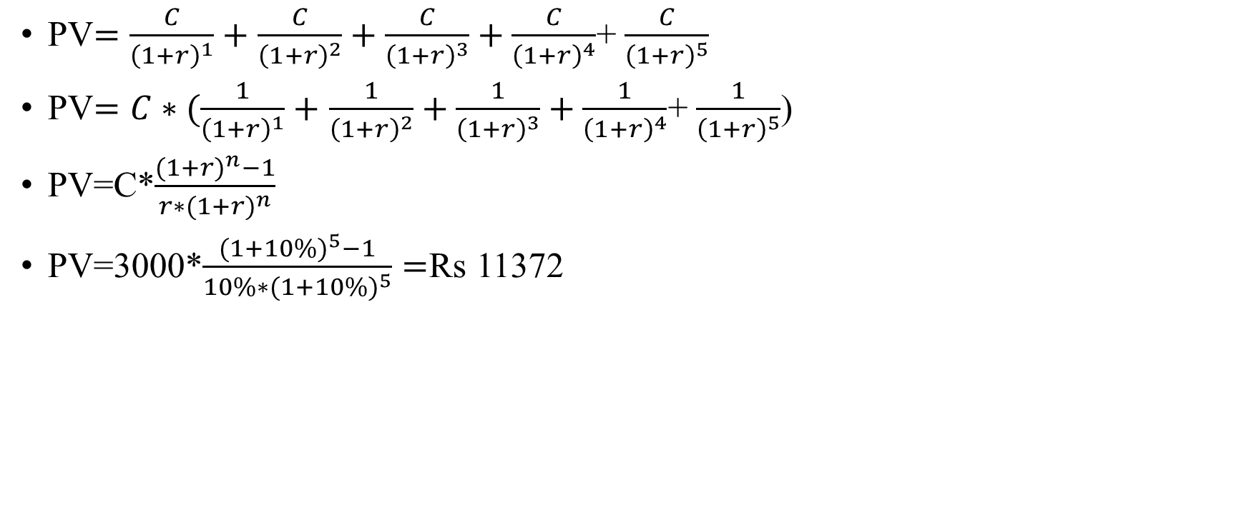
Present value annuities: formula
PV$=\frac{C}{{\left(1+r\right)}^{1}}+$ $\frac{C}{{\left(1+r\right)}^{2}}+\frac{C}{{\left(1+r\right)}^{3}}+\frac{C}{{\left(1+r\right)}^{4}}$+ $\frac{C}{{\left(1+r\right)}^{5}}$
PV$=C∗(\frac{1}{{\left(1+r\right)}^{1}}+$ $\frac{1}{{\left(1+r\right)}^{2}}+\frac{1}{{\left(1+r\right)}^{3}}+\frac{1}{{\left(1+r\right)}^{4}}$+ $\frac{1}{{\left(1+r\right)}^{5}}$)
PV=C*$\frac{({1+r)}^{n}−1}{r∗({1+r)}^{n}}$
PV=3000*$\frac{{(1+10\%)}^{5}−1}{10\%∗{(1+10\%)}^{5}}=$Rs 11372

Slide 24
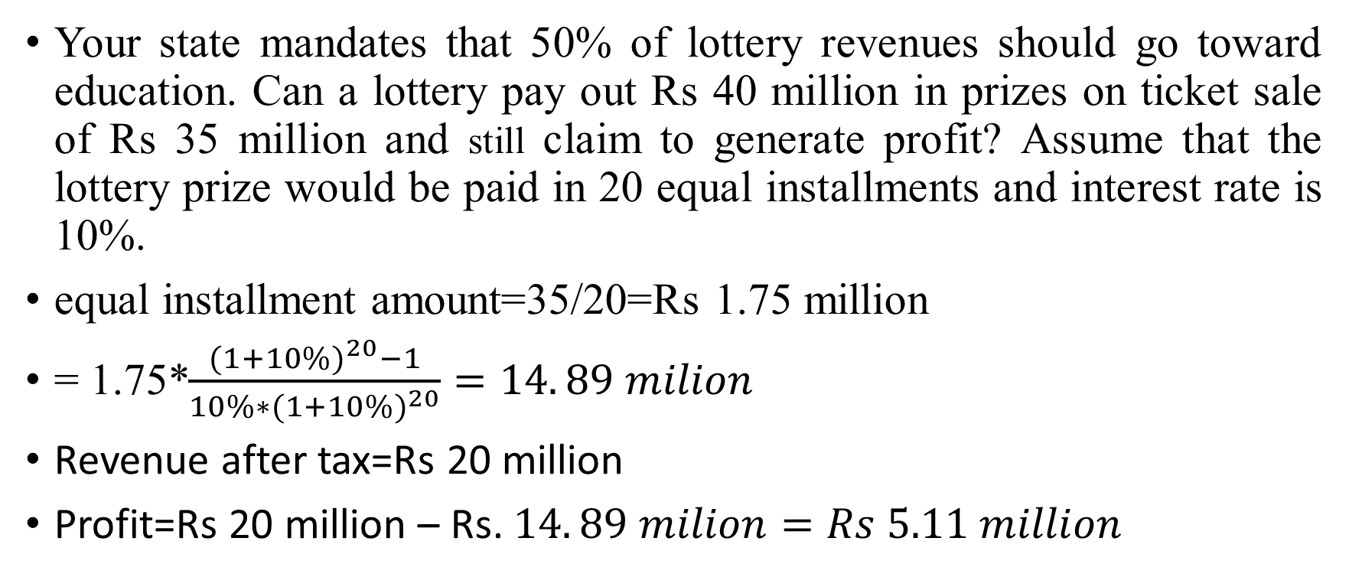
How are they making money?
Your state mandates that 50% of lottery revenues should go toward education. Can a lottery pay out Rs 40 million in prizes on ticket sale of Rs 35 million and still claim to generate profit? Assume that the lottery prize would be paid in 20 equal installments and interest rate is 10%.
equal installment amount=35/20=Rs 1.75 million
= 1.75*$\frac{{(1+10\%)}^{20}−1}{10\%∗{(1+10\%)}^{20}}=14. 89 milion$
Revenue after tax=Rs 20 million
Profit=Rs 20 million – Rs. $14. 89 milion=Rs 5.11 million$

Slide 25
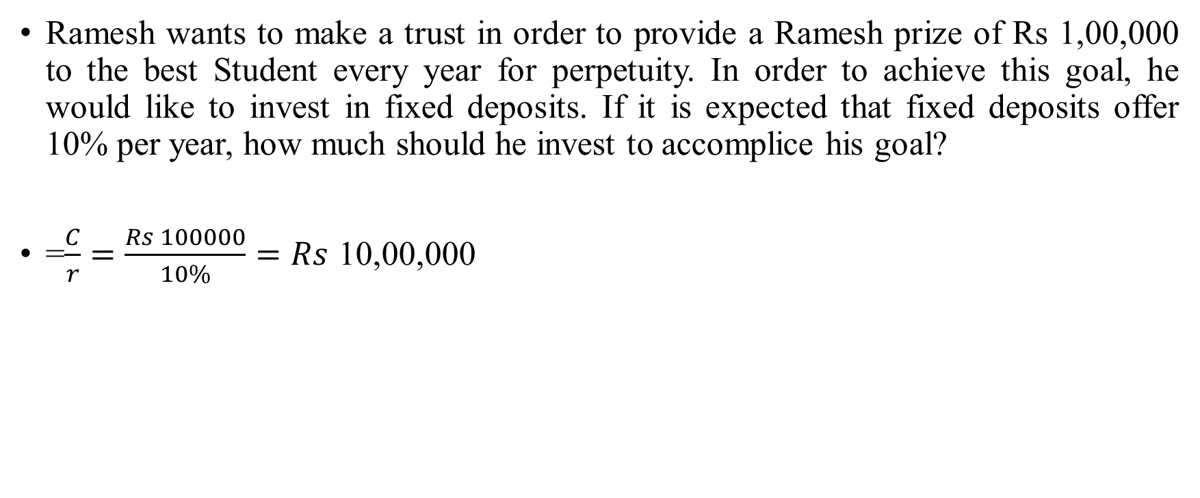
Time value of money: Annuities
Ramesh wants to make a trust in order to provide a Ramesh prize of Rs 1,00,000 to the best Student every year for perpetuity. In order to achieve this goal, he would like to invest in fixed deposits. If it is expected that fixed deposits offer 10% per year, how much should he invest to accomplice his goal?
=$\frac{C}{r}=\frac{Rs 100000}{10\%}=Rs$ 10,00,000

Slide 26
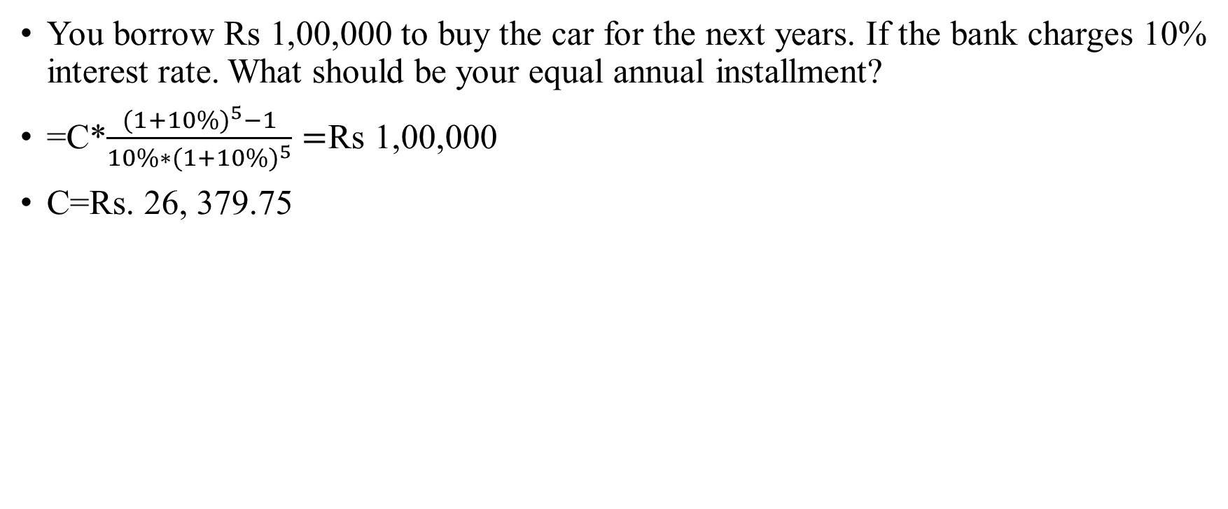
Car loan
You borrow Rs 1,00,000 to buy the car for the next years. If the bank charges 10% interest rate. What should be your equal annual installment?
=C*$\frac{{(1+10\%)}^{5}−1}{10\%∗{(1+10\%)}^{5}}=$Rs 1,00,000
C=Rs. 26, 379.75

Slide 27
Car Loan amortization table
Year | Beginning balance | Yearly payment | Interest amount | Principal repayment
1 | 100000 | 26380 | 10000 | 16380
2 | 83620 | 26380 | 8362 | 18018
3 | 65603 | 26380 | 6560 | 19819
4 | 45783 | 26380 | 4578 | 21801
5 | 23982 | 26380 | 2398 | 23982

Slide 28
Investment principal: Risk and return models

Slide 29
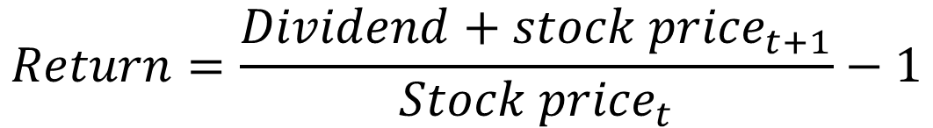
Return measure
The stock price for Stock A was $10 per share 1 year ago. The stock is currently trading at $9.50 per share and shareholders just received a $1 dividend. What return was earned over the past year?
$$Return=\frac{Dividend+{stock price}_{t+1}}{{Stock price}_{t}}−1$$
$1.00 + $9.5 -1
R =
= 5%
$10.00

Slide 30
The notion of a benchmark
Since financial resources are finite, there is an expected return that projects have to cross a hurdle rate (expected return of investors) before being deemed acceptable.
This expected return (hurdle rate) will be higher for riskier projects than for safer projects.
A simple representation of the expected return is a follows
  Expected return=Risk-free rate + Risk premium
  Expected return=Time compensation + Risk compensation
The two basic questions that every risk and return model in finance tries to answer are:
  How do you measure risk?
  How do you translate this risk measure into a risk premium?

Slide 31
What is risk?
Risk, in traditional terms, is viewed as a “negative”. Webster’s dictionary, for instance, defines risk as “ exposing to danger or hazard”. The Chinese symbols for risk, reproduced below, give a much better description of risk.
风险
The first symbol is the symbol for “ danger”, while the second is the symbol for “opportunity”, making risk a mix of danger and opportunity. You cannot have one, without the other.
Risk is therefore neither good nor bad. It is just a fact of life. The question that businesses have to address is therefore not whether to avoid risk but how best to incorporate it into their decision making.

Slide 32
A good risk and return model should..
It should come up with a measure of risk that applies to all assets and not be asset-specific.
It should clearly define what types of risk are rewarded and what are not, and provide a rationale for the definition.
It should come up with standardized risk measures, i.e., an investor presented with a risk measure for an individual asset should be able to draw conclusion about whether the asset is above-average or below average-risk.
It should translate the measure of risk into a rate of return that the investor should demand as compensation for bearing the risk
It should work well not only at explaining past returns, but also in predicting future expected returns.

Slide 33

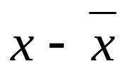
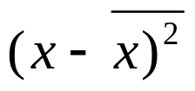
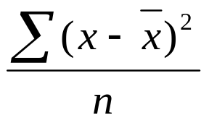
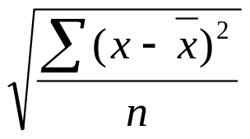
Defining risk: Standard deviation
Standard deviation is a measure of how each value in a data set varies or deviates from the mean
1. Find the mean of the set of data:
2. Find the difference between each value and the mean:
3. Square the difference:
4. Find the average (mean) of these squares:
5. Take the square root to find the standard deviation

Slide 34

Standard Deviation
Find the mean and the standard deviation for the values 78.2, 90.5, 98.1, 93.7, 94.5.
x
(78.2 + 90.5 + 98.1 +93.7 +94.5)
5
= = 91 Find the mean.
x
x
x – x
(x – x)²
Organize the next
steps in a table.
78.2 91 –12.8 163.84
90.5 91 –0.5 .25
98.1 91 7.1 50.41
93.7 91 2.7 7.29
94.5 91 3.5 12.25
Σ(x – x)²
n
σ = Find the standard
deviation.
234.04
5
= 6.8
The mean is 91, and the standard deviation is about 6.8.

Slide 35
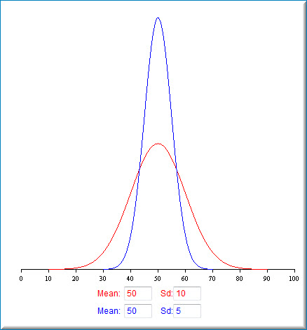
The mean-variance framework
The variance on any investment measures the disparity between actual and expected returns

Slide 36
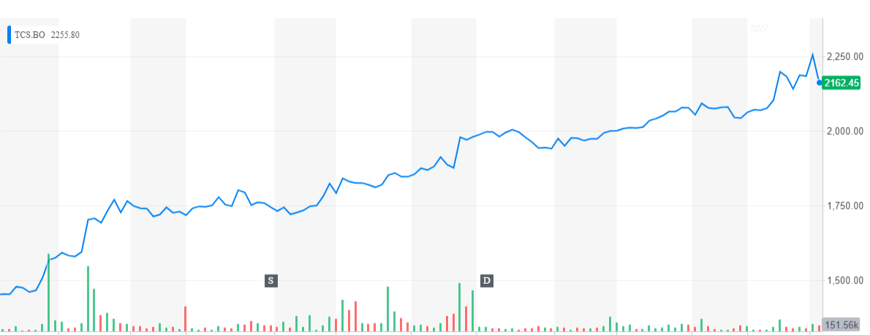
How risky is TCS: A look at the past

Slide 37
Standard deviation of TCS
Daily Std dev=1.42%
Date | Adj Close | Log(return) | Simple return
10/3/2017 | 1198.726
10/4/2017 | 1196.522 | -0.18% | -0.18%
10/5/2017 | 1190.438 | -0.51% | -0.51%
10/6/2017 | 1197.786 | 0.62% | 0.62%
10/9/2017 | 1201.421 | 0.30% | 0.30%
10/10/2017 | 1204.85 | 0.29% | 0.29%
10/11/2017 | 1224.905 | 1.65% | 1.66%
10/12/2017 | 1248.448 | 1.90% | 1.92%
10/13/2017 | 1252.464 | 0.32% | 0.32%
10/16/2017 | 1266.347 | 1.10% | 1.11%
10/17/2017 | 1271.197 | 0.38% | 0.38%
10/18/2017 | 1268.287 | -0.23% | -0.23%
10/19/2017 | 1264.309 | -0.31% | -0.31%

Slide 38
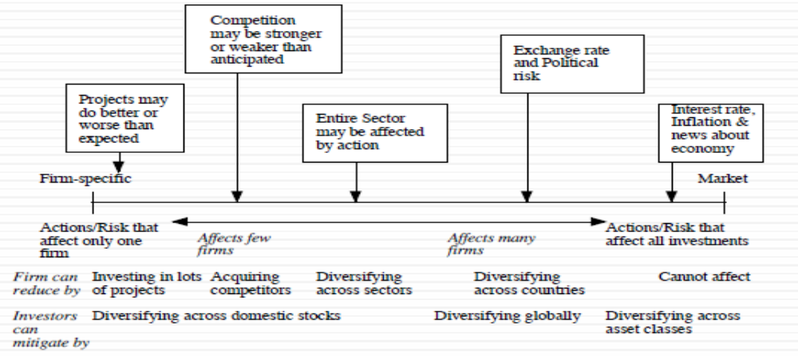
The importance of diversification: Risk types

Slide 39
Risk measures
How to measure riskiness?
  Firm A with the number of shareholders is 1 million.
  Firm B with the number of shareholders is 10.
For widely-held public firms, discount date should reflect the risk perceived by the marginal investor (You have a lot of stocks (different firms) and trade them)
  Macro uncertainly (Systematic risk)
  Micro uncertainty (Unsystematic risk)
Discrete versus continuous uncertainty
  Discreate risk: Risks that lie dormant for period but show up at points in time (Example: Brexit; financial crisis; distress risk, etc.,).
  Continuous risk: Risks changes in interest rate or economic growth occur continuously and affect value they happen.

Slide 40
Why diversification reduces/eliminates firm-specific risk?
Firm-specific risk can be reduced, if not eliminated, by increasing the number of investments in your portfolio. Market-wide risk cannot. This can be justified on either economic or statistical grounds.
On economic grounds, diversifying and holding a larger portfolio eliminant firm-specific risk for two reasons
  Each investment is a much smaller percentage of the portfolio, reducing the effect (positive or negative) on the overall portfolio.
  Firm-specific actions can be negative or positive. In a large portfolio, it is argued, these effect will average out to zero. (For every firm, where something bad happens, there will be some other firm, where something good happens.

Slide 41
Riskiness of two assets: Statistical grounds
Assume we have Rs 10,000 and want to invest in Asset A and B with equal investment.
We measure expected returns of Asset A and Asset B are 10% and 12%, respectively. Std dev of A and B is 5% and 6%.
Expected return of investment (portfolio)=0.50*10%+0.50*12%=11%
How to calculate the riskiness of portfolio?.
  I want to evaluate two students in a team. In such a case, I have to consider their individual performance in a team, plus their relationship each other.

Slide 42
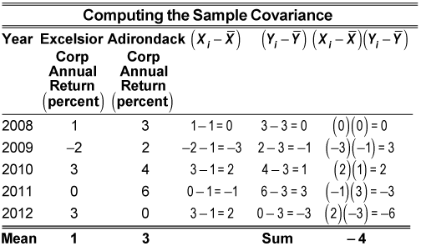


How to measure relationship : Covariance
Covariance measures the strength and the direction of the relationship between the elements of two stock, and the correlation is derived from the covariance
$$covarinace=\frac{−4}{5−1}=−1$$

Slide 43
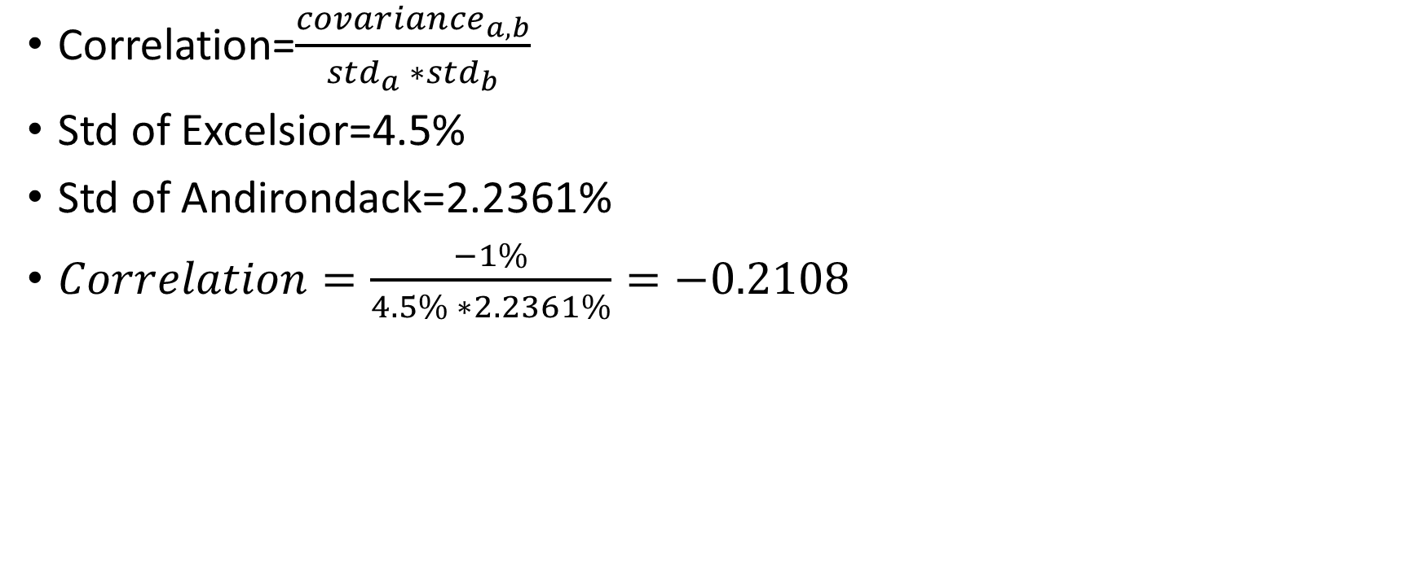
How to measure relationship : Correlation
Correlation=$\frac{{covariance}_{a,b}}{{std}_{a} ∗{std}_{b}}$
Std of Excelsior=4.5%
Std of Andirondack=2.2361%
$Correlation=\frac{−1\%}{4.5\% ∗2.2361\%}=−0.2108$

Slide 44
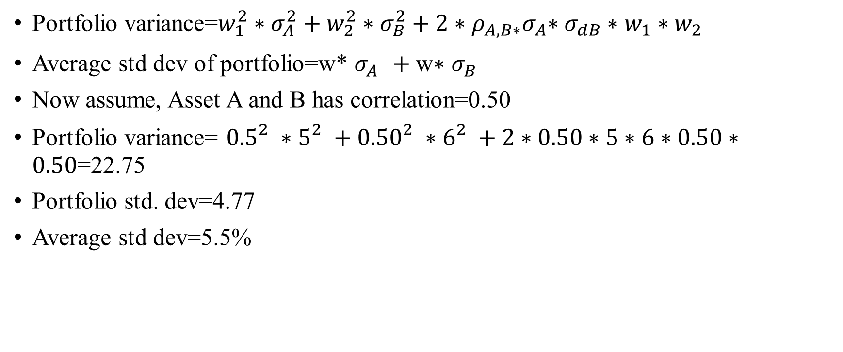
Portfolio risk
Portfolio variance=$w_{1}^{2}∗σ_{A}^{2}+w_{2}^{2}∗σ_{B}^{2}+2{∗ρ_{A,B∗}σ}_{A}∗σ_{dB}∗w_{1}∗w_{2}$
Average std dev of portfolio=w* $σ_{A}^{}+\text{w}\text{∗ }σ_{B}^{}$
Now assume, Asset A and B has correlation=0.50
Portfolio variance= ${0.5}_{}^{2}∗5_{}^{2}+{0.50}_{}^{2}∗6_{}^{2}+2∗0.50∗5∗6∗0.50∗0.50$=22.75
Portfolio std. dev=4.77
Average std dev=5.5%

Slide 45
With various correlations
Correlation | Portfolio std dev
-1 | 0.50
-0.9 | 1.32
-0.8 | 1.80
-0.7 | 2.18
-0.6 | 2.50
-0.5 | 2.78
-0.4 | 3.04
-0.3 | 3.28
-0.2 | 3.50
-0.1 | 3.71
0 | 3.91
0.1 | 4.09
0.2 | 4.27
0.3 | 4.44
0.4 | 4.61
0.5 | 4.77
0.6 | 4.92
0.7 | 5.07
0.8 | 5.22
0.9 | 5.36
1 | 5.50

Slide 46

Portfolio risk with three stocks

Slide 47
The role of the marginal investor
The marginal investor in a firm is the investor who is most likely to be buyer or seller on the next trade and to influence the stock prices.
Generally speaking, the marginal investor in a stock has to own a lot of stock and also trade that stock on regular basis.
In all risk and return models in finance, we assume that the marginal investor is well diversified.

Slide 48
Identifying the marginal investor in your firm
Percent of Stock held by Institutions | Percent of Stock held by Insiders | Marginal Investor
High | Low | Institutional Investor
High | High | Institutional Investor, with insider influence
Low | High (held by founder/manager of firm) | Tough to tell; Could be insiders but only if they trade. If not, it could be individual investors
Low | High (held by wealthy individual investor) | Wealthy individual investor, fairly diversified
Low | Low | Small individual investor with restricted diversification

Slide 49
TCS: Marginal investor
Holder's Name | % Share Holding
Promoters | 71.92%
Foreign Institutions | 16.59%
Financial Institutions | 4.90%
General Public | 3.82%
banks &Mutual Funds | 1.96%
Others | 0.76%
CentralGovt | 0.05%

Slide 50
The risk of an Individual Asset
The essence: The risk of any asset is the risk that it adds to the market portfolio. Statistically, this risk can be measured by how much an asset moves with the market (called the covariance).
The measure: Beta is standardized measure of this covariance, obtained by dividing the covariance of any asset with the market by the variance of the market.
The result: the required return on an investment will be a linear function on its beta
Expected return=Risk-free rate + Beta*(Expected return on the market portfolio-Risk-free rate)

Slide 51
The Capital Asset Pricing Model
Specifies that a portion of variance can be diversified away, and that is only the non-diversified portion that is rewarded.
Measures the non-diversified risk with beta, which is standardized around one.
Translates beta into expected return
  Expected return=Risk-free rate + Beta*Risk premium

Slide 52
How are betas calculated?
The standard procedure for estimating betas is to regress stock returns (Rj ) against market returns (Rm):
Rj = a + b Rm
where a is the intercept and b is the slope of the regression.
The slope of the regression corresponds to the beta of the stock and measures the riskiness of the stock.
The R squared (R2) of the regression provides an estimate of the proportion of the risk (variance) of a firm that can be attributed to market risk. The balance (1 - R2) can be attributed to firm specific risk.

Slide 53
Use the historical stock returns to calculate the beta for PQU.
Year |  | Market |  | PQU
1 |  | 25.7% |  | 40.0%
2 |  | 8.0% |  | -15.0%
3 |  | -11.0% |  | -15.0%
4 |  | 15.0% |  | 35.0%
5 |  | 32.5% |  | 10.0%
6 |  | 13.7% |  | 30.0%
7 |  | 40.0% |  | 42.0%
8 |  | 10.0% |  | -10.0%
9 |  | -10.8% |  | -25.0%
10 |  | -13.1% |  | 25.0%

Slide 54
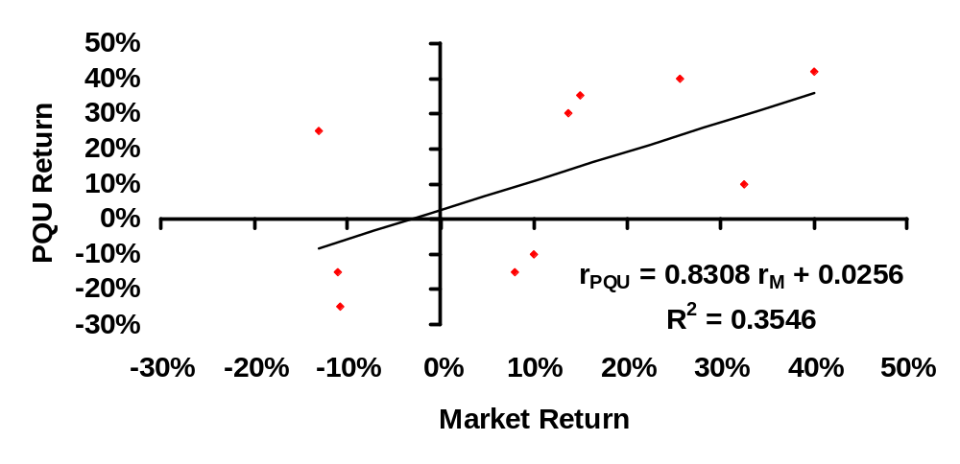
Calculating Beta for PQU

Slide 55
Beta & PQU Co.
Beta reflects slope of line via regression
Rpqu = 0.8308 rM + 0.0256
So, PQU’s beta is .8308 & y-intercept @ 2.56%
PQU’s R² of .3546 means about 35% of PQU’s returns are explained by the market returns
This implies that
  35.46% of the risk at PQU Co comes from market sources
  64.56%, therefore, comes from firm-specific sources
The firm-specific risk is diversifiable and will not be rewarded.

Slide 56
Setting up for the Estimation
Decide on an estimation period
  Services use periods ranging from 2 to 5 years for the regression
  Longer estimation period provides more data, but firms change over time.
  Shorter periods can be affected more easily by significant firm-specific event that occurred during the period.
Decide on a return interval - daily, weekly, monthly
  Shorter intervals yield more observations but suffer from more noise.
  Noise is created by stocks not trading and biases all betas towards one. ¨ ¨
Choose a market index and estimate returns (inclusive of dividends) on the index for each interval for the period.

Slide 57
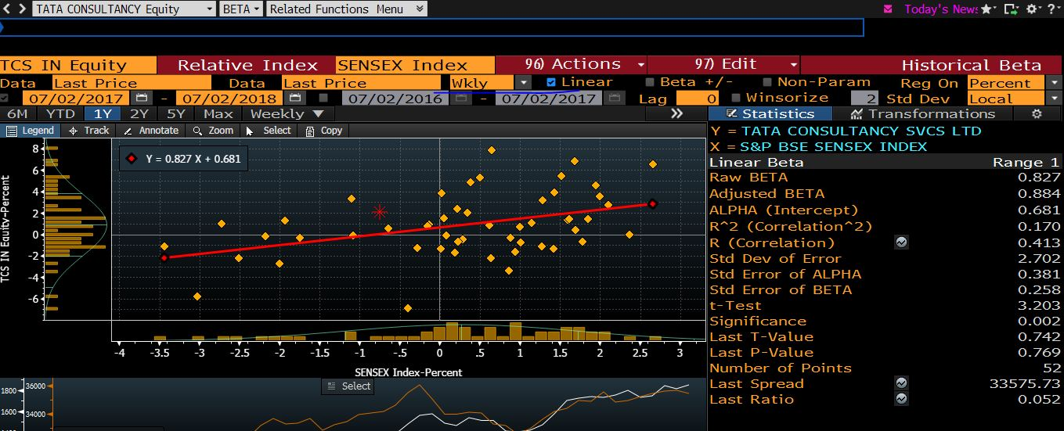

Slide 58
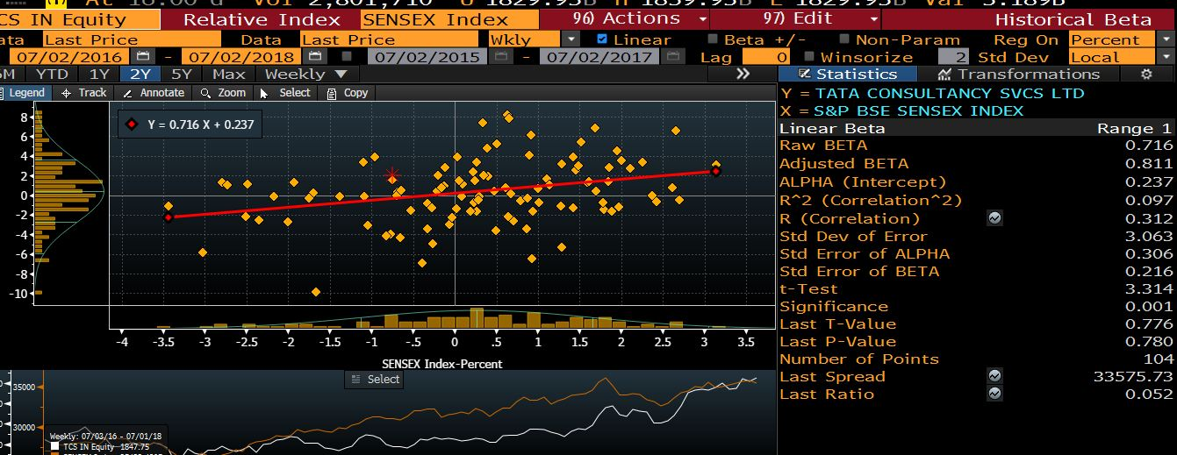

Slide 59
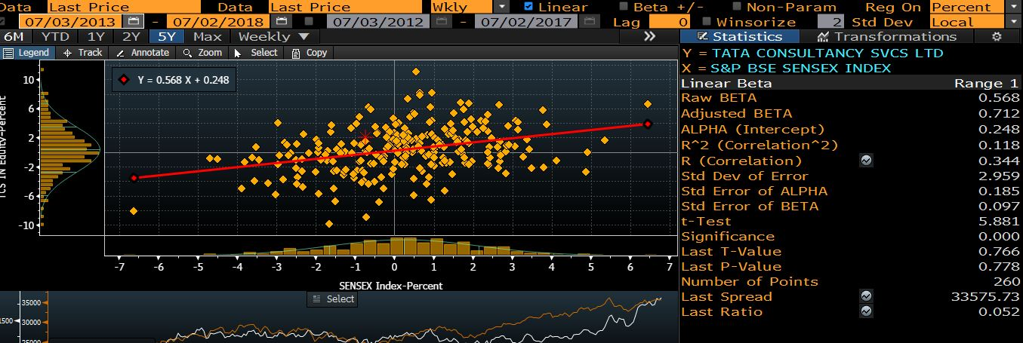

Slide 60
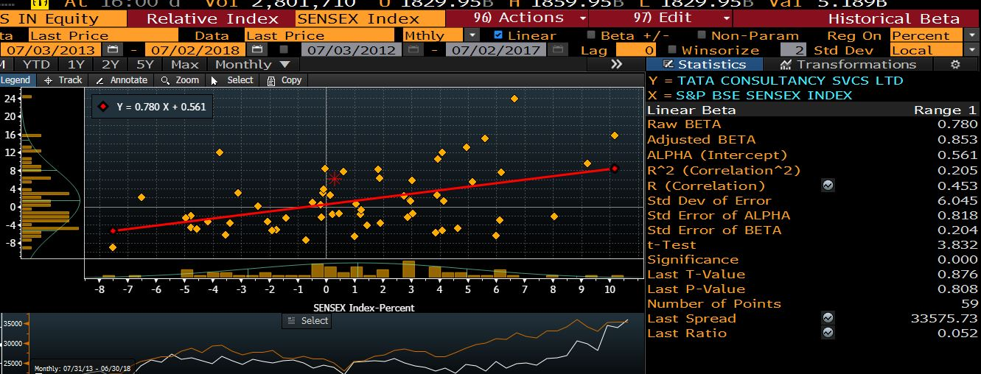

Slide 61
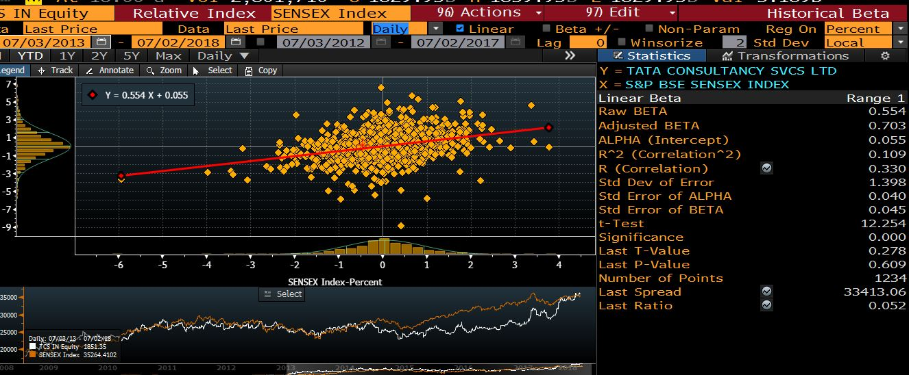

Slide 62
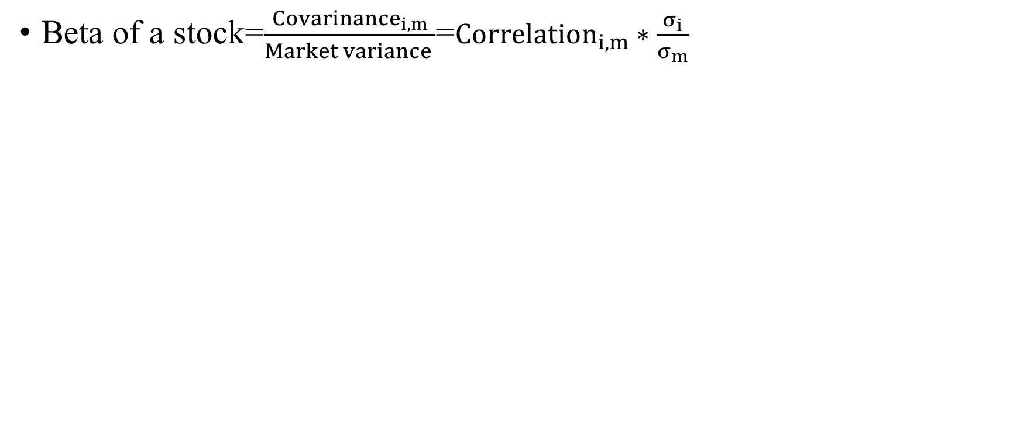
More on beta concept..
Beta of a stock=$\frac{{Covarinance}_{i,m}}{Market variance }$=${Correlation}_{i,m}∗\frac{σ_{i}}{σ_{m}}$

Slide 63
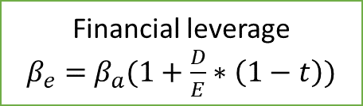
Determinates of beta
Assuming that total risk is born by only equity holders
Beta of equity (Levered Beta)
Beta of Business (Unlevered Beta
Financial leverage
$β_{e}=$ $β_{a}(1+\frac{D}{E}∗\left(1−t\right))$
Nature of product or service offered by firm:
High elasticity (discretionary) of demand of your product would have higher beta
Operating leverage (Fixed Costs as % of total costs)
Firms with high infrastructure needs and rigid costs structures should have higher betas than firms flexible cost structures
Smaller firms should have higher betas than larger firms.
Young firms should have higher betas than more mature firms
Cyclical firms should have higher beta than non-Cyclical firms .
Luxury Goods firms should have higher beta than basic goods
High priced goods/service firms should have higher betas than low prices goods/service.
Growth firms should have higher beta

Slide 64
A Risk-free rate
On a risk-free asset, the actual return is equal to the expected return: zero standard deviation.
  If you buy 1-year bond with the expectation of 5% return and the actual return is also turn out to be 5.
  The returns should be uncorrelated with the risky-investment returns.
For an investment to be risk-free, then, it must have
  No default risk
  No reinvestment risk
    The expected return over 5 years, Can 6-month TB risk-free?
    Can the coupon bond with life of 5 years?
Can we use Indian Govt. bond rate as a Risk-free rate if you want value Indian firms?

Slide 65
A Risk-free rate
India’s sovereign rating (Moody)=Baa2
Credit default swap spreads (CDS): an insurance against default. For instance, If I purchase AA bond and that has probability of default. I can buy insurance against the default of the bond. The price I have to pay to buy the insurance is called Credit default swap spreads.

Slide 66
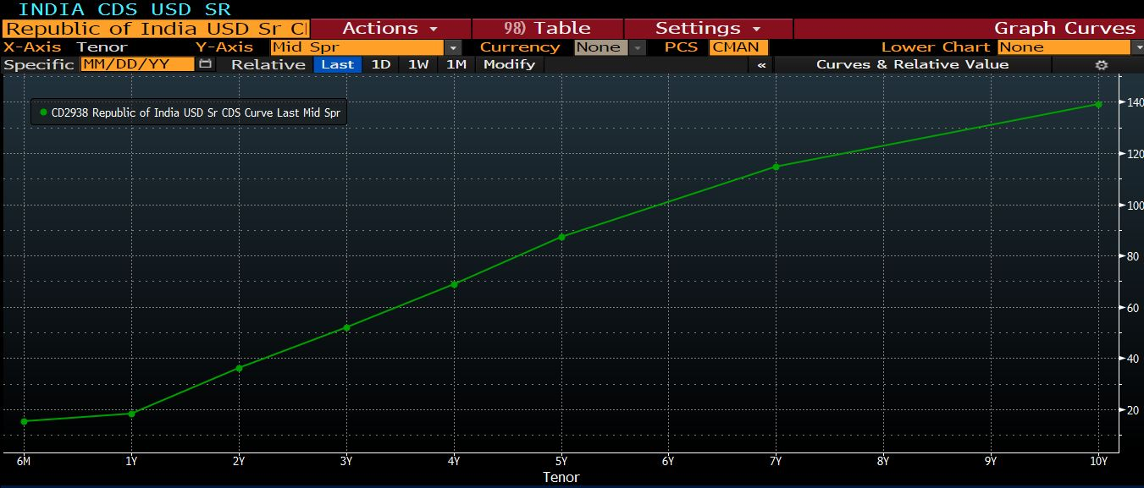
Indian CDS

Slide 67
A Risk-free rate and cost of equity
Risk free rate (CDS)=8.08-1.40=6.68%
Equity risk-premium (current)=4.77% + 1.41%=6.18%
Cost of Equity (HUL)=6.68% + 6.18%*0.40% =9.2%
Cost of Equity (TCS)=6.68% + 6.18%*0.54% =10.01%

Slide 68
Valuing Bonds

Slide 69
Valuing Bonds
Bonds, like the world suggests, binds the borrow to the lender in a contract.
An explicit IOU (I owe you): a promise to pay money in the future in return for the money borrowed.
Key Bond Characteristics
  Face Value: The face value (also known as the par value) of a bond is the price at which the bond is sold to investors when first issued; it is also the price at which the bond is redeemed at maturity.
  Coupon Rate: The periodic interest payments promised to bond holders are computed as a fixed percentage of the bond’s face value; this percentage is known as the coupon rate.
  Maturity: A bond’s maturity is the length of time until the principal is scheduled to be repaid.

Slide 70
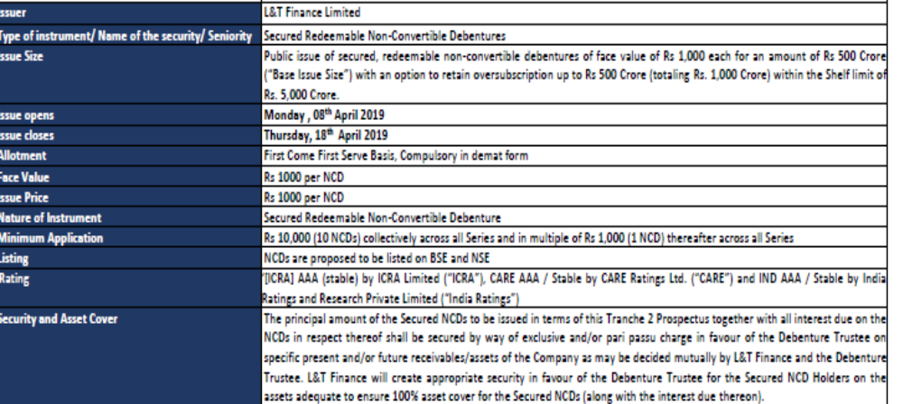
Indian Bond market
Notes:
Source: https://www.hdfcsec.com/hsl.docs//L&T%20Finance%20Ltd%20Taxable%20NCD%20Issue%20product%20note-201904041732046620236.pdf

Slide 71
Bond valuation
L&T finance bond with coupon rate is 8.7% for 3 years maturity. The credit rating is AAA
What should be the value of the bond?
Value of bond=PV of coupon amount + PV of principal amount
0
1
=Rs 87
2
=Rs 87
3
=Rs 87 (Coupon amount)
=Rs 1000 (Principle amount
$Value of a bond=\frac{87}{{(1+r)}^{1}}+\frac{87}{{(1+r)}^{2}}$ + $\frac{1087}{{(1+r)}^{3}}$
Expected rate of return=Expected return on default-free bond + Default spread

Slide 72
Credit rating
Rating | Meanings
AAA | Highest degree of safety
AA | High degree of safety
A | Adequate degree of safety
BBB | Moderate degree of safety
BB | Moderate risk of default
B | High risk of default
C | Very high risk of default
D | Default or expected to be in default soon

Slide 73
Corporate bond Yield
Ratings
Year | AAA | AAA | AAA | AAA | AA | AA | AA | AA
 | 1 years | 3 years | 5 years | 10 years | 1 years | 3 years | 5 years | 10 years
2008-09 |  | 8.1734 | 8.5295 | 8.801 |  |  |  | 9.0184
2009-10 | 6.3939 | 7.1713 | 8.096 | 8.5515 | 6.6913 | 7.6547 | 8.4188 | 8.9509
2010-11 | 6.7263 | 6.9401 | 8.4124 | 8.8213 | 7.5435 | 8.2898 | 8.8806 | 9.0062
2011-12 | 9.6977 | 9.176 | 9.4792 | 9.279 | 9.67 | 9.8356 | 9.6473 | 9.5096
2012-13 | 9.3159 | 9.2599 | 9.13 | 9.0732 | 9.5028 | 9.3168 | 9.4743 | 9.2848
2013-14 | 9.4453 | 9.0034 | 9.1787 | 8.9266 | 9.5223 | 8.9413 | 9.2013 | 8.9992
2014-15 | 8.9918 | 8.8709 | 8.7642 | 8.636 | 9.2229 | 9.1595 | 9.3786 | 9.2875
2015-16 | 8.3979 | 8.2751 | 8.3878 | 8.4176 | 8.8619 | 8.8827 | 9.0552 | 9.2146
2016-17 | 7.5481 | 7.5548 | 7.5499 | 7.8108 | 7.9198 | 8.1983 | 8.2476 | 8.6741
2017-18 | 7.3348 | 7.4283 | 7.4036 | 7.5734 | 7.5844 | 7.8598 | 8.479 | 8.2198
2018-19 | 8.2764 | 8.4044 | 8.5061 | 8.5589 | 8.4005 | 9.1138 | 9.2557 | 8.9407
Notes:
https://countryeconomy.com/bonds/india

Slide 74
Bond valuation
$Value of a bond=\frac{87}{{(\text{1+}\text{8.4044}\text{\%} )}^{1}}+\frac{87}{{(\text{1+}\text{8.4044}\text{\%} )}^{2}}$ + $\frac{1087}{{(\text{1+}\text{8.4044}\text{\%} )}^{3}}$
Value of Bond=Rs 1007.563
Current Market price=Rs 1010
When the expected return on bond is lower than coupon rate, then bond is expected to
trade at premium (more than par value).
2. When the expected return on bond is higher than coupon rate, then bond is expected to
trade at discount (less than par value).
3. When the expected return on bond is equal to coupon rate, then bond is expected to
trade at par.

Slide 75
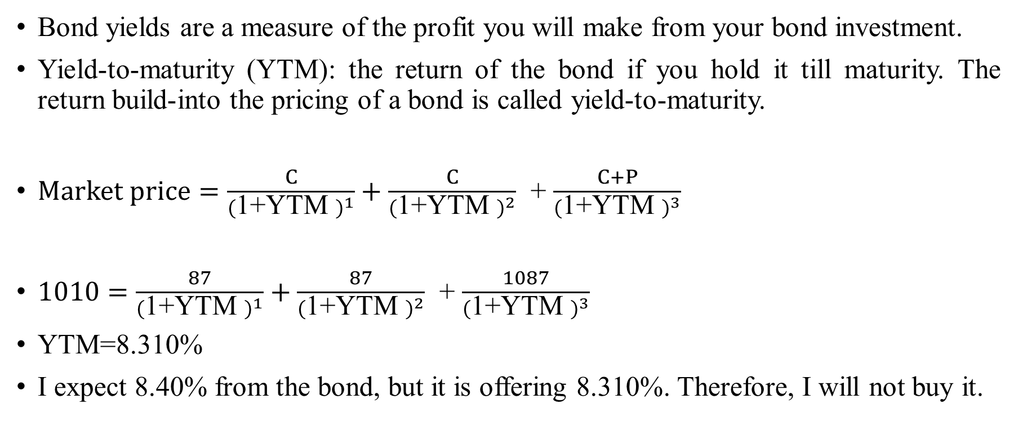
Bond yield
Bond yields are a measure of the profit you will make from your bond investment.
Yield-to-maturity (YTM): the return of the bond if you hold it till maturity. The return build-into the pricing of a bond is called yield-to-maturity.
$Market price=\frac{C}{{(\text{1+}\text{YTM} )}^{1}}+\frac{C}{{(\text{1+}\text{YTM} )}^{2}}$ + $\frac{C+P}{{(\text{1+}\text{YTM} )}^{3}}$
$1010=\frac{87}{{(\text{1+}\text{YTM} )}^{1}}+\frac{87}{{(\text{1+}\text{YTM} )}^{2}}$ + $\frac{1087}{{(\text{1+}\text{YTM} )}^{3}}$
YTM=8.310%
I expect 8.40% from the bond, but it is offering 8.310%. Therefore, I will not buy it.

Slide 76
Yield curve
The relation between yield to maturity and the maturity of bond.
Bond A
Bond B
Which bond is riskier?
0
Year 1
=Rs 1000
Year 10
=Rs 1000
0

Slide 77
Zero coupon bond yield curve

Slide 78
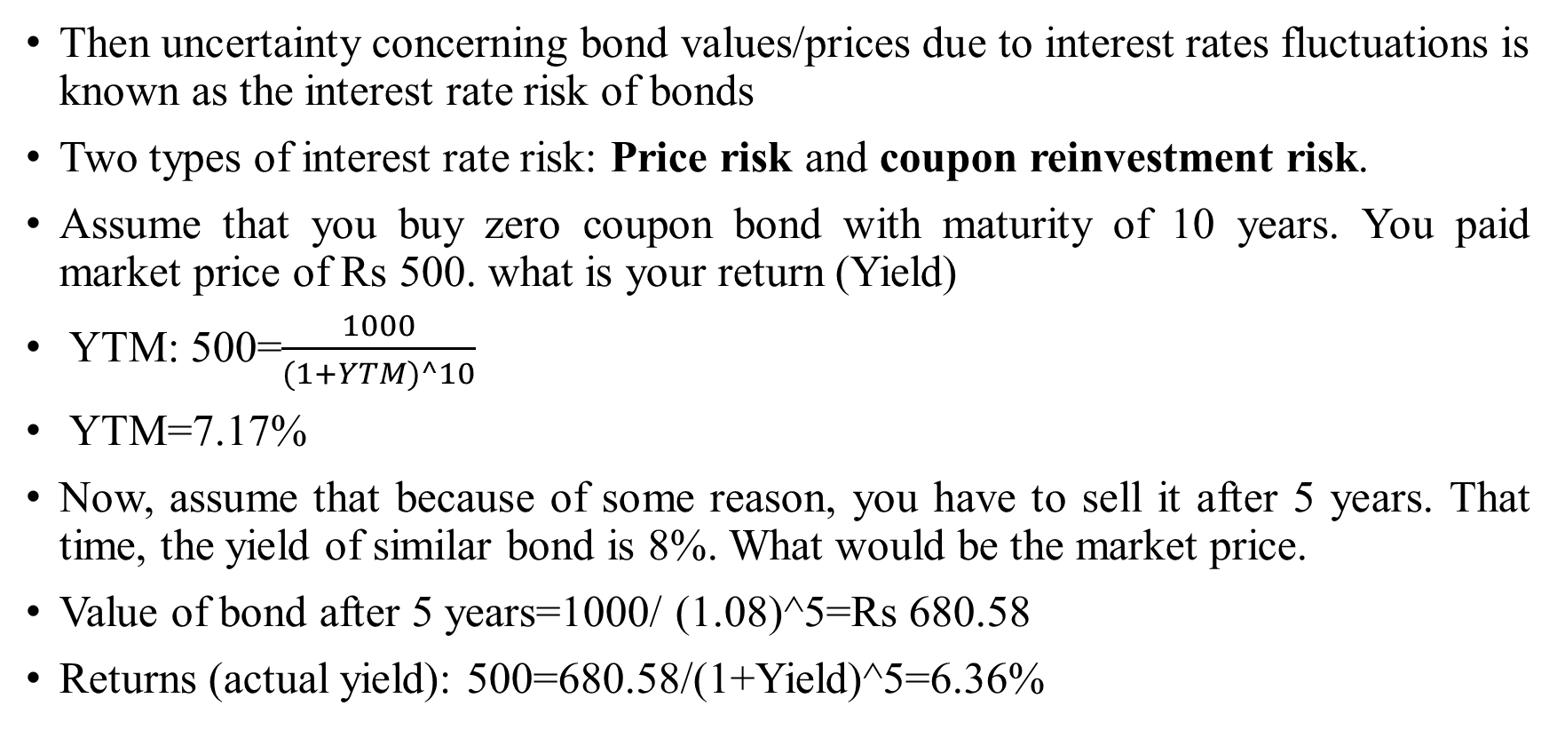
Risk of bonds: Interest rate risk
Then uncertainty concerning bond values/prices due to interest rates fluctuations is known as the interest rate risk of bonds
Two types of interest rate risk: Price risk and coupon reinvestment risk.
Assume that you buy zero coupon bond with maturity of 10 years. You paid market price of Rs 500. what is your return (Yield)
YTM: 500=$\frac{1000}{(1+YTM)^10}$
YTM=7.17%
Now, assume that because of some reason, you have to sell it after 5 years. That time, the yield of similar bond is 8%. What would be the market price.
Value of bond after 5 years=1000/ (1.08)^5=Rs 680.58
Returns (actual yield): 500=680.58/(1+Yield)^5=6.36%

Slide 79
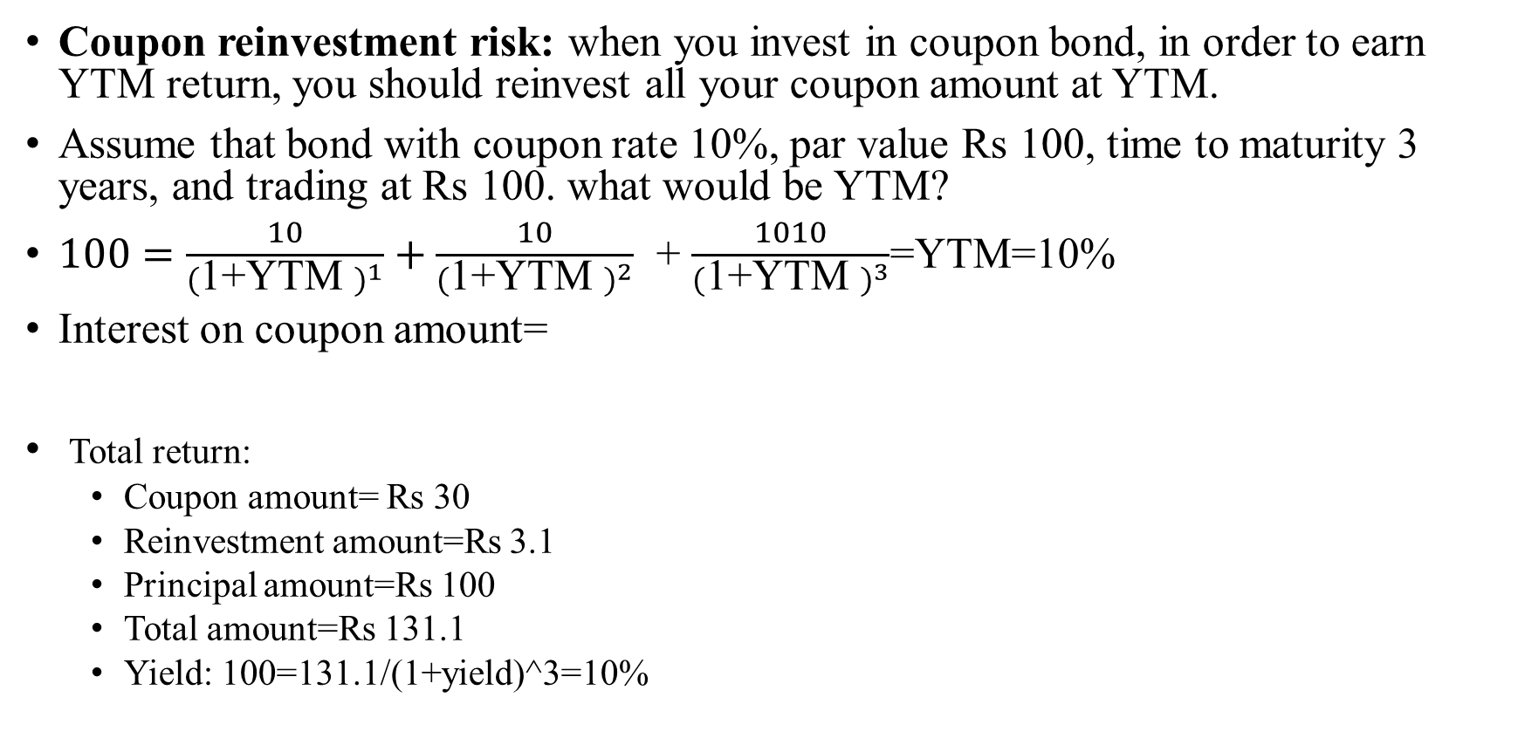
Risk of bonds: Interest rate risk
Coupon reinvestment risk: when you invest in coupon bond, in order to earn YTM return, you should reinvest all your coupon amount at YTM.
Assume that bond with coupon rate 10%, par value Rs 100, time to maturity 3 years, and trading at Rs 100. what would be YTM?
$100=\frac{10}{{(\text{1+}\text{YTM} )}^{1}}+\frac{10}{{(\text{1+}\text{YTM} )}^{2}}$ + $\frac{1010}{{(\text{1+}\text{YTM} )}^{3}}$=YTM=10%
Interest on coupon amount=
Total return:
  Coupon amount= Rs 30
  Reinvestment amount=Rs 3.1
  Principal amount=Rs 100
  Total amount=Rs 131.1
  Yield: 100=131.1/(1+yield)^3=10%
0
1
Rs 10
2
Rs 10
3
Rs 10
=10*(1.1)^0-10=Rs 0
=10*(1.1)^1-10=Rs1
=10*(1.1)^2-10=Rs 2.1

Slide 80
Risk of bonds: Interest rate risk
 | Reinvestment rate
 | 5% | 10% | 15%
Reinvestment amount | Rs. 1.53 | Rs. 3.10 | Rs. 4.72
Coupon amount | Rs. 30 | Rs. 30 | Rs. 30
Principal amount | Rs. 100 | Rs. 100 | Rs. 100
Total return | Rs. 131.53 | Rs. 133.10 | Rs. 134.73
Investment | Rs. 100 | Rs. 100 | Rs. 100
Yield(%) | 9.56% | 10.00% | 10.45%

Slide 81
Valuation of stock

Slide 82
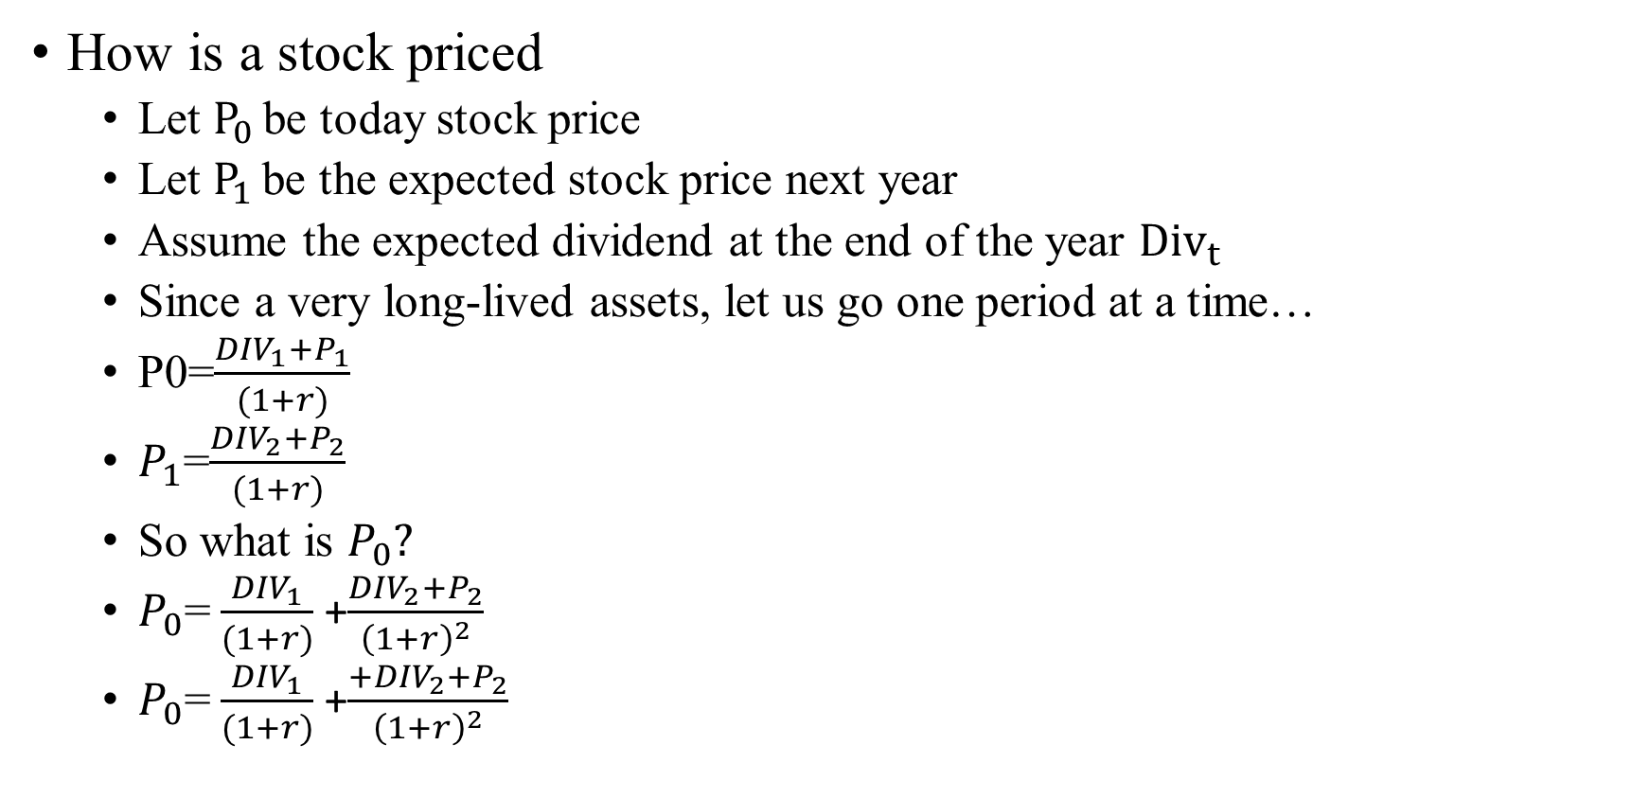
Stock pricing valuation
How is a stock priced
  Let $P_{0 }$be today stock price
  Let $P_{1 }$be the expected stock price next year
  Assume the expected dividend at the end of the year ${Div}_{t }$
  Since a very long-lived assets, let us go one period at a time…
  P0=$\frac{{DIV}_{1}+P_{1}}{(1+r)}$
  $P_{1}$=$\frac{{DIV}_{2}+P_{2}}{(1+r)}$
  So what is $P_{0}?$
  $P_{0}$= $\frac{{DIV}_{1}}{(1+r)}$+$\frac{{DIV}_{2}+P_{2}}{{\left(1+r\right)}^{2}}$
  $P_{0}$= $\frac{{DIV}_{1}}{(1+r)}$+$\frac{+{DIV}_{2}+P_{2}}{{\left(1+r\right)}^{2}}$

Slide 83
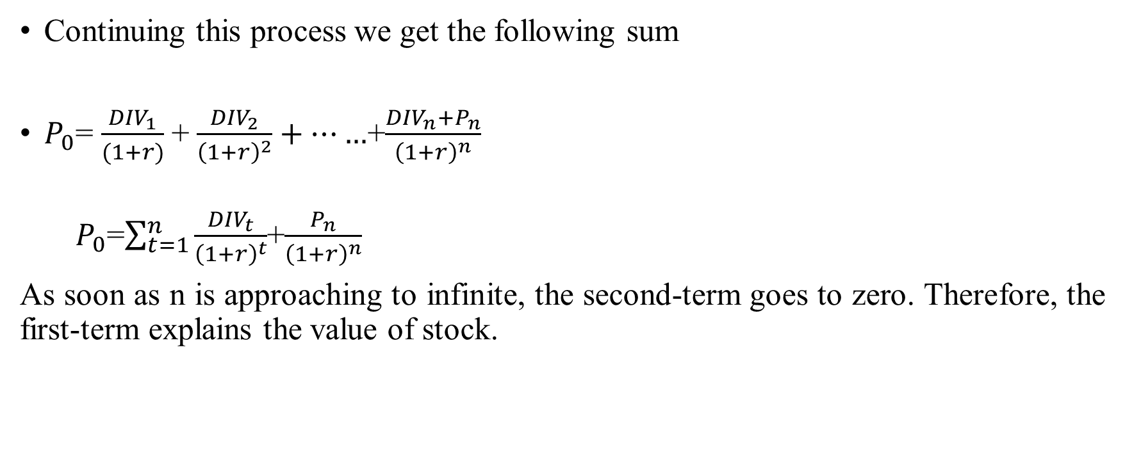
The stock price (Formula…)
Continuing this process we get the following sum
$P_{0}$= $\frac{{DIV}_{1}}{(1+r)}$+ $\frac{{DIV}_{2}}{{\left(1+r\right)}^{2}}+……$+$\frac{{DIV}_{n}+P_{n}}{{\left(1+r\right)}^{n}}$
  $P_{0}$=$\sum_{t=1}^{n}{\frac{{DIV}_{t}}{{\left(1+r\right)}^{t}}}$+$\frac{P_{n}}{{\left(1+r\right)}^{n}}$
As soon as n is approaching to infinite, the second-term goes to zero. Therefore, the first-term explains the value of stock.

Slide 84
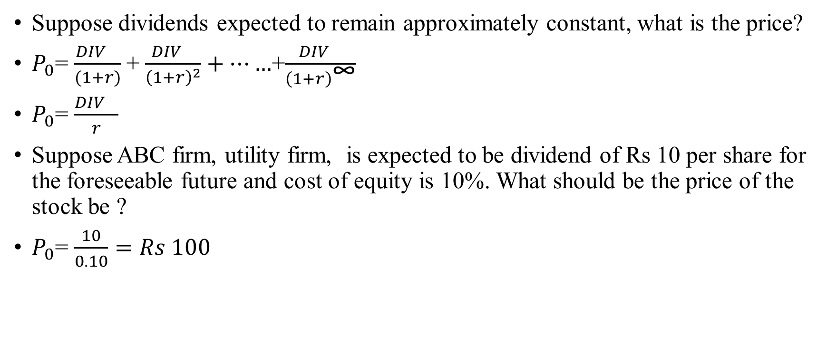
Special case I: Dividend stock
Suppose dividends expected to remain approximately constant, what is the price?
$P_{0}$= $\frac{{DIV}_{}}{(1+r)}$+ $\frac{{DIV}_{}}{{\left(1+r\right)}^{2}}+……$+$\frac{{DIV}_{}}{{\left(1+r\right)}^{\text{∞}}}$
$P_{0}$= $\frac{{DIV}_{}}{r}$
Suppose ABC firm, utility firm, is expected to be dividend of Rs 10 per share for the foreseeable future and cost of equity is 10%. What should be the price of the stock be ?
$P_{0}$= $\frac{10}{0.10}=Rs 100$

Slide 85
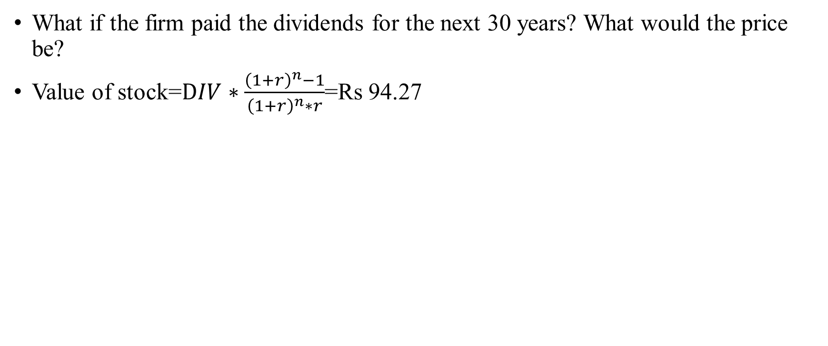
Is forever really forever!
What if the firm paid the dividends for the next 30 years? What would the price be?
Value of stock=$DIV∗\frac{{\left(1+r\right)}^{n}−1}{{\left(1+r\right)}^{n}∗r}$=Rs 94.27

Slide 86
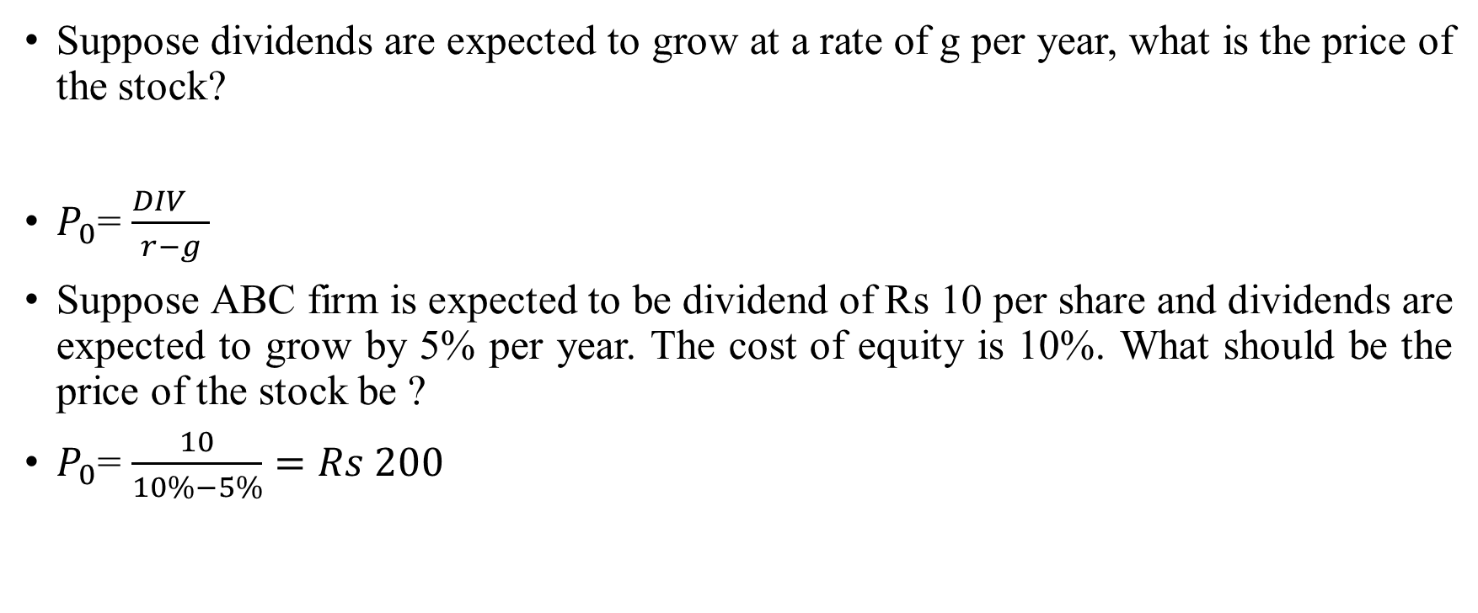
Special Case II: Growth stock
Suppose dividends are expected to grow at a rate of g per year, what is the price of the stock?
$P_{0}$= $\frac{{DIV}_{}}{r−g}$
Suppose ABC firm is expected to be dividend of Rs 10 per share and dividends are expected to grow by 5% per year. The cost of equity is 10%. What should be the price of the stock be ?
$P_{0}$= $\frac{10}{10\%−5\%}=Rs 200$

Slide 87
Engine of growth (assume perpetuities)
A firm reports after-tax operating income Rs 75 million on invested capital of Rs 1 billion. It does not plan to reinvest in new asset but will maintain existing assets and its current return on capital. What should be the growth rate?
If this firm thinks that it can invest 50 million without improving return on capital what growth rate will you see in operating income next year?
If this firm thinks that it can improve its return on capital on existing assets from 7.5% to 10% next year by making them more efficient, what growth rate will you see in operating income next year?
If this firm thinks that it can improve its return on capital on existing assets from 7.5% to 10% next year by making them more efficient, along with 50 million new investment. What growth rate will you see in operating income next year?

Slide 88

Engine of growth
Current investment
Rs 1000
Current ROIC
7.5%
Current earnings
Rs 75
X
=
Current investment
Rs 1000
X
Current ROIC
7.5%
New investment
Rs 50
Current ROIC
7.5%
Next period earnings
Rs 78.75
+
X
=
Current investment
Rs 1000
Change in Current ROIC
0
New investment
Rs 50
Current ROIC
7.5%
Change in next period earnings
Rs 3.75
X
+
X
=
$$\frac{reinvestment amount}{Current earning}X ROIC=\frac{Current in earnings}{Current earnings}$$
$\frac{50}{75} X 7.5\%=\frac{3.75}{75}$=5%

Slide 89
Engine of growth

