Slide 1
Corporate Finance
Yogesh Chauhan

Slide 2
A Dilemma
CCD has an opportunity to open a shop at IIM Raipur. At the same time, it has another opportunity at IIIT Raipur. Now, CCD comes to you to take your opinion.
We find that Govt bond and a corporate bond pay-off Rs 1000 after one year from now. We need to decide how much we should pay for both bonds and why?

Slide 3
Introduction to finance
Finance is the study of value.
Value creation is about two key components: Time and Uncertainty.
(Almost) everything can be valued with our framework.
It is a way of thinking and a set of tools that reflect this way of thinking.
Takeaway: It can improve your decisions making.

Slide 4
Don’t mistake accounting for finance
Accounting Balance sheet
Liabilities | Assets
Equity | Fixed assets (long-lived real assets)
Debt | Current Assets (Short-lived assets)
Other liabilities | Financial investment
Current assets | Intangible assets (Patents &trademarks)

Slide 5
The financial balance sheet
Liabilities | Assets
Equity (Residual Claim on cash flows, Perpetual lives) | Assets in place (Existing investments
Debt (Fixed claim on cash flows, Fixed life) | Growth assets (Expected value that will be created by future investments)

Slide 6
Corporate Finance: The Big Picture
Maximize the value of the business (firm)
The Investment Decision Invest in assets that earn a return greater than the minimum acceptable hurdle rate
The Financing Decision
Find the right kind of debt for your firm and the right mix of debt and equity to fund your operations
The Dividend Decision
If you cannot find investments that make your minimum acceptable rate, return the cash to owners of your business
The hurdle rate should reflect the riskiness of the investment and the mix of debt and equity used to fund it.
The return should reflect the magnitude and the timing of the cashflows as well as all side effects
The optimal mix of debt and equity maximizes firm value
How you choose to return cash to the owners will depend on whether they prefer dividends or buybacks

Slide 7
Time value of money
(Virtually) every decision involves time and uncertainty.
Time value of money is very important to understand the impact of just the passage of time on decision.
The time value of money (TVM) is the concept that money available at the present time is worth more than the identical sum in the future due to its potential earning capacity, such as interest rate you are going to earn on your money.
  Assume you have the option to choose between receiving $10,000 now versus $10,000 in two years. It's reasonable to assume most people would choose the first option

Slide 8
Time value of money: Some terminology
PV=present value (Rs): the value of money today
FV=future value (Rs): the value of money in future
t=# of periods (#)
r=Interest rate (%)>0 (assumption)
Remember, no uncertainty for now!

Slide 9
Time value of money: Interest rate
How much you need to be offered?
  How strong your preference for current consumption over future. consumption: the strong preference of current consumption leads to higher real interest rate.
  Once we add expected inflation with real interest rate, it is called nominal interest rate.
Economists and government officials have been motivating for current consumption that has led American families to save less and consume more of their income, even future income. Keeping everything constant, interest rate in US is expected be lower compared to India.

Slide 10
Important of Timelines!
100
100
100
0
1
2
3
n
At different points of time cash flows cannot be compared to each other.

Slide 11
Simple future value
Suppose a bank pays 10% interest rate per year and you are given a choice between two plans. Which option would you prefer?
  Receive Rs 100 Today
  Receive Rs 100 one year from now
  -Future value=Initial payment plus accumulated interest
  FV=P + r*P= P*(1+r)
  100=100 +10%*100=100*(1+10%)
Time period: 0
1
(A)
Rs 100
(B)
Rs 100

Slide 12
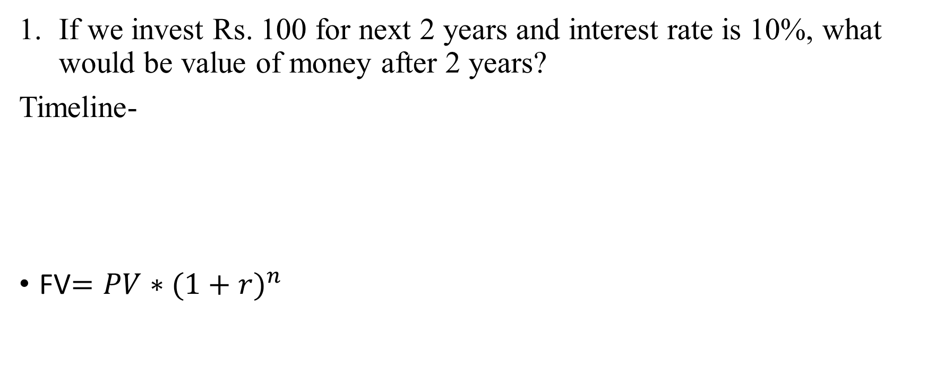
Simple future value
If we invest Rs. 100 for next 2 years and interest rate is 10%, what would be value of money after 2 years?
Timeline-
FV$={PV∗(1+r)}^{n}$
0
1
2
100
110
121
=100*(1+10%)
=110*(1+10%)
=100*(1+10%)*(1+10%)=100*(1+10%)^2

Slide 13
Power of compounding

Slide 14
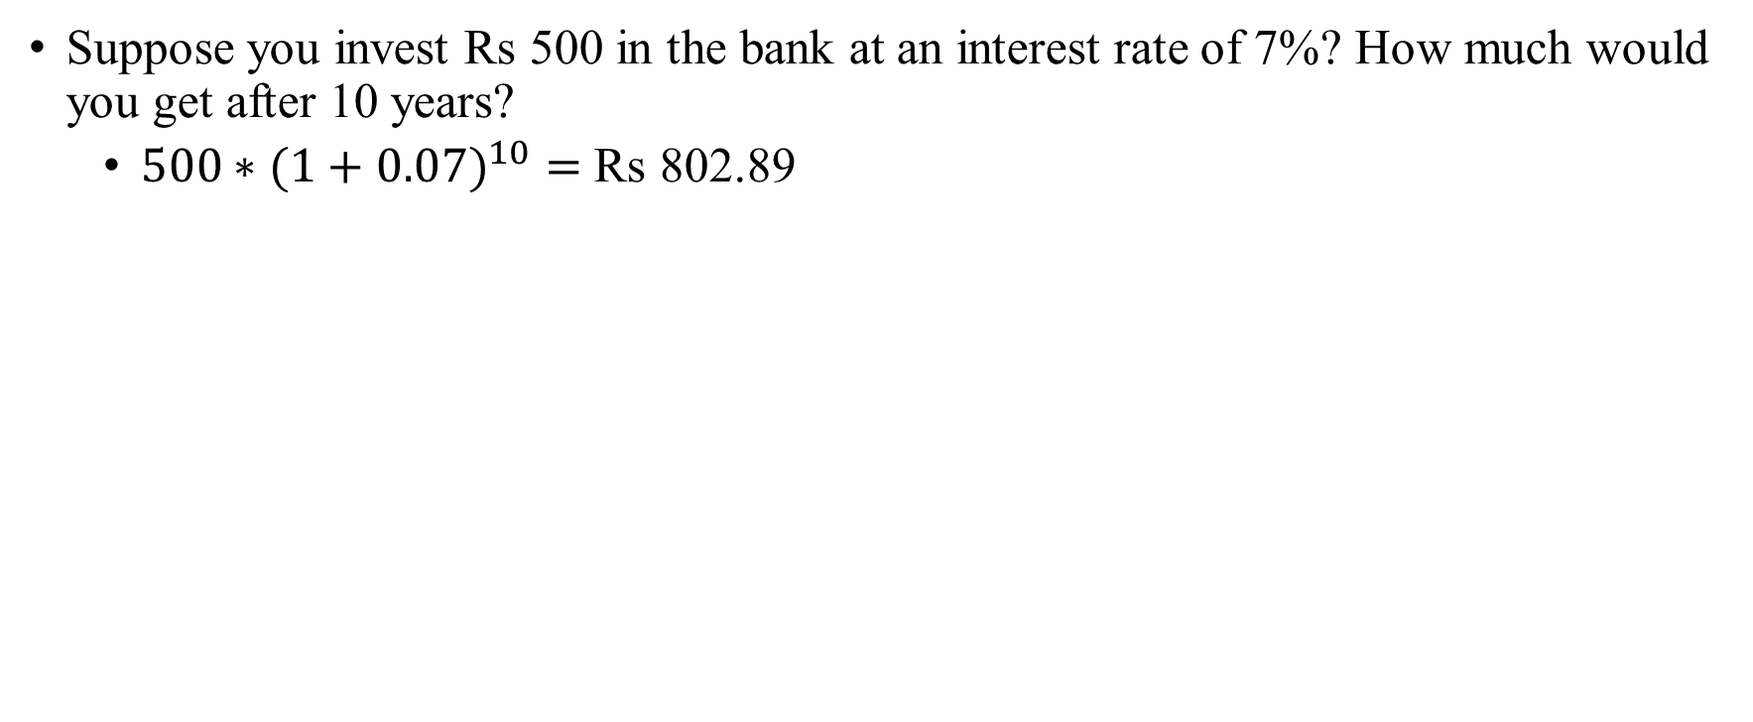
Future value: Example
Suppose you invest Rs 500 in the bank at an interest rate of 7%? How much would you get after 10 years?
  ${500∗(1+0.07)}^{10}=$ Rs 802.89

Slide 15
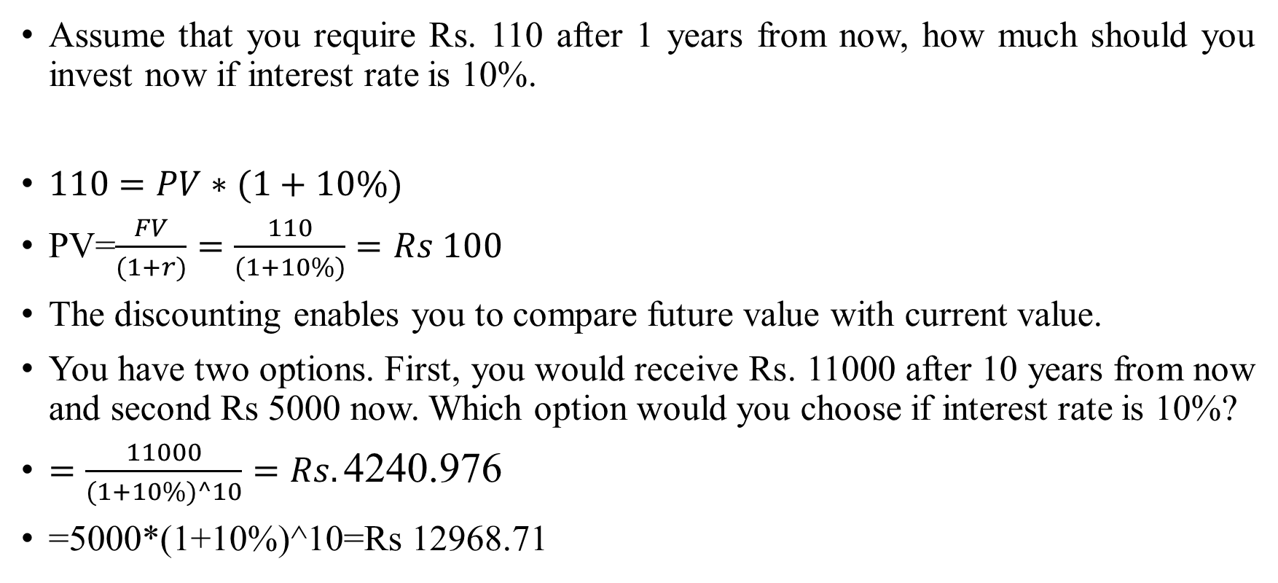
Simple present value
Assume that you require Rs. 110 after 1 years from now, how much should you invest now if interest rate is 10%.
$110=PV∗(1+10\%)$
PV=$\frac{FV}{(1+r)}=\frac{110}{(1+10\%)}=Rs 100$
The discounting enables you to compare future value with current value.
You have two options. First, you would receive Rs. 11000 after 10 years from now and second Rs 5000 now. Which option would you choose if interest rate is 10%?
$=\frac{11000}{(1+10\%)^10}=Rs.\text{4240.976}$
=5000*(1+10%)^10=Rs 12968.71

Slide 16
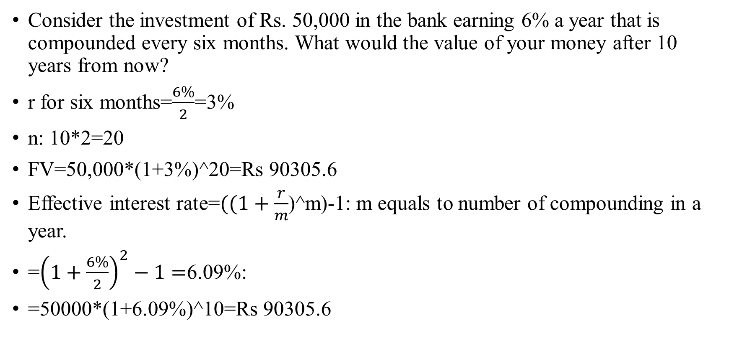
The frequency of discounting and compounding
Consider the investment of Rs. 50,000 in the bank earning 6% a year that is compounded every six months. What would the value of your money after 10 years from now?
r for six months=$\frac{6\%}{2}$=3%
n: 10*2=20
FV=50,000*(1+3%)^20=Rs 90305.6
Effective interest rate=$((1+\frac{r}{m}$)^m)-1: m equals to number of compounding in a year.
=${\left(1+\frac{6\%}{2}\right)}^{2}−1=$6.09%:
=50000*(1+6.09%)^10=Rs 90305.6

Slide 17
The frequency of discounting and compounding
Assume that you are comparing interest rates on several loans, with different banks. The first bank has 8% interest rate, with compounding occurring every month. The second bank has 7.98% interest rate, with compounding occurring every week. The third bank has 7.97% interest rate, with daily compounding. Which is the cheapest loan?
Interest rate | Number of frequency | Effective interest rate
8% | 12 | 8.30%
7.98% | 52 | 8.30%
7.97% | 365 | 8.30%

Slide 18
Time value of money: Annuities
An annuity is a steam of constant cashflows that occur regular intervals for a fixed period of time, such as bank recurring deposit (RD).
Consider you invest Rs 100 the end of every year for the next 3 years in the bank. The bank offers you 10% interest per year. What would be the value of your investment after 3 years
Year | Interest rate | Cash flow | Years to end n | Future value
0 | 10% | 0 | 3 | 0
1 | 10% | 100 | 2 | 121
2 | 10% | 100 | 1 | 110
3 | 10% | 100 | 0 | 100
 |  |  | Total | 331

Slide 19
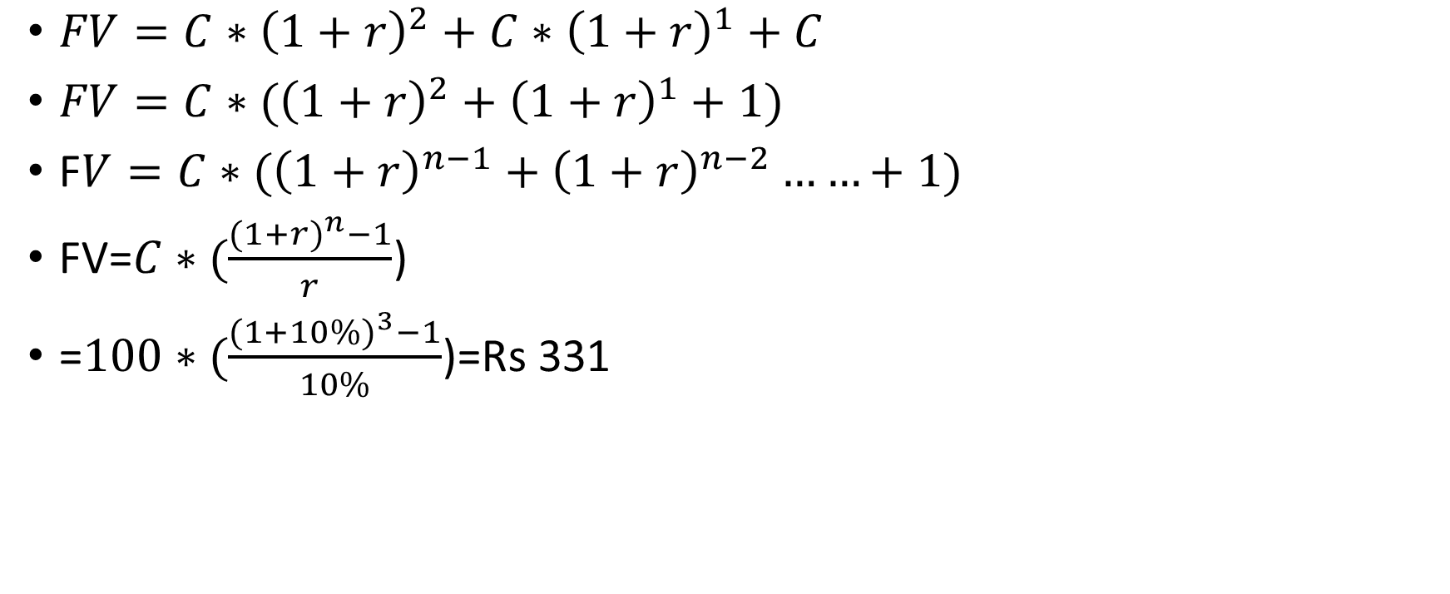
Future value of an annuity: Formula
$FV=C∗{\left(1+r\right)}^{2}+$ $C∗{\left(1+r\right)}^{1}+C$
$FV=C∗({\left(1+r\right)}^{2}+$ ${\left(1+r\right)}^{1}+1)$
F$V=C∗({\left(1+r\right)}^{n−1}+$ ${\left(1+r\right)}^{n−2}……+1)$
FV=$C∗(\frac{{(1+r)}^{n}−1}{r}$)
=$100∗(\frac{{(1+10\%)}^{3}−1}{10\%}$)=Rs 331

Slide 20
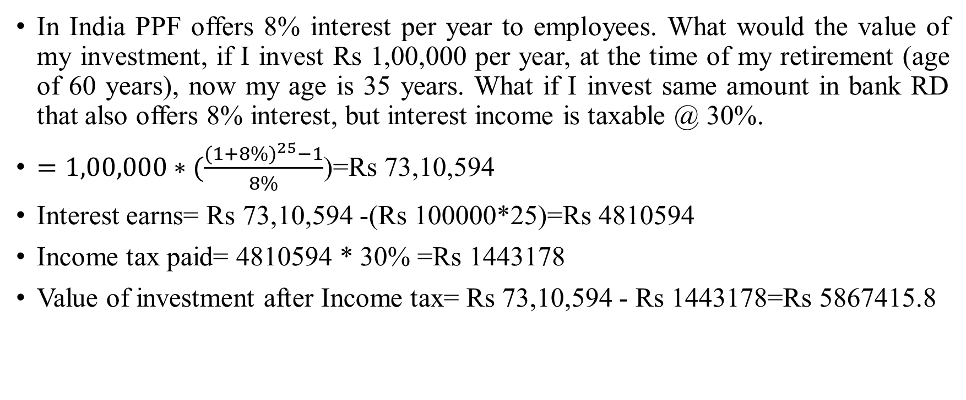
Retirement planning…
In India PPF offers 8% interest per year to employees. What would the value of my investment, if I invest Rs 1,00,000 per year, at the time of my retirement (age of 60 years), now my age is 35 years. What if I invest same amount in bank RD that also offers 8% interest, but interest income is taxable @ 30%.
$=1,00,000∗(\frac{{(1+8\%)}^{25}−1}{8\%}$)=Rs 73,10,594
Interest earns= Rs 73,10,594 -(Rs 100000*25)=Rs 4810594
Income tax paid= 4810594 * 30% =Rs 1443178
Value of investment after Income tax= Rs 73,10,594 - Rs 1443178=Rs 5867415.8

Slide 21
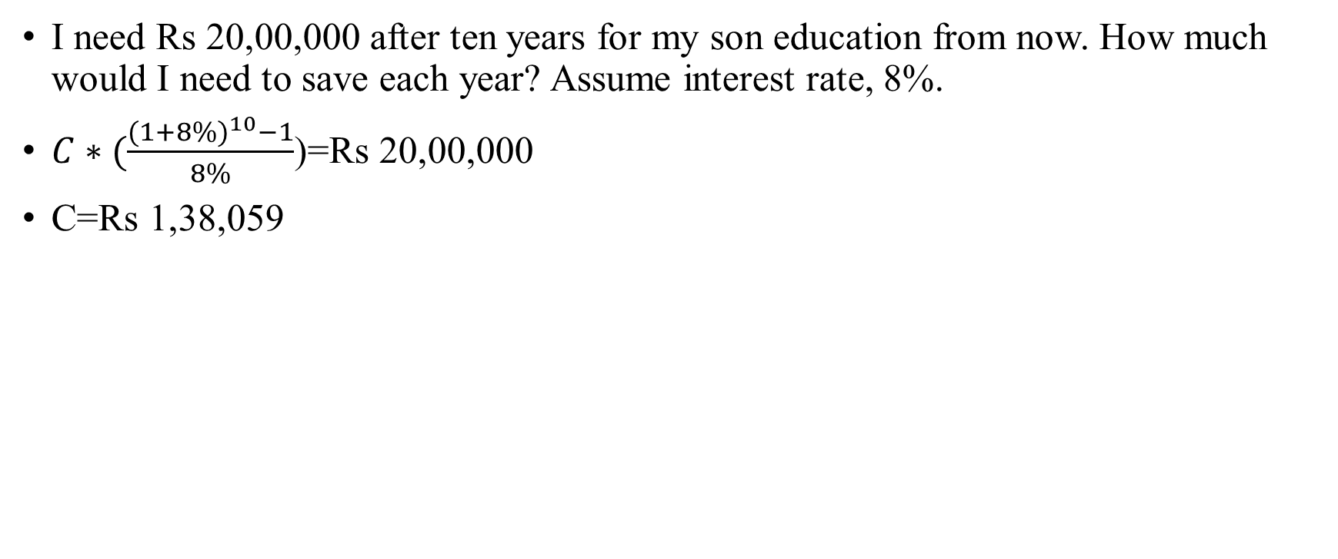
Son’s education plan…
I need Rs 20,00,000 after ten years for my son education from now. How much would I need to save each year? Assume interest rate, 8%.
$C∗(\frac{{(1+8\%)}^{10}−1}{8\%}$)=Rs 20,00,000
C=Rs 1,38,059

Slide 22
Time value of money: present value annuities
You are owner of Firm A and that you have a choice of buying a copier for RS 12000 in cash or paying Rs. 3000 a year for five year for the same copier. If the discount rate is 10%, which option would you rather do?
Year | Interest rate | Cash flow | Years to end : n | Present value
0 | 10% | 0 | 0 | 0
1 | 10% | 3000 | 1 | 2727
2 | 10% | 3000 | 2 | 2479
3 | 10% | 3000 | 3 | 2254
4 | 10% | 3000 | 4 | 2049
5 | 10% | 3000 | 5 | 1863
 |  |  | Total | 11372

Slide 23
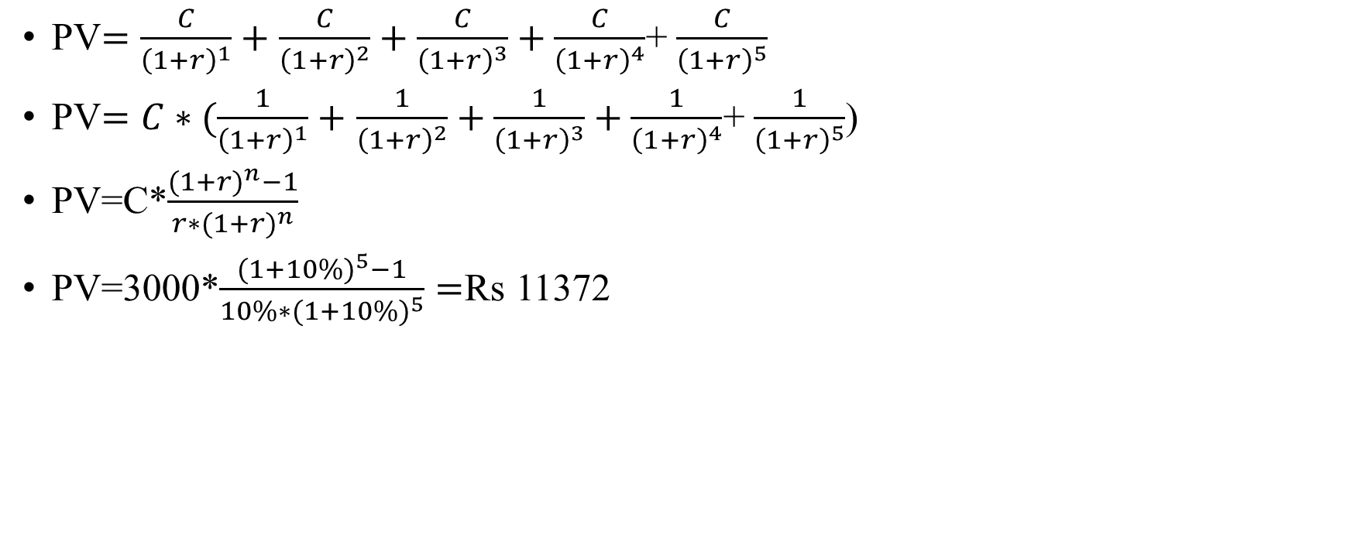
Present value annuities: formula
PV$=\frac{C}{{\left(1+r\right)}^{1}}+$ $\frac{C}{{\left(1+r\right)}^{2}}+\frac{C}{{\left(1+r\right)}^{3}}+\frac{C}{{\left(1+r\right)}^{4}}$+ $\frac{C}{{\left(1+r\right)}^{5}}$
PV$=C∗(\frac{1}{{\left(1+r\right)}^{1}}+$ $\frac{1}{{\left(1+r\right)}^{2}}+\frac{1}{{\left(1+r\right)}^{3}}+\frac{1}{{\left(1+r\right)}^{4}}$+ $\frac{1}{{\left(1+r\right)}^{5}}$)
PV=C*$\frac{({1+r)}^{n}−1}{r∗({1+r)}^{n}}$
PV=3000*$\frac{{(1+10\%)}^{5}−1}{10\%∗{(1+10\%)}^{5}}=$Rs 11372

Slide 24
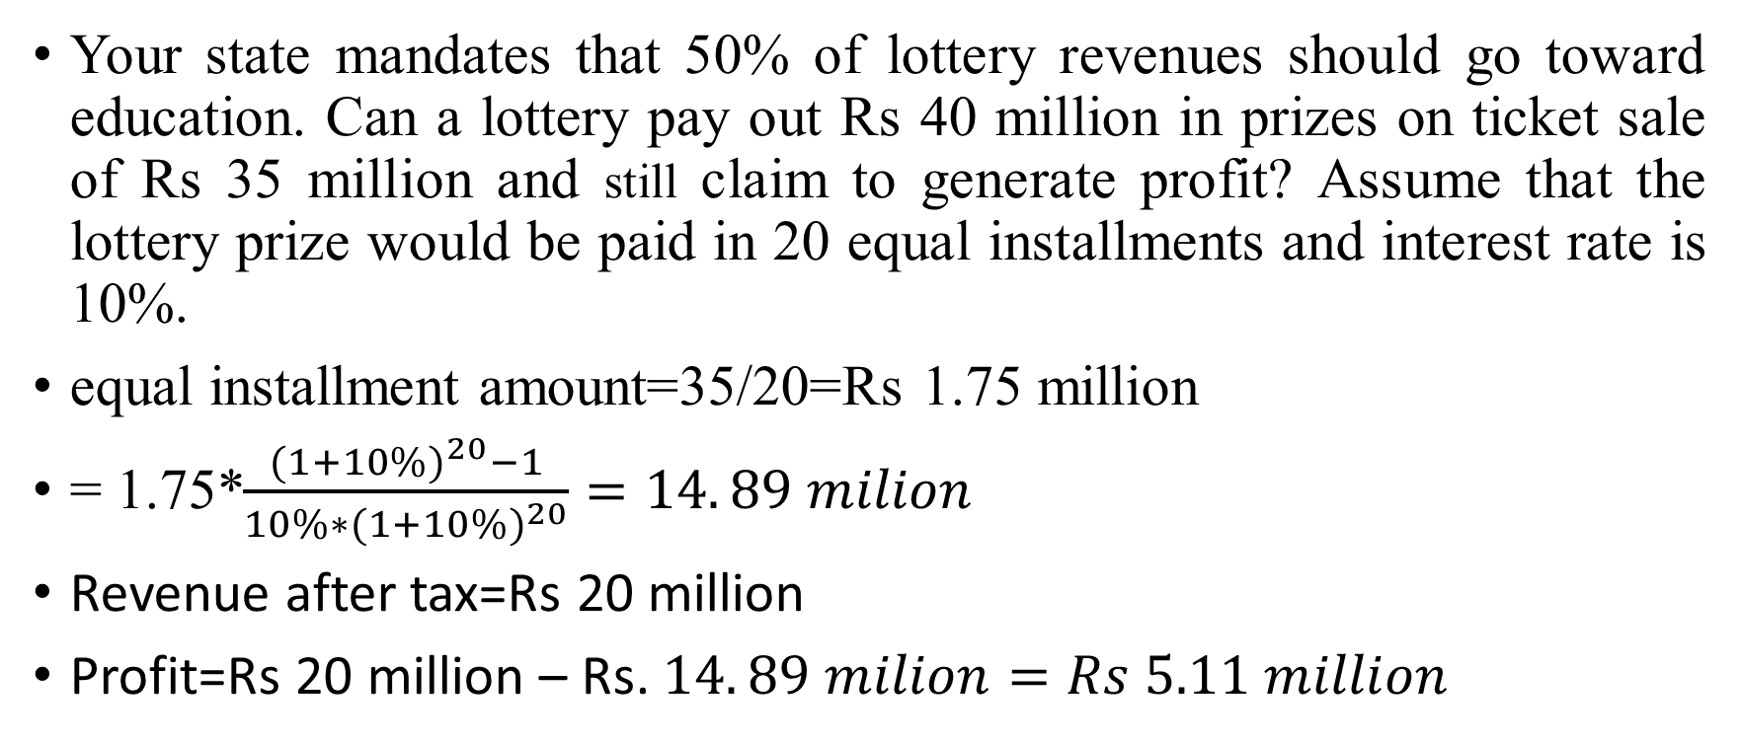
How are they making money?
Your state mandates that 50% of lottery revenues should go toward education. Can a lottery pay out Rs 40 million in prizes on ticket sale of Rs 35 million and still claim to generate profit? Assume that the lottery prize would be paid in 20 equal installments and interest rate is 10%.
equal installment amount=35/20=Rs 1.75 million
= 1.75*$\frac{{(1+10\%)}^{20}−1}{10\%∗{(1+10\%)}^{20}}=14. 89 milion$
Revenue after tax=Rs 20 million
Profit=Rs 20 million – Rs. $14. 89 milion=Rs 5.11 million$

Slide 25
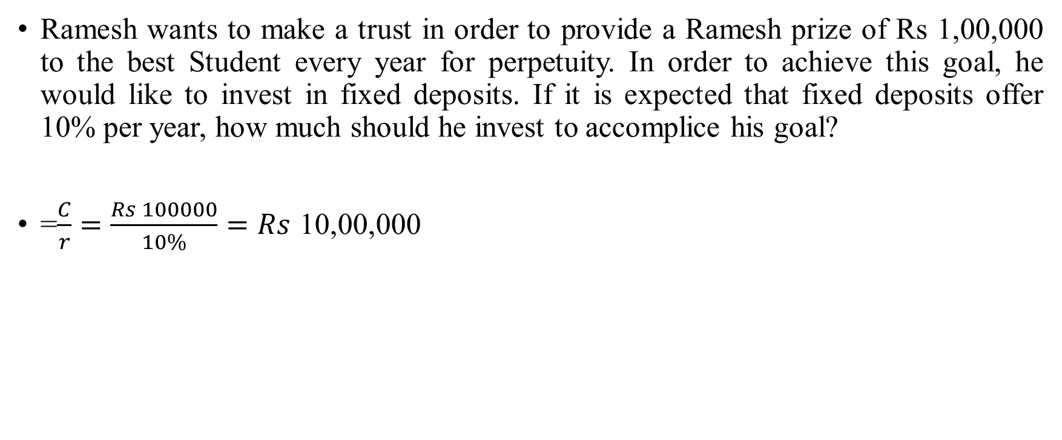
Time value of money: Annuities
Ramesh wants to make a trust in order to provide a Ramesh prize of Rs 1,00,000 to the best Student every year for perpetuity. In order to achieve this goal, he would like to invest in fixed deposits. If it is expected that fixed deposits offer 10% per year, how much should he invest to accomplice his goal?
=$\frac{C}{r}=\frac{Rs 100000}{10\%}=Rs$ 10,00,000

Slide 26
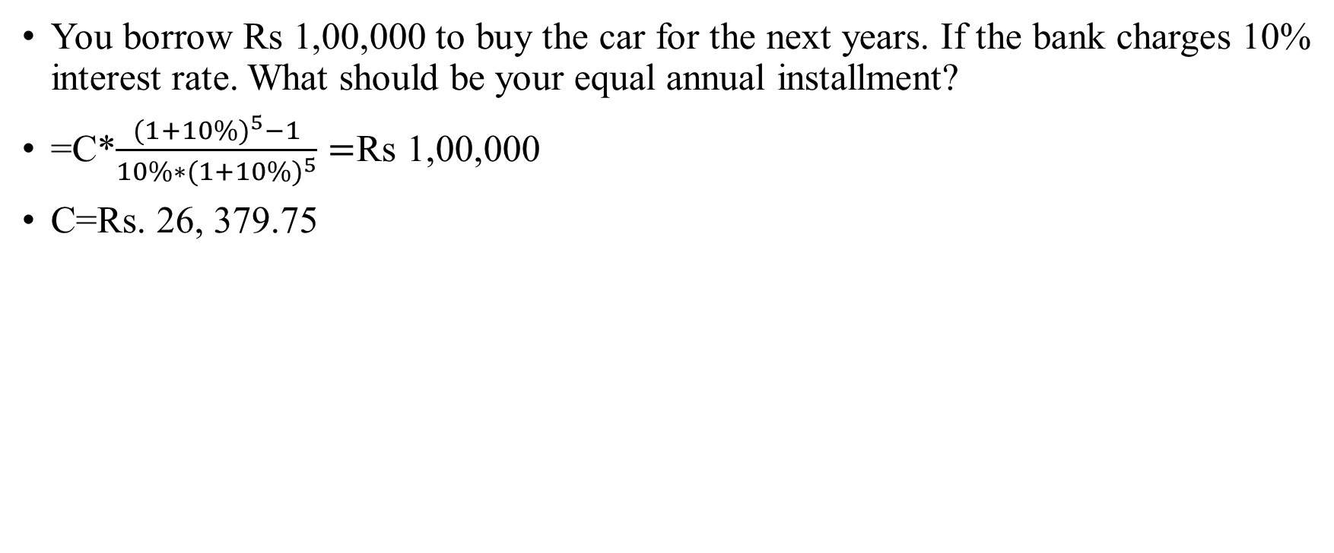
Car loan
You borrow Rs 1,00,000 to buy the car for the next years. If the bank charges 10% interest rate. What should be your equal annual installment?
=C*$\frac{{(1+10\%)}^{5}−1}{10\%∗{(1+10\%)}^{5}}=$Rs 1,00,000
C=Rs. 26, 379.75

Slide 27
Car Loan amortization table
Year | Beginning balance | Yearly payment | Interest amount | Principal repayment
1 | 100000 | 26380 | 10000 | 16380
2 | 83620 | 26380 | 8362 | 18018
3 | 65603 | 26380 | 6560 | 19819
4 | 45783 | 26380 | 4578 | 21801
5 | 23982 | 26380 | 2398 | 23982

Slide 28
Investment principal: Risk and return models

Slide 29
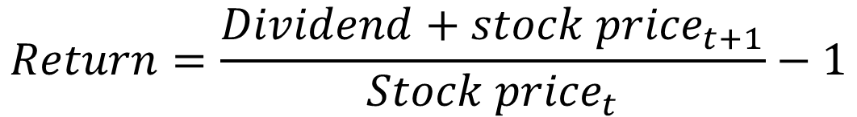
Return measure
The stock price for Stock A was $10 per share 1 year ago. The stock is currently trading at $9.50 per share and shareholders just received a $1 dividend. What return was earned over the past year?
$$Return=\frac{Dividend+{stock price}_{t+1}}{{Stock price}_{t}}−1$$
$1.00 + $9.5 -1
R =
= 5%
$10.00

Slide 30
The notion of a benchmark
Since financial resources are finite, there is an expected return that projects have to cross a hurdle rate (expected return of investors) before being deemed acceptable.
This expected return (hurdle rate) will be higher for riskier projects than for safer projects.
A simple representation of the expected return is a follows
  Expected return=Risk-free rate + Risk premium
  Expected return=Time compensation + Risk compensation
The two basic questions that every risk and return model in finance tries to answer are:
  How do you measure risk?
  How do you translate this risk measure into a risk premium?

Slide 31
What is risk?
Risk, in traditional terms, is viewed as a “negative”. Webster’s dictionary, for instance, defines risk as “ exposing to danger or hazard”. The Chinese symbols for risk, reproduced below, give a much better description of risk.
风险
The first symbol is the symbol for “ danger”, while the second is the symbol for “opportunity”, making risk a mix of danger and opportunity. You cannot have one, without the other.
Risk is therefore neither good nor bad. It is just a fact of life. The question that businesses have to address is therefore not whether to avoid risk but how best to incorporate it into their decision making.

Slide 32
A good risk and return model should..
It should come up with a measure of risk that applies to all assets and not be asset-specific.
It should clearly define what types of risk are rewarded and what are not, and provide a rationale for the definition.
It should come up with standardized risk measures, i.e., an investor presented with a risk measure for an individual asset should be able to draw conclusion about whether the asset is above-average or below average-risk.
It should translate the measure of risk into a rate of return that the investor should demand as compensation for bearing the risk
It should work well not only at explaining past returns, but also in predicting future expected returns.

Slide 33

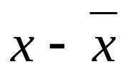
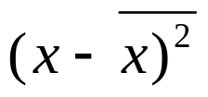
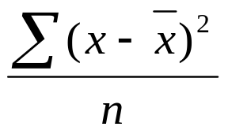
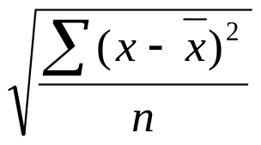
Defining risk: Standard deviation
Standard deviation is a measure of how each value in a data set varies or deviates from the mean
1. Find the mean of the set of data:
2. Find the difference between each value and the mean:
3. Square the difference:
4. Find the average (mean) of these squares:
5. Take the square root to find the standard deviation

Slide 34

Standard Deviation
Find the mean and the standard deviation for the values 78.2, 90.5, 98.1, 93.7, 94.5.
x
(78.2 + 90.5 + 98.1 +93.7 +94.5)
5
= = 91 Find the mean.
x
x
x – x
(x – x)²
Organize the next
steps in a table.
78.2 91 –12.8 163.84
90.5 91 –0.5 .25
98.1 91 7.1 50.41
93.7 91 2.7 7.29
94.5 91 3.5 12.25
Σ(x – x)²
n
σ = Find the standard
deviation.
234.04
5
= 6.8
The mean is 91, and the standard deviation is about 6.8.

Slide 35
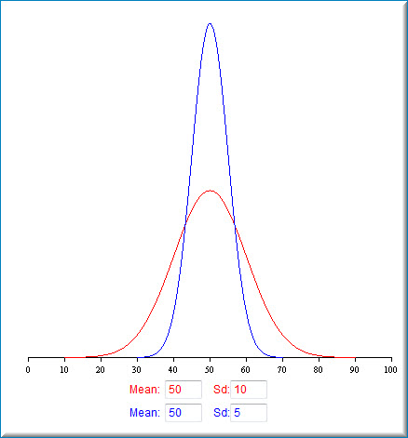
The mean-variance framework
The variance on any investment measures the disparity between actual and expected returns

Slide 36
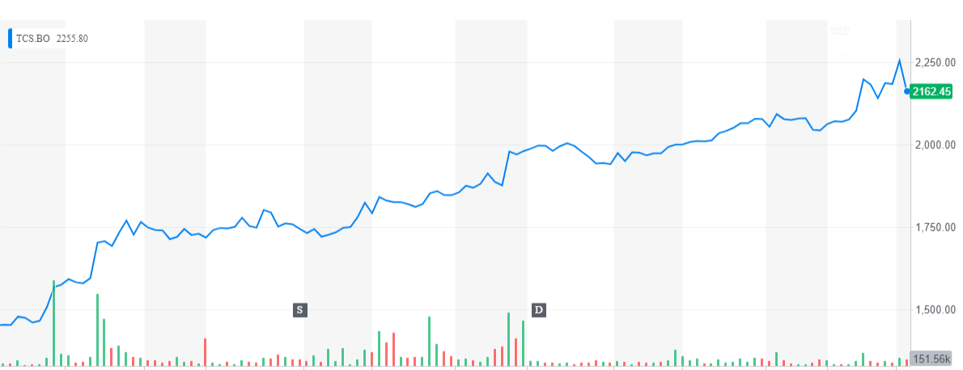
How risky is TCS: A look at the past

Slide 37
Standard deviation of TCS
Daily Std dev=1.42%
Date | Adj Close | Log(return) | Simple return
10/3/2017 | 1198.726
10/4/2017 | 1196.522 | -0.18% | -0.18%
10/5/2017 | 1190.438 | -0.51% | -0.51%
10/6/2017 | 1197.786 | 0.62% | 0.62%
10/9/2017 | 1201.421 | 0.30% | 0.30%
10/10/2017 | 1204.85 | 0.29% | 0.29%
10/11/2017 | 1224.905 | 1.65% | 1.66%
10/12/2017 | 1248.448 | 1.90% | 1.92%
10/13/2017 | 1252.464 | 0.32% | 0.32%
10/16/2017 | 1266.347 | 1.10% | 1.11%
10/17/2017 | 1271.197 | 0.38% | 0.38%
10/18/2017 | 1268.287 | -0.23% | -0.23%
10/19/2017 | 1264.309 | -0.31% | -0.31%

Slide 38
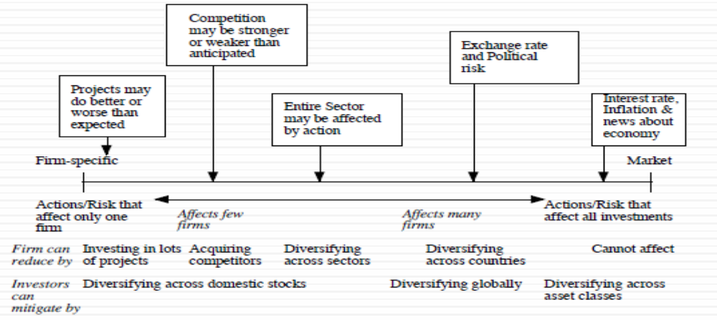
The importance of diversification: Risk types

Slide 39
Risk measures
How to measure riskiness?
  Firm A with the number of shareholders is 1 million.
  Firm B with the number of shareholders is 10.
For widely-held public firms, discount date should reflect the risk perceived by the marginal investor (You have a lot of stocks (different firms) and trade them)
  Macro uncertainly (Systematic risk)
  Micro uncertainty (Unsystematic risk)
Discrete versus continuous uncertainty
  Discreate risk: Risks that lie dormant for period but show up at points in time (Example: Brexit; financial crisis; distress risk, etc.,).
  Continuous risk: Risks changes in interest rate or economic growth occur continuously and affect value they happen.

Slide 40
Why diversification reduces/eliminates firm-specific risk?
Firm-specific risk can be reduced, if not eliminated, by increasing the number of investments in your portfolio. Market-wide risk cannot. This can be justified on either economic or statistical grounds.
On economic grounds, diversifying and holding a larger portfolio eliminant firm-specific risk for two reasons
  Each investment is a much smaller percentage of the portfolio, reducing the effect (positive or negative) on the overall portfolio.
  Firm-specific actions can be negative or positive. In a large portfolio, it is argued, these effect will average out to zero. (For every firm, where something bad happens, there will be some other firm, where something good happens.

Slide 41
Riskiness of two assets: Statistical grounds
Assume we have Rs 10,000 and want to invest in Asset A and B with equal investment.
We measure expected returns of Asset A and Asset B are 10% and 12%, respectively. Std dev of A and B is 5% and 6%.
Expected return of investment (portfolio)=0.50*10%+0.50*12%=11%
How to calculate the riskiness of portfolio?.
  I want to evaluate two students in a team. In such a case, I have to consider their individual performance in a team, plus their relationship each other.

Slide 42
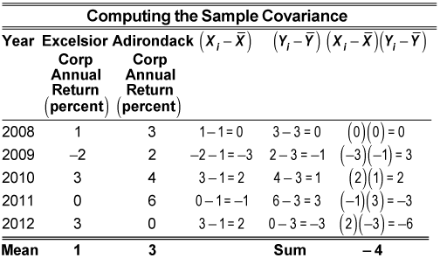


How to measure relationship : Covariance
Covariance measures the strength and the direction of the relationship between the elements of two stock, and the correlation is derived from the covariance
$$covarinace=\frac{−4}{5−1}=−1$$

Slide 43
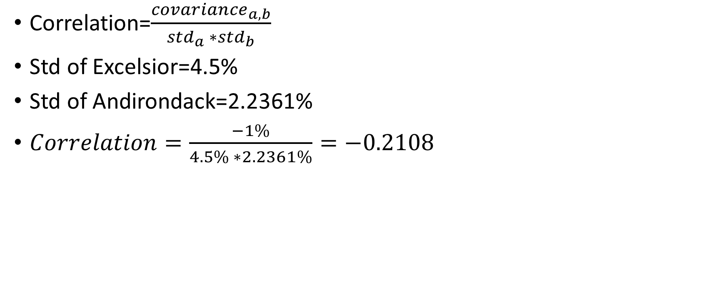
How to measure relationship : Correlation
Correlation=$\frac{{covariance}_{a,b}}{{std}_{a} ∗{std}_{b}}$
Std of Excelsior=4.5%
Std of Andirondack=2.2361%
$Correlation=\frac{−1\%}{4.5\% ∗2.2361\%}=−0.2108$

Slide 44
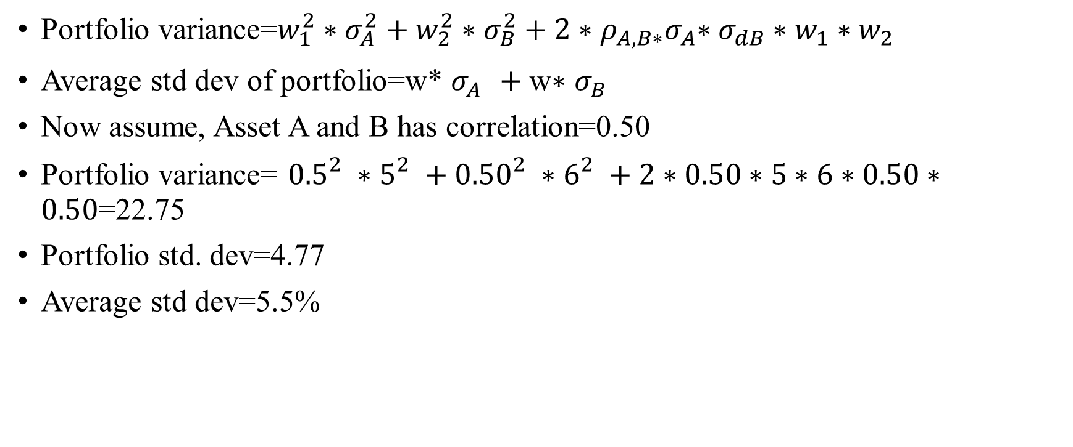
Portfolio risk
Portfolio variance=$w_{1}^{2}∗σ_{A}^{2}+w_{2}^{2}∗σ_{B}^{2}+2{∗ρ_{A,B∗}σ}_{A}∗σ_{dB}∗w_{1}∗w_{2}$
Average std dev of portfolio=w* $σ_{A}^{}+\text{w}\text{∗ }σ_{B}^{}$
Now assume, Asset A and B has correlation=0.50
Portfolio variance= ${0.5}_{}^{2}∗5_{}^{2}+{0.50}_{}^{2}∗6_{}^{2}+2∗0.50∗5∗6∗0.50∗0.50$=22.75
Portfolio std. dev=4.77
Average std dev=5.5%

Slide 45
With various correlations
Correlation | Portfolio std dev
-1 | 0.50
-0.9 | 1.32
-0.8 | 1.80
-0.7 | 2.18
-0.6 | 2.50
-0.5 | 2.78
-0.4 | 3.04
-0.3 | 3.28
-0.2 | 3.50
-0.1 | 3.71
0 | 3.91
0.1 | 4.09
0.2 | 4.27
0.3 | 4.44
0.4 | 4.61
0.5 | 4.77
0.6 | 4.92
0.7 | 5.07
0.8 | 5.22
0.9 | 5.36
1 | 5.50

Slide 46

Portfolio risk with three stocks

Slide 47
The role of the marginal investor
The marginal investor in a firm is the investor who is most likely to be buyer or seller on the next trade and to influence the stock prices.
Generally speaking, the marginal investor in a stock has to own a lot of stock and also trade that stock on regular basis.
In all risk and return models in finance, we assume that the marginal investor is well diversified.

Slide 48
Identifying the marginal investor in your firm
Percent of Stock held by Institutions | Percent of Stock held by Insiders | Marginal Investor
High | Low | Institutional Investor
High | High | Institutional Investor, with insider influence
Low | High (held by founder/manager of firm) | Tough to tell; Could be insiders but only if they trade. If not, it could be individual investors
Low | High (held by wealthy individual investor) | Wealthy individual investor, fairly diversified
Low | Low | Small individual investor with restricted diversification

Slide 49
TCS: Marginal investor
Holder's Name | % Share Holding
Promoters | 71.92%
Foreign Institutions | 16.59%
Financial Institutions | 4.90%
General Public | 3.82%
banks &Mutual Funds | 1.96%
Others | 0.76%
CentralGovt | 0.05%

Slide 50
The risk of an Individual Asset
The essence: The risk of any asset is the risk that it adds to the market portfolio. Statistically, this risk can be measured by how much an asset moves with the market (called the covariance).
The measure: Beta is standardized measure of this covariance, obtained by dividing the covariance of any asset with the market by the variance of the market.
The result: the required return on an investment will be a linear function on its beta
Expected return=Risk-free rate + Beta*(Expected return on the market portfolio-Risk-free rate)

Slide 51
The Capital Asset Pricing Model
Specifies that a portion of variance can be diversified away, and that is only the non-diversified portion that is rewarded.
Measures the non-diversified risk with beta, which is standardized around one.
Translates beta into expected return
  Expected return=Risk-free rate + Beta*Risk premium

Slide 52
How are betas calculated?
The standard procedure for estimating betas is to regress stock returns (Rj ) against market returns (Rm):
Rj = a + b Rm
where a is the intercept and b is the slope of the regression.
The slope of the regression corresponds to the beta of the stock and measures the riskiness of the stock.
The R squared (R2) of the regression provides an estimate of the proportion of the risk (variance) of a firm that can be attributed to market risk. The balance (1 - R2) can be attributed to firm specific risk.

Slide 53
Use the historical stock returns to calculate the beta for PQU.
Year |  | Market |  | PQU
1 |  | 25.7% |  | 40.0%
2 |  | 8.0% |  | -15.0%
3 |  | -11.0% |  | -15.0%
4 |  | 15.0% |  | 35.0%
5 |  | 32.5% |  | 10.0%
6 |  | 13.7% |  | 30.0%
7 |  | 40.0% |  | 42.0%
8 |  | 10.0% |  | -10.0%
9 |  | -10.8% |  | -25.0%
10 |  | -13.1% |  | 25.0%

Slide 54
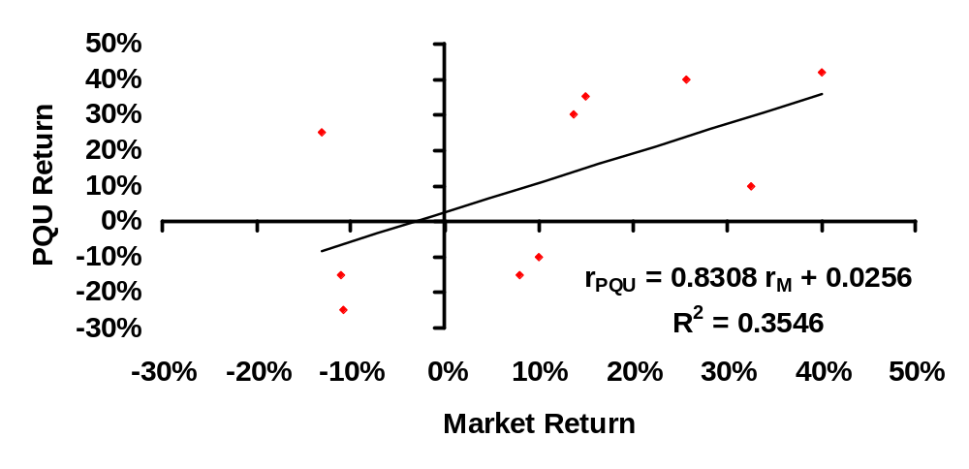
Calculating Beta for PQU

Slide 55
Beta & PQU Co.
Beta reflects slope of line via regression
Rpqu = 0.8308 rM + 0.0256
So, PQU’s beta is .8308 & y-intercept @ 2.56%
PQU’s R² of .3546 means about 35% of PQU’s returns are explained by the market returns
This implies that
  35.46% of the risk at PQU Co comes from market sources
  64.56%, therefore, comes from firm-specific sources
The firm-specific risk is diversifiable and will not be rewarded.

Slide 56
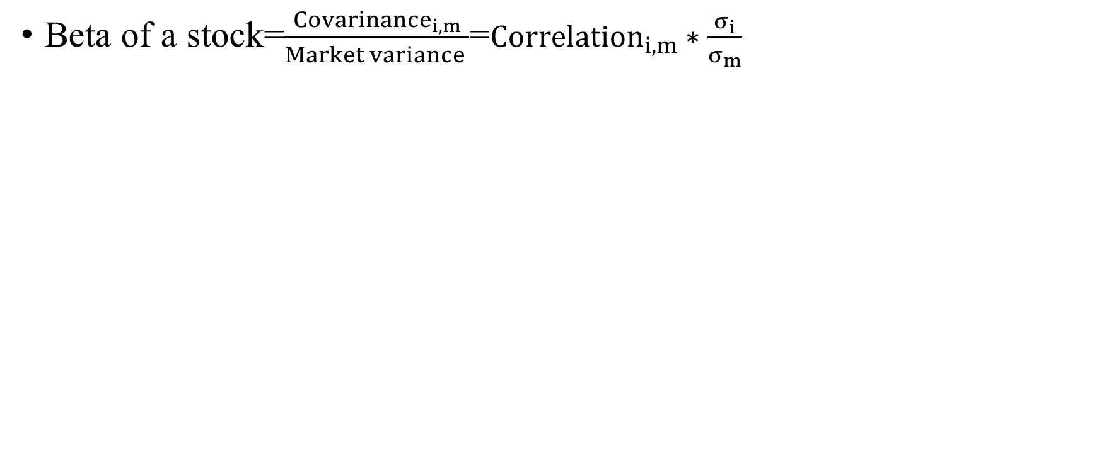
More on beta concept..
Beta of a stock=$\frac{{Covarinance}_{i,m}}{Market variance }$=${Correlation}_{i,m}∗\frac{σ_{i}}{σ_{m}}$

Slide 57
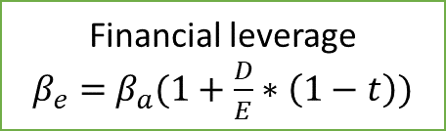
Determinates of beta
Assuming that total risk is born by only equity holders
Beta of equity (Levered Beta)
Beta of Business (Unlevered Beta
Financial leverage
$β_{e}=$ $β_{a}(1+\frac{D}{E}∗\left(1−t\right))$
Nature of product or service offered by firm:
High elasticity (discretionary) of demand of your product would have higher beta
Operating leverage (Fixed Costs as % of total costs)
Firms with high infrastructure needs and rigid costs structures should have higher betas than firms flexible cost structures
Smaller firms should have higher betas than larger firms.
Young firms should have higher betas than more mature firms
Cyclical firms should have higher beta than non-Cyclical firms .
Luxury Goods firms should have higher beta than basic goods
High priced goods/service firms should have higher betas than low prices goods/service.
Growth firms should have higher beta

Slide 58
Setting up for the Estimation
Decide on an estimation period
  Services use periods ranging from 2 to 5 years for the regression
  Longer estimation period provides more data, but firms change over time.
  Shorter periods can be affected more easily by significant firm-specific event that occurred during the period.
Decide on a return interval - daily, weekly, monthly
  Shorter intervals yield more observations but suffer from more noise.
  Noise is created by stocks not trading and biases all betas towards one. ¨ ¨
Choose a market index and estimate returns (inclusive of dividends) on the index for each interval for the period.

Slide 59
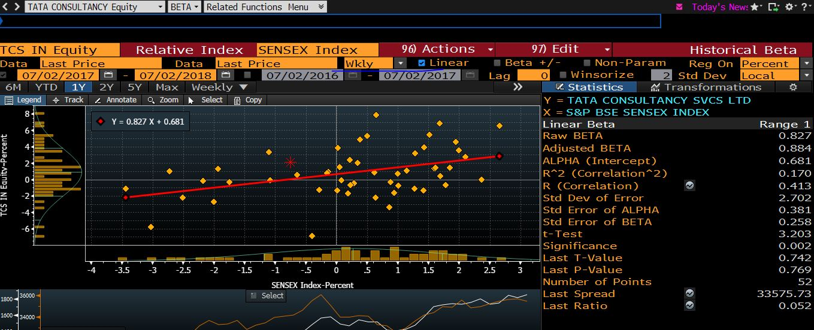

Slide 60
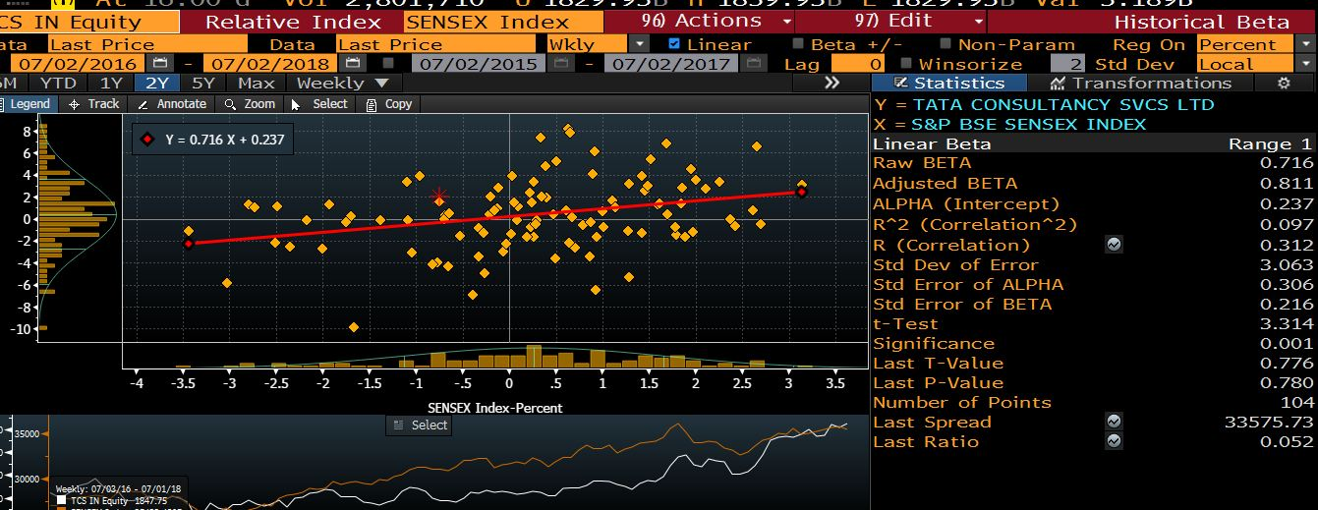

Slide 61
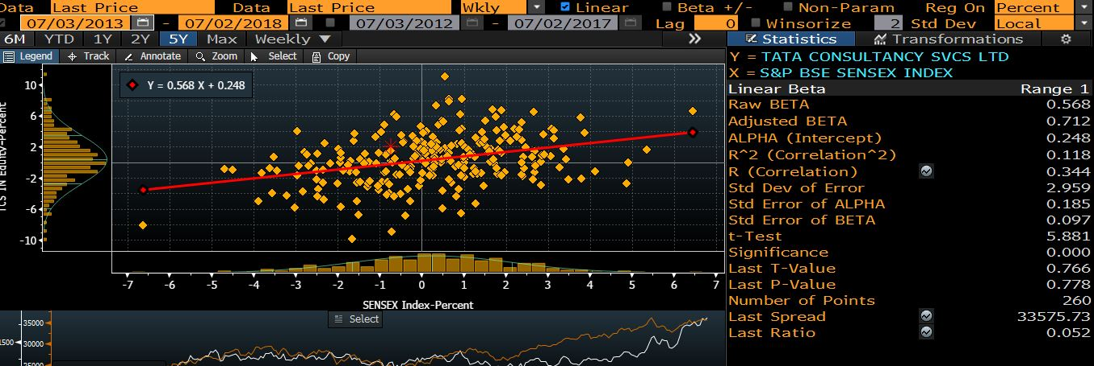

Slide 62
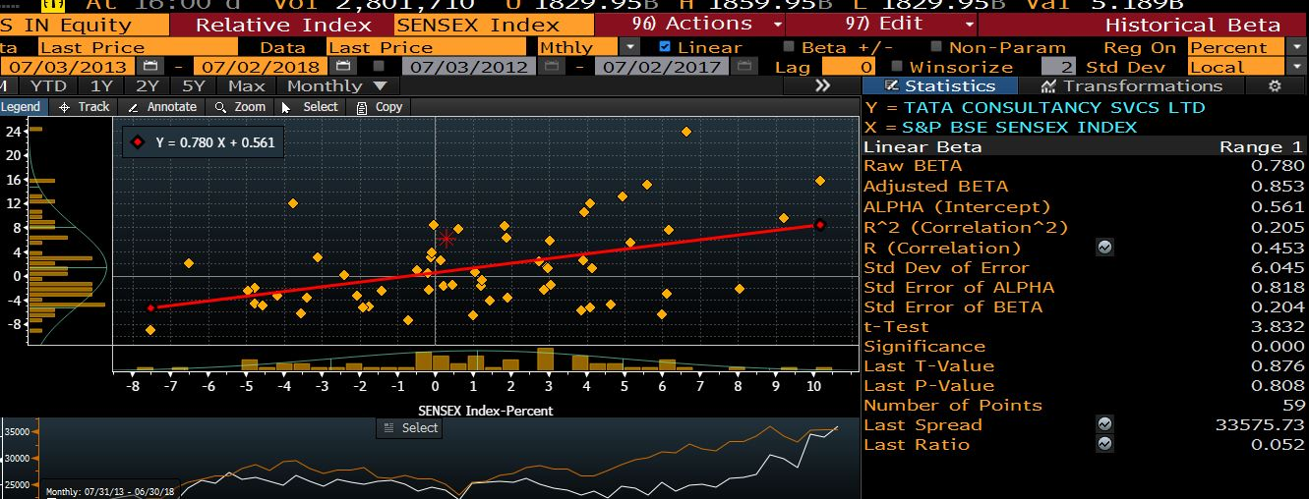

Slide 63
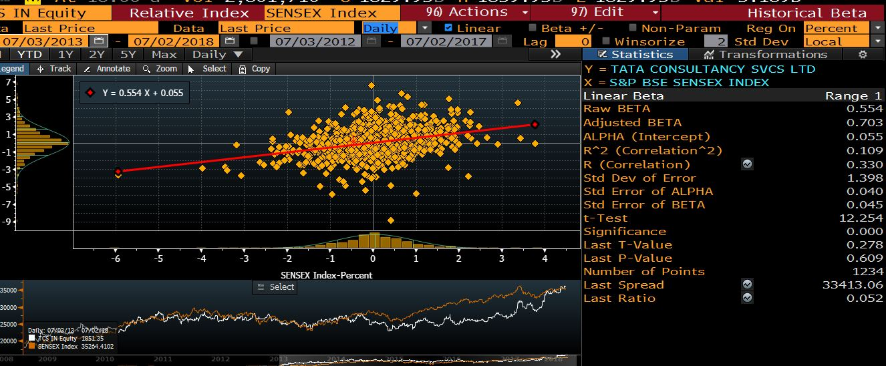

Slide 64
TCS Beta
Index | Return Interval | Time period | Beta | Adjusted Beta | S.E | R^2
Sensex | Wkly | 1 years | 0.827 | 0.884 | 0.258 | 0.17
Sensex | Wkly | 2 years | 0.716 | 0.811 | 0.216 | 0.097
Sensex | Wkly | 5 years | 0.568 | 0.712 | 0.097 | 0.118
Sensex | Mthly | 5 years | 0.78 | 0.853 | 0.204 | 0.205
Sensex | Daily | 5 years | 0.554 | 0.703 | 0.045 | 0.109
MXWO | Mthly | 5 years | 0.521 | 0.68 | 0.304 | 0.049

Slide 65
Reliance Industries Ltd (RIL)
Time period | Beta
1-Months | 1.19
3-Months | 0.91
6-Months | 1.09
1 Year | 1.06
3 Years | 0.98

Slide 66
Reliance Industries Ltd (RIL)
 | 2013 | 2014 | 2015 | 2016 | 2017 | 2018
Refining | 71.1% | 75.9% | 72.4% | 60.1% | 59.4% | 53.2%
Petrochemicals | 23.1% | 18.2% | 19.3% | 27.9% | 26.2% | 26.5%
Organized Retail |  | 2.7% | 3.8% | 7.0% | 10.1% | 16.0%
Others – Crude Petroleum | 3.1% | 1.1% | 2.1% | 2.5% | 2.5% | 2.1%
Oil & Gas | 2.7% | 2.0% | 2.4% | 2.6% | 1.6% | 1.2%
Digital Services |  |  |  |  | 0.2% | 1.1%
D\E ratio |  | 0.28 | 0.19 | 0.06 | 0.04 | 0.02

Slide 67
Measurement issues
Choice of a market Index: Ideally, the index should include all market traded assets (bond, equity, real states, gold, etc.,), but don't have this one and that should be market-weighted.
What should be the return’s interval?
What should be the length of historical data?
The regression beta has the following three problems?
  It has high standard error
  It reflects the firm’s business mix over the period of the regression, not current mix (Reliance Jio)
  It reflects the firm’s average financial leverage over the period rather the current leverage.

Slide 68
BSE Sensex (weight)
 | Total
Paints & varnishes | 1.76%
Banking services | 21.44%
Two & three wheelers | 3.16%
Boilers & turbines | 0.52%
Telecommunication services | 2.22%
Drugs & pharmaceuticals | 8.56%
Other fund based financial services | 1.54%
Natural gas trading & distribution | 0.74%
Cosmetics, toiletries, soaps & detergents | 2.82%
Housing finance services | 7.85%
Tobacco products | 8.32%
Computer software | 16.61%
Industrial construction | 4.52%
Other transport equipment | 2.72%
Passenger vehicles | 2.18%
Electricity generation | 1.26%
Crude oil & natural gas | 1.64%
Refinery | 7.74%
Commercial vehicles | 3.42%
Steel | 0.99%

Slide 69
We will use the following way to estimate beta (bottom-up betas.
Find the business or businesses that you firm operate in.
Find publicly traded firms (you may go globally) in each of these businesses and obtain their regression betas. Unlever all equity betas to remove capital structure effect. Take the average of all unlevered betas within each business.
Estimate how much value your firm drives from each of the different businesses it is in.
Compute a weighted average of the unlevered betas of the different business. Theoretically, we should use the value of business segment. However, this number is not available, we can use revenue of each segment of business.

Slide 70
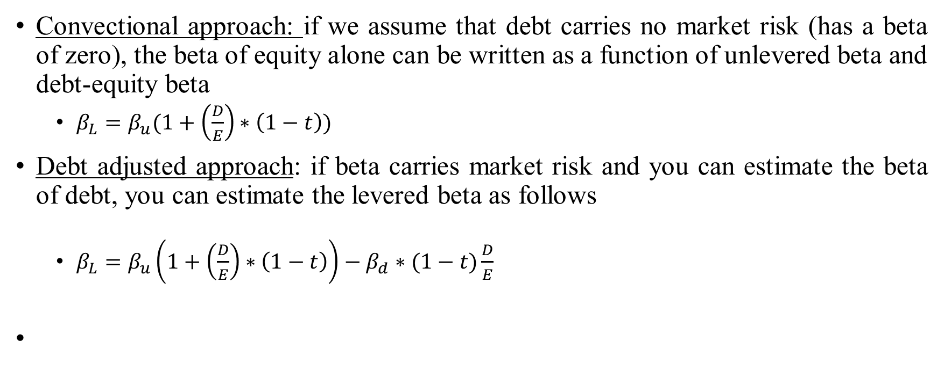
Adjusting for financial leverage
Convectional approach: if we assume that debt carries no market risk (has a beta of zero), the beta of equity alone can be written as a function of unlevered beta and debt-equity beta
  $β_{L}=β_{u}(1+\left(\frac{D}{E}\right)∗\left(1−t\right))$
Debt adjusted approach: if beta carries market risk and you can estimate the beta of debt, you can estimate the levered beta as follows
  $β_{L}=β_{u}\left(1+\left(\frac{D}{E}\right)∗\left(1−t\right)\right)−β_{d}∗(1−t)\frac{D}{E}$

Slide 71
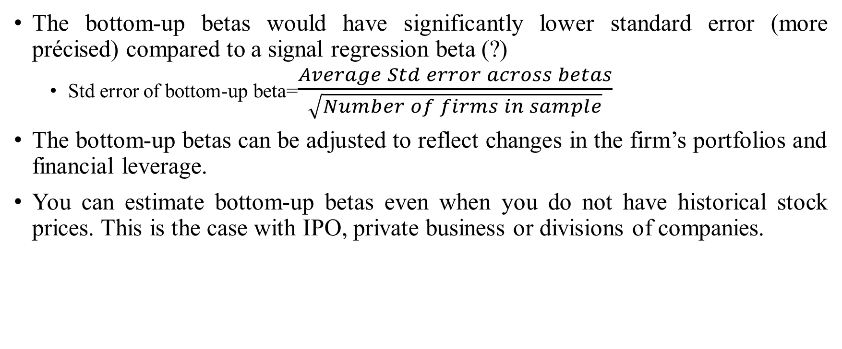
Why bottom-up betas?
The bottom-up betas would have significantly lower standard error (more précised) compared to a signal regression beta (?)
  Std error of bottom-up beta=$\frac{Average Std error across betas}{\sqrt{Number of firms in sample}}$
The bottom-up betas can be adjusted to reflect changes in the firm’s portfolios and financial leverage.
You can estimate bottom-up betas even when you do not have historical stock prices. This is the case with IPO, private business or divisions of companies.

Slide 72
Reliance Industries Ltd (RIL)
Segment | Revenue (%) | Unlevered Beta
Refining | 53.2% | 0.81
Petrochemicals | 26.5% | 0.81
Organized Retail | 16.0% | 1
Others - Crude Petroleum | 2.1% | 0.81
Oil & Gas | 1.2% | 0.81
Digital Services | 1.1% | 0.67
 | Total Debt/Market cap | 0.28
 | Unlevered Beta | 0.839
 | Levered Beta with current D/E | 0.99

Slide 73
A Risk-free rate
On a risk-free asset, the actual return is equal to the expected return: zero standard deviation.
  If you buy 1-year bond with the expectation of 5% return and the actual return is also turn out to be 5.
  The returns should be uncorrelated with the risky-investment returns.
For an investment to be risk-free, then, it must have
  No default risk
  No reinvestment risk
    The expected return over 5 years, Can 6-month TB risk-free?
    Can the coupon bond with life of 5 years?
Can we use Indian Govt. bond rate as a Risk-free rate if you want value Indian firms?

Slide 74
A Risk-free rate
India’s sovereign rating (Moody)=Baa2
Credit default swap spreads (CDS): an insurance against default. For instance, If I purchase AA bond and that has probability of default. I can buy insurance against the default of the bond. The price I have to pay to buy the insurance is called Credit default swap spreads.

Slide 75
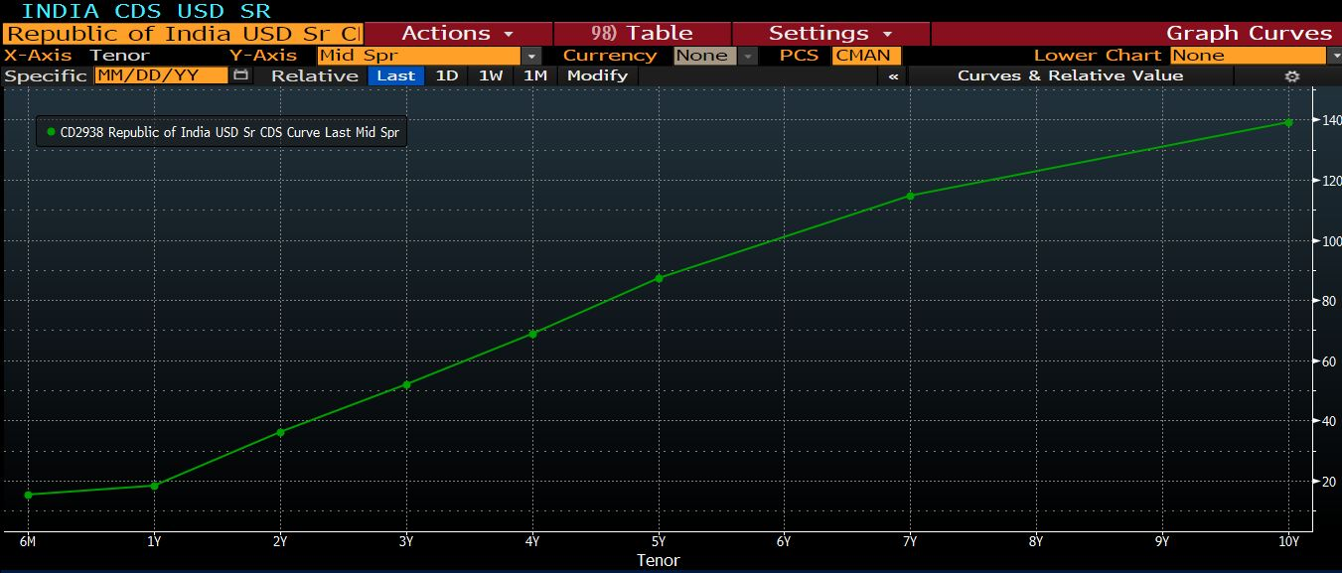
Indian CDS

Slide 76
A Risk-free rate and cost of equity
Risk free rate (CDS)=8.08-1.40=6.68%
Equity risk-premium (current)=4.77% + 1.41%=6.18%
Cost of Equity (HUL)=6.68% + 6.18%*0.40% =9.2%
Cost of Equity (TCS)=6.68% + 6.18%*0.54% =10.01%

Slide 77
Valuing Bonds

Slide 78
Valuing Bonds
Bonds, like the world suggests, binds the borrow to the lender in a contract.
An explicit IOU (I owe you): a promise to pay money in the future in return for the money borrowed.
Key Bond Characteristics
  Face Value: The face value (also known as the par value) of a bond is the price at which the bond is sold to investors when first issued; it is also the price at which the bond is redeemed at maturity.
  Coupon Rate: The periodic interest payments promised to bond holders are computed as a fixed percentage of the bond’s face value; this percentage is known as the coupon rate.
  Maturity: A bond’s maturity is the length of time until the principal is scheduled to be repaid.

Slide 79
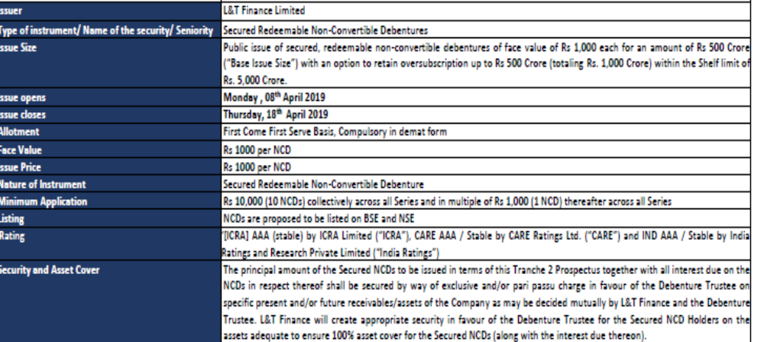
Indian Bond market
Notes:
Source: https://www.hdfcsec.com/hsl.docs//L&T%20Finance%20Ltd%20Taxable%20NCD%20Issue%20product%20note-201904041732046620236.pdf

Slide 80
Bond valuation
L&T finance bond with coupon rate is 8.7% for 3 years maturity. The credit rating is AAA
What should be the value of the bond?
Value of bond=PV of coupon amount + PV of Principal amount
0
1
=Rs 87
2
=Rs 87
3
=Rs 87 (Coupon amount)
=Rs 1000 (Principal amount)
$Value of a bond=\frac{87}{{(1+r)}^{1}}+\frac{87}{{(1+r)}^{2}}$ + $\frac{1087}{{(1+r)}^{3}}$
Expected rate of return=Expected return on default-free bond + Default spread

Slide 81
Credit rating…
Rating | Meanings
AAA | Highest degree of safety
AA | High degree of safety
A | Adequate degree of safety
BBB | Moderate degree of safety
BB | Moderate risk of default
B | High risk of default
C | Very high risk of default
D | Default or expected to be in default soon

Slide 82
Corporate bond Yield
Ratings
Year | AAA | AAA | AAA | AAA | AA | AA | AA | AA
 | 1 years | 3 years | 5 years | 10 years | 1 years | 3 years | 5 years | 10 years
2008-09 |  | 8.1734 | 8.5295 | 8.801 |  |  |  | 9.0184
2009-10 | 6.3939 | 7.1713 | 8.096 | 8.5515 | 6.6913 | 7.6547 | 8.4188 | 8.9509
2010-11 | 6.7263 | 6.9401 | 8.4124 | 8.8213 | 7.5435 | 8.2898 | 8.8806 | 9.0062
2011-12 | 9.6977 | 9.176 | 9.4792 | 9.279 | 9.67 | 9.8356 | 9.6473 | 9.5096
2012-13 | 9.3159 | 9.2599 | 9.13 | 9.0732 | 9.5028 | 9.3168 | 9.4743 | 9.2848
2013-14 | 9.4453 | 9.0034 | 9.1787 | 8.9266 | 9.5223 | 8.9413 | 9.2013 | 8.9992
2014-15 | 8.9918 | 8.8709 | 8.7642 | 8.636 | 9.2229 | 9.1595 | 9.3786 | 9.2875
2015-16 | 8.3979 | 8.2751 | 8.3878 | 8.4176 | 8.8619 | 8.8827 | 9.0552 | 9.2146
2016-17 | 7.5481 | 7.5548 | 7.5499 | 7.8108 | 7.9198 | 8.1983 | 8.2476 | 8.6741
2017-18 | 7.3348 | 7.4283 | 7.4036 | 7.5734 | 7.5844 | 7.8598 | 8.479 | 8.2198
2018-19 | 8.2764 | 8.4044 | 8.5061 | 8.5589 | 8.4005 | 9.1138 | 9.2557 | 8.9407
Notes:
https://countryeconomy.com/bonds/india

Slide 83
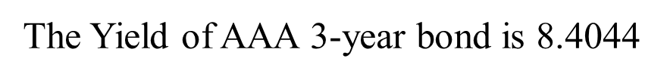
Bond valuation
The Yield of AAA 3-year bond is $\text{8.4044}$
$Value of a bond=\frac{87}{{(\text{1+}\text{8.4044}\text{\%} )}^{1}}+\frac{87}{{(\text{1+}\text{8.4044}\text{\%} )}^{2}}$ + $\frac{1087}{{(\text{1+}\text{8.4044}\text{\%} )}^{3}}$
Value of Bond=Rs 1007.563
Current Market price=Rs 1010
When the expected return on bond is lower than coupon rate, then bond is expected to
trade at premium (more than par value).
2. When the expected return on bond is higher than coupon rate, then bond is expected to
trade at discount (less than par value).
3. When the expected return on bond is equal to coupon rate, then bond is expected to
trade at par.

Slide 84
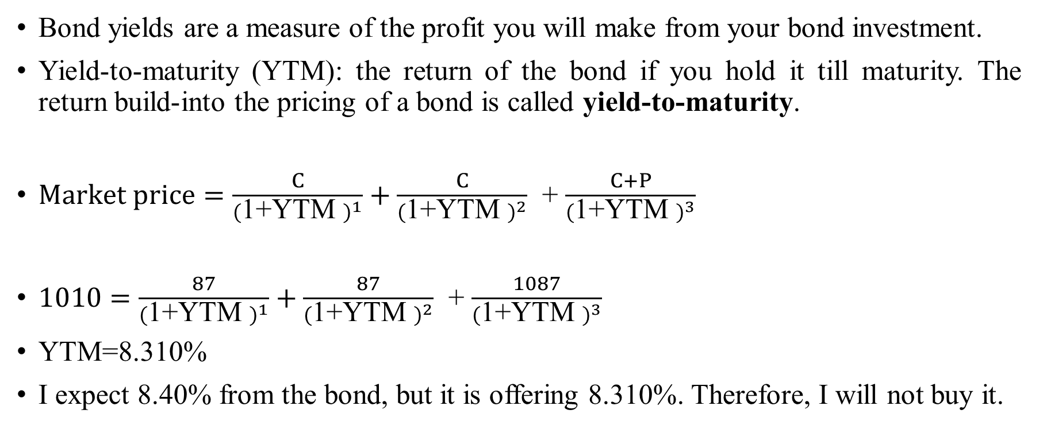
Bond yield
Bond yields are a measure of the profit you will make from your bond investment.
Yield-to-maturity (YTM): the return of the bond if you hold it till maturity. The return build-into the pricing of a bond is called yield-to-maturity.
$Market price=\frac{C}{{(\text{1+}\text{YTM} )}^{1}}+\frac{C}{{(\text{1+}\text{YTM} )}^{2}}$ + $\frac{C+P}{{(\text{1+}\text{YTM} )}^{3}}$
$1010=\frac{87}{{(\text{1+}\text{YTM} )}^{1}}+\frac{87}{{(\text{1+}\text{YTM} )}^{2}}$ + $\frac{1087}{{(\text{1+}\text{YTM} )}^{3}}$
YTM=8.310%
I expect 8.40% from the bond, but it is offering 8.310%. Therefore, I will not buy it.

Slide 85
Yield curve
The relation between yield to maturity and the maturity of bond.
Bond A
Bond B
Which bond is riskier?
0
Year 1
=Rs 1000
Year 10
=Rs 1000
0

Slide 86
Zero coupon bond yield curve

Slide 87
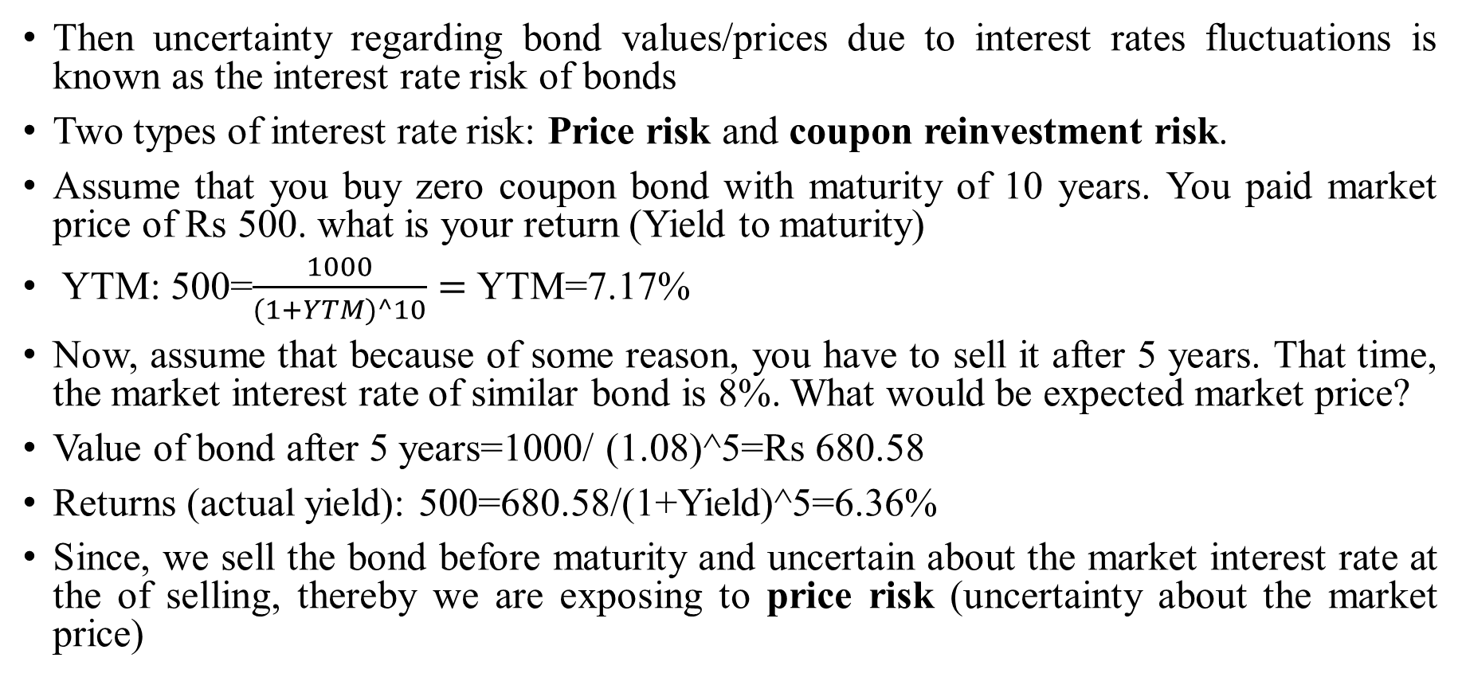
Risk of bonds: Interest-rate risk
Then uncertainty regarding bond values/prices due to interest rates fluctuations is known as the interest rate risk of bonds
Two types of interest rate risk: Price risk and coupon reinvestment risk.
Assume that you buy zero coupon bond with maturity of 10 years. You paid market price of Rs 500. what is your return (Yield to maturity)
YTM: 500=$\frac{1000}{(1+YTM)^10}=$YTM=7.17%
Now, assume that because of some reason, you have to sell it after 5 years. That time, the market interest rate of similar bond is 8%. What would be expected market price?
Value of bond after 5 years=1000/ (1.08)^5=Rs 680.58
Returns (actual yield): 500=680.58/(1+Yield)^5=6.36%
Since, we sell the bond before maturity and uncertain about the market interest rate at the of selling, thereby we are exposing to price risk (uncertainty about the market price)

Slide 88
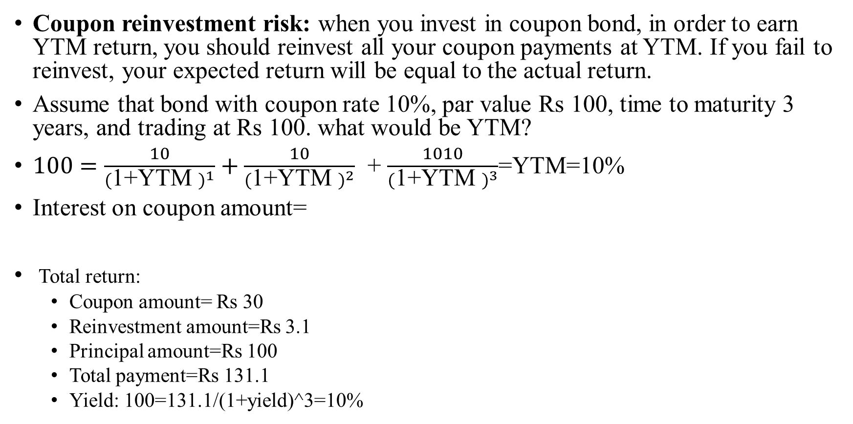
Risk of bonds: Interest rate risk
Coupon reinvestment risk: when you invest in coupon bond, in order to earn YTM return, you should reinvest all your coupon payments at YTM. If you fail to reinvest, your expected return will be equal to the actual return.
Assume that bond with coupon rate 10%, par value Rs 100, time to maturity 3 years, and trading at Rs 100. what would be YTM?
$100=\frac{10}{{(\text{1+}\text{YTM} )}^{1}}+\frac{10}{{(\text{1+}\text{YTM} )}^{2}}$ + $\frac{1010}{{(\text{1+}\text{YTM} )}^{3}}$=YTM=10%
Interest on coupon amount=
Total return:
  Coupon amount= Rs 30
  Reinvestment amount=Rs 3.1
  Principal amount=Rs 100
  Total payment=Rs 131.1
  Yield: 100=131.1/(1+yield)^3=10%
0
1
Rs 10
2
Rs 10
3
Rs 10
=10*(1.1)^0-10=Rs 0
=10*(1.1)^1-10=Rs1
=10*(1.1)^2-10=Rs 2.1

Slide 89
Risk of bonds: Interest rate risk
 | Reinvestment rate
 | 5% | 10% | 15%
Reinvestment payment | Rs. 1.53 | Rs. 3.10 | Rs. 4.72
Coupon payment | Rs. 30 | Rs. 30 | Rs. 30
Principal payment | Rs. 100 | Rs. 100 | Rs. 100
Total return | Rs. 131.53 | Rs. 133.10 | Rs. 134.73
Investment (Market price) | Rs. 100 | Rs. 100 | Rs. 100
Yield(%) | 9.56% | 10.00% | 10.45%
https://beta.nseindia.com/market-data/debt-market-reporting-corporate-bonds-traded-on-exchange

Slide 90
Valuation of stock

Slide 91
The choice of financing
There are only two ways in which a business can raise money.
  The first is debt: The essence of debt is that a debt claim entitles the holder of the claim to a contracted set of cashflows (interest payments and repaying principle). If you fail to make those payments, you lose control of your business.
  The second is equity: With equity, you do get whatever cashflows are left over after you made debt and tax (government) payments.

Slide 92
Debt versus Equity
Fixed claim-Coupon and principal payment
Tax Deductible
High priority in financial trouble
Fixed maturity
No management control
Residual claim-Dividend and selling price
Not Tax Deductible
Low priority in financial trouble
Infinite
Management control
Debt
Bank debt
Commercial paper
Corporate Bonds
Equity
Owner’s equity
Venture capital
Common stock
Warrants
Hybrid securities
Convertible Debt
Preferred stock
Option-linked bonds

Slide 93
A snap-shot of idea/Entity
Liabilities | Assets
Equity | Real assets
Debt

Slide 94
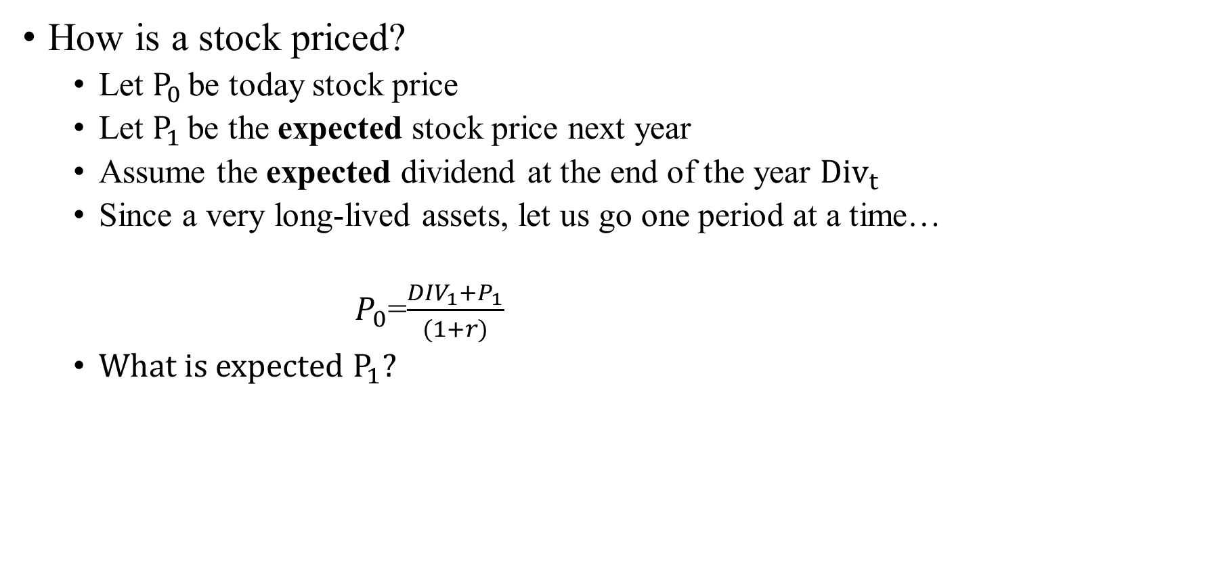
Pricing a stock
How is a stock priced?
  Let $P_{0 }$be today stock price
  Let $P_{1 }$be the expected stock price next year
  Assume the expected dividend at the end of the year ${Div}_{t }$
  Since a very long-lived assets, let us go one period at a time…
  $P_{0}$=$\frac{{DIV}_{1}+P_{1}}{(1+r)}$
  What is expected $P_{1}$?

Slide 95
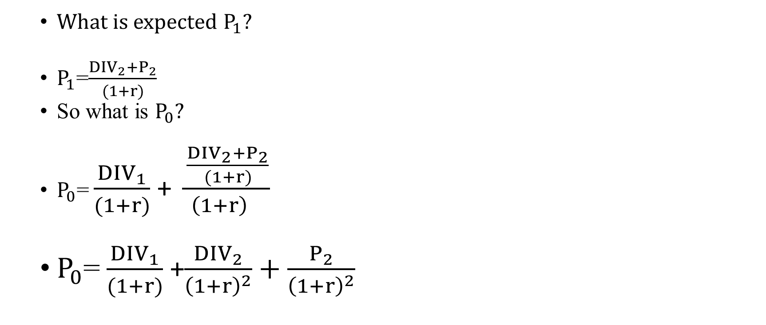
Pricing a stock
  What is expected $P_{1}$?
  $P_{1}$=$\frac{{DIV}_{2}+P_{2}}{(1+r)}$
  So what is $P_{0}?$
  $P_{0}$= $\frac{{DIV}_{1}}{(1+r)}$+ $\frac{\frac{{DIV}_{2}+P_{2}}{(1+r)}}{{\left(1+r\right)}^{}}$
  $P_{0}$= $\frac{{DIV}_{1}}{(1+r)}$+$\frac{{DIV}_{2}}{{\left(1+r\right)}^{2}}+\frac{P_{2}}{{\left(1+r\right)}^{2}}$

Slide 96
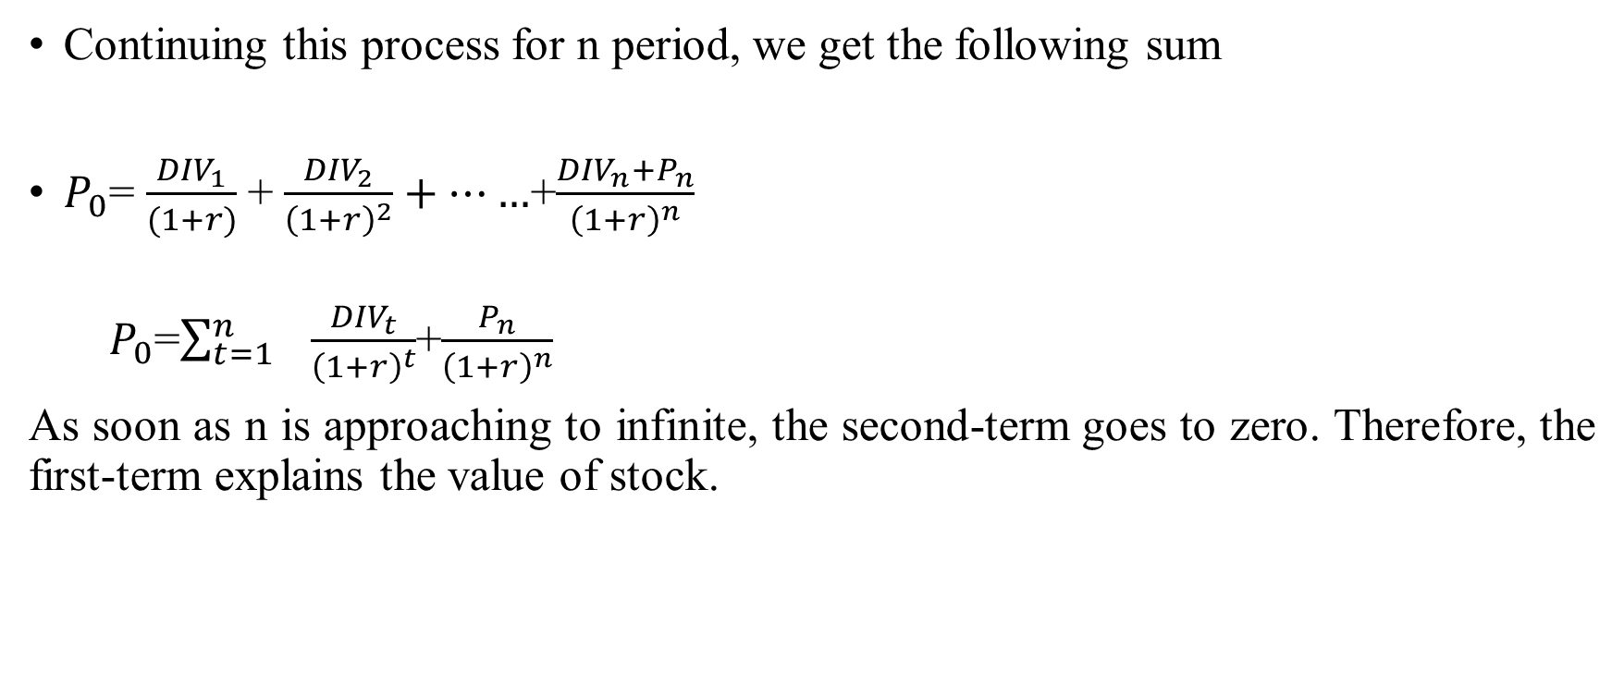
The stock price (Formula…)
Continuing this process for n period, we get the following sum
$P_{0}$= $\frac{{DIV}_{1}}{(1+r)}$+ $\frac{{DIV}_{2}}{{\left(1+r\right)}^{2}}+……$+$\frac{{DIV}_{n}+P_{n}}{{\left(1+r\right)}^{n}}$
  $P_{0}$=$\sum_{t=1}^{n}{ \frac{{DIV}_{t}}{{\left(1+r\right)}^{t}}}$+$\frac{P_{n}}{{\left(1+r\right)}^{n}}$
As soon as n is approaching to infinite, the second-term goes to zero. Therefore, the first-term explains the value of stock.

Slide 97
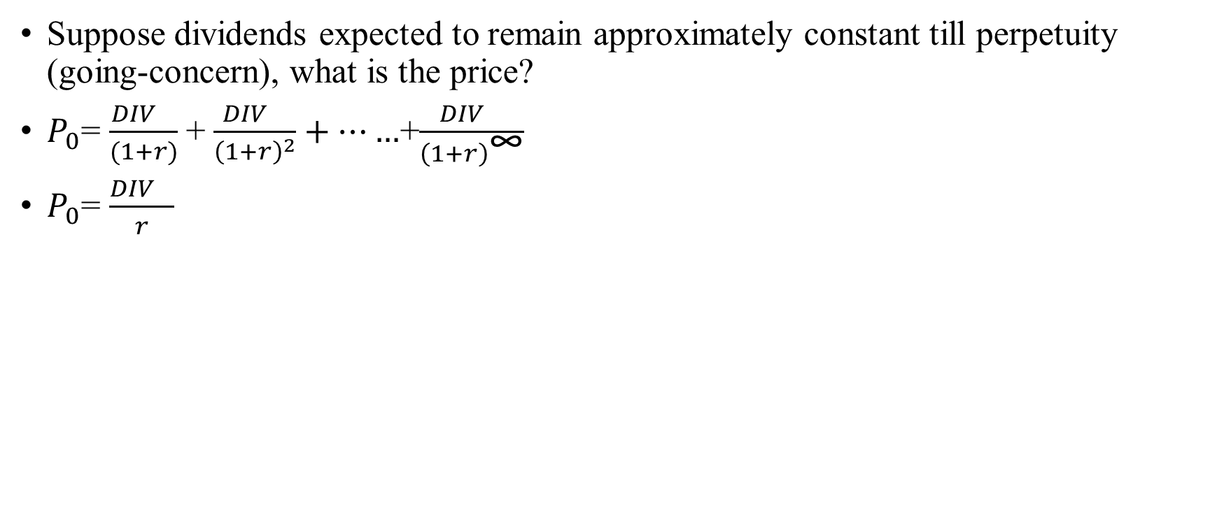
Special case I: Dividend stock
Suppose dividends expected to remain approximately constant till perpetuity (going-concern), what is the price?
$P_{0}$= $\frac{{DIV}_{}}{(1+r)}$+ $\frac{{DIV}_{}}{{\left(1+r\right)}^{2}}+……$+$\frac{{DIV}_{}}{{\left(1+r\right)}^{\text{∞}}}$
$P_{0}$= $\frac{{DIV}_{}}{r}$

Slide 98
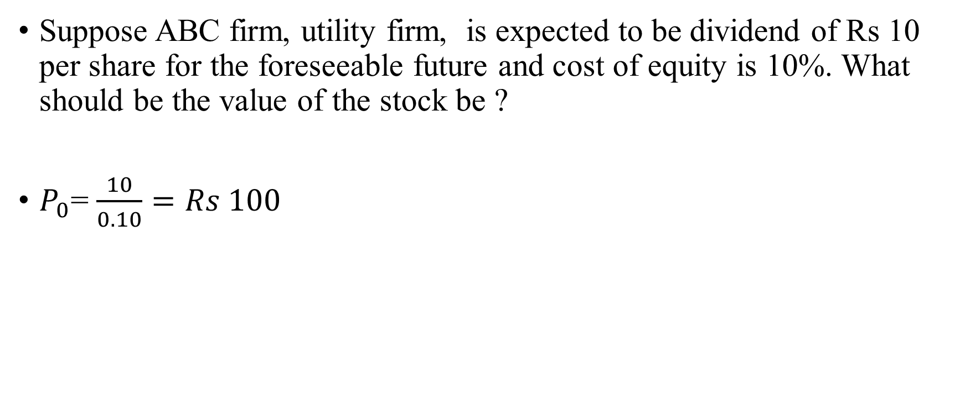
Special case I: Dividend stock (Income stock)
Suppose ABC firm, utility firm, is expected to be dividend of Rs 10 per share for the foreseeable future and cost of equity is 10%. What should be the value of the stock be ?
$P_{0}$= $\frac{10}{0.10}=Rs 100$

Slide 99
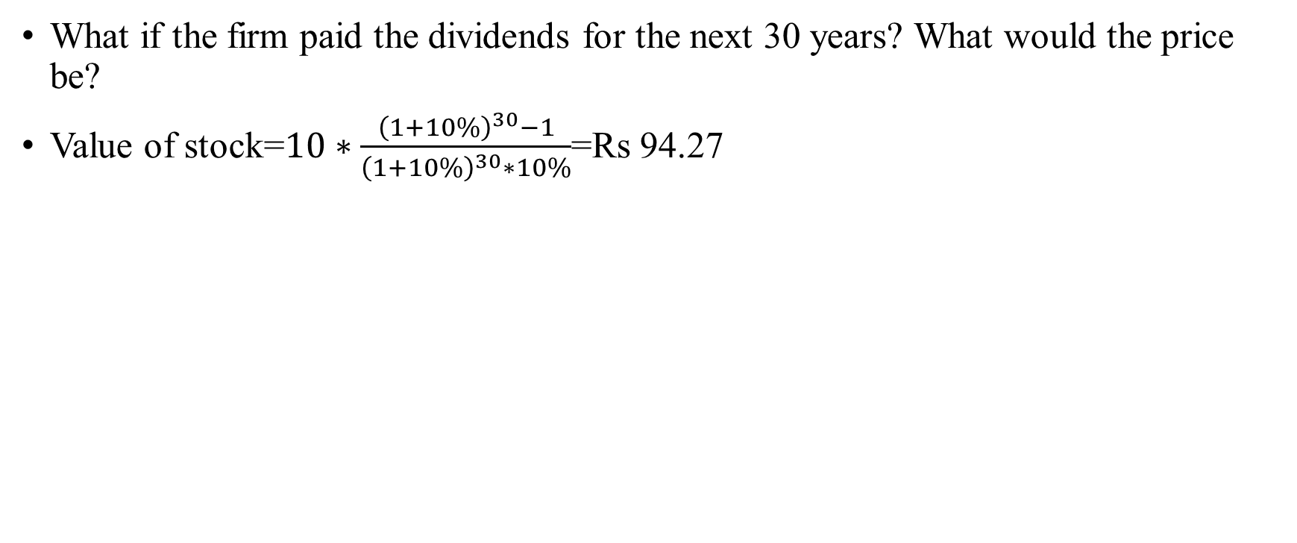
Is forever really forever?
What if the firm paid the dividends for the next 30 years? What would the price be?
Value of stock=$10∗\frac{{\left(1+10\%\right)}^{30}−1}{{\left(1+10\%\right)}^{30}∗10\%}$=Rs 94.27

Slide 100
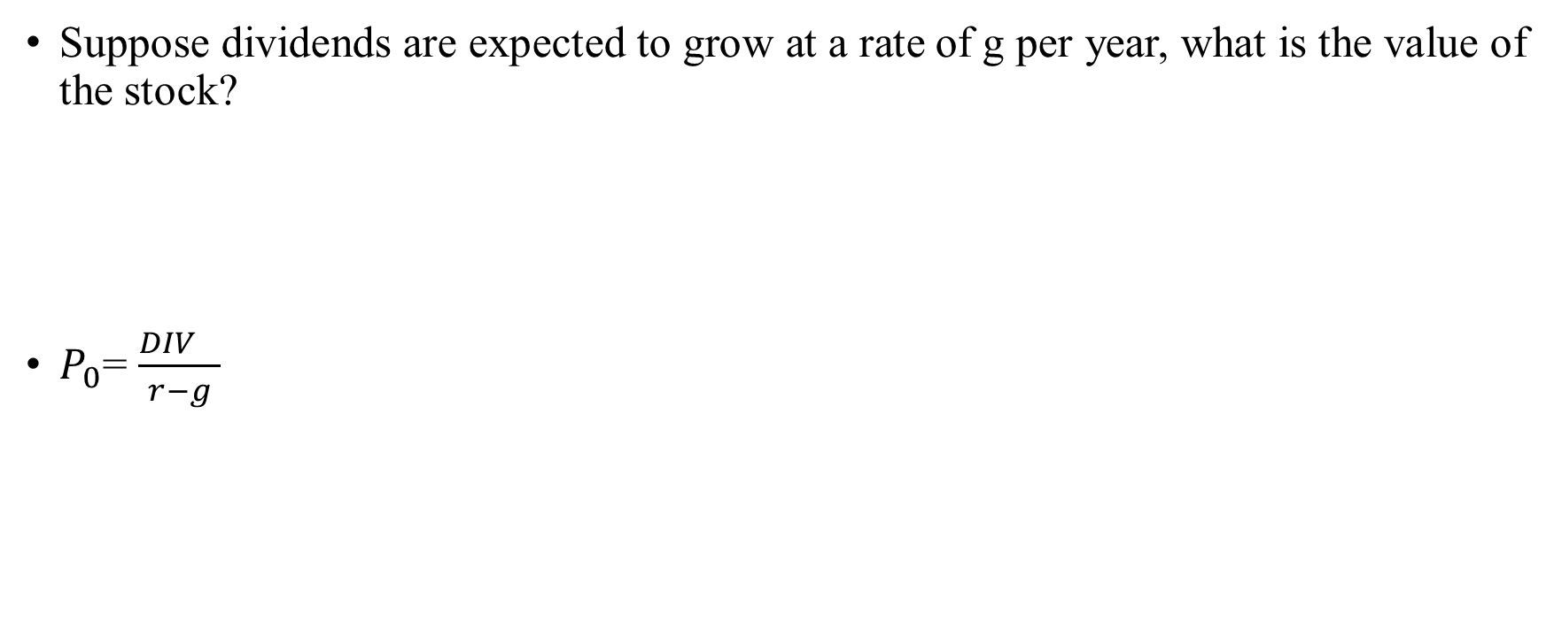
Special Case II: Growth stock
Suppose dividends are expected to grow at a rate of g per year, what is the value of the stock?
$P_{0}$= $\frac{{DIV}_{}}{r−g}$

Slide 101
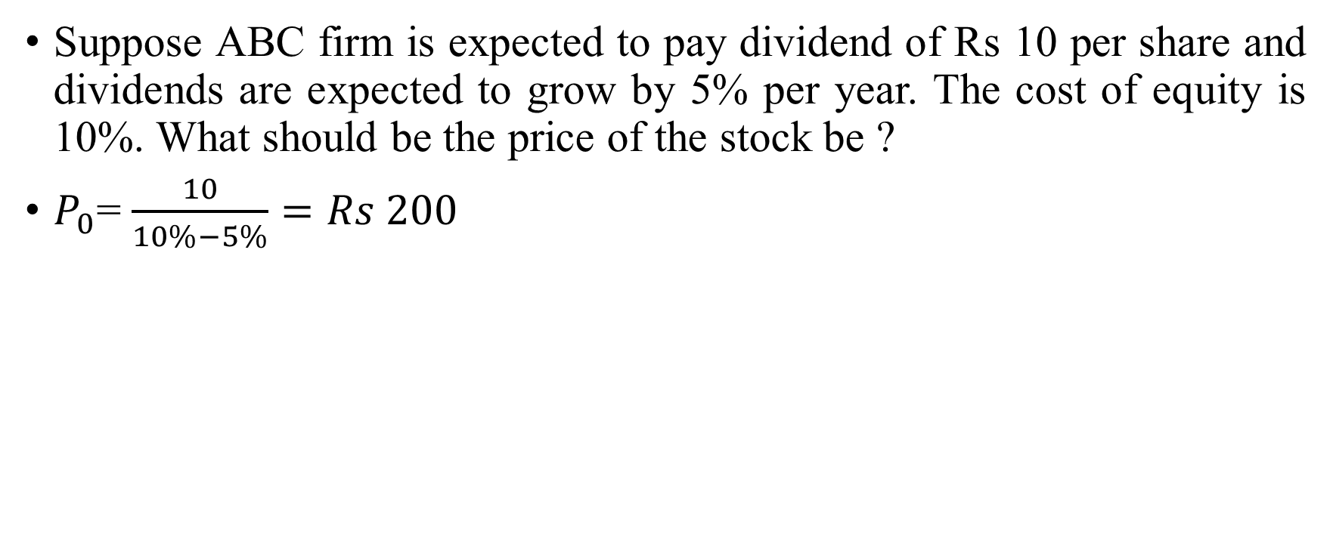
Special Case II: Growth stock
Suppose ABC firm is expected to pay dividend of Rs 10 per share and dividends are expected to grow by 5% per year. The cost of equity is 10%. What should be the price of the stock be ?
$P_{0}$= $\frac{10}{10\%−5\%}=Rs 200$

Slide 102
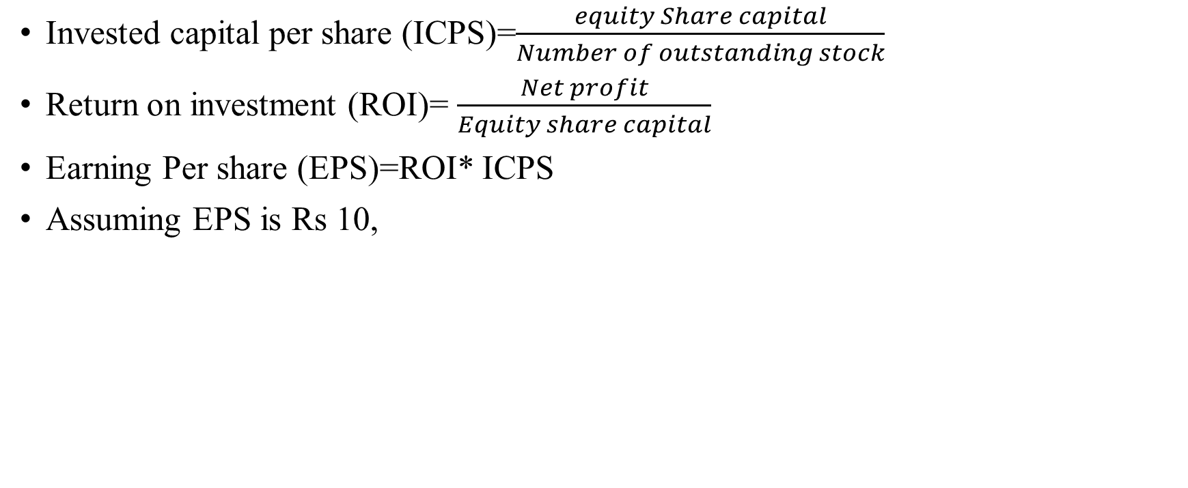
Engine of growth
Invested capital per share (ICPS)=$\frac{equity Share capital}{Number of outstanding stock}$
Return on investment (ROI)= $\frac{Net profit}{Equity share capital}$
Earning Per share (EPS)=ROI* ICPS
Assuming EPS is Rs 10,
EPS
Retained earnings per share
Dividend per share

Slide 103
Engine of growth (assume perpetuities)
A firm reports after-tax operating income Rs 75 million on invested capital of Rs 1 billion. It does not plan to reinvest in new asset but will maintain existing assets and its current return on capital. What should be the growth rate?
If this firm thinks that it can invest 50 million without improving return on capital what growth rate will you see in operating income next year?
If this firm thinks that it can improve its return on capital on existing assets from 7.5% to 10% next year by making them more efficient, what growth rate will you see in operating income next year?
If this firm thinks that it can improve its return on capital on existing assets from 7.5% to 10% next year by making them more efficient, along with 50 million new investment. What growth rate will you see in operating income next year?

Slide 104

Engine of growth
Current investment
Rs 1000
Current ROIC
7.5%
Current earnings
Rs 75
X
=
Current investment
Rs 1000
X
Current ROIC
7.5%
New investment
Rs 50
Current ROIC 7.5%
Next period earnings
Rs 78.75
+
X
=
Current investment
Rs 1000
Change in Current ROIC
0
New investment
Rs 50
Current ROIC
7.5%
Change in next period earnings
Rs 3.75
X
+
X
=
$$\frac{reinvestment amount}{Current earning}X ROIC=\frac{Current in earnings}{Current earnings}$$
$\frac{50}{75} X 7.5\%=\frac{3.75}{75}$=5%

Slide 105
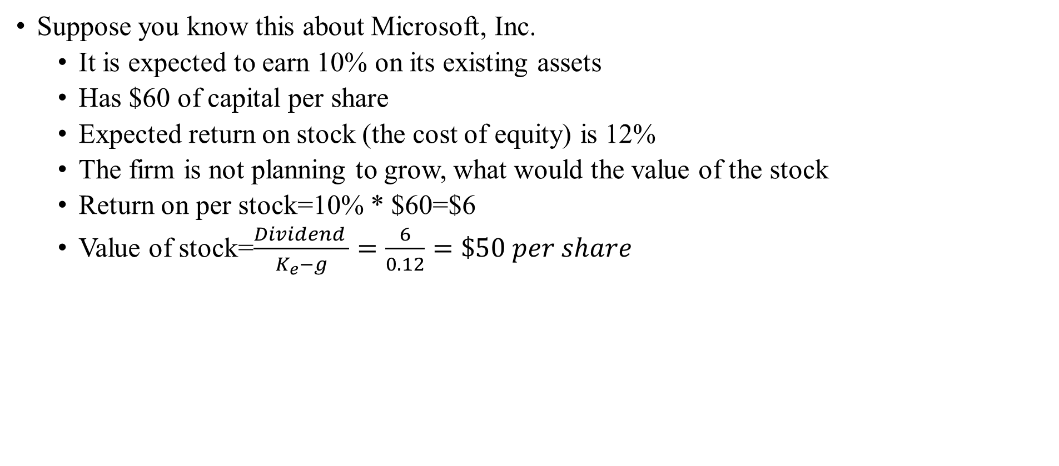
Good or Bad Growth
Suppose you know this about Microsoft, Inc.
  It is expected to earn 10% on its existing assets
  Has $60 of capital per share
  Expected return on stock (the cost of equity) is 12%
  The firm is not planning to grow, what would the value of the stock
  Return on per stock=10% * $60=$6
  Value of stock=$\frac{Dividend }{K_{e}−g}=\frac{6}{0.12}=\$50 per share$

Slide 106
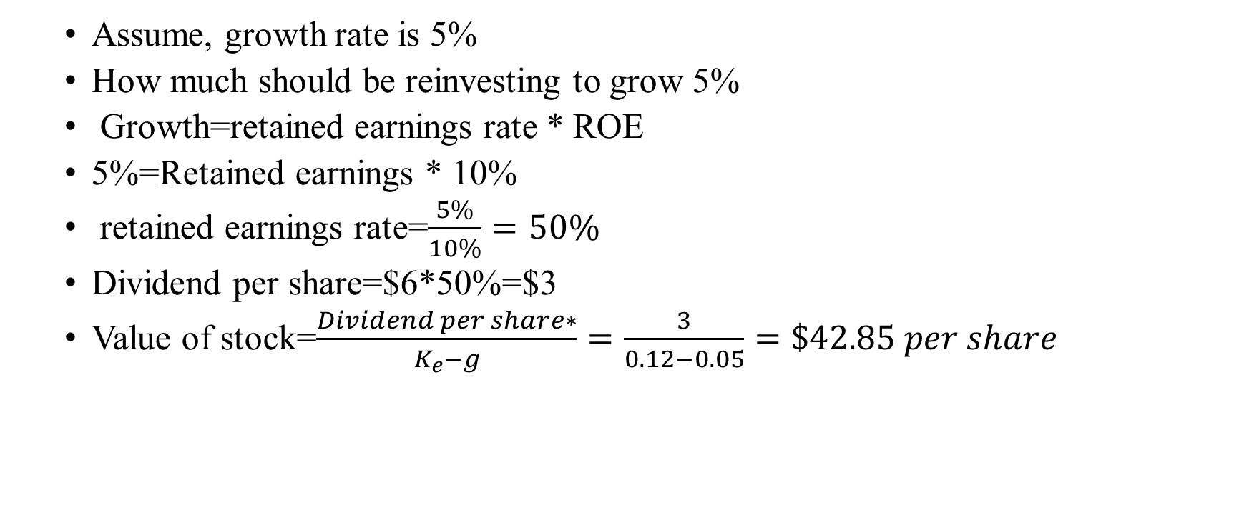
Good or Bad Growth
  Assume, growth rate is 5%
  How much should be reinvesting to grow 5%
  Growth=retained earnings rate * ROE
  5%=Retained earnings * 10%
  retained earnings rate=$\frac{5\%}{10\%}=50\%$
  Dividend per share=$6*50%=$3
  Value of stock=$\frac{Dividend per share∗}{K_{e}−g}=\frac{3}{0.12−0.05}=\$42.85 per share$

Slide 107
Case 1: Good growth-: ROE> Cost of equity
Expected EPS | DPR | Retention ratio | Ke | ROE | Growth rate | Dividend Amount | Equity Value
100 | 10% | 90% | 10% | 11% | 9.90% | 10 | 10000.00
100 | 20% | 80% | 10% | 11% | 8.80% | 20 | 1666.67
100 | 30% | 70% | 10% | 11% | 7.70% | 30 | 1304.35
100 | 40% | 60% | 10% | 11% | 6.60% | 40 | 1176.47
100 | 50% | 50% | 10% | 11% | 5.50% | 50 | 1111.11
100 | 60% | 40% | 10% | 11% | 4.40% | 60 | 1071.43
100 | 70% | 30% | 10% | 11% | 3.30% | 70 | 1044.78
100 | 80% | 20% | 10% | 11% | 2.20% | 80 | 1025.64
100 | 90% | 10% | 10% | 11% | 1.10% | 90 | 1011.24
100 | 100% | 0% | 10% | 11% | 0.00% | 100 | 1000.00

Slide 108
Case 2: Bad growth :- Cost of equity>ROE
Expected EPS | DPR | Retention ratio | Ke | ROE | Growth rate | Dividend Amount | Equity Value
100 | 10% | 90% | 10% | 9% | 8.10% | 10 | 526.32
100 | 20% | 80% | 10% | 9% | 7.20% | 20 | 714.29
100 | 30% | 70% | 10% | 9% | 6.30% | 30 | 810.81
100 | 40% | 60% | 10% | 9% | 5.40% | 40 | 869.57
100 | 50% | 50% | 10% | 9% | 4.50% | 50 | 909.09
100 | 60% | 40% | 10% | 9% | 3.60% | 60 | 937.50
100 | 70% | 30% | 10% | 9% | 2.70% | 70 | 958.90
100 | 80% | 20% | 10% | 9% | 1.80% | 80 | 975.61
100 | 90% | 10% | 10% | 9% | 0.90% | 90 | 989.01
100 | 100% | 0% | 10% | 9% | 0.00% | 100 | 1000.00

Slide 109
Case 3: Who cares:- Cost of equity= ROE
Expected EPS | DPR | Retention ratio | Ke | ROE | Growth rate | Dividend Amount | Equity Value
100 | 10% | 90% | 10% | 10% | 9.00% | 10 | 1000.00
100 | 20% | 80% | 10% | 10% | 8.00% | 20 | 1000.00
100 | 30% | 70% | 10% | 10% | 7.00% | 30 | 1000.00
100 | 40% | 60% | 10% | 10% | 6.00% | 40 | 1000.00
100 | 50% | 50% | 10% | 10% | 5.00% | 50 | 1000.00
100 | 60% | 40% | 10% | 10% | 4.00% | 60 | 1000.00
100 | 70% | 30% | 10% | 10% | 3.00% | 70 | 1000.00
100 | 80% | 20% | 10% | 10% | 2.00% | 80 | 1000.00
100 | 90% | 10% | 10% | 10% | 1.00% | 90 | 1000.00
100 | 100% | 0% | 10% | 10% | 0.00% | 100 | 1000.00

Slide 110
Valuation of HDFC

Slide 111
Bottom-up beta-HDFC Bank
Bank | Beta | Market Cap | Weights
Axis Bank Ltd. | 1.17 | 1731032 | 14.89%
City Union Bank Ltd. | 0.76 | 143434.4 | 1.23%
Federal Bank Ltd. | 1.3 | 174684.6 | 1.50%
I C I C I Bank Ltd. | 1.34 | 2712895 | 23.34%
IndusInd Bank Ltd. | 0.99 | 979553.3 | 8.43%
Kotak Mahindra Bank Ltd. | 0.8 | 2927238 | 25.18%
R B L Bank Ltd. | 1.24 | 165204.5 | 1.42%
State Bank Of India | 1.61 | 2600186 | 22.37%
Yes Bank Ltd. | 1.3 | 190451.4 | 1.64%
Bottom-up beta | 1.200

Slide 112
Dividend history of HDFC Bank
Dividend History of HDFC Bank
Year | dividend paid | PAT | Loan loss provisions | Reserves and funds | Total capital | Net profit+Provisions | equity capital | ROE | Dividend payout
2009 | -4263.2 | 29487 | 22,887.40 | 210647.5 | 4577.4 | 52,374.40 | 215224.9 | 0.24 | 0.14
2010 | -5519.4 | 39264 | 11,985.50 | 249140.4 | 4652.3 | 51,249.50 | 253792.7 | 0.20 | 0.14
2011 | -7695.5 | 51670.9 | 10,917.70 | 294553.5 | 4693.4 | 62,588.60 | 299246.9 | 0.21 | 0.15
2012 | -10130.6 | 67262.8 | 12,342.10 | 357382.7 | 4758.8 | 79,604.90 | 362141.5 | 0.22 | 0.15
2013 | -13134.9 | 84783.8 | 16,325.80 | 429988.2 | 4798.1 | 101,109.60 | 434786.3 | 0.23 | 0.15
2014 | -16492.8 | 102159.2 | 17,235.80 | 615081.2 | 5013 | 119,395.00 | 620094.2 | 0.19 | 0.16
2015 | -20091.6 | 122962.1 | 21,336.30 | 721721.4 | 5056.4 | 144,298.40 | 726777.8 | 0.20 | 0.16
2016 | -24083.1 | 145496.4 | 31,453.00 | 889498.5 | 5125.1 | 176,949.40 | 894623.6 | 0.20 | 0.17
2017 | -28312.7 | 174867.3 | 49,104.30 | 1057759.9 | 5190.2 | 223,971.60 | 1062950.1 | 0.21 | 0.16
2018 | -33842.9 | 210781.7 | 63,941.10 | 1486616.9 | 5446.6 | 274,722.80 | 1492064 | 0.18 | 0.16
 |  |  |  |  |  | Average |  | 0.21 | 0.16

Slide 113
DDM-HDFC Bank
Cost of equity=6.68+4.77*1.20+1.41=13.81%
Implied growth rate=(1-dividend payout ratio)* ROE=(1-0.16)*21%=17.66%
Implied dividend payout ratio=(1-(growth/ROE))
Current year ROE + Loan loss provisions=Rs 274,722.80 million

Slide 114
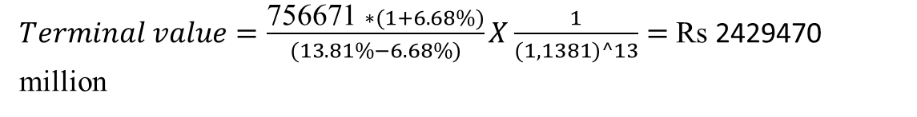
DDM-HDFC
 | High growth period |  |  | Transition period
 | 2019 | 2020 | 2021 | 2022 | 2023 | 2024 | 2025 | 2026 | 2027 | 2028 | 2029 | 2030 | 2031
Net Profit | 274723 | 323238 | 380321 | 443681 | 513161 | 588389 | 668761 | 753424 | 841271 | 930949 | 1020876 | 1109281 | 1194248
Growth rate | 17.66% | 17.66% | 17.66% | 16.66% | 15.66% | 14.66% | 13.66% | 12.66% | 11.66% | 10.66% | 9.66% | 8.66% | 7.66%
ROE | 20.91% | 20.91% | 20.91% | 20.91% | 20.91% | 20.91% | 20.91% | 20.91% | 20.91% | 20.91% | 20.91% | 20.91% | 20.91%
Dividend payout ratio | 15.52% | 15.52% | 15.52% | 20.31% | 25.09% | 29.88% | 34.66% | 39.44% | 44.23% | 49.01% | 53.79% | 58.58% | 63.36%
Dividend amount | 42649 | 50181 | 59043 | 90103 | 128760 | 175781 | 231783 | 297166 | 372057 | 456249 | 549155 | 649773 | 756671
Cost of equity | 13.81% | 13.81% | 13.81% | 13.81% | 13.81% | 13.81% | 13.81% | 13.81% | 13.81% | 13.81% | 13.81% | 13.81% | 13.81%
Present value | 37473 | 44091 | 45581 | 61117 | 76739 | 92048 | 106643 | 120132 | 132153 | 142390 | 150584 | 156551 | 160180
$Terminal value=\frac{\text{756671} ∗(1+6.68\%)}{(13.81\%−6.68\%)}X\frac{1}{(1,1381)^13}=$ Rs 2429470 million
Value of equity (March 2019)= 1325682 + 2429470 = Rs 3755152 million
Value of equity today= 3755152*(1.1381)^(5/12)= 3963151
Value of options= Rs 5359
Value of equity=3963151-5359=3957792
Outstanding shares= 2680.00 million : Value per share= 3957792 / 2680.00 = Rs. 1401.18

Slide 115
The cost of equity: A recap
bottom-up betas
Historical Premium
Mature equity market premium stocks over T bonds
Country risk premium
$$Cost of equity=Riskfree rate+Beta∗Risk premium$$
Must be in the same currency as cash flows and defined in same terms (real or nominal) as the cash flows

Slide 116
Cost of debt

Slide 117
What is debt?
Commitment to make fixed payments in the future
  The fixed payments are tax deductible.
  Failure to make the payments can lead to either default or loss of control of the firm to the party to whom payments are due.
Therefore, debt should include
  Any interest-bearing liability, whether short term or long term.
  Any lease obligation, whether operating or capital.

Slide 118
Estimating the Cost of Debt
If the firm has bonds outstanding, and the bonds are traded, the yield to maturity on a long-term, straight (no special features) bond can be used as the interest rate.
If the firm is rated, use the rating and a typical default spread on bonds with that rating to estimate the cost of debt.
  Cost of debt (pretax)=Risk-free rate + firm’s default spread + country’s default spread.
If the firm is not rated,
  it has recently borrowed long term from a bank, use the interest rate on the borrowing or
  estimate a synthetic rating for the company and use the synthetic rating to arrive at a default spread and a cost of debt.
The cost of debt has to be estimated in the same currency as the cost of equity and the cash flows in the valuation.

Slide 119
Rating-wise yield..
Ratings
Year | AAA | AAA | AAA | AAA | AA | AA | AA | AA
 | 1 years | 3 years | 5 years | 10 years | 1 years | 3 years | 5 years | 10 years
2008-09 |  | 8.1734 | 8.5295 | 8.801 |  |  |  | 9.0184
2009-10 | 6.3939 | 7.1713 | 8.096 | 8.5515 | 6.6913 | 7.6547 | 8.4188 | 8.9509
2010-11 | 6.7263 | 6.9401 | 8.4124 | 8.8213 | 7.5435 | 8.2898 | 8.8806 | 9.0062
2011-12 | 9.6977 | 9.176 | 9.4792 | 9.279 | 9.67 | 9.8356 | 9.6473 | 9.5096
2012-13 | 9.3159 | 9.2599 | 9.13 | 9.0732 | 9.5028 | 9.3168 | 9.4743 | 9.2848
2013-14 | 9.4453 | 9.0034 | 9.1787 | 8.9266 | 9.5223 | 8.9413 | 9.2013 | 8.9992
2014-15 | 8.9918 | 8.8709 | 8.7642 | 8.636 | 9.2229 | 9.1595 | 9.3786 | 9.2875
2015-16 | 8.3979 | 8.2751 | 8.3878 | 8.4176 | 8.8619 | 8.8827 | 9.0552 | 9.2146
2016-17 | 7.5481 | 7.5548 | 7.5499 | 7.8108 | 7.9198 | 8.1983 | 8.2476 | 8.6741
2017-18 | 7.3348 | 7.4283 | 7.4036 | 7.5734 | 7.5844 | 7.8598 | 8.479 | 8.2198
2018-19 | 8.2764 | 8.4044 | 8.5061 | 8.5589 | 8.4005 | 9.1138 | 9.2557 | 8.9407

Slide 120
CRISIL default (%)
Rating category | Three-year
AAA | 0.00%
AA | 0.20%
A | 1.90%
BBB | 3.89%
BB | 11.17%
B | 20.99%
C | 39.01%

Slide 121

How to measure default rate?
$Alman Z score=1.2∗\left(\frac{Working capital}{Total assets}\right)+1.4∗\left(\frac{Retainted earnings}{total assets}\right)+3.3∗\left(\frac{EBIT}{Total assets}\right)+0.6∗\left(\frac{Equity value}{total liabilities}\right)+0.999∗(\frac{Total sales}{Total assets)}$
In this model, if the Z value is greater than 2.99, then the firm is said to be in the “safe zone” and has a negligible probability of filing bankruptcy.
If the Z value is between 2.99 and 1.81, then the firm is said to be in the “grey zone” and has a moderate probability for bankruptcy.
And finally, if the Z value is below 1.81, then it is said to be in the “distress zone” and has a very high probability of reaching the stage of bankruptcy.

Slide 122
Altman z score for emerging market firms
𝐴𝑙𝑚𝑎𝑛 𝑍 𝑠𝑐𝑜𝑟𝑒=6.56*((𝑊𝑜𝑟𝑘𝑖𝑛𝑔 𝑐𝑎𝑝𝑖𝑡𝑎𝑙)/(𝑇𝑜𝑡𝑎𝑙 𝑎𝑠𝑠𝑒𝑡𝑠) + 3.26∗((𝑅𝑒𝑡𝑎𝑖𝑛𝑡𝑒𝑑 𝑒𝑎𝑟𝑛𝑖𝑛𝑔𝑠)/(𝑡𝑜𝑡𝑎𝑙 𝑎𝑠𝑠𝑒𝑡𝑠)) + 6.72∗(𝐸𝐵𝐼𝑇/(𝑇𝑜𝑡𝑎𝑙 𝑎𝑠𝑠𝑒𝑡𝑠)) + 0.6∗((𝐸𝑞𝑢𝑖𝑡𝑦 𝑣𝑎𝑙𝑢𝑒)/(total liabilities)) + 1.05∗((𝑇𝑜𝑡𝑎𝑙 𝑠𝑎𝑙𝑒𝑠)/(𝑇𝑜𝑡𝑎𝑙 𝑎𝑠𝑠𝑒𝑡𝑠))
In this model, if the Z value is greater than 2.6, then the firm is said to be in the “safe zone” and has a negligible probability of filing bankruptcy.
If the Z value is between 2.6 and 1.1, then the firm is said to be in the “grey zone” and has a moderate probability for bankruptcy.
And finally, if the Z value is below 1.1, then it is said to be in the “distress zone” and has a very high probability of reaching the stage of bankruptcy.

Slide 123
Default rate (TCS) in 2019
 | (in crores) |  |  | Weight
Current Liabilities | 14789 | Working capital to total assets | 0.448 | 6.56
Current assets | 50752 | Retained earning to total assets | 0.978 | 3.26
Working capital | 35963 | EBIT/TA | 0.546 | 6.72
Total assets | 80265 | Equity value/total liabilities | 620.241 | 0.6
𝑅𝑒𝑡𝑎𝑖𝑛𝑡𝑒𝑑 𝑒𝑎𝑟𝑛𝑖𝑛𝑔𝑠 | 78523 | Sales/TA | 1.825 | 1.05
EBIT | 43817
Sales | 146463
Equity value(market cap) | 847870
total liabilities | 1367 | Altman z score | 383.86
 |  | Probability of default | 0.00

Slide 124
Cost of debt (TCS)
Default rate=0.00
Expected Rating =AAA
ICRA Rating =AAA
Cost of debt (Pre-tax)=8.5589%

Slide 125
Subsidized Debt: What should we do?
Assume that Indian govt. lends money to XYZ firm at subsidized interest rate (say 5%). In computing the cost of capital to value XYZ firm. What should we use from the following?
  The subsidized cost of debt (5%). That is what the firm is paying.
  The fair cost of debt (9%). That is what the firm should require its project to cover.
  A number in the middle.

Slide 126
Cost of debt (tax advantage)
Almost all countries (perhaps middle east), firms borrow money and they pay interest before tax payment. Therefore, they receive tax advantage.
We generally use cost of debt (pre-tax) and multiple by (1-tax rate) to estimate cost of debt (post-tax). However, we get tax advantage if a firm’s operating income is more than interest amount.
Would you use cost of debt (post-tax) or cost of debt (pre-tax) for One97 Communications Limited (Paytm), given the firm has negative earnings?

Slide 127

Tax Rate in India

Slide 128
Weights for the cost of capital computation
In computing the cost of capital for a publicly traded firm, the general rule for computing weights for debt and equity is that you use market value weights (and not book value weights). Why?
  Because the market is often right.
  Because market values are easy to obtain.
  Because book values of debt and equity are meaningless.
  None of the above.

Slide 129

Cost of capital of RIL
Cost of equity=6.68% + 4.77%*1.07 + 1.47%=13.25%
Cost of Debt=8.35%
Market value of equity=Rs. 8024906 million
Vale of debt=Rs 91,4269.9 million
Tax rate(Should be marginal tax rate)=34.61%
Cost of capital =$13.25\%∗(\text{8024906}$/ (914269.9 + 8024906) + 9.18%*(91 4269.9 /(91 4269.9 + 8024906)=12.83%

Slide 130
Corporate Finance: The Big Picture
Maximize the value of the business (firm)
The Investment Decision Invest in assets that earn a return greater than the minimum acceptable hurdle rate
The Financing Decision
Find the right kind of debt for your firm and the right mix of debt and equity to fund your operations
The Dividend Decision
If you cannot find investments that make your minimum acceptable rate, return the cash to owners of your business
The hurdle rate should reflect the riskiness of the investment and the mix of debt and equity used to fund it.
The return should reflect the magnitude and the timing of the cashflows as well as all side effects
The optimal mix of debt and equity maximizes firm value. The right kind of debt matches the tenor of your assets
How you choose to return cash to the owners will depend on whether they prefer dividends or buybacks

Slide 131
Debt versus Equity
Fixed claim
Tax Deductible
High priority in financial trouble
Fixed maturity
No management control (why?)
Residual claim
Not Tax Deductible
Low priority in financial trouble
Infinite
Management control (why?)
Debt
Bank debt
Commercial paper
Corporate Bonds
Equity
Owner’s equity
Venture capital
Common stock
Warrants
Hybrid securities
Convertible Debt
Preferred stock
Option-linked bonds

Slide 132

The corporate life cycle

Slide 133

Financing pattern of Indian firms

Slide 134
Measuring a firm’s financing mix
My firm is having Rs 10 million debt. Is it high or low
The simplest measure of how much debt and equity a firm is using currently is to look at proportion of debt in the total financing: This ratio is called the debt to capital ratio:
  Debt to Capital ratio=Debt/(debt+capital)
Debt includes all interest-bearing liabilities, short-term as well long-term. It should also include other commitments that meet the criteria for debt: contractually pre-set payments that must be made, no matter what the firm’s financial standing.
Equity can be defined either accounting terms (book value of equity) or in market value terms (based on the current price). The resulting debt ratios can be very different.

Slide 135
The financing mix question
In deciding to raise financing for a business, is there an optimal mix of debt and equity?
  If yes, what is the trade off that lets us determine this optimal mix?
  What are the costs of using debt instead of equity?

Slide 136
The illusory benefits of debt
At first sight, the benefit of debt seems obvious. The cost of debt is lower than the cost of equity.
The benefit is an illusion , though, because debt is cheaper than equity for a simple reason. The lender gets both first claim on cashflows and a contractually pre-set cashflows. The equity investor is last in line and should demand a higher rate of return than the lender does.
Equity holders face not only business risk (uncertainty about the business), also financial risk (uncertainty about fixed claim payment).
By borrowing money at a lower rate, you are not making a business more valuable, but moving the risk around, since more borrowing makes existing equity and debt riskier.

Slide 137
Costs and benefits of debt
Advantages of Borrowing | Disadvantages of Borrowing
Tax Benefit: Higher tax rates --> Higher tax benefit | Bankruptcy Cost: Higher business risk --> Higher Cost
Added Discipline: Greater the separation between managers and stockholders --> Greater the benefit | Agency Cost: Greater the separation between stockholders & lenders --> Higher Cost
 | Loss of Future Financing Flexibility: Greater the uncertainty about future financing needs --> Higher Cost

Slide 138
Costs and benefits of debt
 | Firm A | Firm B
Total investment | 10,000 | 10,000
ROI | 10% | 10%
Debt @8% | 0 | 5000
Equity | 10000 | 5000
EBIT | 1000 | 1000
Less Interest | 0 | 400
EBT | 1000 | 600
Less Tax @30% | 300 | 180
PAT | 700 | 420
Benefits of debt
  Tax benefits: The tax code is tilted in favor of debt, with interest payments being tax deductible in most parts of the world, while cashflows to equity are not

Slide 139
A pizza size cannot be changed, but I can reduce the share of my brother by borrowing

Slide 140

 | Firm A | Firm B | Difference
Return on equity (PAT/equity investments) | 700/10000=7.00% | 420/5000=8.40% | 1.4%
Return on assets (EBIT*(1-t))/Total investments | (1000*(1-.30))/10000=7% | 1000*(1-.30))/10000=7% | 0%
ROE=ROA+(ROA-Interest rate*(1-t))*D/E
$$8.4\%=7\%+\left(7\%−8\%∗\left(1−30\%\right)\right)∗\frac{5000}{5000}$$
Operating decisions
Financing decisions (Financial leverage)

Slide 141
Tax benefits of debt
When you borrow money, you can deduct interest expenses from your income to arrive at taxable income. This reduces your taxes. When you use equity, you are not allowed to deduct payments to equity (such as dividends) to arrive at taxable income
The dollar tax benefits from the interest payment in any year is a function of your tax rate and the interest payment:
  Tax benefit each year=Tax rate*Interest payments
The caveat is that you need to have the income to cover interest payments to get this tax benefit.
Proposition 1: Other things being equal, the higher the marginal tax rate of a business, the more debt it will have in its capital structure.

Slide 142
Debt adds discipline to management (Monitoring)
If you are manager of a firm with no debt, and you generate high income and cashflows each year, you tend to become self-satisfied. The satisfaction can lead to inefficiency and investing in poor projects. There is little or no cost born by the managers.
Forcing such a firm to borrow money can be an antidote to the satisfaction. The managers now have to ensure that the investments they make will earn at least enough return to cover interest expenses. The cost of not doing so is liquidation and loss of such a job.

Slide 143
Debt and discipline
Assume that you into this argument that debt adds discipline to management. Which of the following types of firms will most benefit from debt adding this discipline?
Conservatively financed (very little debt), privately owned firms.
Conservatively financed, publicly traded firms, with stocks held millions of investors, none of whom hold a large percent of the stock.
Conservatively financed, publicly traded firms, with an activist and primarily institutional holding.

Slide 144
Bankruptcy cost
The expected bankruptcy cost is a function of two variables:
  The probability of bankruptcy, which will depend on how uncertain you are about future cashflows.
    The size of operating cashflows relative to size of cashflows on debt obligations.
    Variance in operating cashflows (business risk; the sensitivity of the demand of the firm’s products with the economic condition)
  The cost of going bankrupt
    Direct costs: the outflows of cash during bankruptcy, such as legal and admin costs, at the time of bankruptcy. The bankruptcy cost of Leman brother is $2 billion
    Indirect costs: Costs arising because people perceive you to be in financial trouble.
On Oct 1, 2008, A strong rumor that ICICI Bank has gone bankrupt sent several depositors rushing for ATMs to withdraw money. The ICICI Bank stock is down 37.47% from its recent high of Rs 551.45 on 1 October 2008.

Slide 145
Bankruptcy cost
Proposition 2: firms with more volatile earnings and cashflows should use debt less than otherwise similar firms with stable cashflows.
Proposition 3: Other things being equal, the greater the indirect bankruptcy cost, the less debt the firm can afford to use for any given level of debt.
In Indian system, business groups operate multiple independent firms, where one firm provide insurance to another firms. What are the implications of this structure on financing mix?

Slide 146
Bankruptcy cost
Firms with following products are likely to have greater bankruptcy (indirect) costs
  Firms that sell durable products with long lives that require replacement parts and service: Tata motor would have greater indirect costs associated with bankruptcy than Avenue supermarts.
  Firms that provide goods or service for which quality is an important attribute that is difficult to determine in advance: Manipal Hospitals would have more indirect costs associated with bankruptcy than Jubilant Foodworks.
  Firms that provide service after sale:

Slide 147
Debt & Bankruptcy cost
Rank the following firms on the magnitude of bankruptcy (indirect) costs from the most to least, considering both explicit and implicit costs:
A Grocery store
An Airplane Manufacture
High Technology firm

Slide 148
Agency cost
An agency cost arises whenever you hire someone else to do something for you. It arises because your interests(as the principal) may deviate from those of the person you hired (as the agent).
When you lend money to a business, you are allowing stockholders to use that money in the course of running that business. Stockholders interests are different from your interests, because
  You (as lender) are interested in getting your money back.
  Stockholders are interested in maximizing their wealth
In some cases, the clash of interests can lead to stockholders..
  Investing in riskier projects than you would want them to
  Paying themselves large dividends when you would rather have kept the cash in the business.

Slide 149
Selfish Investment Strategy 1
The value of outstanding bond=Rs. 100
Value of firm if low-risk project is chosen
 | Probability | Value of firm |  | Stock | Bond
Recession | 0.5 | 100 | = | 0 | 100
Boom | 0.5 | 200 | = | 100 | 100
 | Expected value=0.5*100+200*.5=150 Expected value of bond=100*0.5+100*0.5=$100 Expected value of stock=$150-$100=$50
Value of firm if high-risk project is chosen
Recession | 0.5 | 50 | = | 0 | 50
Boom | 0.5 | 240 | = | 140 | 100
 | Expected value=0.5*50+240*.5=145 Expected value of bond=50*0.5+100*0.5=75 Expected value of stock=$145-$75=$70

Slide 150
Selfish Investment Strategy 2
Consider a firm with Rs 4000 of principle and investment payments due at the end of the year. The firm is also having a positive NPV project with value of Rs 1700, after investment of Rs 1000 (possible equity investment).
 | Firm without project |  |  | Firm with project
 | Boom | Recession |  | Boom | Recession
Firm cashflow | 5000 | 2400 |  | 6700 | 4100
Bondholders' claim | 4000 | 4000 |  | 4000 | 4000
Stockholders' claim | 1000 | 0 |  | 2700 | 100

Slide 151
Debt and Agency Costs
Assume that you are a bank. Which of the following businesses would you perceive the greatest agency costs?
  A Large Technology firm
  A Large Regulated Electric Utility
  A Real Estate corporation

Slide 152
Can debtholders reduce agency problem?
In order to protect the interest of borrowers, the monitoring (covenants) is incorporated as part of loan document.
Typically, the monitoring cost of borrowers is higher for firms whose investments cannot be easily observed and monitored. For instance, service firms.
The monitoring cost is also high for firms whose projects are long-term, follow unpredictable paths. For instance, Pharma firms.
Proposition 4: Other things being equal, the greater the agency problems associated with lending to a firm, the less debt the firm can afforded to use.

Slide 153
Loss of future financing flexibility
When a firm borrows up to its capacity, it loses the flexibility of financing future projects with debt.
Thus, if the firm is faced with an unexpected investment opportunity or a business shortfall, it will not be able to draw on debt capacity, if it has already used it up.
Proposition 5: Other things remaining equal, the more uncertain a firm is about its future financing requirements and projects, the less debt the firm will use for financing current projects.

Slide 154

Debt policy factors
Debt policy factors

Slide 155
Application Test: Would you expect your firm to gain or lose from using a lot of debt?
Considering, for your firm,
  The potential tax benefits of borrowing
  The benefits of using debt as a disciplinary mechanism
  The potential for expected bankruptcy costs
  The potential for agency costs
  The need for financial flexibility
Would you expect your firm to have a high debt ratio or a low debt ratio?
Does the firm’s current debt ratio meet your expectations?

Slide 156
The trade off for Dr. Reddy'S Laboratories Ltd, Bajaj Auto Ltd., and Hindustan Unilever Ltd.
Debt trade-off | Discussion of relative benefits/costs
Tax benefits | Margin tax rate is same for all firms, but there is an offsetting tax benefit for Dr. Reddy , such as Depreciation relative to operating profit.
Added discipline | The benefits would be higher for Dr. Reddy where there is a clear separation of ownership and management (promoter holding =27%).
Expected Bankruptcy costs | Volatility in earnings is higher at Bajaj auto (cyclicality), and Dr Reddy and lower at HUL. Indirect bankruptcy cost likely to be highest at Dr. Reddy, since its products have impact on Human life. Bajaj auto would be at the second place because its products (automobiles) have long lives and require service.
Agency cost | Highest at Dr. Reddy because its assets are intangible and therefore, difficult to monitor. Bajaj Auto is highly visible and easily monitored. Moreover, because of part of family group.
Flexibility needs | Dr. Reddy will value flexibility more than other firms, because Pharma is an unpredictable business, where future investment needs are difficult to forecast. The flexibility needs should be lower at HUL because it is matured firm and well-established investment needs

Slide 157
A firm in a heaven
Assume that you live in a heaven where
There are no taxes
Managers have stockholders' interests at heart and do what’s best for stockholders
No firm ever goes bankrupt
Equity investors are honest with lenders, there is no subterfuge or attempt to find loopholes in loan agreements
Firms know their future financing needs with certainty
What happens to trade off between debt and equity? How much should you borrow for this firm?

Slide 158

The Miller-Modigliani Theorem
In an environment, where there are no taxes, default risk or agency costs, capital structure is irrelevant.
If the Miller Modigliani theorem holds:
  A firm's value will be determined the quality of its investments and not by its financing mix.
  The cost of capital of the firm will not change with leverage. As a firm increases its leverage, the cost of equity will increase just enough to offset any gains to the leverage.

Slide 159
What do firms look at in financing?
There are some who argue that firms follow a financing hierarchy, with retained earnings being the most preferred choice for financing, followed by debt and that new equity is the least preferred choice. In particular
  Managers value flexibility. Managers value being able to use capital (on new investments or assets) without restrictions on that use or having to explain its use to others.
  Managers value control. Managers like being able to maintain control of their businesses.
With flexibility and control being key factors:
  Would you rather use internal financing (retained earnings) or external financing?
  With external financing, would you rather use debt or equity?

Slide 160
Preference rankings long-term finance: Results of a survey
Ranking | Source | Score
1 | Retained Earnings | 5.61
2 | Straight Debt | 4.88
3 | Convertible Debt | 3.02
4 | External Common Equity | 2.42
5 | Straight Preferred Stock | 2.22
6 | Convertible Preferred | 1.72

Slide 161
Financing choice
You are reading business news paper and notice a firm, offering to sell convertible preferred stock. What would you hypothesize about the health of the firm issuing these securities?
  Nothing
  Healthier than the average firm
  In much more financial trouble than the average firm

Slide 162
CAPITAL STRUCTURE: FINDING THE RIGHT FINANCING MIX

Slide 163
The cost of capital approach
Value of firm=present value of cashflows to the firm, discounted back at the cost of capital.
If the cashflows to the firm are held constant, and cost of capital is minimized, the value of firm will be maximized.
Cost of capital=cost of equity (E/(D+E)) +Pretax cost of debt *(1-t) *(D/(D+E)).
Now, as debt ratio changes, how does the cost of capital change?

Slide 164
Synthetic credit ratings
(Interested coverage ratio)
Greater Than | ≤ to | Rating is | Spread is
-100000 | 0.199999 | D2/D | 18.60%
0.2 | 0.649999 | C2/C | 13.95%
0.65 | 0.799999 | Ca2/CC | 10.63%
0.8 | 1.249999 | Caa/CCC | 8.64%
1.25 | 1.499999 | B3/B- | 4.37%
1.5 | 1.749999 | B2/B | 3.57%
1.75 | 1.999999 | B1/B+ | 2.98%
2 | 2.2499999 | Ba2/BB | 2.38%
2.25 | 2.49999 | Ba1/BB+ | 1.98%
2.5 | 2.999999 | Baa2/BBB | 1.27%
3 | 4.249999 | A3/A- | 1.13%
4.25 | 5.499999 | A2/A | 0.99%
5.5 | 6.499999 | A1/A+ | 0.90%
6.5 | 8.499999 | Aa2/AA | 0.72%
8.50 | 100000 | Aaa/AAA | 0.54%
http://pages.stern.nyu.edu/~adamodar/
New_Home_Page/datafile/ratings.htm

Slide 165

The debt trade off on the cost of capital

Slide 166
Cost of capital approach: Good to the book..
Assuming cashflows=200, growth rate=3%
$$Value=\frac{Expected cashflow next year}{Cost of capital−growth}=\frac{200}{Cost of capital−growth}$$
D/(D+E) | Cost of equity | Cost of debt(post tax) | WACC | Firm Value
0 | 10.50% | 4.80% | 10.50% | 2746.67
10% | 11% | 5.10% | 10.41% | 2780.03
20% | 11.60% | 5.40% | 10.36% | 2798.91
30% | 12.30% | 5.52% | 10.27% | 2835.12
40% | 13.10% | 5.70% | 10.14% | 2885.15
50% | 14.50% | 6.10% | 10.30% | 2821.92
60% | 15% | 7.20% | 10.32% | 2814.21
70% | 16.10% | 8.10% | 10.50% | 2746.67
80% | 17.20% | 9% | 10.64% | 2696.34
90% | 18.40% | 10.20% | 11.02% | 2568.58
100% | 19.70% | 11.40% | 11.40% | 2452.38

Slide 167
Current cost of captial: Adani Ports & Special Economic Zone Ltd.
Equity Value: Rs. 904073.99 million
Debt value: Long term debt (180750)+ Short-term debt (32621.2)
Firm value: 904073.99+ 180750+ 32621.2= Rs. 1117445 million
Equity Beta: 1.63
Unleveraged Beta : 1.63/((1+ (213371/ 904073.99)*(1-0.34))=1.41
EBIT= Rs. 68980.1 million
Debt to capital ratio= 213371.2/ 1117445 =19%

Slide 168
Current cost of capital: Adani Ports & Special Economic Zone Ltd.
Cost of equity=6.68%+(4.77%* 1.63)+1.47%=15.92%
Credit rating= AA+
Default spread=1%
Cost of debt (pretax)= 6.68%+1%+1.40%=9.08%
Current Cost of capital=19%*9.08*(1-0.3461)+15.92%*(1-19%)=14.023%

Slide 169
Credit ratings and spread for Indian firms with different levels of debt
For each firm, we have only one rating for given level of debt. How can we find credit ratings and spread for the same firm with different levels of debt.
I define synthetic credit ratings based on interest coverage ratio because of the following reasons.
  It is first among the nine ratios that are used by rating agencies, such as S&P, and Moody’s to determine rating.
  The research has found a significant correlation between interest coverage ratio and bond rating.

Slide 170
Synthetic credit ratings
(Interested coverage ratio)
Greater Than | ≤ to | Rating is | Spread is
-100000 | 0.199999 | D2/D | 18.60%
0.2 | 0.649999 | C2/C | 13.95%
0.65 | 0.799999 | Ca2/CC | 10.63%
0.8 | 1.249999 | Caa/CCC | 8.64%
1.25 | 1.499999 | B3/B- | 4.37%
1.5 | 1.749999 | B2/B | 3.57%
1.75 | 1.999999 | B1/B+ | 2.98%
2 | 2.2499999 | Ba2/BB | 2.38%
2.25 | 2.49999 | Ba1/BB+ | 1.98%
2.5 | 2.999999 | Baa2/BBB | 1.27%
3 | 4.249999 | A3/A- | 1.13%
4.25 | 5.499999 | A2/A | 0.99%
5.5 | 6.499999 | A1/A+ | 0.90%
6.5 | 8.499999 | Aa2/AA | 0.72%
8.50 | 100000 | Aaa/AAA | 0.54%
http://pages.stern.nyu.edu/~adamodar/
New_Home_Page/datafile/ratings.htm

Slide 171
Mechanics of cost of capital estimation
1. Estimate the cost of equity at different levels of debt:
  Equity will become riskier> Beta will increase> cost of equity will increase
2. Estimate the cost of debt at different levels of debt:
  Default risk will increase, and bond ratings will go down as debt goes up> cost of debt will increase
  To estimate bond ratings, we will use the interest coverage ratio (EBIT/Interest expense)
3. Estimate the cost of capital at different levels of debt
4. Calculate the effect on firm value and stock price.

Slide 172
Can we calculate for 30% level of debt?
 | Current | Iteration 1 | Iteration 2 | Iteration 3 | Iteration 4
Debt to capital | 20% | 30% | 30% | 30% | 30%
Debt/Equity | 25% | 43% | 43% | 43% | 43%
Firm value (Rs) | 1117445 | 1117445 | 1117445 | 1117445 | 1117445
Debt value (Rs) | 279361 | 335233.56 | 335233.56 | 335233.56 | 335233.56
EBIT (Rs) | 68980.1 | 68980.1 | 68981.1 | 68981.1 | 68981.1
Interest payment (Rs) | 6263 | 28897 | 31344 | 35065 | 37077
Interest coverage ratio | 11.01 | 2.38 | 2.20 | 1.96 | 1.86
Expected rating | AA+ | AA+ | Baa2/BBB | Ba2/BB | B1/B+
Risk-free rate | 6.68% | 6.68% | 6.68% | 6.68% | 6.68%
Country-risk premium | 1.40% | 1.40% | 1.40% | 1.40% | 1.40%
Default spread | 0.54% | 0.54% | 1.27% | 2.38% | 2.98%
Expected Interest rate | 8.62% | 8.62% | 9.350% | 10.460% | 11.060%

Slide 173
What would be the cost of debt @ 40% debt?
 | Iteration 1 | Iteration 2 | Iteration 3
Debt ratio | 0.4 | 0.4 | 1.4
Debt/Equity | 67% | 67% | 67%
Firm value (Rs) | 1117445 | 1117445 | 1117445
Debt value (Rs) | 446978.08 | 446978.08 | 446978.08
EBIT (Rs) | 68982.10 | 68982.10 | 68982.10
Interest payment (Rs) | 49435.78 | 55648.77 | 74734.73
Interest coverage ratio | 1.40 | 1.24 | 0.92
Expected rating |  | B3/B- | Caa/CCC
Default spread |  | 4.37% | 8.64%
Expected Interest rate | 11.06% | 12.45% | 16.72%

Slide 174
Bond rating, and cost of debt
Debt portion | Rating | Interest rate | Debt value | Interest amount | EBIT | Interest coverage ratio | Tax Rate
0 | AAA | 8.62% | 0 | 0 | 68980 | Infinte | 34.00%
0.1 | AAA | 8.62% | 111745 | 9632 | 68980 | 7.16 | 34.00%
0.2 | AA+ | 9.08% | 223489 | 20293 | 68980 | 3.40 | 34.00%
0.3 | B1/B+ | 11.06% | 335234 | 37077 | 68980 | 1.86 | 34.00%
0.4 | B2/B | 16.72% | 446978 | 74735 | 68980 | 0.92 | 31.38%
0.5 | Ca2/CC | 18.71% | 558723 | 104537 | 68980 | 0.66 | 22.44%
0.6 | C2/C | 22.03% | 670467 | 147704 | 68980 | 0.47 | 15.88%
0.7 | C2/C | 22.03% | 782212 | 172321 | 68980 | 0.40 | 13.61%
0.8 | D2/D | 26.68% | 893956 | 238508 | 68980 | 0.29 | 9.83%
0.9 | D2/D | 26.68% | 1005701 | 268321 | 68980 | 0.26 | 8.74%

Slide 175
Adjusted marginal tax rate
You need taxable income for interest to provide a tax savings. Note that the EBIT at Adani is Rs. 68980.1 million. As long as interest expenses are less than Rs 68980.1 million, interest expenses remain fully tax-deductible and earn the 34% tax benefit. However, at 40% debt ratio, interest expenses are Rs 74735 million, which is greater than EBIT of Rs 68980.1 million. We consider the tax benefit on the interest expenses up to this amount.
  Maximum tax benefits=EBIT*Margin tax rate= 68980.1*0.34= Rs 23453.23 million
  Adjusted marginal tax rate=Maximum tax benefit/Interest expenses= 23453.23/ 74735=31.38%

Slide 176
Cost of equity
debt portion | Debt to equity | Interest rate | Tax Rate | Unlevered beta | Equity beta | Cost of equity
0 | 0.00 | 8.62% | 34.00% | 1.41 | 1.410 | 14.88%
0.1 | 0.11 | 8.62% | 34.00% | 1.41 | 1.513 | 15.37%
0.2 | 0.25 | 9.08% | 34.00% | 1.41 | 1.643 | 15.99%
0.3 | 0.43 | 11.06% | 34.00% | 1.41 | 1.809 | 16.78%
0.4 | 0.67 | 16.72% | 31.38% | 1.41 | 2.055 | 17.95%
0.5 | 1.00 | 18.71% | 22.44% | 1.41 | 2.504 | 20.09%
0.6 | 1.50 | 22.03% | 15.88% | 1.41 | 3.189 | 23.36%
0.7 | 2.33 | 22.03% | 13.61% | 1.41 | 4.252 | 28.43%
0.8 | 4.00 | 26.68% | 9.83% | 1.41 | 6.956 | 41.33%
0.9 | 9.00 | 26.68% | 8.74% | 1.41 | 13.912 | 74.51%
Equity beta=1.41*(1+D/E*(1-tax rate)=
Cost of equity=6.68%+1.41*4.77%+1.47%= 14.88%

Slide 177
Cost of capital (WACC)
debt portion | Debt to equity | Interest rate | Tax Rate | After tax cost of debt | Cost of equity | WACC
0 | 0.00 | 8.62% | 34.00% | 5.69% | 14.88% | 14.88%
0.1 | 0.11 | 8.62% | 34.00% | 5.69% | 15.37% | 14.40%
0.2 | 0.25 | 9.08% | 34.00% | 5.99% | 15.99% | 13.99%
0.3 | 0.43 | 11.06% | 34.00% | 7.30% | 16.78% | 13.93%
0.4 | 0.67 | 16.72% | 31.38% | 11.47% | 17.95% | 15.36%
0.5 | 1.00 | 18.71% | 22.44% | 14.51% | 20.09% | 17.30%
0.6 | 1.50 | 22.03% | 15.88% | 18.53% | 23.36% | 20.46%
0.7 | 2.33 | 22.03% | 13.61% | 19.03% | 28.43% | 21.85%
0.8 | 4.00 | 26.68% | 9.83% | 24.06% | 41.33% | 27.51%
0.9 | 9.00 | 26.68% | 8.74% | 24.35% | 74.51% | 29.36%

Slide 178
Cost of capital: Adani Ports & Special Economic Zone Ltd.

Slide 179
Cost of capital approach suggest
Adani currently has Rs 213371 million in debt. The optimal rupee debt (at 30%) is around Rs 335234 million. Adani has excess debt capacity of Rs 121863 million.
To move to its optimal and gain the increase in value, Adani should borrow Rs 121863 million and buyback stock.
Given the magnitude of this decision, you should expect to answer three questions:
  Why should we do it?
  What if something goes wrong?
  What if we don’t want buyback stock and want to make investments with additional debt capacity?

Slide 180

Why should we do it? Effect on Firm Value – Full Valuation
Step 1: estimate the cashflows to Adani:
  Free cashflow to Firm =EBIT*(1-t) (intuitively)
  FCFF= 68980.1*(1-0.34)=Rs 45526.87 million
Step 2: Back out the implied growth rate in the current market value.
  Current market value of firm=Rs 1117445 million
  Firm value=FCFF*(1+growth)/(WACC-growth)
  WACC=14.023%
  $\text{1117445}$=$\frac{\text{45526.87}∗(1+growth)}{\text{(}\text{14.023\%}−−growth)}$
  Implied growth=9.56%

Slide 181

Revalue firms
Step 3: Revalue the firm with the new cost of capital
  Firm value=$\frac{FCFF∗(1+growth)}{Cost of capial−growth}=\frac{\text{45526.87}∗(1+9.56\%)}{(13.93\%−9.56\%)}$=Rs 1140033 million
  Increase in firm value= 1140033- $\text{1117445}$=Rs 22588 million

Slide 182
Firm value
Debt (%) | EBIDT | Tax rate | Implired Growth | WACC | FCFF | Firm value
0% | 68980 | 34.00% | 9.56% | 14.88% | 45527 | 938216
10% | 68980 | 34.00% | 9.56% | 14.40% | 45527 | 1030215
20% | 68980 | 34.00% | 9.56% | 13.99% | 45527 | 1126553
30% | 68980 | 34.00% | 9.56% | 13.93% | 45527 | 1140033
40% | 68980 | 31.38% | 9.56% | 15.36% | 47333 | 893899
50% | 68980 | 22.44% | 9.56% | 17.30% | 53504 | 757049
60% | 68980 | 15.88% | 9.56% | 20.46% | 58027 | 582993
70% | 68980 | 13.61% | 9.56% | 21.85% | 59592 | 531112
80% | 68980 | 9.83% | 9.56% | 27.51% | 62197 | 379584
90% | 68980 | 8.74% | 9.56% | 29.36% | 62951 | 348239

Slide 183
Firm value, cost of capital, and debt ratio

Slide 184
Effect on Value: Incremental approach
Firm value @ 30% debt= 1140033-1117445=Rs. 22588 million
Saving (cost of capital)=13.93%-14.023%= -0.093%
Annual saving next year=(13. 93%-14.023%)*1117445= Rs. 1039.22 million
Increase in value= 1039.22 /(13.93%-9.56%)=Rs 23780.77 million
Enterprise value after recapitalization
  =Existing enterprise value +PV of savings=Rs 1140033 + Rs 23780.77=Rs 1163813.77

Slide 185
From Firm value to per share value: The rational investor solution
Total outstanding stocks 2070.95 million
Increase in value per share= 23780.77 million/ 2070.95 million=Rs 11.48 per stock
Expected stock value=Current Market Price +Increase in per share value
= 436+11.48= Rs.447.48

Slide 186
What if buy-buy price is equal to fair value?
New borrowed amount=Rs. 121862.8 million
With the buyback price of Rs. 447.48, How many stock can be bought back= 121862.8/447.48=272.33 million
New outstanding share after buy back: 2070.95 -272.33=Rs.1798.62 million
Value of equity after buy-back
  Optimal firm value=Rs 1141225.77 million
  Debt value (30%)= Rs. 335234 million
  Equity value= Rs 1141225.77- Rs. 335234 =Rs. 805991.77 million
  Value per share after buyback= 805991.77/1798.62 =Rs. 448.11

Slide 187
What if buy-buy price is equal to current market price Rs 436?

Slide 188
Normalized operating income
A key input that drives the optimal capital structure is current operating income . If the income is low, either because the firm is cyclical firm or because there are some specific factors that are expected to be temporary, the optimal debt ratio that will emerge from the analysis will be much lower than the firm’s true optimal. For instance, if we use estimate optimal debt ratio just after to a recession, the operating income which we consider is likely to be lower.
If you are cyclical firms, earnings will track the economy looked abnormally high in boom years and abnormally low or negative in recession years.
Since you are making a judgment on debt capacity for the long-term, you should be borrowing on income that you can generate across a cycle, not just the most recent year.

Slide 189
How to normalize operating income?
Go back over time to cover an entire cycle or better still, more than on economic cycle.
You can average across the cycle, but if the firm is growing up.
For growing firm, you may consider future sales and profit margin of the industry. Operating profit would be sales*profit margin of industry.

Slide 190
What if something goes wrong? The downside risk
Sensitivity to assumptions
What if analysis: As we know the operating debt ratio is a function of inputs on operating income, tax rates, and macro variables. It is a good idea look at the historical operating profit to understand the volatility of operating profit and perform what if analysis.
Economic scenario approach: we can develop different economic scenario, based on economic conditions, and examine the optimal debt ratio under each one. For instance, we could look at the optimal debt ratio for a cyclical firm under a book economy, a regular economy and an economy in recession.

Slide 191
Adani Ports & Special Economic Zone Ltd: Safty buffers
EBIT drops by | EBIT | Optimal debt ratio
0% | 68980.1 | 30%
10% | 62082.1 | 30%
20% | 49665.7 | 20%

Slide 192
Constraints on Ratings
Management often defines a “desired rating” below which they do not want to fall. For example, Adani port’s management wants to maintain at least AA+
  In order to borrow funds for future requirements
Every rating constraint has a cost.
  The cost of a rating constraint is the difference between the unconstraint value and the value of firm with the constraint
  Managers should be aware of above cost of constraint.

Slide 193
Cost of rating constraint for Adani Port
If managers insisted on AA+ rating, the optimal debt ratio for Adani port is then 20%, and the cost of ratings constraint would be:
Cost of ratings constraint=Value of firm at unconstraint optimal-value of firm at constraint optimal
=Value of firm at 30% debt-value of firm at 20% debt
= 1140033-1126553=Rs 13,480 million

Slide 194
Will the optimal be different if you invest in projects instead of buying back stock?
The optimal debt ratio is ultimately a function of the underlying riskiness of the business in which you operate.
Will the optimal be different if you invest in projects instead of buying back stock?
  No, as long as the projects financed are the same business mix that the firm has always been in
  Yes, if the projects are entirely different types of business.

Slide 195
Design the perfect financing instrument

Slide 196
Design the perfect financing instrument
The objective in designing debt is to make the cash flows on debt match up as closely as possible with the cash flows that the firm makes on its assets.
By doing so, we reduce our risk of default, increase debt capacity and increase firm value.

Slide 197

Firm with mismatched debt

Slide 198

Firm with matched Debt

Slide 199

Design the perfect financing instrument
The perfect financing instrument will
  Have all of the tax advantages of debt
  While preserving the flexibility offered by equity

Slide 200
Approaches for evaluating Asset Cash Flows
Intuitive Approach
  Are the projects typically long term or short term? What is the cash flow pattern on projects?
  How much growth potential does the firm have relative to current projects?
  How cyclical are the cash flows? What specific factors determine the cash flows on projects?
Project Cash Flow Approach
  Estimate expected cash flows on a typical project for the firm
  Do scenario analyses on these cash flows, based upon different macro economic scenarios
Historical Data
  Operating Cash Flows
  Firm Value

Slide 201
Intuitive Approach - Reliance Industries Limited
Business | Project cashflow characteristic | Type of financing
Energy, petrochemicals, and natural resources | Projects are likely to be Very long-term Currency will be a function of the region (rather than country) where resources are located. Affected by success of exploration | Debt should be Long-term Mix of currencies, based on resources location. If possible, tied to the success of exploration.
Textiles, and retail | The projects are likely to Be short-term Have cash outflows primarily in rupee (because Textiles and retail originate from India) | Debt should be 1. Short-term 2. Indian currency debt
Telecommunications | Projects are likely to Be short- to medium-term, with high growth potential and significant risk Cashflows are likely to be in Indian rupee. | Debt should be short-term-medium term , convertible Indian rupee debt.

Slide 202
Application Test: Choosing your Financing Type
Based upon the business that your firm is in, and the typical investments that it makes, what kind of financing would you expect your firm to use in terms of
  Duration (long term or short term)
  Currency
  Fixed or Floating rate
  Straight or Convertible

Slide 203
Project Specific Financing
With project specific financing, you match the financing choices to the project being funded. The benefit is that the debt is truly customized to the project.
Project specific financing makes the most sense when you have a few large, independent projects to be financed. It becomes both impractical and costly when firms have portfolios of projects with interdependent cashflows.

Slide 204

Duration of project cashflows
Duration of the project=18.91 years

Slide 205
The perfect debt…
The perfect debt for this project would have a duration of roughly 19 years and be in a mix of Indian and dollar (since it has most of revenue from US dollar).

Slide 206
Analyzing RIL’s current debt
RIL has Rs 23,107 crore interest bearing market debt with a face value weighted average maturity of 19.15 years.
Bank loan with average life of 5 years is 58,140 crore.
RIL is not having much foreign currency loans.
RIL is not having convertible bond

