Slide 1
Session - I
Prof. Chandreie Mukherjee
Management Communication Area
chandreie@iimv.ac.in

Slide 2
Corporate Communication
Internal employee communications : company newsletters, emails, itranet (unity, motivate and shared purpose)
External communications through media and public relations
Crisis communications (make or break reputation)
Effective strategies to navigate communication challenges in today's dynamic business environment (role of social media in shaping exception)
Pitching methods of products in different companies (communication shapes public perception)

Slide 3
Importance of Corporate Communication
Collaboration
Team Alignment
Relationship with Stakeholders
Drives Innovation
Ensures Resilience

Slide 4
A Crisis
  Crisis is a negative event or situation that:
    Stops business as usual to some extent and
    Requires escalation to leadership for decision-making, guidance and directives
    Product recalls, financial scandals, natural disaster, accidents, cyber attacks
It threatens long-term material impact on:
  Reputation
  People (stakeholders)
  Environment
  Business operations and/or
  Bottom line

Slide 5
Crisis Communications
The effort taken by an organization or individual to communicate with their important audiences when a crisis happens or is expected to happen.
- requires proactive planning
- clear communication strategies
- ability to respond swiftly and effective in uncertain times

Slide 6
Crisis Response Strategy:
Refutation strategies seek to eliminate the crises.
Elimination is achieved by denying a crisis exists, or clarifying why there is no crisis. Organizations can also attack, or confront those who have wrongly reported that a crisis exists. The most aggressive refutation strategy is intimidation. Intimidation is most often the threat of legal action against those who say an organization is experiencing a crisis. If an organization uses refutational strategies the leaders must be absolutely sure they are correct that a crisis does not exist

Slide 7
2. Avoidance strategies acknowledge the crisis and attempt to create public acceptance of the crisis while weakening the linkage between the crisis and the organization. Organizations attempt to excuse or justify the crisis when using avoidance strategy. An organization can excuse the crisis by denial of intention, "we didn't mean to hurt anyone," or by denial of violation, "no laws were broken here“.

Slide 8
3. Justification is an avoidance strategy that seeks to minimize the damage associated with the crisis. Organizations can minimize a crises by denying the seriousness of injury, or claiming the victim disserved what happened, "our oil spill was a drop in the bucket compared to the Exxon Valdez," or "its is tragic that someone was killed in a Ford, but they didn't have their seatbelt on“.

Slide 9
4. Attachment strategies seek to gain public approval for the organization during a crisis. This is done by bolstering the organization's attributes, "our organization ads $ 1 billion to the local economy," or transcendence, "the soldiers were killed in the defense of freedom," or by praising others, "the heroic efforts of those that helped clean this oil spill can not be overstated”.

Slide 10
5. Forgiveness strategies attempt to win forgiveness of the publics and to create acceptance for the crises. There are three forgiveness strategies: remediation, repentance, and rectification (Marcus & Goodman, 1991). Remediation offers some sort of compensation to the victims of a crisis (usually money). Negative feelings may be lessened if an organization takes positive actions to help the victims of a crisis. The airline industry is particularly adept at this following a crash.

Slide 11
6. Repentance is a forgiveness strategy that simply asks for forgiveness. If an organization apologizes for the crises the negatives associated with the crisis should be lessoned as people accept the apology and forgive the organization for its misdeeds. Rectification is a forgiveness strategy that normally follows repentance. Rectification involves taking action to prevent recurrence of the crisis in the future.

Slide 12
7. Sympathy strategy. An organization attempts to portray itself as the victim of a malicious outside entity. If the CIA had agents sell secrets to a foreign adversary, they could claim they were victims of a malicious employee gone bad.

Slide 13
Base Case Crisis
When no one externally knows there was a problem
Because the organization managed/navigated a potential crisis so that it helped its brand, won its position, etc.

Slide 14

Tylenol is a Johnson & Johnson product
1982: Cyanide-laced Tylenol kills 7 in Chicago
J&J actions:
Removed product from shelves/offered replacement
Advised consumers not to take product
Posted reward
J& J was:
Candid and contrite
Committed to solving the murders, protecting the public
Strengthened brand
Dr. Chandreie Mukherjee, Management Communication, IIM Visakhapatnam

Slide 15
Let’s Look at Another Example 17/4/17
United Express Flight 3411 Chicago to Louisville
Sunday, 10/4/17; 7.24 pm EDT
2nd video 8.10 p.m.
3rd Video (https://twitter.com/tyler_bridges/status/851228695360663552?lang=en)
8.21 p.m.

Slide 16
You work for United.
What will you do?

Slide 17
Here is what you know at this time.
United Express flight 3411 from ORD to Louisville, managed by Republic
Airlines
After flight was fully boarded, 4 United employees approached United gate agents. Said they were deadheading & needed 4 seats.
Passengers offered $1000 vouchers to give up their seats. Three agreed. One refused. Chicago Aviation Security (CAS) called in.
Despite repeated requests by CAS, one passenger refused to leave. CAS removed
him. Passenger returned to plane. CAS removed him again.
Passengers name and nationality are not known at this point.

Slide 18
Establish a crisis communication team : communications, senior management, legal operations
Conducting risk assessment : identifying potential external and internal vulnerabilities
Strategies to mitigate and address
Planning effective responses
Developing crisis communication plan : communication protocols, key roles, responsibilities, spokespersons, channels

Slide 19
Crisis Communication Plan:
A coordinated, consistent approach
Anticipating potential crisis
Preparing pre-approved messaging
Developing templates for press-releases (adapted, customised, time-convenient, consistency in messaging)
Developing statements and social media posts
Build transparent communication
Choosing the right communication channel: press release, social media, direct communication, websites
Monitoring and addressing misinformation

Slide 20
Empathy and compassion (maintain goodwill and support)
Conducting post-crisis evaluation
Learning from the experience
Having a single credible spokesperson – consistent, reduces conflict, information dissemination
Remaining proactive – leveraging social media platforms – sharing real time updates – respond to inquiries
Crafting clear, concise, jargon free messages
Timely response and rapid actions
All communication should align with company’s values and vision

Slide 21
Tips to Consider When Developing a Cyber Crisis Communications Plan
List of potential cyber security events.
Members of the crisis communications team.
Response steps.
Crisis evaluation framework.
Draft templates.
Communication channels.
Media response.
Guidelines for spokespeople

Slide 22
Communication plans should:
identify the most appropriate senders of change messages
customize messages based on the audience
use several different channels
repeat messages several times provide answers to your employees’ questions

Slide 23
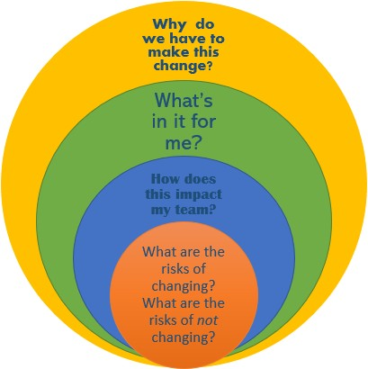
https://medium.com/@jblastland730/the-raci-side-of-communication-plans-8f32bbf61c11
Dr. Chandreie Mukherjee, Management Communication, IIM Visakhapatnam

Slide 24
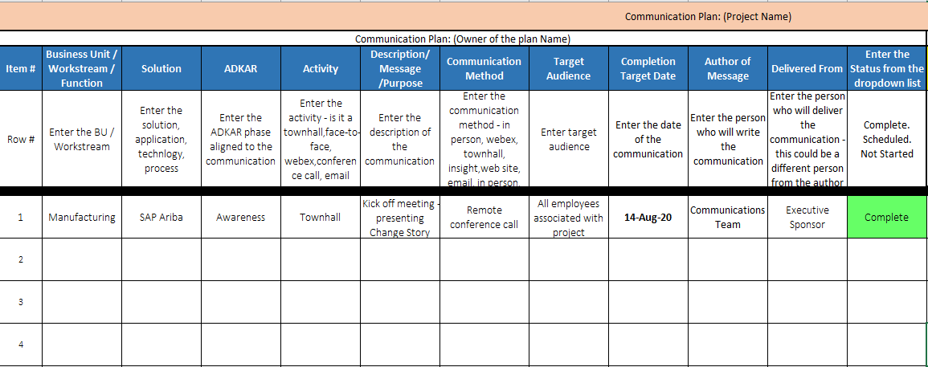
Dr. Chandreie Mukherjee, Management Communication, IIM Visakhapatnam

Slide 25
What Not To Do in Crisis Communication
Blame the media
“Downplay the crimes”
“Defend the tainted”
RACI (responsibility, accountability, consulted, informed)
– RACI MATRIX

