Slide 1
Conversion Tracking on Google Ads

Slide 2
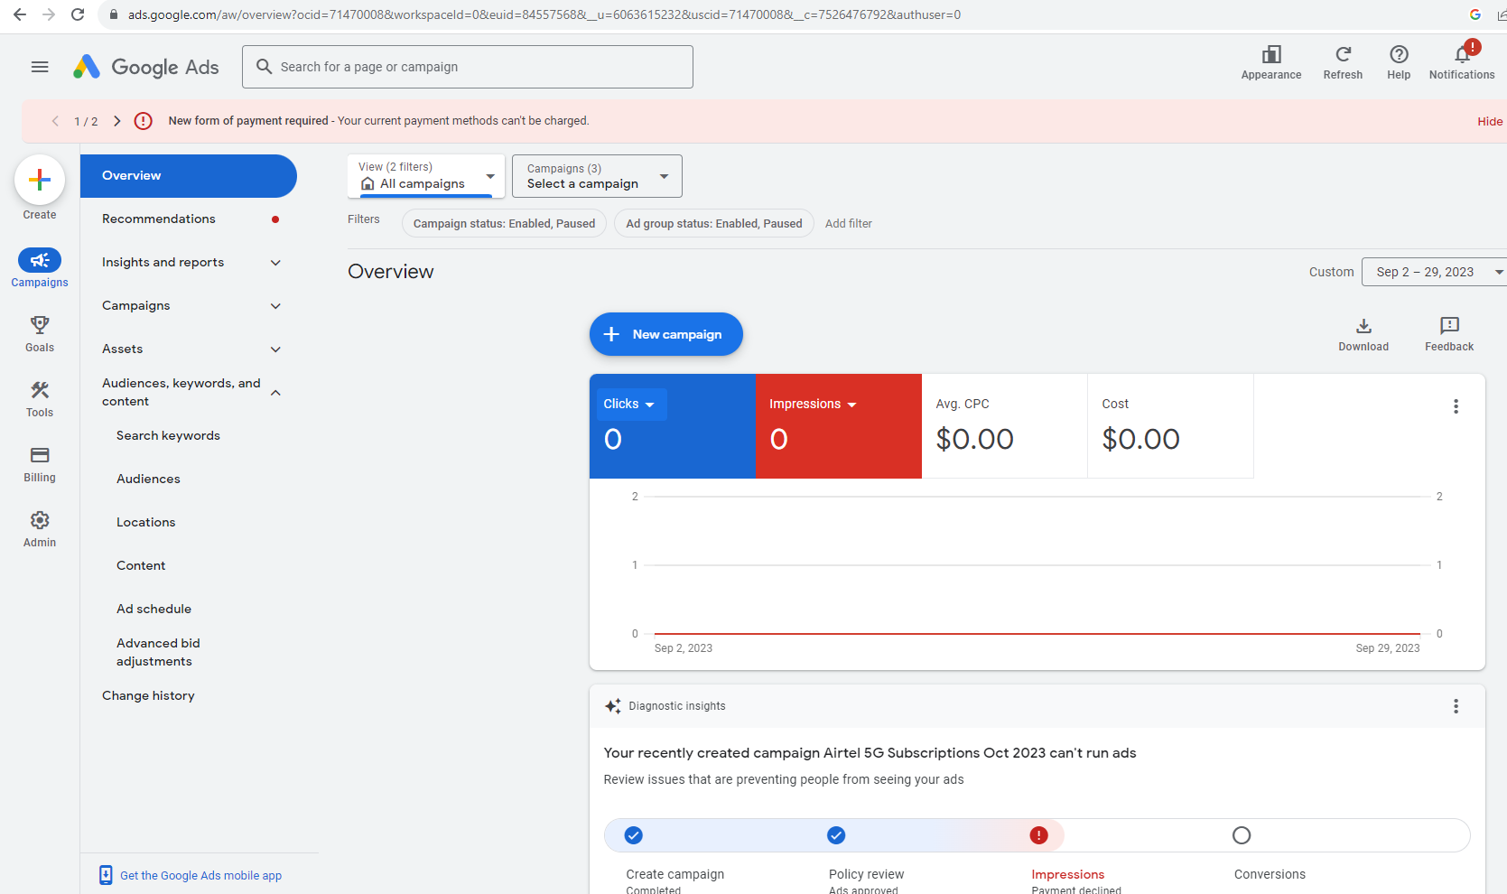
1. Click CREATE
2. Then Click CONVERSION ACTION from the options

Slide 3
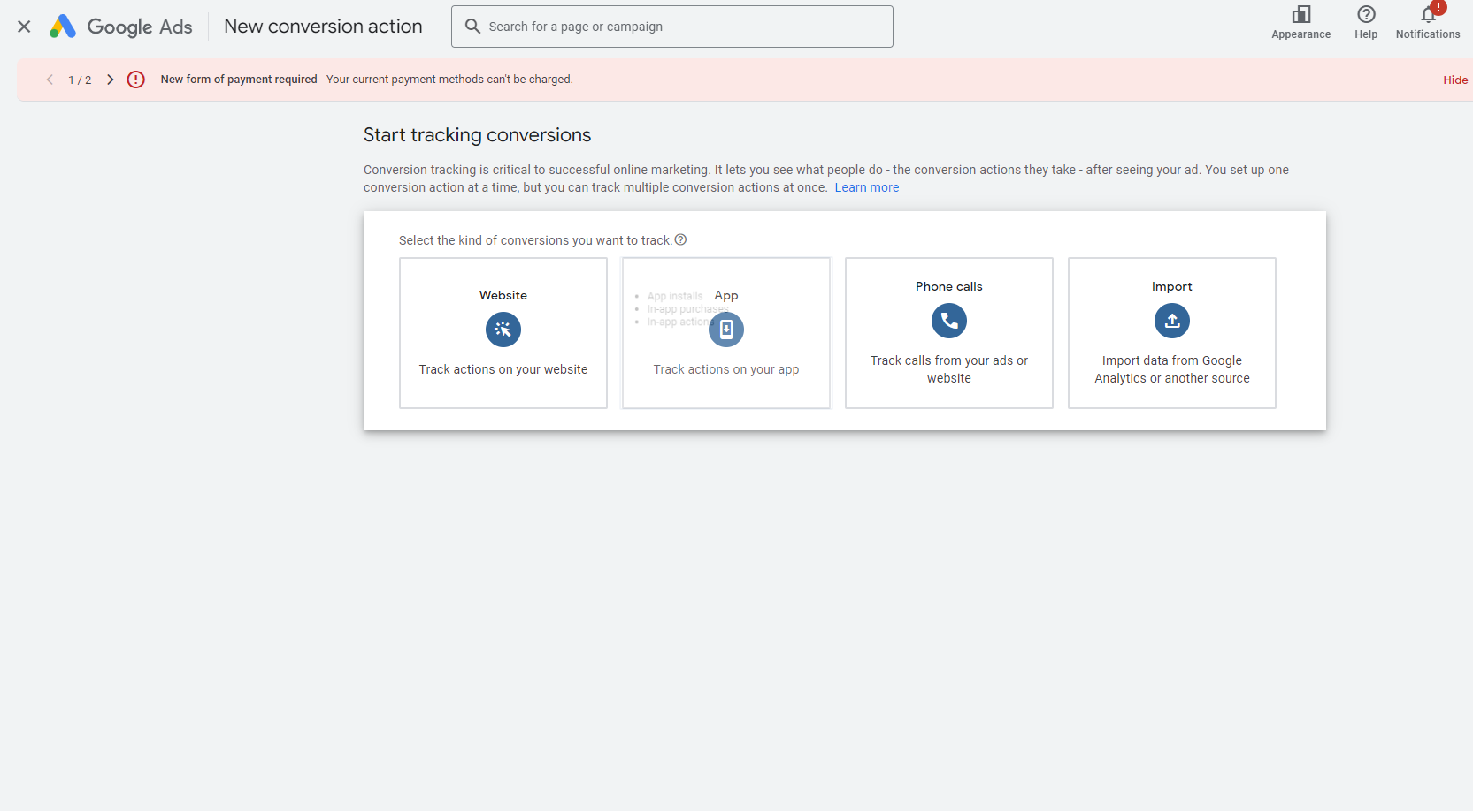
This Page will Open
Now Click HERE, because we are interested in Tracking Conversions on our Website

Slide 4
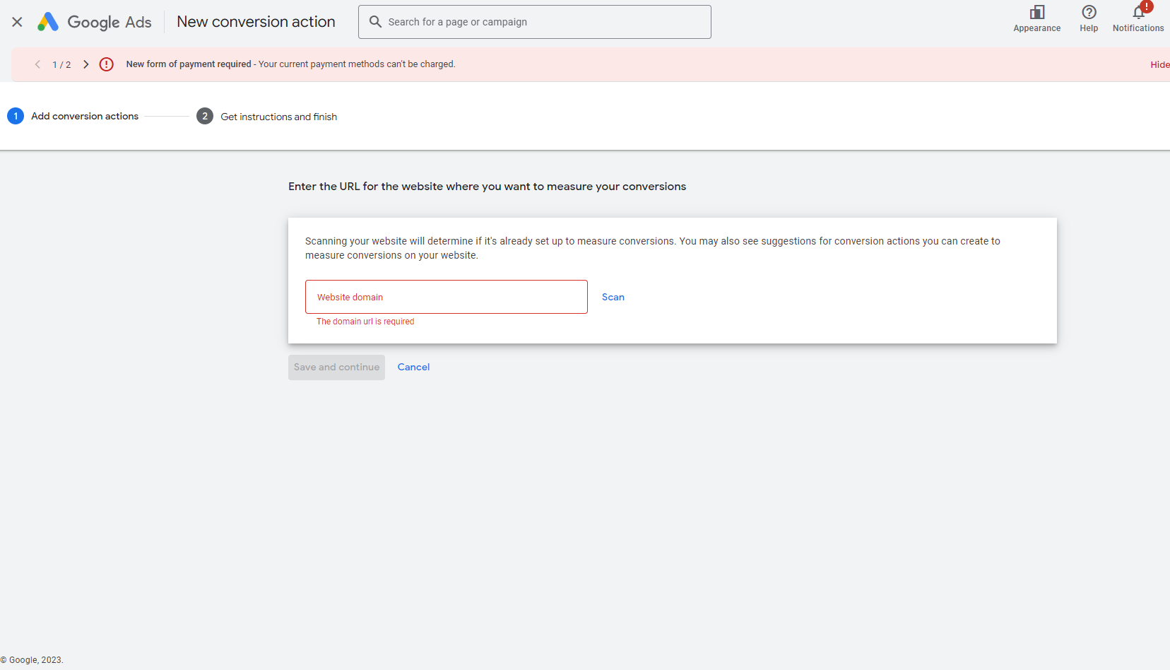
NOW, This Page will Open
1. Now enter your website domain HERE, e.g. www.airtel.in
2. Now click on Scan

Slide 5
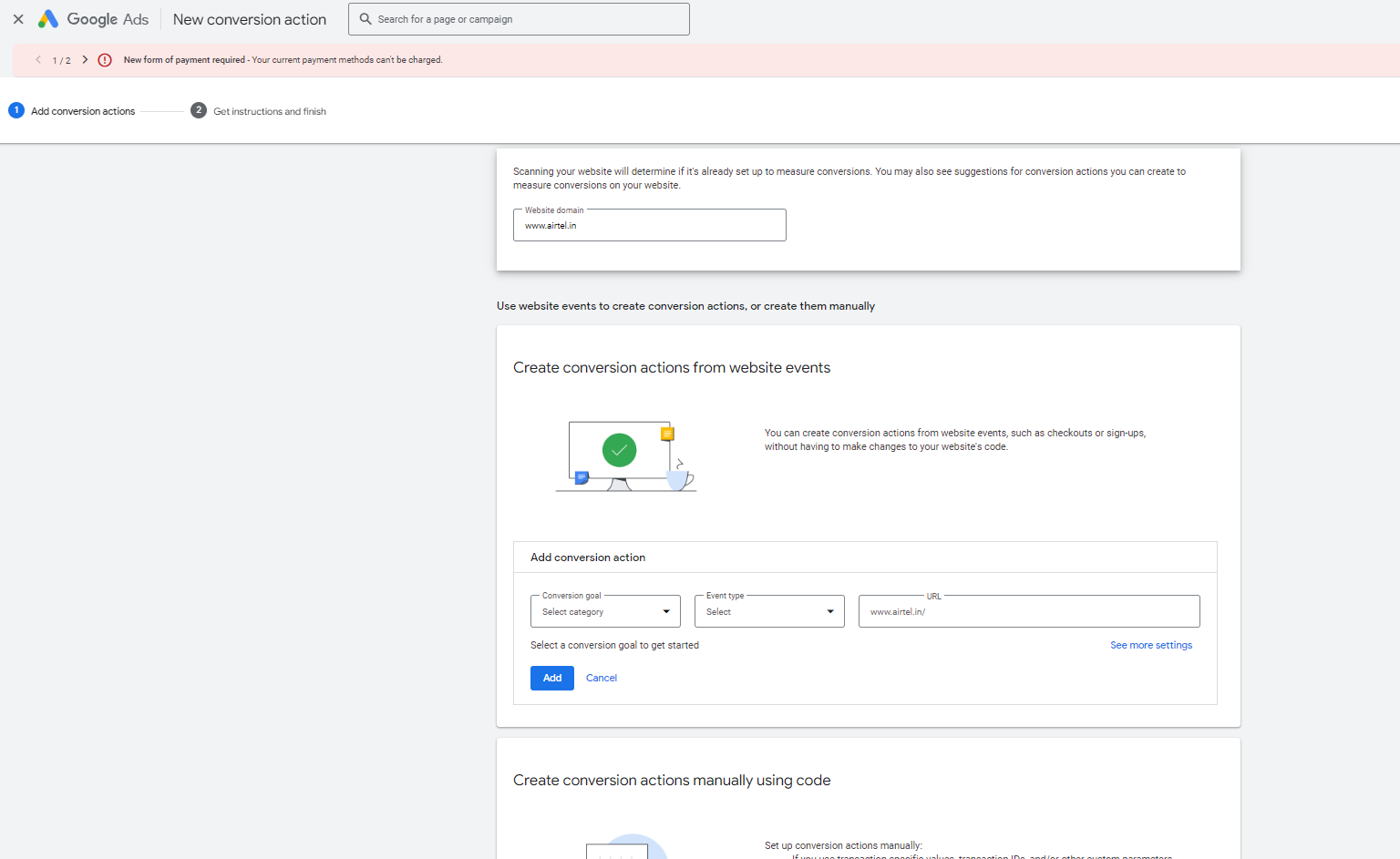
Following PAGE will open
Now click on +Add a conversion action manually button towards the end of this page

Slide 6
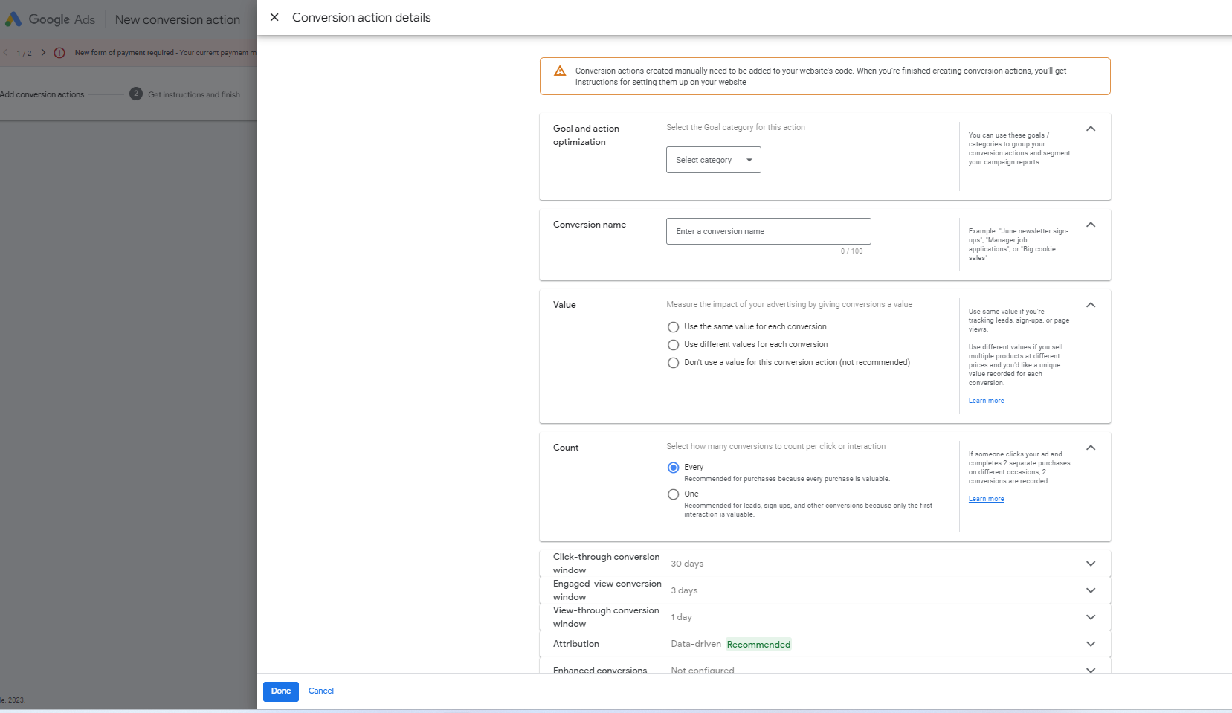
Choose desired category like “Purchase”
NOW, Following Page will Open
1.
Enter Campaign name like “Airtel Prepaid Subscriptions”
2.
Choose this option for Beginners, despite not recommended by Google
3.
For leads/Signups, select ONE, for purchase select EVERY
4.
5.
Then Click DONE

Slide 7
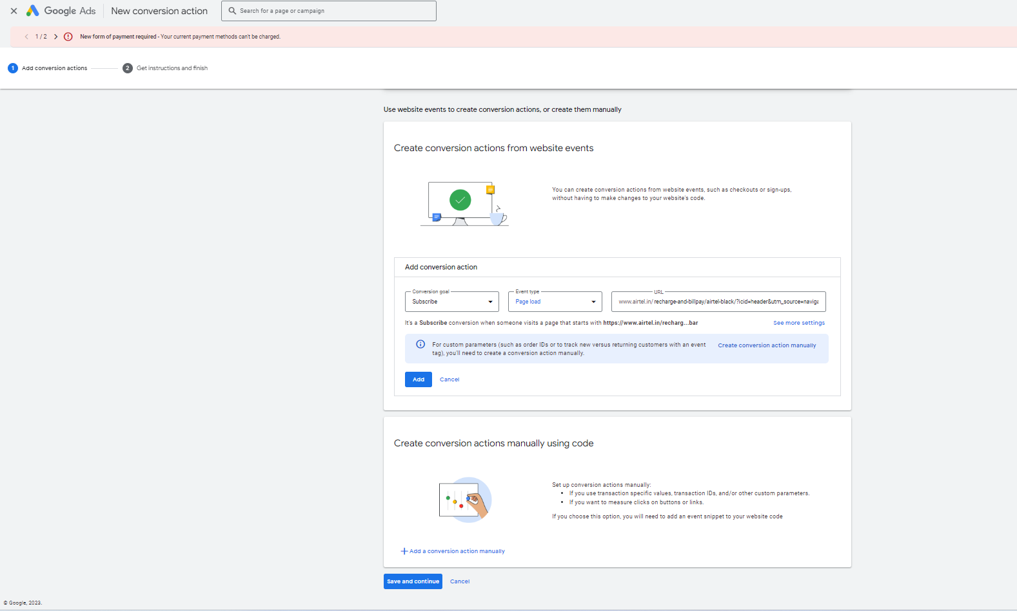
NOW, Following Page will Open
1 Enter following details and click on ADD
2. Now click on
3. Click DONE on next Page

Slide 8
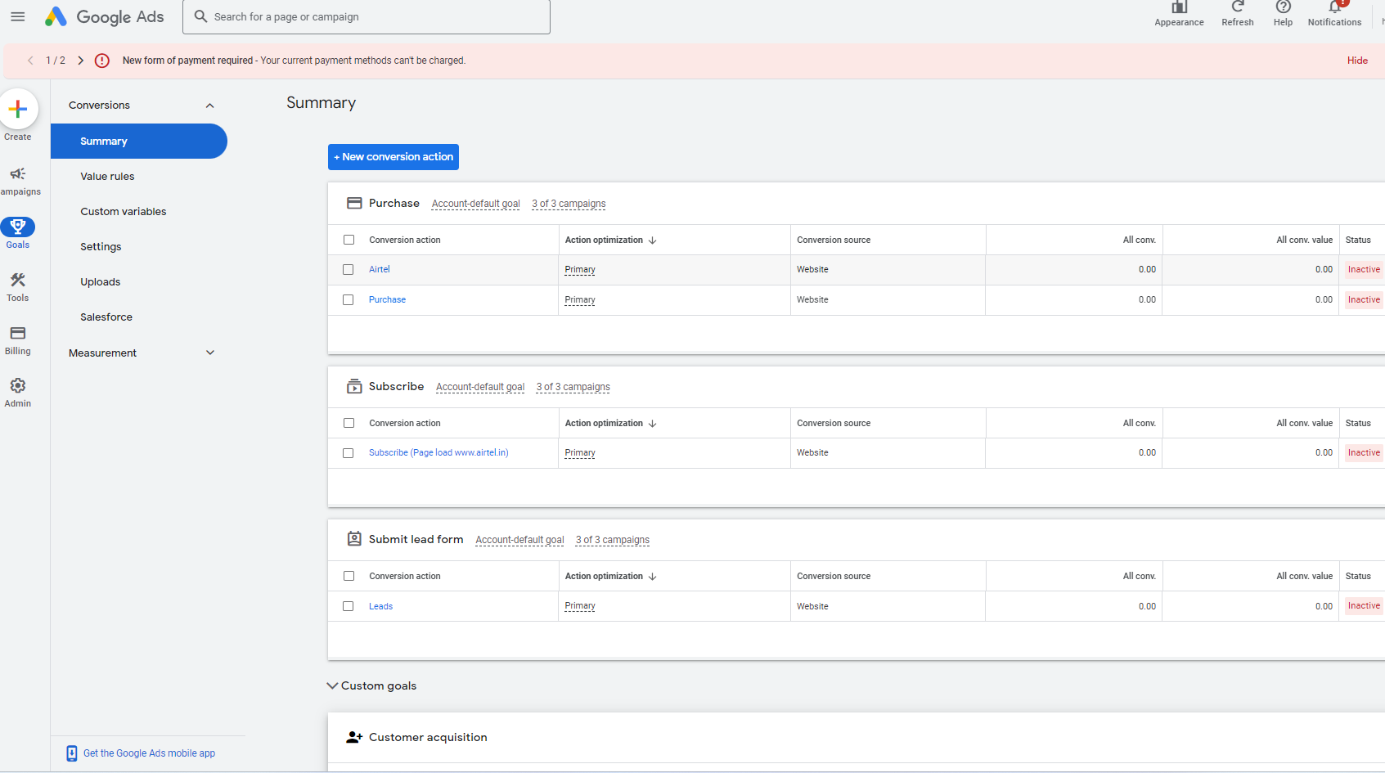
NOW, your Tag is set up

