Slide 1
Intent to Intentless Conversational AI
Dr. Bipul Kumar

Slide 2
Types of AI assistants & platforms
AI assistant type | Uses | Skills you need to build one | Technology Focus | Example Platforms
Conversational AI (sometimes called a chatbot) | Customer service Guided buying experience New employee training | Designing and coding process flows with one or many steps Using conversational state to determine the next step Writing dialogue Classifying utterances into intents Extracting entities from utterances to support the intent Writing code to call external application programming interfaces (APIs) | Conversation and dialogue flow | IBM Watson Assistant Microsoft Azure Bot Service Rasa
Command Interpreter | Natural language or voice interface to devices | Classifying statements into commands Extracting supporting parameters from a command statement Writing code to call external APIs | Classification and calling APIs | Apple Siri Amazon Alexa
Event Classifier | Sorting email into folders Routing messages (such as emails) to an appropriate handler | Classifying messages based on message content and metadata Extracting many entities that support or augment the classification | Classification and entity identification | Google Gmail Natural Language Understanding services

Slide 3
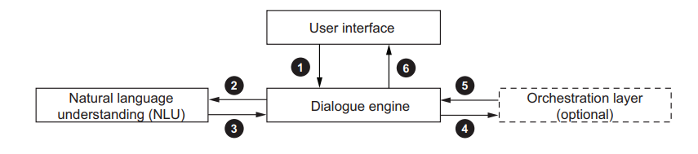
AI architecture & Control flow

Slide 4
Primary components of architecture.
Interface—The way end users interact with the assistant. The interface can be a text or voice interface and is the only part of the AI assistant that is visible to users.
Dialogue engine—Manages dialogue state and coordinates building the assistant’s response to the user.
Natural language understanding (NLU)—This component is invoked by the dialogue engine to extract meaning from a user’s natural language input. The NLU generally extracts an intent as well as information that supports the intent.
Orchestrator—(Optional) Coordinates calls to APIs to drive business processes and provide dynamic response data.

Slide 5
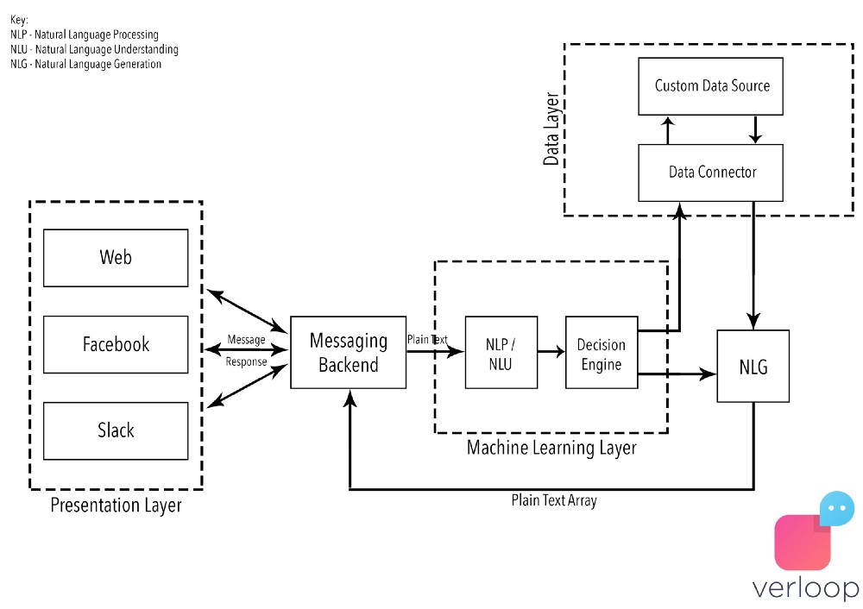

Slide 6
Chatbot Pipeline
Language Model
Tokenizer
Featurizer
Intent Classifier
Entity Extractor
Entity Mapper
Conversation Design (Dialogue)
NLP/NLU
NLG

Slide 7
Conversational AI
Conversational AI is the type of assistant that most frequently comes to mind when you hear the words “AI assistant.” A conversational AI assistant has a conversational interface and services a variety of requests. Those requests may be satisfied in one of these two methods.
simple question-and-answer format or
may require an associated conversational flow.
Let’s take a look at few examples for better understanding.

Slide 8
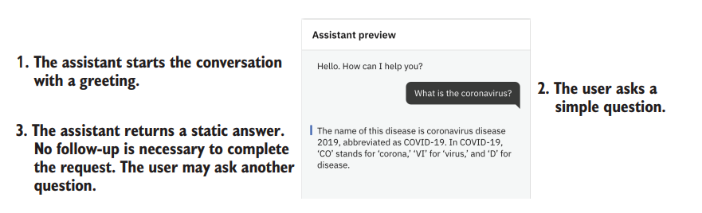
Conversational AI (Simple question & answer)

Slide 9
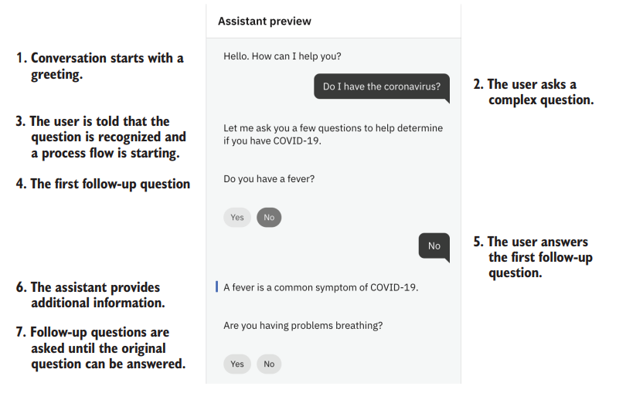
Conversational AI (Requires missing parameters)

Slide 10
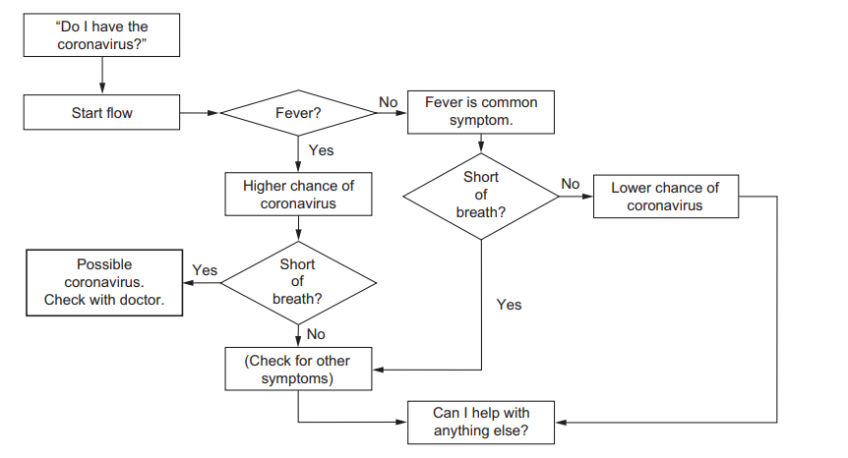
Conversational AI (Requires missing parameters flow)

Slide 11
Command Interpreter
A simpler use of AI assistant technology is the command interpreter pattern.
This pattern is prevalent in smart devices such as phones, remote controls, and appliances.
The command interpreter deals with a limited vocabulary, enough to invoke the commands it supports, and the interaction is finished as soon as the information needed to execute the task is collected.
Examples of command interpreters & supported formats.
Command Interpreter type | Example Commands
Smartphone Voice-powered television remote Smart home controller | “Set an alarm for 9 p.m.” “Call Mom.” “Open Facebook.” “Increase volume.” “Turn to channel 3.” “Turn on the light.” “Set the air temperature to 76 degrees.”

Slide 12
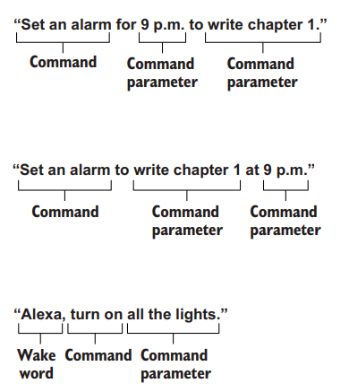
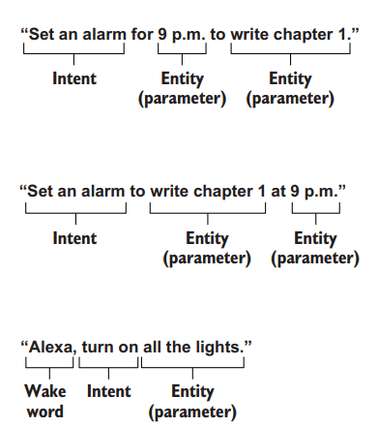
Command Interpreter
Exploring parts of a command. | Alternative technology for command interpreter

Slide 13
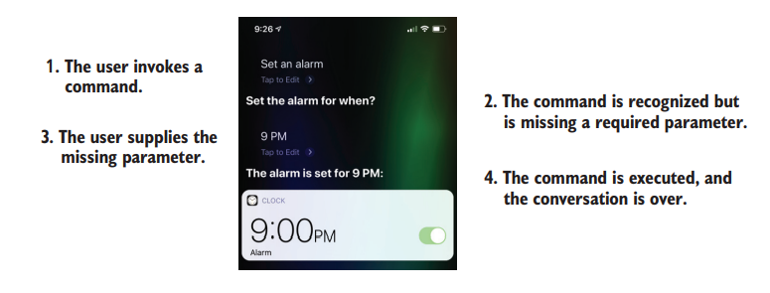
Example of Command Interpreter

Slide 14
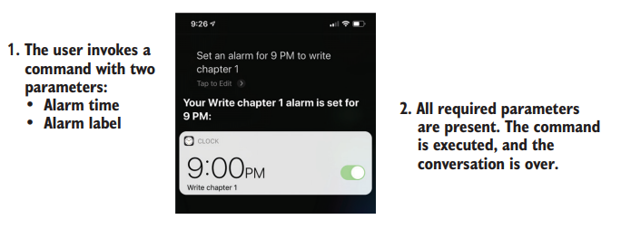
Example of Command Interpreter

Slide 15
Event Classifier.
Event classifiers use a mixture of rules and machine learning techniques to decide how mail should be routed. In Gmail’s case, the classifier decides which inbox to choose.
Gmail offers several ways for the user to personalize or train the classifier through a mix of rules and training options.
When we select an email in the Promotions folder and we’re offered the following training options:
Add sender to contacts
Block sender
Report spam
Report phishing
Filter messages like these

Slide 16
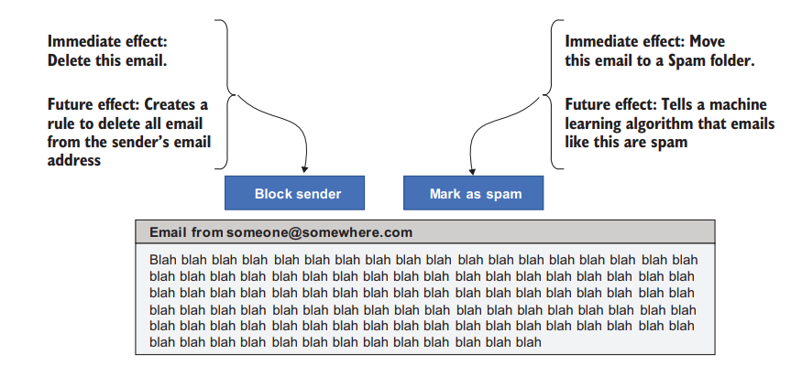
Event Classifier example

Slide 17
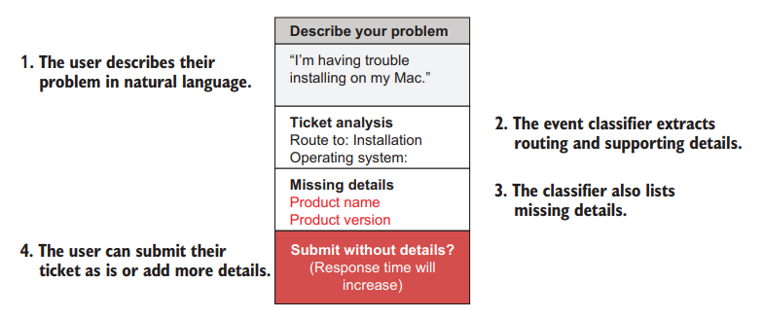
Event Classifier Customer support examples

Slide 18
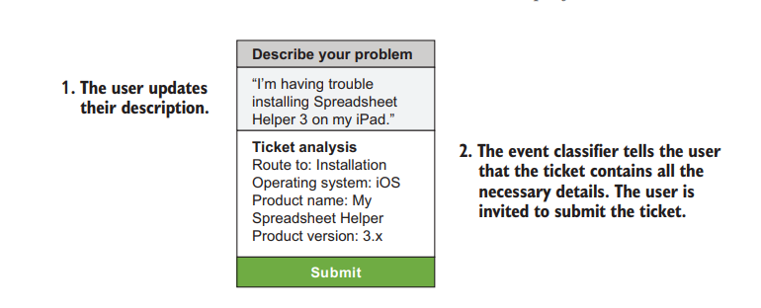
Event Classifier Customer support examples

Slide 19
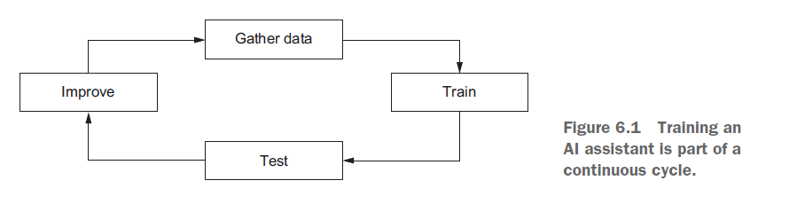
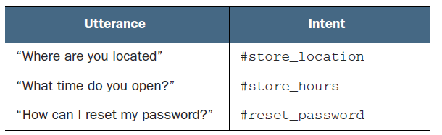
Training Your AI Assistant
An example of training data in conversational AI

Slide 20
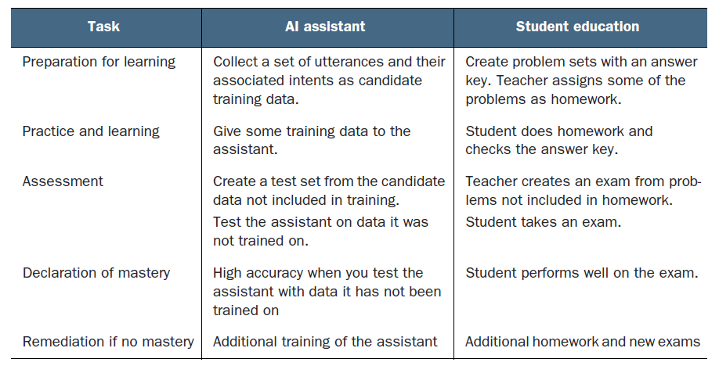
Comparison with student training

Slide 21
Finding Training Data
How can the team find the best possible training data? It ultimately needs to find out three things:
The intents, or categories of questions that users will ask,
the relative frequency, or distribution, of those intents
How those intents are worded
The primary sources include
production logs,
mock user interfaces, and
subject-matter experts (SMEs).

Slide 22
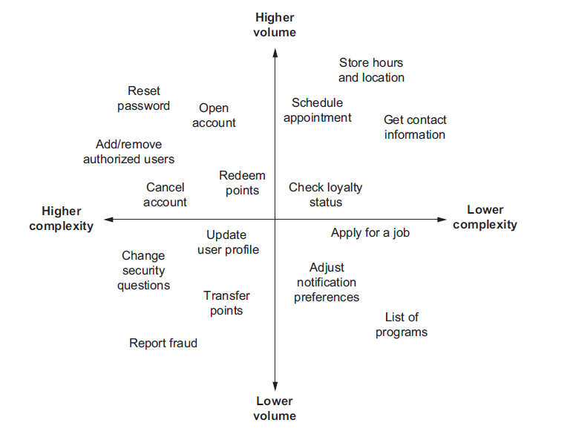
Distribution of intent

Slide 23
Data source 1: Production Logs
Data Source | Good for | Reason | Caveat
Human-to-human chat logs | Conversational AI | Will closely mirror utterances sent to an automated text chat conversational AI | Will need adaptation for voice assistants; the intents will match but not the wording.
Human-to-human call transcripts | Conversational AI | Will closely mirror the distribution of intents received by a conversational assistant | People speak differently to other humans compared with how they talk to machines.
Search logs | Conversational AI | Will closely mirror the distribution of intents received by a conversational AI | Search queries tend to be much shorter than conversational utterances.
Emails | Event classifiers Conversational AI | An email classifier should be trained on real email. | An email is longer than a conversational utterance. But the subject line or first sentence can be close to a conversational utterance.
Customer relationship management (CRM) event records | Any | Will closely mirror the distribution of intents | Will not provide any insight into how these intents are phrased by customers

Slide 24
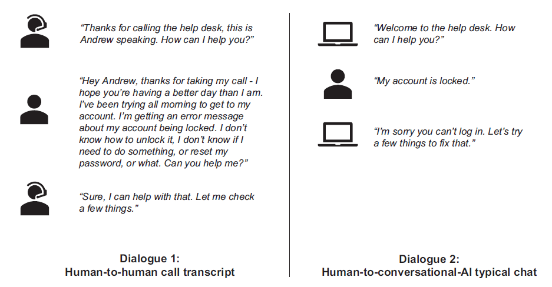
An Example

Slide 25
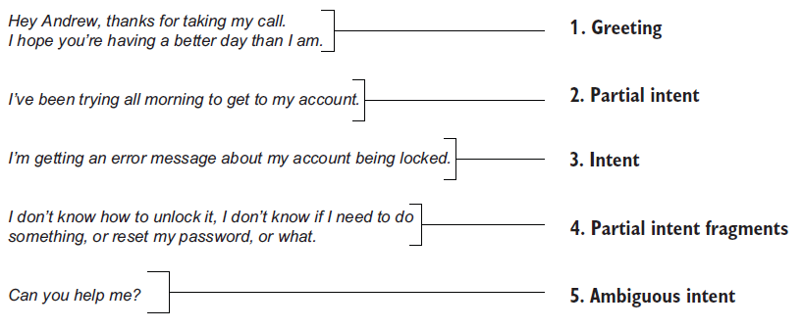
Example continued
Breaking down the 63 word opening from Human to human

Slide 26
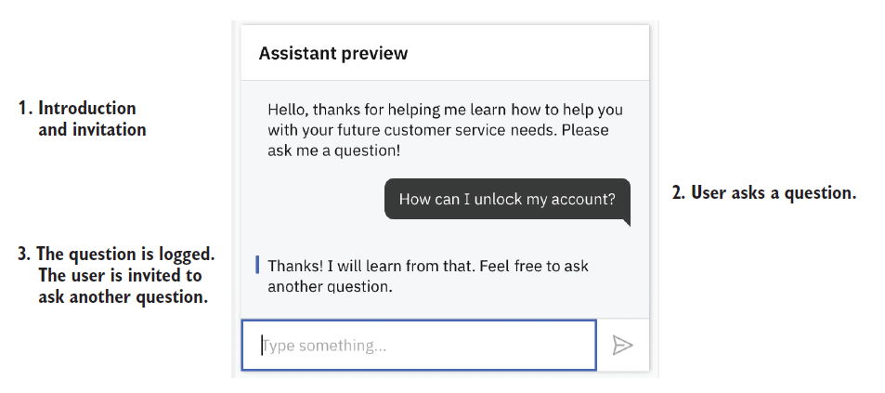
Data Source 2: Mock User Interface; Asking users to do the work

Slide 27
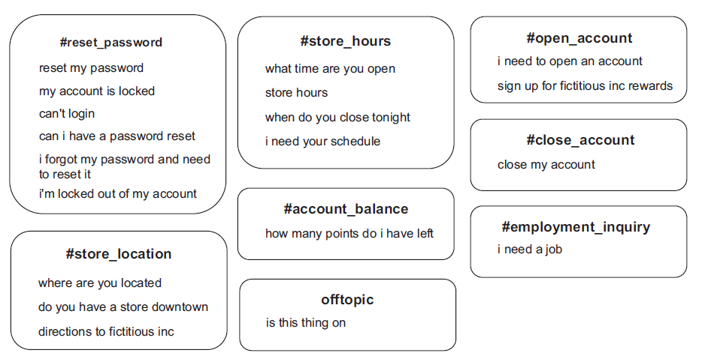
Data Source 3: Subject Matter Experts
Organising data into intent

Slide 28
Assessing if you have the right training data.
Training data must meet three criteria to produce optimum results, and I refer to these criteria as the three Vs:
Variety
Volume
Veracity

Slide 29
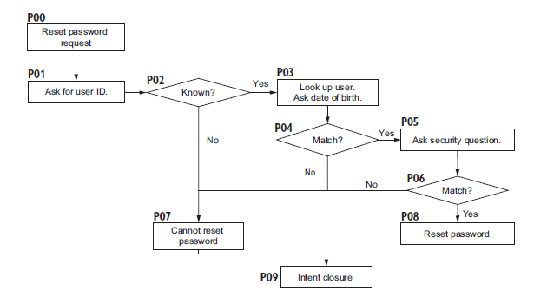
Testing a Functional Dialogue flow
Flowchart verifying a reset password conversational flow

Slide 30
Continued..
There are four paths through the reset password flowchart.
Happy path—The user’s password is reset (P00, P01, P02, P03, P04, P05, P06, P08, and P09).
Unhappy path—Security question incorrect (P00, P01, P02, P03, P04, P05, P06, P07, and P09).
Unhappy path—User date of birth is incorrect (P00, P01, P02, P03, P04, P07, and P09).
Unhappy path—The user ID is unknown (P00, P01, P02, P07, and P09).

Slide 31
NLG
What happens when computer write language
Structured data into text.

Slide 32
NLG
1 Narrative design
also called conversation design
Conversation driven development
rules known as “conditional logic” or response classification
outputs based on which conditions are being met and which are not.

Slide 33
NLG
Narrative Design
Slot filling: memorizing the entities
Fallback design: utterance is ambiguous ?
Checkpoints: make stories modular

Slide 34
NLG
1 Dynamic design
Algorithm based
Sequential models
RNN, LSTM, Transformers LLMs

Slide 35
NLG
LLM reference

Slide 36
Frameworks
Rasa: https://rasa.com/docs/
IBM watson: watson assistant
Google: Dialogflow
Microsoft : wit.ai

