Slide 1
CI/CD
Presented by: Rajdip Sengupta 13/04/2024

Slide 2
Agenda
01. The origin of CI/CD
02. What is Continuous Integration?
03. What is Continuous Delivery?
04. Pipelines
05. Feature Flags
06. Canary Releases and A/B Testing
07. Q&A

Slide 3
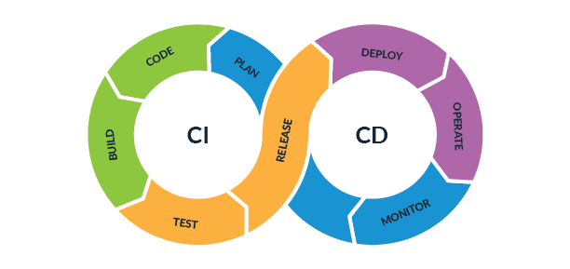
The Origin of CI/CD
CI stands for Continuous Integration
CD stands for Continuous Delivery (Deployment)
First proposed in 1991, It's the practice of regularly merging all developers' working codebases with the main branch, potentially multiple times per day.
Even though CI/CD was proposed much earlier than Agile practices, it started gaining popularity along with Agile. The objective of the CI/CD approach Is to enable teams to release a constant flow of software updates into production to quicken release cycles, lower costs, and reduce the risks associated with development.

Slide 4
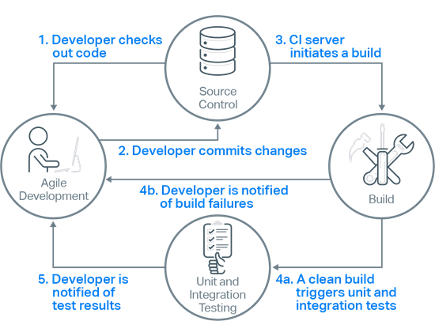
Continuous Integration
Developers check out code into their private workspaces. They then make their changes and test them locally.
When done, developers check in their changes into the source control repository.
The CI server monitors the source control repository and when it detects a change it triggers a build of the relevant sources.
After a successful build, the CI server performs some or all the following activities:
  Makes deployable artefacts available for testing
  Assigns a build label to the version of the code that was just built
  Notifies the relevant team members that a successful build occurred
  triggers unit and integration testing

Slide 5
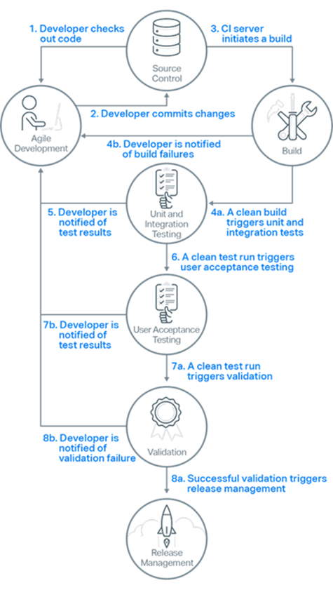
Continuous Delivery
Post successful Build generation after unit testing, the delivery cycle begins.
After the unit and integration testing has completed successfully, the CI server triggers the running of more comprehensive, automated acceptance tests.
If the acceptance tests all pass, a decision is made whether or not to release. If the acceptance tests result in failures, the CI server sends notifications to the relevant developers who restart the process from step 1 to make the changes necessary to resolve the test failures.
If the validation decision is to release, release management is triggered. This results in the built package being released or deployed to the appropriate environment. If the validation decision is not to release, the relevant team members are notified, and development work continues as normal.

Slide 6
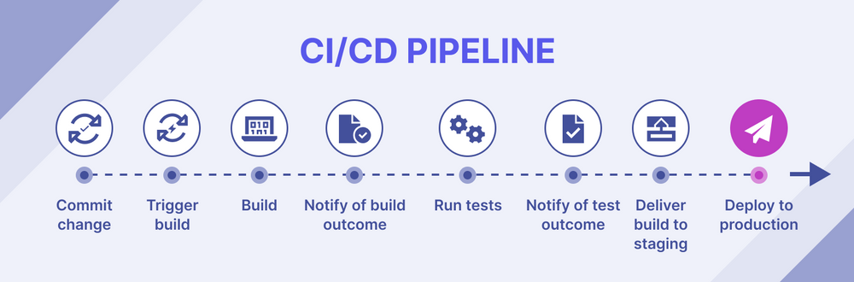
What is a Pipeline?
1

Slide 7
What is a Pipeline?
2
1

Slide 8
What is a Pipeline?
3
2
1

Slide 9
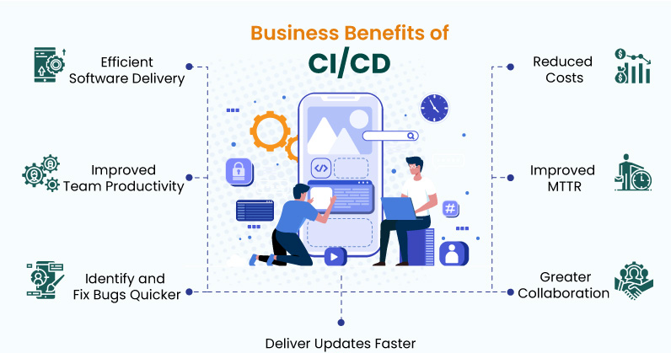
Advantages of CI/CD

Slide 10

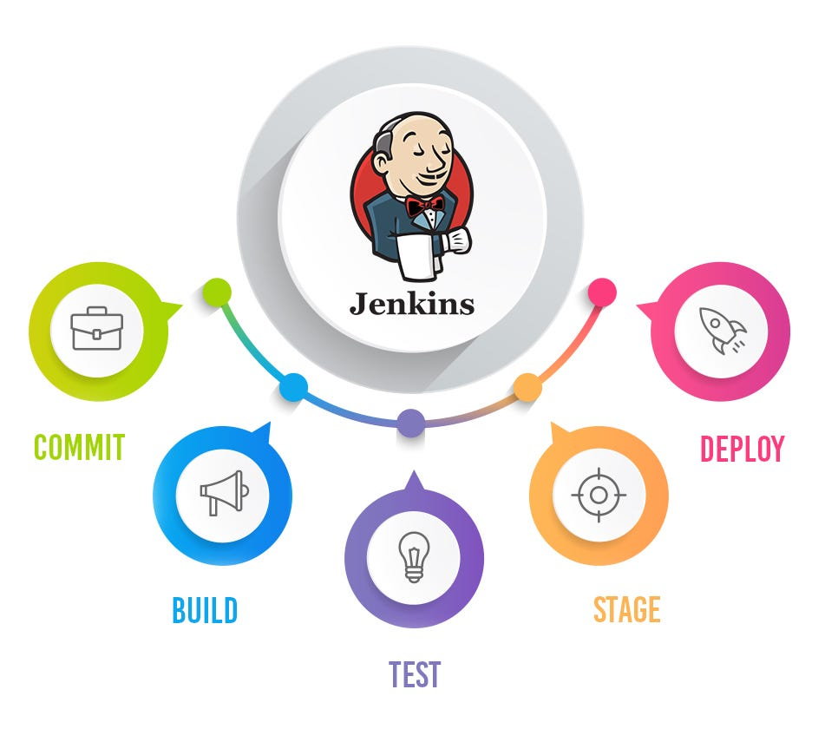
Tools for CI/CD

Slide 11
Testing Types and Environment
Development Environment
Unit Testing : A set of test cases that are used to validate whether the developed feature works as per expectation or not
QA Environment
Regression Testing : A set of more comprehensive test cases to make sure the feature works as per expectation and has no impact on any other existing module
Integration Testing : A set of test cases to make sure that all existing modules of the product work as per expectation
Preprod Environment
User Acceptance Testing : Validation done by the users to test if the feature works as per expectation
Performance validation Testing : Validation done on all modules to check if the performance of the product meets user expectations

Slide 12

Feature Flags and Canary Deployment

Slide 13
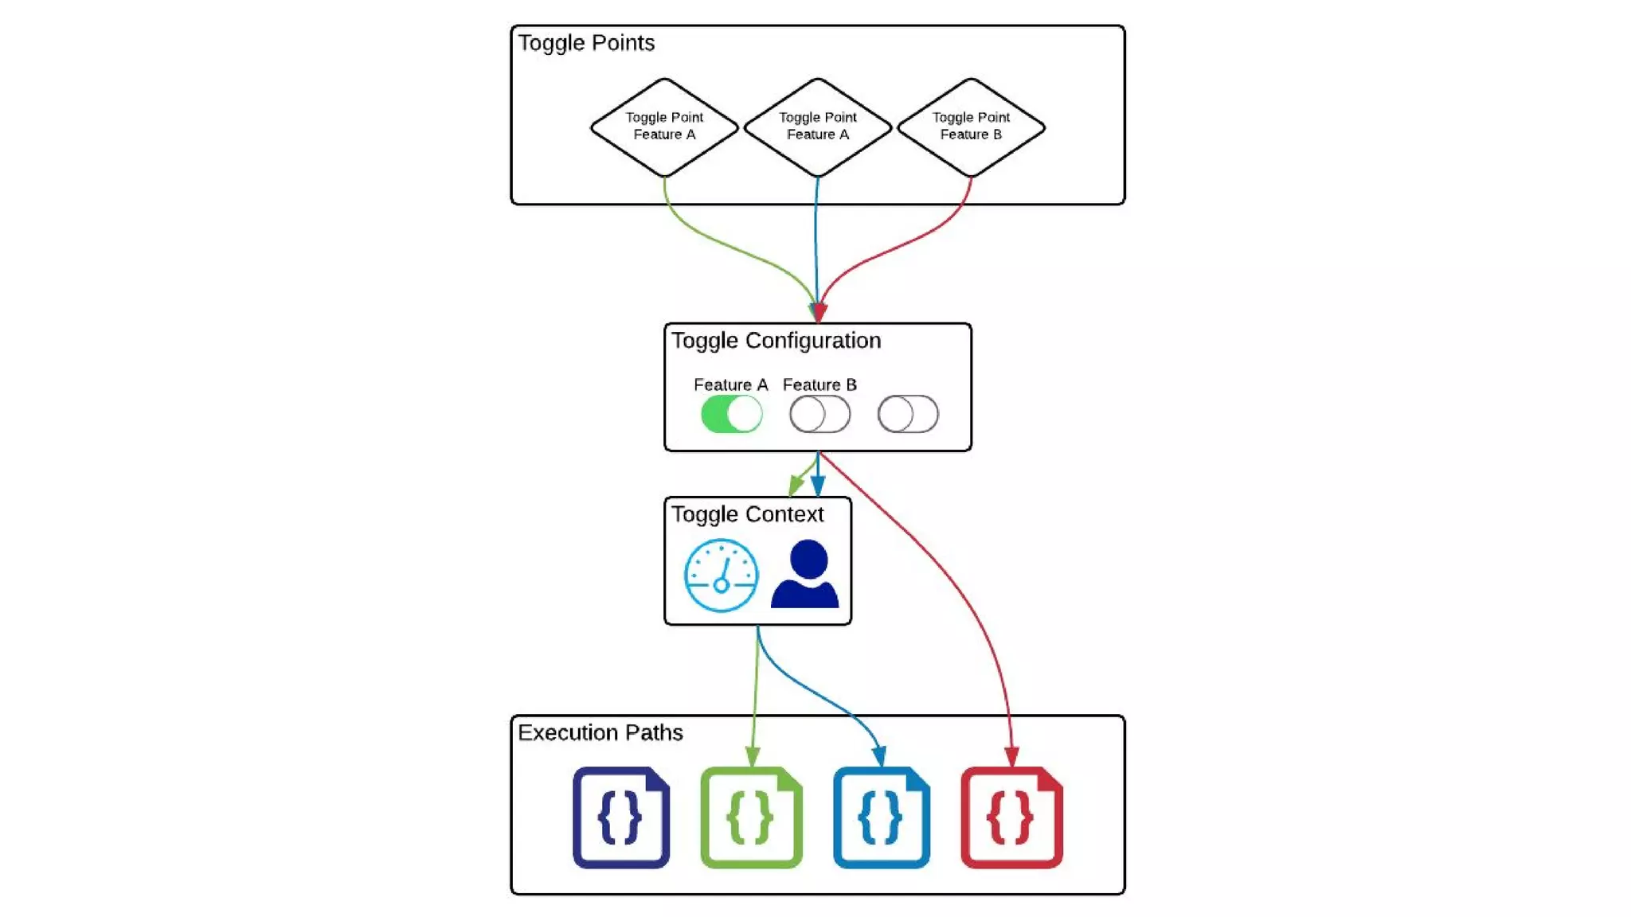
Feature Flags
Feature flagging is a multi-purpose technique for easily turning features on and off.
In theory a Feature flag or a toggle point is a simple conditional code snippet:
If Featureflag – True
ExecuteNewFeature()
Else
ExecuteOldFeature()
CI/CD 13/04/2024

Slide 14
Why do we need Feature Flags?
Usecase 1
Continuous Integration and Continuous Delivery of incomplete features
Usecase 2
Gradual Release – Internal testing, Canary releases
Usecase 3
Timed Releases , Due to Business or legal obligations
Usecase 4
A/B testing and other experiments
Usecase 5
Circuit breakers for high-risk feature launches

Slide 15
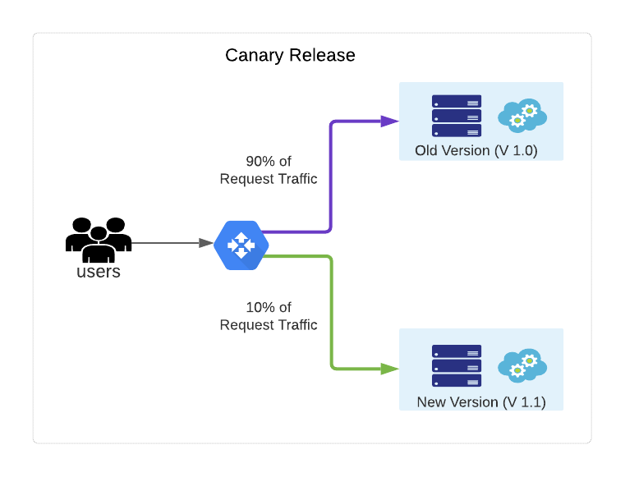
Canary Release Technique
A canary release is a deployment strategy whereby changes are initially released to a small subset of users.
The system is then carefully monitored for signs of trouble, using both business KPIs and operational metrics. Once we are confident that your changes have not adversely impacted functionality, performance or security, we can roll out the changes to remaining users either in further increments or all at once.

Slide 16
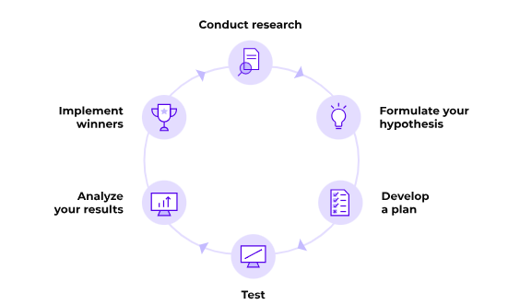
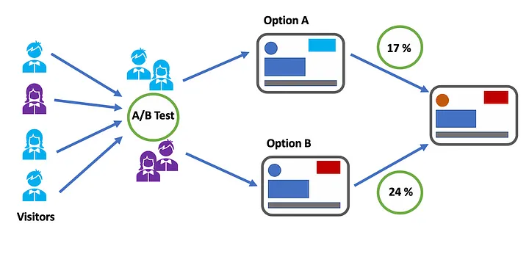
A/B Testing
A/B testing (also known as split testing or bucket testing) is a methodology for comparing two versions of a webpage or app against each other to determine which one performs better.

Slide 17
Q&A

Slide 18

Thank you
Thanks to your commitment and participation throughout the session
For any queries feel free to write to me at:
Email ID:
Rajdip.sengupta17@iimranchi.ac.in
CI/CD 13/04/2024

