Slide 1

Conflict and Project Life Cycle

Slide 2
Introduction
Nearly 2/3 of U.S. workers have experienced incivility at work (SHRM, 2024). Workers who rate their workplace as “Uncivil” are 3x more likely to be unsatisfied with their job and 2x as likely to leave their job in the next year (SHRM, 2024).
1/3 of U.S. workers believe that workplace conflict will increase over the next 12 months (SHRM, 2024). This perception may stem from underlying tensions and unresolved issues within workplaces, indicating potential triggers for future conflict.
The total annual cost of conflict to employers (including management and resolution) is £28.5 billion. This represents an average of just over £1,000 for every employee in the UK annually, and just under £3,000 annually for each individual involved in conflict (Acas, 2021).
An average of 485,800 employees resign each year due to conflict, costing £14.9 billion annually, including £2.6 billion in recruitment and £12.2 billion in lost output as new employees get up to speed (Acas, 2021). Presenteeism related to stress, anxiety, and/or depression has an estimated annual cost between £590 million and £2.3 billion (Acas, 2021).
Managers spend up to 40% of their time dealing with interpersonal problems stemming from poor behavior and misunderstanding (Mettl, 2018)

Slide 3

Contd..
What is Conflict?
It is any disagreement, friction, or clash between individuals or groups within a work environment.
It is a situation where people have differing opinions, goals, or needs to create tension or disruption.

Slide 4
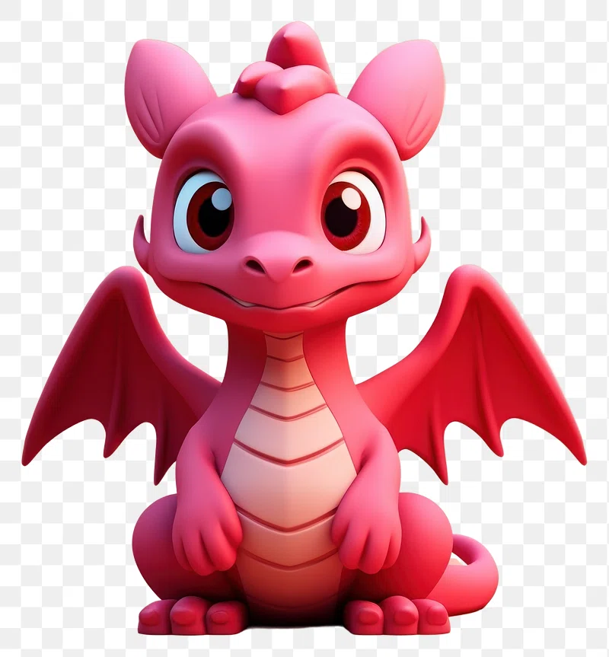
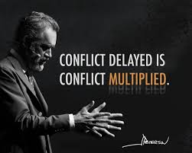

Slide 5
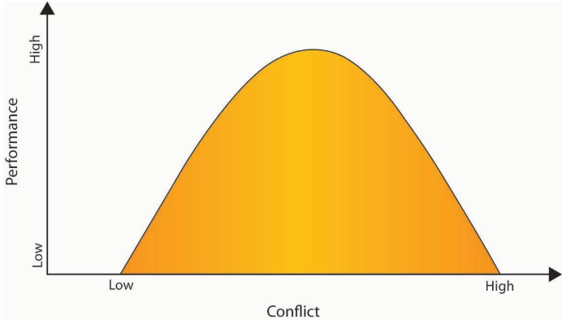
Is Conflict Always Bad?
The Inverted U Relationship Between Performance and Conflict
Source: (Amason, 1996)

Slide 6

Root Causes
Indecisiveness
Communication Gap
Frustration
Unclear Objectives
Lack of Understanding
Clash of Egos
Lack of Trust & Collaborative Environment

Slide 7
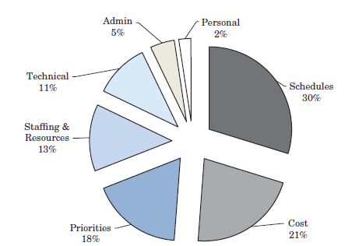
Sources of conflict perceived by Project Managers

Slide 8
Contd..
Conflict over schedules. Disagreements may develop around the
timing, sequencing, and scheduling of project-related tasks.
Conflict over cost. Frequently, conflict may develop between support areas and project integrators over cost estimates. Another common source of conflict is cost escalation over the project life cycle due to a variety of issues that have their root cause in other areas, such as shifting priorities, technical difficulties, and scope changes.
Conflict over project priorities. The views of project participants often differ over the sequence of activities and tasks that should be undertaken to achieve successful project completion. Conflict over priorities may occur not only between the project team and other support groups but also within the project team itself.

Slide 9
Contd..
Conflict over staffing and resources. Conflicts may arise over the staffing of the project team with personnel from other functional and support areas or from the desire to use another department ’s personnel for project support, even though the personnel remain under the authority of their functional superiors.
Conflict over technical issues. Especially in technology-based organizations, disagreements may arise over technical issues related to performance-cost tradeoffs, specifications, quality, reliability, and broad issues of optimizing results.

Slide 10
Contd..
Conflict over administrative procedures. Managerial and administration- oriented conflicts may develop over how the project will be managed, including defining project managers ’ reporting relationships and responsibilities, interfaces, project scope, operational requirements, plan of execution, negotiated work agreements with other groups, and procedures for administrative support.
Personality conflict. Disagreements may originate from differences in personality, culture, or attitude. Personality conflicts are often very subtle, not always visible to the outsider. While the frequency of these types of conflict is relatively low, the impact on team performance and overall project success can be significant.

Slide 11
Categories of Conflict
1. Groups working on the project may have different goals and expectations.
2. There is significant uncertainty about who has the authority to make decisions.
3. There are interpersonal conflicts between the stakeholders in the project.

Slide 12
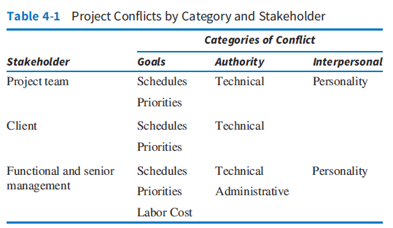
Project Conflicts by Category and Stakeholder

Slide 13
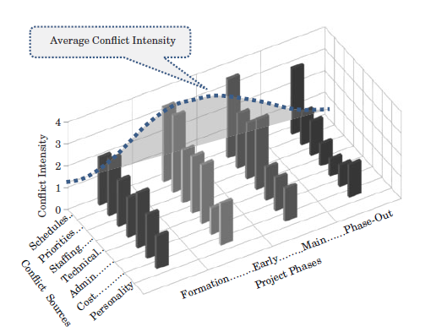
CONFLICT IN THE PROJECT LIFE CYCLE
Conflict during Project Formation
How will the project organization be structured?
To whom will the project manager report?
What is the authority of the project manager?
Does the project manager have control over the workforce and material resources?
What reporting and communication channels will be used?
Who establishes schedules, performance specifications, and review criteria?

Slide 14
Technical Objectives must be set
Senior Management and Line Managers must commit to the project
Organization Structure
Priority of the project

Slide 15
Conflict and Project Life Cycle
Project Startup and Early Buildup Phase
Disagreements over project schedules and priorities continue as important determinants of conflict, followed by staffing, technical, and administrative problems.
Conflict over technical issues becomes more pronounced and intensive during project build-up. Most technical conflict occurs among functional support groups over system/component interfaces.
Typically, conflict occurs when the project manager needs to change some specifications or part of the configuration in response to essential changes in the market or customer community. At the same time, the technology groups find it impossible to accommodate the change requirements without increasing budgets and/or delivery dates.
Personality conflicts start flaring up during project buildup.

Slide 16


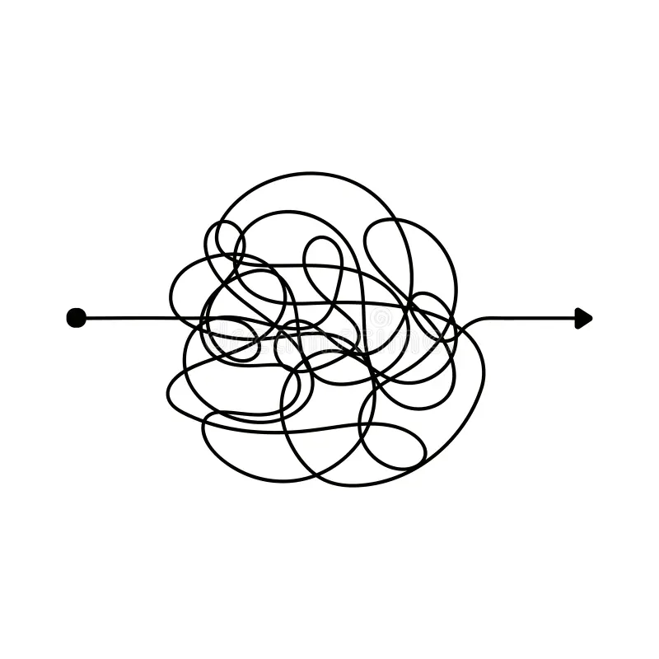

Conflict and Project Life Cycle
Main Project Phase
Schedules are a major Source
Tasks will be late, and the schedules will be adjusted, or the time will be made up
The more complex the project, the more difficult it is to trace source of conflict
Technical Conflicts

Slide 17



Conflict and Project Life Cycle
Project Phase-Out
Deadlines are biggest Source
Technical conflicts are rare
Personality conflicts will be a great deal due to time pressure

Slide 18
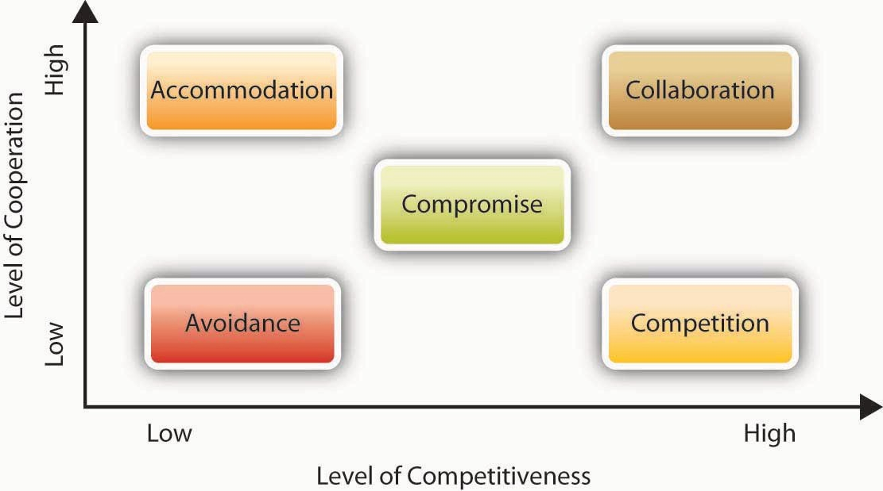
Conflict-Handling Styles

Slide 19



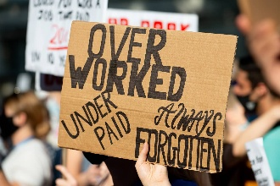
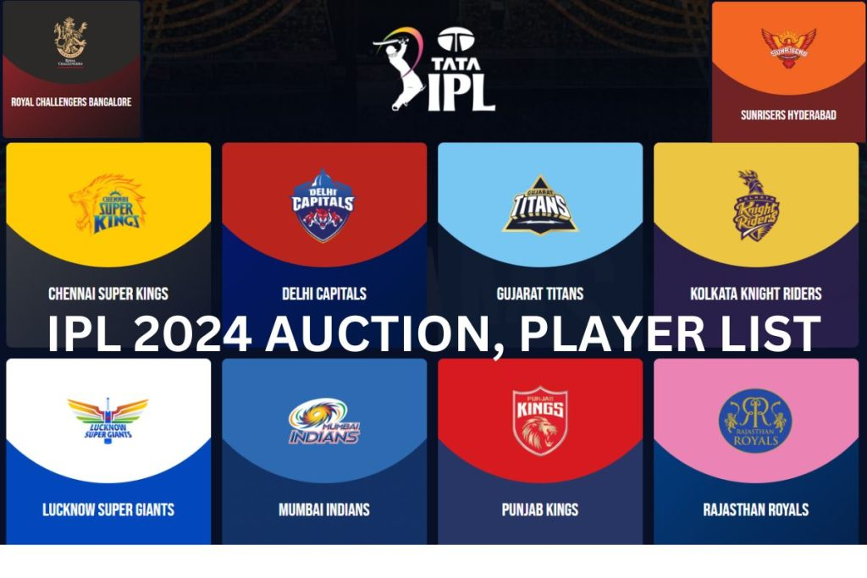

Negotiation

Slide 20

It is a requirement of all conflicting parties to seek solutions to the conflict that not only satisfy their own individual needs but also satisfy the needs of other parties to the conflict, as well as the needs of the parent organization.
Negotiating a win-win solution is the key to conflict resolution in project management.

Slide 21
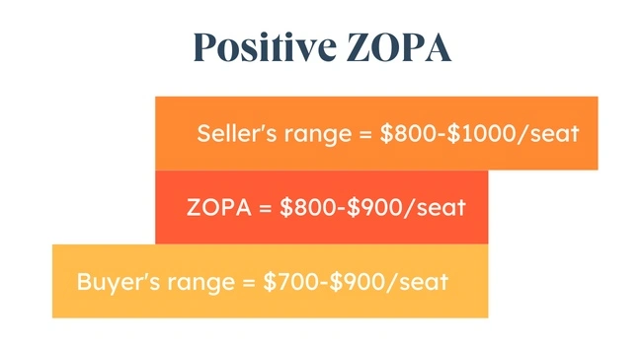
Zone of Possible Agreement

Slide 22
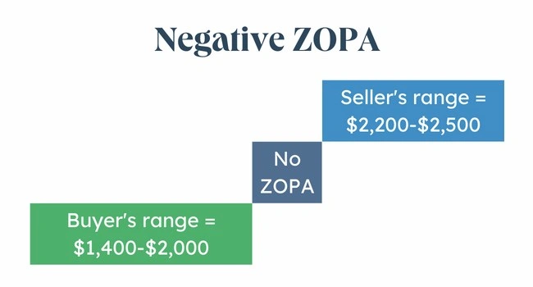
Zone of Possible Agreement

Slide 23
Shark Tank
https://youtu.be/dKSrVSXvm4Y

Slide 24
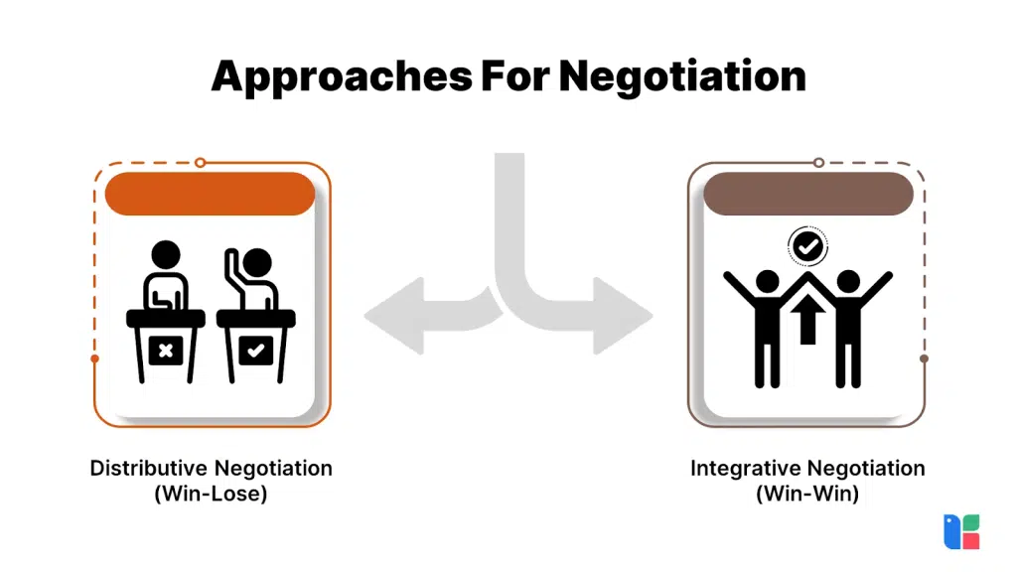
Negotiation Strategies
Feature | Distributive Negotiation | Integrative Negotiation
Goal | Maximize individual gain | Create mutual gains
Resource | Fixed, limited | Expansive, potential for expansion
Relationship | Can be adversarial, potentially damaging long-term relationships | Collaborative, fosters trust and future collaboration
Communication | Competitive, often withholding information | Open, information sharing, focusing on interests
Focus | Positions and demands | Interests and needs
Outcome | Often a zero-sum (one party wins, one loses) | Often a win-win (all parties benefit)

Slide 25



There are “Traps” too
Mythical fixed pie of negotiation
Solution: Asses yourself Are you striving to be right or to win instead try to achieve the outcome that will meet your needs
Egocentrism: Blaming the parties as the opponent party is responsible for the climate change
Solution: Imagine how an unbiased observer would view your negotiation and probe your counterpart's perspective by asking many questions.
Overestimating your value: Tend to demand more to sell a commodity than the buyer would pay.
Solution: Seeking Objective Value Assessment from an unbiased party

Slide 26

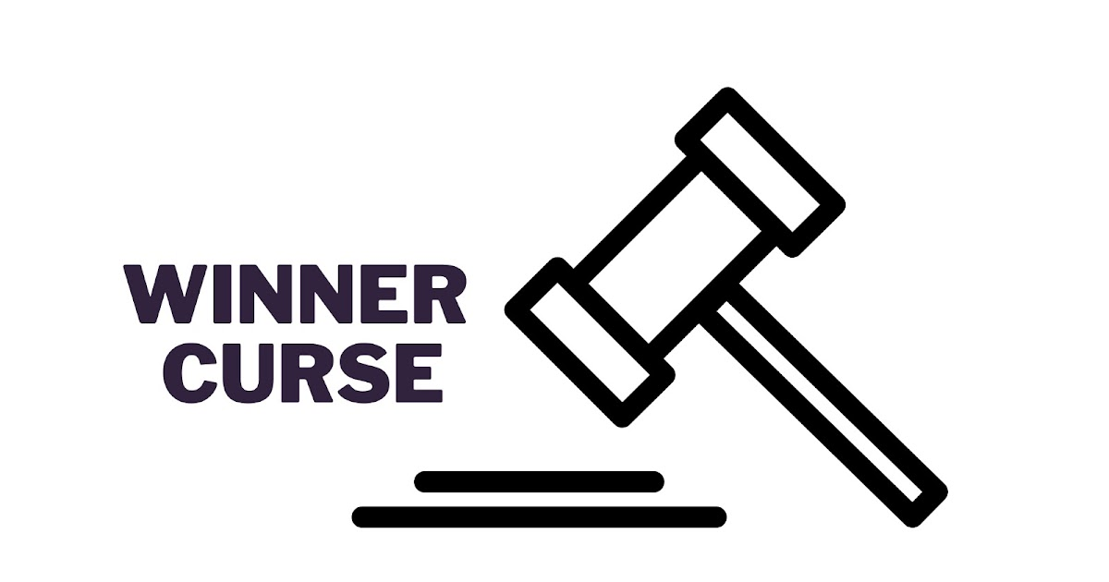

Contd..
Vividness bias is the tendency to overweight the vivid and prestigious attributes of a decision, such as salary or an employer's status.
Solution: Assign numeric weights ahead of time.
The high bidder typically overpays and ends up becoming a victim of the Winner’s Curse.
Solution: Set your walkaway bid beforehand.
Escalation of Conflict: Tendency to commit to an initial course of action even in the face of mounting losses.
Solution: Understand the motive of an opponent.

Slide 27
Fisher et al. (1983)..
Separate the people from the problem.
Focus on interests, not positions.
Before trying to reach an agreement, invent options for mutual gain.
Insist on using objective criteria.

Slide 28
Adding Complexity: Beyond Two Parties

Slide 29

When All Else Fails: Third-Party Negotiations
Alternative Dispute Resolution (ADR)
Mediation
Arbitration - Award

Slide 30
Negotiating as a Team
Discuss the negotiations’ substance
Asses skills and roles
Plan the negotiation process

Slide 31
Reference
Mantel, Samuel J._Meredith, Jack R._Shafer, Scott M - Project management_ a managerial approach-Wiley (2015)

