Slide 1

Concept Selection
Instructor:
Dr. Sushil Kumar
Assistant Professor
Entrepreneurship , IIM Visakhapatnam

Slide 2
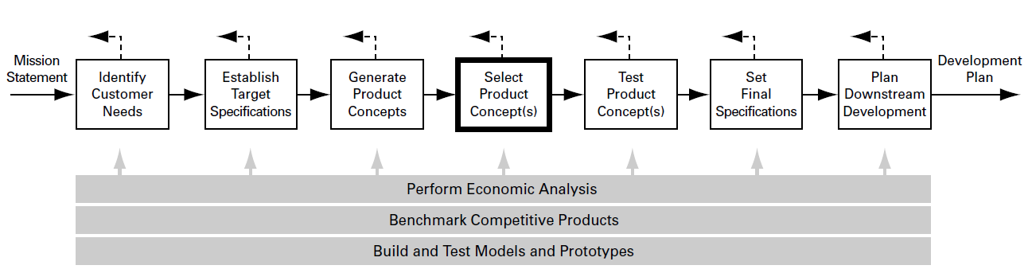
CONCEPT SELECTION IS AN INTEGRAL PART OF THE PRODUCT DEVELOPMENT PROCESS
Concept selection is the process of evaluating concepts with respect to customer needs and other criteria, comparing the relative strengths and weaknesses of the concepts, and selecting one or more concepts for further investigation, testing, or development.

Slide 3
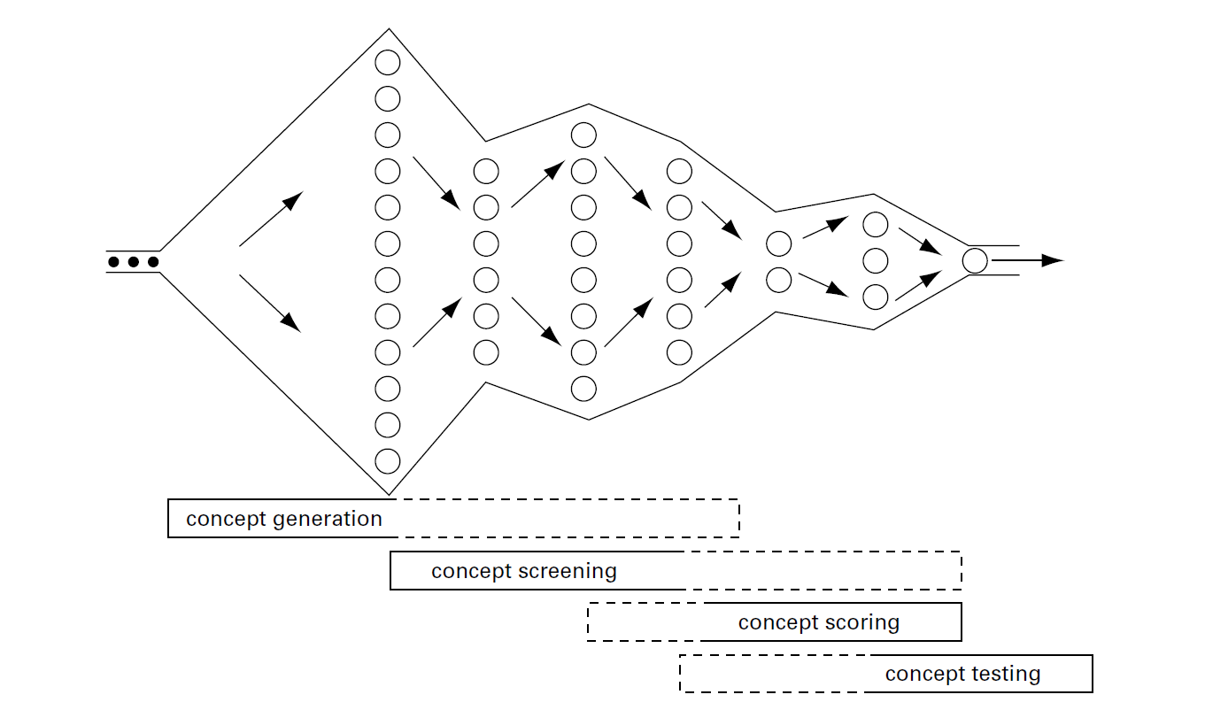
Concept selection is an iterative process closely related to concept generation and testing. The concept screening and scoring methods help the team refine and improve the concepts, leading to one or more promising concepts upon which further testing and development activities will be focused.

Slide 4
ALL TEAMS USE SOME METHOD FOR CHOOSING A CONCEPT
External decision
Product champion
Intuition
Multivoting
Pros and cons
Prototype and test
Decision matrices

Slide 5
A STRUCTURED METHOD OFFERS SEVERAL BENEFITS
A customer-focused product
A competitive design
Better product-process coordination
Reduced time to product introduction
Effective group decision making
Documentation of the decision process

Slide 6
OVERVIEW OF METHODOLOGY
The first stage is called concept screening.
The second stage is called concept scoring.
Both stages, follow a six-step process which leads the team through the concept selection activity. The steps are:
  Prepare the selection matrix.
  Rate the concepts.
  Rank the concepts.
  Combine and improve the concepts.
  Select one or more concepts.
  Reflect on the results and the process.

Slide 7
CONCEPT SCREENING
Step 1: Prepare the Selection Matrix
Concepts should be presented at the same level of detail for meaningful comparison and unbiased selection.
If the team is considering more than about 12 concepts, the multivote technique may be used.
After careful consideration, the team chooses a concept to become the benchmark, or reference concept, against which all other concepts are rated.

Slide 8
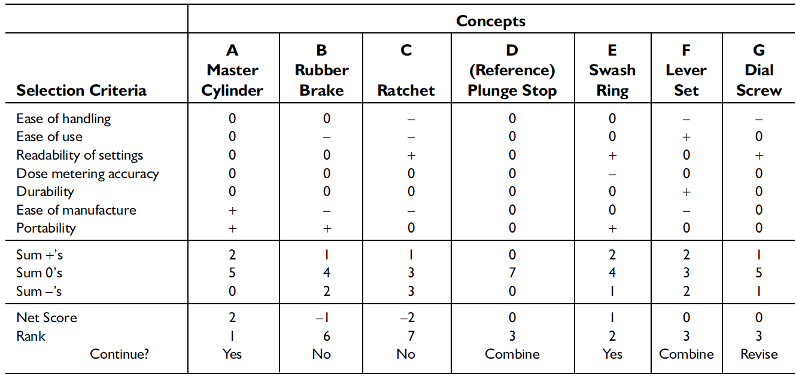
The concept screening matrix example

Slide 9
Step 2: Rate the Concepts
A relative score of “better than” (+), “same as” (0), or “worse than” (–) is placed in each cell of the matrix to represent how each concept rates in comparison to the reference concept relative to the particular criterion.

Slide 10
Step 3: Rank the Concepts
After rating all the concepts, the team sums the number of “better than,” “same as,” and “worse than” scores and enters the sum for each category in the lower rows of the matrix.
Once the summation is completed, the team rank-orders the concepts.

Slide 11
Step 4: Combine and Improve the Concepts
Two issues to consider are:
  Is there a generally good concept which is degraded by one bad feature? Can a minor modification improve the overall concept and yet preserve a distinction from the other concepts?
  Are there two concepts which can be combined to preserve the “better than” qualities while annulling the “worse than” qualities?
Combined and improved concepts are then added to the matrix, rated by the team, and ranked along with the original concepts.

Slide 12
Step 5: Select One or More Concepts
Once the team members are satisfied with their understanding of each concept and its relative quality, they decide which concepts are to be selected for further refinement and analysis.

Slide 13
Step 6: Reflect on the Results and the Process
All of the team members should be comfortable with the outcome.
If an individual is not in agreement with the decision of the team, then perhaps one or more important criteria are missing from the screening matrix, or perhaps a particular rating is in error, or at least is not clear.

Slide 14
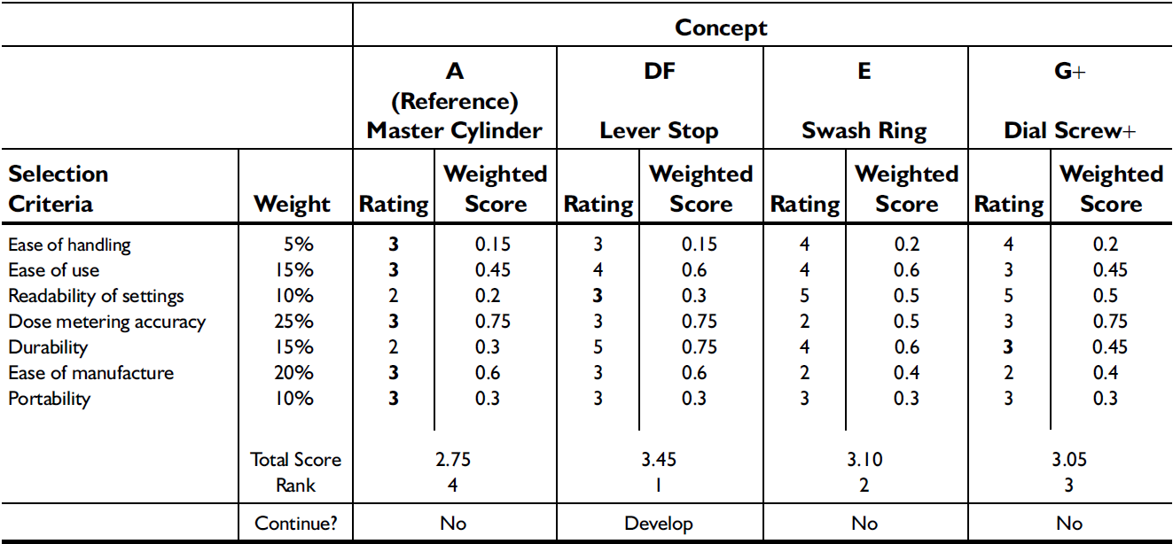
CONCEPT SCORING
The concept scores are determined by the weighted sum of the ratings.

Slide 15
Step 1: Prepare the Selection Matrix
In most cases a computer spreadsheet is the best format to facilitate ranking and sensitivity analysis.
The use of hierarchical relations is a useful way to illuminate the criteria.
After the criteria are entered, the team adds importance weights to the matrix.

Slide 16
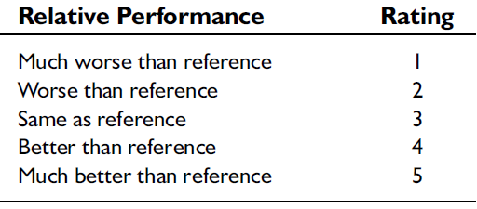
Step 2: Rate the Concepts
Because of the need for additional resolution to distinguish among competing concepts, a finer scale is used in this stage, such as, a scale from 1 to 5.

Slide 17
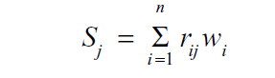
Step 3: Rank the Concepts
Once the ratings are entered for each concept, weighted scores are calculated by multiplying the raw scores by the criteria weights. The total score for each concept is the sum of the weighted scores:
Finally, each concept is given a rank corresponding to its total score.

Slide 18
Step 4: Combine and Improve the Concepts
Step 5: Select One or More Concepts
Step 6: Reflect on the Results and the Process

