Slide 1



Concept Development & Testing
Dr. Neeraj Singh
Marketing & Strategy Area
Indian Institute of Management Rohtak

Slide 2
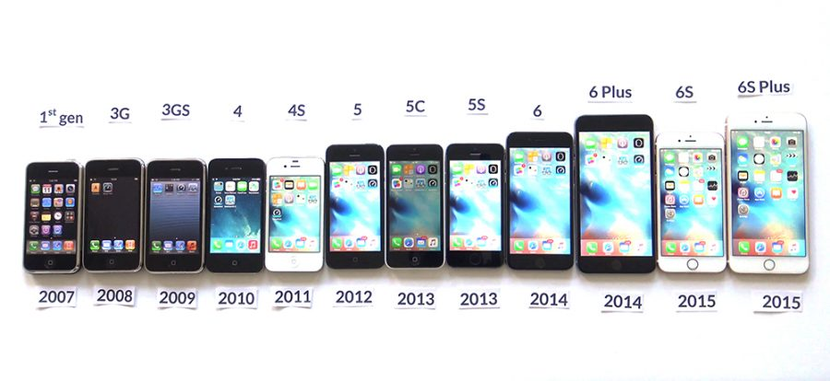
Discussion
What is a concept?
From where the new concepts of product emerge?
Why do we perform concept testing before product development?

Slide 3
Product Concept
An approximate description of -
  Technology
  Working Principle
  Form of the product
Maybe a rough 3D sketch with a brief text description.
p _{translation}
Concept
Market performance of final product
Likelihood of effective translation
Eppinger, S.D. and Ulrich, K., 2020. Product design and development (7th Edition). McGraw-Hill Publication

Slide 4
Discussion
What are the important steps in product development?

Slide 5
Concept Testing is part of Structured Product Development Schematics
Identify customer needs
Establish the target
Concepts Generation
Concept Selection
Concept Testing
Final Specifications
Development plans
Economic analysis
Benchmarking with competing products
Eppinger, S.D. and Ulrich, K., 2020. Product design and development (7th Edition). McGraw-Hill Publication

Slide 6
Five steps of concept generation
Search externally
Existing Concepts
Lead users
Experts
Patents/Literature
Benchmarks
Explore Systematically
Integrate
Solutions
Reflection on Solutions and Process
Clarify the problem
Sub-problems
Classification tree
Combination table
Feedback
Understanding
Problem Decomposition
Focus on critical sub-problems
Search internally
New Concepts
Individuals
Groups
Eppinger, S.D. and Ulrich, K., 2020. Product design and development (7th Edition). McGraw-Hill Publication

Slide 7
Step1: Clarify the problem: Class Activity
“Fresh milk” is often used by consumers to describe milk that is distributed under chilled conditions. This usually refers to pasteurized milk, which means the milk that has been heated at 72-74°C for 15-20 seconds. Pasteurization kills all pathogenic (disease causing) microorganisms in the raw milk. To limit the growth of the remaining spoilage micro-organisms, pasteurized milk needs to be kept under chilled conditions throughout the distribution and storage.
The shelf life of pasteurized milk depends on the initial load of microorganisms as well as storage temperature but is normally around 7 days. Raw milk refers to the milk produced by cows (or other animals) without processing. Drinking raw milk can cause serious diseases, as it can harbour dangerous microorganisms. According to the Food and Drug Administration (FDA), between 1993 and 2006 more than 1500 people in the United States became sick from drinking raw milk or eating cheese made from raw milk. For this reason, in many countries, all milk products sold in retail outlets must be pasteurized. In some markets, consumers buy raw milk and boil it at home. This makes the milk safe to drink but it is hard to control the process to maintain the quality. A recent consumer study indicates that the consumers living in metropolitan cities prefer not to purchase their milk daily but once in a month from the super markets. The alternative such as the spray-dried milk has poor acceptance. Also the packaging of traditional milk in plastic sheets is not appealing to the consumers. They prefer a more ergonomic packaging with information about end-to end traceability, nutrient profile and aesthetic appeal. There is a need to develop the concept of liquid milk with higher shelf life (up to 6 months). Amul, India is looking to arrive at an alternative milk product (in concept development stage) for these new age consumers.
Identify the problem and split it into sub-problems
Source:
https://www.tetrapak.com/en-in/solutions/aseptic-solutions/uht-faq#:~:text=The%20ultra%2Dhigh%20heat%20treatment,months%20without%20need%20of%20refrigeration.

Slide 8

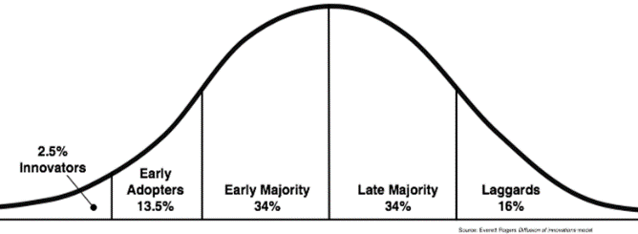
Step2: Search Externally
Interview lead users:
  Lead users are innovators working to arrive at solutions. These user groups generally arrive at local solutions personally to fulfil their needs.
  They can offer valuable insights.
Consult Experts
Search for published patents and literature.
Benchmarking closely related products.
Diligent External searches help in gathering solution concepts.

Slide 9
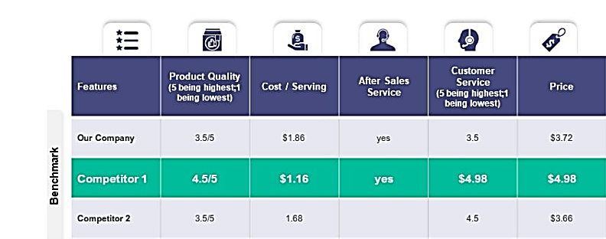
Benchmarking Matrix: An Example
Eppinger, S.D. and Ulrich, K., 2020. Product design and development (7th Edition). McGraw-Hill Publication

Slide 10
STEP 3: Search Internally
Personal and team knowledge & Creativity to arrive at possible solutions.
Team Brainstorming exercises. Set up a time limit.
Open-ended discussions.
Creating an Idea bank for sub-problems (Even seemingly infeasible ideas are welcome at this stage).
Welcome the use of graphics and physical media like foam/clay/ cardboard models.

Slide 11
Step 4: Systematic Exploration
Concept Classification Tree
In Step 3: We arrive at possible concept fragments.
Remember, we split Problem → Sub-problems before proceeding with an external and internal solution.
We need to classify these concept fragments into independent classes.

Slide 12
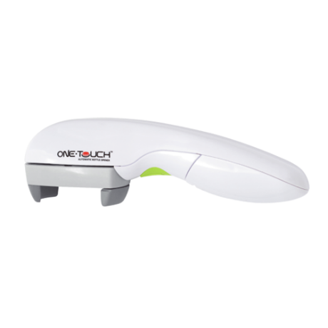
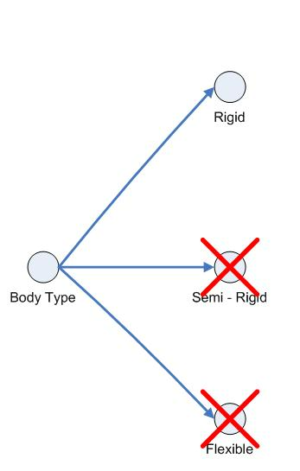
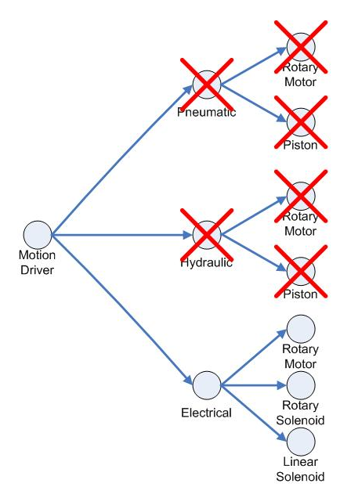
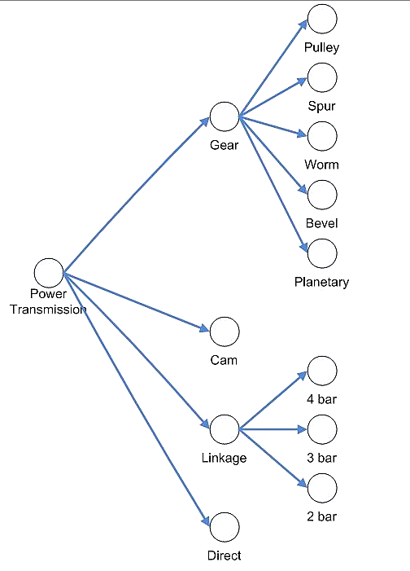
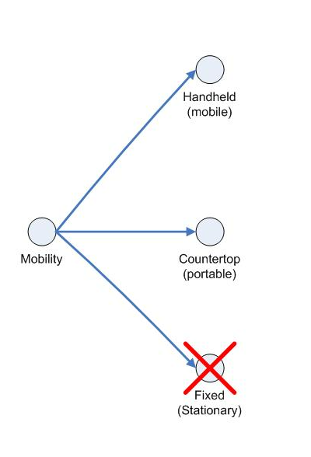
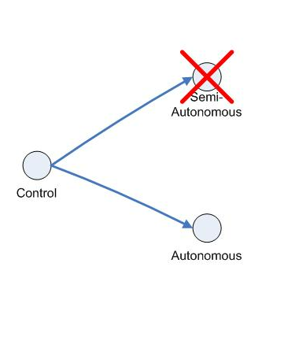
Concept Classification Tree
Automated Bottle Opener
Sub-problems: Power transmission, Controls, Motion devices, Mobility, and Machine body type.
Concept classification trees are created to show the possible choices that can be utilised.
It makes the decision-making easier.
Attributes
Sources:
https://web.stevens.edu/ses/me/fileadmin/me/senior_design/2007/group04/class.html
Eppinger, S.D. and Ulrich, K., 2020. Product design and development (7th Edition). McGraw-Hill Publication

Slide 13
Case Discussion:
Hindustan Oil Mills Limited
Can you develop the Concept Classification Tree for the ‘New Daisy’ Soap?
Based on the information provided in the case.

Slide 14
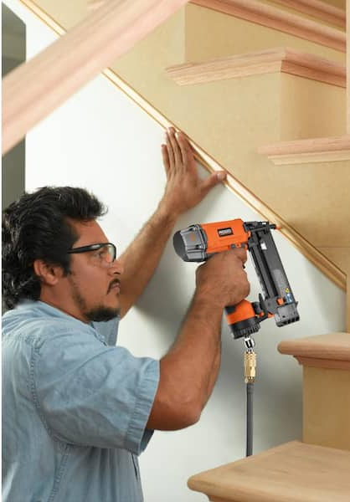
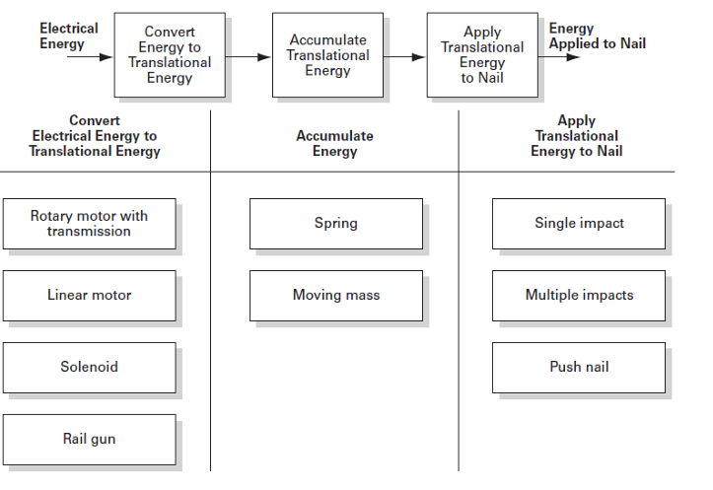
Concept combination Table
Identify the Logical sequence of event
Sub-concept alternatives
Nail Gun Concept

Slide 15

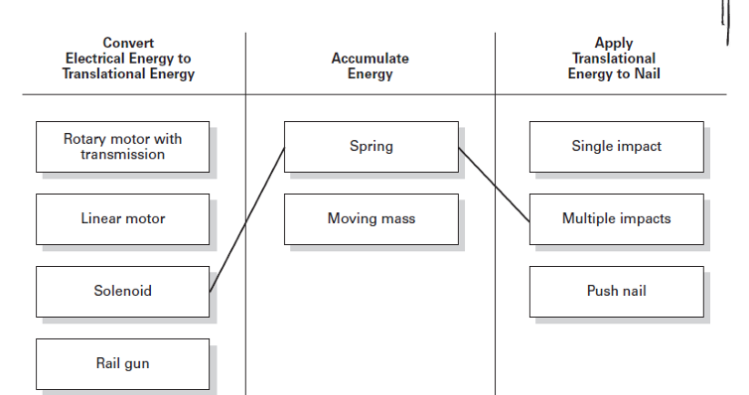
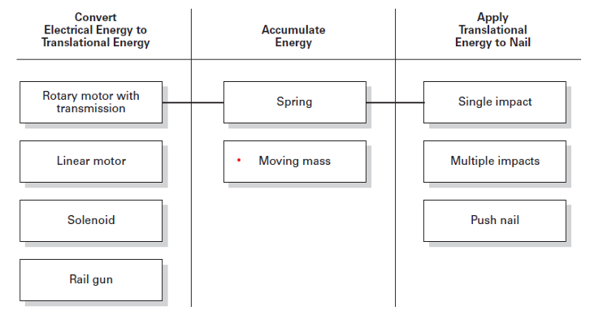

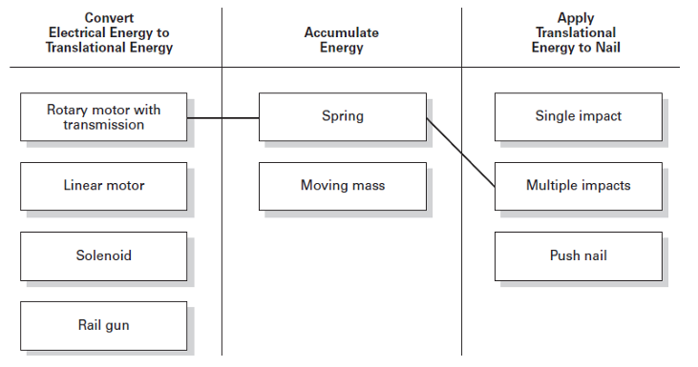
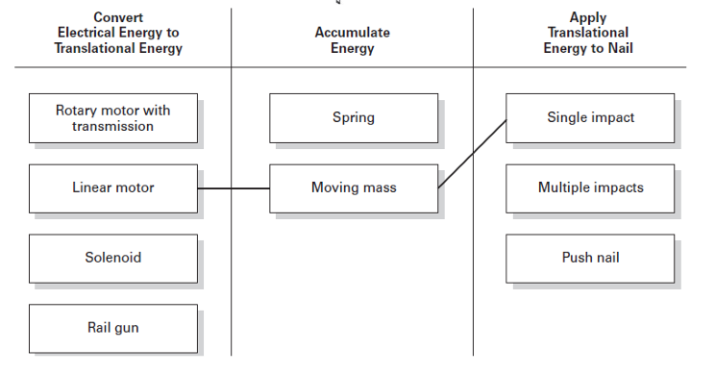

Concept combination Table

Slide 16
Key Questions
Is it feasible to develop the selected solutions?
Can we make them in-house, or do we have external dependence?
How quickly can we produce them?
What advantages does it have over other alternatives?
Cost/benefit analysis.
Benchmarking.

Slide 17
Step 5: Reflection on the solutions and the Process
Ask the following questions:
  Is the team confident that the solution space has been completely thoroughly?
  Whether we have ignored alternative solutions?
  Are there alternative ways of decomposing the problem?
  Have the external sources been thoroughly pursued?
  Have Ideas from everyone in the internal discussion been accepted and integrated into the process?

Slide 18
Case Discussion:
Hindustan Oil Mills Limited

Slide 19
Discuss
What are the strengths of Hindustan oil mills limited?
Discuss their product portfolio.
Why develop a ‘New Daisy Soap’?
Is there any other soap developed by Hindustan oil mills?

Slide 20
Hindustan Oil Mills Limited
Manufacturing vegetable oils, Soap, cosmetics and allied products.
Strengths
  Strong Distribution Network.
  Financial resources
  The capability of rapid innovation and aggressively introducing new products.

Slide 21
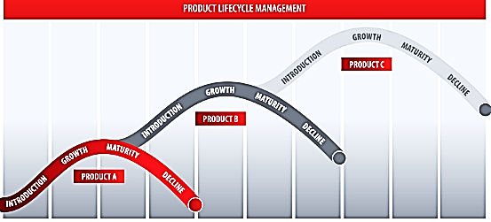
New ‘Daisy’ replacing the Old ‘Daisy’
Old Daisy:
Launched in 1954.
To be phased out in 1962.
Concept development and testing for ‘New Daisy’ started in 1959.
New Daisy
Future Products
Sales
Old Daisy
Time
Eppinger, S.D. and Ulrich, K., 2020. Product design and development (7th Edition). McGraw-Hill Publication

Slide 22
Discuss
Discuss the product attributes most important for developing the new Daisy Soap.
Discuss about the bottleneck in production of ‘New Daisy’

Slide 23
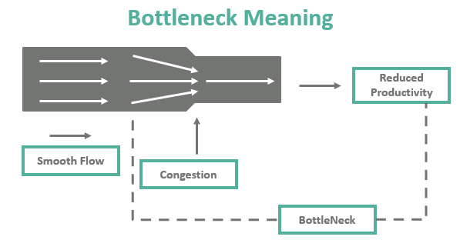
Attributes of Daisy Soap
Intrinsic control
Perfume
Colour
Shape
Wrapper (Bottleneck)
Intrinsic control
Intrinsic control
High External Dependence
Designers
Printers
Delayed launching
Reduced Production
Eppinger, S.D. and Ulrich, K., 2020. Product design and development (7th Edition). McGraw-Hill Publication

Slide 24
1959: New ‘Daisy’ Concept Development started simultaneously on all four attributes
Perfume
Colour
Shape
Wrapper
‘Blinded product’ Test
Consumers prefer new Colour and perfume
Perfume fades: Strong perfume
Jasmine flavour
Perfume is not stable. High Cost
Pink: Based on the survey
Matches the competitor ‘Dumex baby soap.’
The problem of colour fade
?
Shape similar to Samila Soap (Inhouse)
with rounded corners
Earlier studies and experience: ‘Samila Soap’

Slide 25
Decided by the chairman: Aluminum foil-based → Costlier (Acceptable)
Do we have the capability of printing Aluminum foil wrappers → ??
Are there any external aluminium foil printers → ??
Are we going to be excessively dependent on a single printer →YES
No ex-ante feasibility study: A major lapse.
  The final design was finalised by the committee.
  External Design expert was recruited: Design is Good.
    Design to be printed on a good rotary offset machine.
    Glossy ink is to be used.
  The ink supplied by the All India advertisers from Colourful Printers (Not sure if samples of Maroon colour are alkali resistant)
  Size issues in the wrapper.
  Colourful Printer only printing firm in the market capable of printing on foil.
Wrapper

Slide 26
Hindustan Oil Mills
March 1962
New ‘Daisy’ Soap production started.
June 1962
New ‘Daisy’ Soap was launched
June-July 1962
New ‘Daisy’ Soap is received well by consumers.
  Target of 16,000 Soap Cases till June
  Due to lapses in wrapper supply: only 14,500 Soap cases were produced.
October 1962
New ‘Daisy’ Soap
Production problems.
Shape : Dented
Perfume: Not as per standards
Colour : Not as per standards
  Is the new wrapper ink Alkali resistant??
  Poor Communication
  Overdependence on single printer.
Good consumer demand but production issues in New ‘Daisy’ Soap.

Slide 27
Issues:
The unique wrapping material (Aluminum based) was chosen based on Chairman’s feedback without any market or manufacturing feasibility study.
As a result, there is only one printer in the market, the ‘colourful printer’.
Further, there are lapses in communication: whether the colour used is alkali resistant and other technical specifications:
  This affects all the other attributes of the soap: colour, perfume and shape.
Ineffective integration of promising partial solutions.

Slide 28
Course of action in October 1962
  Short term: Ensure the communication of technical specifications of the dye (same shades) that should be used for manufacturing the wrapper. (especially ensuring that it is alkali resistant).
  Clear and timely communication between Hindustan Oil Mills, All India advertisers and Colourful Printers.
  Search for alternatives to Colourful printers (removing the bottlenecks).
  In the future, develop in-house wrapper printing and manufacturing capacity and reduce the dependence on an external player.
    (The organisation is rapidly trying out new products, they already have another soap, ‘Samila Soap,’ and there are no financial constraints).

Slide 29
Intrinsic control
Perfume
Colour
Shape
Wrapper (Bottleneck)
Intrinsic control
Intrinsic control
No internal control

Slide 30
Concept Testing

Slide 31
Concept Testing
Managers screen new product concepts w.r.t Internal Considerations:
  Can we efficiently manufacture the product?
  Does it fit our existing channels of distribution?
  Does it fit our general corporate image?
Once the internal checks are met, then the attention shifts towards market.
Dolan, R.J., 1989. Concept testing. Harvard Business School.

Slide 32
Concept Testing
Market viability assessment
  Focus group discussion with the consumers (open but moderated discussion).
  Quantitative market research, consumer perception towards the proposed product dimensions: the likelihood of purchase, perceived importance of product, perceived quality of the product.
  Generate the sales volume forecast.
  Diagnostic information to guide the positioning in the marketplace.
Followed by the actual fabrication of the product.

Slide 33
Concept Testing
Many organisations develop a standard procedure for concept testing for all their products (under the same portfolio).
This help in creating a database of benchmarks.
These benchmarks provide meaningful insights for concept testing exercises.

Slide 34
Executing a Concept Test
Dolan, R.J., 1989. Concept testing. Harvard Business School.

Slide 35
Concept communication method
Concept Communication can be Factual or Persuasive:
  For example, General Mill’s new low-calorie peanut butter
Concept A: ‘Core Idea’
  “A low-calorie form of peanut butter that can be used in most diets.”
Concept B: ‘Positioning Concept‘
  “A marvellous new way to chase the blahs from your diet has been discovered by General Mills scientists- a low-calorie version of ever-popular peanut butter. As tasty as ever and produced by a natural process, our new light peanut butter will fit every weight-control diet in use today virtually without restriction.”

Slide 36
Concept communication method
Statement A: Advantage of eliciting evaluation of the concept. But does not take into account the concept plus communication strategy.
  Another disadvantage is that consumer is now reacting to something quite unlike what they will see in the marketplace.
Statement B: Yield better behavioral prediction from consumers since there is a greater similarity to the actual purchase situation.

Slide 37
Concept communication method
Whether to use words only or to add illustrations (rough sketch/ photograph/ video).
Mode | Tone
 | A. Factual | B. Persuasive
1. Words only
2. Visual Only
3. Words + Visual

Slide 38
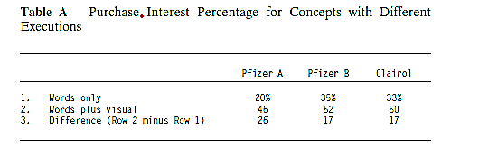
Concept communication method
It is important to recognize the impact of concept type on respondents, reactions-particularly, the “purchase intention score.”
Generally, if we move from a factual to a persuasive tone, there is an improvement in the purchase intention among consumers.
Similarly, words plus visuals produce better scores than either alone.
Factual
Persuasive
Dolan, R.J., 1989. Concept testing. Harvard Business School.

Slide 39
Determining the Data to collect for Concept Testing
Three categories:
  Purchase Intention
  Overall Product Diagnostics
  Special Attribute Diagnostics

Slide 40
Purchase Intentions and Frequency
Purchase measures are part of all concept tests.
It covers Purchase intentions and Expected frequency.
The questions may be formulated on a 5/7 point Likert scale.

Slide 41
Form
====================Product Description====================
“Based on the product description, how likely would you be to buy this product if it were available at a store in your area?”
(Check one)
  Definitely would buy
  Probably would buy
  Might or might not buy
  Probably would not buy
  Definitely would not buy

Slide 42
Frequency of purchase: For Non-durables
This tests whether the product is likely to become part of daily/regular consumption habits or is it a special occasion item.
“ Which statement best describes how often you think you would buy this product if it were available?” (Check one)
    Once a week or more often
    Once every two or three weeks
    Once a month
    Once every two to three months
    Once every four to six months
    Once or twice a year
    Less often
    Never
“How many units you are likely to purchase at one purchase event”

Slide 43
Estimated Sales Volume
Estimated sales volume per household in given time period= f(n,a,b,c)
    n= An estimate of target population (socio-demographic estimates).
    a= Fraction of households in the market who will try the product.
    b= Expected #purchases in the period for triers.
    c= Expected #units per purchase.

Slide 44
Concept Diagnostics
Managers want to obtain data to understand why the purchase measures are low/ high.
Concept diagnostics are of two types:
  Diagnosing the overall idea.
  Diagnosing specific product attributes.

Slide 45

Concept Diagnostics: Overall idea diagnostics
Standard battery of questions addressing following item:
  Uniqueness or differentiation from other products.
  Believability.
  Importance in solving a consumer’s problem
  Inherent interest among the consumer about the idea.
  Value for the money.

Slide 46
Specific Attribute Diagnostics
Product Attributes:
  Product attributes are the properties that describe a product.
  They include specific details that are tangible and intangible, subjective and objective.
  This information enables consumers to find, compare, and choose products.
The consumers need to be probed on the individual attributes of concept.
Utility estimates on product attributes: Conjoint Analysis/ Discrete Choice Experiments
Consumer preferences towards the product individual attributes.

Slide 47
Specific Attribute Diagnostics
Open-ended questions probing the respondents on attributes of the product.
  For instance
  “ You said that you [state the response of respondent]. What is it specifically about the product which makes you feel this way.”

Slide 48
Specific Attribute Diagnostics
Collect data on perceptions of specific attributes and their importance to the consumers.
For instance, for a ‘Heat and Eat’ food item concept
Attributes | Perception
 | Poor<====================================================>Excellent
Ease of preparation at home
Calorie level
Suitability for serving guest

Slide 49
Specific Attribute Diagnostics
Attributes | Attribute importance
 | Low <=====================================================>High
Ease of preparation at home
Calorie level
Suitability for serving guest

Slide 50
Quadrant analysis
Perceptual Rating
Classify the attributes
High
1: Concept is good at wrong things.
Consumer do not care about these attributes
2: Key attributes: Both important and product does well on them
Importance
Low
High
3:
Consumers do not care about these attributes
The poor rating of product on these attributes. Can be ignored
4:
Key attributes:
Important attributes for consumers.
An effort should be made to improve these attributes.
Low
Schwartz, D. Concept Testing, AMACOM, 1987.

Slide 51
Concept Development & Testing
We can predict the demand estimates for a product concept.
Which product configuration (attributes) is more likely to be preferred by the consumers?
A pool of potential concepts is then selected for further specification and development.

Slide 52

Business Model Canvas
Dr. Neeraj Singh
Marketing & Strategy Area
Indian Institute of Management Rohtak

Slide 53
The Business Model Canvas
Alexander Osterwalder proposed the business model ontology as part of his Ph.D. thesis in 2005. Later, this business model ontology was refined to become the business model canvas (BMC).
The BMC is based on describing nine central building blocks of a business and modeling the relationships between these building blocks.
Value proposition is the core building block of the BMC.
Value turnover includes four building blocks: customer segments, channels, customer relationships, and revenue stream. These building blocks describe how the organization disseminates its value proposition to the customers and how the customers generate revenues for the company
BMC
Value proposition
Customer segments
Channels
Customer relationships
Key activities
Key resources
Key partners
Cost structure
Revenue streams

Slide 54
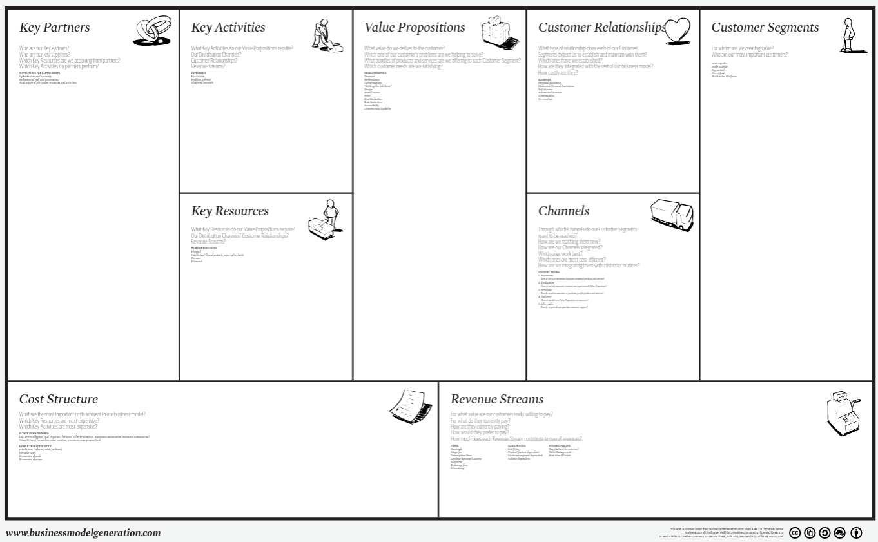

Slide 55
Value Form
How the Value is Delivered ?
How Value is Created ?
How the Value is Captured ?

Slide 56
Spotify
Discuss what is Spotify.
What value proposition it offers?

Slide 57
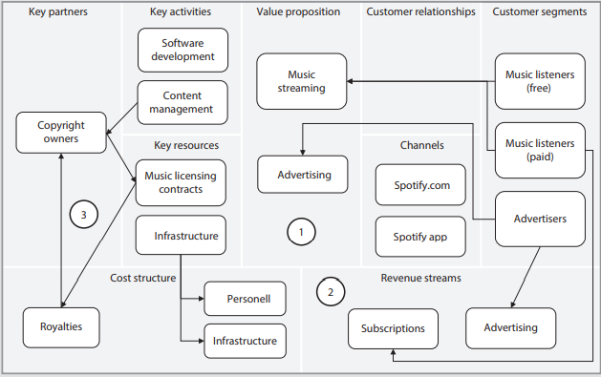
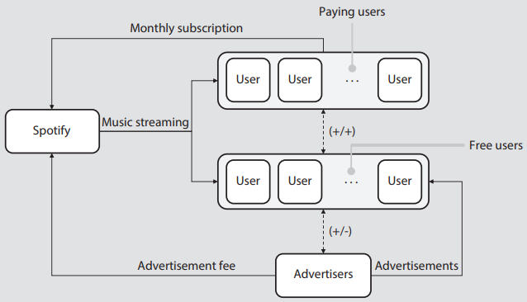
Case Study-II Spotify
Spotify is an example of a digital service that uses the freemium business model. Here, the digital service is offered to two different consumer segments: One gets the service for free and other pays for the service
Spotify has two value propositions
  one for music streaming services and one for advertisements. The subset of listeners paying for the service contributes to the revenue of Spotify
  This corresponds to about 90% of the revenue (2017). The other source of revenue—advertisements— constituted about 10% of the income (2017).
Spotify modeled using the SRM
Spotify modeled using the BMC

Slide 58
Airbnb
Discuss what is Airbnb.
What value proposition does it offer?

Slide 59
Value proposition of platform
DMTE as a cycle
Discovery
Matching
Transaction
Evaluation
4. The platform provide mechanism for evaluation and feedback of product and services offered
1. Reduce search cost for one entity, transaction may not occur on platform.
2. Reduce search cost for both interested entities, transaction may not occur on platform
3. The transactions are subsumed in the platform
Srinivasan, R. (2021). Platform Business Models. Springer.
Kanoria, Y., & Saban, D. (2021). Facilitating the search for partners on matching platforms. Management Science, 67(10), 5990-6029.
Hänninen, M. (2020). Review of studies on digital transaction platforms in marketing journals. The International Review of Retail, Distribution and Consumer Research, 30(2), 164-192.
Bonina, C., Koskinen, K., Eaton, B., & Gawer, A. (2021). Digital platforms for development: Foundations and research agenda. Information Systems Journal, 31(6), 869-902.
.

Slide 60
Airbnb
Discuss what Airbnb is?
What value proposition does it offer?
Business Model: 3 questions?

Slide 61
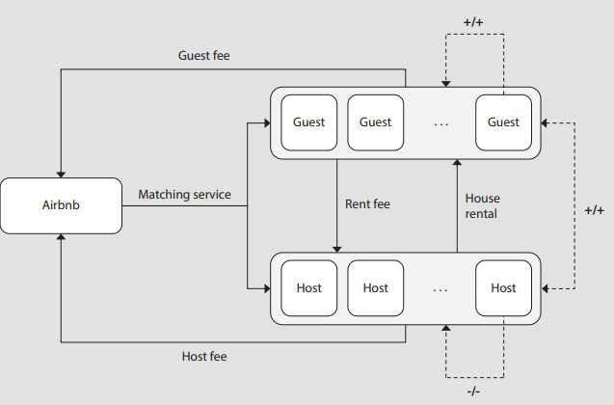
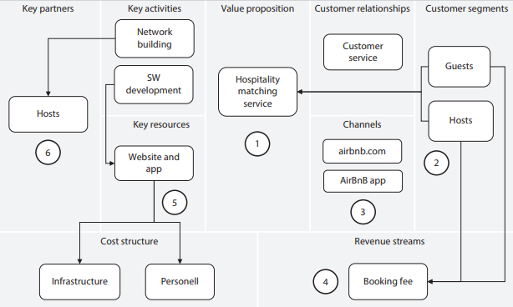
Airbnb
Airbnb is an example of an organization using the multisided platform business model
The main value proposition of Airbnb is to offer a mediation service between the two customer segments hosts and guests . This is done on the website or mobile app
Airbnb modeled using the SRM
Airbnb modeled using the BMC

Slide 62
Thank you

