Slide 1
Concept Testing For New Product Design

Slide 2
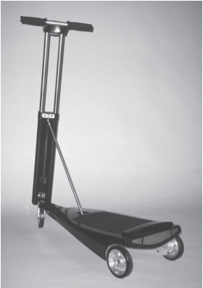
A prototype of emPower Corporation’s electric scooter product concept.

Slide 3
A prototype of emPower Corporation’s electric scooter product concept.
The emPower Corporation, a start-up company, had developed a new product concept to address the personal transportation market.
The concept was a three-wheeled electric-powered scooter that could be folded up and carried easily
emPower wished to assess the customer response to this concept to decide whether to proceed with its development and to support the company’s financing efforts.
In a concept test, the development team solicits a response to a description of the product concept from potential customers in the target market.
This type of testing may be used to select which of two or more concepts should be pursued.

Slide 4
A prototype of emPower Corporation’s electric scooter product concept.
It helps to gather information from potential customers on how to improve a concepts.
It helps to estimate the sales potential of the product.

Slide 5
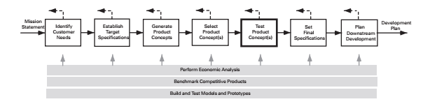
Concept Testing
Concept testing is distinct from concept selection as it is based on data gathered directly from potential customers and relies to a lesser degree on judgments made by the development team.

Slide 6
Seven-step method for testing product concepts
Define the purpose of the concept test
Choose a survey population.
Choose a survey format
Communicate the concept
Measure customer response.
Interpret the results
Reflect on the results and the process

Slide 7
STEP 1: DEFINE THE PURPOSE OF THE CONCEPT TEST
The primary questions addressed in concept testing are typically:
  Which of several alternative concepts should be pursued?
  How can the concept be improved to better meet customer needs?
  Approximately how many units are likely to be sold?
  Should development be continued?

Slide 8
STEP 2: CHOOSE A SURVEY POPULATION
Target population of potential customers surveyed reflects that of the target market for the product.
The first few questions are called the screener questions and generally are used to verify that the respondent fits the definition of the target market for the product
An accurate concept test requires that potential customers from each target segment be surveyed.

Slide 9
STEP 2: CHOOSE A SURVEY POPULATION
For the scooter, there were two primary consumer segments: college students and urban commuters.
The team had also identified several smaller secondary segments, including transportation
for factory and airport employees.
Sample sizes for concept testing are sometimes as small as 10 (e.g., when gathering qualitative feedback on a new surgical device for a highly specialized procedure).
Sample size for concept testing as large as 1,000 (e.g., when trying to quantitatively assess the potential demand for a new portable telephone that is targeted at a market segment comprising 10 million households).

Slide 10
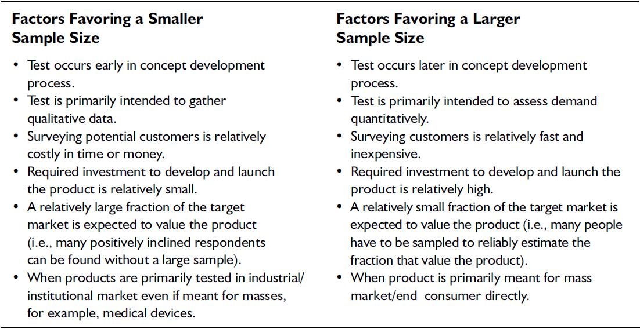
Factors leading to relatively smaller or larger survey sample sizes

Slide 11
STEP 3: CHOOSE A SURVEY FORMAT
Face-to-face interaction
Telephone
Postal mail
Electronic mail
Internet

Slide 12
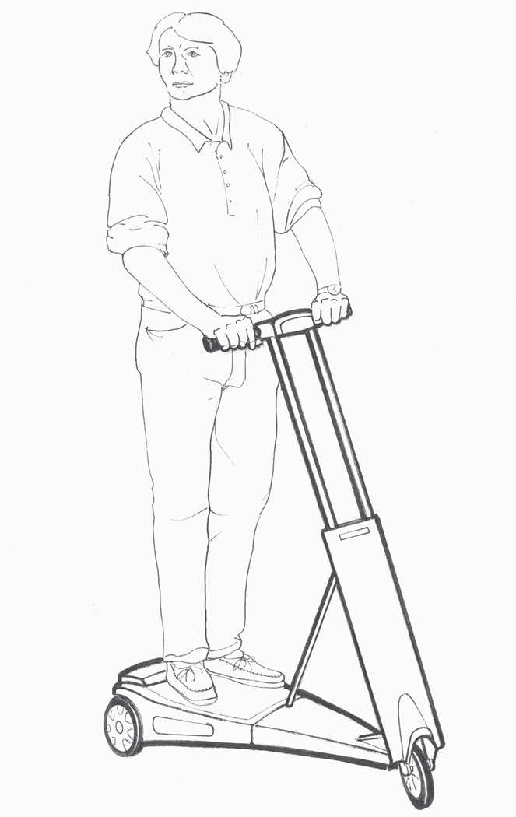
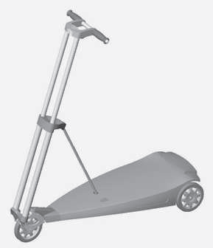
STEP 4: COMMUNICATE THE CONCEPT
Verbal description
Sketch
Photos and renderings

Slide 13
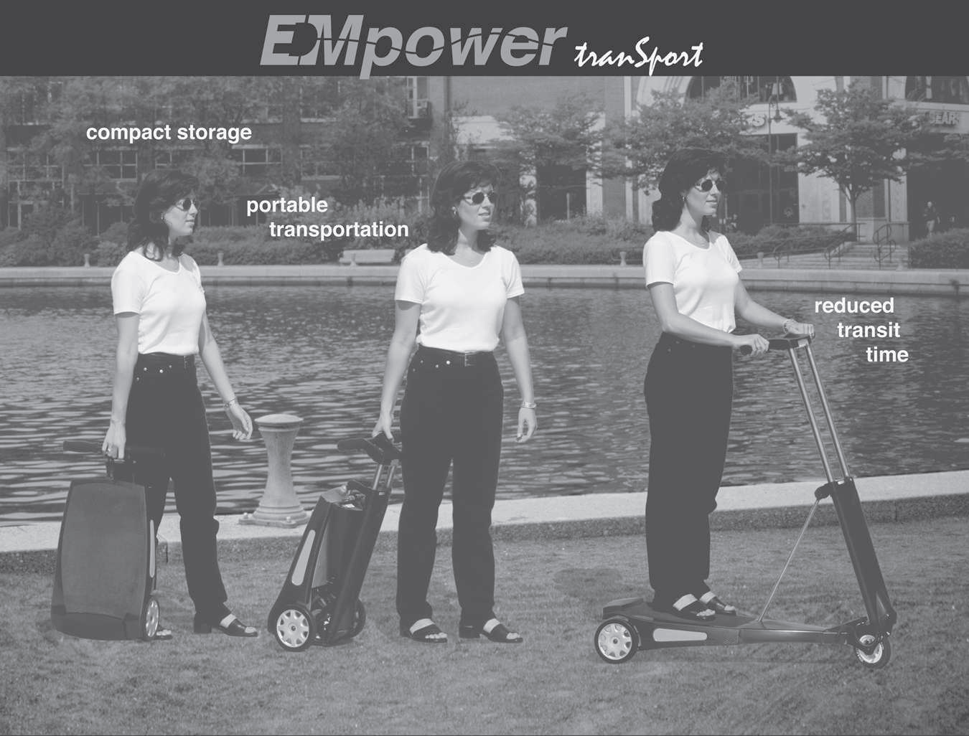
Storyboard

Slide 14
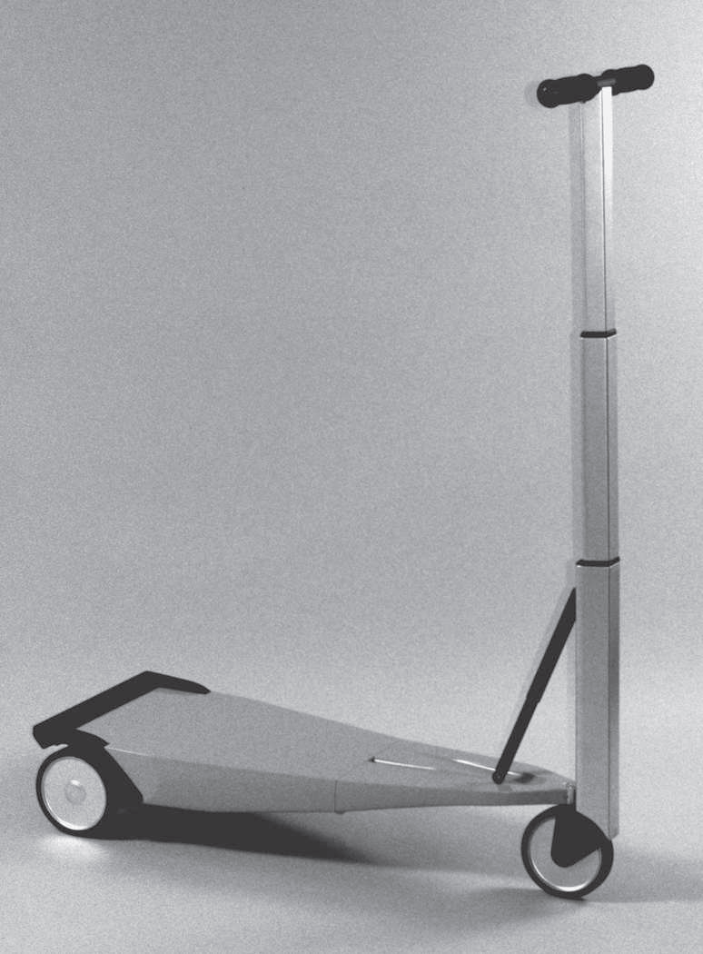
STEP 4: COMMUNICATE THE CONCEPT
Video
Simulation
Interactive multimedia
Physical appearance models
Working prototypes
Physical appearance models

Slide 15
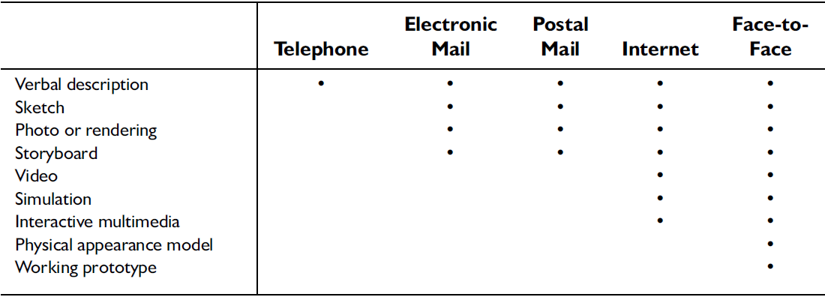
Appropriateness of different survey formats for different ways of communicating the product concept

Slide 16
STEP 5: MEASURE CUSTOMER RESPONSE
The most commonly used purchase-intent scale has five response categories:
  Definitely would buy.
  Probably would buy.
  Might or might not buy.
  Probably would not buy.
  Definitely would not buy.

Slide 17

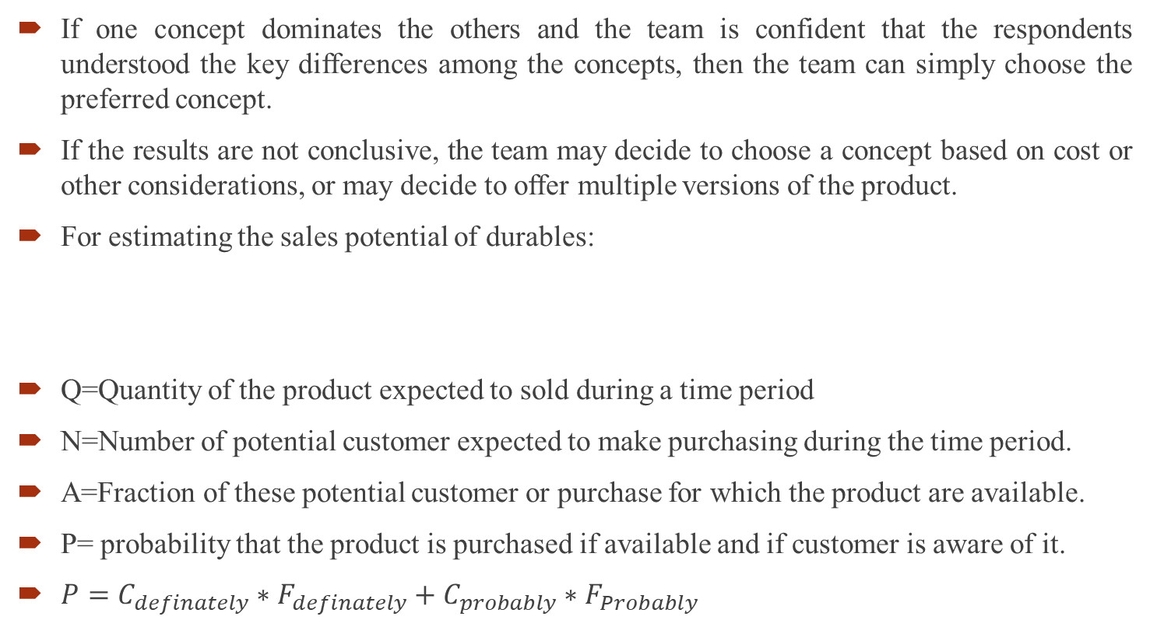
STEP 6: INTERPRET THE RESULTS
If one concept dominates the others and the team is confident that the respondents understood the key differences among the concepts, then the team can simply choose the preferred concept.
If the results are not conclusive, the team may decide to choose a concept based on cost or other considerations, or may decide to offer multiple versions of the product.
For estimating the sales potential of durables:
Q=Quantity of the product expected to sold during a time period
N=Number of potential customer expected to make purchasing during the time period.
A=Fraction of these potential customer or purchase for which the product are available.
P= probability that the product is purchased if available and if customer is aware of it.
$P=C_{definately}∗F_{definately}+C_{probably}∗F_{Probably}$

Slide 18
Factors that can cause actual purchase patterns differ from the purchase intention
Importance of word-of-mouth
Fidelity of the concepts description
Pricing
Level of Promotion

Slide 19
STEP 7: REFLECT ON THE RESULTS AND THE PROCESS
Was the concept communicated in a way that is likely to elicit customer response that reflects true intent?
Is the resulting forecast consistent with observed sales rates of similar products?

