Slide 1
Concept Selection

Slide 2
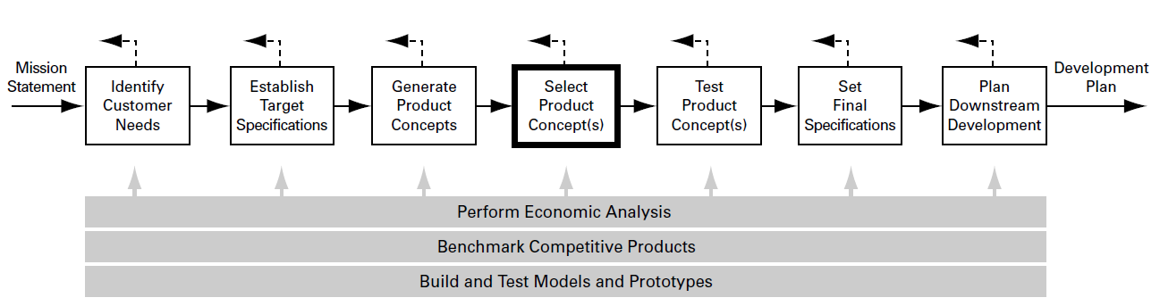
CONCEPT SELECTION IS AN INTEGRAL PART OF THE PRODUCT DEVELOPMENT PROCESS
Concept selection is the process of evaluating concepts with respect to customer needs and other criteria, comparing the relative strengths and weaknesses of the concepts, and selecting one or more concepts for further investigation, testing, or development.

Slide 3
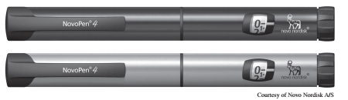
Concept Selection
A medical supply company retained a product design firm to develop a reusable syringe with precise dosage control for outpatient use.
Current problem with the product
  Product Cost
  Accuracy of Dose Metering

Slide 4
Criteria on which choice of the product would be based
Ease of Handling
Ease of Use
Readability of dose settings
Dose metering accuracy
Durability
Ease of manufacturing
Profitability

Slide 5
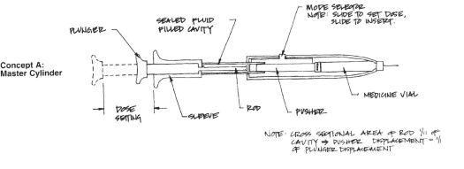
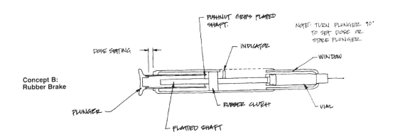
Seven Concepts for the outpatient Syringe

Slide 6
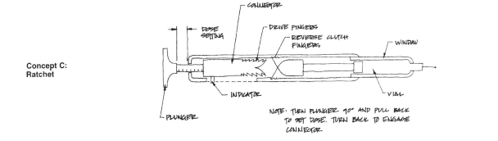
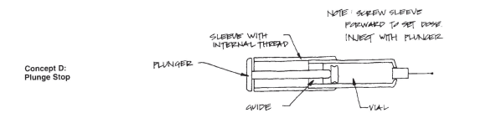
Seven Concepts for the outpatient Syringe

Slide 7
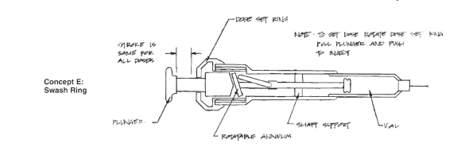
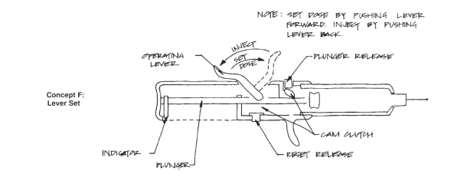
Seven Concepts for the outpatient Syringe

Slide 8
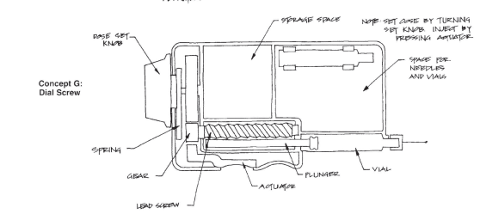
Seven Concepts for the outpatient Syringe

Slide 9
Need to select one syringe from many
How can the team choose the best concept, given that the design are still quite abstract?
How can a decision be made that is embraced by the whole team?
How can desirable attributes of otherwise weak concepts be identified and used?
How can the decision-making process be documented?

Slide 10
STRUCTURED METHODS FOR CHOOSING A CONCEPT
External decision
Product champion
Intuition
Multivoting
Online Survey/Crowdsourcing
Pros and cons
Prototype and test
Decision matrices

Slide 11
A STRUCTURED METHOD OFFERS SEVERAL BENEFITS
A customer-focused product
A competitive design
Better product-process coordination
Reduced time to product introduction
Effective group decision making
Documentation of the decision process

Slide 12
OVERVIEW OF METHODOLOGY
The first stage is called concept screening.
The second stage is called concept scoring.
Both stages, follow a six-step process which leads the team through the concept selection activity. The steps are:
  Prepare the selection matrix.
  Rate the concepts.
  Rank the concepts.
  Combine and improve the concepts.
  Select one or more concepts.
  Reflect on the results and the process.

Slide 13
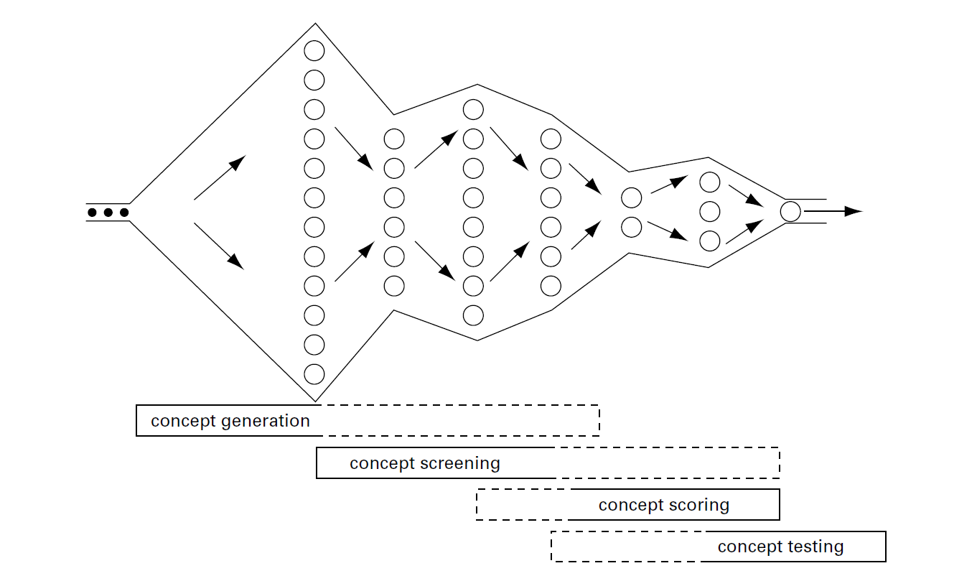
Concept selection is an iterative process closely related to concept generation and testing. The concept screening and scoring methods help the team refine and improve the concepts, leading to one or more promising concepts upon which further testing and development activities will be focused.

Slide 14
Concept Screening
Concept Screening is based on a method developed by the late Stuart Pugh in the 1980s
Purpose of this stage are to narrow the number of concepts quickly and to improve the concepts.
Steps involve in concept screening process
  Prepare the selection Matrix
  Rate the concepts
  Rank the Concepts
  Combine and improve the concepts
  Select one or more concepts
  Reflect on the results and the process

Slide 15
Step 1: Prepare the Selection Matrix
Concepts should be presented at the same level of detail for meaningful comparison and unbiased selection.
If the team is considering more than about 12 concepts, the multivote technique may be used.
After careful consideration, the team chooses a concept to become the benchmark, or reference concept, against which all other concepts are rated.

Slide 16
The concept screening matrix example
Concepts
Selection Criteria | A Master Cylinder | B Rubber Break | C Ratchet | D Plunge-stop | E Swash Ring | F Lever set | G Dial Screw
Ease of Handling
Ease of use
Readability of setting
Does Metering accuracy
Durability
Ease of Manufacturing
Portability
Sum+’s
Sum0’s
Sum-’s
Net Score
Rank
Continue

Slide 17
Step 2: Rate the Concepts
A relative score of “better than” (+), “same as” (0), or “worse than” (–) is placed in each cell of the matrix to represent how each concept rates in comparison to the reference concept relative to the particular criterion.

Slide 18
Rate the Concepts
Concepts
Selection Criteria | A Master Cylinder | B Rubber Break | C Ratchet | D Plunge-stop | E Swash Ring | F Lever set | G Dial Screw
Ease of Handling | 0 | 0 | - | 0 | 0 | - | -
Ease of use | 0 | - | - | 0 | 0 | + | 0
Readability of setting | 0 | 0 | + | 0 | + | 0 | +
Does Metering accuracy | 0 | 0 | 0 | 0 | - | 0 | 0
Durability | 0 | 0 | 0 | 0 | 0 | + | 0
Ease of Manufacturing | + | - | - | 0 | 0 | - | 0
Portability | + | + | 0 | 0 | + | 0 | 0
Sum+’s
Sum0’s
Sum-’s
Net Score
Rank
Continue

Slide 19
Step 3: Rank the Concepts
After rating all the concepts, the team sums the number of “better than,” “same as,” and “worse than” scores and enters the sum for each category in the lower rows of the matrix.
Once the summation is completed, the team rank-orders the concepts.

Slide 20
Rate the Concepts
Concepts2
Section Criteria | A Master Cylinder | B Rubber Break | C Ratchet | D Plunge-stop | E Swash Ring | F Lever set | G Dial Screw
Ease of Handling | 0 | 0 | - | 0 | 0 | - | -
Ease of use | 0 | - | - | 0 | 0 | + | 0
Readability of setting | 0 | 0 | + | 0 | + | 0 | +
Does Metering accuracy | 0 | 0 | 0 | 0 | - | 0 | 0
Durability | 0 | 0 | 0 | 0 | 0 | + | 0
Ease of Manufacturing | + | - | - | 0 | 0 | - | 0
Portability | + | + | 0 | 0 | + | 0 | 0
Sum+’s | 2 | 1 | 1 | 0 | 2 | 2 | 1
Sum0’s | 5 | 4 | 3 | 7 | 4 | 3 | 5
Sum-’s | 0 | 2 | 3 | 0 | 1 | 2 | 1
Net Score | 2 | -1 | -2 | 0 | 1 | 0 | 0
Rank | 1 | 6 | 7 | 3 | 2 | 3 | 3
Continue

Slide 21
Step 4: Combine and Improve the Concepts
Two issues to consider are:
  Is there a generally good concept which is degraded by one bad feature? Can a minor modification improve the overall concept and yet preserve a distinction from the other concepts?
  Are there two concepts which can be combined to preserve the “better than” qualities while annulling the “worse than” qualities?
Combined and improved concepts are then added to the matrix, rated by the team, and ranked along with the original concepts.

Slide 22
Rate the Concepts
Concepts2
Section Criteria | A Master Cylinder | B Rubber Break | C Ratchet | D Plunge-stop | E Swash Ring | F Lever set | G Dial Screw
Ease of Handling | 0 | 0 | - | 0 | 0 | - | -
Ease of use | 0 | - | - | 0 | 0 | + | 0
Readability of setting | 0 | 0 | + | 0 | + | 0 | +
Does Metering accuracy | 0 | 0 | 0 | 0 | - | 0 | 0
Durability | 0 | 0 | 0 | 0 | 0 | + | 0
Ease of Manufacturing | + | - | - | 0 | 0 | - | 0
Portability | + | + | 0 | 0 | + | 0 | 0
Sum+’s | 2 | 1 | 1 | 0 | 2 | 2 | 1
Sum0’s | 5 | 4 | 3 | 7 | 4 | 3 | 5
Sum-’s | 0 | 2 | 3 | 0 | 1 | 2 | 1
Net Score | 2 | -1 | -2 | 0 | 1 | 0 | 0
Rank | 1 | 6 | 7 | 3 | 2 | 3 | 3
Continue | Yes | No | No | Combine | Yes | Combine | Revise

Slide 23
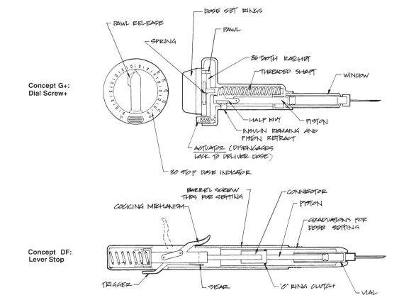
Combine and Improve the Concepts

Slide 24
Step 5: Select One or More Concepts
Once the team members are satisfied with their understanding of each concept and its relative quality, they decide which concepts are to be selected for further refinement and analysis.

Slide 25
Step 6: Reflect on the Results and the Process
All of the team members should be comfortable with the outcome.
If an individual is not in agreement with the decision of the team, then perhaps one or more important criteria are missing from the screening matrix, or perhaps a particular rating is in error, or at least is not clear.

Slide 26
Concept Scoring
The concept scores are determined by the weighted sum of the ratings
In this stage, the team weighs the relative importance of the selection criteria and focuses on more refined comparison with respect to each criterion.

Slide 27
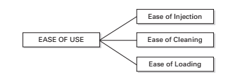
Step 1: Prepare the Selection Matrix
In most cases a computer spreadsheet is the best format to facilitate ranking and sensitivity analysis.
The use of hierarchical relations is a useful way to illuminate the criteria.
After the criteria are entered, the team adds importance weights to the matrix.

Slide 28
Step 1: Prepare the Selection Matrix
Concepts
 |  | A Reference Master Cylinder |  | DF, Lever Shop |  | E Swash Ring |  | G+ Dial Screw
Selection Criteria | Weight | Rating | Weighted Score | Rating | Weighted Score | Rating | Weighted Score | Rating | Weighted Score
Ease of Handling | 5%
Ease of Use | 15%
Readability of settings | 10%
Does metering accuracy | 25%
Durability | 15%
Ease of Manufacturing | 20%
Profitability | 10%

Slide 29
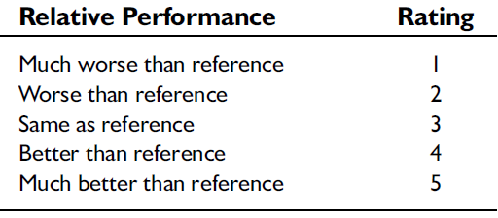
Step 2: Rate the Concepts
Because of the need for additional resolution to distinguish among competing concepts, a finer scale is used in this stage, such as, a scale from 1 to 5.

Slide 30
Step 2: Rate the Concepts
Concepts
 |  | A Reference Master Cylinder |  | DF, Lever Shop |  | E Swash Ring |  | G+ Dial Screw
Selection Criteria | Weight | Rating | Weighted Score | Rating | Weighted Score | Rating | Weighted Score | Rating | Weighted Score
Ease of Handling | 5% | 3 |  | 3 |  | 4 |  | 4
Ease of Use | 15% | 3 |  | 4 |  | 4 |  | 3
Readability of settings | 10% | 2 |  | 3 |  | 5 |  | 5
Does metering accuracy | 25% | 3 |  | 3 |  | 2 |  | 3
Durability | 15% | 2 |  | 5 |  | 4 |  | 3
Ease of Manufacturing | 20% | 3 |  | 3 |  | 2 |  | 2
Profitability | 10% | 3 |  | 3 |  | 3 |  | 3

Slide 31
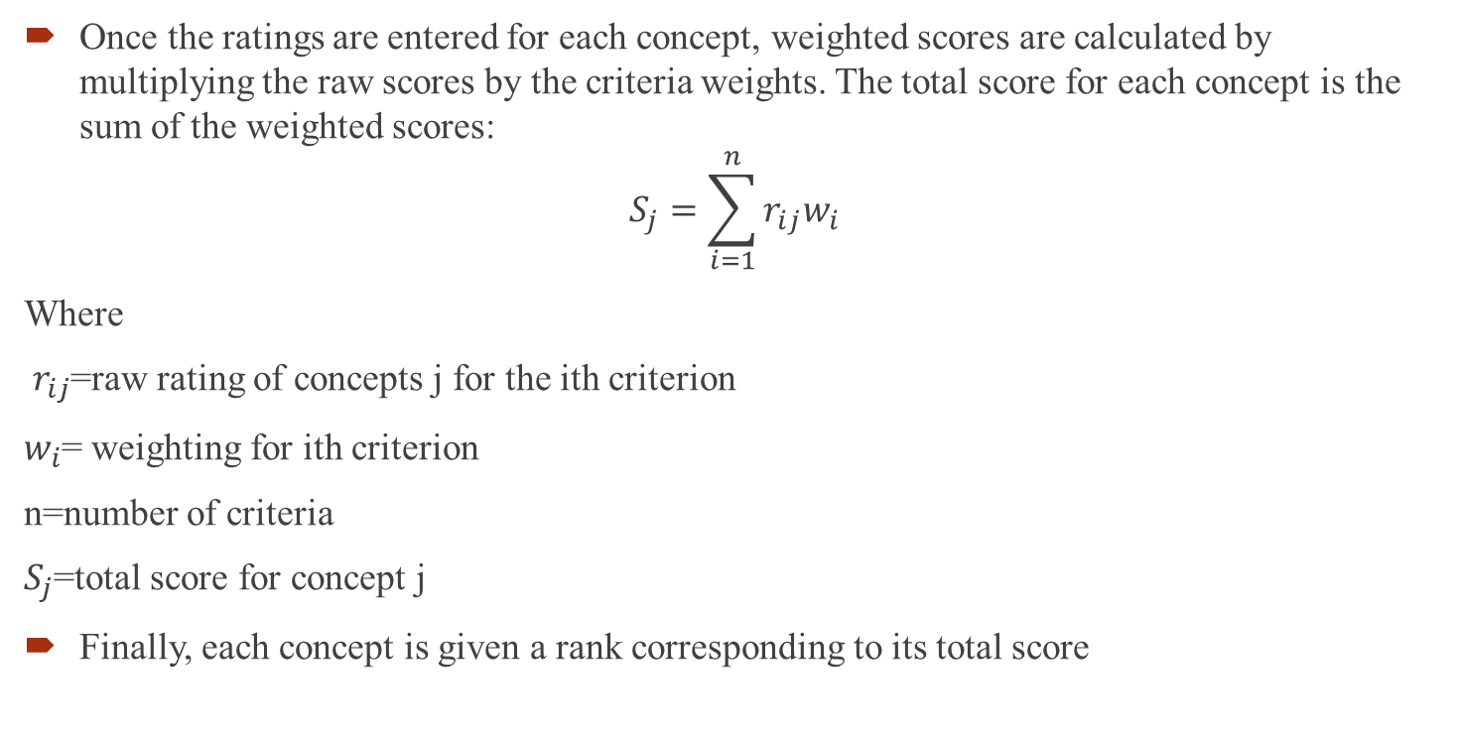
Step 3: Rank the Concepts
Once the ratings are entered for each concept, weighted scores are calculated by multiplying the raw scores by the criteria weights. The total score for each concept is the sum of the weighted scores:
$$S_{j}=\sum_{i=1}^{n}{r_{ij}w_{i}}$$
Where
$r_{ij}$=raw rating of concepts j for the ith criterion
$w_{i}$= weighting for ith criterion
n=number of criteria
$S_{j}$=total score for concept j
Finally, each concept is given a rank corresponding to its total score

Slide 32
Step 3: Rank the Concepts
Concepts
 |  | A Reference Master Cylinder |  | DF, Lever Shop |  | E Swash Ring |  | G+ Dial Screw
Selection Criteria | Weight | Rating | Weighted Score | Rating | Weighted Score | Rating | Weighted Score | Rating | Weighted Score
Ease of Handling | 5% | 3 | 0.15 | 3 | 0.15 | 4 | 0.2 | 4 | 0.2
Ease of Use | 15% | 3 | 0.45 | 4 | 0.6 | 4 | 0.6 | 3 | 0.45
Readability of settings | 10% | 2 | 0.2 | 3 | 0.3 | 5 | 0.5 | 5 | 0.5
Does metering accuracy | 25% | 3 | 0.75 | 3 | 0.75 | 2 | 0.5 | 3 | 0.75
Durability | 15% | 2 | 0.3 | 5 | 0.75 | 4 | 0.6 | 3 | 0.45
Ease of Manufacturing | 20% | 3 | 0.6 | 3 | 0.6 | 2 | 0.4 | 2 | 0.4
Profitability | 10% | 3 | 0.3 | 3 | 0.3 | 3 | 0.3 | 3 | 0.3
 | Total Score Rank |  | 2.75 4 |  | 3.45 1 |  | 3.10 2 |  | 3.05 3
 | Continue? |  | No |  | Develop |  | No |  | No

Slide 33
Step 4: Combine and Improve the Concepts
Step 5: Select One or More Concepts
Step 6: Reflect on the Results and the Process
Two questions are useful in improving the process for subsequent concept for selection activities:
In what way did the concept selection method facilitate team decision making?
How can the method be modified to improve team performance.

Slide 34
Important Complexity to be consider for concept selection
Decomposition of concept quality
Subjective Criteria
To facilitate improvement of concepts
Where to include cost
Selecting elements of aggregate concepts
Applying concept selection throughout the development process.

Slide 35
Class Exercise
How can the concepts selection methods be used to benchmark or evaluate existing products? Performance such an evaluation for five automobiles you might consider purchasing.

Slide 36
Important Factor Before buying a car
Brand
Maintenance and Service Network
Style and Needs
The Price
Safety Features/ Car Safety

