Slide 1


Competitive Analysis

Slide 2
Competitive analysis
Competitive analysis is an important part of the job description for most marketers
Develop an impactful marketing strategy
Complex decisions involved in strategy formulation
  [Promotion Strategy: Consumer Based Promotions/Trade based promotions]
  GTM Strategy for Castrol
Competitive Analysis Frameworks
1.) SWOT 2.) TOWS 3.) GAP ANALYSIS 4.) PORTER’s FIVE FORCES 5.) PERCEPTUAL MAPPING 6.) BCG MATRIX.

Slide 3
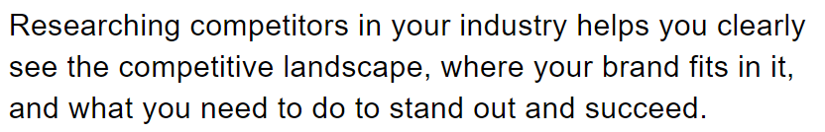
Where does our brand stand?
What can we do that’s the same as our competitors?
What can we do that’s different from our competitors?
What are the opportunities in our market?
What can we do to beat competitors?
Where do we need to focus?

Slide 4
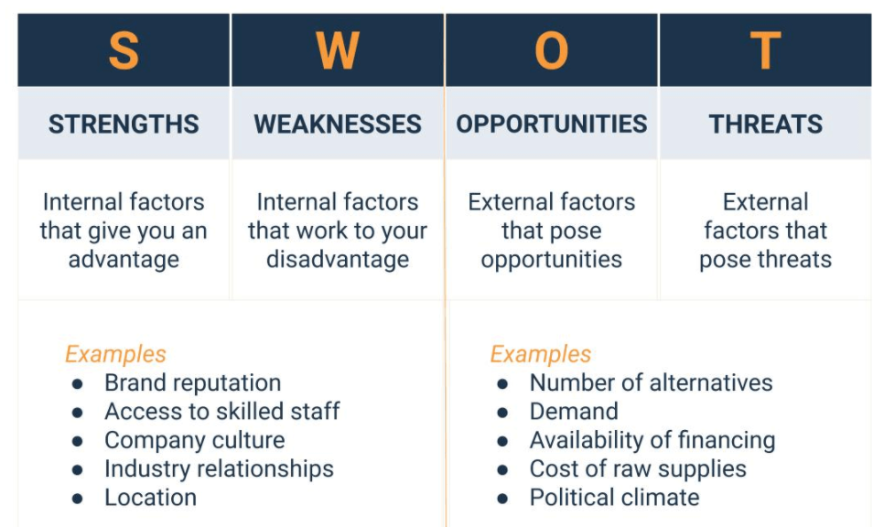
SWOT Analysis

Slide 5
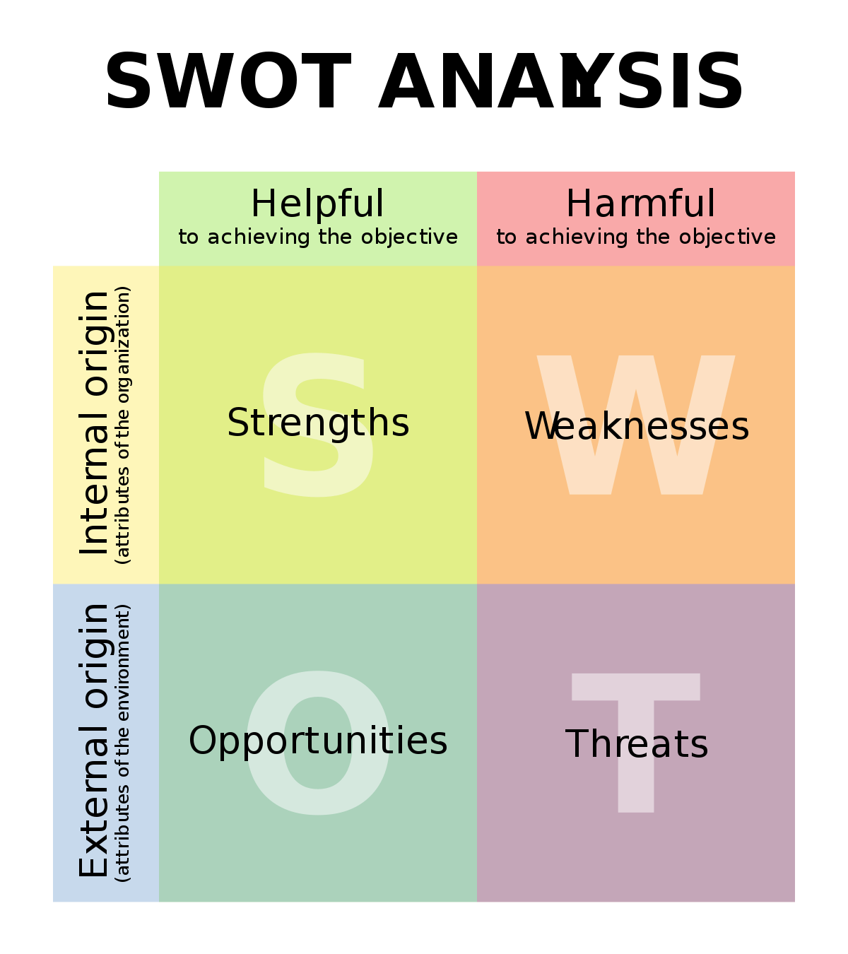

Slide 6

Arrow Electronics

Slide 7
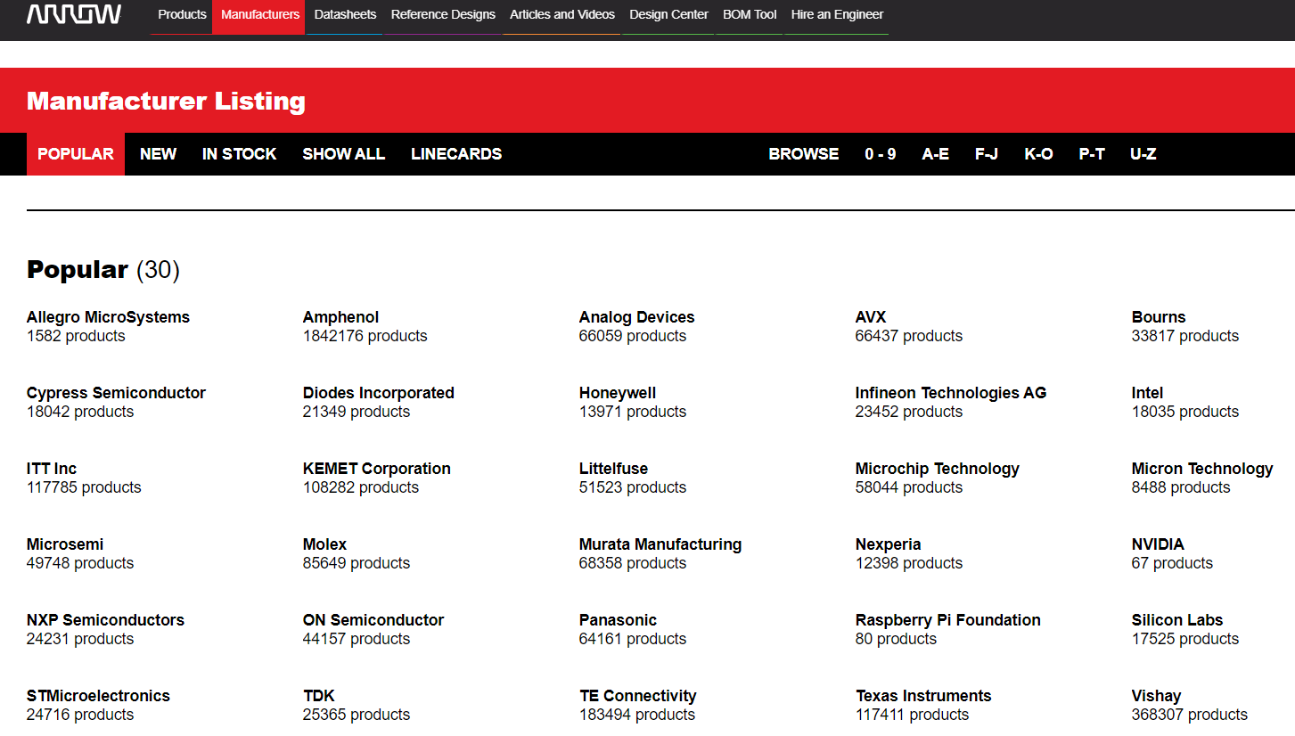

Slide 8
Relationships
Manufacturer---------------------→Distributor--------------------→Customer
INTEL ARROW ALIBABA
Jump Ball Strategy Design and Win Strategy

Slide 9

Gap Analysis

Slide 10
Relationships
Manufacturer---------------------→Distributor--------------------→Customer
INTEL ARROW ALIBABA
Jump Ball Strategy Design and Win Strategy
EXPRESS

Slide 11
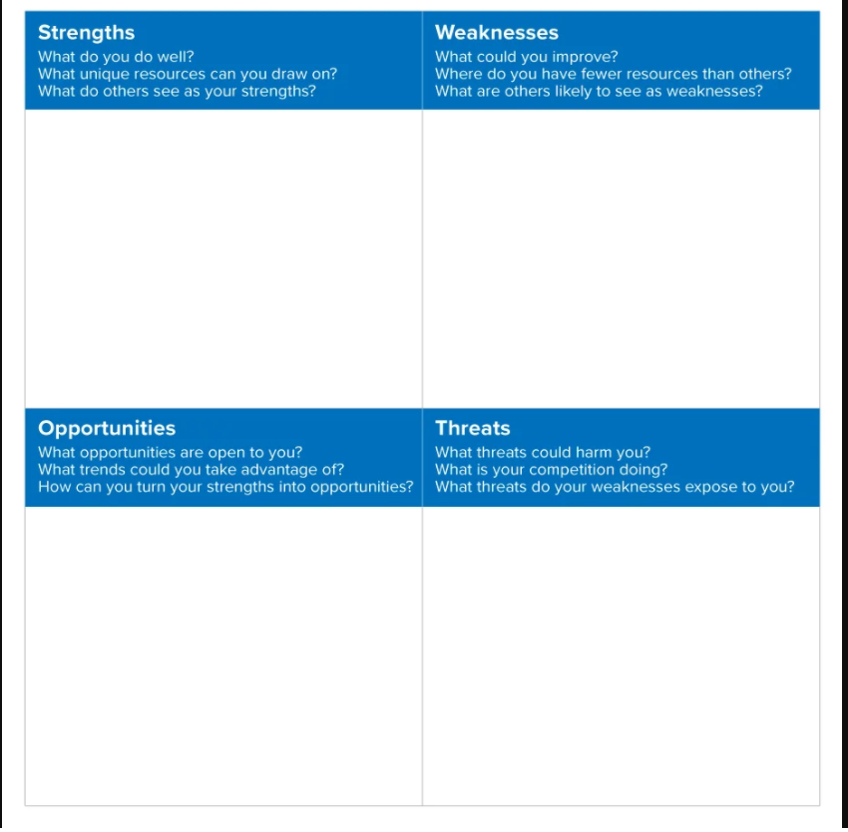

Slide 12
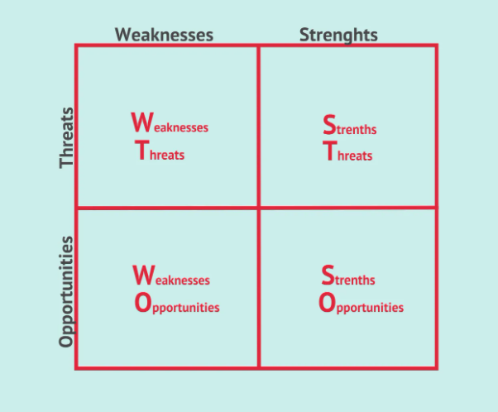
TOWS Analysis

Slide 13
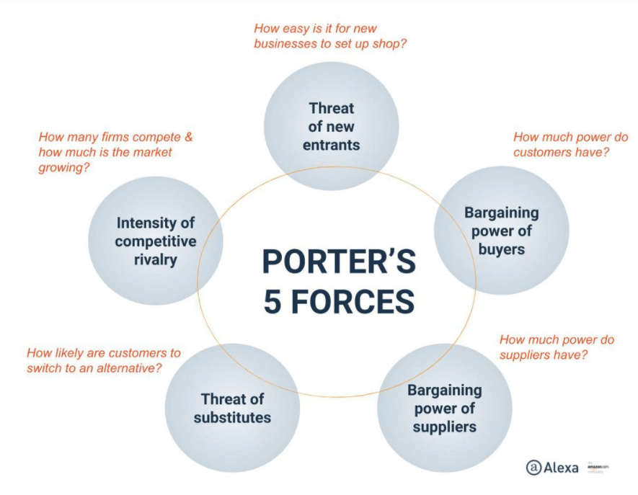
Porter’s Five Forces

Slide 14
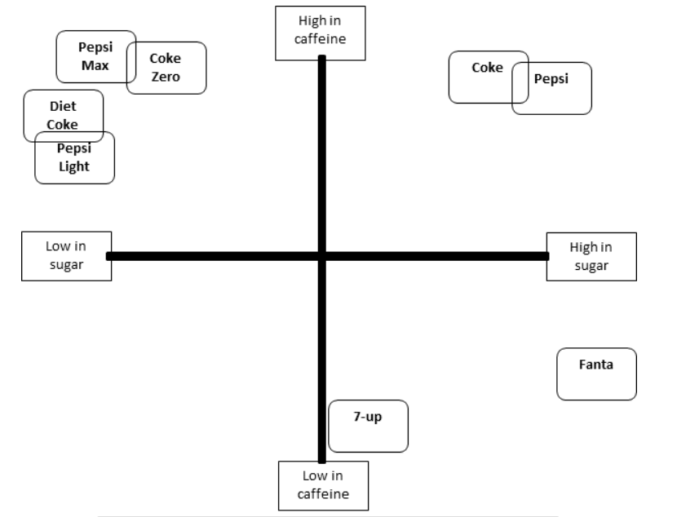
PERCEPTUAL MAPPING

Slide 15
USES OF PERCEPTUAL MAPPING
We get a true understanding of how our brand is perceived in the marketplace
We can track how the perception of our brand is evolving over time, with new products and campaigns
We can track the perception of competitor products and measure the impact of their marketing strategies
We can identify positioning preferences (i.e. ideal combination of products) for different market segments
We can identify possible gaps and opportunities for new products
We can identify possible opportunities for repositioning our brand

Slide 16
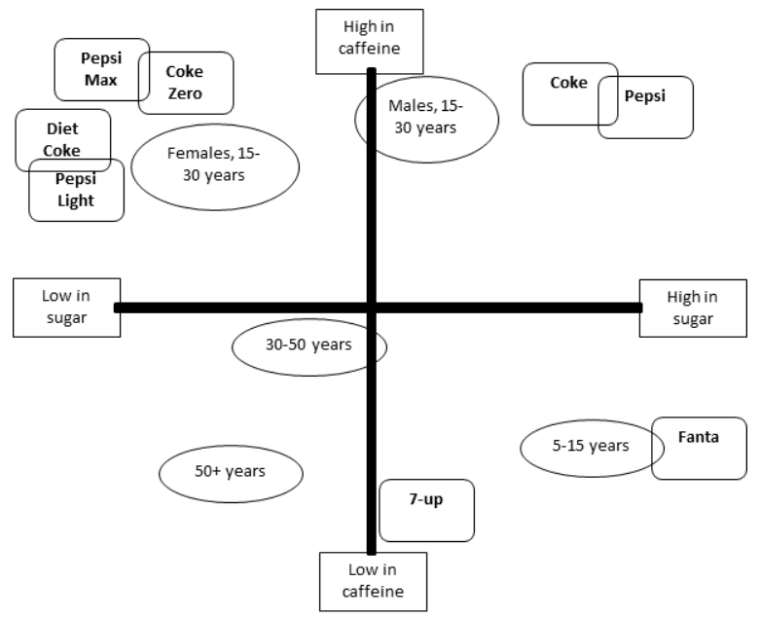
JOINT PERCEPTUAL MAPS

Slide 17

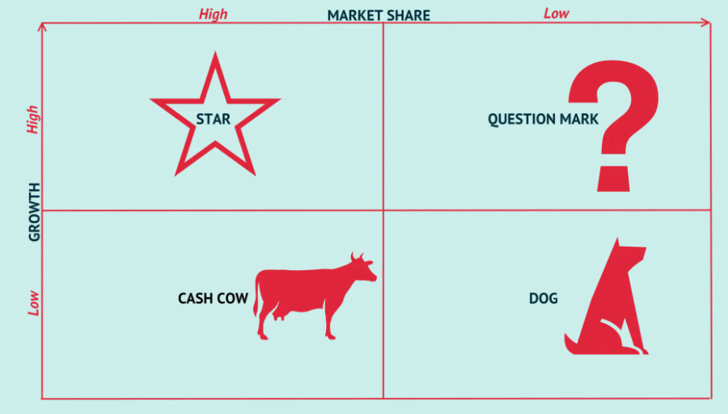

Slide 19
QUERIES

