Slide 1
Clustering (Advanced)
Measuring goodness

Slide 2
  Why to measure cluster goodness
  To answer -
  Do clusters correspond to reality or are they simply artifacts of mathematical convenience?
  What are the optimal number of cluster to identify?
  How do I measure whether one set of clusters is preferable to another?
  The silhouette method and the pseudo-F statistic will help us address these questions by measuring cluster goodness

Slide 3
  Concepts Measures Should Address
  Cluster separation represents how distant the clusters are from each other
  Cluster cohesion refers to how tightly related the records within the individual clusters are
  Good measures should incorporate both as do the silhouette and pseudo-F statistic
  However, the sum of squares error (SSE) only accounts for cluster cohesion and is monotonically decreasing with increasing numbers of clusters

Slide 4
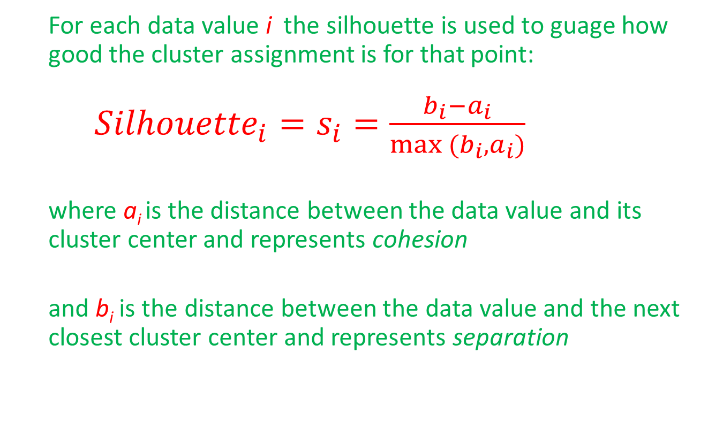
  The Silhouette Method
  For each data value i the silhouette is used to guage how good the cluster assignment is for that point:
  ${Silhouette}_{i}=s_{i}=\frac{b_{i}−a_{i}}{max (b_{i}, a_{i})}$
  where a_{i} is the distance between the data value and its cluster center and represents cohesion
  and b_{i} is the distance between the data value and the next closest cluster center and represents separation

Slide 5
  The Silhouette Method (cont.)
  A positive value indicates that the assignment is good, with higher values better than lower values
  A value close to zero is considered to be weak since the observation could have been assigned to the next cluster with little negative consequence
  A negative value is considered to be misclassified since assignment to the next closest cluster would have been better

Slide 6
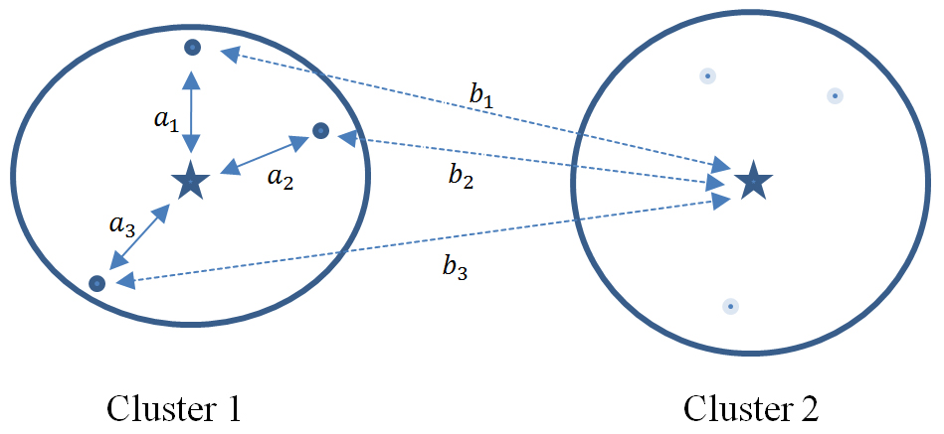
  Silhouette Accounts for Separation & Cohesion
  Each data value in Cluster 1 has its values of a_{i} and b_{i} represented by solid and dotted lines, respectively
  b_{i} > a_{i} for each data value, thus each data value’s silhouette is positive, indicating the data are not misclassified

Slide 7
  The Average Silhouette Value
  The average silhouette value over all records yields a measure of how well the cluster solution fits. A thumbnail interpretation, meant as a guide only:
  0.5 or better provides good evidence of the reality of the clusters in the data
  0.25 – 0.5 provides some evidence of the reality of the clusters in the data.
  Less than 0.25 provides scant evidence of cluster reality

Slide 8
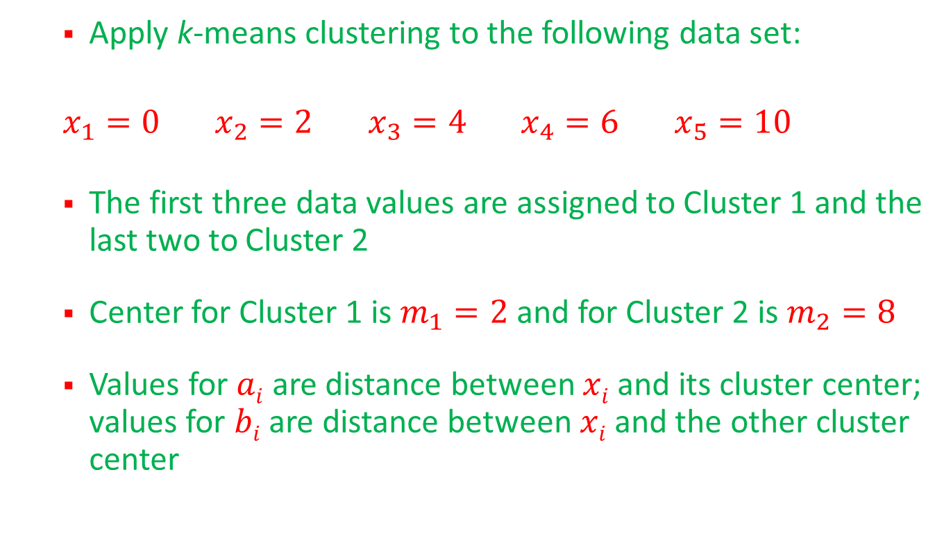
  Silhouette Example (cont.)
  Apply k-means clustering to the following data set:
  $x_{1}=0$ $x_{2}=2$ $x_{3}=4$ $x_{4}=6$ $x_{5}=10$
  The first three data values are assigned to Cluster 1 and the last two to Cluster 2
  Center for Cluster 1 is $m_{1}=2$ and for Cluster 2 is $m_{2}=8$
  Values for $ai$ are distance between $xi$ and its cluster center; values for $bi$ are distance between $xi$ and the other cluster center

Slide 9
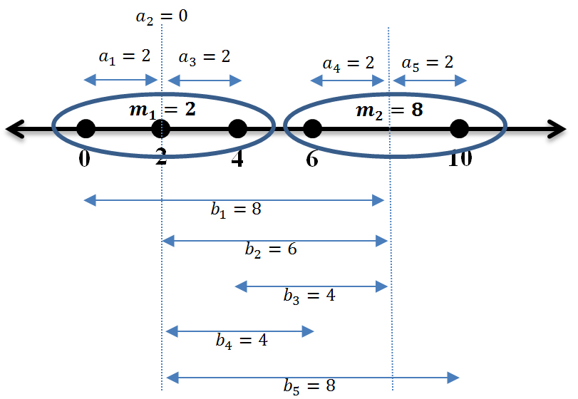
  Silhouette Example (cont.)
  Distances between the data values and cluster centers:

Slide 10
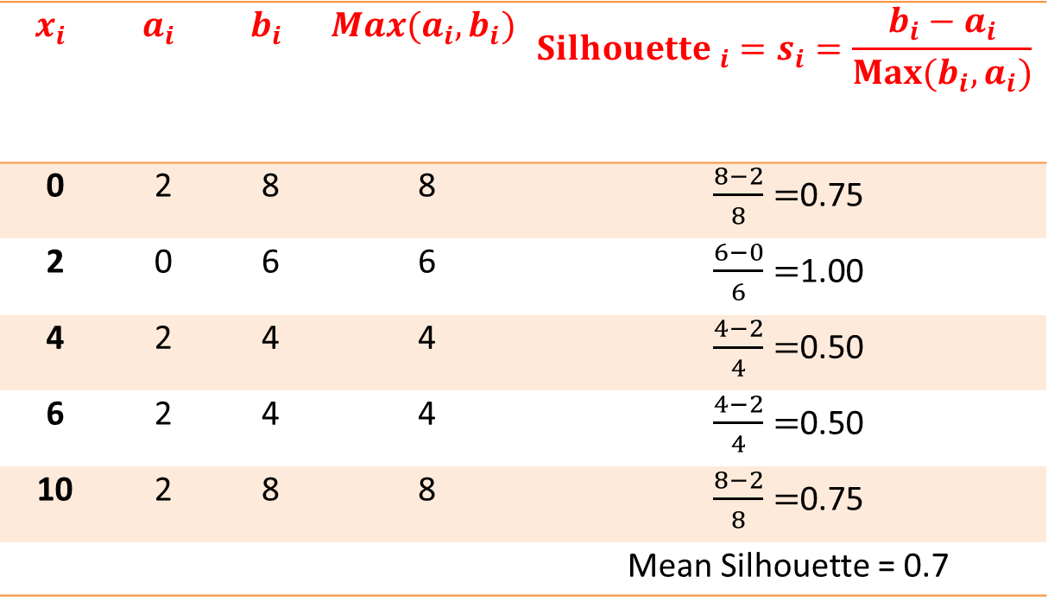
  Silhouette Example (cont.)
  Calculations for individual data values:
$$x_{i}$$ | $$a_{i}$$ | $$b_{i}$$ | $${Max(a}_{i},b_{i})$$ | $${Silhouette }_{i}=s_{i}=\frac{b_{i}−a_{i}}{Max⁡(b_{i}, a_{i})}$$
0 | 2 | 8 | 8 | $\frac{8−2}{8}=$0.75
2 | 0 | 6 | 6 | $\frac{6−0}{6}=$1.00
4 | 2 | 4 | 4 | $\frac{4−2}{4}=$0.50
6 | 2 | 4 | 4 | $\frac{4−2}{4}=$0.50
10 | 2 | 8 | 8 | $\frac{8−2}{8}=$0.75
 |  |  |  | Mean Silhouette = 0.7

Slide 11
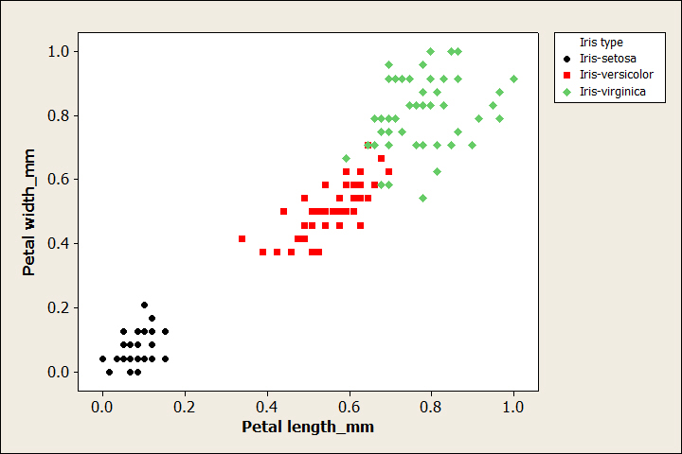
  Silhouette Analysis of Iris Data
  Scatterplot of petal width vs. petal length by species, where two of the species seem to blend into one another

Slide 12
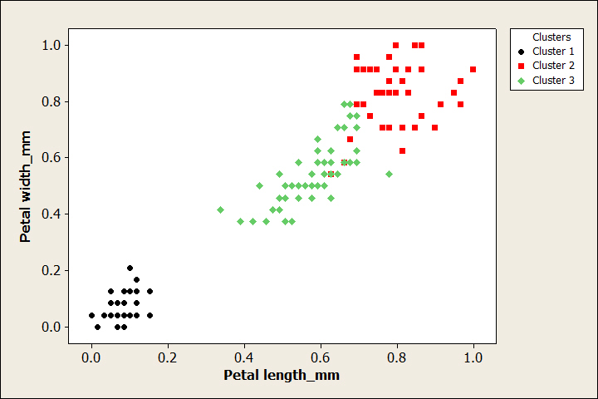
  Silhouette Analysis of Iris Data (cont.)
  Results of k=3 k-means clustering do not match perfectly with species:

Slide 13
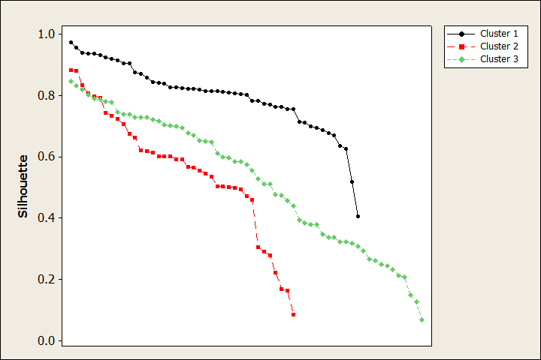
  Silhouette Analysis of Iris Data (cont.)
  Values of silhouette for each flower calculated and shown sorted from highest to lowest for each cluster:

Slide 14
  Silhouette Analysis of Iris Data (cont.)
  Cluster 1 is the best defined with most values rather high
  Clusters 2 and 3 have some high and some low values
  The mean silhouette values for each cluster suggest that Cluster 1 is well defined, and that Clusters 2 and 3 are not so well defined:
 | Cluster 1 | Cluster 2 | Cluster 3 | Overall
Mean Silhouette | 0.8002 | 0.5593 | 0.5254 | 0.6258

Slide 15
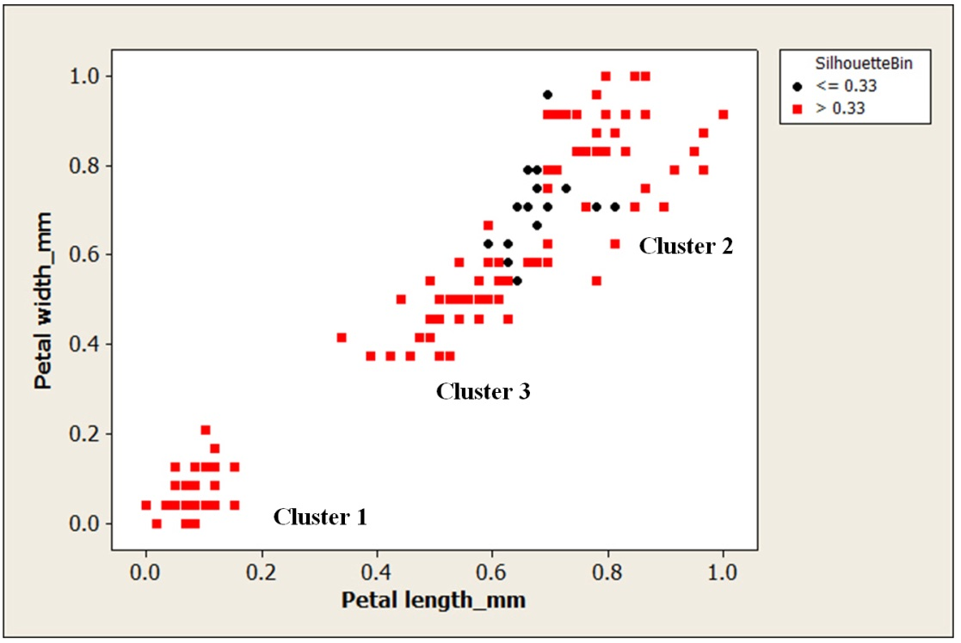
  Silhouette Analysis of Iris Data (cont.)
  Low silhouette values come from the boundary area between Clusters 2 and 3:

Slide 16
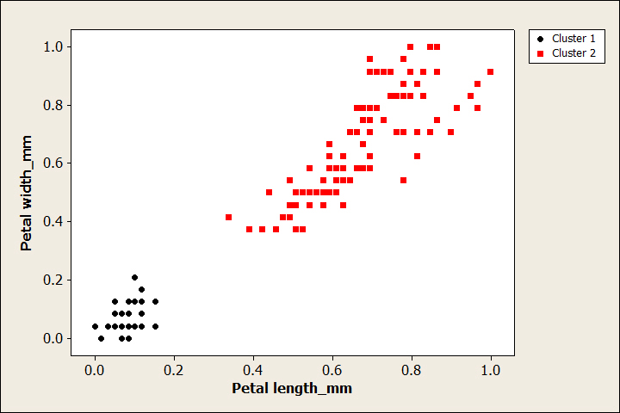
  Silhouette Analysis of Iris Data (cont.)
  Results of k=2 k-means clustering combine the Versicolor and Virginica into a single cluster:

Slide 17
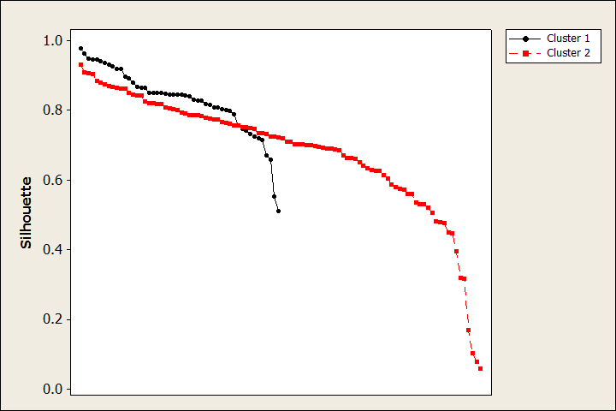
  Silhouette Analysis of Iris Data (cont.)
  The silhouette plot has fewer lower values than for k=3 and higher mean values
 | Cluster 1 | Cluster 2 | Overall
Mean Silhouette | 0.8285 | 0.6838 | 0.7321

Slide 18
Silhouette function in cluster package of R can be used to generate it.

Slide 19
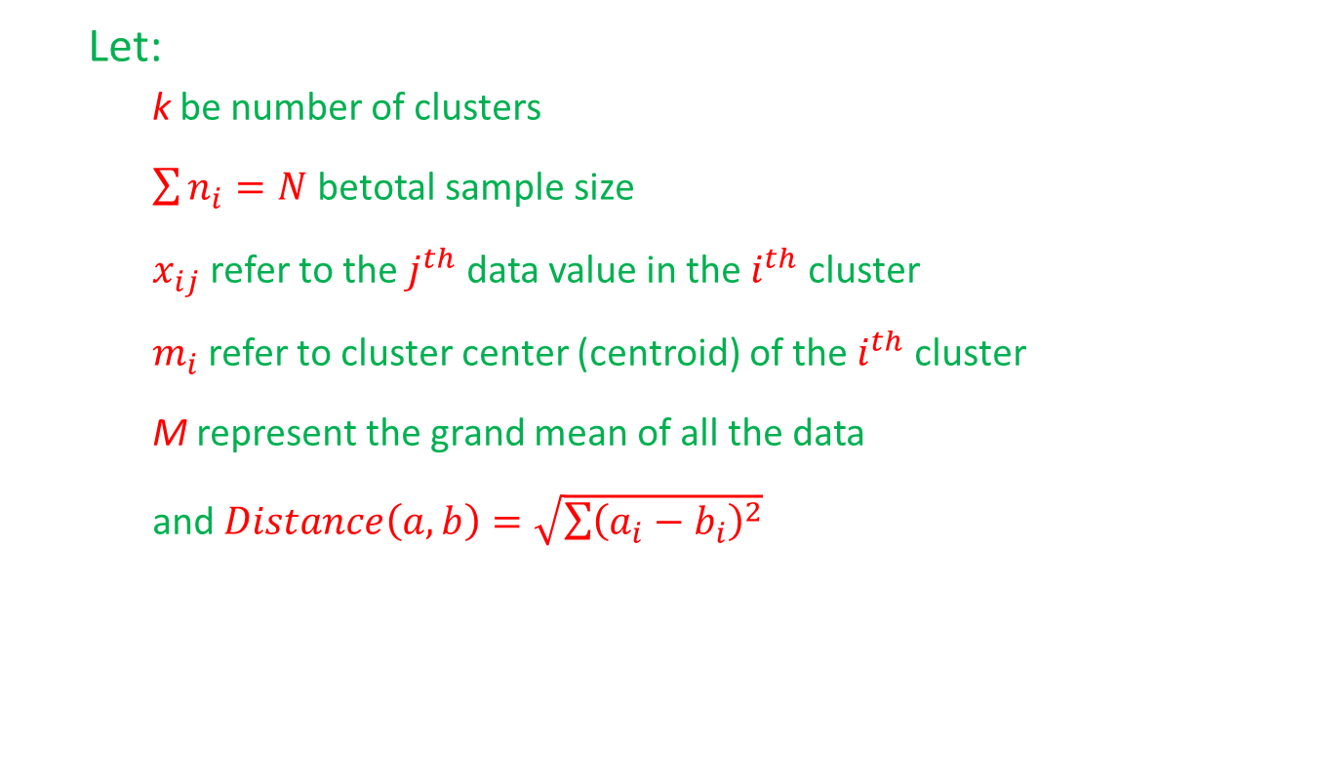
  The pseudo-F Statistic
  Let:
    k be number of clusters
    $\sum{n_{i}=N}$ betotal sample size
    $x_{ij}$ refer to the $j^{th}$ data value in the $i^{th}$ cluster
    $m_{i}$ refer to cluster center (centroid) of the $i^{th}$ cluster
    M represent the grand mean of all the data
    and $Distance\left(a,b\right)=\sqrt{\sum{{\left(a_{i}−b_{i}\right)}^{2}}}$

Slide 20
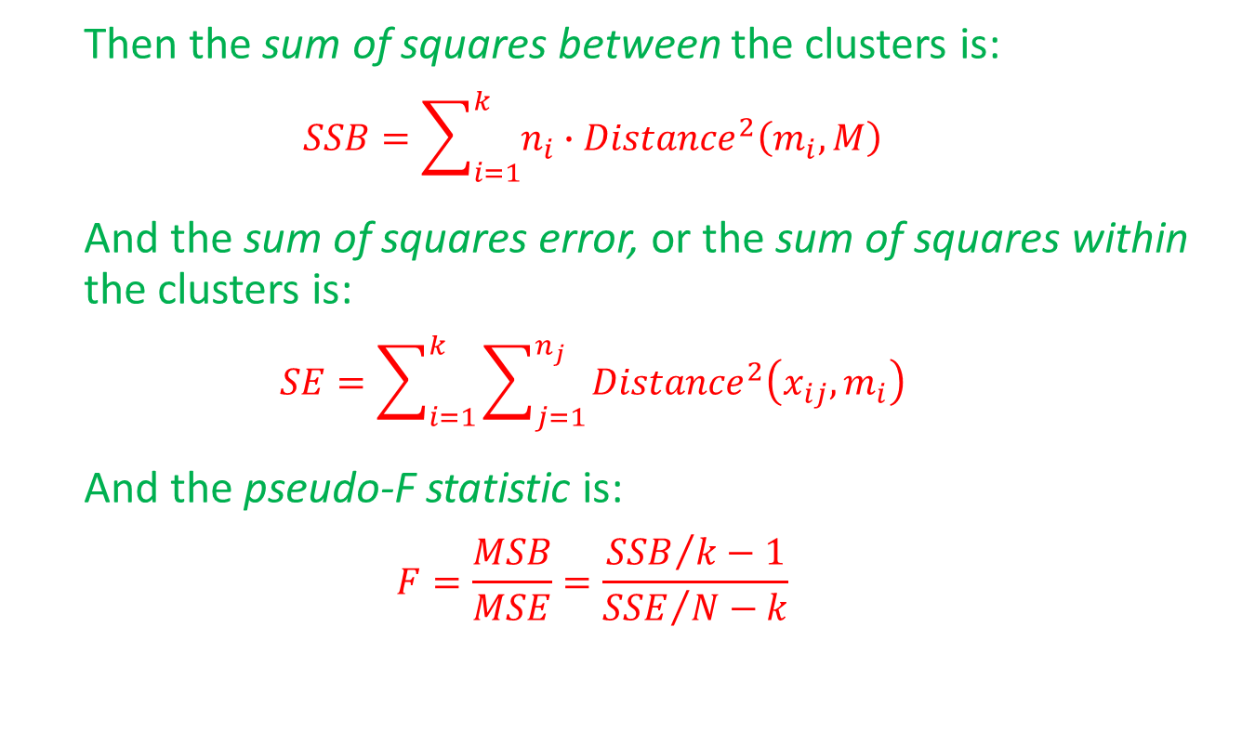
  The pseudo-F Statistic (cont.)
  Then the sum of squares between the clusters is:
  $$SSB=\sum_{i=1}^{k}{n_{i}∙{Distance}^{2}\left(m_{i}, M\right)}$$
  And the sum of squares error, or the sum of squares within the clusters is:
  $$SE=\sum_{i=1}^{k}{\sum_{j=1}^{n_{j}}{{Distance}^{2}\left(x_{ij},m_{i}\right)}}$$
  And the pseudo-F statistic is:
  $$F=\frac{MSB}{MSE}=\frac{{SSB}/{k−1}}{{SSE}/{N−k}}$$

Slide 21
  The pseudo-F Statistic (cont.)
  The pseudo-F statistic should not be used to determine the presence of clusters but can be used to select the optimal number of clusters

Slide 22
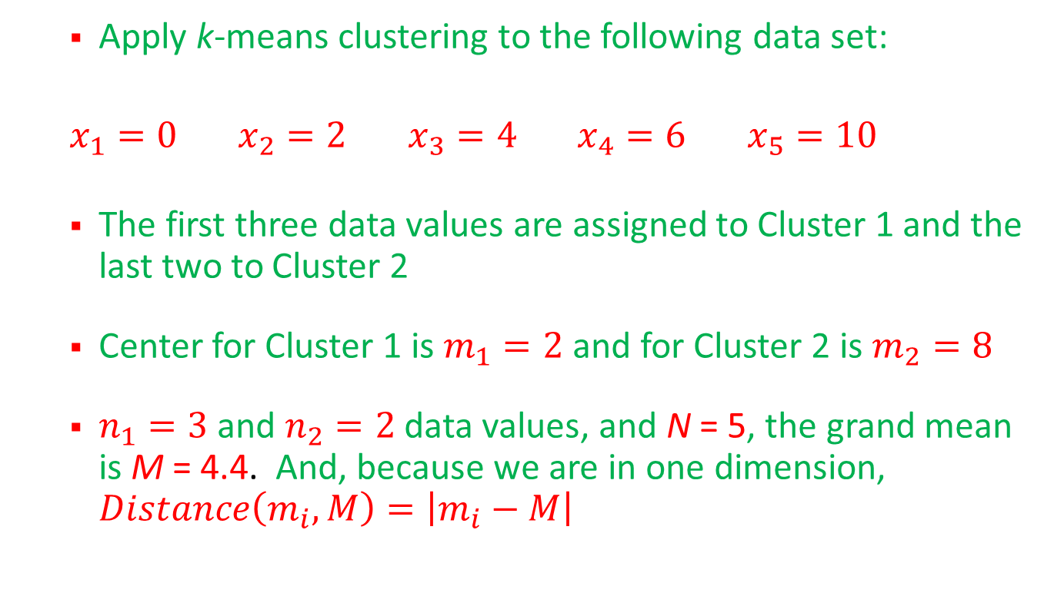
  Pseudo-F Statistic Example
  Apply k-means clustering to the following data set:
  $x_{1}=0$ $x_{2}=2$ $x_{3}=4$ $x_{4}=6$ $x_{5}=10$
  The first three data values are assigned to Cluster 1 and the last two to Cluster 2
  Center for Cluster 1 is $m_{1}=2$ and for Cluster 2 is $m_{2}=8$
  $n_{1}=3$ and $n_{2}=2$ data values, and N = 5, the grand mean is M = 4.4. And, because we are in one dimension, $Distance\left(m_{i}, M\right)=\left|m_{i}−M\right|$

Slide 23
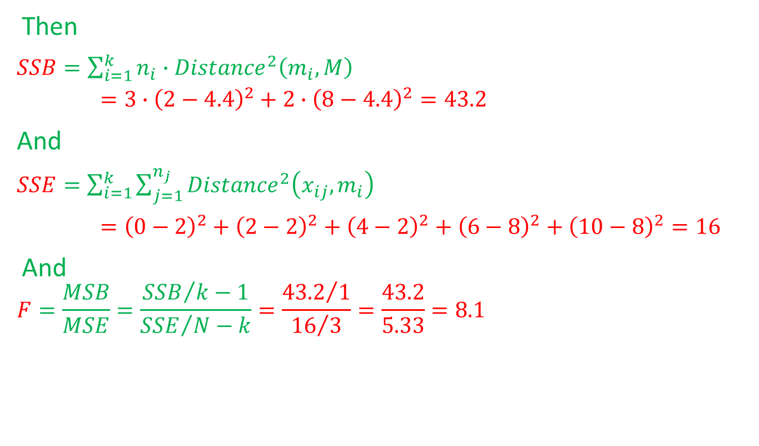
  Pseudo-F Statistic Example (cont.)
Then
$SSB=\sum_{i=1}^{k}{n_{i}∙{Distance}^{2}\left(m_{i}, M\right)}$
$=3∙{\left(2−4.4\right)}^{2}+2∙{\left(8−4.4\right)}^{2}=43.2$
And
$SSE=\sum_{i=1}^{k}{\sum_{j=1}^{n_{j}}{{Distance}^{2}\left(x_{ij},m_{i}\right)}}$
$={\left(0−2\right)}^{2}+{\left(2−2\right)}^{2}+{\left(4−2\right)}^{2}+{\left(6−8\right)}^{2}+{\left(10−8\right)}^{2}=16$
And
$$F=\frac{MSB}{MSE}=\frac{{SSB}/{k−1}}{{SSE}/{N−k}}=\frac{{43.2}/1}{{16}/3}=\frac{43.2}{5.33}=8.1$$

Slide 24
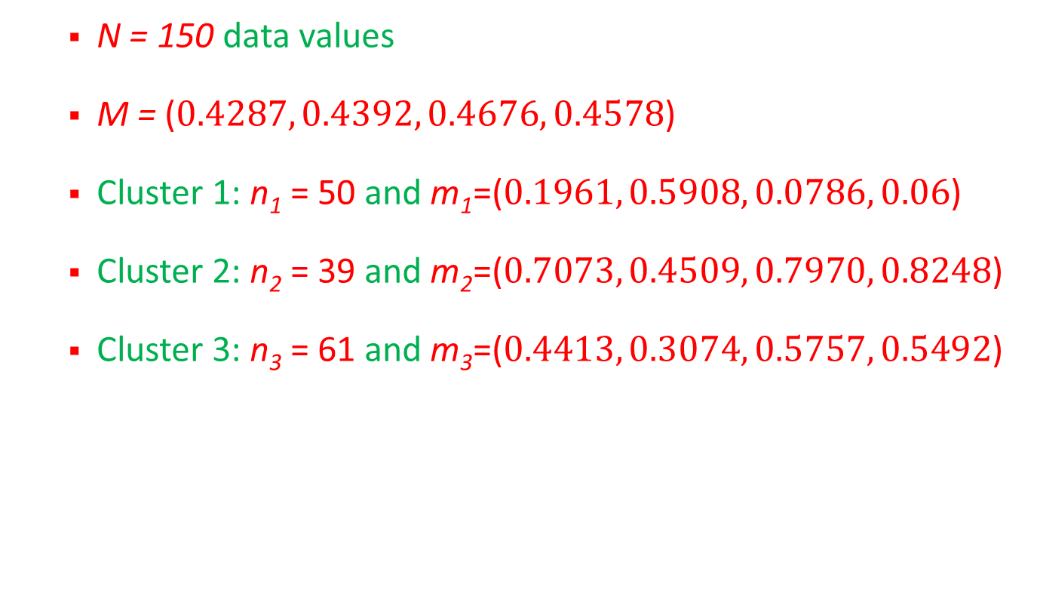
  Pseudo-F Statistic Applied to Iris Data
  N = 150 data values
  M = ($0.4287, 0.4392, 0.4676, 0.4578$)
  Cluster 1: n₁ = 50 and m₁=($0.1961, 0.5908, 0.0786, 0.06$)
  Cluster 2: n₂ = 39 and m₂=($0.7073, 0.4509, 0.7970, 0.8248$)
  Cluster 3: n₃ = 61 and m₃=($0.4413, 0.3074, 0.5757, 0.5492$)

Slide 25
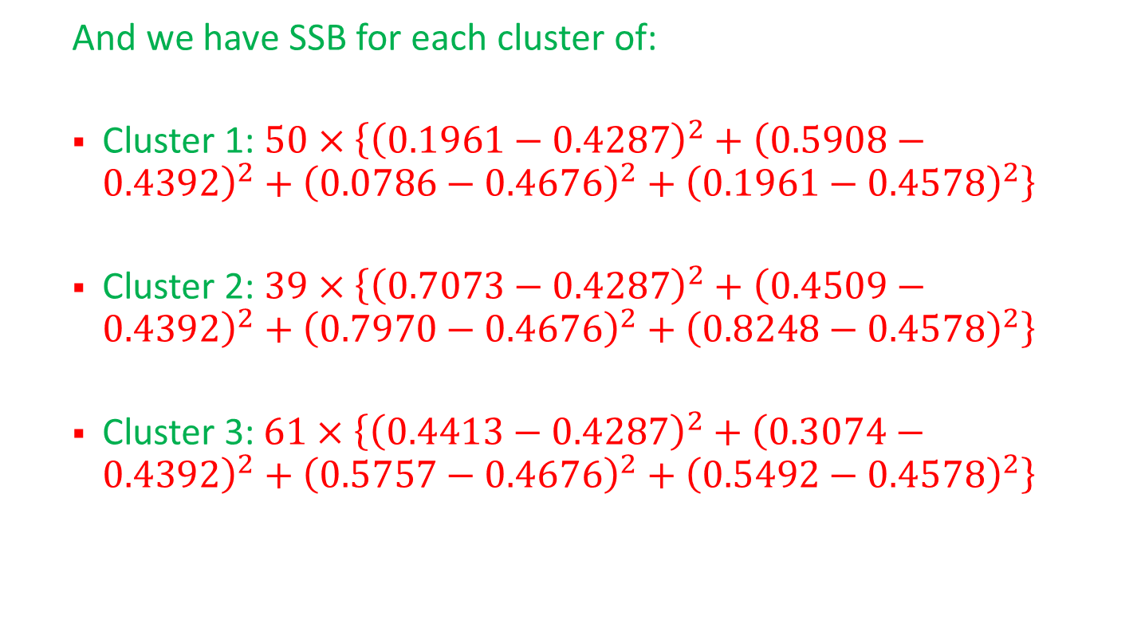
  Pseudo-F Statistic Applied to Iris Data (cont.)
  And we have SSB for each cluster of:
  Cluster 1: $50×\left\{{\left(0.1961−0.4287\right)}^{2}+{\left(0.5908−0.4392\right)}^{2}+{\left(0.0786−0.4676\right)}^{2}+{\left(0.1961−0.4578\right)}^{2}\right\}$
  Cluster 2: $39×\left\{{\left(0.7073−0.4287\right)}^{2}+{\left(0.4509−0.4392\right)}^{2}+{\left(0.7970−0.4676\right)}^{2}+{\left(0.8248−0.4578\right)}^{2}\right\}$
  Cluster 3:$61×\left\{{\left(0.4413−0.4287\right)}^{2}+{\left(0.3074−0.4392\right)}^{2}+{\left(0.5757−0.4676\right)}^{2}+{\left(0.5492−0.4578\right)}^{2}\right\}$

Slide 26
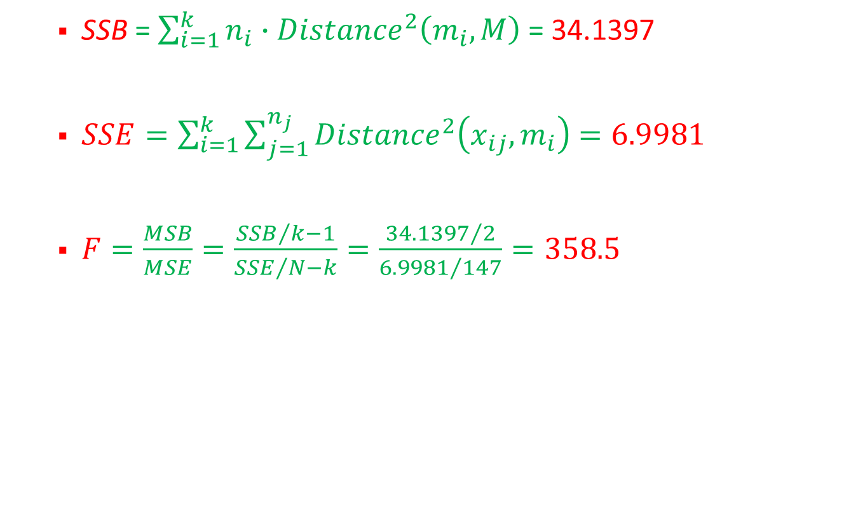
  Pseudo-F Statistic Applied to Iris Data (cont.)
  SSB = $\sum_{i=1}^{k}{n_{i}∙{Distance}^{2}\left(m_{i}, M\right)}$ = 34.1397
  $SSE=\sum_{i=1}^{k}{\sum_{j=1}^{n_{j}}{{Distance}^{2}\left(x_{ij},m_{i}\right)}}$ $=6.9981$
  $F=\frac{MSB}{MSE}=\frac{{SSB}/{k−1}}{{SSE}/{N−k}}=\frac{{34.1397}/2}{{6.9981}/{147}}=358.5$

