Slide 1
Clustering

Slide 2
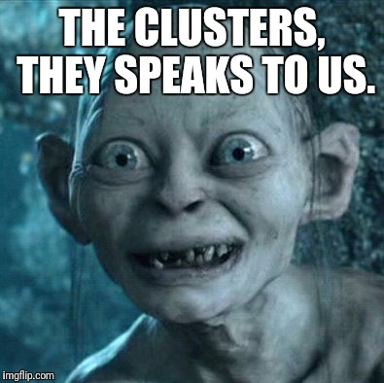
Unsupervised

Slide 3
INTRODUCTION TO CLUSTERING
Cluster analysis or clustering is the task of grouping a set of objects in such a way that objects in the same group are more similar to each other than to those in other groups

Slide 4


Slide 5
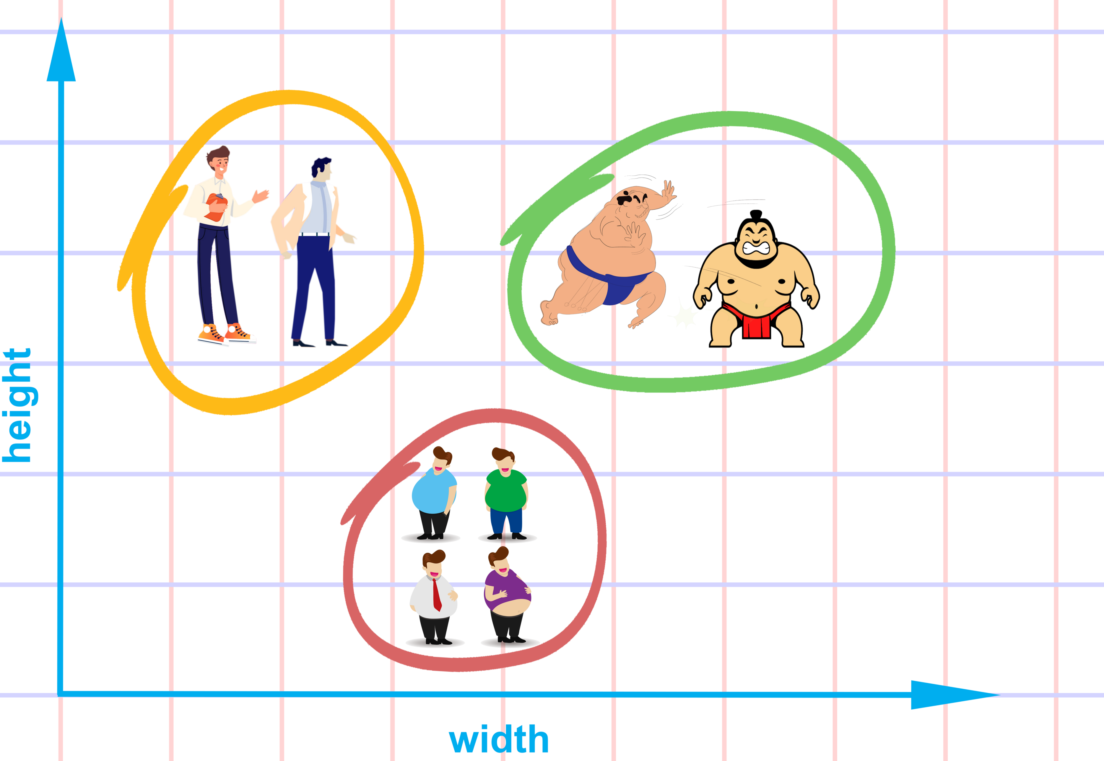

Slide 6
Clustering is usually one of the first tasks performed in most analytics projects. It helps data scientists to analyze individual clusters further.

Slide 7
Applications of Cluster Analysis
Clustering analysis is broadly used in many applications such as market research, pattern recognition, data analysis, and image processing.
Clustering can also help marketers discover distinct groups in their customer base. And they can characterize their customer groups based on the purchasing patterns.
In the field of biology, it can be used to derive plant and animal taxonomies, categorize genes with similar functionalities and gain insight into structures inherent to populations.
Clustering also helps in identification of areas of similar land use in an earth observation database. It also helps in the identification of groups of houses in a city according to house type, value, and geographic location.
Clustering also helps in classifying documents on the web for information discovery.
Clustering is also used in outlier detection applications such as detection of credit card fraud.
As a data mining function, cluster analysis serves as a tool to gain insight into the distribution of data to observe characteristics of each cluster.

Slide 8
Example: Public Utilities
Goal: find clusters of similar utilities
Data: 22 firms, 8 variables
    Fixed-charge covering ratio
    Rate of return on capital
    Cost per kilowatt capacity
    Annual load factor
    Growth in peak demand
    Sales
    % nuclear
    Fuel costs per kwh

Slide 9
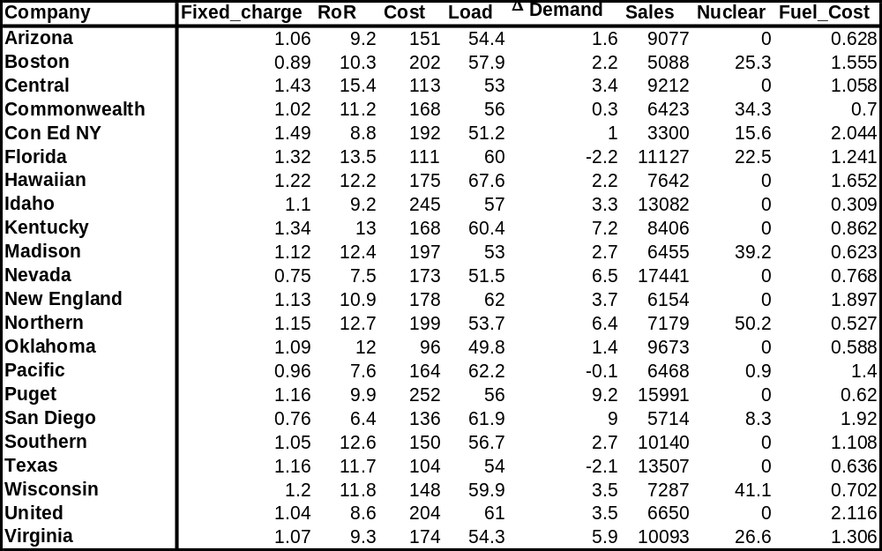

Slide 10
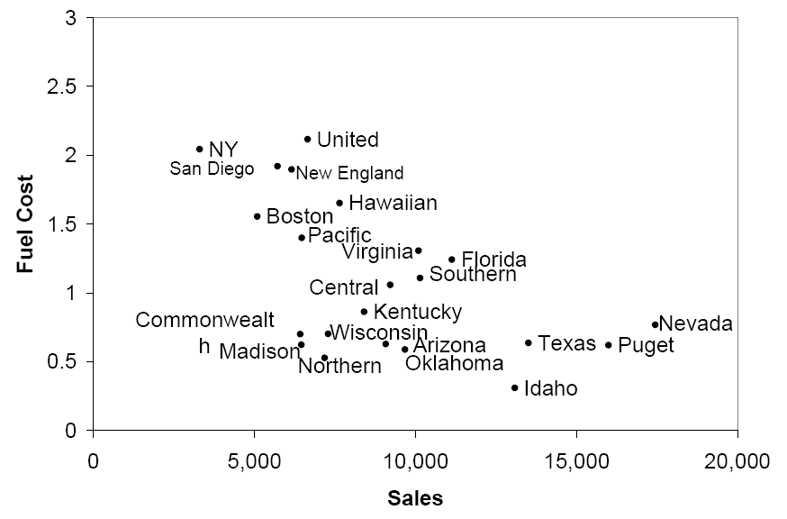
Based on Sales & Fuel Cost:
3 rough clusters can be seen
High fuel cost, low sales
Low fuel cost, high sales
Low fuel cost, low sales

Slide 11
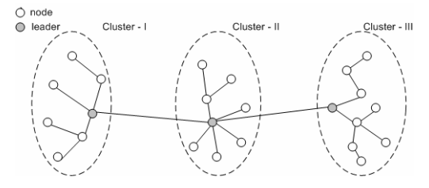
Non-overlapping clusters
Cluster in which each observation belongs to only one cluster. Non-overlapping clusters are more frequently used clustering techniques in practice.

Slide 12
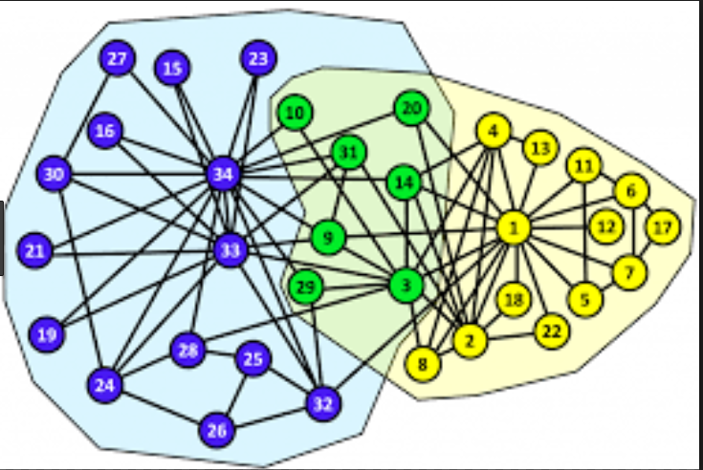
Overlapping clusters
An observation may belong to more than one cluster

Slide 13
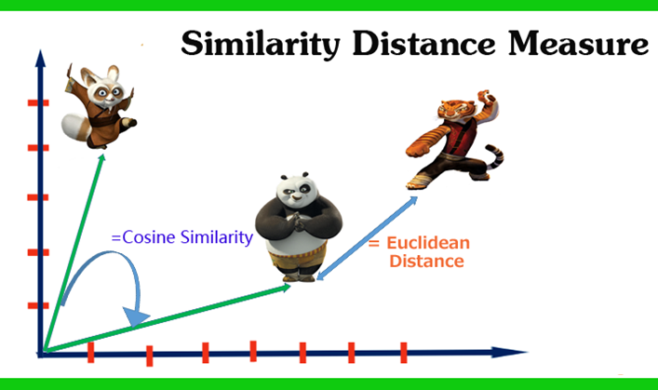
Distances

Slide 14
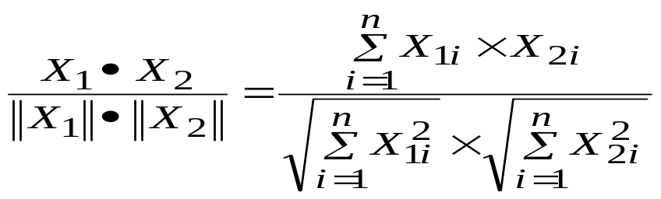
Cosine Similarity
The cosine similarity between X₁ and X₂ is given by
Similarity (X1, X2) = cos(θ) =
In cosine similarity, X₁ and X₂ are two n-dimensional vectors and it measures the angle between two vectors (thus called vector space model).

Slide 15
Euclidean Distance
Euclidean is one of the frequently used distance measures when the data are either in interval or ratio scale.
The Eucledian distance between two n-dimensional observations X₁ (x₁₁, x₁₂, …, x_{1n}) and X₂ (x₂₁, x₂₂, …, x_{2n}) is given by

Slide 16
K-Means Clustering
K-means clustering is one of the frequently used clustering algorithms.
It is a non-hierarchical clustering method in which the number of clusters (K) is decided a priori.

Slide 17
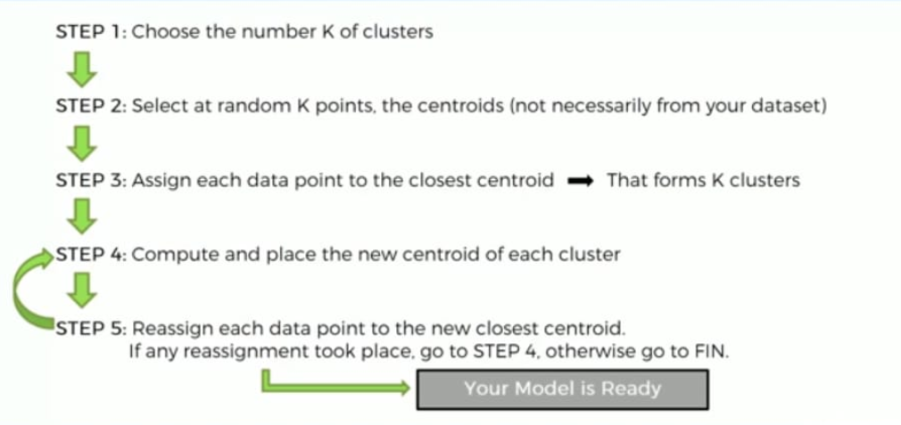

Slide 18
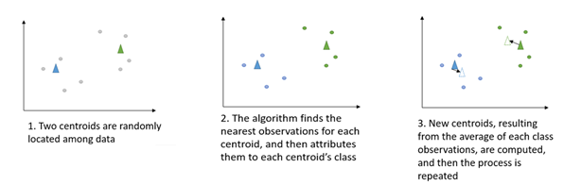

Slide 19
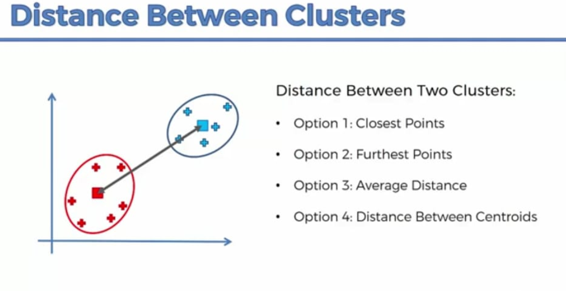

Slide 20
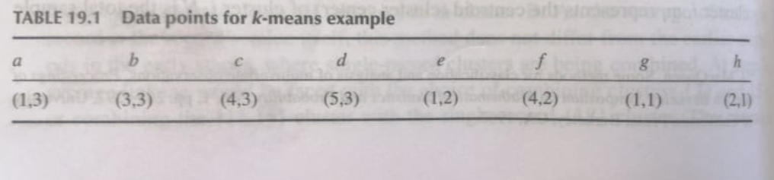

Slide 21
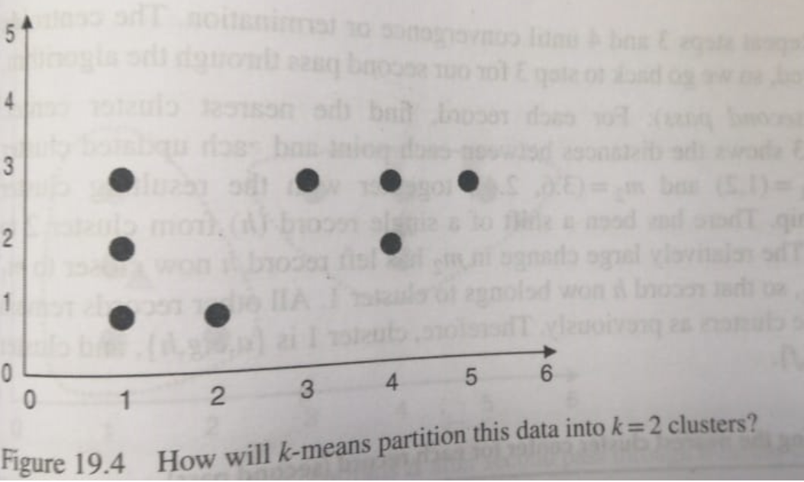

Slide 22
Initial cluster
M1(1,1)
M2(2,1)

Slide 23
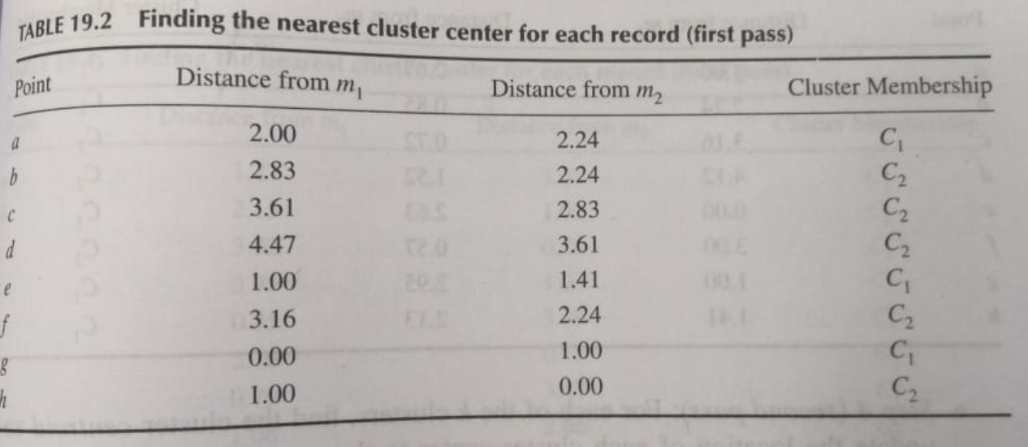

Slide 24
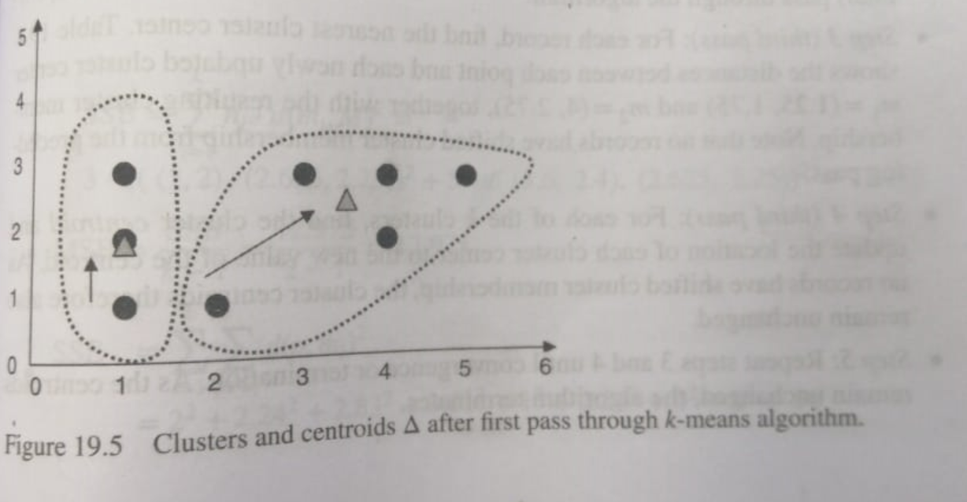

Slide 25
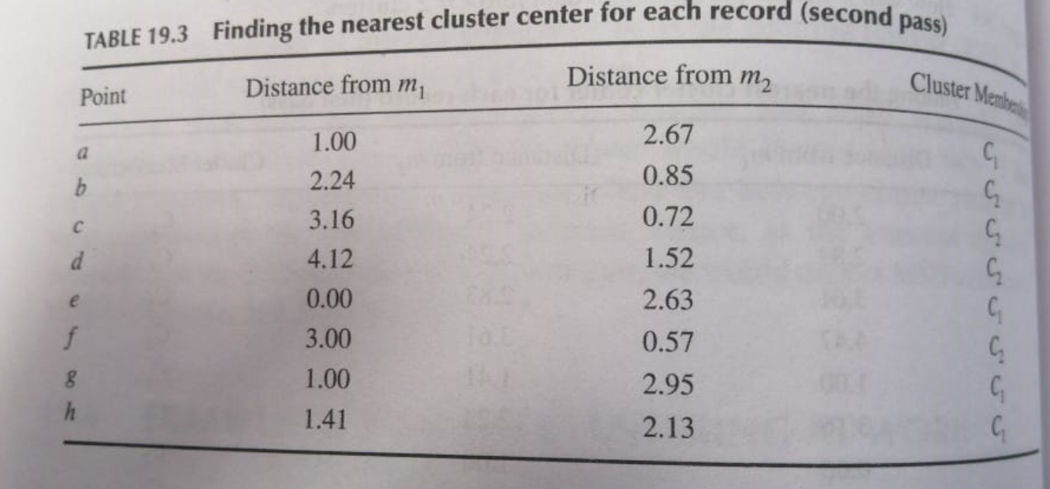

Slide 26
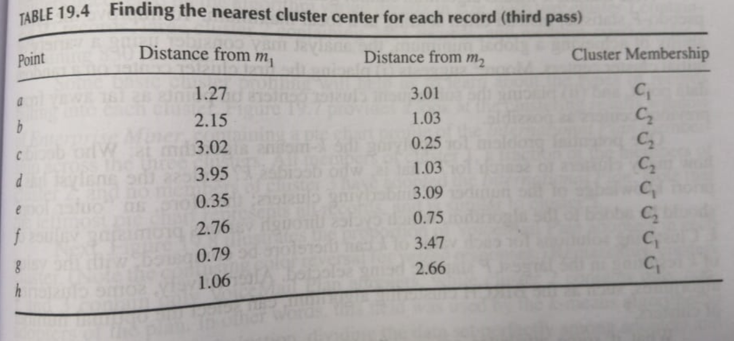

Slide 27
In class problem
Student | History Grade | Geography Grade
A | 2 | 2
B | 3 | 2
C | 1 | 1
D | 3 | 1
E | 1.5 | 0.5
Create clusters, presume k = 2

Slide 28
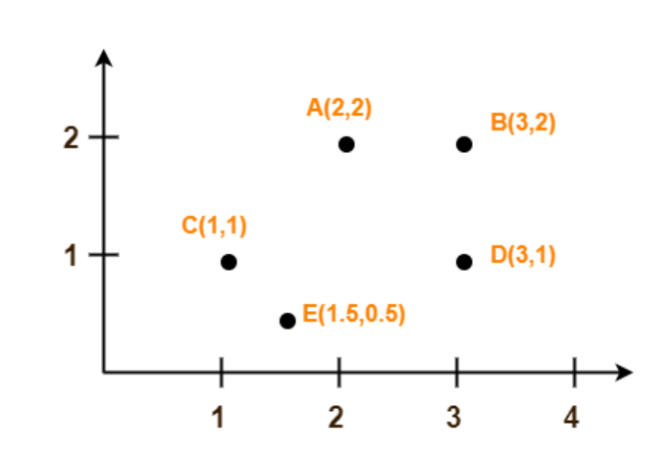

Slide 29
Assume A(2, 2) and C(1, 1) are centers of the two clusters.

Slide 30

within-cluster sum of squares (WCSS):

Slide 31
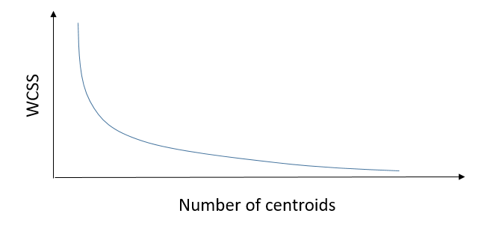
elbow of the arm is the optimal number of centroids (clusters) .

Slide 32
Hands on
R
https://hub.knime.com/knime/spaces/Examples/04_Analytics/03_Clustering/01_Performing_a_k-Means_Clustering~QqKlIQmDnCAg0lEQ/most-recent
https://hub.knime.com/knime/spaces/Examples/50_Applications/24_Customer_Segmentation_Use_Case/02_Customer_Segmentation_Use_Case~37cHxqru6dblIUeP/most-recent

Slide 33
Measuring Cluster Goodness

Slide 34
  Rational for Measuring Cluster Goodness
  Do clusters correspond to reality or are they simply artifacts of mathematical convenience?
  What are the optimal number of cluster to identify?
  How do I measure weather one set of clusters is preferable to another?
  The silhouette method and the pseudo-F statistic will help us address these questions by measuring cluster goodness

Slide 35
  Concepts Measures Should Address
  Cluster separation represents how distant the clusters are from each other
  Cluster cohesion refers to how tightly related the records within the individual clusters are
  Good measures should incorporate both as do the silhouette and pseudo-F statistic
  However, the sum of squares error (SSE) only accounts for cluster cohesion and is monotonically decreasing with increasing numbers of clusters

Slide 36
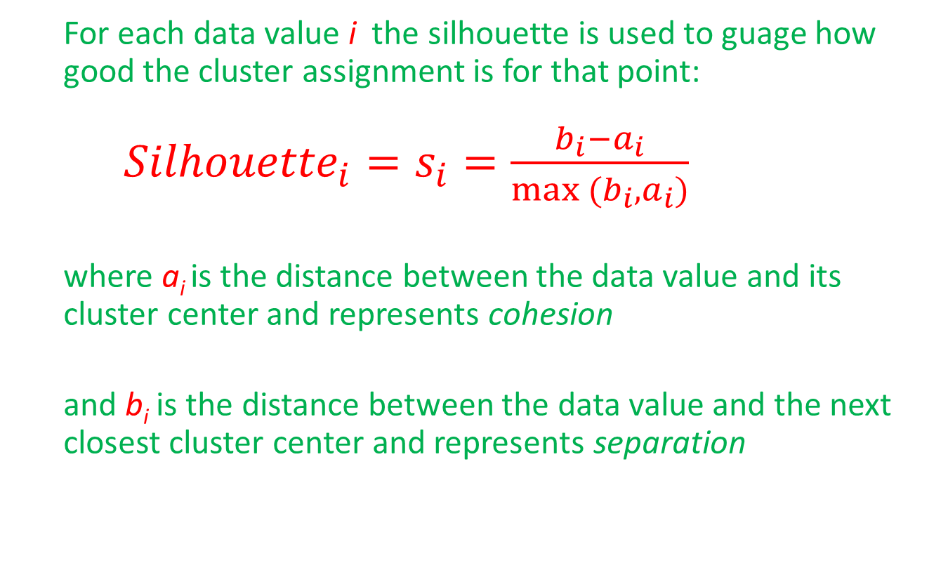
  The Silhouette Method
  For each data value i the silhouette is used to guage how good the cluster assignment is for that point:
  ${Silhouette}_{i}=s_{i}=\frac{b_{i}−a_{i}}{max (b_{i}, a_{i})}$
  where a_{i} is the distance between the data value and its cluster center and represents cohesion
  and b_{i} is the distance between the data value and the next closest cluster center and represents separation

Slide 37
  The Silhouette Method (cont.)
  A positive value indicates that the assignment is good, with higher values better than lower values
  A value close to zero is considered to be weak since the observation could have been assigned to the next cluster with little negative consequence
  A negative value is considered to be misclassified since assignment to the next closest cluster would have been better

Slide 38
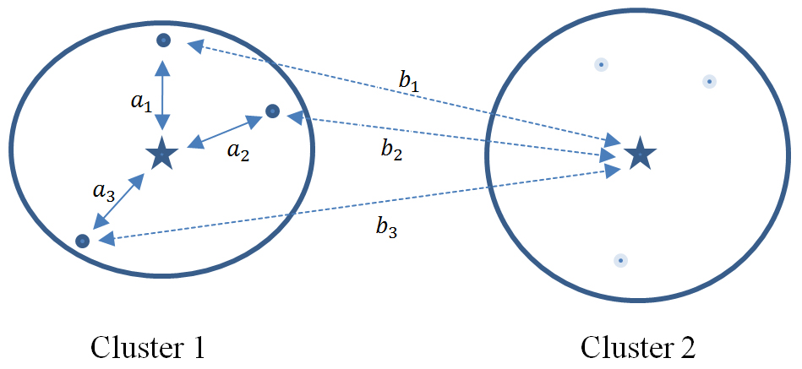
  Silhouette Accounts for Separation & Cohesion
  Each data value in Cluster 1 has its values of a_{i} and b_{i} represented by solid and dotted lines, respectively
  b_{i} > a_{i} for each data value, thus each data value’s silhouette is positive, indicating the data are not misclassified

Slide 39
  The Average Silhouette Value
  The average silhouette value over all records yields a measure of how well the cluster solution fits. A thumbnail interpretation, meant as a guide only:
  0.5 or better provides good evidence of the reality of the clusters in the data
  0.25 – 0.5 provides some evidence of the reality of the clusters in the data.
  Less than 0.25 provides scant evidence of cluster reality

Slide 41
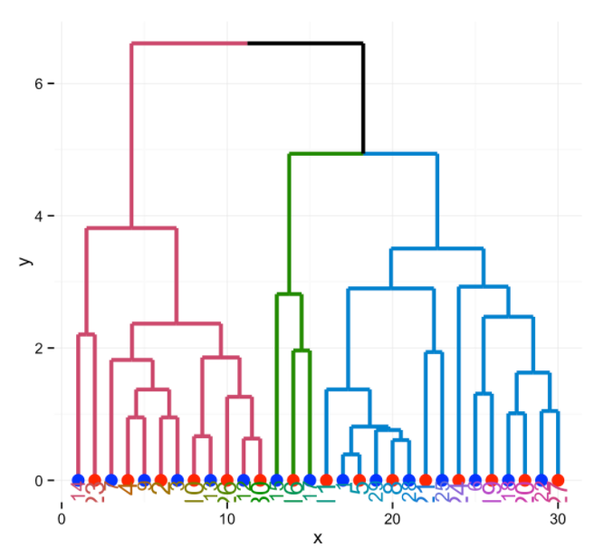
Hierarchical clustering
Hierarchical clustering creates subsets of data similar to a tree-like structure in which the root node corresponds to the complete set of data. Branches are created from the root node to split the data into heterogeneous subsets (clusters).

Slide 42
Hierarchical Methods
Agglomerative Methods
  Begin with n-clusters (each record its own cluster)
  Keep joining records into clusters until one cluster is left (the entire data set)
  Most popular
Divisive Methods
  Start with one all-inclusive cluster
  Repeatedly divide into smaller clusters

Slide 43
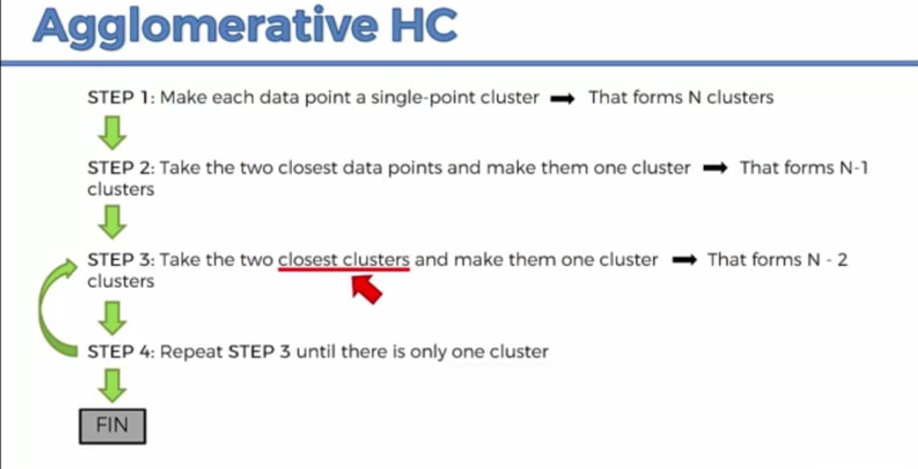

Slide 44
