Slide 1
Cloud Computing & modern product architectures

Slide 2
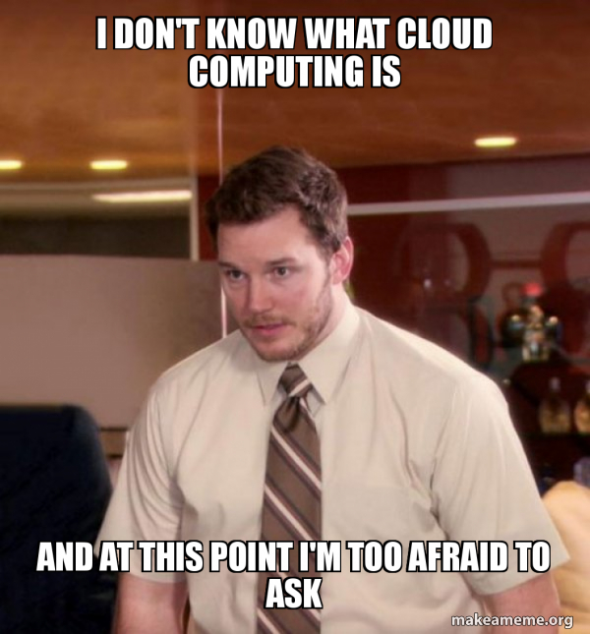

Slide 3
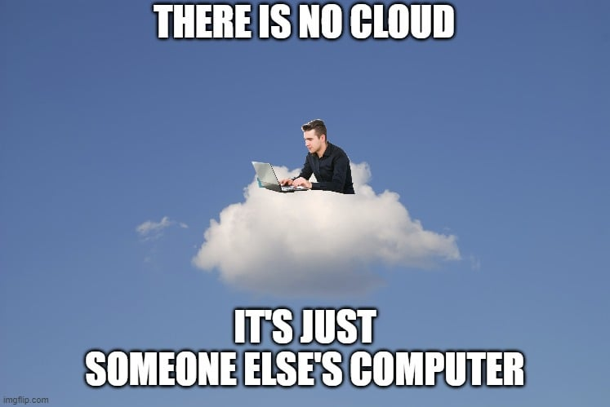
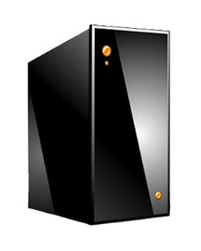
What is a Cloud?
It’s a cluster!
It’s a supercomputer!
It’s a datastore!
It’s superman!
None of the above
All of the above
Cloud = Lots of storage + compute cycles nearby

Slide 4

What is a Cloud?
Cloud computing is the on-demand availability of computer system resources, especially data storage and computing power, without direct active management by the user. Large clouds often have functions distributed over multiple locations, each of which is a data center

Slide 5
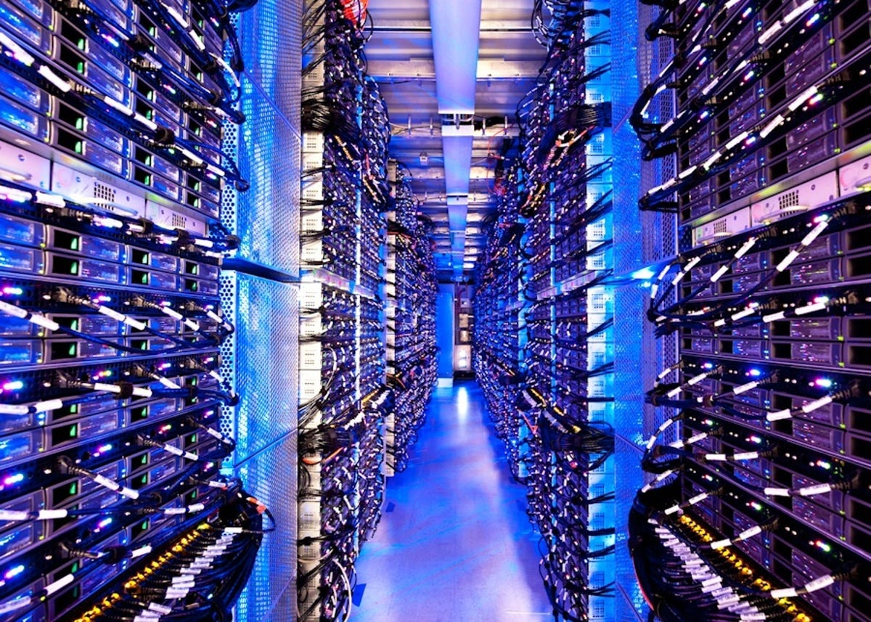


Slide 6


A single-site cloud (aka “Datacenter”) consists of
  Compute nodes (grouped into racks) (2)
  Switches, connecting the racks
  A network topology, e.g., hierarchical
  Storage (backend) nodes connected to the network (3)
  Front-end for submitting jobs and receiving client requests (1)
  (1-3: Often called “three-tier architecture”)
  Software Services
A geographically distributed cloud consists of
  Multiple such sites
  Each site perhaps with a different structure and services

Slide 7
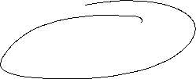

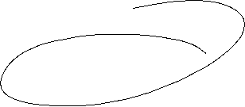
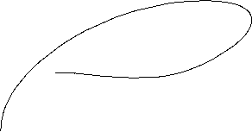
Two Categories of Clouds
Can be either a (i) public cloud, or (ii) private cloud
Private clouds are accessible only to company employees
Public clouds provide service to any paying customer
You’re starting a new service/company: should you use a public cloud or purchase your own private cloud?

Slide 8
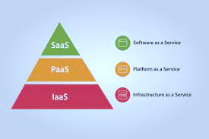






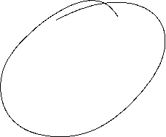




Slide 9
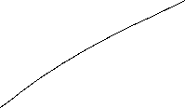






SaaS
SaaS (sometimes called cloud application services) is cloud-hosted, ready-to-use application software.
Users pay a monthly or annual fee to use a complete application from within a web browser, desktop client or mobile app.
The application and all of the infrastructure required to deliver it—servers, storage, networking, middleware, application software, data storage—are hosted and managed by the SaaS vendor.

Slide 10
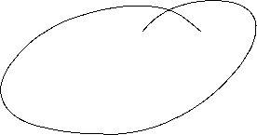



PaaS
PaaS provides a cloud-based platform for developing, running, managing applications.
The cloud services provider hosts manages and maintains all the hardware and software included in the platform—servers (for development, testing and deployment), operating system (OS) software, storage, networking, databases, middleware, runtimes, frameworks, development tools—as well as related services for security, operating system and software upgrades, backups and more.

Slide 11


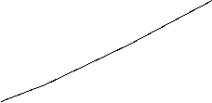

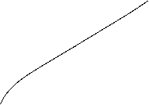
IaaS
IaaS is on-demand access to cloud-hosted computing infrastructure—servers, storage capacity and networking resources—that customers can provision, configure and use in much the same way as they use on-premises hardware.
The difference is that the cloud service provider hosts, manages and maintains the hardware and computing resources in its own data centers.
VMs
IaaS customers use the hardware via an internet connection, and pay for that use on a subscription or pay-as-you-go basis.

Slide 12
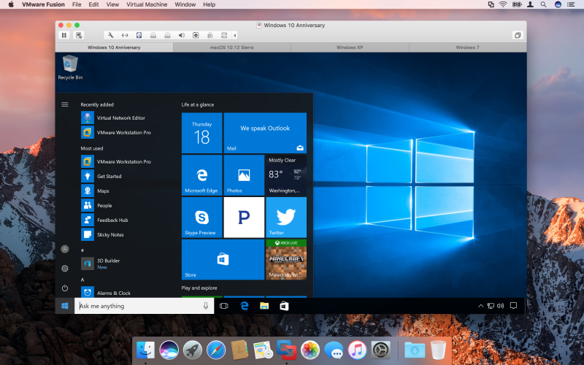
Vmware

Slide 13

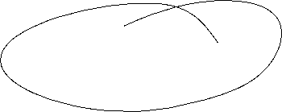

To Use or Not to Use !
Medium-sized organization: wishes to run a service for M months
  Service requires 128 servers (1024 cores) and 524 TB
  Same as UIUC CCT (Cloud Computing Testbed) cloud site (bought in 2009, now decommissioned)
Outsource (e.g., via AWS): monthly cost
  S3 costs: $0.12 per GB month. EC2 costs: $0.10 per CPU hour (costs from 2009)
  Storage = $ 0.12 X 524 X 1000 ~ $62 K
  Total = Storage + CPUs = $62 K + $0.10 X 1024 X 24 X 30 ~ $136 K
Own: monthly cost
  Storage ~ $349 K / M
  Total ~ $ 1555 K / M + 7.5 K (includes 1 sysadmin / 100 nodes)
    using 0.45:0.4:0.15 split for hardware:power:network and 3 year lifetime of hardware

Slide 14
To Use or Not to Use !
Breakeven analysis: more preferable to own if:
  ^{- $349 K / M < $62 K (storage)}
  ⁻ $ 1555 K / M + 7.5 K < $136 K (overall)
  ^{Breakeven points}
  ^{M > 5.55 months (storage)}
  ^{M > 12 months (overall)}
^{As a result}
    ^{Startups use clouds a lot}
    Cloud providers benefit monetarily most from storage

Slide 15
Free and Pricing
https://aws.amazon.com/free/
https://aws.amazon.com/premiumsupport/technology/trusted-advisor/
https://cloud.google.com/products/calculator?hl=en

Slide 16



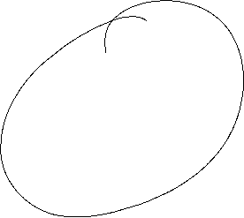


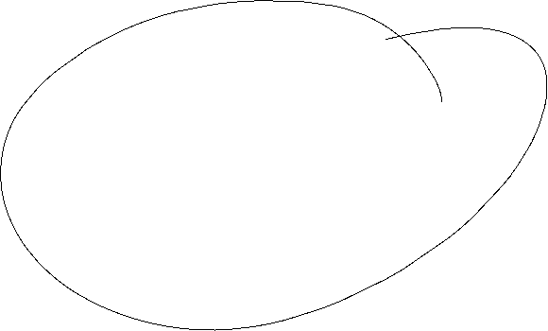










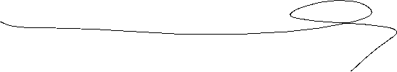

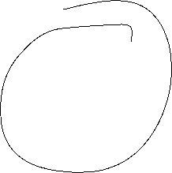








Slide 17
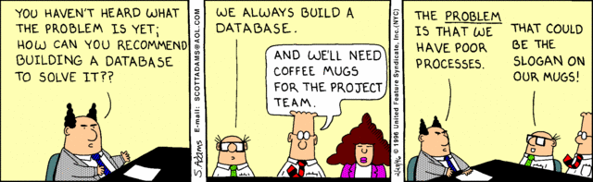

Slide 18
Difference between software and program ?

Slide 19
Why it’s important for you ?

Slide 20
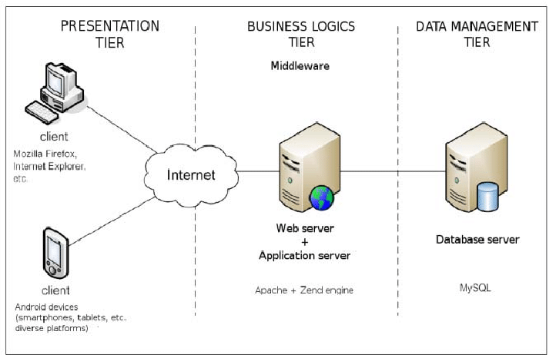
Web Application 3 Tier Architecture
Santi et al , Building a Software Service for Mobile Devices to Enhance Awareness in Web Collaboration, - Proceedings - 2014 International Conference on Intelligent Networking and Collaborative Systems, IEEE INCoS 2014

Slide 21
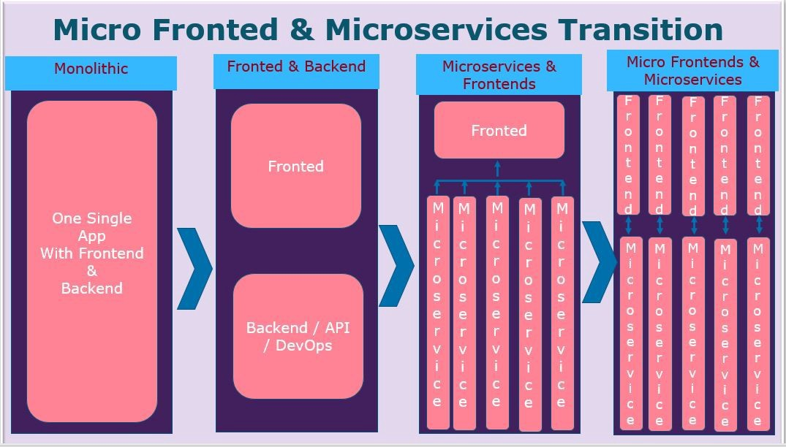
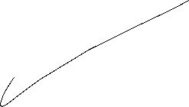





Evolution of Webapp Architecture

Slide 22
Microservices
are the architectural approach to building an application backend as a composition of multiple, loosely coupled, and independently deployable smaller components, or services.
Each service runs its own process and has its own codebase, integration pipelines.

Slide 23
Micro frontend
is an architectural and organizational style (NOT a specific technology!!!) in which the front-end of the app is decomposed into individual, loosely coupled “micro apps” that can be built, tested, and deployed independently.
Micro frontends break modern web apps into pages and feature slices.
Just like in the world of microservices where the backend is chopped into individual services.

Slide 24
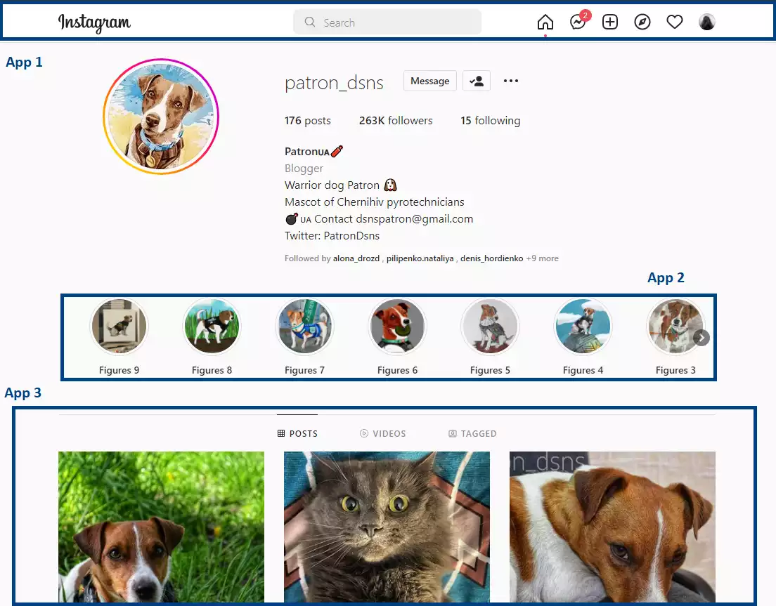
https://www.instagram.com/patron_dsns/
An Instagram web page presented as a set of possible micro-apps

Slide 25
How does Micro frontend style impact project management

Slide 26
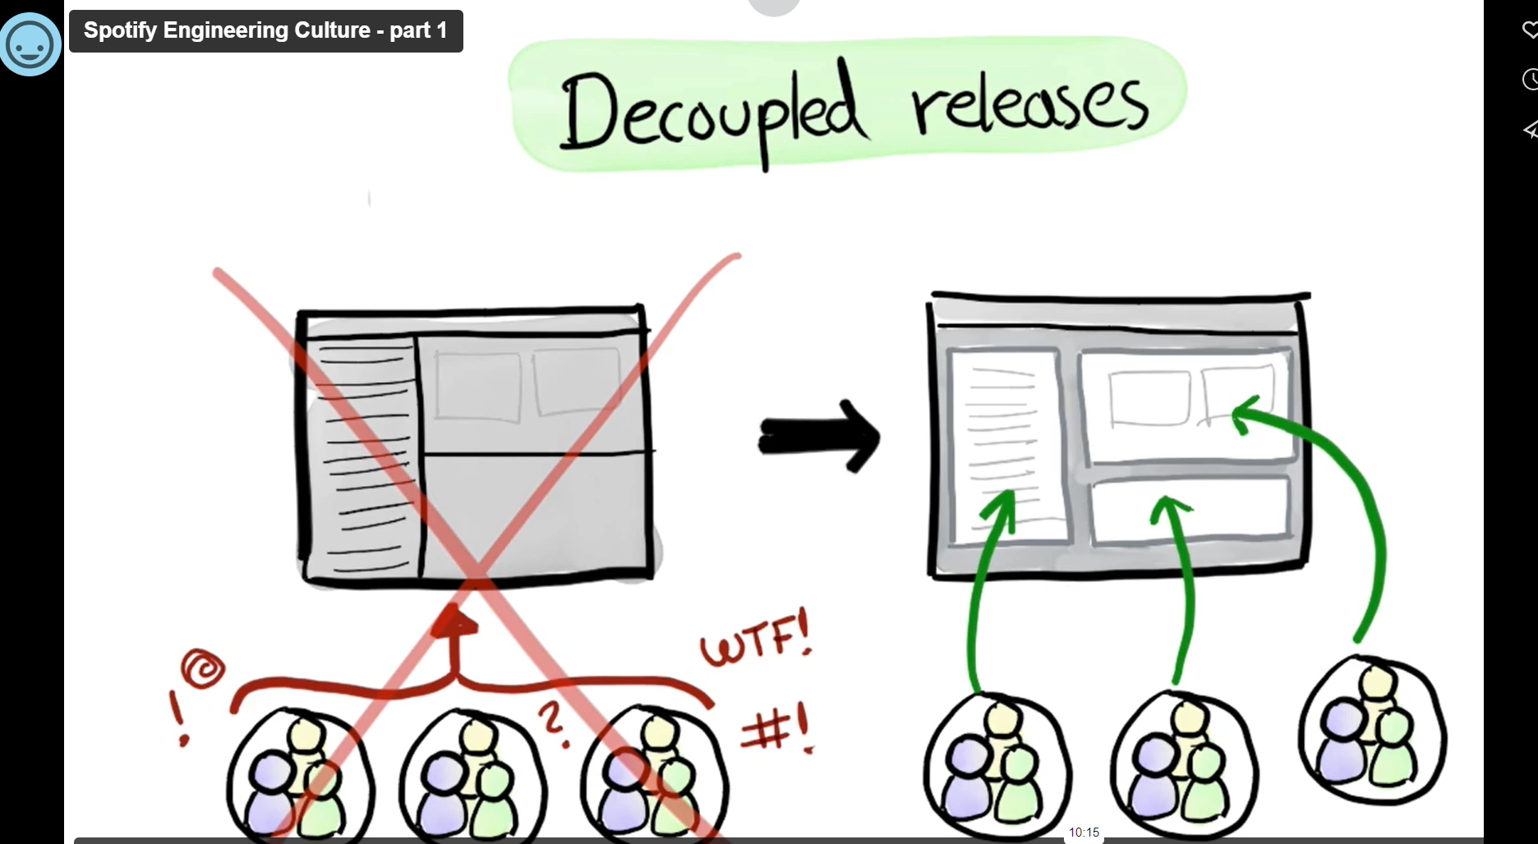
https://open.spotify.com/
https://engineering.atspotify.com/2014/03/spotify-engineering-culture-part-1/

Slide 27
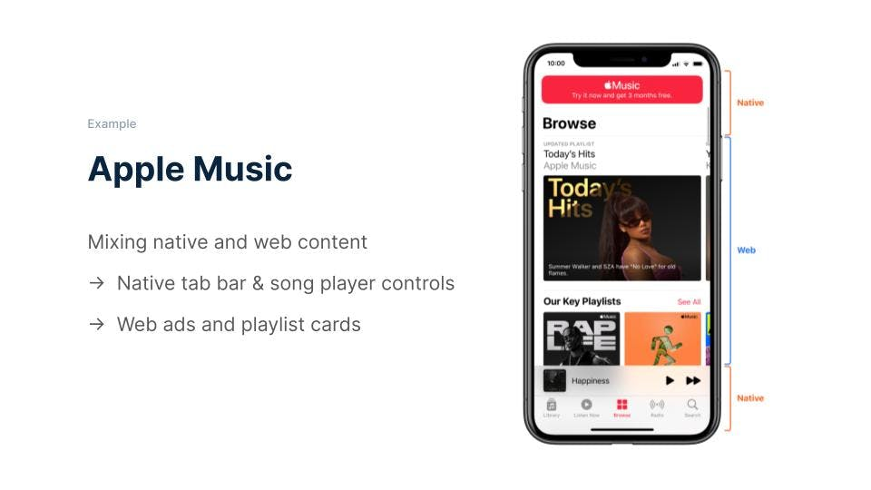
https://ionic.io/resources/articles/micro-frontends-for-mobile-with-ionic-portals

Slide 28
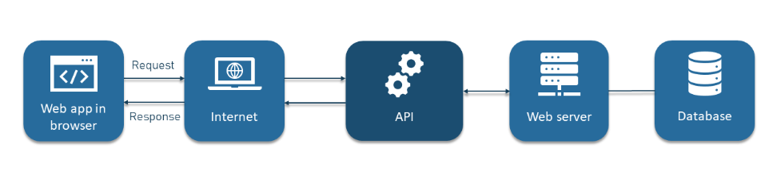
How do APIs work ?
API architecture is usually explained in terms of client and server. The application sending the request is called the client, and the application sending the response is called the server. So in the weather example, the bureau’s weather database is the server, and the mobile app is the client.
@altexsoft

Slide 29
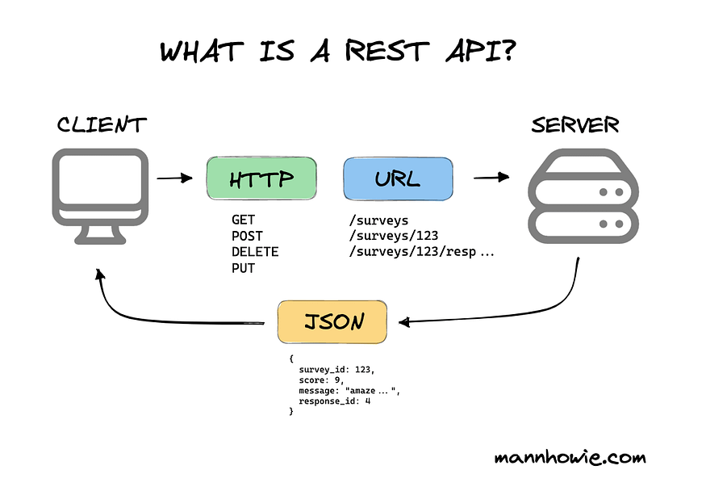

Slide 30
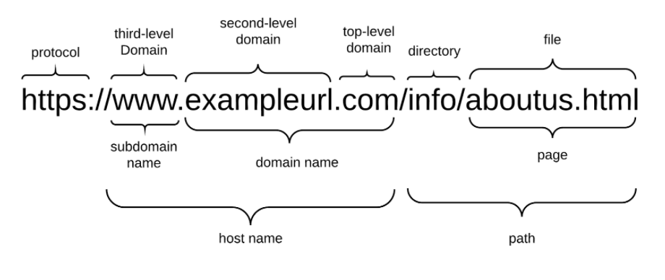

Slide 31
REST
Representational State Transfer (REST) is an architectural style that defines a set of constraints for creating web services.
REST API (Application Programming Interface) is an interface that allows systems to communicate with each other over HTTP in a way that follows REST principles.
REST APIs typically use standard HTTP methods (GET, POST, PUT, DELETE) to perform CRUD (Create, Read, Update, Delete) operations on resources.
REST APIs often use JSON or XML as their data format for request and response payloads.
REST APIs are commonly used for exposing functionalities of a single application or service to external clients or other parts of the same application.

Slide 32
Microservices
Microservices is an architectural approach where an application is composed of loosely coupled, independently deployable services that are organized around business capabilities.
Each microservice is a small, self-contained unit that focuses on performing a single business function.
Microservices communicate with each other typically through lightweight protocols like HTTP or messaging queues.
Microservices architecture promotes scalability, resilience, and agility by allowing each service to be developed, deployed, and scaled independently.
Microservices can use REST APIs for communication between services, but they are not limited to REST; other communication protocols such as gRPC or message queues can also be used.

Slide 33
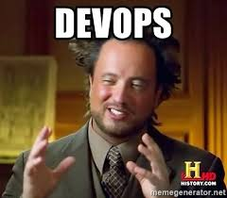

Slide 34
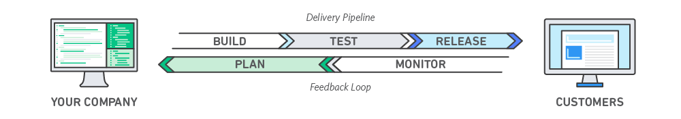
DevOps
is a set of technical and management practices that aim to increase an organization’s velocity in releasing high-quality software.
speed, reliability, scale, and security

Slide 35
DevOps Practices
Continuous Integration & Continuous Delivery (CI/CD) - Developers regularly merge their code changes into a central repository, after which automated builds and tests are run and code is deployed.
Microservices - design approach to build a single application as a set of small services. Each service runs in its own process and communicates with other services through a well-defined interface using a lightweight mechanism, typically an HTTP-based application programming interface (API).
Monitoring and Logging

Slide 36
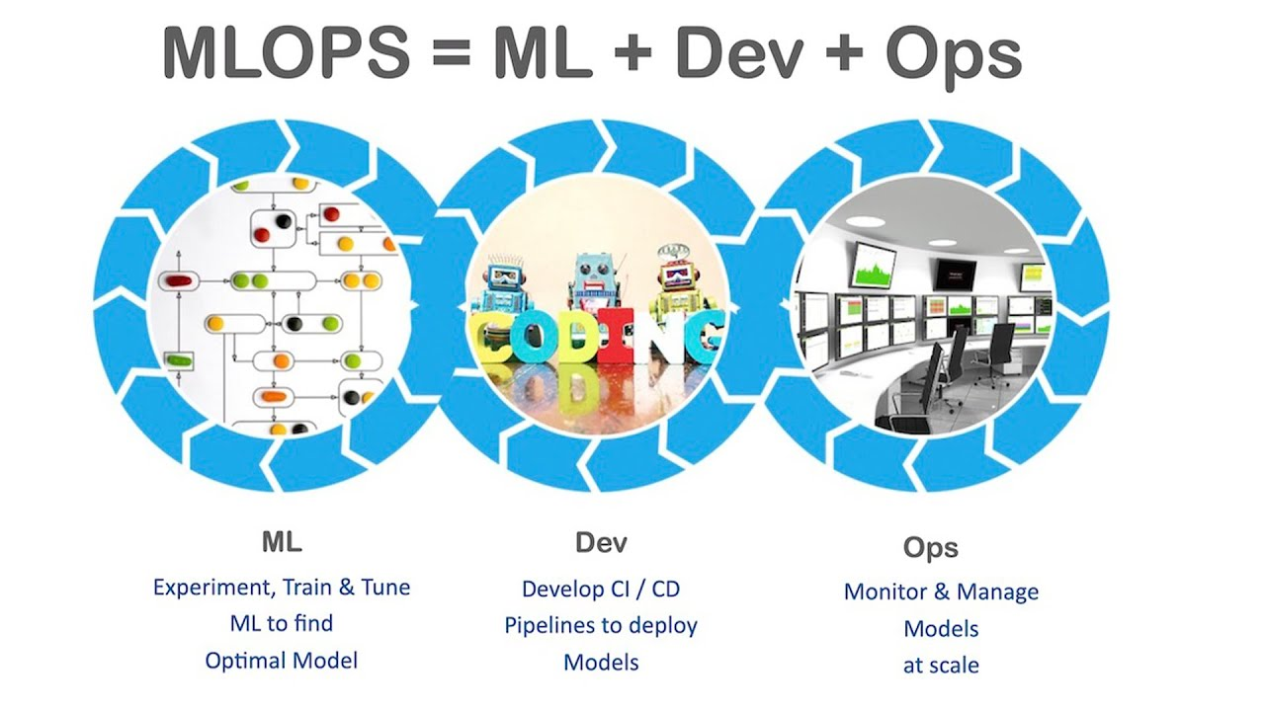

Slide 37
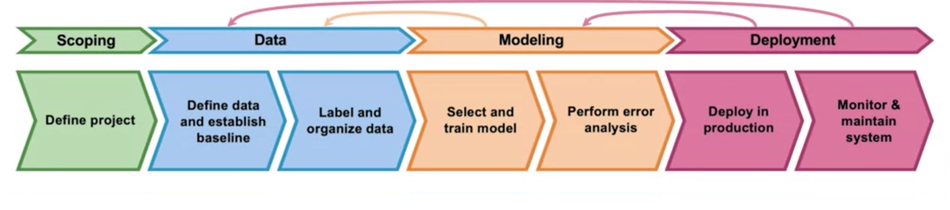
ML project lifecycle

Slide 38
Why do we need to retrain models ?

Slide 39
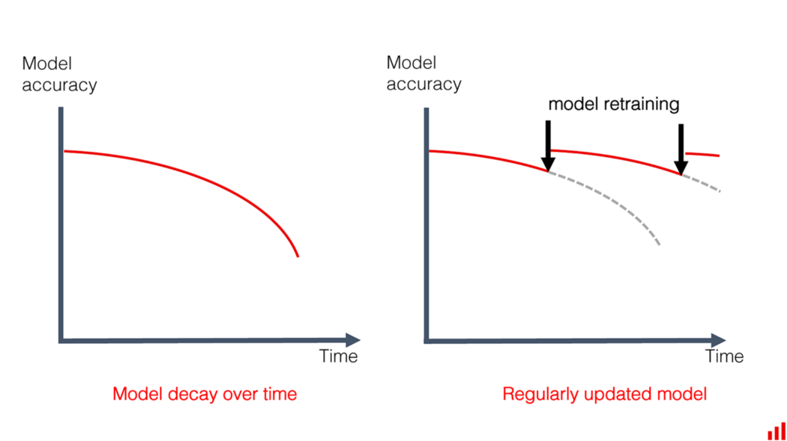

Slide 40
Deployment patterns

Slide 41
Shadow Mode Deployment – Existing workflow ( human/older model) continues to take decision, apart from the model . Model is updated till threshold accuracy is reached.

Slide 42
Blue-green deployment - utilizes two identical environments, a “blue” and a “green” environment with different versions of an application or service. Can easily be interchanged .

Slide 43
Canary deployment - Releases the model incrementally to a subset of users. All infrastructure in a target environment is updated in small phases (e.g: 2%, 25%, 75%, 100%).

Slide 44
Some Tools

Slide 45
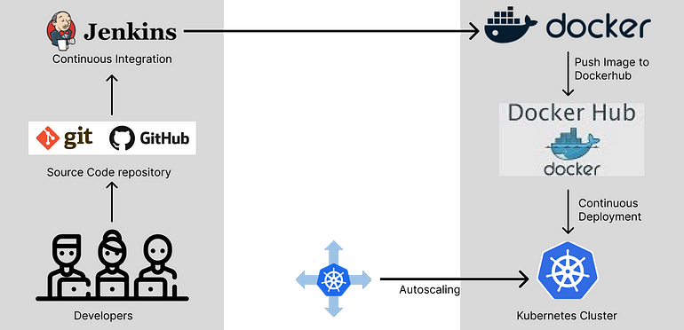

Slide 46
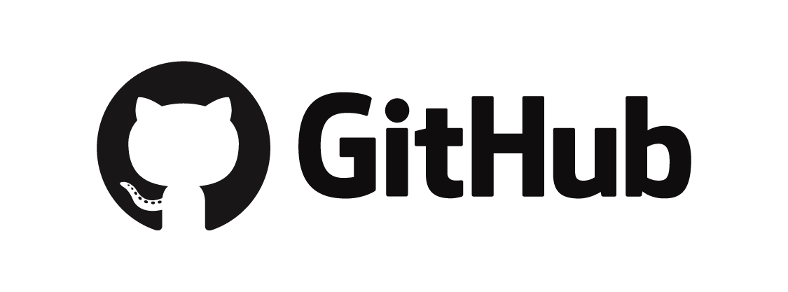

Slide 47
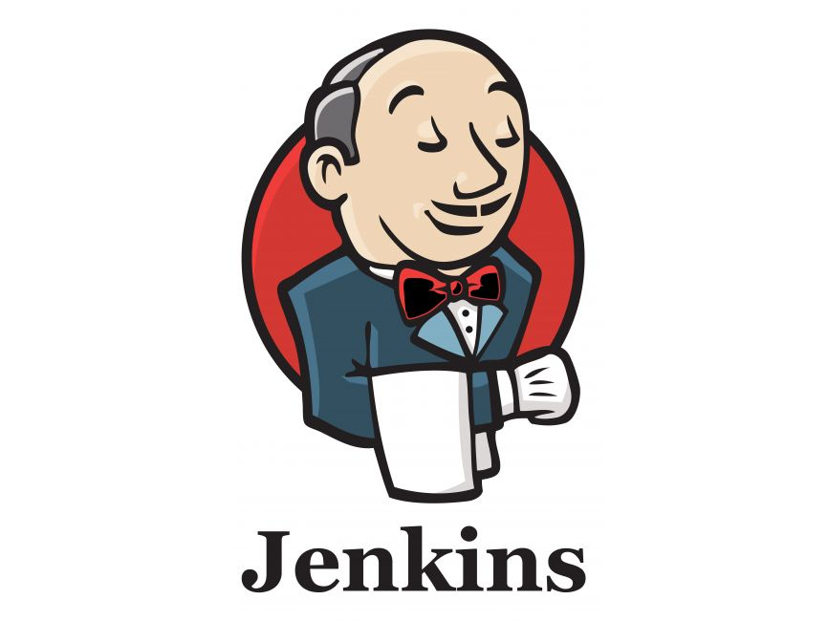
Jenkins
Jenkins is an open source continuous integration/continuous delivery and deployment (CI/CD) automation software DevOps tool written in the Java programming language. It is used to implement CI/CD workflows, called pipelines.

Slide 48
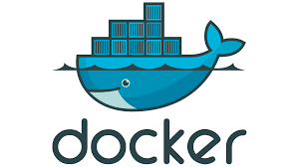
Docker
They are basically containers that allows you to ship, test, and deploy your applications in any environment without worrying about incompatible issues regardless of the machine's configuration settings.
It enables you to separate your applications from your infrastructure so you can deliver software quickly.

Slide 49
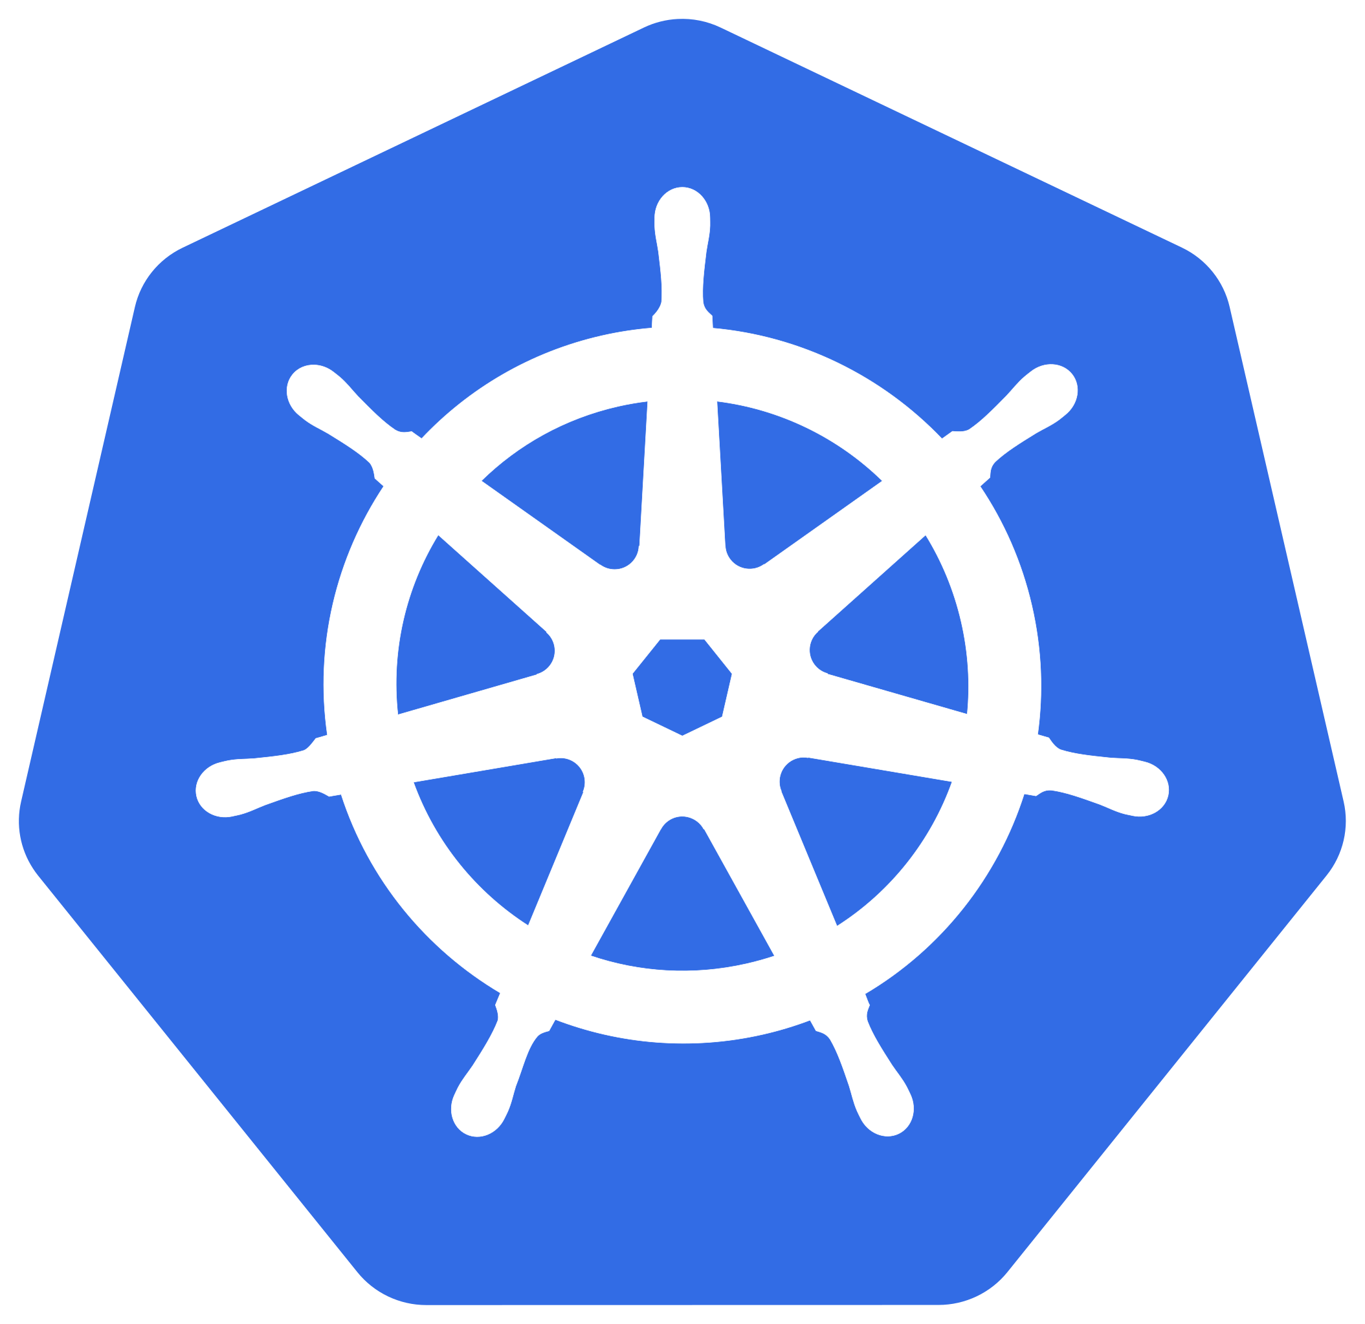
Kubernetes (K8S)
automates operational tasks of container management and includes built-in commands for deploying applications, rolling out changes to your applications, scaling your applications up and down to fit changing needs, monitoring your applications, and more—making it easier to manage applications.

Slide 50
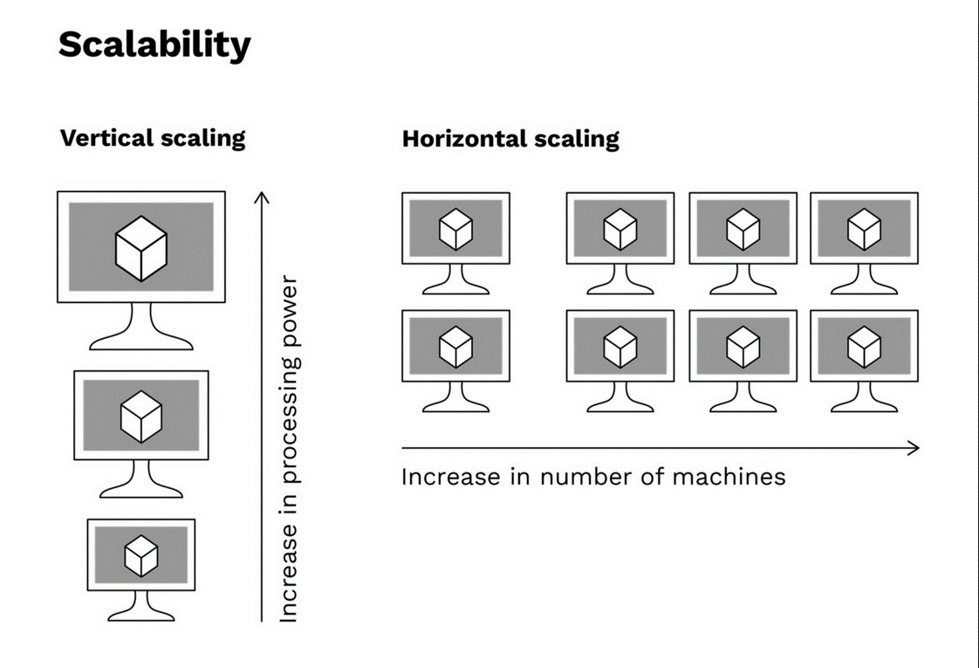

Slide 51
Summary
 | Development ML | Production ML
Objective | High-accuracy model | Efficiency of the overall system
Dataset | Fixed | Evolving
Code quality | Secondary importance | Critical
Model training | Optimal tuning | Fast turn-arounds
Reproducibility | Secondary importance | Critical
Traceability | Secondary importance | Critical

Slide 52
Technical Debt

Slide 53
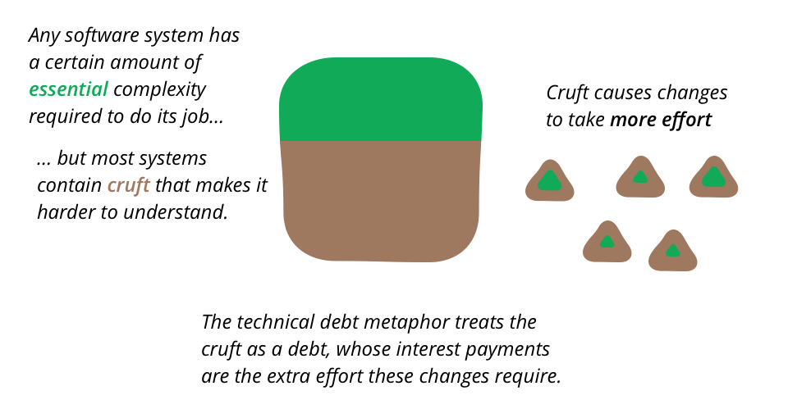
Technical Debt

Slide 54
