Slide 1

Technical Demo Session

Slide 2
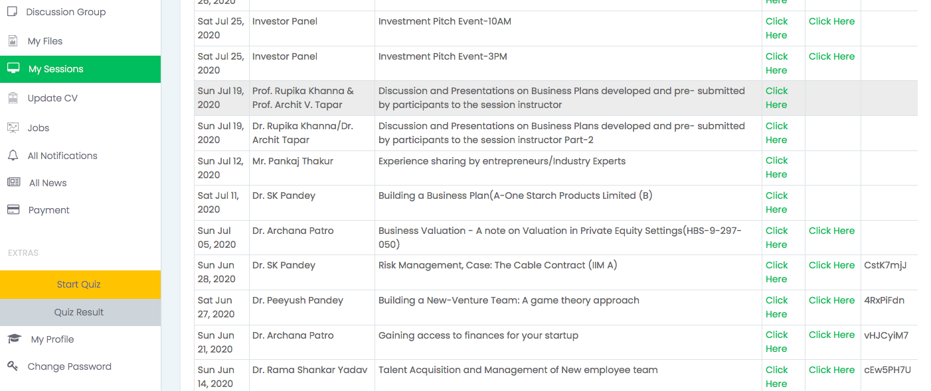
Slide 1 – Login Screen
Step 1 – How to Login in Live session.
Login to your student portal >www.uptop.in /https://portal.uptop.in
Navigate for My Sessions > Check the date you need to appear for live session > click on the link as Session Link. System will automatically connect you with the live sessions.

Slide 3
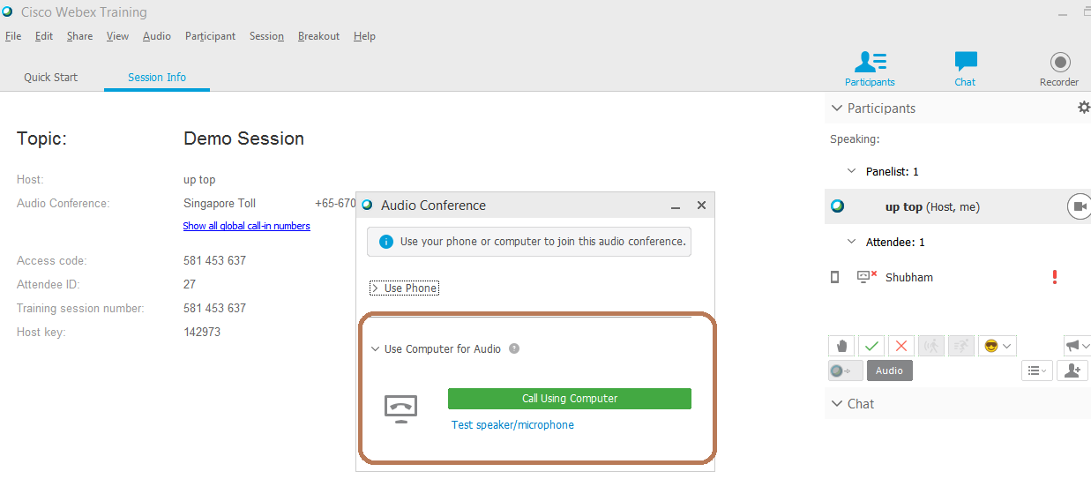
Slide 3 – Home Screen
Step 2 – What do I need to follow.
Make sure you do follow the Audio process to connect your MIC and CAM with the live session.

Slide 4
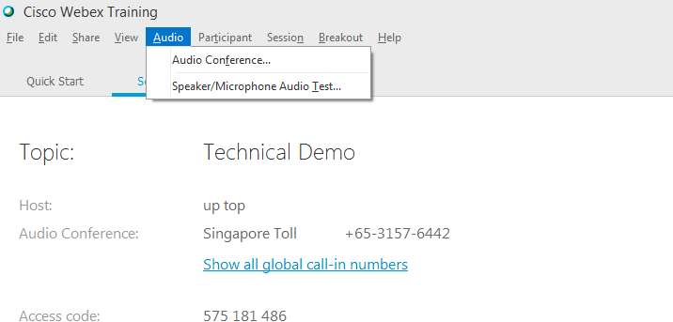
Slide 5 – Audio & Mic Settings
In case, if you are still not able to hear, Please go to option “Audio” which at the top of your screen.
You will get two options ( Audio Conference & Speaker /Microphone Audio test)

Slide 5
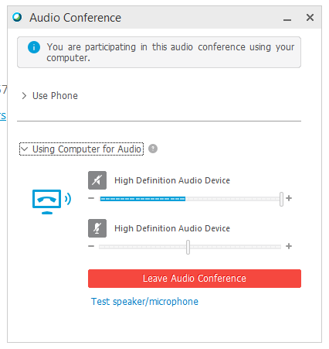
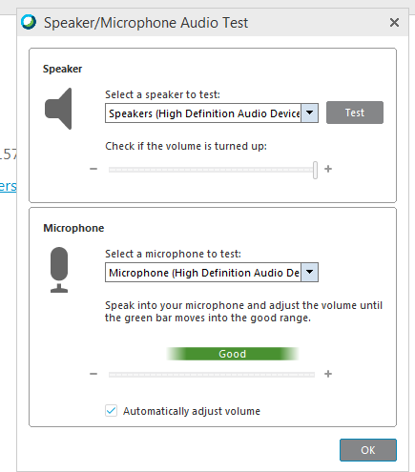
Slide 6 – Audio & Mic Setting Window
Audio is connected.

Slide 6
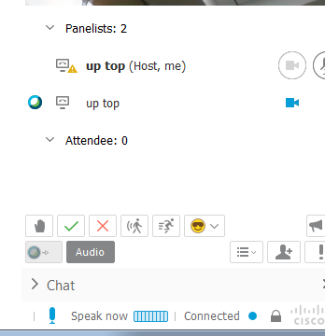
Slide 7 – Frequently Used Options
Hand Raise Option
Hand Raise – If you have a question or want to ask something from professor.
Right Tick – It indicates your acknowledgement or agreement towards the understanding of any topic.
Red Cross – It indicates you disagreement towards the understanding of any topic.
Forward – It indicates, professor running fast and needs slow down the pace of the delivery.
Backward – It indicates, professor is running slow and needs to pick up a pace.
Backward Option
Right Tick Option
Red Cross Option
Forward Option

Slide 7
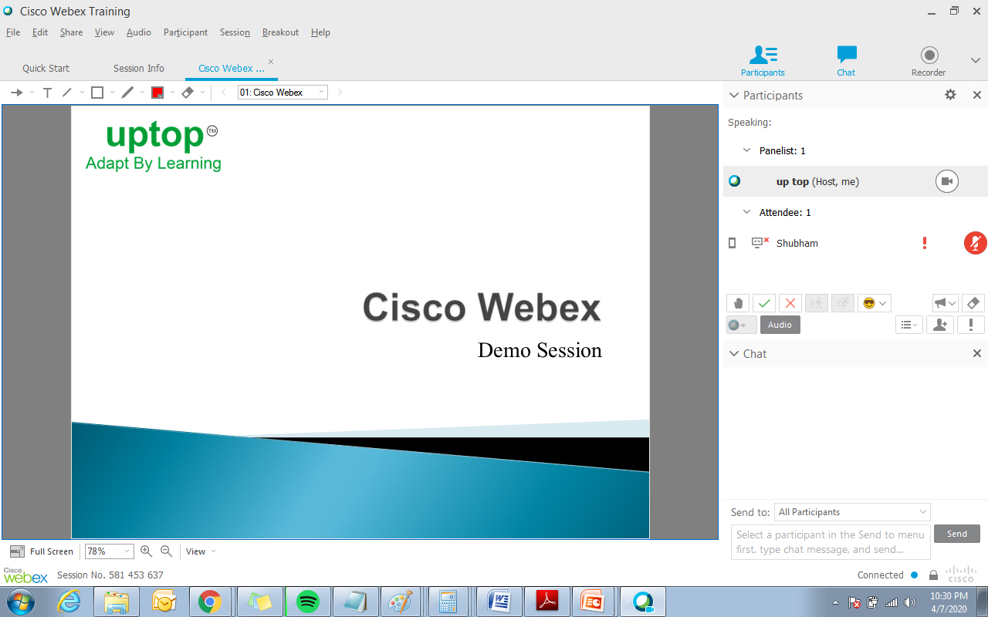
Slide 4 – Home Screen Panel

Slide 8
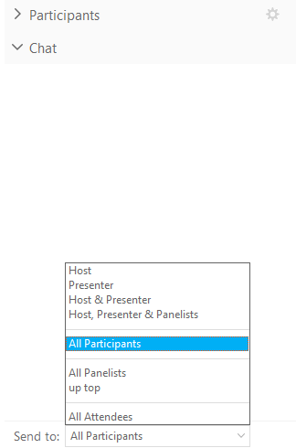
Slide 8 – Chat Window
Chat Window will reflect just below to participants option.
Host – Technical Support Team from UpTop will be live for entire live session to support both participants and professor.
Presenter – He/She is a professor who is delivering the session.
Panelists – It includes all individuals who are attending live session including presenter & host.
Use of Chat Window
Any participant who wants to ask something separately to professor (Presenter) or UpTop technical support team (Host) or to entire batch (Panelists), can drop a message without disturbing the session.

Slide 9
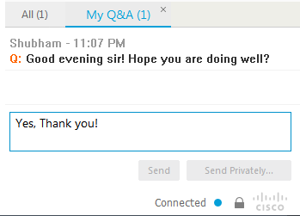
Slide 9 – Q&A Option
This Q&A option is available for all panelist . Where all students can ask their questions/queries while professor explaining any topic without interfering Professor in between.

Slide 10
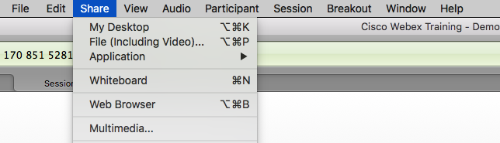
Sharing your Desktop :
Menu Tools Bar
Prof. will give you access to give presentations, hence you need to click on share and my desktop to share your screen.

Slide 11
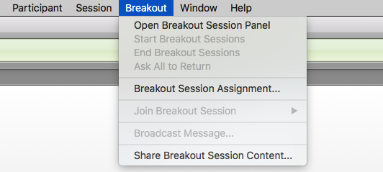
Breakout
Prof. may breakout the complete batch into small units to discuss case studies and come up with group discussions.

Slide 12
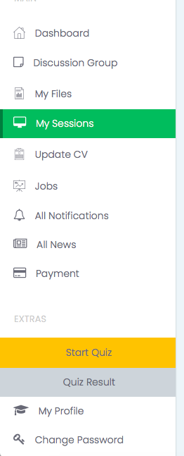
Student Portal :
Participants can post and ask question related to any of their queries, quiz toppers result and updates.
Participants can discuss in group regarding assessment, assignment, quiz and case studies.
Study materials, case studies etc. can be accessed in My Files tab.
Job posting updates.
Participants can attend quiz on Start Quiz tab.
Quiz results can be checked on Quiz Results tab.
Personal Details update and changes.

Slide 13

Thank You

