Slide 1
Intro to ChatGPT
How does ChatGPT Work?

Slide 2
History

Slide 3
Open AI
A Brief Time Line
2015
Dec, 2015
2016
2016
Elon Musk, John Schulman, Greg Brockman, Wojech Zaremba & Sam Altman, as well as other prominent silicon valley figures, Pledged $1 Billion to OpenAI
According to OpenAI’s website the company’s aim was to create a non profit focused on developing AI in the way “most likely to benefit humanity as a whole”
Gym, a platform letting researchers develop & compare machine learning reinforcement systems is launched.
Universe, a toolkit for training intelligent agents across websites & gaming platforms is released.

Slide 4
Open AI
A Brief Time Line
2018
2018
2018
2019
Open Ai releases a version of their AI tool as GPT-2, GPT-3
The first version of GPT, which stands for Generative Pre-Trained transformer is released.
Musk resigns from Open AI Board of directors, Continues to donate
Open AI makes transition from non profit to a for profit model

Slide 5
Open AI
A Brief Time Line
2019
2019
2019
2021
Open Ai partners with Microsoft
Open AI also announces plans to license its tech for commercial use.
Open AI introduces GPT-3, a language model trained on extensive internet datasets.
Open AI introduces DALL-E, an advanced deep learning model that has ability to generate digital

Slide 6
Open AI
A Brief Time Line
2022
2022
2023
2023
Open Ai introduces ChatGPT
Google, the king of search recognizes ChatGPT as such an existential threat to its business model, it issues an internal “code red” warning about the technology
ChatGPT reaches the 100mn user mark.
Microsoft plans to invest $10 Bn in openAI over the next few years

Slide 7
What is an LLM
“ A large language model or LLM is a deep learning algorithm that can recognize, summarize, translate, predict & generate text and other content based on knowledge gained from massive datasets” – Nvidia
They aren’t just for teaching AI human languages, they :
Help researchers understand proteins.
Allow programmers to write more optimized code.
Help website developers reimagine search engines.
Give marketers gripping ad content.
Assist educators with better tutoring services.
Make robots more useful.
Provide writers with research assistance.

Slide 8
What is an LLM
Large language models learn from huge volumes of data. As the name suggests, central to an LLM is the size of the dataset it’s trained on. But the definition of large is evolving with AI.

Slide 9
How large was the GPT Model?
The first version of GPT was released in 2018. It had 117 Mn parameters and was trained on about 40 gigs of text data.
GPT-2 was released in 2019 & was trained on similar sized data set as GPT had 1.5 bn parameters
GPT-3 was the first major increase in the training data set and was trained on 570 gigs of text data & 175 Bn parameters.
ChatGPT 4 represents a massive improvement over previous models. The dataset size & number of parameters have not been disclosed.

Slide 10
Part 1: How to build a large language Model (LLM)

Slide 11
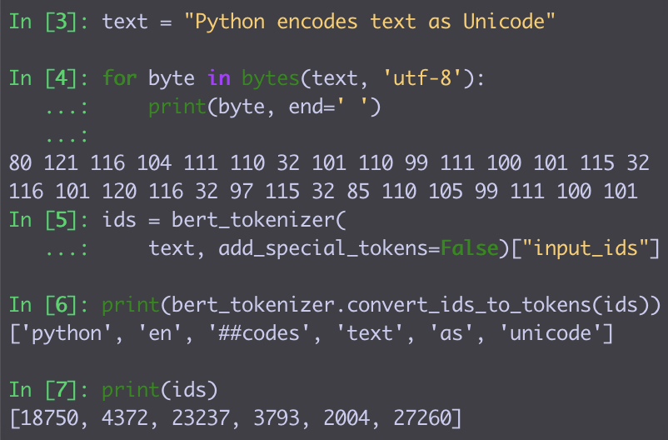
Representing Natural Language in Machines
Strings:
Each character is 1-2 bytes
Great for text manipulations
  Concatenate, Find + Replace
No semantics or morphology
Tokens:
Map each word to a token ID
In practice:
  Some words are too rare / misspelled
  Split these into common word parts
  and map these to IDs

Slide 12
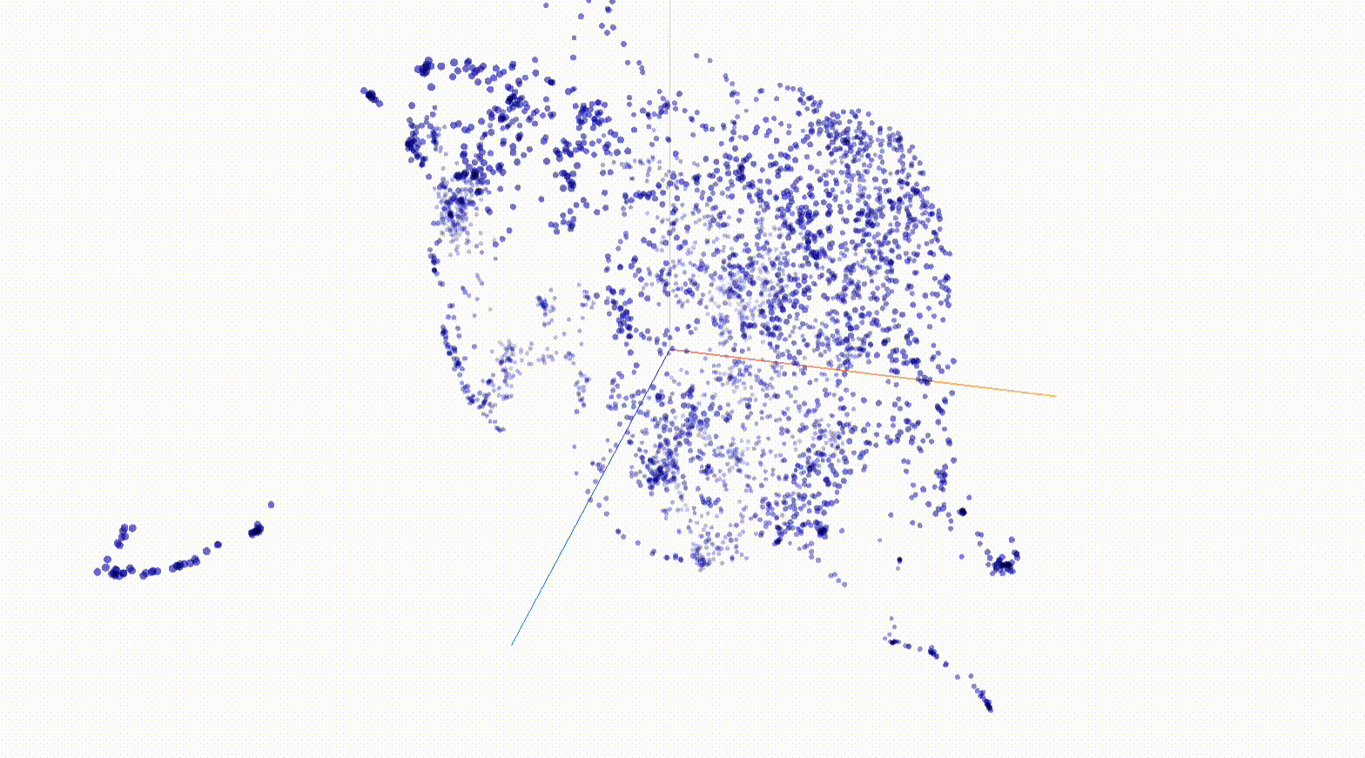
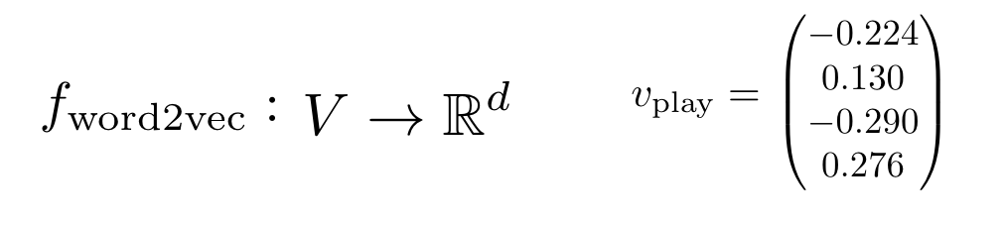
Representing Natural Language in Neural Networks
Word embeddings:
≈ 100–1000 dims!
…..
Models can learn
similar words ≈ similar vectors
in many possible directions.

Slide 13
Modeling Natural Language
Language Models: Assign a probability to any sequence of tokens.
e.g. p(dog) > p(turtle)
10⁻⁴ 10⁻⁶
p(a turtle swims in the ocean) > p(a dog swims in the ocean)
10⁻¹¹ 10⁻¹³
Left-to-right language models:
p(a turtle swims in the ocean) = p(a)
p(turtle | a)
p(swims | a turtle)
p(in | a turtle swims)
p(the | a turtle swims in)
p(ocean | a turtle swims in the)

Slide 14
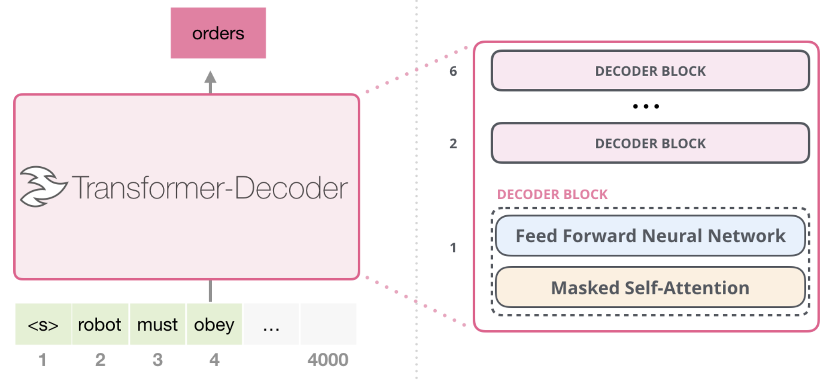
The Transformer Architecture:
How to model p(next token | previous tokens)?
≈ 10–100
layers
[from Alammar, The Illustrated GPT-2, https://jalammar.github.io/illustrated-gpt2/]

Slide 15
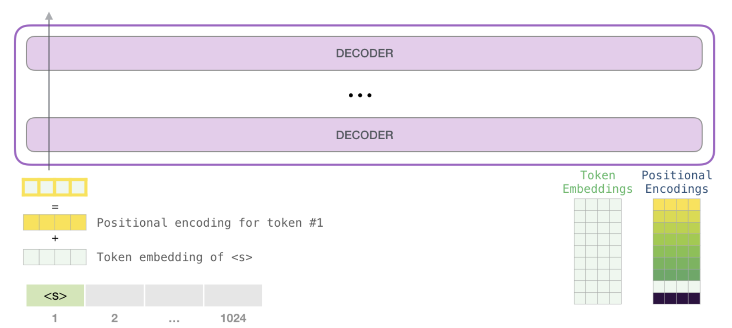
The Transformer Architecture:
Embedding Layer
[from Alammar, The Illustrated GPT-2, https://jalammar.github.io/illustrated-gpt2/]

Slide 16
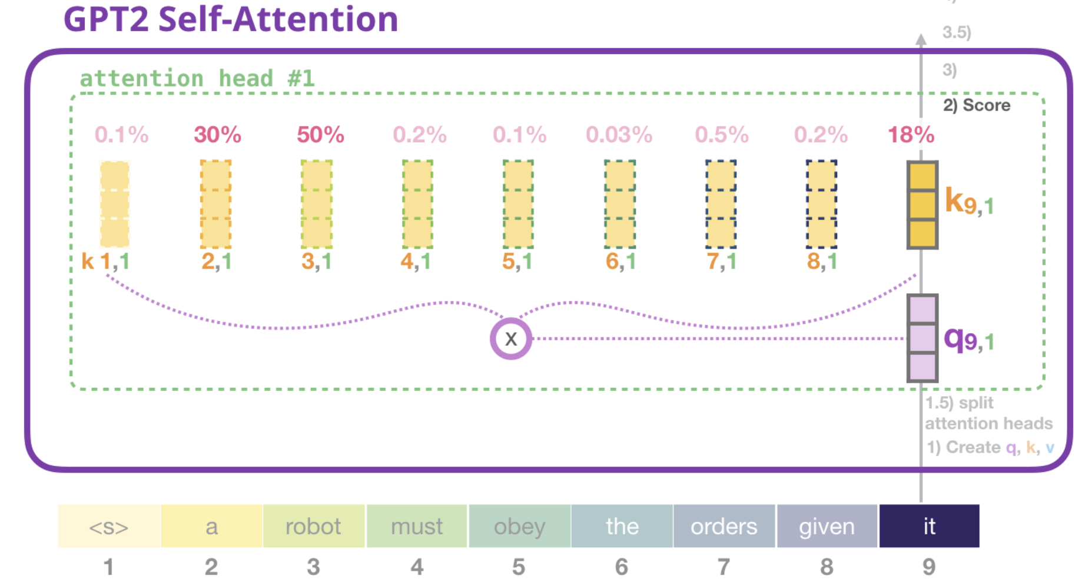
The Transformer Architecture:
Attention Layer
⇒ Integrates information from previous tokens
⇒ Can perform operations like lookup or copy
[from Alammar, The Illustrated GPT-2, https://jalammar.github.io/illustrated-gpt2/]

Slide 17
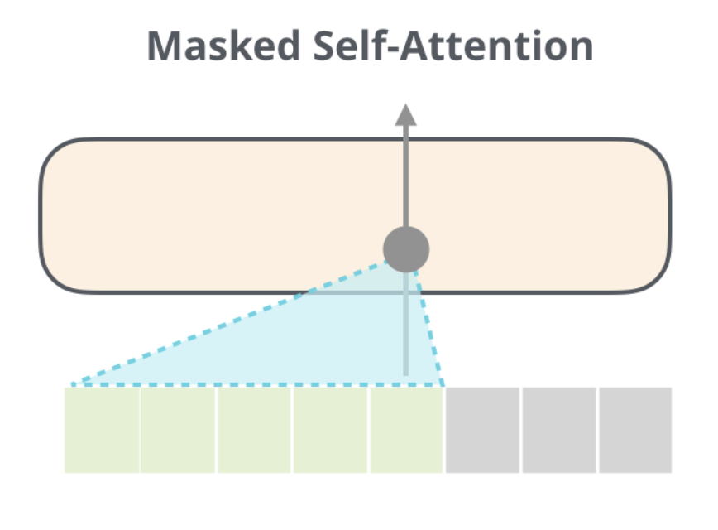
The Transformer Architecture:
Attention Layer
⇒ Don’t attend to future tokens
[from Alammar, The Illustrated GPT-2, https://jalammar.github.io/illustrated-gpt2/]

Slide 18
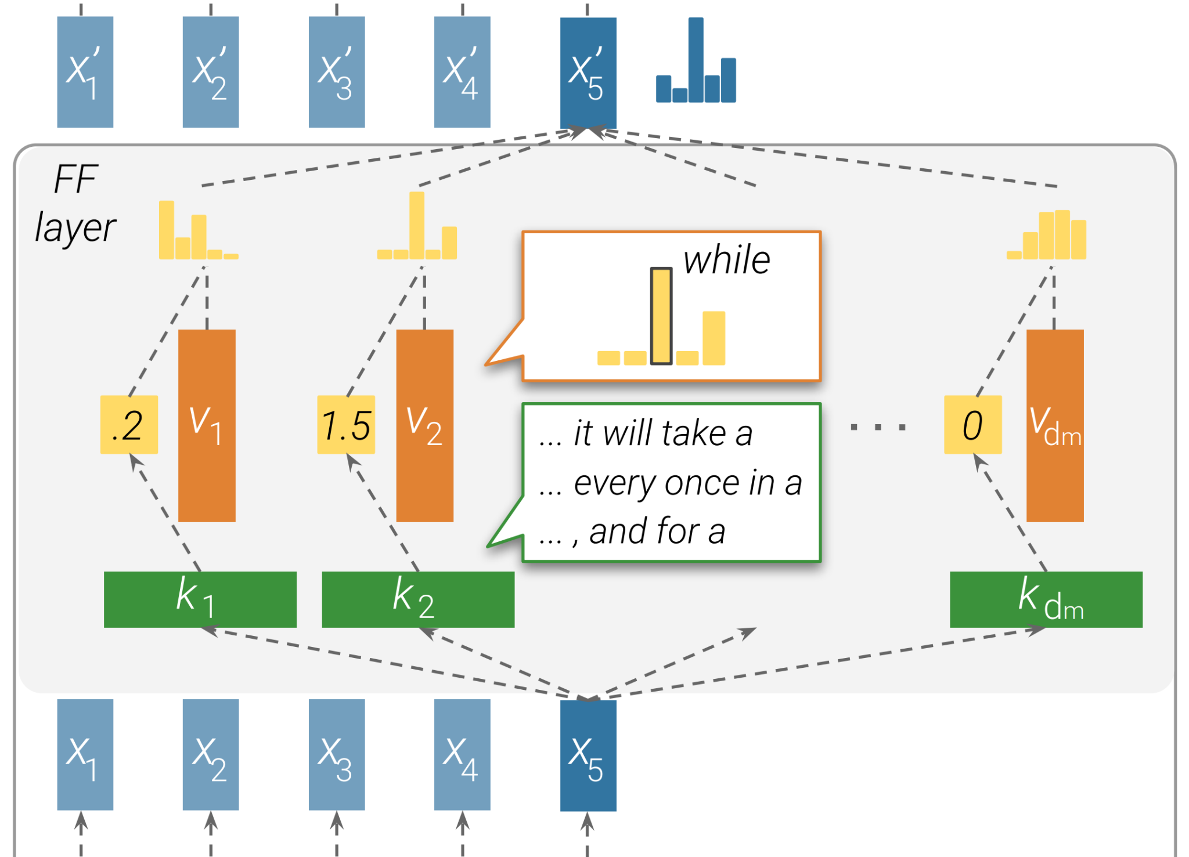
The Transformer Architecture:
Feed-forward Layer
⇒ Store knowledge as a dictionary between embeddings

Slide 19
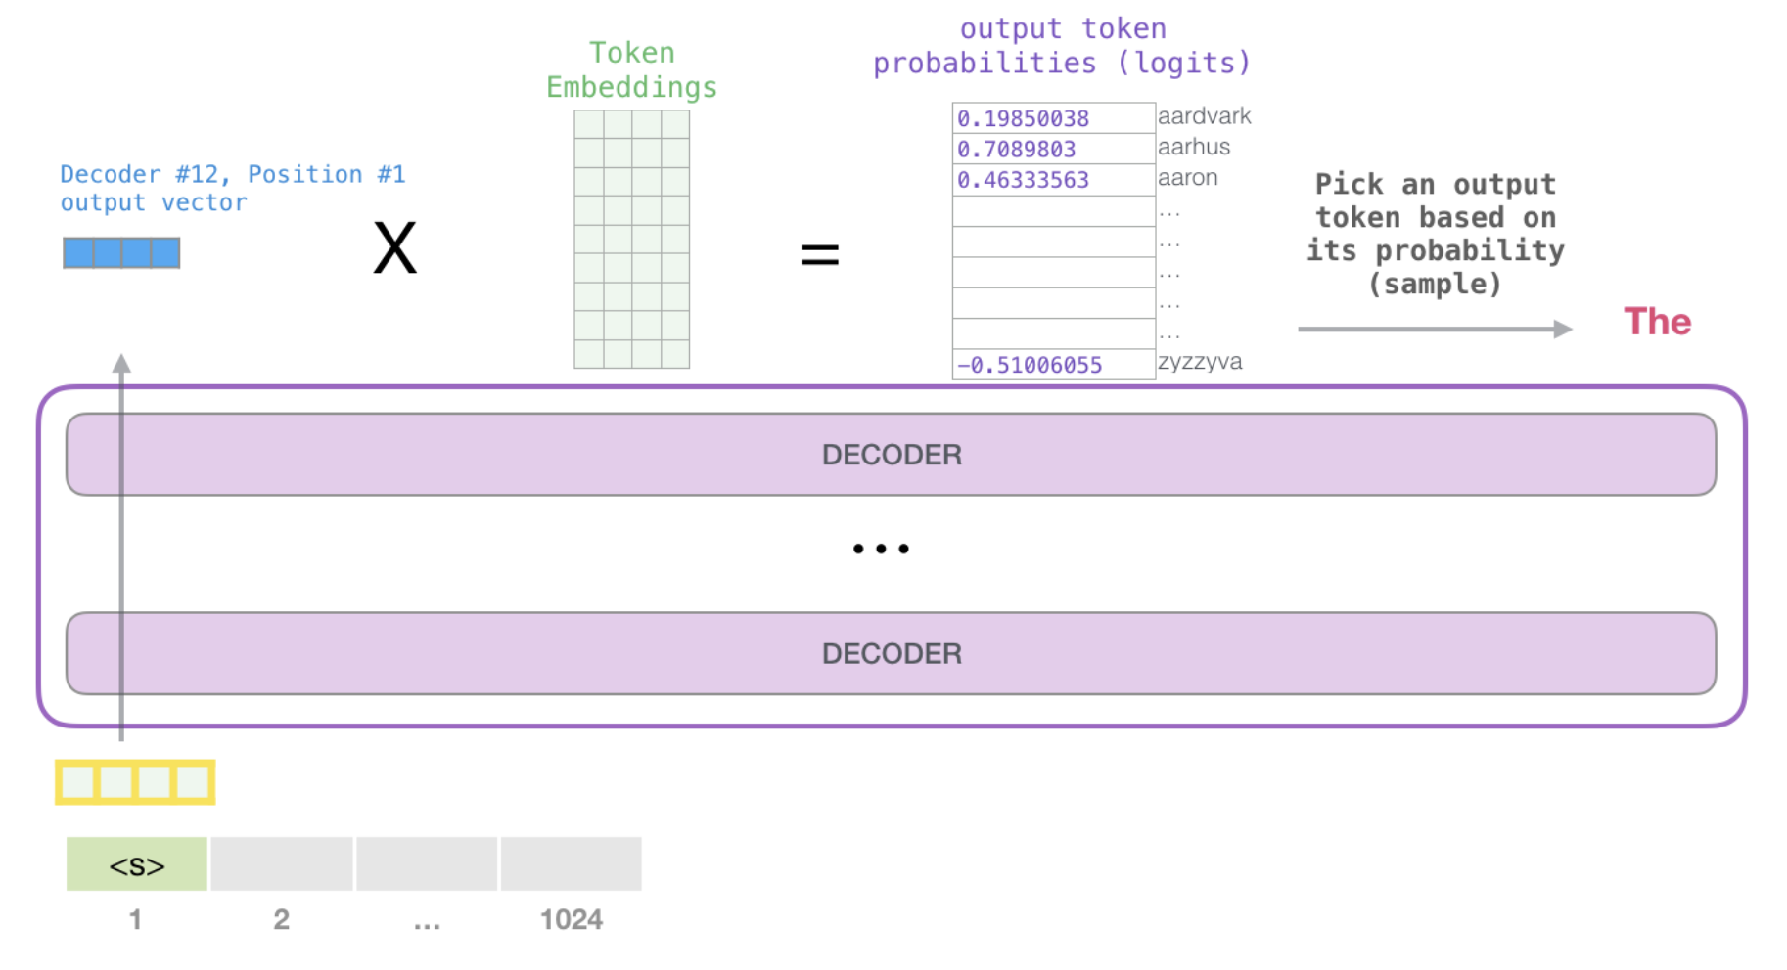
The Transformer Architecture:
Prediction
Finally, compare the final embedding against all token embeddings

Slide 20
The Transformer Architecture:
Prediction
Finally, compare the final embedding against all token embeddings
Obtain scores over next token candidates and convert to probabilities

Slide 21
Training an LLM: Optimization
Now we can compute the LLM’s guess for p(next token | previous tokens)
How can we improve the model?
Check the probability of the correct token and move the model parameters a tiny bit to make the correct token more likely (stochastic gradient descent)
How do we know which parameters need to change? ⇒ Can compute the gradient of each parameter.
Always consider a batch of 10³-10⁶ of predictions and average gradients. ⇒ Parameters move to produce the best effect overall.
🔁 Repeat millions of times.

Slide 22
Training a LLM: Optimization
Now we can compute the LLM’s guess for p(next token | previous tokens)
How can we improve the model?
Check the probability of the correct token and move the model parameters a tiny bit to make the correct token more likely (stochastic gradient descent)
How do we know which parameters need to change? ⇒ Can compute the gradient of each parameter.
Always consider a batch of 10³-10⁶ of predictions and average gradients. ⇒ Parameters move to produce the best effect overall.
🔁 Repeat millions of times.

Slide 23
Training a LLM: Optimization
Now we can compute the LLM’s guess for p(next token | previous tokens)
How can we improve the model?
Check the probability of the correct token and move the model parameters a tiny bit to make the correct token more likely (stochastic gradient descent)
How do we know which parameters need to change? ⇒ Compute the gradient of each parameter.
Always consider a batch of 10³-10⁶ of predictions and average gradients. ⇒ Parameters move to produce the best effect overall.
🔁 Repeat millions of times.

Slide 24
Training a LLM: Optimization
Now we can compute the LLM’s guess for p(next token | previous tokens)
How can we improve the model?
Check the probability of the correct token and move the model parameters a tiny bit to make the correct token more likely (stochastic gradient descent)
How do we know which parameters need to change? ⇒ Can compute the gradient of each parameter.
Always consider a batch of 10³-10⁶ of predictions and average gradients. ⇒ Parameters move to produce the best effect overall.
🔁 Repeat millions of times.

Slide 25
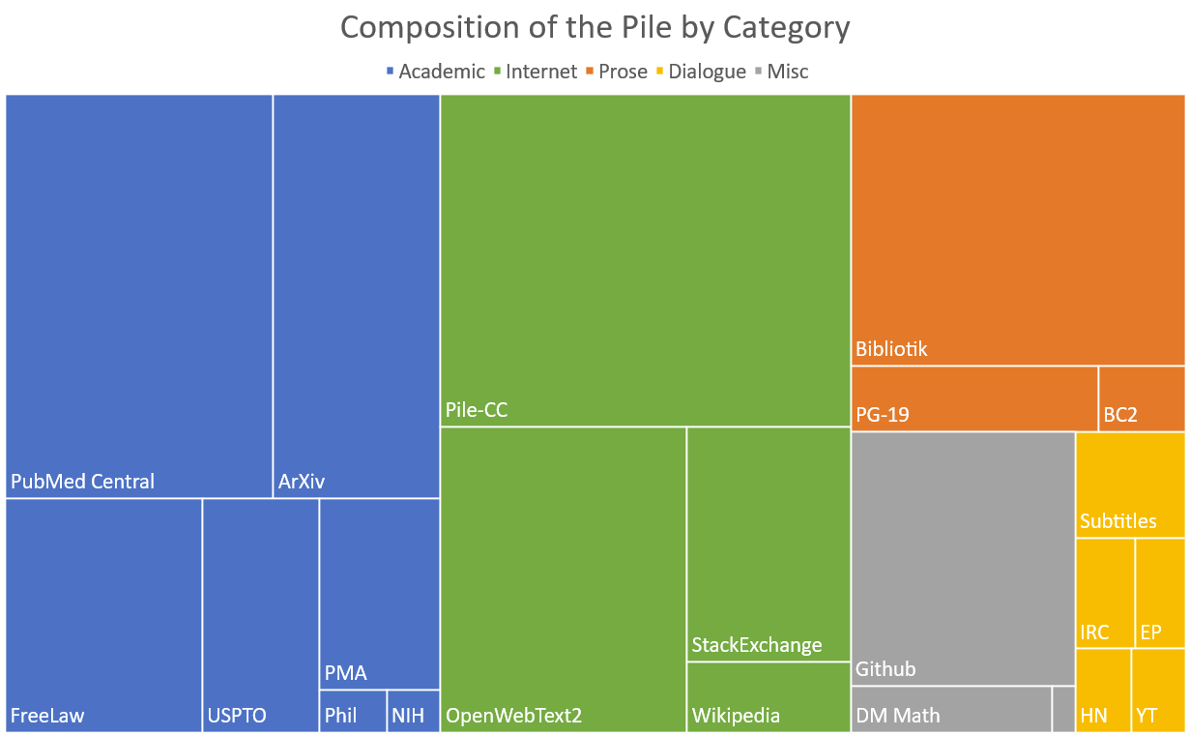
Training a LLM: Data
800GB of open-source data
[from Gao et al., The Pile: An 800GB Dataset of Diverse Text for Language Modeling]

Slide 26
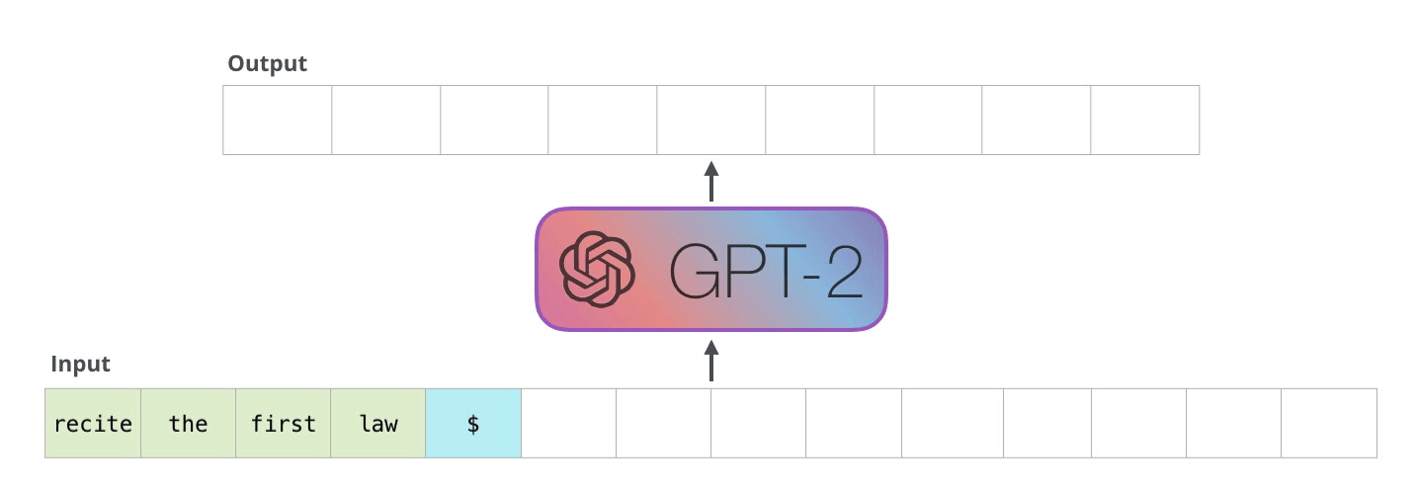
Text Generation
Sample a token from ~ p(next token | previous tokens)
Append the token to the input
Run the new input through the transformer
… and so on…
[from Alammar, The Illustrated GPT-2, https://jalammar.github.io/illustrated-gpt2/]

Slide 27
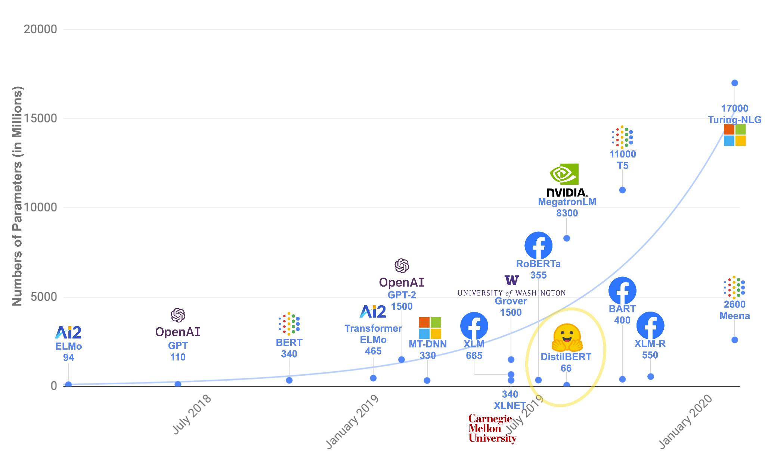
Scaling Up
[adapted from https://huggingface.co/course/chapter1/4]

Slide 28
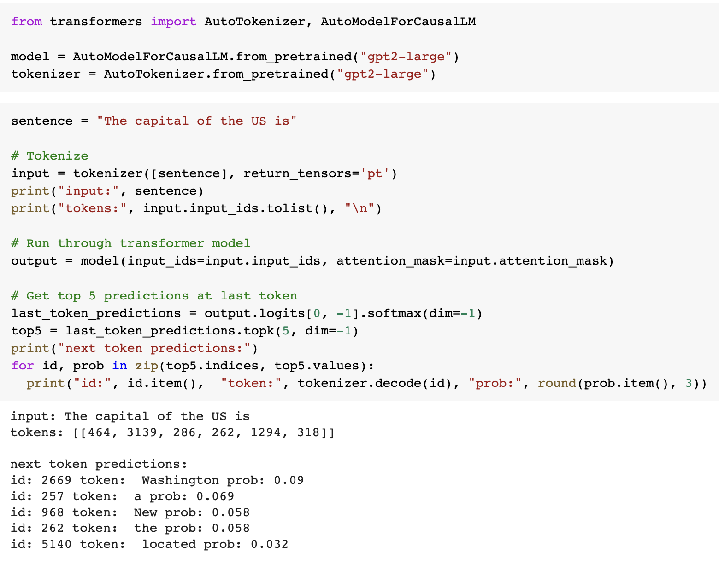
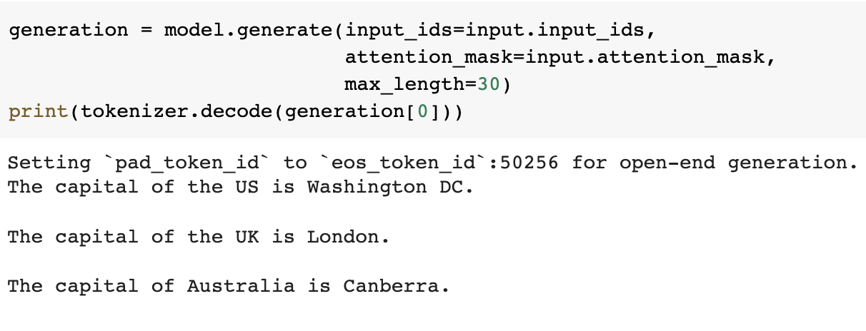
Resources for Coding
Huggingface transformers library:
Check out https://huggingface.co/course

Slide 29
Part 2: Interacting with LLMs & ChatGPT

Slide 30
Framing tasks as next-token prediction
LLMs are trained to predict the next token.
But how is that useful?
Many tasks conform to next token prediction!
“The plot was substandard, but it left a smile!”
What is the sentiment of above sentence? _________

Slide 31
Framing tasks as next-token prediction
LLMs are trained to predict the next token.
But how is that useful?
Many tasks conform to next token prediction!
“The plot was substandard, but it left a smile!”
What is the sentiment of above sentence? Positive

Slide 32
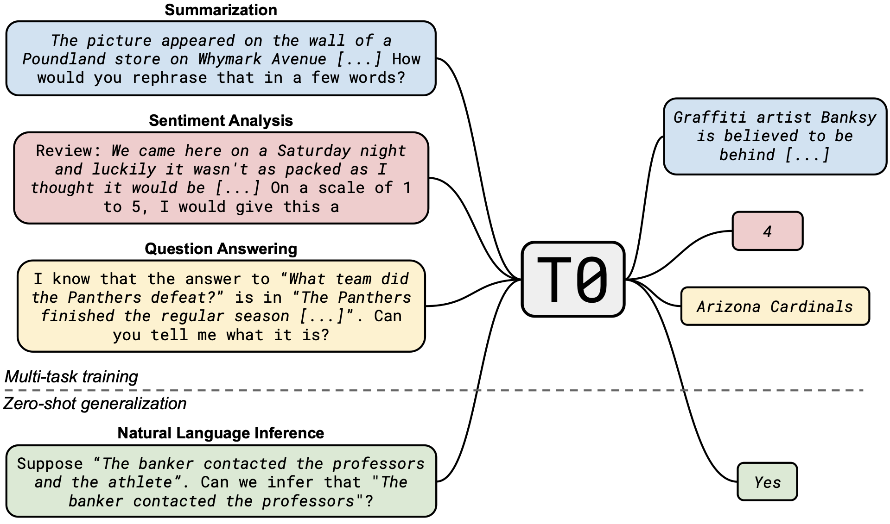
Framing tasks as next-token prediction
Tasks can similarly be framed as next-token prediction.
[Sanh et al., 2022: https://arxiv.org/pdf/2110.08207.pdf]

Slide 33
Aligning LLM responses with humans preferences
￼
Both the responses are technically completions, but which one is better?

Slide 34
Aligning LLM responses with humans preferences
Thought experiment.
Consider the prompt - “Write a strongly worded email to your co-worker about their unfinished task”.
Consider the following responses:
  The task is of extreme importance and I wish you took its completion seriously.
  You are a terrible colleague and do not finish assigned tasks.
Which one would you prefer?
Even though there are multiple correct answers, users have a preference.
How do we encode this preference in the LLM?

Slide 35

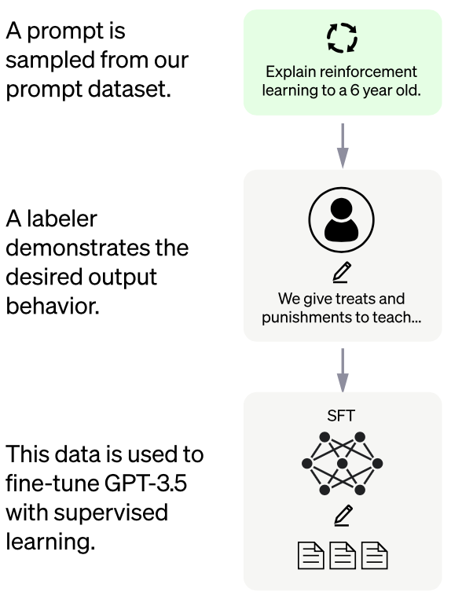
Aligning LLM responses with humans preferences

Slide 36
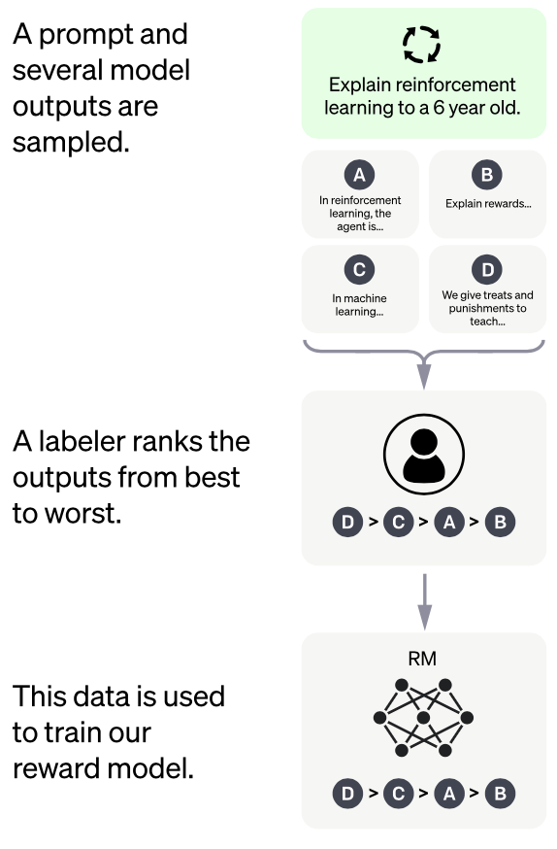
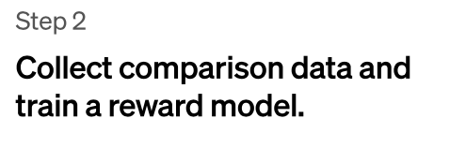
Aligning LLM responses with humans preferences

Slide 37
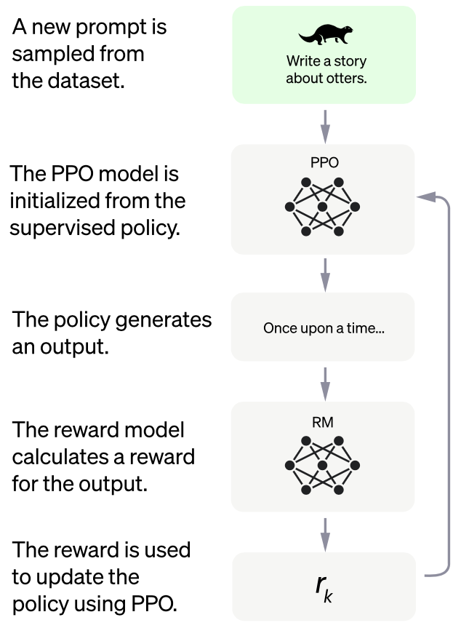
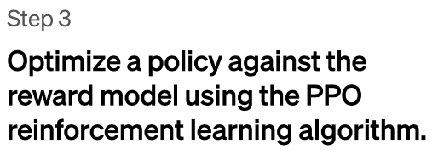
Aligning LLM responses with humans preferences

Slide 38
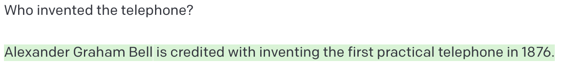
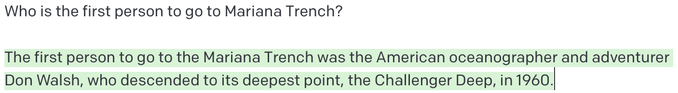
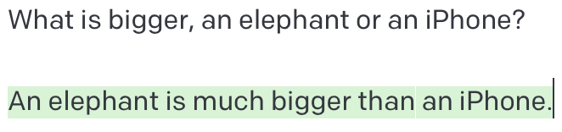
ChatGPT as a knowledge retriever

Slide 39
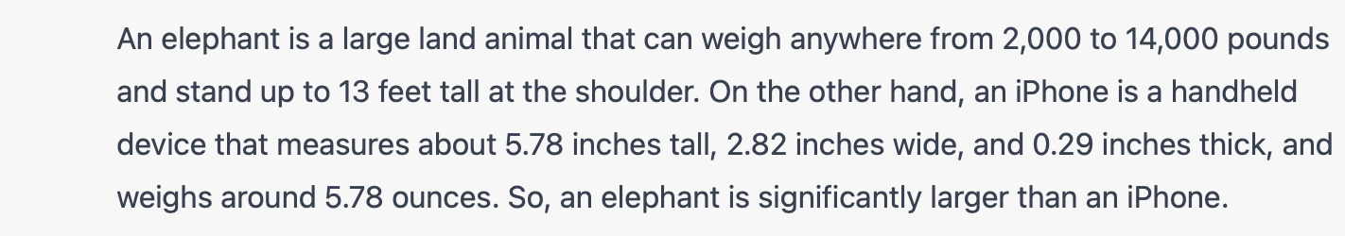
Reasoning capability of ChatGPT
ChatGPT can answer knowledge based questions, but what about questions which require reasoning?

Slide 40
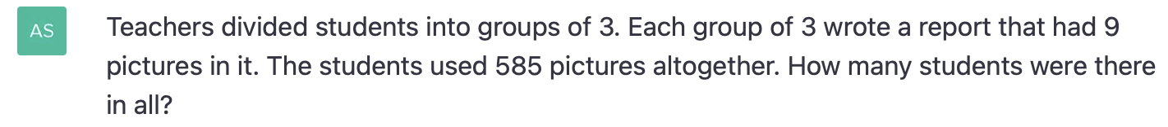
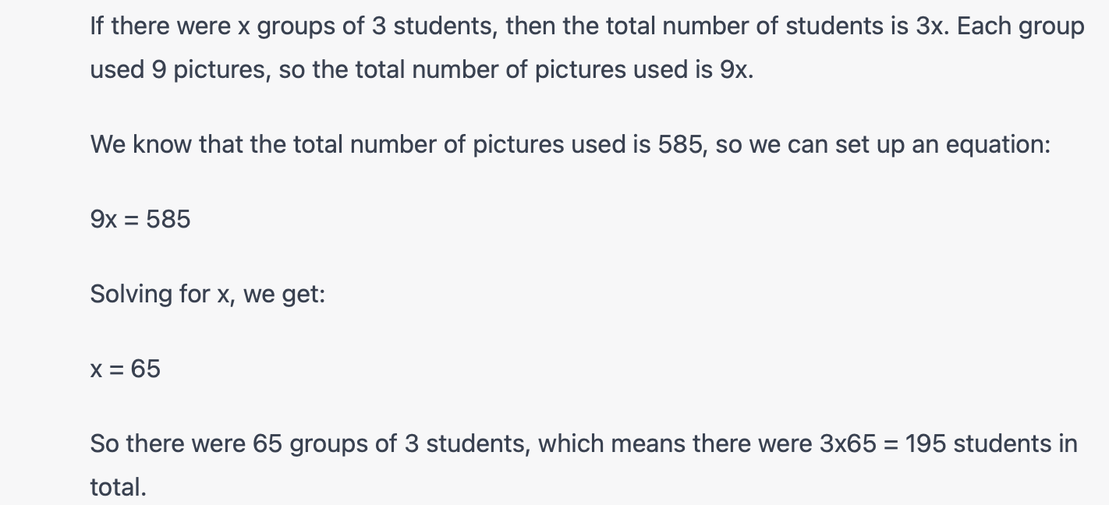
Mathematical reasoning

Slide 41
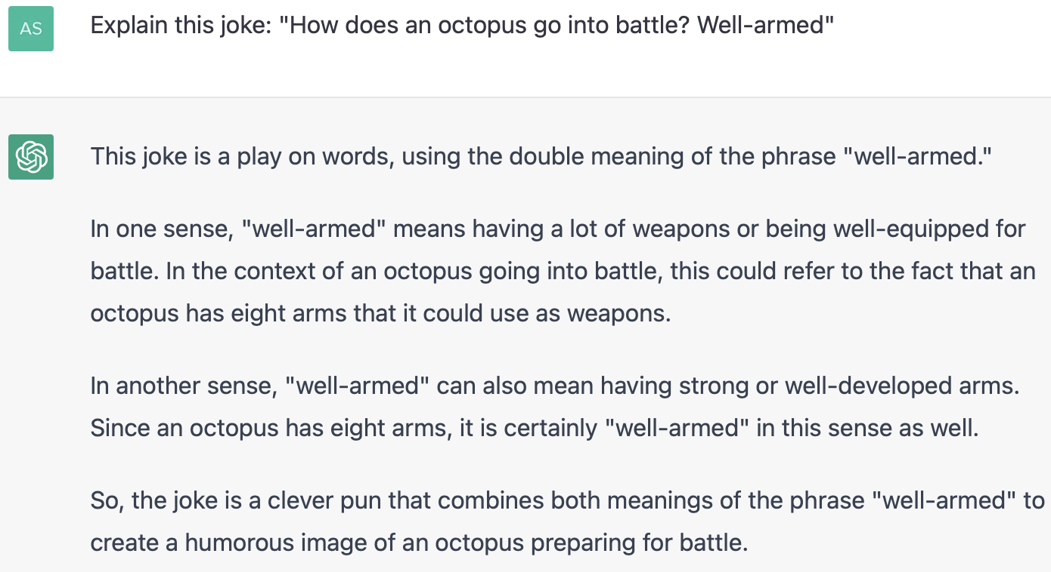
Reasoning about humor

Slide 42
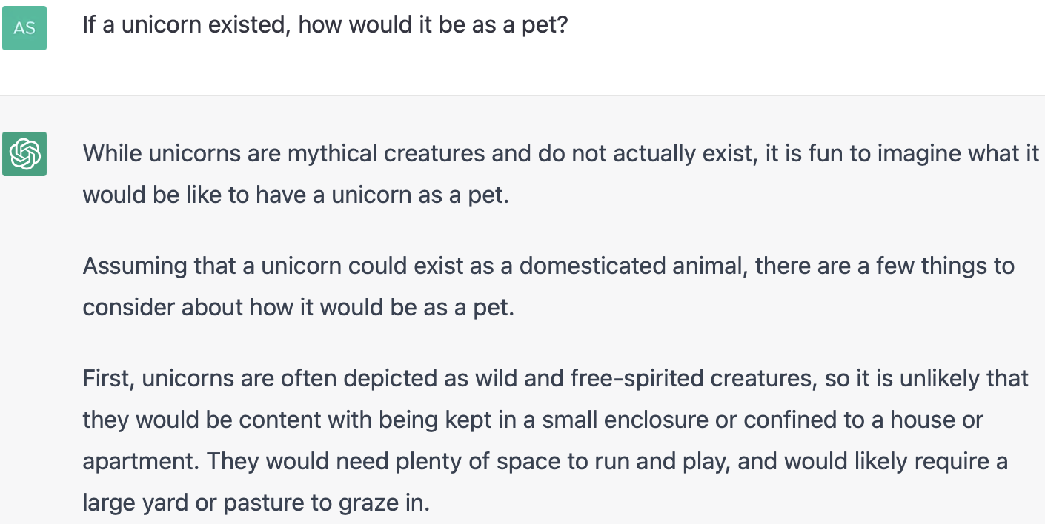
Hypothetical reasoning

Slide 43
ChatGPT for creative tasks
Writing essays and emails.
Paraphrasing or summarizing.
Explaining large amounts of information.
Notes:
Creativity: Most likely many correct ways of solving problems.

Slide 44
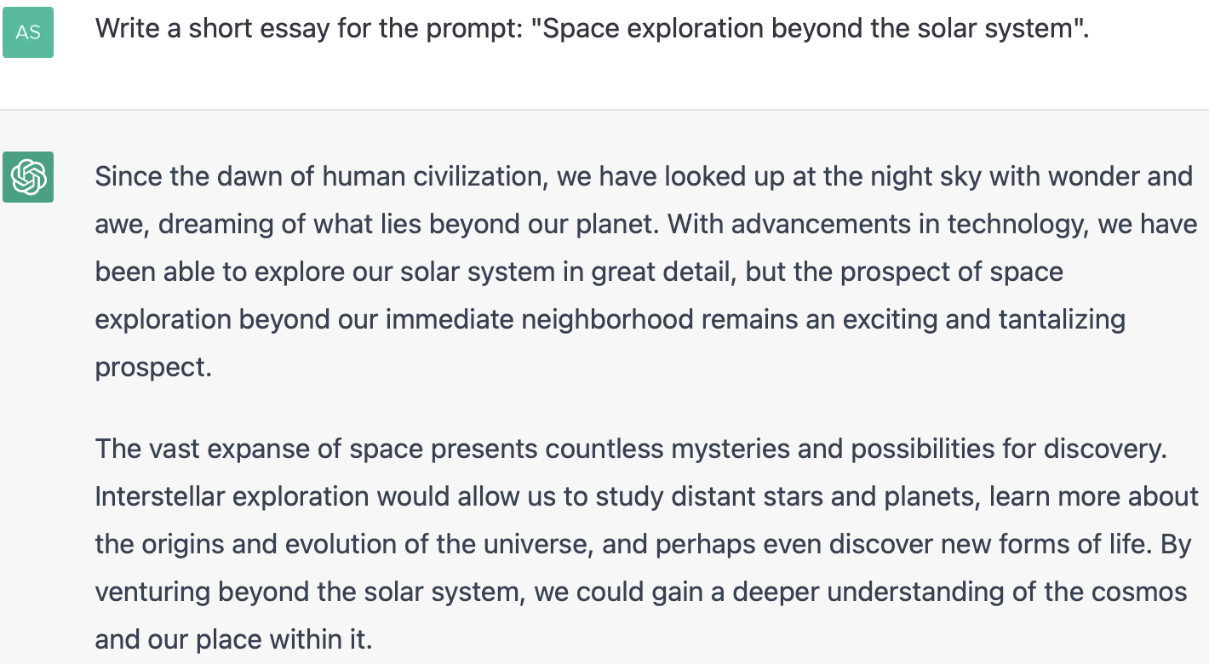
ChatGPT for creative tasks: Writing essays
Notes:
Creativity: Most likely many correct ways of solving problems.

Slide 45
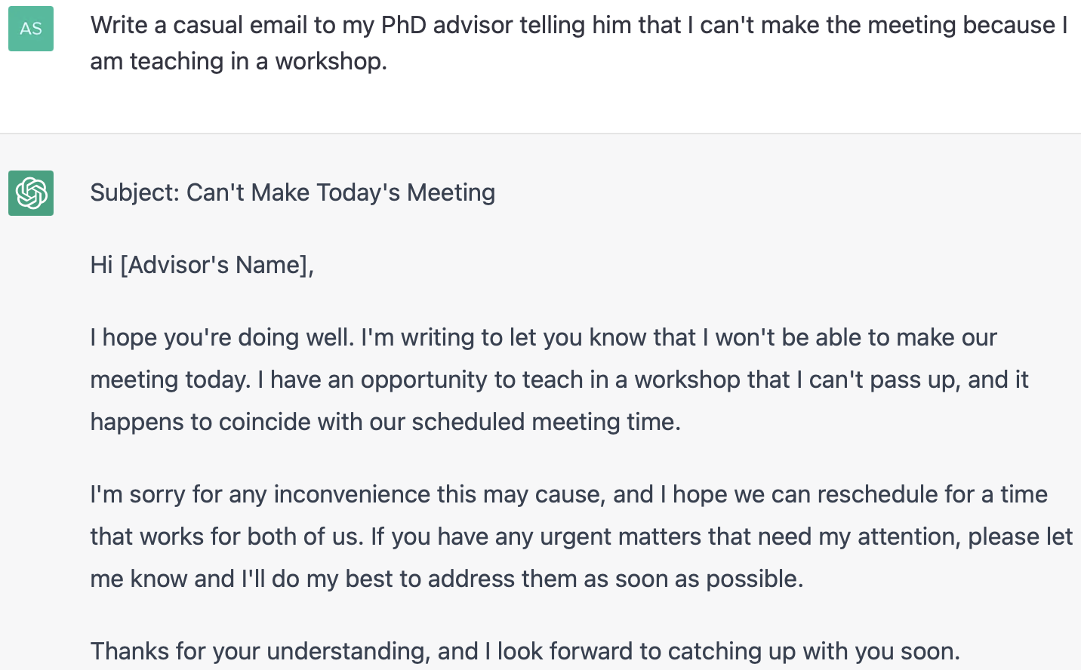
ChatGPT for creative tasks: Writing drafts
Notes:
Creativity: Most likely many correct ways of solving problems.

Slide 46
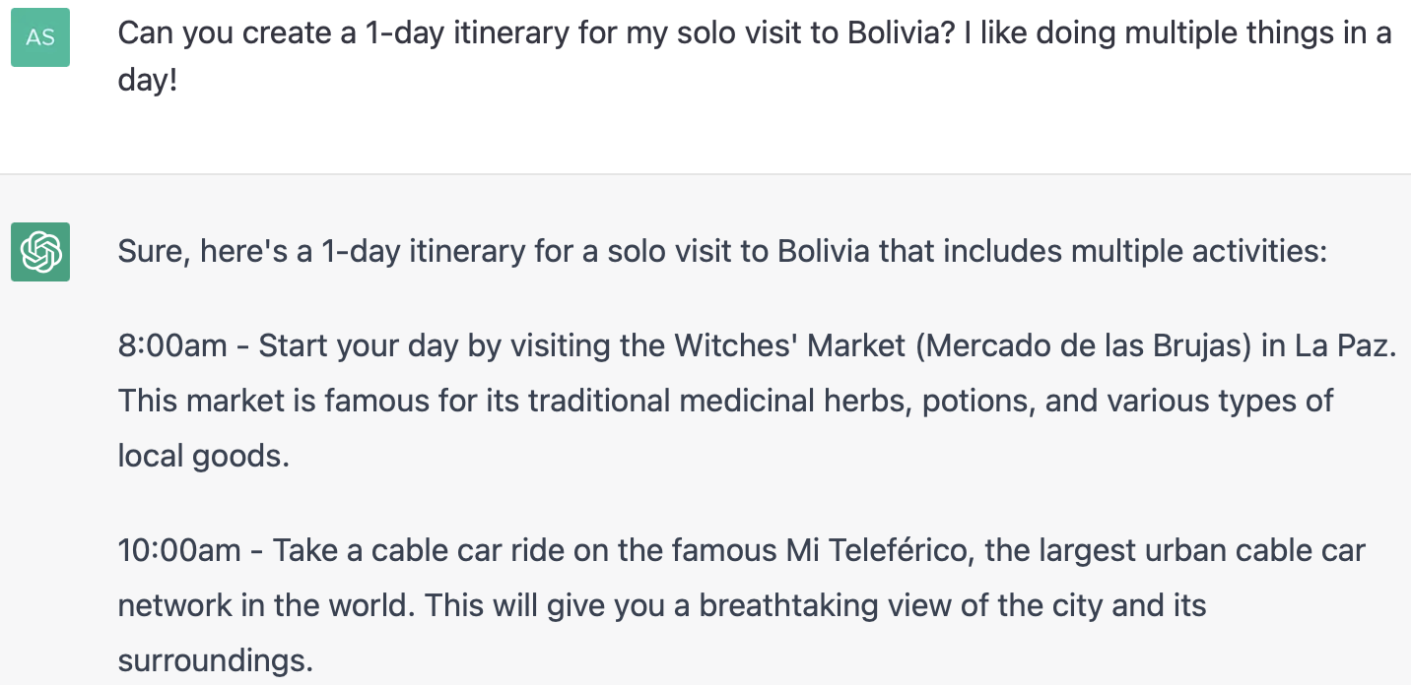
ChatGPT for creative tasks: Creating itineraries
Notes:
Creativity: Most likely many correct ways of solving problems.

Slide 47
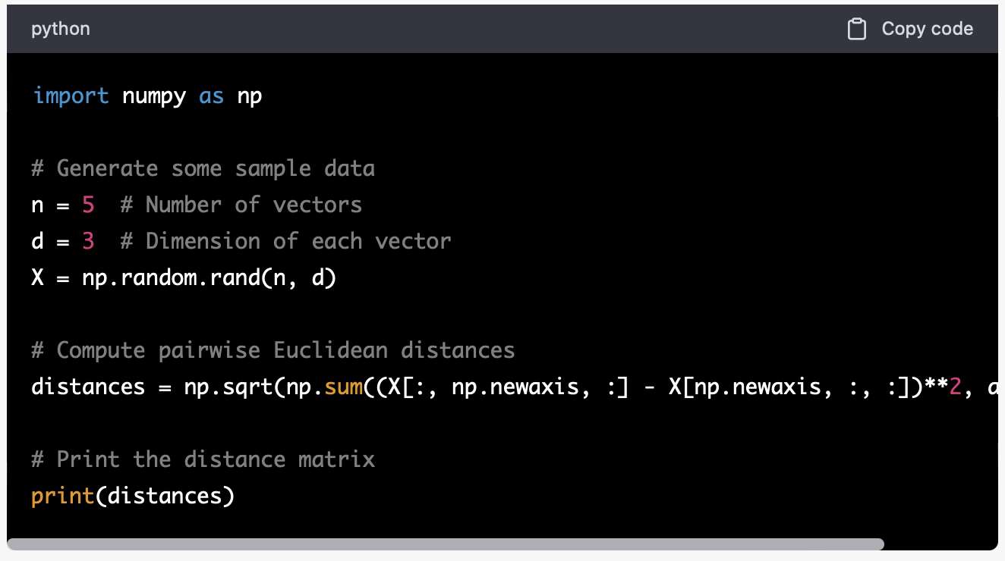
ChatGPT for code
Notes:
Creativity: Most likely many correct ways of solving problems.

Slide 48
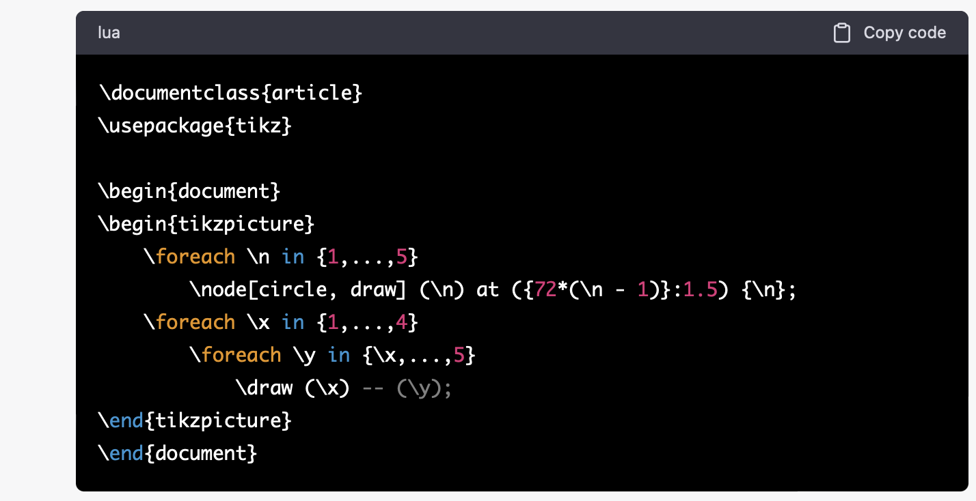
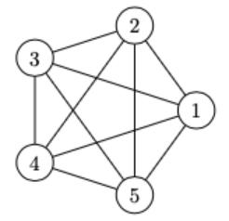
ChatGPT for code
Notes:
Creativity: Most likely many correct ways of solving problems.

Slide 49
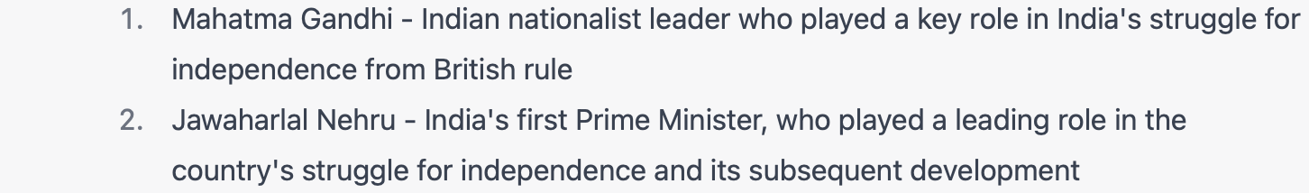
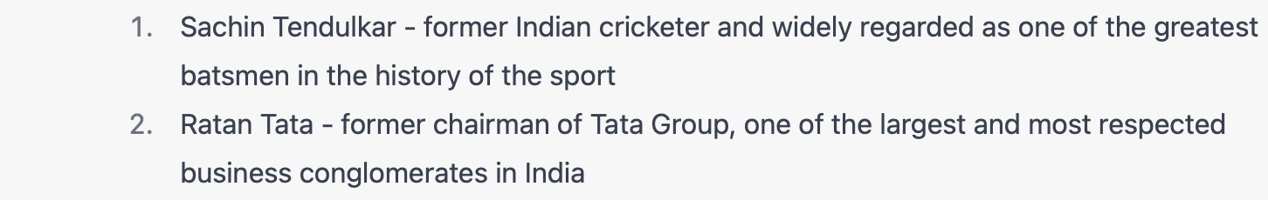
Dialogue: Incorporating history into models

Slide 50
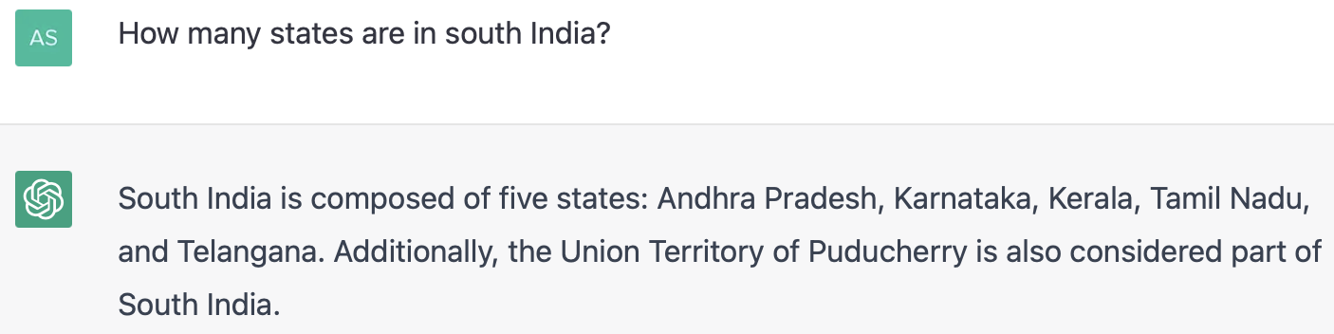
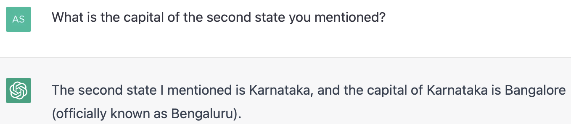
Dialogue: How does it work?
GPT-3 is fine-tuned for next-token prediction on dialogue datasets, so it learns to produce the next utterance for a user query.

Slide 51
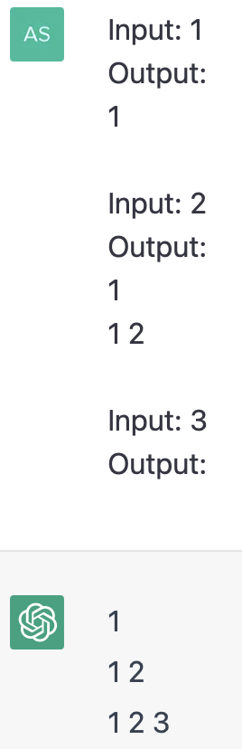
In-context learning
Can LLMs solve novel tasks not seen during training?
Or answer questions in a certain style?
Demonstrations

Slide 52
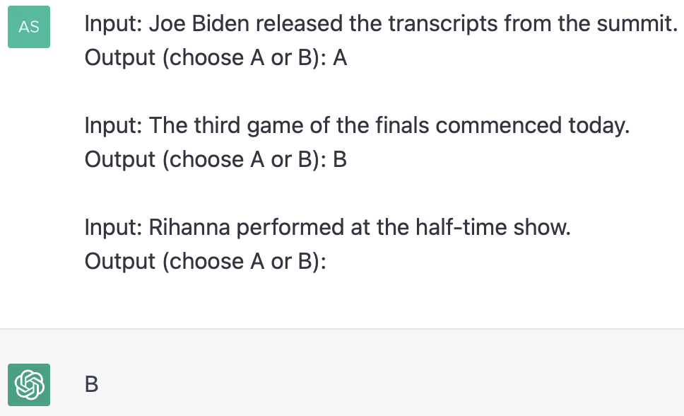
In-context learning
Can LLMs extrapolate from demonstrations?
ChatGPT understands that:
A = politics
B = sports

Slide 53
Part III: Potential limitations of ChatGPT

Slide 54
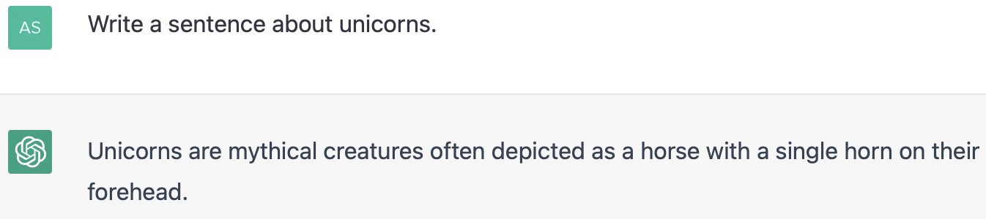
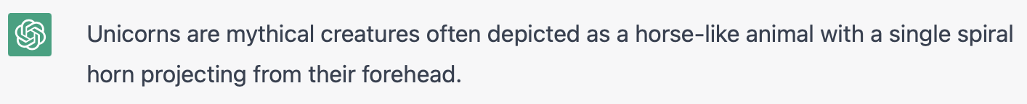
Outputs are probabilistic

Slide 55
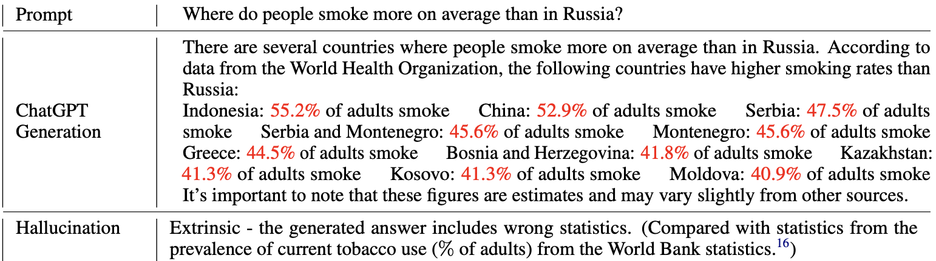
ChatGPT can hallucinate
Numbers marked in red are wrong, ChatGPT imagines them.
[Bang et al., 2023:https://arxiv.org/pdf/2302.04023.pdf]

Slide 56
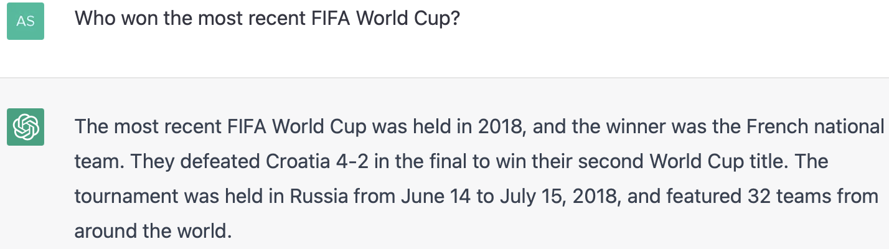
ChatGPT has a timestamp
The answer should have been Argentina, but it is not always trained on the most recent data.

Slide 57

LLMs can be toxic and have bias!
Systems are constantly changing!
Check the following paper for a recent analysis.
https://qrco.de/bdjKPM
[Zhuo et al., 2023:https://arxiv.org/pdf/2301.12867.pdf]

Slide 58
Questions?

