Slide 1
Change Management
Sun, Feb 02, 2025
Faculty: Prof. Anupama Sharma, IIM-V
anupama@iimv.ac.in

Slide 2
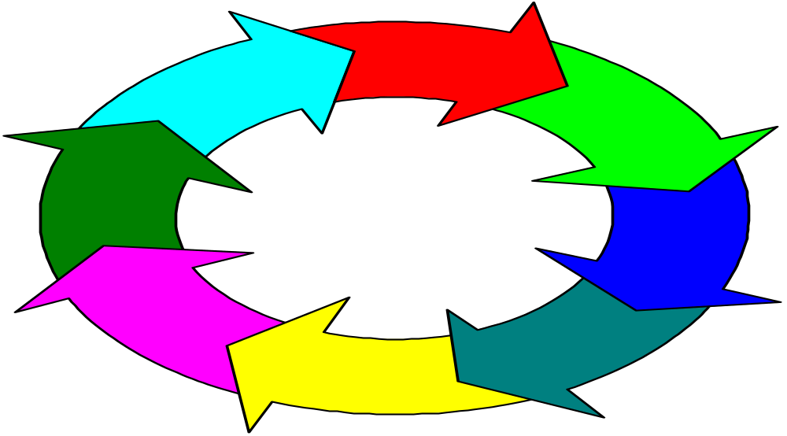
Change Process
Resistance to Change
Notes:
Lesson 1
Change process is a series of phases
Each phase takes time
Important that each phase occur
Lesson 2
Mistakes in any single phase can negatively impact on gains made in earlier phases

Slide 3
Sources of Change
Internal
External

Slide 4
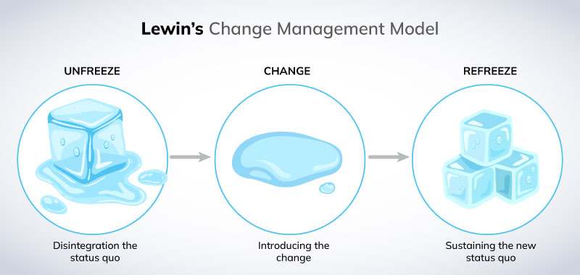
Kurt Lewin Change Model
Unfreeze → Change → Refreeze

Slide 5
1. Not Establishing a Sense of Urgency
Why Transformation Efforts Fail (John P. Kotter, HBR)
Examining market and competitive realities
Identifying and discussing crises, or major opportunities
Notes:
50 % of companies fail in phase 1
Insufficient time spent in this phase
Not enough leaders, too many managers
If there is insufficient urgency, the transformation process cannot success
How do we evaluate when the urgency is high enough
When 75 percent of management is convinced that business as usual is totally unacceptable.

Slide 6
2. Not Creating a Powerful Guiding Coalition
Assembling a group with enough power to lead
Encouraging the group to work as a team
Notes:
Establishment of a powerful guiding team
senior management
people with expertise
reputations
strong networking capabilities
operates outside normal hierarchy
Size:
3 to 5 people during first year
emphasis on the use of retreats
Why this phase fails
underestimate the importance of a coalition
Key line managers not in charge
Overwhelmed by opposition

Slide 7
3. Lacking a Vision
Creating a vision to direct the change effort
Developing strategies for achieving vision
5-minute vision
Notes:
Purpose of Vision
Provide direction
Reason for failure in this stage
After vision is created, an operational plan for achieving vision is required
Creation of a Transformation Vision
Easy to communicate and appeals to employees, and target group
Clarifies direction that the organization will take
Should include new growth possibilities
Needs to be a clear compelling statement, rule of thumb, if it doesn’t initiate interest in 5 minutes or less, work isn’t finished

Slide 8
4. Undercommunicating the Vision
Relentless communication of new vision and strategies
Teaching new behaviors by the example of the guiding coalition
Notes:
Promotion of the vision with in the organization is crucial.
Although speeches, newsletters and endorsements are important, the emphasis in definitely on people “walking the talk” -actions speak louder than words.
Management need to:
tie vision into every day operations
ensure that management related training, courses also tie into new initiative.
Success at this stage is indicated by the increasingly larger numbers of people what become involved in the initiative

Slide 9
5.Not Removing Obstacles to New Vision
Getting rid of obstacles to change
Changing systems or structures that undermine vision
Encouraging risk taking, nontraditional ideas, activities and actions
Notes:
This phase focuses on the elimination or removal of obstacles
Obstacles:
people who refuse to change
organizational structure
Emphasis is on rewarding and recognizing behavior which supports the new vision

Slide 10
6. Not Planning and Creating Short-Term Wins
Planning for performance improvements
Creating improvements
Recognizing and Rewarding
Notes:
Planning process needs to include identifying short term wins
Purpose: keeps the urgency levels up
Reduce people becoming discouraged (1-2 years)
Strategy in this phase
find clear performance improvements
establish and achieve goals and objectives
reward people
Caution: short term wins, don’t declare victory too soon.

Slide 11
7. Declaring Victory Too Soon
Using credibility to change systems, structures and policies that stand in way
Hiring, promoting, developing employees to implement change
Reinvigorating with new projects, themes and change agents
Notes:
Strategy:
Don’t declare victory, but do reward
Use opportunity to tactile even bigger issues, systems or obstinacies
Attention should be paid to hiring, development and promotion of staff

Slide 12
8. Not Anchoring Changes into Organization’s Culture
Articulating connections between new behaviors and success
Developing means to ensure leadership development and succession
Notes:
Action:
Need to continually promote and inform staff of the new changes
Choice of new staff, senior management is critical
Tying requirements for promotion into the vision

Slide 13
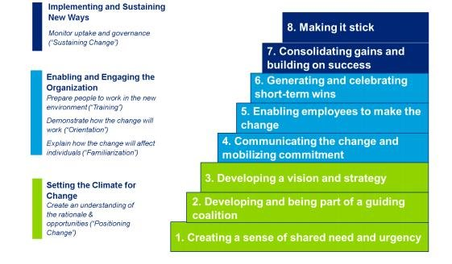
Leading Change by John P Kotter (8 Step Model)

Slide 14
Thank You

