Slide 1
Capital Budgeting
Estimating Cash Flows

Slide 2
Problem 1
Project | Co | C1 | C2 | C3 | C4
A | -5000 | +1000 | +1000 | +3000 | 0
B | -1000 | 0 | +1000 | +2000 | +3000
C | -5000 | +1000 | +1000 | +3000 | +5000
What is the payback period on each of the following projects?
Given that you wish to use the payback rule with a cutoff period of two years, which projects would you accept?
If you use a cutoff period of three years, which projects would you accept?
If the opportunity cost of capital is 10%, which projects have positive NPVs?

Slide 3
Problem 2
Consider projects Alpha and Beta. The opportunity cost of capital is 8%. Suppose you can undertake Alpha or Beta, but not both. Use the IRR rule to make the choice.
Project | Co | C1 | C2 | IRR%
Alpha | -400,000 | +241,000 | +293,000 | 21
Beta | -200,000 | +131,000 | +172,000 | 31

Slide 4
Problem 3
Pipli Ltd has Rs 1 million allocated for capital expenditures. Which of the following projects should the company accept to stay within the Rs. 1 million budget? How much does the budget limit cost the company in terms of its market value? The opportunity cost of capital for each project is 11%.
Project | Investment Rs ‘000 | NPV Rs’000 | IRR %
1 | 300 | 66 | 17.2
2 | 200 | -4 | 10.7
3 | 250 | 43 | 16.6
4 | 100 | 14 | 12.1
5 | 100 | 7 | 11.8
6 | 350 | 63 | 18.0
7 | 400 | 48 | 13.5

Slide 5
Problem 4
Davis Industries must choose between a gas-powered and an electric-powered forklift truck for moving materials in its factory. Since both forklifts perform the same function, the firm will choose only one. (They are mutually exclusive investments.) The electric-powered truck will cost more, but it will be less expensive to operate; it will cost $22,000, whereas the gas-powered truck will cost $17,500. The cost of capital that applies to both investments is 12%. The life for both types of trucks is estimated to be 6 years, during which time the net cash flows for the electric-powered truck will be $6,290 per year, and those for the gas-powered truck will be $5,000 per year. Calculate the NPV and IRR for each type of truck, and decide which to recommend.

Slide 6
Problem 5
The Pinkerton Publishing Company is considering two mutually exclusive expansion plans. Plan A calls for the expenditure of $50 million on a large-scale, integrated plant that will provide an expected cash flow stream of $8 million per year for 20 years. Plan B calls for the expenditure of $15 million to build a somewhat less efficient, more labor-intensive plant that has an expected cash flow stream of $3.4 million per year for 20 years. The firm’s cost of capital is 10%.
  Calculate each project’s NPV and IRR.
  Set up a Project Δ by showing the cash flows that will exist if the firm goes with the large plant rather than the smaller plant. What are the NPV and the IRR for this Project Δ?

Slide 7

Cash Flow Estimation
We learnt how to evaluate projects
How do we estimate the cash flows for projects?

Slide 8
  Applying Net Present Value Rule
Rule 1: Only Cash Flow Is Relevant
  Capital Expenses
    Record capital expenditures when they occur
    To determine cash flow from income, add back depreciation and subtract capital expenditure
  Working Capital
    Difference between the company’s short-term assets and liabilities

Slide 9
  Applying Net Present Value Rule
Rule 2: Estimate Cash Flows on an Incremental Basis
  Include taxes, salvage value, incidental effects, and opportunity costs
  Do not confuse average with incremental payoffs
  Forecast sales today, recognise after-sales cash flow to come later
  Forget sunk costs
  Beware of allocated overhead costs

Slide 10
  Applying Net Present Value Rule
Rule 3: Treat Inflation Consistently
  Use nominal interest rates to discount nominal cash flows
  Use real interest rates to discount real cash flows
  Same results from real and nominal figures

Slide 11
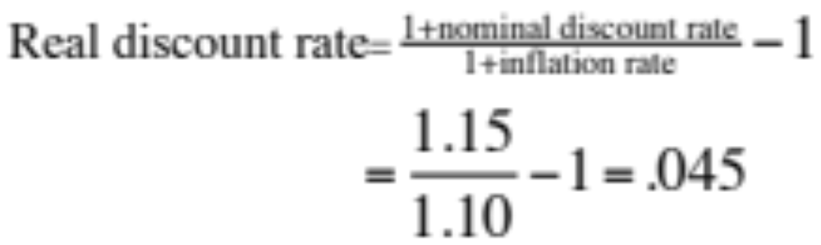
  Example (Inflation)
Project produces real cash flows of –100 in year zero and then +35, +50, and +30 in the following three years.
Nominal discount rate is 15% and inflation rate is 10%.
What is NPV?

Slide 12
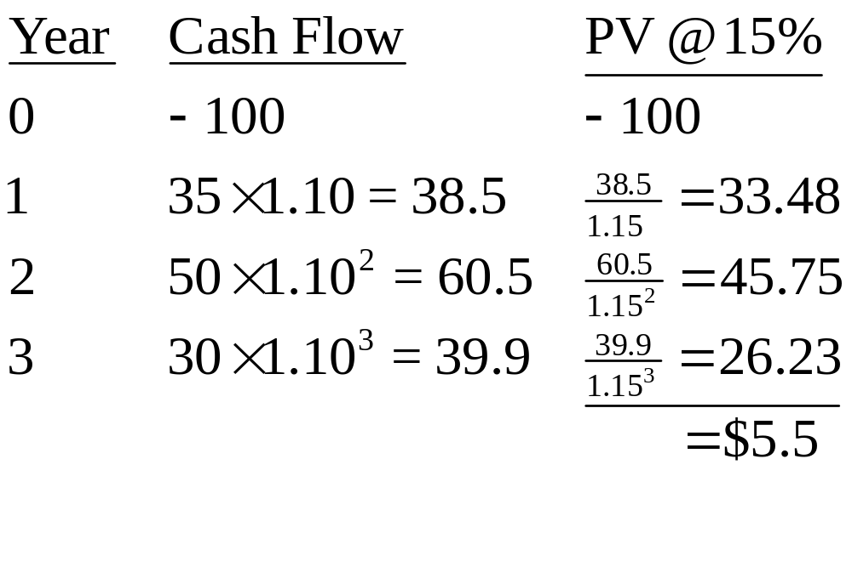
  Example - Nominal figures

Slide 13
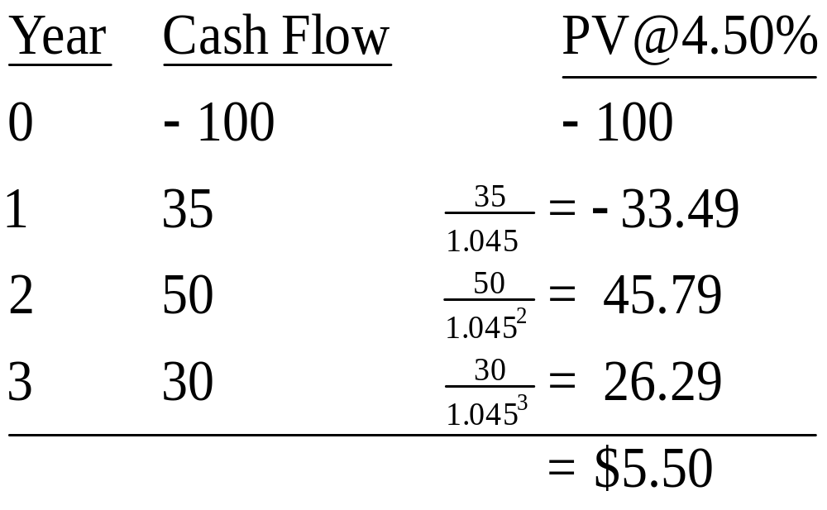
Example—Real figures

Slide 14
Applying Net Present Value Rule
Rule 4: Separate Investment and Financing Decisions
  Regardless of financing, treat cash outflows required for the project as coming from investors
  Regardless of the financing, treat cash inflows as going to investors

Slide 15
Problem 1 – Project NPV
Flatte Restaurant is considering the purchase of a $7,500 souffle maker. The souffle maker has an economic life of five years and will be fully depreciated by the straight-line method. The machine will produce 1,300 souffles per year, with each costing $2.15 to make and priced at $5.25. Assume that the discount rate is 14% and the tax rate is 34%. Should the company make the purchase?

Slide 16
Problem 2 – Project NPV
With limited capital, two recent MBA graduates decided to focus on floor lamps to accent people's homes. They projected unit sales of these lamps to be 9,500 in the first year, with a growth of 8% each year for the next five years. Production of these lamps will require $45,000 in net working capital to start. Total fixed costs are $115,000 per year, variable production costs are $21 per unit, and the units are priced at $53 each. The equipment needed to begin production will cost $190,000. The equipment will be depreciated using the straight-line method over a five-year life and is not expected to have a salvage value. The effective tax rate is 34%, and the required rate of return is 18%. What is the NPV of this project?

Slide 17
Using the NPV Rule to Choose Projects
1: Investment Timing Decision
  Some projects are more valuable if undertaken in the future
  Examine start dates (t) for investment and calculate the net future value for each date
    Discount net values back to the present

Slide 18
Using the NPV Rule to Choose Projects
2: Choice between Projects of Unequal Lives
  Example: Given the cost of operating two machines and a 6% cost of capital, which machine has the higher value using the equivalent annual annuity method?
Quality & quantity produced by both machines are the same each year
 | Year
Machine | 0 | 1 | 2 | 3 | PV@6% | E.A.A.
A | 15 | 5 | 5 | 5 | 28.37
B | 10 | 6 | 6 |  | 21.00

Slide 19
Using the NPV Rule to Choose Projects
Choice between Long- and Short-Term Equipment
Quality & quantity produced by both machines are the same each year
 | Year
Machine | 0 | 1 | 2 | 3 | PV@6% | E.A.A.
A | 15 | 5 | 5 | 5 | 28.37 | 10.61
B | 10 | 6 | 6 |  | 21.00 | 11.45

Slide 20
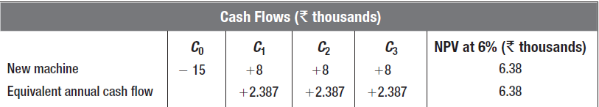
Using the NPV Rule to Choose Projects
3: When to Replace an Old Machine
  Example: A machine is expected to produce a net inflow of Rs.4,000 this year and Rs.4,000 next year before breaking. You can replace it now with a machine that costs Rs.15,000 and will produce an inflow of Rs.8,000 per year for three years. Should you replace it now or wait a year? The cost of Capital is 6%.

Slide 21
Using the NPV Rule to Choose Projects
4: Cost of Excess Capacity
  Example: A computer system costs Rs.500,000 to buy and operate at a discount rate of 6% and lasts five years
      Equivalent annual cost of Rs.118,700
      Undertaking project in year 4 has a present value of 118,700/(1.06)⁴, or about Rs.94,000

