Slide 1
Capstone Project

Slide 2
Capstone Project Details
Project Theme:
Designing a Next-Generation Fintech solution
2. Project Overview:
Groups are tasked with conceptualizing and designing an innovative digital financial service or product (Fintech service or product) in any industry. This service should address a current gap in the market or improve existing financial services. The project will involve market research, design thinking, technological planning, risk assessment, regulatory compliance consideration, and implementation strategy.

Slide 3

Capstone Project Details
3. Project Title:
It should come under the major theme of "Designing a Next-Generation Digital Financial Service“. For Example:
PayTech: "Tokenization Revolution: Securing Payments with Blockchain in PayTech“
RegTech: "ComplianceBot: AI-Powered Regulatory Compliance Monitoring for Fintech“
LendingTech: "BNPL Innovations: Redefining Consumer Credit with Flexible Payment Options“
InsuranceTech: "SmartClaims: Streamlining Insurance Claims Processing Using Blockchain“
WealthTech: "AI WealthGuard: Personalized Financial Planning for Every Investor“
Fintech application in different industries*

Slide 4

Capstone Project Details
4. Project Objectives:
Identify a pressing need or opportunity in the digital finance space and propose an innovative solution.
Leverage various elements of the Fintech ecosystem, including payment technologies, AI/ML, blockchain, cloud computing, and more, to design your service.
Conduct a thorough risk assessment, including financial and cybersecurity risks.
Ensure the proposed solution complies with current regulations and ethical standards, including data protection and privacy laws.
Develop a comprehensive implementation plan covering technology requirement, partnerships, customer acquisition, and scaling strategy.

Slide 5

Capstone Project Details
5. Deliverables:
i. Capstone Project Report:
The report should be structured as follows:
Executive Summary
Introduction to the Problem/Opportunity
Market Analysis
Description of the Proposed Solution
Technological Framework
Risk Analysis
Regulatory and Compliance Framework
Implementation roadmap
Potential impact on the BFSI

Slide 6
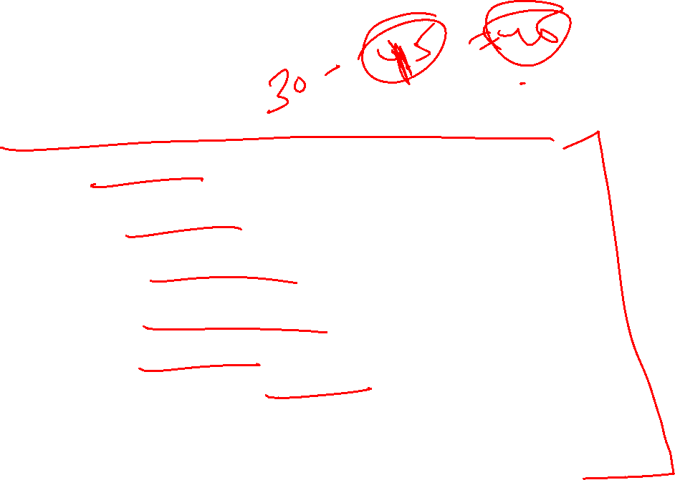
Capstone Project Details
Deliverables:
ii. Presentation:
45 minutes presentation summarizing the key aspects of the project. This should include:
Introduction and motivation for the chosen solution
Market need and solution overview
Key technological components and innovations
Business model and financial sustainability
Risk and regulatory considerations
Implementation roadmap and future steps
Q&A session to address any queries from the audience

Slide 7

Capstone Project Details
6. Evaluation Criteria:
Innovation and Practicality: Originality of the idea and its feasibility in the real world.
Comprehensiveness: Depth of analysis across all required dimensions (market, technology, finance, risk, regulation).
Clarity and Quality: Clear articulation of ideas in both the written report and presentation. Quality of analysis and recommendations.
Feasibility of Implementation Plan: Realism and thoroughness of the implementation roadmap.
Team Collaboration: Evidence of effective teamwork and integration of diverse perspectives.

Slide 8
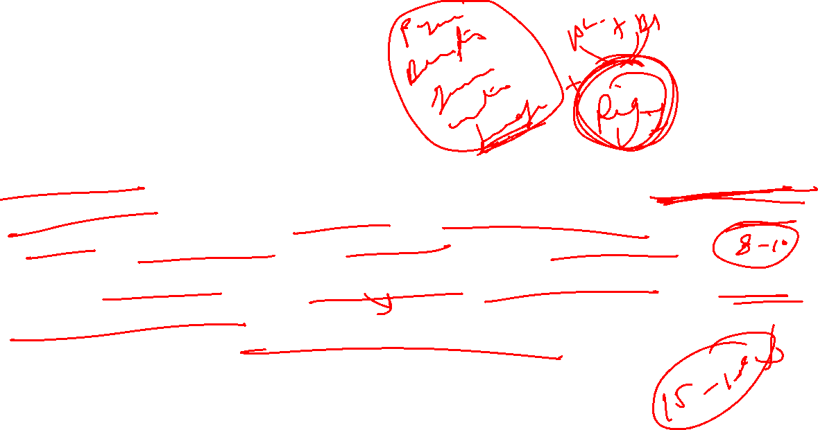
Capstone Project Details
7. Project Timeline:
13th January 2025: Topic selection, initial research, and formation of the project plan. (One Page proposal)
17th February 2025: Deep dive into market research, technological framework development, Financial and risk analysis, regulatory considerations, and initial drafting of the report. (Mid report)
A week before Campus Immersion: Finalization of the report, preparation of the presentation. (Final Report)
During Campus Immersion: Presentation of the project followed by Q&A. (Project Ppt Presentation)

Slide 9
Capstone Project Details
8. Project Output:
This capstone project will enable participants to apply and integrate their learning in a practical setting, fostering not just a deeper understanding of fintech and digital finance but also promoting innovation and strategic thinking in addressing real-world financial challenges.

Slide 10
Thanks

