Slide 1
Learning Objectives
Understanding applications of financial techniques for analysis of projects
  Analyse Yellow Snow Dilemma in the context of capital budgeting
Learning project cost management processes such as resource planning, Cost estimating, Cost budgeting and Cost control.

Slide 2
The Capital Budgeting Decision Process
The Capital Budgeting Process involves three basic steps:
Identifying potential investments
Reviewing, analyzing, and selecting from the proposals that have been generated
Implementing and monitoring the proposals that have been selected
  Managers should separate investment and financing decisions

Slide 3
A Capital Budgeting Process Should:
Account for the time value of money
Account for risk
Focus on cash flow
Rank competing projects appropriately
Lead to investment decisions that maximize shareholders’ wealth

Slide 4
What is the future value (FV) of an initial $100 after 3 years, if I/YR = 10%?
Finding the FV of a cash flow or series of cash flows when compound interest is applied is called compounding.
FV can be solved by using the arithmetic, financial calculator, and spreadsheet methods.
1
2
3
10%
100
FV = ?

Slide 5
Solving for FV:
The arithmetic method
After 1 year:
  FV₁ = PV ( 1 + i ) = $100 (1.10)
  = $110.00
After 2 years:
  FV₂ = PV ( 1 + i )² = $100 (1.10)²
  =$121.00
After 3 years:
  FV₃ = PV ( 1 + i )³ = $100 (1.10)³
  =$133.10
After n years (general case):
  FV_{n} = PV ( 1 + i )^{n}

Slide 6
What is the present value (PV) of $100 due in 3 years, if I/YR = 10%?
Finding the PV of a cash flow or series of cash flows when compound interest is applied is called discounting (the reverse of compounding).
The PV shows the value of cash flows in terms of today’s purchasing power.
0
1
2
3
10%
PV = ?
100

Slide 7
Solving for PV:
The arithmetic method
Solve the general FV equation for PV:
  PV = FV_{n} / ( 1 + i )^{n}
  PV = FV₃ / ( 1 + i )³
  = $100 / ( 1.10 )³
  = $75.13

Slide 8
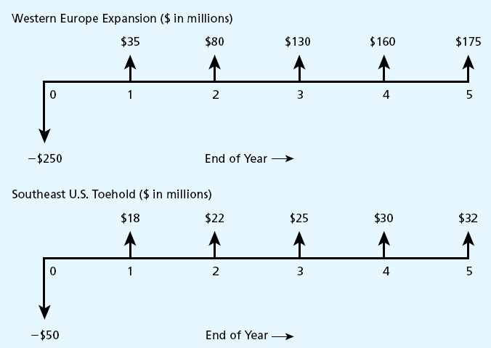
Capital Budgeting Example

Slide 9
Capital Budgeting Decision Techniques
Payback period: most commonly used
Accounting rate of return (ARR): focuses on project’s impact on accounting profits
Net present value (NPV): best technique theoretically
Internal rate of return (IRR): widely used with strong intuitive appeal
Profitability index (PI): related to NPV

Slide 10
Payback Period
The payback period is the amount of time required for the firm to recover its initial investment
If the project’s payback period is less than the maximum acceptable payback period, accept the project
If the project’s payback period is greater than the maximum acceptable payback period, reject the project
Management determines maximum acceptable payback period

Slide 11
Payback Period
The payback period is calculated by dividing the initial investment by the annual cash flows.
Shorter paybacks are more attractive than longer payback periods. Let’s calculate the payback period for the below investment

Slide 12

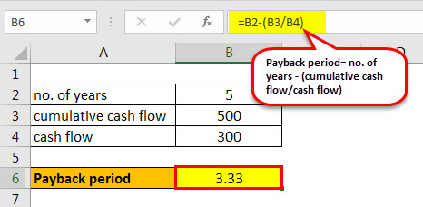
Example-Pay Back
Example
For example, there is an initial investment of ₹1000 in a project and it generates a cash flow of ₹ 300 for the next 5 years Therefore the payback period is calculated as below
Therefore the payback period is calculated as below:
Payback period = no. of years – (cumulative cash flow/cash flow)
Payback period = 5- (500/300)
= 3.33 years
Therefore it will take 3.33 years to recover the investment.

Slide 13
Pros And Cons Of Payback Method
Advantages of payback method:
  Computational simplicity
  Easy to understand
  Focus on cash flow
Disadvantages of payback method:
  Does not account properly for time value of money
  Ignores cash flows after cutoff period
  Does not account properly for risk
  Cutoff period is arbitrary
  Does not lead to value-maximizing decisions

Slide 14
Accounting Rate Of Return (ARR)
Can be computed from available accounting data
  Need only profits after taxes and depreciation
  Accounting ROR = Average profits after taxes ÷ Average investment
Average profits after taxes are estimated by subtracting average annual depreciation from the average annual operating cash inflows
ARR uses accounting numbers, not cash flows; no time value of money
=
Average annual operating cash inflows
Average annual
depreciation
Average profits
after taxes
-

Slide 15
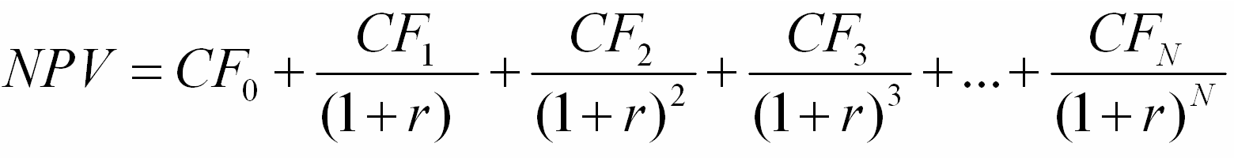
Net Present Value
The present value of a project’s cash inflows and outflows
Discounting cash flows accounts for the time value of money
Choosing the appropriate discount rate accounts for risk
Accept projects if NPV > 0

Slide 16
Net Present Value
A key input in NPV analysis is the discount rate
  r represents the minimum return that the project must earn to satisfy investors
  r varies with the risk of the firm and/or the risk of the project

Slide 17
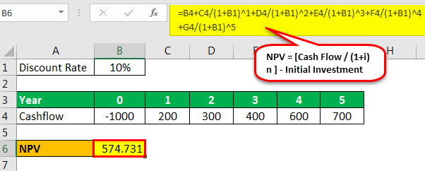
Example :Net Present Value
Example
Let us see an example to discuss it.
Let us assume the discount rate is 10%
NPV = -1000 + 200/(1+0.1)^1 + 300/(1+0.1)^2+400/(1+0.1)^3+600/(1+0.1)^4+ 700/(1+0.1)^5
= 574.731

Slide 18
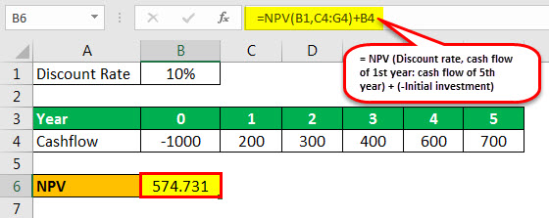
Example :Net Present Value
We can also calculate it by basic excel formulas.
There is an in-built excel formula of “NPV” which can be used. The discounting rate and the series of cash flows from the 1st year to the last year is taken as arguments. We should not include the year zero cash flow in the formula. We should later subtract it.
= NPV (Discount rate, cash flow of 1st year: cash flow of 5th year) + (-Initial investment)
= NPV (10%, 200:700) – 1000
= 574.731

Slide 19
Independent versus Mutually Exclusive Projects
Independent projects – accepting/rejecting one project has no impact on the accept/reject decision for the other project
Mutually exclusive projects – accepting one project implies rejecting another
  If demand is high enough, projects may be independent
  If demand warrants only one investment, projects are mutually exclusive
When ranking mutually exclusive projects, choose the project with highest NPV

Slide 20
Pros and Cons Of Using NPV As Decision Rule
NPV is the “gold standard” of investment decision rules
Key benefits of using NPV as decision rule
  Focuses on cash flows, not accounting earnings
  Makes appropriate adjustment for time value of money
  Can properly account for risk differences between projects
Though best measure, NPV has some drawbacks
  Lacks the intuitive appeal of payback
  Doesn't’t capture managerial flexibility (option value) well

Slide 21
Internal Rate of Return
Internal rate of return (IRR) is the discount rate that results in a zero NPV for the project
IRR found by computer/calculator or manually by trial and error
The IRR decision rule is:
  If IRR is greater than the cost of capital, accept the
  project
  If IRR is less than the cost of capital, reject the project

Slide 22

Example: Internal Rate of Return
While calculating, we need to find out the rate at which NPV is zero. This is usually done by error and trial method else we can use excel for the same.
Let us assume the discount rate to be 10%.
NPV at a 10 % discount is ₹ 574.730.
So we need to increase the discount percentage to make NPV as 0.
So if we increase the discount rate to 26.22 %, the NPV is 0.5 that is almost zero.

Slide 23
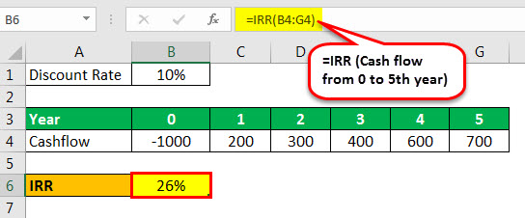
Example: Internal Rate of Return
There is an in-built excel formula of “IRR” which can be used. The series of cash flows is taken as arguments.
=IRR (Cash flow from 0 to 5th year)
= 26 %
Therefore in both ways, we get 26 % as the internal rate of return.

Slide 24
Advantages and Disadvantages of IRR
Advantages
  Properly adjusts for time value of money
  Uses cash flows rather than earnings
  Accounts for all cash flows
  Project IRR is a number with intuitive appeal
Three key problems encountered in using IRR:
  Multiple IRRs
  No real solutions
IRR and NPV rankings do not always agree

Slide 25
Modified Internal Rate of return
The main drawback of the internal rate of return that it assumes that the amount will be reinvested at the IRR itself which is not the case. MIRR solves this problem and reflects the profitability in a more accurate manner.
The formula is as below:-
MIRR= (FV (Positive cash flows* Cost of capital)​​/ PV(Initial outlays * Financing cost))1/n −1
Where,
N = the number of periods
FVCF = the future value of positive cash flow at the cost of capital
PVCF = the present value of negative cash flows at the financing cost of the company.

Slide 26
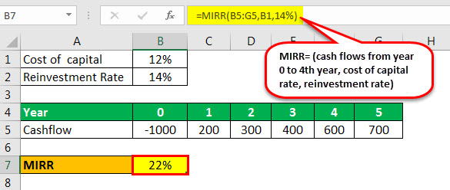
Example MIRR
We can calculate MIRR for the below example:
Let us assume the cost of capital at 12%. In MIRR we need to take into account the reinvested rate which we assume as 14%. In Excel, we can calculate as the below formulae
MIRR= (cash flows from year 0 to 4th year, cost of capital rate, reinvestment rate)
MIRR= (-1000: 600, 12%, 14%)
MIRR= 22%

Slide 27
Conflicts Between NPV and IRR: Scale
NPV and IRR do not always agree when ranking competing projects
The scale problem:
  When choosing between mutually exclusive investments, we cannot conclude that the one offering the highest IRR necessarily provides the greatest wealth creation opportunity.
Resolution to the scale problem:
  The solution involves calculating the IRR for a hypothetical project with cash flows equal to the difference in cash flows between the two mutually exclusive investments.

Slide 28
Reconciling NPV and IRR
Timing and scale problems can cause NPV and IRR methods to rank projects differently
In these cases, calculate the IRR of the incremental project
  Cash flows of large project minus cash flows of small project
  Cash flows of long-term project minus cash flows of short-term project
If incremental project’s IRR exceeds the cost of capital
  Accept the larger project
  Accept the longer term project

Slide 29
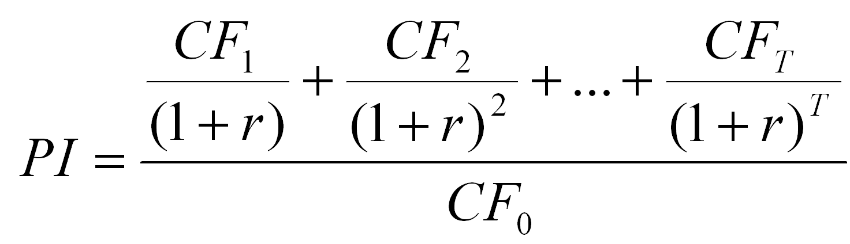
Profitability Index
Calculated by dividing the PV of a project’s cash inflows by the PV of its outflows
Decision rule: Accept projects with PI > 1.0, equal to NPV > 0
Like IRR, PI suffers from the scale problem

Slide 30
Thank you

