Slide 1
Capital Structure -Introduction
A firm’s capital structure is the mix of financial securities used to finance its activities.
The mix will always include common stock and will often include debt and preferred stock.
The firm may have several classes of common stock, for example with different voting rights and possibly different claims on the cash flows available to stockholders.

Slide 2
Capital Structure -Introduction
The debt at a firm can be long term or short term, secured or unsecured, convertible or not convertible into common stock, and so on.
Preferred stock can be cumulative or noncumulative and convertible or not convertible into common stock.

Slide 3
Capital Structure -Introduction
THE OPTIMAL CAPITAL STRUCTURE
Managers at a firm choose a capital structure so that the mix of securities making up the capital structure minimizes the cost of financing the firm’s activities.
The capital structure that minimizes the cost of financing the firm’s projects is also the capital structure that maximizes the total value of those projects and, therefore, the overall value of the firm.

Slide 4
Capital Structure -Introduction
The value of a firm is defined to be the sum of the value of the firm’s debt and the firm’s equity.
V = D + E
If the goal of the firm’s management is to make the firm as valuable as possible, then the firm should pick the debt-equity ratio that makes the pie as big as possible.
S
D
E
Value of the Firm

Slide 5
Financial leverage
The fraction of the total financing that is represented by debt is a measure of the financial leverage in the firm’s capital structure.
A higher fraction of debt indicates a higher degree of financial leverage.
The amount of financial leverage in a firm’s capital structure is important because it affects the value of the firm.

Slide 6
Financial leverage
FL is measured by
Debt Financing ratio: D/D+E
Long term debt to capitalisation: LTD/LTD+E
Notes:
Note: Market (not Book value ) of debt and equity correctly determines the Capital structure.

Slide 7
Magic of Financial Leverage
A tale of 2 capital structures
Capital structure | All equity | Half Debt
Shares | 1000 | 500
Price per share | 10 | 10
Equity Value | 10000 | 5000
Debt Value | 0 | 5000
Asset value | 10000 | 10000
Proposed
Rs.20,000
Rs.8,000
Rs.12,000
2/3
8%
240
Rs.50

Slide 8
Magic of Financial Leverage
EPS and ROE Under Current Structure
EBIT | 500 | 1000 | 1500 | 2000
Interest Expense | 0 | 0 | 0 | 0
Net Income | 500 | 1000 | 1500 | 2000
EPS | 0.5 | 1 | 1.5 | 2
ROE | 0.05 | 0.1 | 0.15 | 0.2

Slide 9
Magic of Financial Leverage
EPS and ROE Under Proposed Structure
EBIT | 500 | 1000 | 1500 | 2000
Interest Expense | 500 | 500 | 500 | 500
Net Income | 0 | 500 | 1000 | 1500
EPS | 0.00 | 1 | 2 | 3
ROE | 0.00 | 0.10 | 0.20 | 0.30
Notes:
1.Increses ROE for likely Business result
Increases Variability in ROE

Slide 10
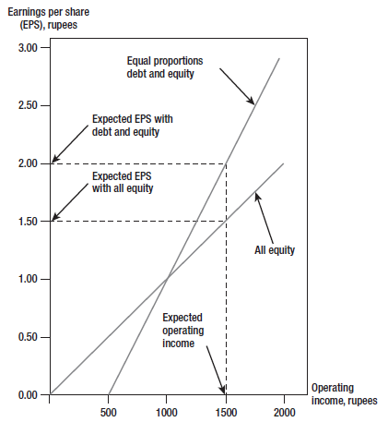
Figure Borrowing Increases EPS
Notes:
The price per share remains the same, but the expected return per share increases with leverage. This is also called EBIT-EPS analysis. At income levels less than Rs.1,000, an all-equity firm is better. At income levels greater than Rs.1,000 a levered firm is better.

Slide 11
The Modigliani And Miller Propositions
  M&M Proposition 1
    Modigliani and Miller Proposition 1 states that the capital structure decisions a firm makes will have no effect on the value of the firm if:
      There are no taxes.
      There are no information or transaction costs.
      No other imperfections
  Hence market value of company does not depend on capital structure
Notes:
If you don’t fully understand the
conditions under which MM’s theory holds, you won’t
fully understand why one capital structure is better than
another. The financial manager needs to know what
kinds of market imperfection to look for.
Perfect Capital Markets:
Perfect competition
Firms and investors can borrow/lend at the same rate
Equal access to all relevant information
No transaction costs
No taxes

Slide 12

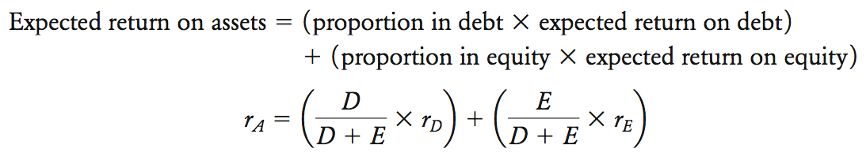
The Modigliani And Miller Propositions
  M&M Proposition 1
Notes:
Expected return on assets = r_{A} = (expected operating income)/(market value of all securities)
r_{A =} [D/(D+E)](r_{D}) + [E/( D+E)](r_{E});
r_{A}(D+E) = (D)(r_{D}) + E(r_{E}); r_{E} = r_{A}(D/E + 1) – r_{D}(D/E);
r_{E} = r_{A} + [D/E](r_{A} – r_{D});
For an all-equity firm r_{A} = r_{E} = 0.15

Slide 13
The Modigliani And Miller Propositions
  M&M Proposition 2
  - States that the cost of (required return on) a firm’s common stock is directly related to the debt-to-equity ratio.

Slide 14
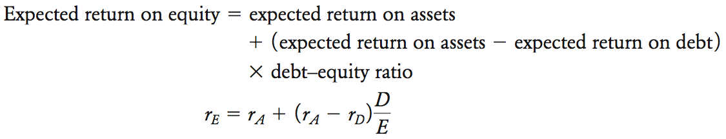
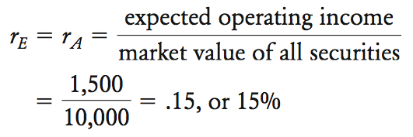
The Modigliani And Miller Propositions
Proposition II and MM
Notes:
r_{E} = r_{A} + [D/E](r_{A} – r_{D});
For an all-equity firm r_{A} = r_{E} = 0.15

Slide 15

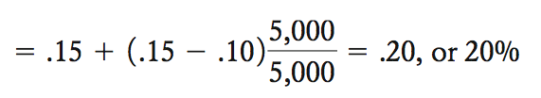
The Modigliani And Miller Propositions
Proposition II and MM
Notes:
If D/E = 1, r_{E} = 0.15 + 1(0.15 – 0.1) = 0.20 = 20%;
Return on equity increases linearly with leverage (debt-equity ratio):
r_{E} = r_{A} + [D/E](r_{A} – r_{D}); This is MM’s Proposition II.

Slide 16
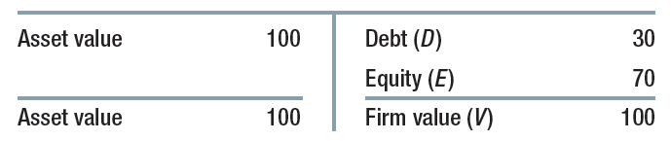
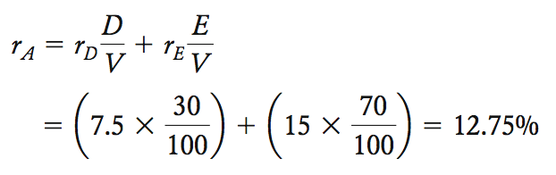

Leverage and Cost of Equity
Leverage and Returns
Notes:
r_{A} = [D/(D+E)](r_{D}) + [E/( D+E)](r_{E}); if r_{D} = 7.5% and r_{E} = 15%
Then r_{A} = (0.4)(7.5) + (0.6)(15) = 12.75%; Where D/V = 40% and E/V = 60% ;(V = D+E)
Return on equity of a levered firm is higher if the cost of debt increases with leverage.

Slide 17

Leverage and Cost of Equity
Leverage and Returns
Notes:
A similar relationship can be obtained for betas.
β_{A} = β_{D}(D/V) + β_{E} (E/V)
β_{E} = β_{A} + [D/E]( β_{A} – β_{D}); [Note: If the debt is risk free then β_{D} = 0]

Slide 18
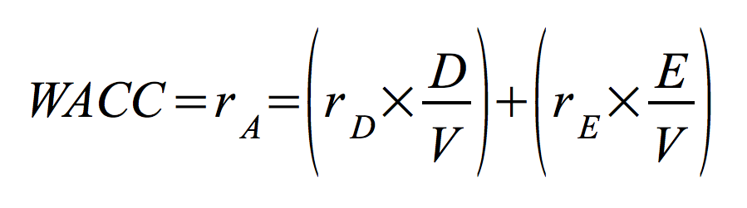
Weighted-Average Cost Of Capital
Weighted-Average Cost of Capital (WACC)
Notes:
The weighted average cost of capital is the weighted average of debt and equity returns.
WACC = r_{A} = [D/(D+E)]×(r_{D}) + [E/( D+E)] × (r_{E}) = [D/V] × (r_{D}) + [E/V] × (r_{E})

Slide 19
Selecting a Capital Structure
Weighted-Average Cost Of Capital and Leverage-Naïve view
r
r_{E}
r_{A} = WACC
r_{D}
D
V
Notes:
This graph shows the relationship between WACC and leverage assuming that the return on equity does not change with leverage. The WACC declines with higher leverage. According to traditional views the expected rate of return on equity is unaffected by financial leverage. Then WACC declines as the firm borrows more. This can only happen in an imperfect market.

Slide 20
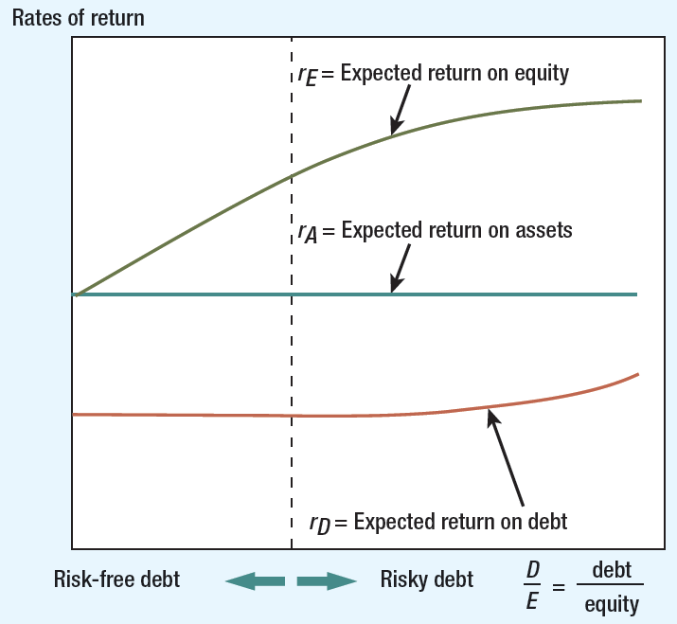
Figure 1 Proposition II and MM veiw
Notes:
This graph shows that the WACC remains constant as leverage increases, according to MM Proposition I.

Slide 21
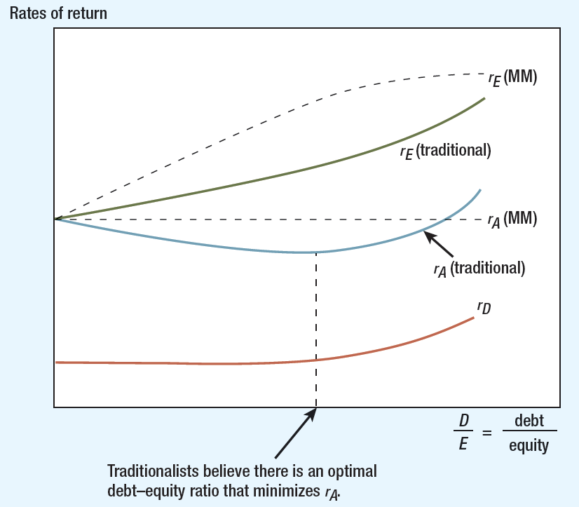
Figure 2 WACC Traditional View
Notes:
The traditionalists say that borrowing at first increases r_{E} more slowly than MM predicts, but r_{E} shoots up with higher levels of debt. Using the right amount of debt can minimize the Weighted Average Cost of Capital. This graph also shows that the WACC remains constant as leverage increases and is consistent with MM Proposition I.

Slide 22
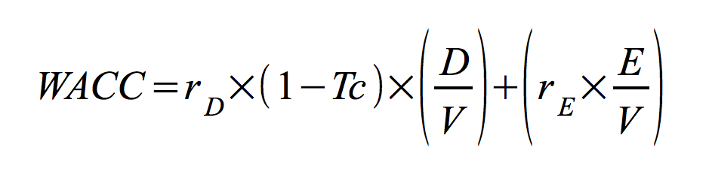
After-Tax Weighted-Average Cost of Capital
After-Tax WACC
  Tax benefit from interest-expense deductibility must include cost of funds
  Tax benefit reduces effective cost of debt by factor of marginal tax rate
Notes:
This shows the formula for the weighted average cost of capital (WACC).

Slide 23
After-Tax Weighted-Average Cost of Capital
After-Tax WACC
  Kate’s Café has marginal tax rate of 35%
  Cost of equity 10.0% and pretax cost of debt 5.5%
  Given book- and market-value balance sheets, what is tax-adjusted WACC?
Notes:
Another Example: Kate’s Café WACC:
Where: r_{D} = 5.5%; r_{E} = 10%; & T = 35%

Slide 24
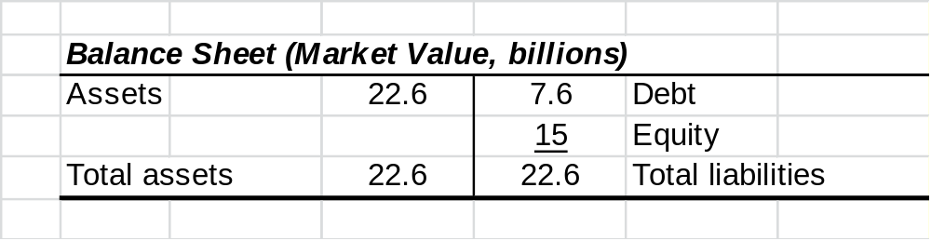
Final Word on After-Tax Weighted-Average Cost of Capital
After-Tax WACC
Notes:
Another Example: Kate’s Café WACC:
WACC = (r_{D}) × (1 – T_{C} ) × [D/V] + (r_{E}) × [E/V]
Where: D = $7.6 billion at r_{D} = 5.5%; E = $15 billion at r_{E} = 10%; Firm value V = $22.6 billion; T = 35%

Slide 25
Final Word on After-Tax Weighted-Average Cost of Capital
After-Tax WACC
  Debt ratio = (D/V) = 7.6/22.6 = .34 or 34%
  Equity ratio = (E/V) = 15/22.6 = .66 or 66%
Notes:
D/V = 7.6/22.6 = 34% & E/V = 15/22.6 = 66%
WACC = (r_{D}) × (1 – T_{C} ) × [D/V] + (r_{E}) × [E/V]

Slide 26
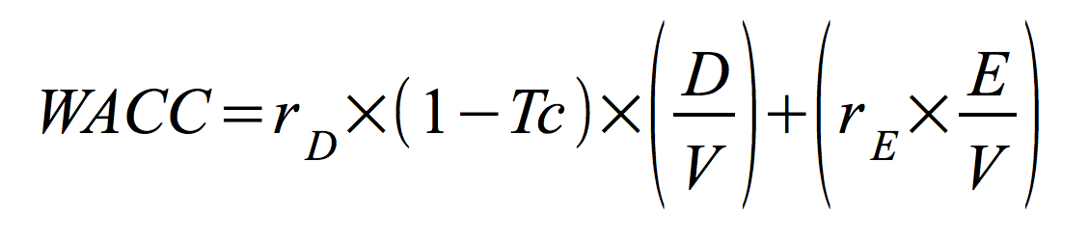
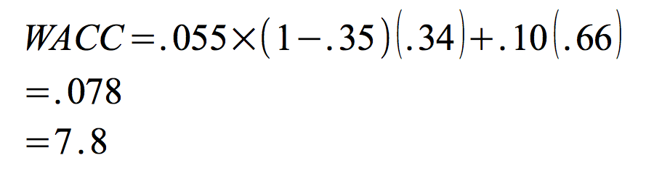
Final Word on After-tax Weighted-Average Cost Capital
After-Tax WACC
Notes:
WACC = (r_{D}) × (1 – T_{C} ) × [D/V] + (r_{E}) × [E/V]
After-tax WACC = 0.055(1-0.35)(0.34) + (0.10)(0.66) = 7.8%

Slide 27
The Benefits and Costs of Using Debt
THE BENEFITS OF DEBT
  Interest Tax Shield Benefit
    The most important benefit from including debt in a firm’s capital structure stems from the fact that firms can deduct interest payments for tax purposes but cannot deduct dividend payments.
    This makes it less costly to distribute cash to security holders through interest payments than through dividends.

Slide 28
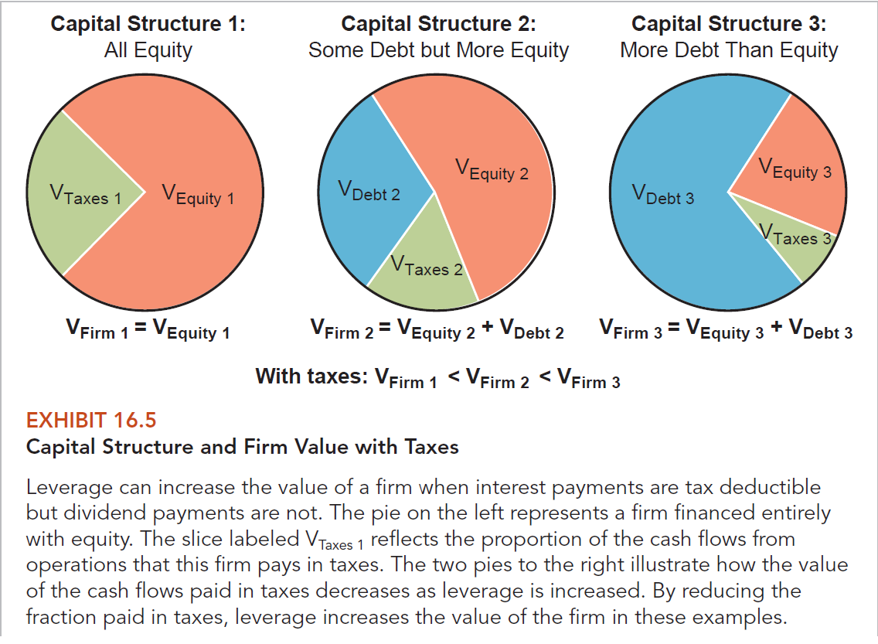
Exhibit : Capital Structure and Firm Value with Taxes

Slide 29
The Benefits and Costs of Using Debt
THE BENEFITS OF DEBT
  Interest Tax Shield Benefit
    The total dollar amount of interest paid each year, and therefore the amount that will be deducted from the firm’s taxable income, is “D × k_{Debt}”.
    This will result in a reduction in taxes paid (the interest tax shield) of “D × k_{Debt} × t”, where t is the firm’s marginal tax rate that applies to the interest expense deduction.

Slide 30
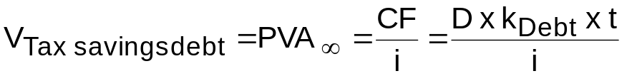
The Benefits and Costs of Using Debt
THE BENEFITS OF DEBT
  Interest Tax Shield Benefit
    If this reduction will continue in perpetuity, the present value of the tax savings from debt, is:

Slide 31

The Benefits and Costs of Using Debt
THE BENEFITS OF DEBT
  Interest Tax Shield Benefit
    Since the firm will benefit from the interest tax shield only if it is able to make the required interest payments, the cash savings associated with the tax shield are about as risky as the cash flow stream associated with the interest payments.

Slide 32
The Benefits and Costs of Using Debt
THE BENEFITS OF DEBT
  Effect of Debt Example
    You are considering borrowing $1,000,000 at an interest rate of 6 percent for your pizza business. Your pizza business generates pretax cash flows of $300,000 each year and pays taxes at a rate of 25 percent. What is the value of your firm without debt, and how much would debt increase its value? What is WACC before and after restructuring?

Slide 33
    V_{Firm} = [$300,000 × (1 – 0.25)]/0.10 = $2,250,000
    Value of tax shield = $1,000,000 × 0.25 = $250,000

Slide 34
The Benefits and Costs of Using Debt
THE BENEFITS OF DEBT
  Effect of Debt Example
  WACC before financial restructuring = k_{cs} = 10%
  After restructuring:
  Value of equity = $2,500,000 - $1,000,000 = $1,500,000
  After-tax cash flows to stockholders
  = [$300,000 - ($1,000,000 × 0.06)] × (1 - 0.25) = $180,000
  k_{cs} = $180,000/1,500,000 = 0.12, or 12 percent
  WACC = ($1,000,000/$2,500,000)(0.06)(1 - 0.25) + ($1,500,000/$2,500,000)(0.12)
  = 0.09, or 9%.

Slide 35
The Benefits and Costs of Using Debt
THE BENEFITS OF DEBT
  Interest Tax Shield Benefit
    The perpetuity model assumes that
      The firm will continue to be in business forever.
      The firm will be able to realize the tax savings in the years in which the interest payments are made (the firm’s EBIT will always be at least as great as the interest expense).
      The firm’s tax rate will remain constant.

Slide 36
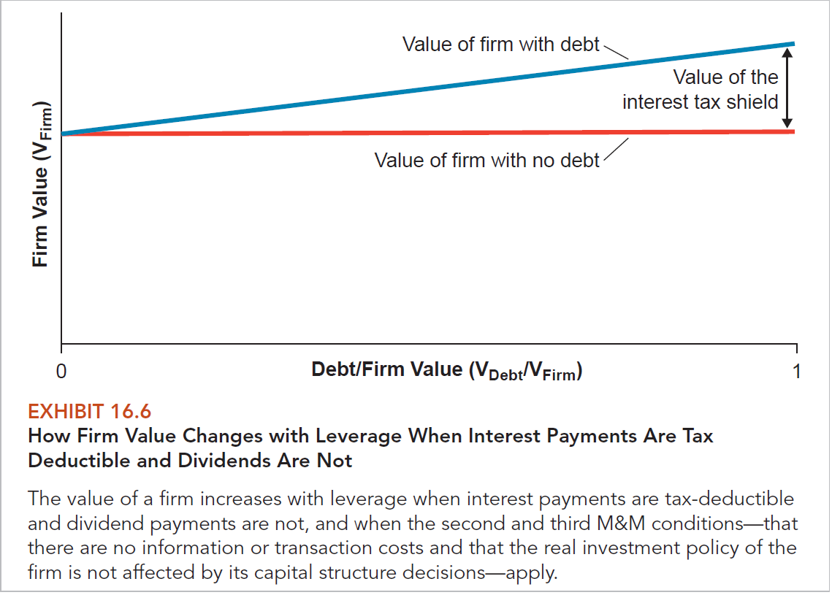
Exhibit : How Firm Value Changes

Slide 37
The Benefits and Costs of Using Debt
THE BENEFITS OF DEBT
  Other Benefits
    Underwriting spreads and out-of-pocket costs are more than three times as large for stock sales as they are for bond sales.
    Debt provides managers with incentives to focus on maximizing the cash flows that the firm produces since interest and principal payments must be made when they are due.

Slide 38
The Benefits and Costs of Using Debt
THE BENEFITS OF DEBT
  Other Benefits
    Because managers must make these interest and principal payments or face the prospect of bankruptcy, not making the payments can destroy a manager’s career.
    Debt can be used to limit the ability of bad managers to waste the stockholders’ money on things such as fancy jet aircraft, plush offices, and other negative-NPV projects that benefit the managers personally.

Slide 39
The Benefits and Costs of Using Debt
THE COSTS OF DEBT
  Financial managers limit the amount of debt in their firms’ capital structures in part because there are costs that can become quite substantial at high levels of debt.
  At low levels of debt, the benefits are greater than the costs, and adding additional debt increases the overall value of the firm.

Slide 40
The Benefits and Costs of Using Debt
THE COSTS OF DEBT
  At some point, the costs begin to exceed the benefits, and adding more debt financing destroys firm value.
  Financial managers want to add debt just to the point at which the value of the firm is maximized.

Slide 41
The Benefits and Costs of Using Debt
THE COSTS OF DEBT
  Bankruptcy costs
    Also referred to costs of financial distress, are costs associated with financial difficulties that a firm might get into because it uses too much debt financing.
    The term bankruptcy cost is used rather loosely in capital structure discussions to refer to costs incurred when a firm gets into financial distress.
    Firms can incur bankruptcy costs even if they never actually file for bankruptcy.

Slide 42
The Benefits and Costs of Using Debt
THE COSTS OF DEBT
  Bankruptcy costs
    Direct Bankruptcy costs are out-of-pocket costs that a firm incurs as a result of financial distress.
    They include things such as fees paid to lawyers, accountants, and consultants.
    Indirect Bankruptcy costs are costs associated with changes in the behavior of people who deal with a firm in financial distress.

Slide 43
The Benefits and Costs of Using Debt
THE COSTS OF DEBT
  Bankruptcy costs
    Some of this firm’s potential customers will decide to purchase a competitor’s products because of:
      Concerns that the firm will not be able to honor its warranties.
      Parts or service will not be available in the future.
    Some customers will demand a lower price to compensate them for these risks.

Slide 44
The Benefits and Costs of Using Debt
THE COSTS OF DEBT
  Agency Costs
    Result from conflicts of interest between principals and agents where one party, known as the principal, delegates its decision-making authority to another party, known as the agent.
    The agent is expected to act in the interest of the principal, but agents sometimes have interests that conflict with those of the principal.

Slide 45
The Benefits and Costs of Using Debt
THE COSTS OF DEBT
  Agency Costs
    Stockholder-Manager Agency Costs – occur to the extent that if the incentives of the managers are not perfectly identical to those of the stockholders, managers will make some decisions that benefit themselves at the expense of the stockholders.
    Using debt financing provides managers with incentives to focus on maximizing the cash flows that the firm produces and limits the ability of bad managers to waste the stockholders’ money on negative-NPV projects.

Slide 46
The Benefits and Costs of Using Debt
THE COSTS OF DEBT
  Agency Costs
    These benefits amount to reductions in the agency costs associated with the principal-agent relationship between stockholders and managers.
    While the use of debt financing can reduce agency costs, it can also increase these costs by altering the behavior of managers who have a high proportion of their wealth riding on the success of the firm, through their stockholdings, future income, and reputations.

Slide 47
The Benefits and Costs of Using Debt
THE COSTS OF DEBT
  Agency Costs
    The use of debt increases the volatility of a firm’s earnings and the probability that the firm will get into financial difficulty.
    Increased risk causes managers to make more conservative decisions.
    Stockholder-Lender Agency Costs – occur when investors lend money to a firm and delegate authority to the stockholders to decide how that money will be used.

Slide 48
The Benefits and Costs of Using Debt
THE COSTS OF DEBT
  Agency Costs
    Lenders expect that the stockholders, through the managers they appoint, will invest the money in a way that enables the firm to make all of the interest and principal payments that have been promised.
    However, stockholders may have incentives to use the money in ways that are not in the best interests of the lenders.

Slide 49
The Benefits and Costs of Using Debt
THE COSTS OF DEBT
  Agency Costs
    Lenders know that stockholders have incentives to distribute some or all of the funds that they borrow as dividends and so they protect themselves against this sort of behavior by including provisions in the lending agreements that limit the ability of stockholders to pay dividends and conduct other behaviors.
    These protections are however, not foolproof.

Slide 50
The Benefits and Costs of Using Debt
THE COSTS OF DEBT
  Agency Costs
    One example of this behavior is known as the asset substitution problem, where once a loan has been made to a firm, the stockholders have an incentive to substitute less risky assets for more risky assets such as negative-NPV projects.

Slide 51
The Benefits and Costs of Using Debt
THE COSTS OF DEBT
  Agency Costs
    Another example behavior is known as the underinvestment problem and it occurs in a financially distressed firm when the value that is created by investing in a positive-NPV project is likely to go to the lenders instead of the stockholders; therefore the firm forgoes financing and undertaking the project.

