Slide 1
Navigating Growth through Strategic Capital Budgeting
PG Certificate Program in Digital Transformation Strategy & Leadership

Slide 2
Introduction
In the relentless pursuit of growth and sustained competitiveness, companies must foster a continuous flow of innovative ideas. This involves:

Slide 3
Introduction
In the relentless pursuit of growth and sustained competitiveness, companies must foster a continuous flow of innovative ideas. This involves:
  Developing New Products/Services

Slide 4
Introduction
In the relentless pursuit of growth and sustained competitiveness, companies must foster a continuous flow of innovative ideas. This involves:
  Developing New Products/Services
  Enhancing the quality of existing Products/Services

Slide 5
Introduction
In the relentless pursuit of growth and sustained competitiveness, companies must foster a continuous flow of innovative ideas. This involves:
  Developing New Products/Services
  Enhancing the quality of existing Products/Services
  Streamlining the cost of production/operations

Slide 6
Introduction
In the relentless pursuit of growth and sustained competitiveness, companies must foster a continuous flow of innovative ideas. This involves:
  Developing New Products/Services
  Enhancing the quality of existing Products/Services
  Streamlining the cost of production/operations
  Expanding into new markets/geographies, and more.

Slide 7
Introduction
In the relentless pursuit of growth and sustained competitiveness, companies must foster a continuous flow of innovative ideas. This involves:
  Developing New Products/Services
  Enhancing the quality of existing Products/Services
  Streamlining the cost of production/operations
  Expanding into new markets/geographies, and more.
This sets the stage for Business Results Leadership, where visionary leaders actively seek, scrutinize, and choose project proposals that maximize value.

Slide 8
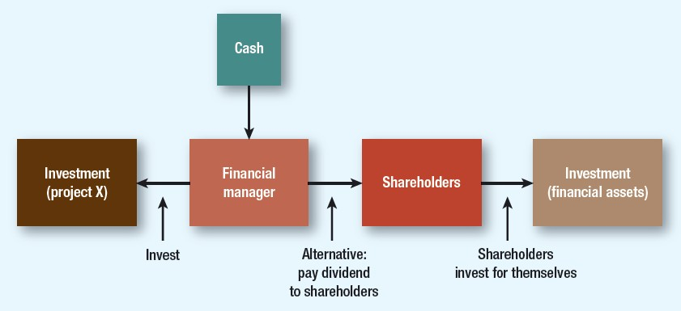
Basis of Cash Transfers decision for leaders…

Slide 9
Capital Budgeting and Leadership
As we delve into the heart of Business Results Leadership, we encounter a linchpin: Capital Budgeting.

Slide 10
Capital Budgeting and Leadership
As we delve into the heart of Business Results Leadership, we encounter a linchpin: Capital Budgeting.
Capital Budgeting is the process of identifying projects that add substantial value to the firm, particularly to its shareholders.

Slide 11
Capital Budgeting and Leadership
As we delve into the heart of Business Results Leadership, we encounter a linchpin: Capital Budgeting.
Capital Budgeting is the process of identifying projects that add substantial value to the firm, particularly to its shareholders.
At every organizational echelon, Capital Budgeting stands out as one of the most pivotal decisions leaders make. Why?

Slide 12
Capital Budgeting and Leadership
As we delve into the heart of Business Results Leadership, we encounter a linchpin: Capital Budgeting.
Capital Budgeting is the process of identifying projects that add substantial value to the firm, particularly to its shareholders.
At every organizational echelon, Capital Budgeting stands out as one of the most pivotal decisions leaders make. Why?
  Defines Strategic Direction: Shapes the firm's strategic trajectory through decisions on product and geographical diversification.

Slide 13
Capital Budgeting and Leadership
As we delve into the heart of Business Results Leadership, we encounter a linchpin: Capital Budgeting.
Capital Budgeting is the process of identifying projects that add substantial value to the firm, particularly to its shareholders.
At every organizational echelon, Capital Budgeting stands out as one of the most pivotal decisions leaders make. Why?
  Defines Strategic Direction: Shapes the firm's strategic trajectory through decisions on product and geographical diversification.
  Long-Term Implications: Imposes enduring effects, influencing financial flexibility and organizational stability.

Slide 14
Capital Budgeting and Leadership
As we delve into the heart of Business Results Leadership, we encounter a linchpin: Capital Budgeting.
Capital Budgeting is the process of identifying projects that add substantial value to the firm, particularly to its shareholders.
At every organizational echelon, Capital Budgeting stands out as one of the most pivotal decisions leaders make. Why?
  Defines Strategic Direction: Shapes the firm's strategic trajectory through decisions on product and geographical diversification.
  Long-Term Implications: Imposes enduring effects, influencing financial flexibility and organizational stability.
  Risk of Poor Decisions: Affects the company's future profoundly, with the
potential for serious value erosion. This includes the critical challenges of
Overinvestment and Underinvestment.

Slide 15
Project A
Year - 0: Investment of 700,000
Year - 1: Cash Flow of 30,000
Year – 2: Cash Flow of 30,000 & Sale at the end of year @ 840,000

Slide 16
Project A
Year - 0: Investment of 700,000
Year - 1: Cash Flow of 30,000
Year – 2: Cash Flow of 30,000 & Sale at the end of year @ 840,000
Is this project profitable?
  Cash Outflow (Investment) = 700,000
  Cash Inflow = 900,000 (30,000+30,000+840,000)

Slide 17
Project A
Year - 0: Investment of 700,000
Year - 1: Cash Flow of 30,000
Year – 2: Cash Flow of 30,000 & Sale at the end of year @ 840,000
Is this project profitable?
  Cash Outflow (Investment) = 700,000
  Cash Inflow = 900,000 (30,000+30,000+840,000)
Profit = (900,000-700,000)/700,000 = 28%

Slide 18

Time Value of Money
A rupee today is worth more than a rupee tomorrow.
Investments in projects that are expected to generate cash flows in the future. Since the cash received at different time periods is not the same, we need a way to be able to assess their value.

Slide 19
Future Values and Present Values
Future Value
Amount to which investment will grow after earning interest
FV = Present CF*(1+r)^n
Present Value
Value today of future cash flow
PV = Future CF/(1+r)^n

Slide 20
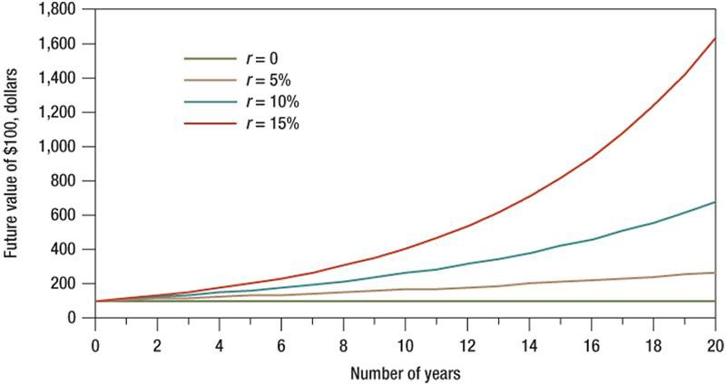

Future Values with Compounding

Slide 21
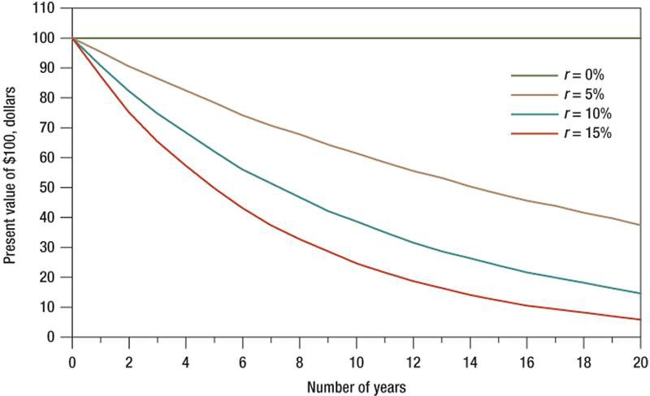
Present Values with Compounding

Slide 22
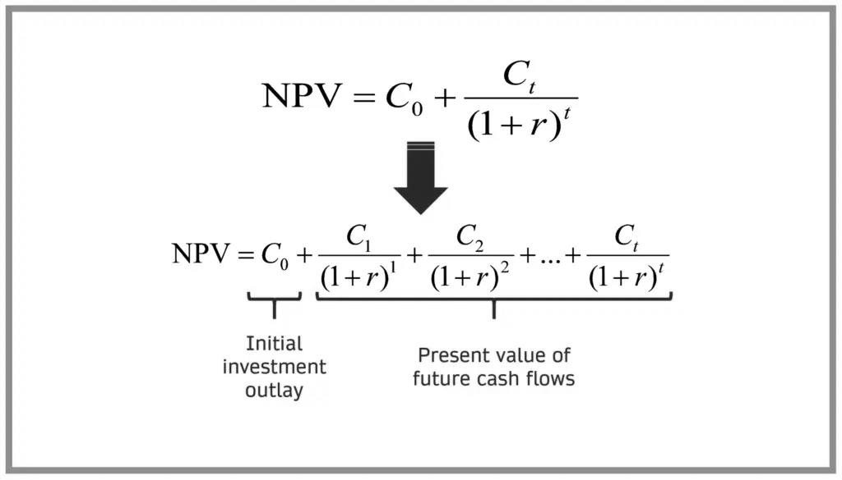

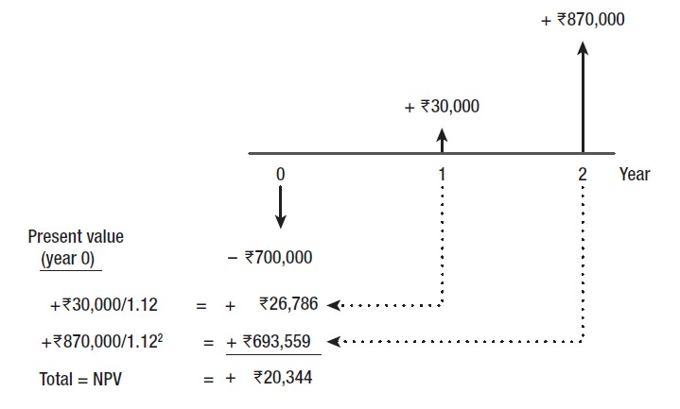
The Net Present Value
Cost of capital = 12%

Slide 23
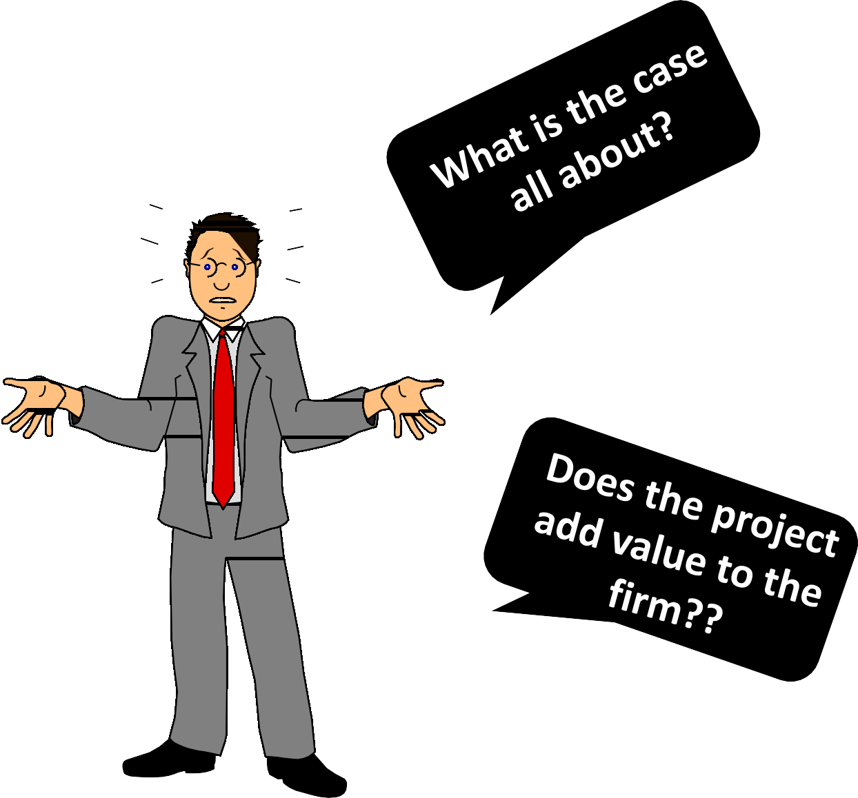
Let’s turn to the case: Regency Integrated Chips
Take 5 minutes and read the Case...
15-23

Slide 24
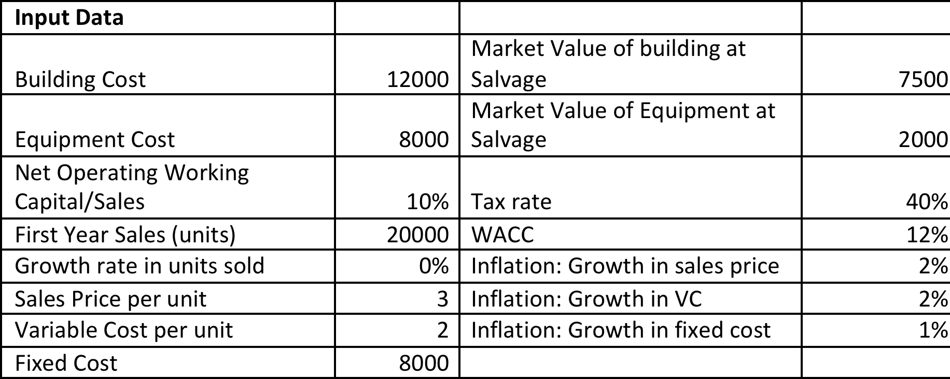
A quick snapshot of the Case & key numbers…

Slide 25
= Investment Outlay
+ Net Operating cash Flow (NOPAT)
+ Net change in Operating Working Capital
+ Salvage cash Flow (if any)
Free Cash Flow (FCF)
Projected Net Cash Flows in our case for the year 2023-2027?

Slide 26
2023 | 2024 | 2025 | 2026 | 2027
Investment Outlay - Long Term investments
Bulding
Equipment
Operating Cash Flow of the Project
Units Sold
Sales Price
Sales Revenue
Variable Cost
Fixed Operating cost
Dep. (Building)
Dep. (Equipment)
Operating Income before taxes (EBIT)
Tax on operating Income (40%)
NOPAT
Add back the Dep.
Operating Cash Flow
Cash Flow due to net operating working capital change
Net Operating working capital (based on sales)
Cash flow due to investments in NOWC
Salvage cash Flow- long term assets
Net Salvage cash Flow (Building)
Net Salvage cash Flow (Equipement)
Project Net cash Flow

Slide 27

So, let’s check if our expansion project has a positive NPV or not?

Slide 28

Is NPV the only available tool to evaluate Capital
Budgeting Projects?

Slide 29
Six commonly used Capital Budgeting Tools/Methods…
Net Present Value (NPV)

Slide 30
Six commonly used Capital Budgeting Tools/Methods…
Net Present Value (NPV)
Internal Rate of Return (IRR)
Modified Internal Rate of Return (MIRR)

Slide 31
Six commonly used Capital Budgeting Tools/Methods…
Net Present Value (NPV)
Internal Rate of Return (IRR)
Modified Internal Rate of Return (MIRR)
Payback Method
Discounted Payback Method

Slide 32
Six commonly used Capital Budgeting Tools/Methods…
Net Present Value (NPV)
Internal Rate of Return (IRR)
Modified Internal Rate of Return (MIRR)
Payback Method
Discounted Payback Method
Profitability Index (PI)

Slide 33

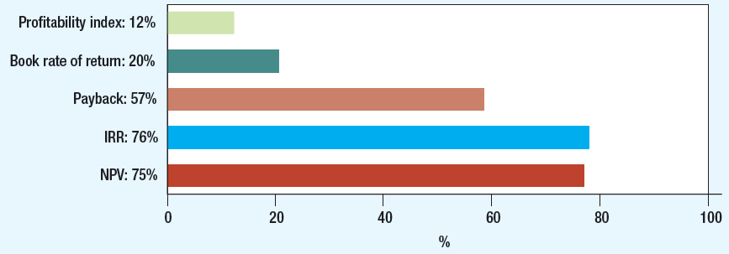
CFO Decision Tools (Globally)

Slide 34

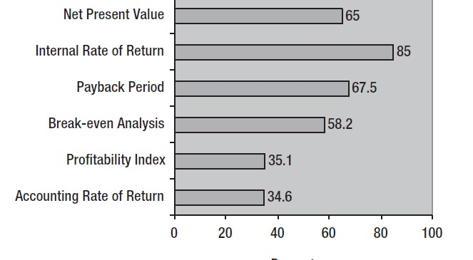
CFO Decision Tools (India)

Slide 35
Now that we know that our expansion project is Positive
NPV…

Slide 36
Now that we know that our expansion project is Positive
NPV…
Is this information good enough to take up the project?

Slide 37
Now that we know that our expansion project is Positive
NPV…
Is this information good enough to take up the project?
Do we worry about the associated risk with the project?

Slide 38
Now that we know that our expansion project is Positive
NPV…
Is this information good enough to take up the project?
Do we worry about the associated risk with the project?
How do we assess the standalone project risk?

Slide 39
How to measure Project Risk?

Slide 40
How to measure Project Risk?
Commonly used techniques of analyzing Standalone Project’s
risk:
  Sensitivity Analysis
  Scenario Analysis
  Monte Carlo Simulation

Slide 41
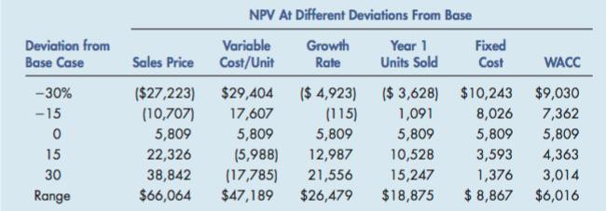
Sensitivity Analysis

Slide 42
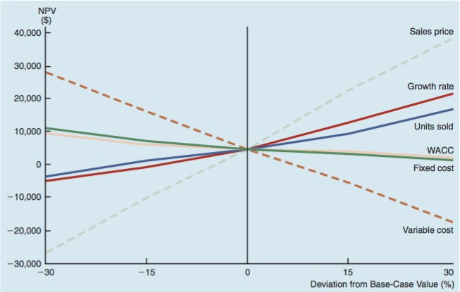

Slide 43
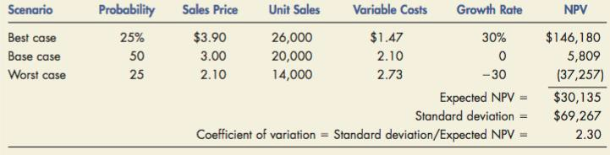
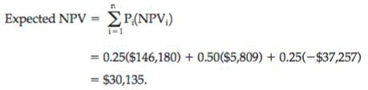
Scenario Analysis

Slide 44
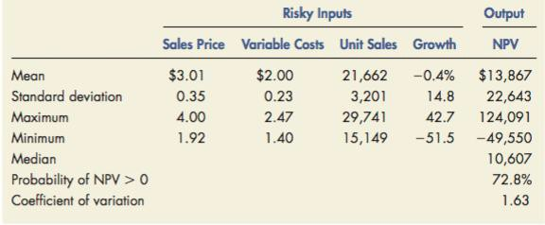
Monte-Carlo Simulation

