Slide 1

CAPITAL BUDGETING

Slide 2
What is Capital Budgeting?
Process of identifying projects that add value to the firm (shareholders).
At all levels, Capital Budgeting is one of the most important and crucial decisions which managers have to make.

Slide 3
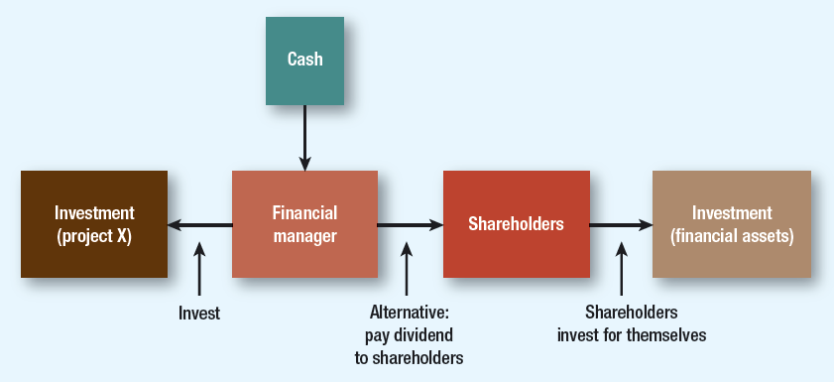
Basis of Cash Transfer decision

Slide 4
Capital Budgeting
The process to evaluate whether or not to fund major projects or investments intended to increase cash flow or advance strategic objectives.
The planning and analysis of investment in long-term assets such as new or replacement machinery, new plants, products or R&D.

Slide 5
The goal of Capital Budgeting
determine whether an investment or project is worth pursuing
ensure the company's capital resources are efficiently allocated
the assets require a considerable amount of funding and are not easily liquidated

Slide 6
Why?
Capital Budgeting:
  Defines the strategic direction of the firm(Product/Geographical diversification)
  Long term implications (reducing financial flexibility)
  Poor decisions can have serious value eroding consequences in future
    (Overinvestment/ underinvestment) leading to excess capacity or inferior quality w.r.t. competition resulting in reduced profitability or shrinking market share.

Slide 7
Why?
For Firm’s growth and survival in the competitive market space, it needs,
Constant Flow of Ideas, for:
  Developing New Product/Services
  Improving the quality of existing Product/Service
  Reducing the cost of production/operations
  Reach to new markets/geographies, etc.
Thus, good companies should always be looking new project proposals, screen them and choose the ones which are value maximizing!

Slide 8
India Inc steps up capex plans
According to Moody’s, India Inc. to spend $45-50 bn annually over next 1-2 years
With annual capex budget of around $15 billion, Reliance Industries to account for around 30% of the capex
Oil and Natural Gas Corporation Ltd. and Indian Oil to spend USD 6 billion and USD 4 billion, respectively, in each of the next two years on reserves addition, downstream integration and energy transition
https://www.fortuneindia.com/macro/india-inc-to-spend-45-50-bn-annually-over-next-1-2-years-moodys/118084#:~:text=Rated%20Indian%20companies'%20capex%20will,30%25%20of%20the%20portfolio%20capex.

Slide 9
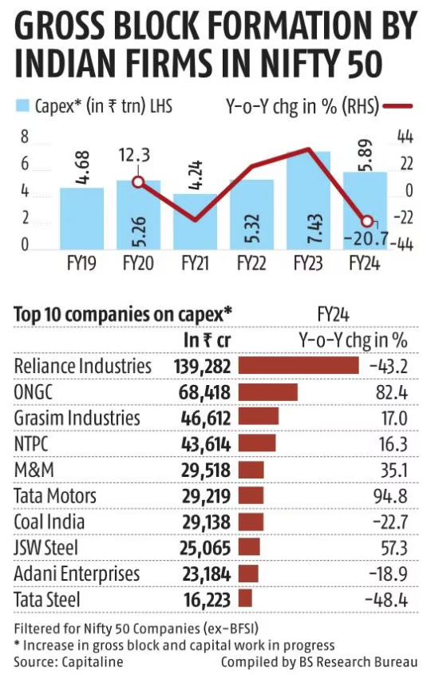
New-age sectors like green hydrogen, solar modules and semiconductors hike their capex in FY24

Slide 10
Capital Budgeting Methods
Net Present Value (NPV)
Internal Rate of Return (IRR)
Payback Method
Discounted Payback Method
Profitability Index (PI)

Slide 11
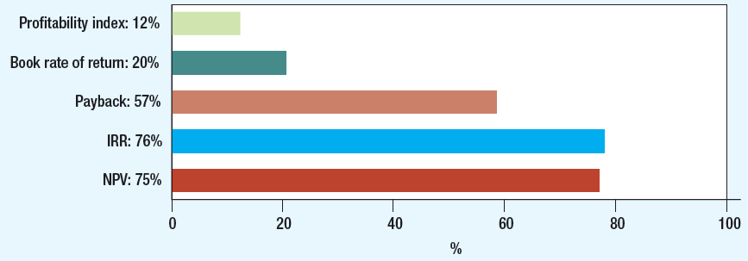
CFO Decision Tools (Globally)
Source: J.R. Graham and C.R. Harvey, “The Theory and Practice of Finance: Evidence from the Field”, Journal of Financial Economics, 2001

Slide 12
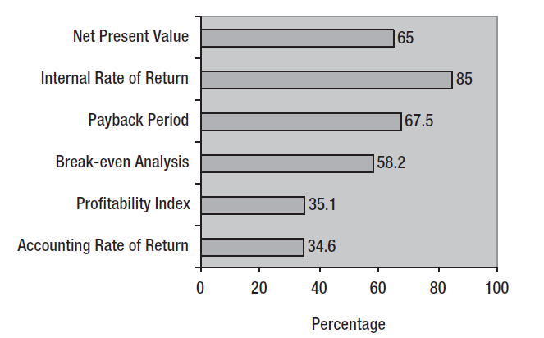
CFO Decision Tools (India)
Source: Anand M.,” Corporate Finance Practices in India: A Survey”, Vikalpa, 2002

Slide 13
Project S & L
Project/ Year | t=0 | t=1 | t=2 | t=3 | t=4
Project-S | -1,000 | 500 | 400 | 300 | 100
Project-L | -1,000 | 100 | 300 | 400 | 600
Cost of Capital = (Project ) |  | 10%

Slide 14

Net Present Value (NPV) Method
Let’s calculate the NPV of Project S & L…
  78.82
  49.18

Slide 15

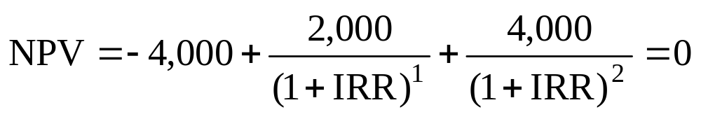
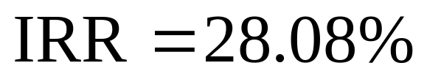
Internal Rate of Return
Example
  Tool A costs 4,000. The investment will generate Rs. 2,000 and Rs. 4,000 cash flows for two years. What is IRR?

Slide 16
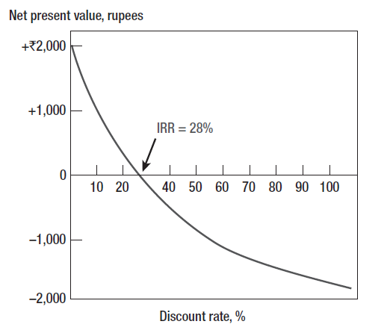
Internal Rate of Return

Slide 17
Choosing Capital Investments When Resources are Limited
Capital Rationing
  Limit set on the amount of funds available for investment
    Soft Rationing
      Imposed by management
    Hard Rationing
      Imposed by the unavailability of funds in the capital market

Slide 18
Choosing Capital Investments When Resources are Limited
Profitability Index (PI)
  Tool for selecting between project combinations and alternatives
  Set of limited resources and projects can yield various combinations
  Highest weighted average PI indicates optimal project

Slide 19
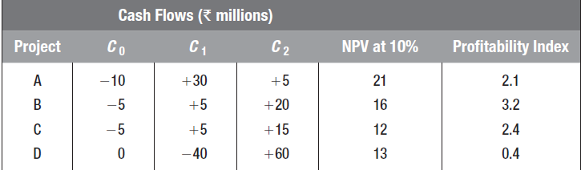
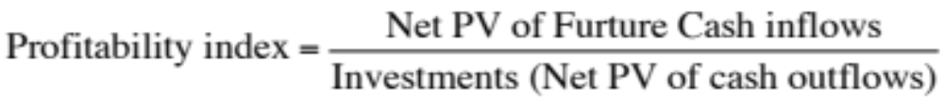
Choosing Capital Investments When Resources are Limited

Slide 20
Choosing Capital Investments When Resources are Limited
Example
  Select best projects for Rs. 300,000
Project | NPV | Investment | PI
A | 230,000 | 200,000 | 1.15
B | 141,250 | 125,000 | 1.13
C | 194,250 | 175,000 | 1.11
D | 162,000 | 150,000 | 1.08

Slide 21
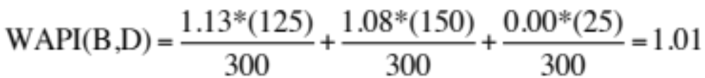
Choosing Capital Investments When Resources are Limited
Example
Project | NPV | Investment | PI
A | 230,000 | 200,000 | 1.15
B | 141,250 | 125,000 | 1.13
C | 194,250 | 175,000 | 1.11
D | 162,000 | 150,000 | 1.08
Select Projects with the highest Weighted average PI

Slide 22
Choosing Capital Investments When Resources are Limited
Select projects with the highest weighted average PI
  WAPI (BD) = 1.01
  WAPI (A) = 0.77
  WAPI (BC) = 1.12
Project | NPV | Investment | PI
A | 230,000 | 200,000 | 1.15
B | 141,250 | 125,000 | 1.13
C | 194,250 | 175,000 | 1.11
D | 162,000 | 150,000 | 1.08

Slide 23
Payback
Payback Period
  Number of years before cumulative cash flow equals initial outlay
Payback Rule
  Only accept projects that pay back within the desired time frame
  Ignores later year cash flows and the present value of future cash flows

Slide 24
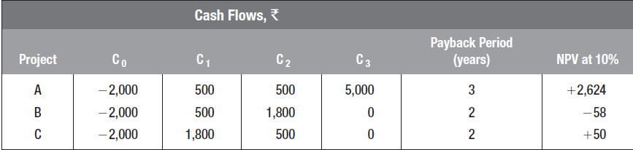
Payback
Example
  Find the disadvantage of only taking projects with a payback period of two years or less

Slide 25
Payback for Project I
0
1
2
2.4
3
CF_{t}
-100
10
60
80
Cumulative
-100
-90
-30
0
50
Payback_{L}
=
2 + $30/$80 = 2.375 years

Slide 26
Payback for Project II
0
1
1.6
2
3
CF_{t}
-100
70
50
20
Cumulative
-100
-30
0
20
40
Payback_{S}
=
1 + $30/$50 = 1.6 years

Slide 27
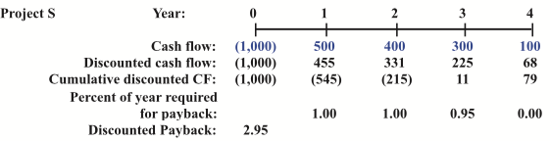
Discounted Payback
Number of years required to recover the investment from discounted net cash flows.

Slide 28
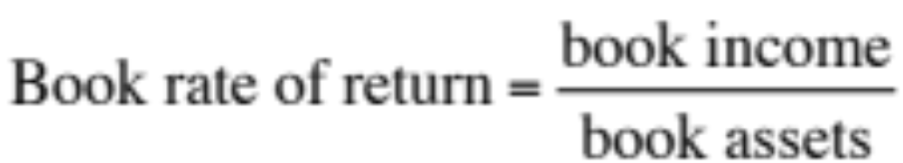
Book Rate of Return
  Average income divided by average book value over the project life
  Also called accounting rate of return
  Components reflect tax and accounting figures, not market values or cash flows

Slide 29
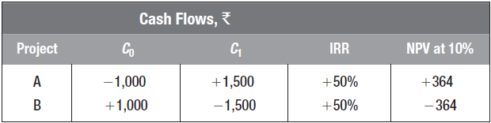
Internal Rate of Return
Pitfall 1: Lending or Borrowing?

Slide 30
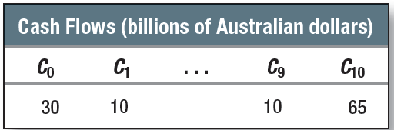
Internal Rate of Return
Pitfall 2: Multiple Rates of Return
  Certain cash flows generate NPV = 0 at two different discount rates
  Following cash flow generates NPV @10% = $A2.53 million at IRR% of 3.5% and 19.54%

Slide 31
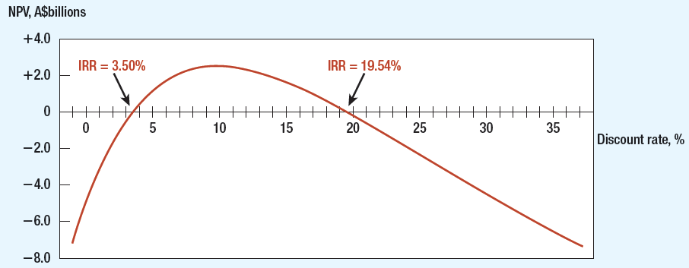
Multiple Rates of Return

Slide 32
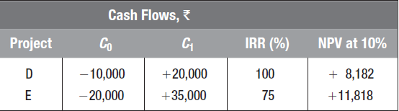
Internal Rate of Return
Pitfall 3: Mutually Exclusive Projects
  IRR sometimes ignores the magnitude of the project

Slide 33
Incremental Investment
Project | Co | C1 | IRR % | NPV at 10%
E-D | -10,000 | +15,000 | 50% | +3,636

Slide 34
Internal Rate of Return
Pitfall 4: More than One Opportunity Cost of Capital
    Assume discount rates stable during the term of the project

Slide 35
Cash flows for projects L and S
0
1
2
3
10%
L’s CFs:
-100.00
10
60
80
0
1
2
3
10%
S’s CFs:
-100.00
70
50
20

Slide 36
NPV
NPV_{L} = 18.78
NPV_{S} = 19.98
If S and L are mutually exclusive, accept S because NPV_{s} > NPV_{L}.
If S & L are independent, accept both; NPV > 0.

Slide 37
IRR
IRR_{L} = 18.13%. IRR_{S} = 23.56%.
If S and L are independent, accept both: IRR_{S} > r and IRR_{L} > r.
If S and L are mutually exclusive, accept S because IRR_{S} > IRR_{L}.

Slide 38
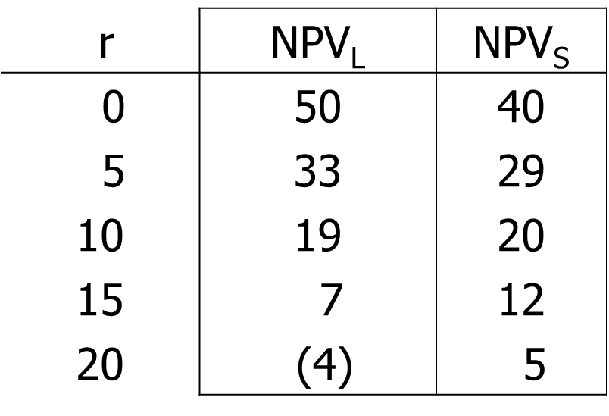
NPV Profiles
find NPV_{L} and NPV_{S} at different discount rates:

Slide 39
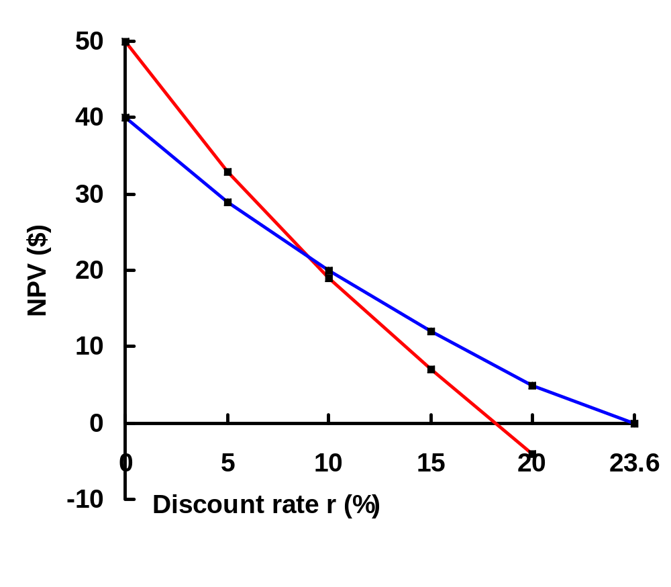
NPV Profile
L
Crossover
Point = 8.7%
S
IRR_{S} = 23.6%
IRR_{L} = 18.1%

Slide 40
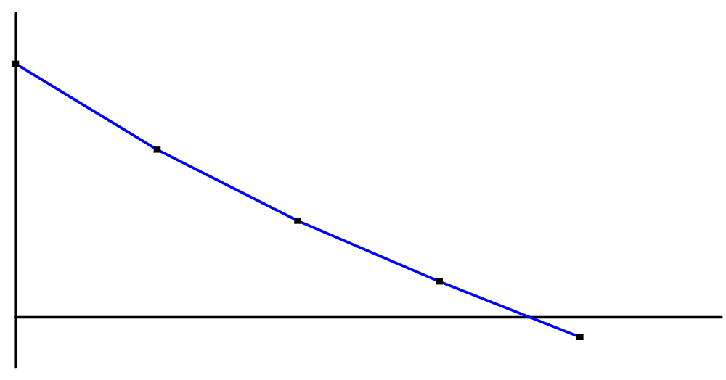
NPV and IRR:
No conflict for independent projects
NPV ($)
IRR > r
and NPV > 0
Accept.
r > IRR
and NPV < 0.
Reject.
r (%)
IRR

Slide 41
Mutually Exclusive Projects
NPV ($)
r < 8.7%: NPV_{L}> NPV_{S} , IRR_{S} > IRR_{L}
CONFLICT
L
r > 8.7%: NPV_{S}> NPV_{L} , IRR_{S} > IRR_{L}
NO CONFLICT
S
IRR_{S}
8.7
r (%)
IRR_{L}

Slide 42
Two Reasons NPV Profiles Cross
If profiles don’t cross, one project dominates the other.
Size (scale) differences. Smaller project frees up funds at t = 0 for investment. The higher the opportunity cost, the more valuable these funds, so high r favors small projects.
Timing differences. Project with faster payback provides more CF in early years for reinvestment. If r is high, early CF especially good, NPV_{S} > NPV_{L}.

Slide 43
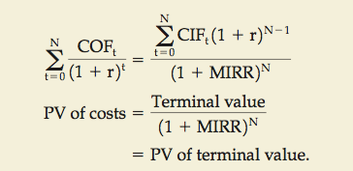
Modified Internal Rate of Return (MIRR)
MIRR is the discount rate that causes the PV of a project’s terminal value (TV) to equal the PV of costs.

Slide 44
MIRR for Project L
0
1
2
3
10%
-100.0
10.0
60.0
80.0
10%
66.0
12.1
10%
-100.0
158.1
PV outflows
TV inflows

Slide 45
find the discount rate that equates PV and TV
0
1
2
3
-100.0
MIRR = 16.5%
158.1
PV outflows
TV inflows
$158.1
(1+MIRR_{L})³
$100 =
MIRR_{L} = 16.5%

Slide 46
Problem 1
Project | Co | C1 | C2 | C3 | C4
A | -5000 | +1000 | +1000 | +3000 | 0
B | -1000 | 0 | +1000 | +2000 | +3000
C | -5000 | +1000 | +1000 | +3000 | +5000
What is the payback period on each of the following projects?
Given that you wish to use the payback rule with a cutoff period of two years, which projects would you accept?
If you use a cutoff period of three years, which projects would you accept?
If the opportunity cost of capital is 10%, which projects have positive NPVs?

Slide 47
Problem 2
Consider projects Alpha and Beta. The opportunity cost of capital is 8%. Suppose you can undertake Alpha or Beta, but not both. Use the IRR rule to make the choice.
Project | Co | C1 | C2 | IRR%
Alpha | -400,000 | +241,000 | +293,000 | 21
Beta | -200,000 | +131,000 | +172,000 | 31

Slide 48
Problem 3
Pipli Ltd has Rs 1 million allocated for capital expenditures. Which of the following projects should the company accept to stay within the Rs. 1 million budget? How much does the budget limit cost the company in terms of its market value? The opportunity cost of capital for each project is 11%.
Project | Investment Rs ‘000 | NPV Rs’000 | IRR %
1 | 300 | 66 | 17.2
2 | 200 | -4 | 10.7
3 | 250 | 43 | 16.6
4 | 100 | 14 | 12.1
5 | 100 | 7 | 11.8
6 | 350 | 63 | 18.0
7 | 400 | 48 | 13.5

Slide 49
Problem 4
Davis Industries must choose between a gas-powered and an electric-powered forklift truck for moving materials in its factory. Since both forklifts perform the same function, the firm will choose only one. (They are mutually exclusive investments.) The electric-powered truck will cost more, but it will be less expensive to operate; it will cost $22,000, whereas the gas-powered truck will cost $17,500. The cost of capital that applies to both investments is 12%. The life for both types of trucks is estimated to be 6 years, during which time the net cash flows for the electric-powered truck will be $6,290 per year, and those for the gas-powered truck will be $5,000 per year. Annual net cash flows include depreciation expenses. Calculate the NPV and IRR for each type of truck, and decide which to recommend.

Slide 50
Problem 5
The Pinkerton Publishing Company is considering two mutually exclusive expansion plans. Plan A calls for the expenditure of $50 million on a large-scale, integrated plant that will provide an expected cash flow stream of $8 million per year for 20 years. Plan B calls for the expenditure of $15 million to build a somewhat less efficient, more labor-intensive plant that has an expected cash flow stream of $3.4 million per year for 20 years. The firm’s cost of capital is 10%.
  Calculate each project’s NPV and IRR.
  Set up a Project Δ by showing the cash flows that will exist if the firm goes with the large plant rather than the smaller plant. What are the NPV and the IRR for this Project Δ?

