Slide 1

CAPITAL BUDGETING

Slide 2
What is Capital Budgeting?
Process of identifying projects that add value to the firm (shareholders).
At all levels, Capital Budgeting is one of the most important and crucial decisions which managers have to make.

Slide 3
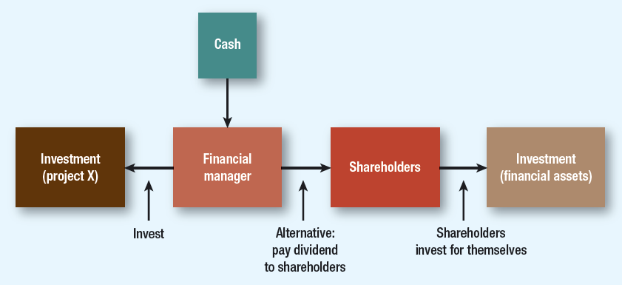
Basis of Cash Transfer decision

Slide 4
Capital Budgeting
The process to evaluate whether or not to fund major projects or investments intended to increase cash flow or advance strategic objectives.
The planning and analysis of investment in long-term assets such as new or replacement machinery, new plants, products or R&D.

Slide 5
The goal of Capital Budgeting
determine whether an investment or project is worth pursuing
ensure the company's capital resources are efficiently allocated
the assets require a considerable amount of funding and are not easily liquidated

Slide 6
Why?
Capital Budgeting:
  Defines the strategic direction of the firm(Product/Geographical diversification)
  Long term implications (reducing financial flexibility)
  Poor decisions can have serious value eroding consequences in future
    (Overinvestment/ underinvestment) leading to excess capacity or inferior quality w.r.t. competition resulting in reduced profitability or shrinking market share.

Slide 7
Why?
For Firm’s growth and survival in the competitive market space, it needs,
Constant Flow of Ideas, for:
  Developing New Product/Services
  Improving the quality of existing Product/Service
  Reducing the cost of production/operations
  Reach to new markets/geographies, etc.
Thus, good companies should always be looking new project proposals, screen them and choose the ones which are value maximizing!

Slide 8
Capital Budgeting Methods
Net Present Value (NPV)
Internal Rate of Return (IRR)
Payback Method
Discounted Payback Method
Profitability Index (PI)

Slide 9
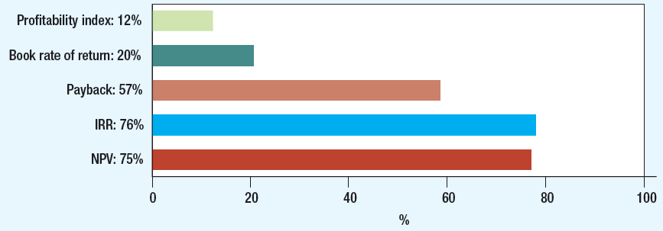
CFO Decision Tools (Globally)
Source: J.R. Graham and C.R. Harvey, “The Theory and Practice of Finance: Evidence from the Field”, Journal of Financial Economics, 2001

Slide 10
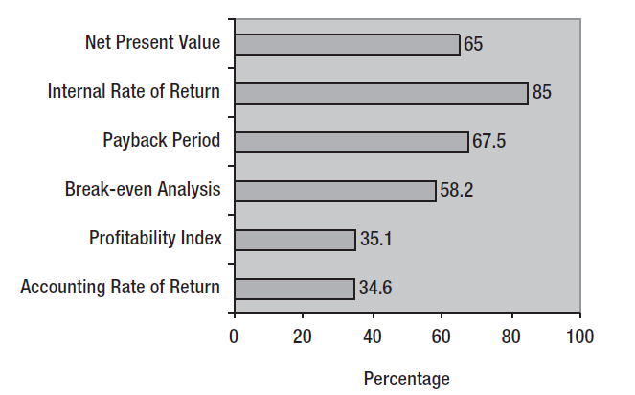
CFO Decision Tools (India)
Source: Anand M.,” Corporate Finance Practices in India: A Survey”, Vikalpa, 2002

Slide 11
Project S & L
Project/ Year | t=0 | t=1 | t=2 | t=3 | t=4
Project-S | -1,000 | 500 | 400 | 300 | 100
Project-L | -1,000 | 100 | 300 | 400 | 600
Cost of Capital = (Project ) |  | 10%

Slide 12

Net Present Value (NPV) Method
Let’s calculate the NPV of Project S & L…
  78.82
  49.18

Slide 13

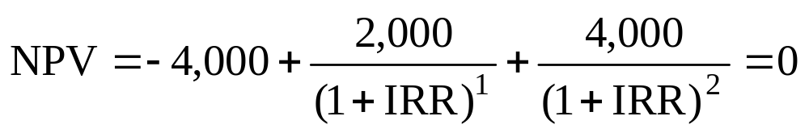
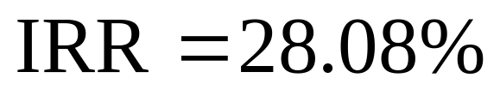
Internal Rate of Return
Example
  Tool A costs 4,000. The investment will generate Rs. 2,000 and Rs. 4,000 cash flows for two years. What is IRR?

Slide 14
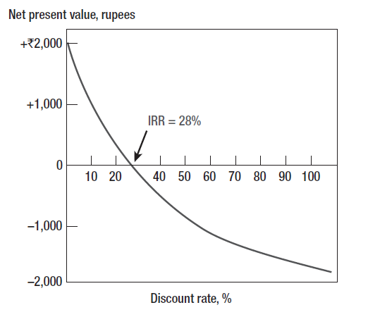
Internal Rate of Return

Slide 15
Choosing Capital Investments When Resources are Limited
Capital Rationing
  Limit set on the amount of funds available for investment
    Soft Rationing
      Imposed by management
    Hard Rationing
      Imposed by the unavailability of funds in the capital market

Slide 16
Choosing Capital Investments When Resources are Limited
Profitability Index (PI)
  Tool for selecting between project combinations and alternatives
  Set of limited resources and projects can yield various combinations
  Highest weighted average PI indicates optimal project

Slide 17
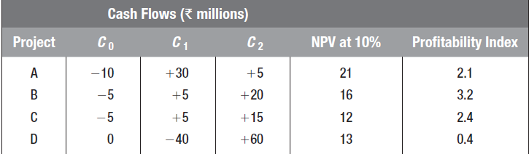
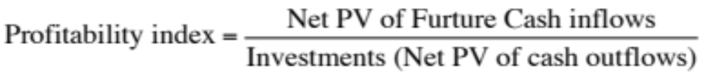
Choosing Capital Investments When Resources are Limited

Slide 18
Choosing Capital Investments When Resources are Limited
  Select best projects for Rs. 300,000
Project | NPV | Investment | PI
A | 230,000 | 200,000 | 1.15
B | 141,250 | 125,000 | 1.13
C | 194,250 | 175,000 | 1.11
D | 162,000 | 150,000 | 1.08

Slide 19
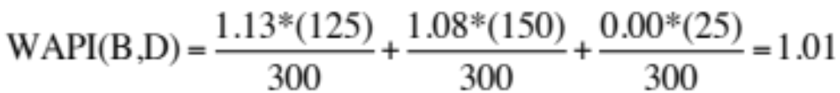
Choosing Capital Investments When Resources are Limited
Project | NPV | Investment | PI
A | 230,000 | 200,000 | 1.15
B | 141,250 | 125,000 | 1.13
C | 194,250 | 175,000 | 1.11
D | 162,000 | 150,000 | 1.08
Select Projects with the highest Weighted average PI

Slide 20
Choosing Capital Investments When Resources are Limited
Select projects with the highest weighted average PI
  WAPI (BD) = 1.01
  WAPI (A) = 0.77
  WAPI (BC) = 1.12
Project | NPV | Investment | PI
A | 230,000 | 200,000 | 1.15
B | 141,250 | 125,000 | 1.13
C | 194,250 | 175,000 | 1.11
D | 162,000 | 150,000 | 1.08

Slide 21
Payback
Payback Period
  Number of years before cumulative cash flow equals initial outlay
Payback Rule
  Only accept projects that pay back within the desired time frame
  Ignores later year cash flows and the present value of future cash flows

Slide 22
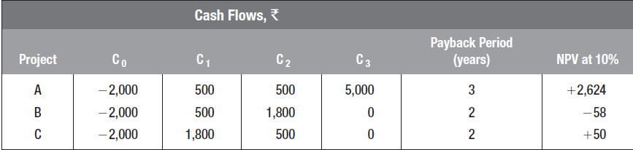
Payback
Example
  Find the disadvantage of only taking projects with a payback period of two years or less

Slide 23
Payback for Project I
0
1
2
2.4
3
CF_{t}
-100
10
60
80
Cumulative
-100
-90
-30
0
50
Payback_{L}
=
2 + $30/$80 = 2.375 years

Slide 24
Payback for Project II
0
1
1.6
2
3
CF_{t}
-100
70
50
20
Cumulative
-100
-30
0
20
40
Payback_{S}
=
1 + $30/$50 = 1.6 years

Slide 25
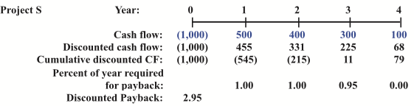
Discounted Payback
Number of years required to recover the investment from discounted net cash flows.

Slide 26
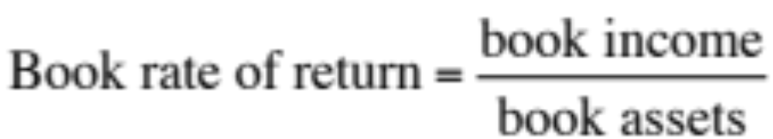
Book Rate of Return
  Average income divided by average book value over the project life
  Also called accounting rate of return
  Components reflect tax and accounting figures, not market values or cash flows

Slide 27
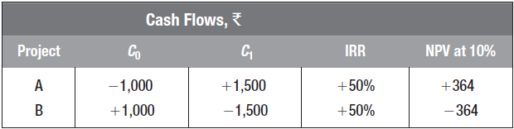
Internal Rate of Return
Pitfall 1: Lending or Borrowing?

Slide 28
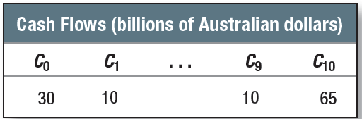
Internal Rate of Return
Pitfall 2: Multiple Rates of Return
  Certain cash flows generate NPV = 0 at two different discount rates
  Following cash flow generates NPV @10% = $A2.53 million at IRR% of 3.5% and 19.54%

Slide 29
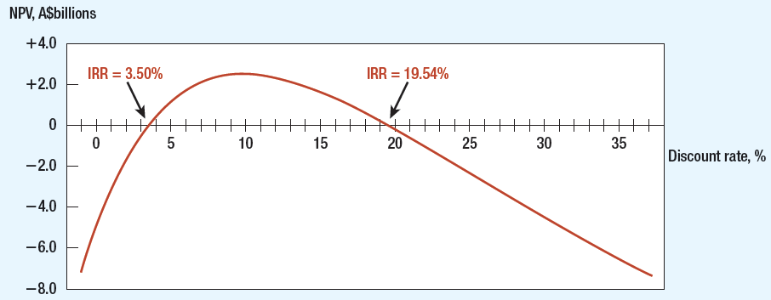
Multiple Rates of Return

Slide 30
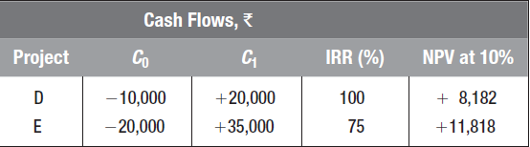
Internal Rate of Return
Pitfall 3: Mutually Exclusive Projects
  IRR sometimes ignores the magnitude of the project

Slide 31
Incremental Investment
Project | Co | C1 | IRR % | NPV at 10%
E-D | -10,000 | +15,000 | 50% | +3,636

Slide 32
Internal Rate of Return
Pitfall 4: More than One Opportunity Cost of Capital
    Assume discount rates stable during the term of the project

Slide 33
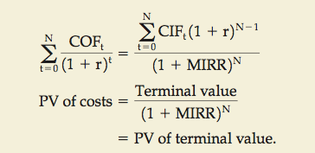
Modified IRR
MIRR is the discount rate that causes the PV of a project’s terminal value (TV) to equal the PV of costs.

Slide 34
MIRR for Project L
0
1
2
3
10%
-100.0
10.0
60.0
80.0
10%
66.0
12.1
10%
-100.0
158.1
PV outflows
TV inflows

Slide 35
The discount rate that equates PV and TV
0
1
2
3
-100.0
MIRR = 16.5%
158.1
PV outflows
TV inflows
$158.1
(1+MIRR_{L})³
$100 =
MIRR_{L} = 16.5%

