Slide 1

Capacity Planning

Slide 2
Learning Objective
Capacity Planning
Measuring the service facilities Performance
The Variety of Queuing Models
  Model A: (M/M/1)
  Model B: (M/M/S)
  Model C: (M/D/1)
Factors influencing the waiting time
Case: Workforce Management at Sequoia Airlines

Slide 3
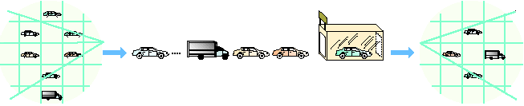
Example: Capacity planning at Car wash facility
Population of
dirty cars
Arrivals
from the
general
population …
Queue
(waiting line)
Service
facility
Exit the system
Dave’s
Car Wash
enter
exit
Arrivals to the system
In the system
Exit the system
Notes:
This slide can be used to frame a discussion of capacity.
Points to be made might include:
- capacity definition and measurement is necessary if we are to develop a production schedule
- while a process may have “maximum” capacity, many factors prevent us from achieving that capacity on a continuous basis.
Students should be asked to suggest factors which might prevent one from achieving maximum capacity.

Slide 4
Common Queuing Situations
Situation | Arrivals in Queue | Service Process
Supermarket | Grocery shoppers | Checkout clerks at cash register
Highway toll booth | Automobiles | Collection of tolls at booth
Doctor’s office | Patients | Treatment by doctors and nurses
Telephone company | Callers | Switching equipment to forward calls
Notes:
This slide provides some reasons that capacity is an issue. The following slides guide a discussion of capacity.

Slide 5
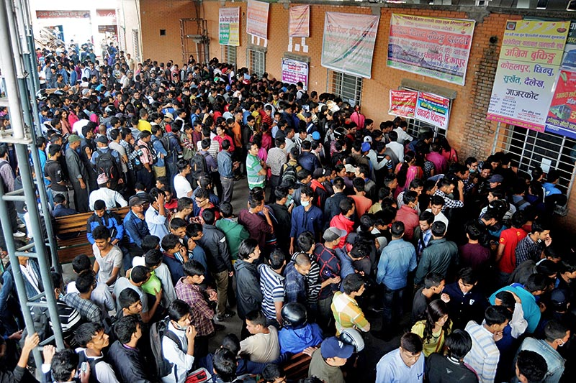
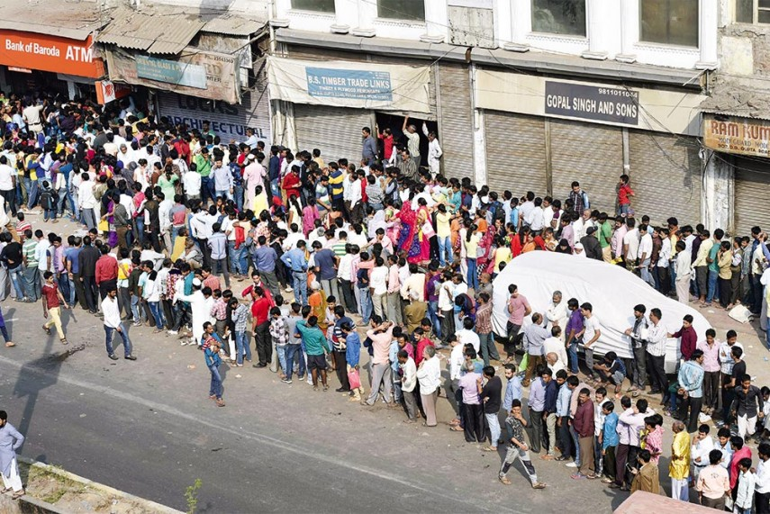

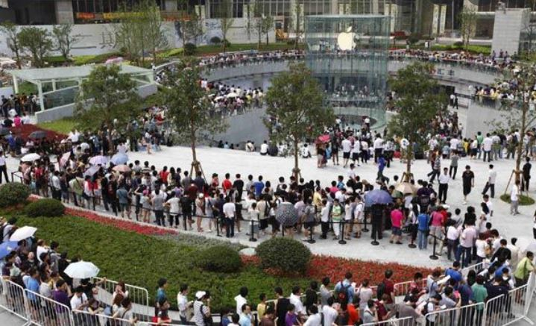
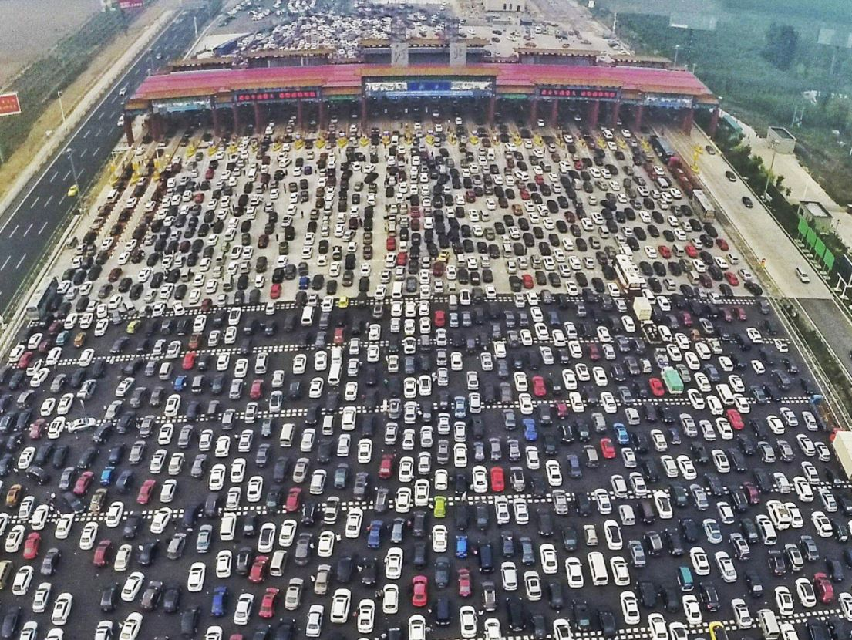
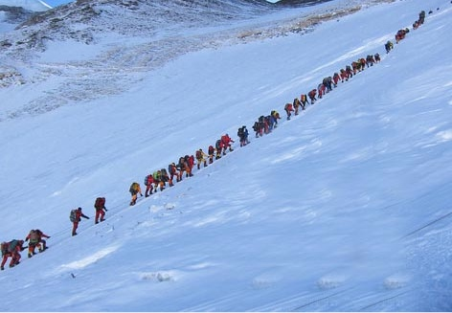
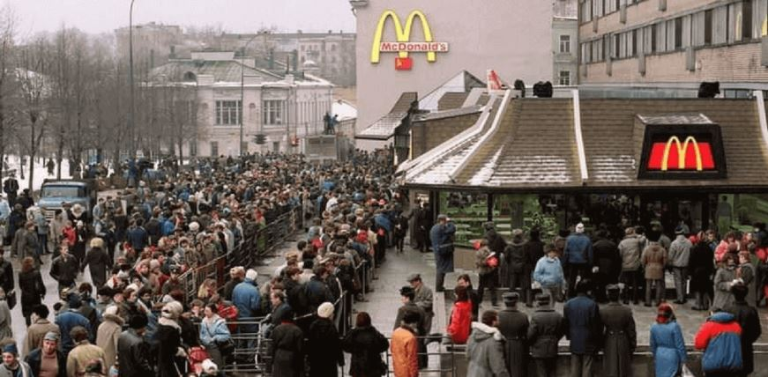
Crowded Queue

Slide 6
Arrival Characteristics
Size of the population
  Unlimited (infinite)
  Limited (finite)
Pattern of arrivals
  Scheduled
  Random, often a Poisson distribution
Notes:
This slide can be used to frame a discussion of capacity.
Points to be made might include:
- capacity definition and measurement is necessary if we are to develop a production schedule
- while a process may have “maximum” capacity, many factors prevent us from achieving that capacity on a continuous basis.
Students should be asked to suggest factors which might prevent one from achieving maximum capacity.

Slide 7
Pattern of Arrival
0.25 –
0.02 –
0.15 –
0.10 –
0.05 –
–
Probability
0
1
2
3
4
5
6
7
8
9
x
Distribution for λ = 2
Notes:
This slide can be used to frame a discussion of capacity.
Points to be made might include:
- capacity definition and measurement is necessary if we are to develop a production schedule
- while a process may have “maximum” capacity, many factors prevent us from achieving that capacity on a continuous basis.
Students should be asked to suggest factors which might prevent one from achieving maximum capacity.

Slide 8
Poisson Distribution
e^{-λ}λ^{x}
x!
P(x) = for x = 0, 1, 2, 3, 4, …
where P(x) = probability of x arrivals
x = number of arrivals per unit of time
λ = average arrival rate
Notes:
This slide can be used to frame a discussion of capacity.
Points to be made might include:
- capacity definition and measurement is necessary if we are to develop a production schedule
- while a process may have “maximum” capacity, many factors prevent us from achieving that capacity on a continuous basis.
Students should be asked to suggest factors which might prevent one from achieving maximum capacity.

Slide 9
Arrival Characteristics
3. Behavior of arrivals
  Wait in the queue and do not switch lines
  Balking or reneging

Slide 10
Waiting-Line Characteristics
Limited or unlimited queue length
Queue discipline - first-in, first-out is most common
Other priority rules may be used in special circumstances
Notes:
This slide can be used to frame a discussion of capacity.
Points to be made might include:
- capacity definition and measurement is necessary if we are to develop a production schedule
- while a process may have “maximum” capacity, many factors prevent us from achieving that capacity on a continuous basis.
Students should be asked to suggest factors which might prevent one from achieving maximum capacity.

Slide 11
Service Characteristics
Queuing system designs
  Single-channel system, multiple-channel system
  Single-phase system, multiphase system
Single-channel, single-phase system
Queue
Arrivals
Service facility
Departures
after service
dentist’s office
Notes:
This slide can be used to frame a discussion of capacity.
Points to be made might include:
- capacity definition and measurement is necessary if we are to develop a production schedule
- while a process may have “maximum” capacity, many factors prevent us from achieving that capacity on a continuous basis.
Students should be asked to suggest factors which might prevent one from achieving maximum capacity.

Slide 12
Queuing System Designs
Single-channel, multiphase system
Queue
Arrivals
Phase 1 service facility
Phase 2 service facility
Departures
after service
Passport office
Notes:
This slide can be used to frame a discussion of capacity.
Points to be made might include:
- capacity definition and measurement is necessary if we are to develop a production schedule
- while a process may have “maximum” capacity, many factors prevent us from achieving that capacity on a continuous basis.
Students should be asked to suggest factors which might prevent one from achieving maximum capacity.

Slide 13
Queuing System Designs
Multi-channel, single-phase system
Service facility
Channel 1
Queue
Arrivals
Service facility
Channel 2
Departures
after service
Service facility
Channel 3
Airport Security Check-in
Notes:
This slide can be used to frame a discussion of capacity.
Points to be made might include:
- capacity definition and measurement is necessary if we are to develop a production schedule
- while a process may have “maximum” capacity, many factors prevent us from achieving that capacity on a continuous basis.
Students should be asked to suggest factors which might prevent one from achieving maximum capacity.

Slide 14
Queuing System Designs
Multi-channel, multiphase system
Phase 1 service facility
Channel 1
Phase 2 service facility
Channel 1
Queue
Arrivals
Departures
after service
Phase 1 service facility
Channel 2
Phase 2 service facility
Channel 2
Baggage drop and Security check
Notes:
This slide can be used to frame a discussion of capacity.
Points to be made might include:
- capacity definition and measurement is necessary if we are to develop a production schedule
- while a process may have “maximum” capacity, many factors prevent us from achieving that capacity on a continuous basis.
Students should be asked to suggest factors which might prevent one from achieving maximum capacity.

Slide 15
Service Characteristics
2. Service time distribution
  Constant service time
  Random service times, usually a negative exponential distribution

Slide 16
Queuing Costs = Waiting cost + Cost of Capacity
Cost
Total expected cost
Minimum
Total
cost
Cost of Capacity
Cost of waiting time
Low level
of service
Optimal
service level
High level
of service
Notes:
This slide can be used to frame a discussion of capacity.
Points to be made might include:
- capacity definition and measurement is necessary if we are to develop a production schedule
- while a process may have “maximum” capacity, many factors prevent us from achieving that capacity on a continuous basis.
Students should be asked to suggest factors which might prevent one from achieving maximum capacity.

Slide 17
Measuring Queue Performance
Average time that each customer or object spends in the queue
Average queue length
Average time in the system
Average number of customers in the system
Probability the service facility will be idle
Utilization factor for the system
Probability of a specified number of customers in the system
Notes:
This slide can be used to frame a discussion of capacity.
Points to be made might include:
- capacity definition and measurement is necessary if we are to develop a production schedule
- while a process may have “maximum” capacity, many factors prevent us from achieving that capacity on a continuous basis.
Students should be asked to suggest factors which might prevent one from achieving maximum capacity.

Slide 18
λ = Average number of arrivals per time period
µ = Average number of units served per time period
L_{q} = Average number of customer in Queue
L_{s} = Average number of customer in System
W_{q} = Average waiting time of customer in the queue
W_{s} = Average waiting time of customer in the system

Slide 19
Little’s law
Average number of customer in Queue
L_{q} = λ*W_{q}
Average number of customer in System
L_{s} = λ*W_{s}
Average number of
customers in system
λ
µ
L_{s} = L_{q} +
Average waiting
time in system
1
µ
W_{s} = W_{q} +

Slide 20
Model A - Single Channel
Arrivals are FIFO and every arrival waits to be served regardless of the length of the queue
Arrivals are independent of preceding arrivals but the average number of arrivals does not change over time
Service times occur according to the negative exponential distribution
The service rate is faster than the arrival rate
Notes:
This slide can be used to frame a discussion of capacity.
Points to be made might include:
- capacity definition and measurement is necessary if we are to develop a production schedule
- while a process may have “maximum” capacity, many factors prevent us from achieving that capacity on a continuous basis.
Students should be asked to suggest factors which might prevent one from achieving maximum capacity.

Slide 21
Model A - Single Channel
L_{s} = Average number of units (customers) in the system (waiting and being served)
=
p = Utilization factor for the system
=
λ
µ – λ
λ
µ
Notes:
This slide can be used to frame a discussion of capacity.
Points to be made might include:
- capacity definition and measurement is necessary if we are to develop a production schedule
- while a process may have “maximum” capacity, many factors prevent us from achieving that capacity on a continuous basis.
Students should be asked to suggest factors which might prevent one from achieving maximum capacity.

Slide 22
Model A - Single Channel
P₀ = Probability of 0 units in the system (that is, the service unit is idle)
= 1 –
P_{n > k} = Probability of more than k units in the system, where n is the number of units in the system
λ
µ
k + 1
λ
µ
Notes:
This slide can be used to frame a discussion of capacity.
Points to be made might include:
- capacity definition and measurement is necessary if we are to develop a production schedule
- while a process may have “maximum” capacity, many factors prevent us from achieving that capacity on a continuous basis.
Students should be asked to suggest factors which might prevent one from achieving maximum capacity.

Slide 23
Single Channel Example
Tom Jones, the mechanic at Golden Shop, is able to repair new phones at an average rate of 3 per hour (or about 1 every 20 minutes), according to a negative exponential distribution. Customers seeking this service arrive at the shop on the average of 2 per hour, following a Poisson distribution. They are served on a first-in, first-out basis and come from a very large (almost infinite) population of possible buyers.
Find?
Average customer time in the queue, Average queue length
Average time in the system, Average customers in the system
Probability the service facility will be idle
Utilization factor for the system

Slide 24
Single Channel Example
λ = 2 customer arriving/hour µ= 3 phone serviced/hour
L_{s} = = = 2 customer in the system on average
W_{s} = = = 1 hour average waiting time in the system
L_{q} = = = 1.33 customer waiting in line
λ
µ – λ
2
3 - 2
1
µ – λ
1
3 - 2
λ²
µ(µ – λ)
2²
3(3 - 2)
Notes:
This slide can be used to frame a discussion of capacity.
Points to be made might include:
- capacity definition and measurement is necessary if we are to develop a production schedule
- while a process may have “maximum” capacity, many factors prevent us from achieving that capacity on a continuous basis.
Students should be asked to suggest factors which might prevent one from achieving maximum capacity.

Slide 25
Single Channel Example
λ = 2 customer arriving/hour µ= 3 phone serviced/hour
W_{q} = = = 40 minute average waiting time
p = λ/µ = 2/3 = 66.6% of time mechanic is busy
λ
µ(µ – λ)
2
3(3 - 2)
P₀ = 1 - = .33 probability there are 0 customers in the system
λ
µ
Notes:
This slide can be used to frame a discussion of capacity.
Points to be made might include:
- capacity definition and measurement is necessary if we are to develop a production schedule
- while a process may have “maximum” capacity, many factors prevent us from achieving that capacity on a continuous basis.
Students should be asked to suggest factors which might prevent one from achieving maximum capacity.

Slide 26
Multi-Channel Model
M = number of channels open
λ = average arrival rate
µ = average service rate at each channel
1
P₀ = for Mµ > λ
M – 1
1
n!
λ
µ
n
1
M!
λ
µ
M
Mµ
Mµ - λ
∑
+
n = 0
λµ(λ/µ)
M
λ
µ
L_{s} = P₀ +
(M - 1)!(Mµ - λ)
2
Notes:
This slide can be used to frame a discussion of capacity.
Points to be made might include:
- capacity definition and measurement is necessary if we are to develop a production schedule
- while a process may have “maximum” capacity, many factors prevent us from achieving that capacity on a continuous basis.
Students should be asked to suggest factors which might prevent one from achieving maximum capacity.

Slide 27
Multi-Channel Example
 | Single Channel | Two Channels
 | 0.67 | 0.5
P₀ | .33 | .5
L_{s} | 2 customer | .75 customer
W_{s} | 60 minutes | 22.5 minutes
L_{q} | 1.33 customer | .083 customer
W_{q} | 40 minutes | 2.5 minutes
λ
µ
Notes:
This slide can be used to frame a discussion of capacity.
Points to be made might include:
- capacity definition and measurement is necessary if we are to develop a production schedule
- while a process may have “maximum” capacity, many factors prevent us from achieving that capacity on a continuous basis.
Students should be asked to suggest factors which might prevent one from achieving maximum capacity.

Slide 28
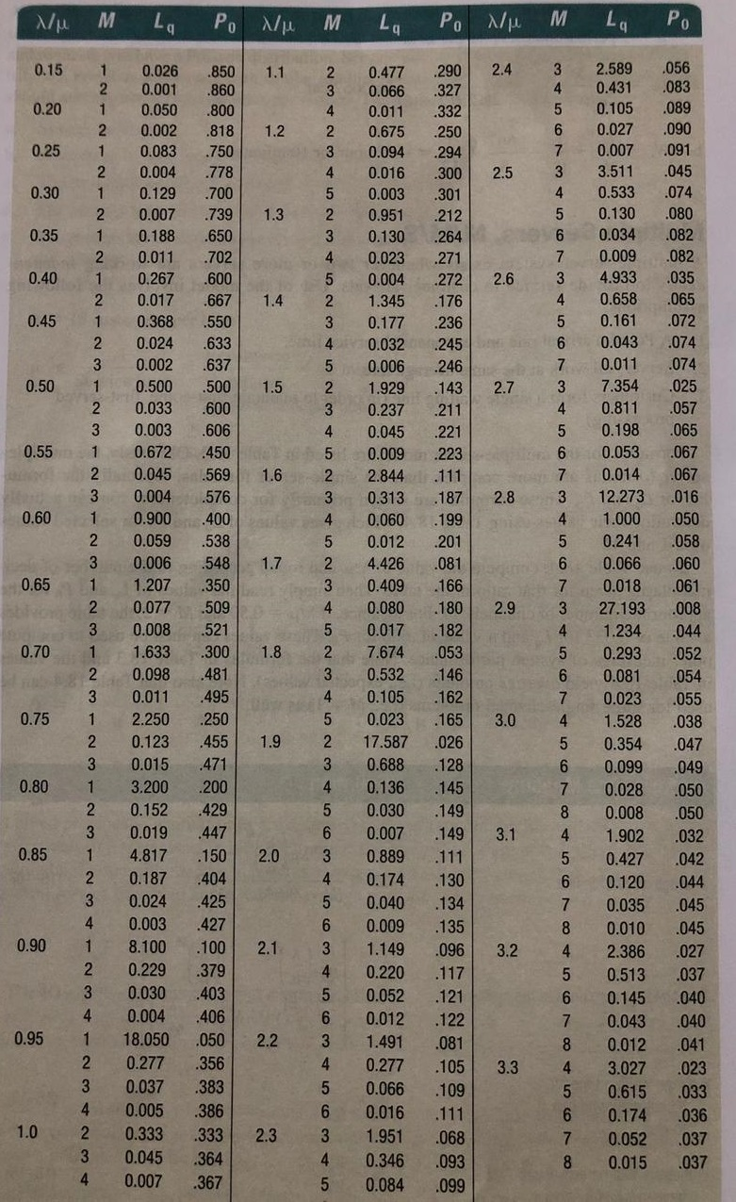

Slide 29
Constant Service Model
Average length
of queue
λ²
2µ(µ – λ)
L_{q} =
Average waiting time
in queue
λ
2µ(µ – λ)
W_{q} =
Notes:
This slide can be used to frame a discussion of capacity.
Points to be made might include:
- capacity definition and measurement is necessary if we are to develop a production schedule
- while a process may have “maximum” capacity, many factors prevent us from achieving that capacity on a continuous basis.
Students should be asked to suggest factors which might prevent one from achieving maximum capacity.

Slide 30
Example
Trucks arrive at a warehouse at a rate of 15 per hour during business hours. Crews can unload the trucks at a rate of 5 per hour. The high unloading rate is due to cargo being containerized. Recent changes in wage rates have caused the warehouse manager to reexamine the question of how many crews to use. The new rates are:
  crew and dock is $100 per hour
  truck and driver cost is $120 per hour
# of Crews | Crews & Dock Cost | Avg. # of trucks in System | Driver/ Truck cost | Total Cost
4 | 400 | 1.528 + 3 = 4.528 | 543.36 | = 943.6
5 | 500 | 0.354 + 3 = 3.354 | 402.48 | = 902.48
6 | 600 | 0.099 + 3 = 3.099 | 371.88 | = 971.88
7 | 700 | 0.028 + 3 = 3.028 | 363.36 | =1063.36

Slide 31
Psychology of waiting time
Occupied time feels shorter than unoccupied time
Uncertain waits are longer than known
Unexplained waits are longer than explained waits
Unfair waits are longer than equitable waits
The more valuable are the services, the longer the customers wait
Solo waits feels longer than groups

Slide 32
Alternative solutions
Companies have come up with some novel solutions:
Charging customers for skipping or advancing in the line.
Use distraction: Reading materials, television or conversation.
Keep customers informed
Inform overestimated waiting time to customers

Slide 33
Tips/tricks for customer
Choose left side for faster service (Robert Samuel, founder of Same Ole Line Dudes)
Look for female cashiers (Prof. Marsden, Beacon College, Leesburg)
Study the customers ahead (Prof. Marsden, Beacon College, Leesburg)
Beware of lines with obstructions (Prof. Niederhoff , University of Washington)
Choose a single line that leads to several cashiers (Julie Niederhoff, Syracuse University)
The variance is larger for the parallel line system than for the single serpentine line- meaning that you could be served very quickly, or have a very long delay (Prof. Richard Larson, MIT)

Slide 34
Sequoia Airlines Case

Slide 35
Sequoia Airlines
Sequoia Airlines is a well-established regional airline serving
  California,
  Nevada,
  Arizona,
  Utah.
Sequoia competes on the basis of:
  Price,
  Frequency of flight service,
  Ability to meet schedules,
  Baggage handling,
  Service delivery through flight attendants

Slide 36
Sequoia Airlines
Maintaining its flight-attendant staff at desired levels has been difficult in the past, however, and many times, it has had to ask flight attendants to work overtime because of worker shortages.
This has resulted in:
  Excessive personnel costs
  Morale problems among the attendants.
  Turnover rate is higher-than-industry-average
  Experienced attendants being hired away by competitors

Slide 37
Sequoia Airlines
Data analysis was performed on the 6-month data of flight attendants hiring and firing for the upcoming time period.
Month | Demand (attendant hours)
July | 14000
August | 16000
September | 13000
October | 12000
November | 18000
December | 20000

Slide 38
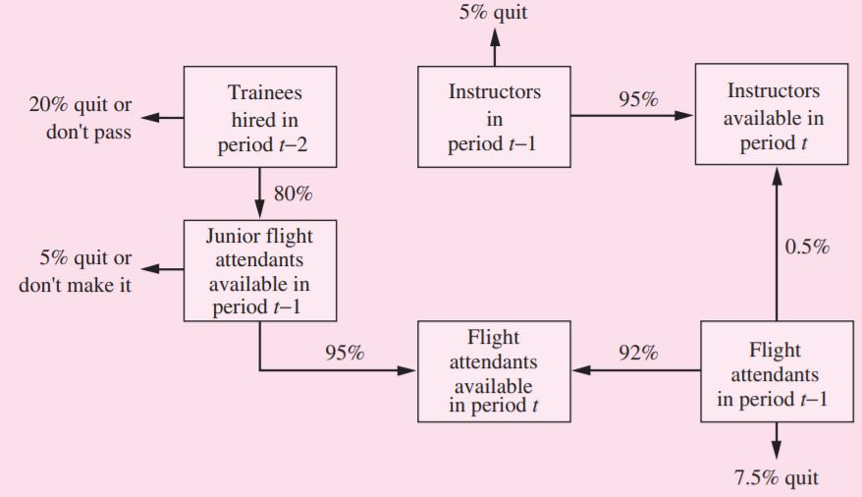
Sequoia Airlines
Sequoia’s training program for new personnel requires an entire month of classroom preparation before they are assigned to regular flight service. As junior flight attendants, they remain on probationary status for 1 additional month.

Slide 39
Sequoia Airlines
During the training period, each new employee is paid $750.
Junior flight attendant works an average of 140 hours per month and is paid a salary of $1,050 during the probationary period.
Experienced flight attendants works an average of 125 hours per month and is paid a salary of $1,400 per month.
Each instructor receives a salary of $1,500 per month.

Slide 40
Sequoia Airlines
There are at most 5 trainees per instructor.
Instructors not needed in a particular month (i.e., surplus) may be used as flight attendants.
The proportion of junior flight attendant hours not exceed 25 percent of any month’s total (i.e., junior plus experienced) attendant hours.
In May, Sequoia hired 10 new employees to enter the training program,
In June, it hired 10 more.
At the beginning of June, there were 120 experienced flight attendants and 6 instructors on Sequoia’s staff.

Slide 41
Sequoia Airlines
For the forecast period (i.e., July–December), determine the number of new trainees who must be hired at the beginning of each month so that total personnel costs for the flight-attendant staff and training program are minimized?
Formulate the problem as an LP model and solve?
How would you deal with non-integer results?
Discuss how you would use the LP model to make your hiring decision for the next six months?

Slide 42
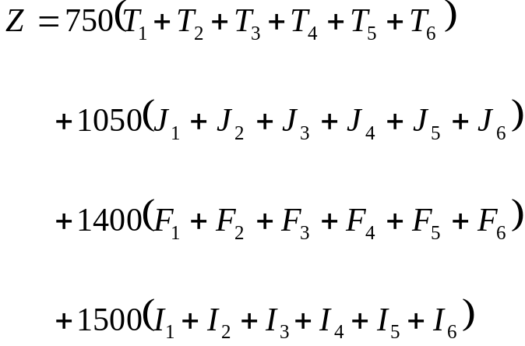
Solution
Minimize:

Slide 43









Solution
Subject to:
$140∗J_{i}+125∗F_{i}$+$125∗S_{i}$ ≥ $D_{i}$, for all i = 1, 2,…6
$140∗J_{i}≤0.25∗(140∗J_{i}+125∗F_{i}\text{+}125∗S_{i}$), for all i = 1, 2,…6
$I_{i}$ ≥ ${0.2∗T}_{i}$, for all i = 1, 2,…6
$J_{i}$ = ${0.8∗T}_{i−1}$, for all i = 2, 3,…6
$F_{i}$ = ${0.95∗J}_{i−1}+{0.92∗F}_{i−1}$, for all i = 2, 3,…6
$I_{i}$ = ${0.95∗I}_{i−1}+{0.005∗F}_{i−1}$, for all i = 2, 3,…6
$S_{i}$ = $I_{i}−{0.2∗T}_{i}$, for all i = 1, 2,…6
$J_{1}$ = $8,$
$F_{1}$ = $119,$
$I_{1}$ = $6$
$S_{i}$ ≥ 0, $I_{i}\text{≥ 0,} { T}_{i}$ ≥ 0, $J_{i}\text{≥ 0,} F_{i}$≥ 0, for all i = 1, 2,…6

Slide 44
Thank You

