Slide 1
Capacity Management

Slide 2
capacity in operations management
Capacity: the ability to hold, receive, store, or accommodate
In business, viewed as the amount of output that a system is capable of achieving over a specific period of time
Capacity management needs to consider both inputs and outputs
Many industries measure and report capacity in terms of output
Industries whose product mix is very uncertain, like hospitals, often express capacity in terms of inputs
Objectives of strategic capacity planning – to maximize the volume of the products/output that can be generated at the minimum long term cost.
In the case of high product variety, objective is to maximize the availability of resources for production at minimum long term cost.

Slide 3
Types of capacity planning
Long range
Greater than one year. Capacity is referred to as fixed assets like building, machinery
Intermediate range
Monthly or quarterly plans covering the next 6 to 18 months. Capacity is referred to as variable assets like contractual manpower, auxiliary tools, etc purchased cyclically.
Short range
Less than one month. Raw materials used for production

Slide 4
Importance of capacity planning
Level of capacity effects the cost, inventory policy, response time to uncertainty, customer satisfaction, etc
Less than optimum capacity may cause firm to loose customers and encourage competition.
Higher than optimum long term capacity may require firm to give discounts so that utilization is fairly good.

Slide 5
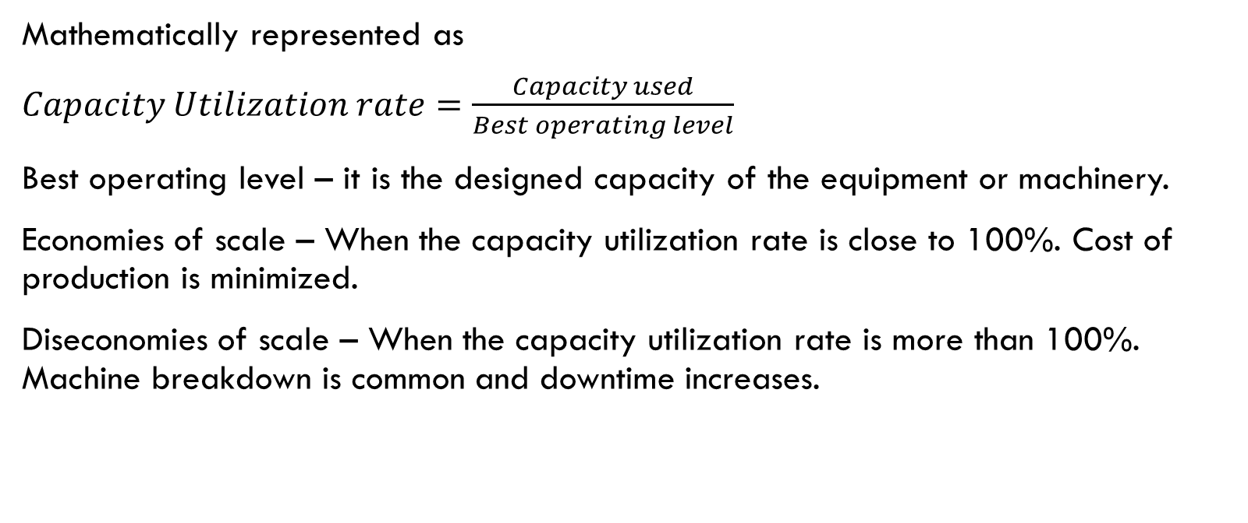
Metric to evaluate goodness of capacity planning
Mathematically represented as
$Capacity Utilization rate=\frac{Capacity used}{Best operating level}$
Best operating level – it is the designed capacity of the equipment or machinery.
Economies of scale – When the capacity utilization rate is close to 100%. Cost of production is minimized.
Diseconomies of scale – When the capacity utilization rate is more than 100%. Machine breakdown is common and downtime increases.

Slide 6
Capacity Flexibility
Flexible Plants
Flexible Processes
Flexible manufacturing systems
Simple, easily set up equipment
Flexible Workers
Ability to switch from one kind of task to another quickly
Multiple skills (cross training)
Ability to quickly adapt to change
Zero-changeover time

Slide 7
Considerations in Changing Capacity
Maintaining System Balance
Similar capacities desired at each operation
Frequency of Capacity Additions
Cost of upgrading too frequently
Cost of upgrading too infrequently
External Sources of Capacity
Outsourcing
Sharing capacity
Decreasing Capacity
Temporary reductions
Permanent reductions
Manage bottleneck operations

Slide 8
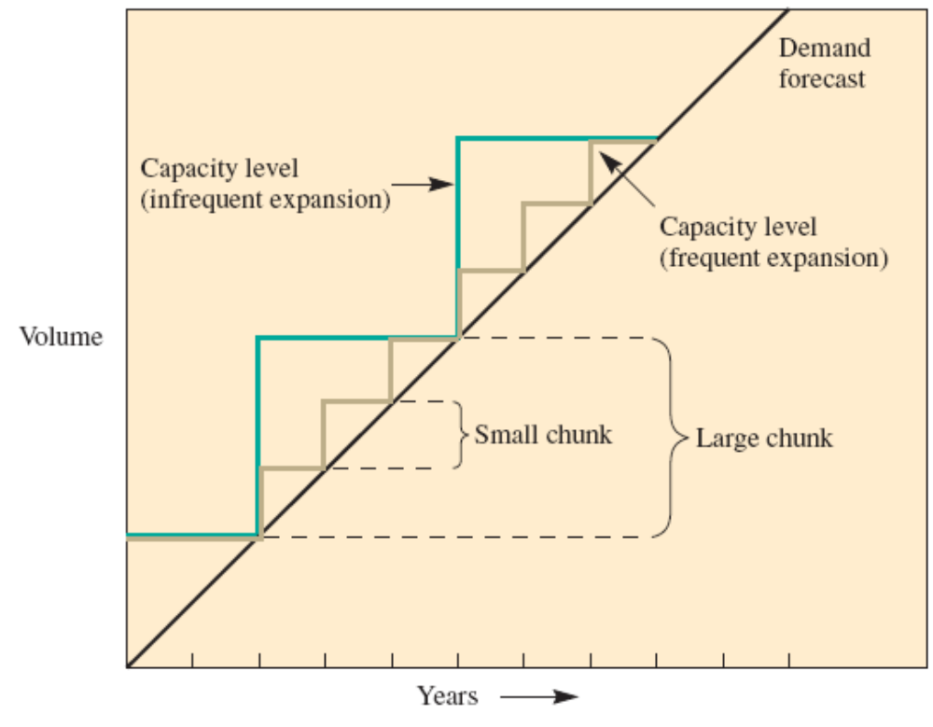
Frequent versus Infrequent Capacity Expansions

Slide 9
Determining Capacity Requirements
Use forecasting to predict sales for individual products
Calculate labor and equipment requirements to meet forecasts
Project labor and equipment availability over the planning horizon

Slide 10
Illustrative example
Stewart Company produces two flavors of salad dressing
  Paul’s and Newman’s
Each is available in bottles and single-serving bags
Have three machines that can package 150,000 bottles each year
  Each machine requires two operators
Have five machines that can package 250,000 plastic bags per year
  Each machine requires three operators
What are the capacity and labor requirements for the next five years?

Slide 11
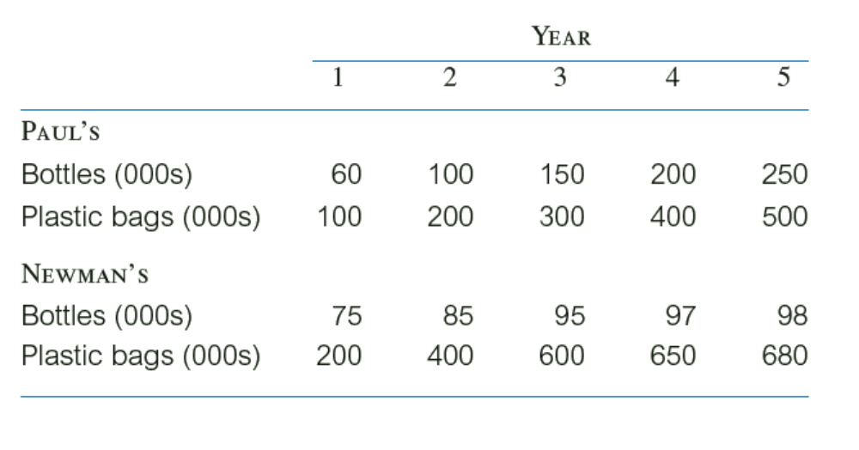
Step 1: Use Forecast to Predict Sales for Individual Products

Slide 12
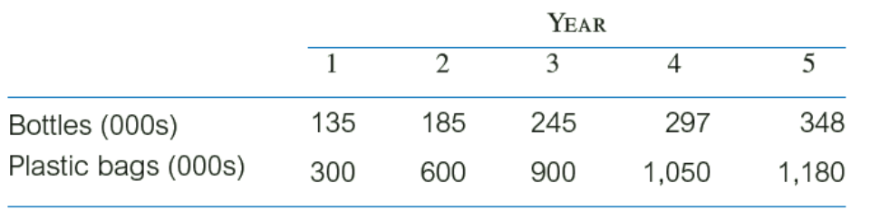
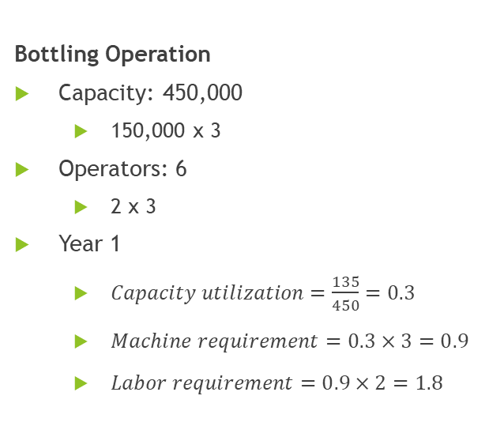
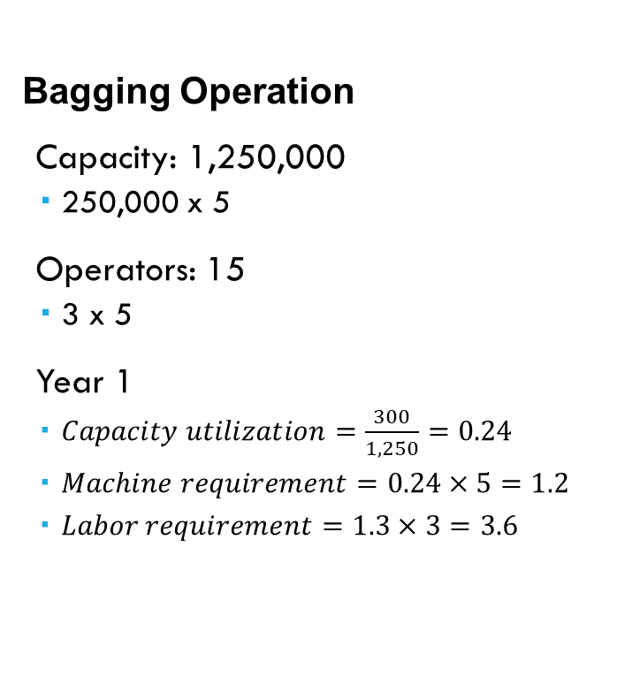
Step 2: Calculate Equipment and Labor Requirements
Bottling Operation
Capacity: 450,000
  150,000 x 3
Operators: 6
  2 x 3
Year 1
  $Capacity utilization=\frac{135}{450}=0.3$
  $Machine requirement=0.3×3=0.9$
  $Labor requirement=0.9×2=1.8$
Bagging Operation
Capacity: 1,250,000
  250,000 x 5
Operators: 15
  3 x 5
Year 1
  $Capacity utilization=\frac{300}{1,250}=0.24$
  $Machine requirement=0.24×5=1.2$
  $Labor requirement=1.3×3=3.6$

Slide 13
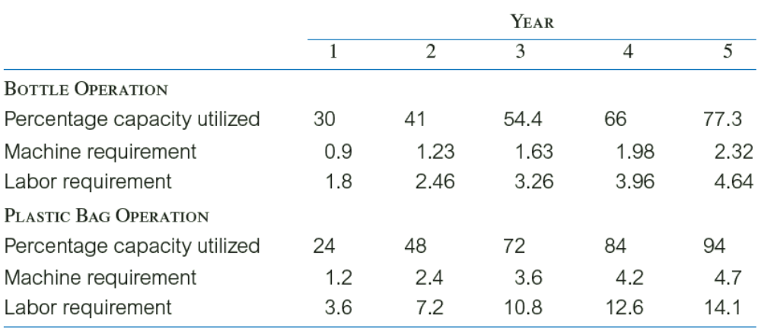
Step 3: Project Equipment and Labor Availabilities over the Planning Horizon

Slide 14
Using Decision Trees to Evaluate Capacity Alternatives
A decision tree is a schematic model of the sequence of steps in a problem – including the conditions and consequences of each step
Decision trees help analysts understand the problem and assist in identifying the best solution
Decision tree components include the following:
  Decision nodes – represented with squares
  Chance nodes – represented with circles
  Paths – links between nodes
Work from the end of the tree backwards to the start of the tree
Calculate expected values at each step

Slide 15
Illustrative example
The owner of Hackers Computer Store is evaluating three options – expand at current site, expand to a new site, do nothing
The decision process includes the following assumptions and conditions
  Strong growth has a 55% probability
  New site cost is $210,000
    Payoffs: strong growth = $195,000; weak growth = $115,000
  Expanding current site cost is $87,000 (in either year 1 or 2)
    Payoffs: strong growth = $190,000; weak growth = $100,000
  Do nothing
    Payoffs: strong growth = $170,000; weak growth = $105,000

Slide 16
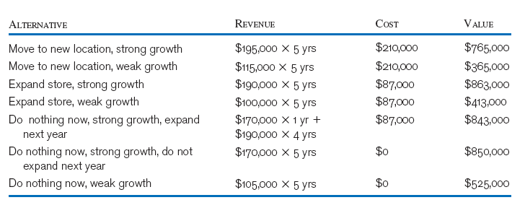
Calculate the value of each alternative

Slide 17
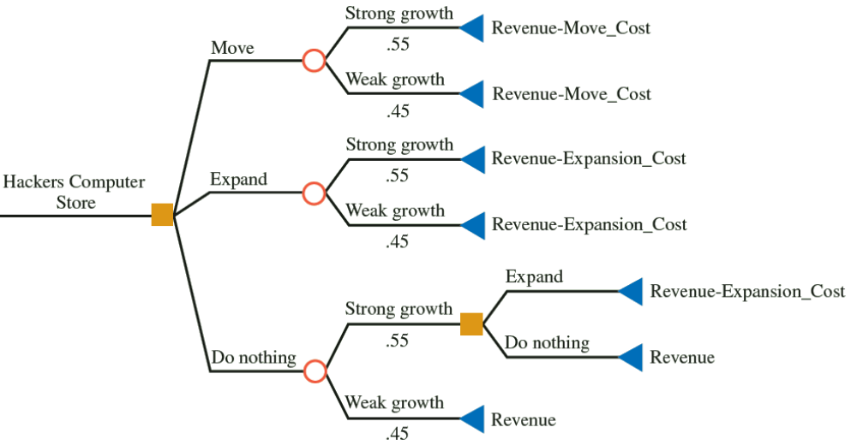
Decision tree for the problem

Slide 18
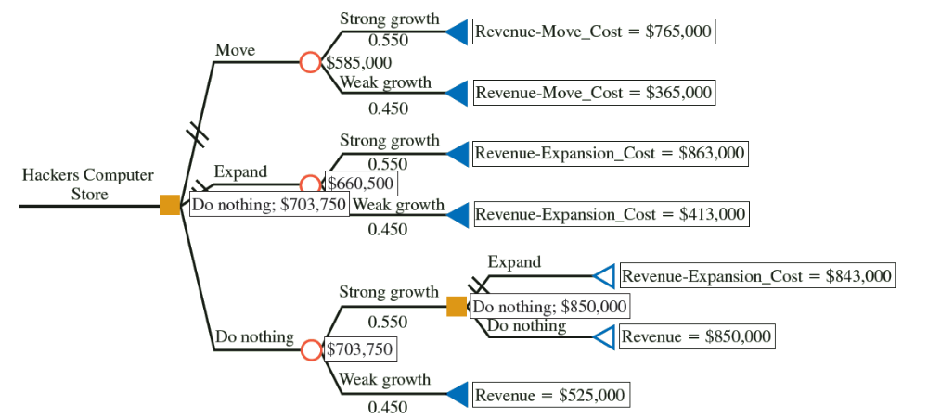
Decision tree continued.

Slide 19
Planning Service Capacity
Manufacturing Capacity
Goods can be stored for later use
Goods can be shipped to other locations
Service Capacity
Capacity must be available when service is needed – cannot be stored
Service must be available at customer demand point
Volatility of demand is relatively low
Much higher volatility is typical

Slide 20
Capacity Utilization and Service Quality
The relationship between service capacity utilization and service quality is critical
  Arrival rate: the average number of customers that come to a facility during a specific period of time
  Service rate: the average number of customers that can be processed over the same period of time
  Best operating point is near 70 percent
Optimal levels of utilization are context specific
  Low rates are appropriate when the degree of uncertainty (in demand) is high and/or the stakes are high (e.g., emergency rooms, fire departments)
  Higher rates are possible for predictable services or those without extensive customer contact (e.g., commuter trains, postal sorting)

Slide 21
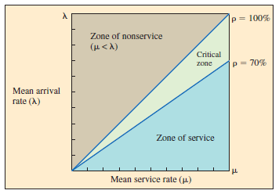
Relationship Between the Rate of Service Utilization and Service Quality

Slide 22
extensions
Dynamic capacity expansion problem – objective is to determine the size of the facility to be added and the associated time interval to minimize the total long term operating cost.
Factors considered for formulating this problem –
Planning horizon
Product mix
Technology upgradation alternatives
Economies of scale (utilization of machinery). Economies of scope and their trade-off
Net present value

