Slide 1
Computer vision !

Slide 2
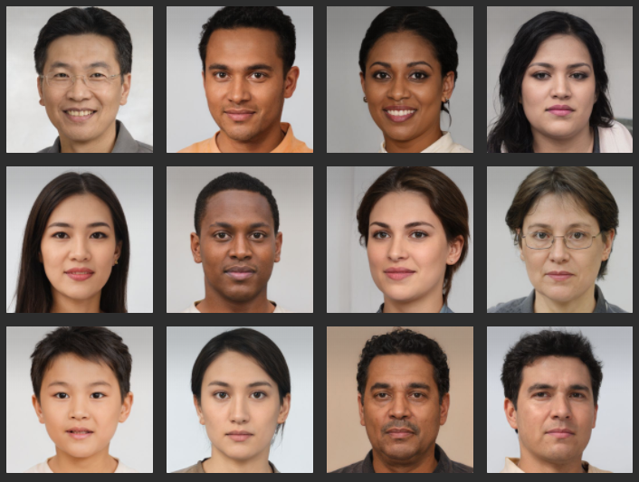

Slide 3
What is Vision !

Slide 4
Difference between Computer Vision and Image processing.

Slide 5
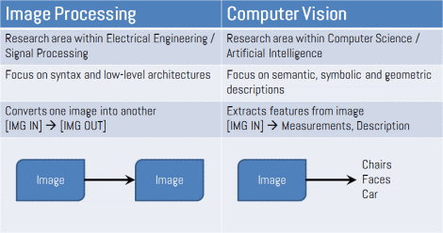
https://www.houseofbots.com/news-detail/11893-1-what-is-the-difference-between-image-processing-and-computer-vision

Slide 6
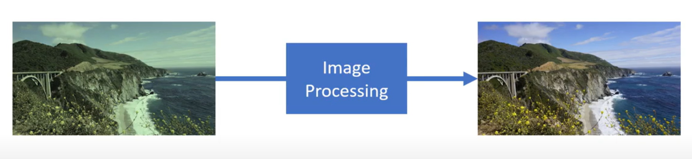
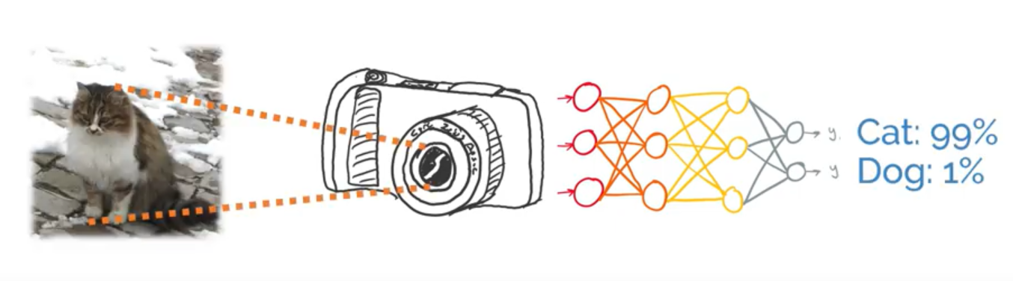
https://www.houseofbots.com/news-detail/11893-1-what-is-the-difference-between-image-processing-and-computer-vision

Slide 7
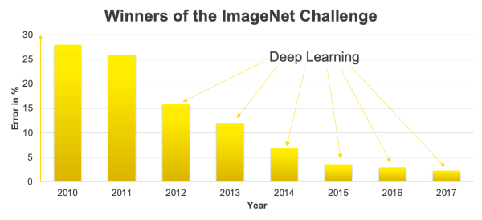
ImageNet Large Scale Visual Recognition Challenge (ILSVRC)
Alexnet 2012

Slide 8
Let’s see how machine sees

Slide 9
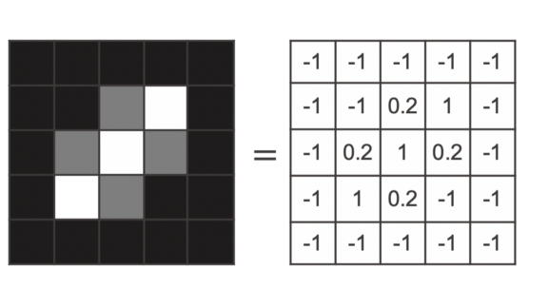
@Kathrin Melcher

Slide 10
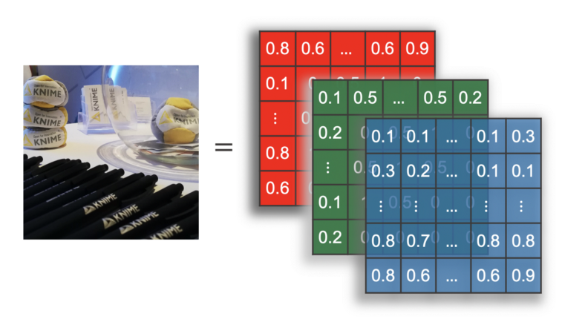
@Kathrin Melcher

Slide 11
Features in CV

Slide 12
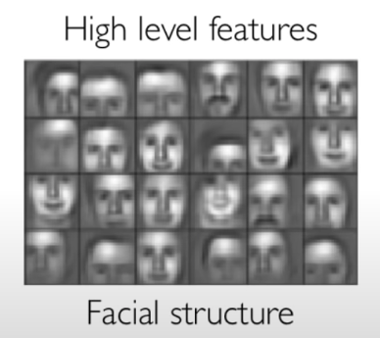
@Kathrin Melcher

Slide 13
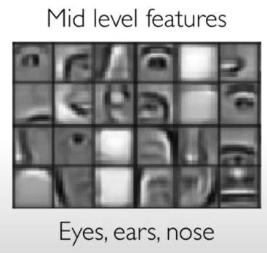
@Kathrin Melcher

Slide 14
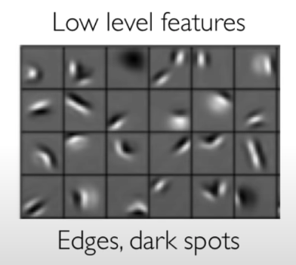
@Kathrin Melcher

Slide 15
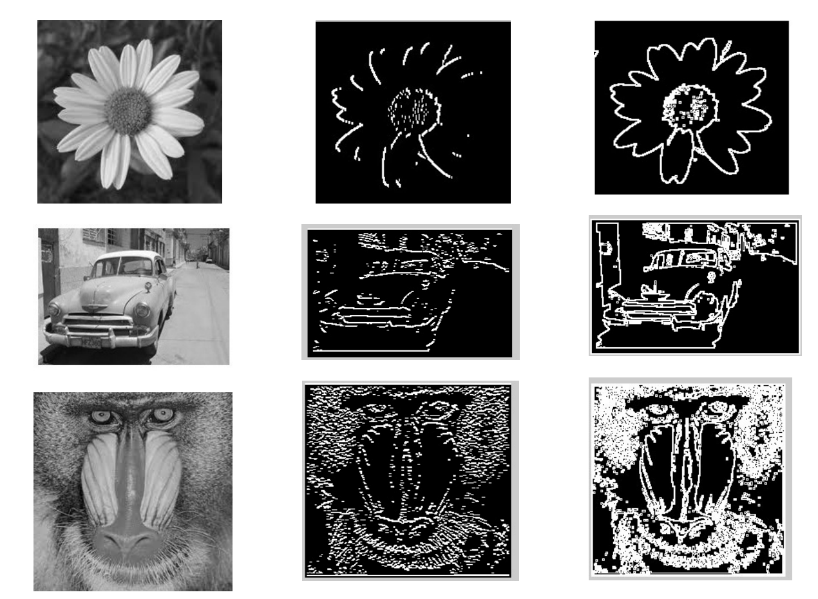
@Aryaman Sharda

Slide 16
CV tasks

Slide 17
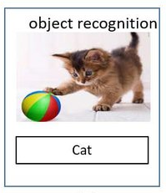

Slide 18
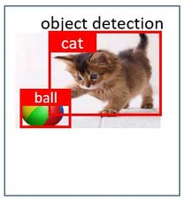

Slide 19
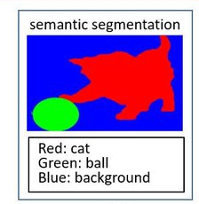

Slide 20
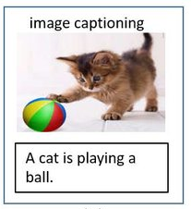

Slide 21
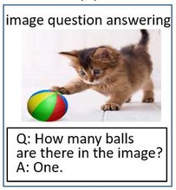

Slide 22
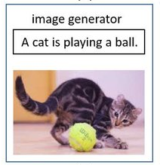

Slide 23
IBM Watson Demo
https://visual-recognition-code-pattern.ng.bluemix.net/

Slide 24
But IBM Has messed up It’s Watson product family ….
engineering failure , or marketing failure !

Slide 25
Google vision API Demo
https://cloud.google.com/vision/docs/drag-and-drop

Slide 26



Slide 27
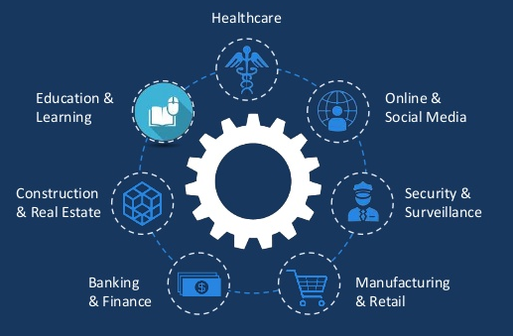
Application areas

Slide 28
A Sample CV project

Slide 29
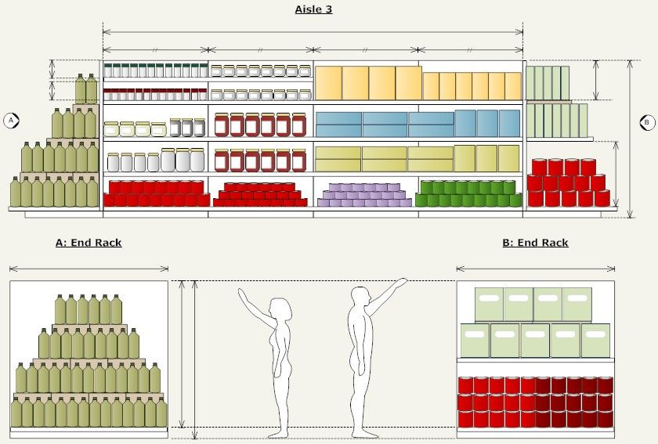

Slide 30
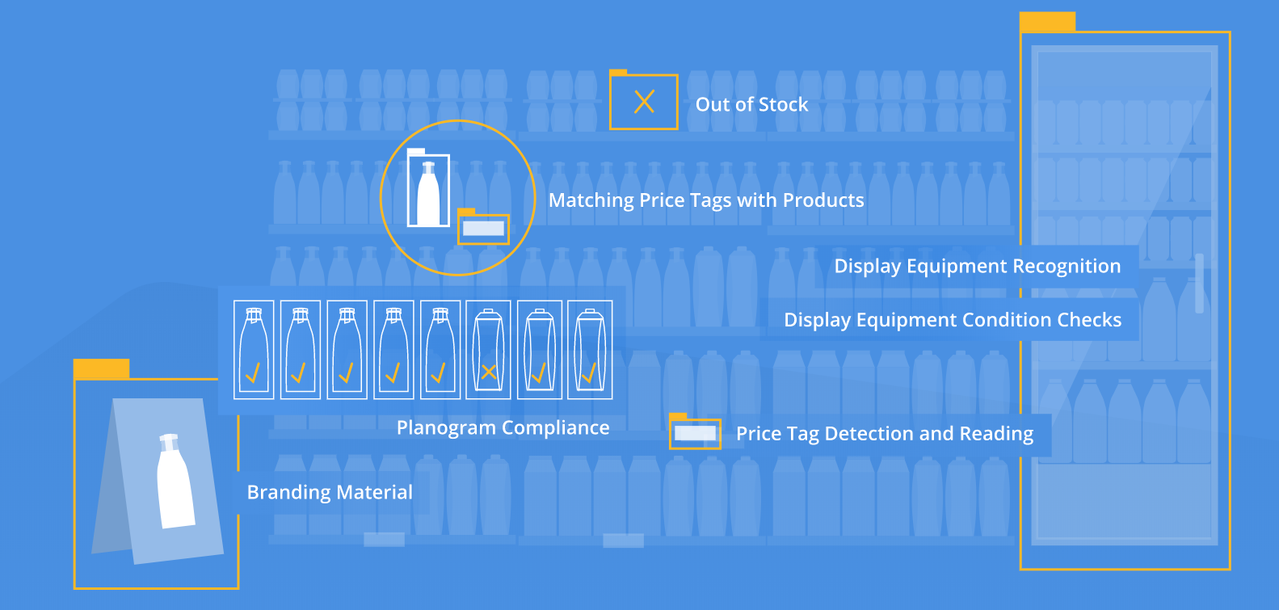
Computer vision in planogram
https://vispera.co/technology

