Slide 1
Computer vision !

Slide 2
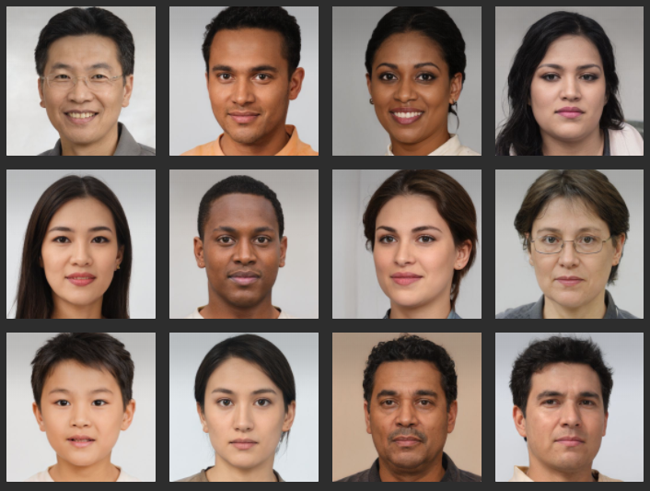

Slide 3
What is Vision !

Slide 4
Difference between Computer Vision and Image processing.

Slide 5
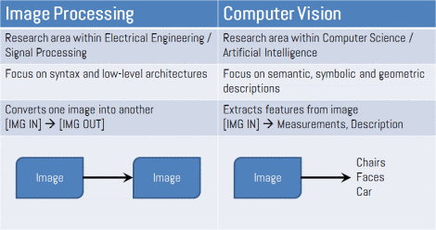
https://www.houseofbots.com/news-detail/11893-1-what-is-the-difference-between-image-processing-and-computer-vision

Slide 6
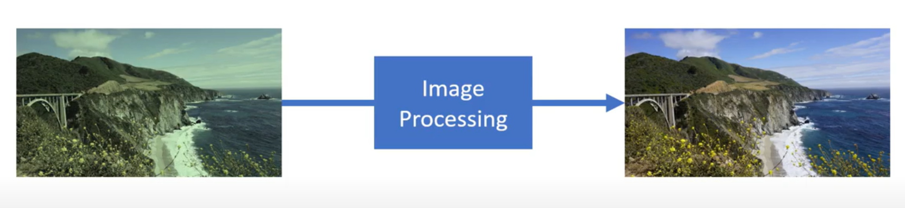
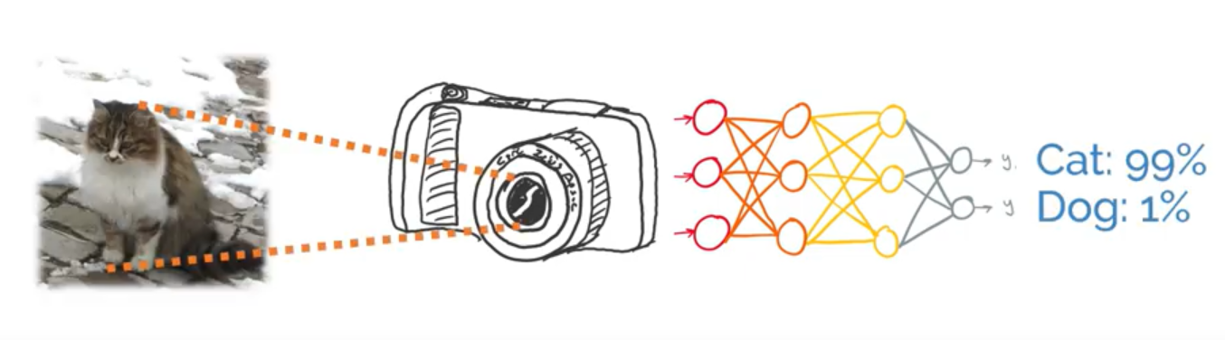
https://www.houseofbots.com/news-detail/11893-1-what-is-the-difference-between-image-processing-and-computer-vision

Slide 7
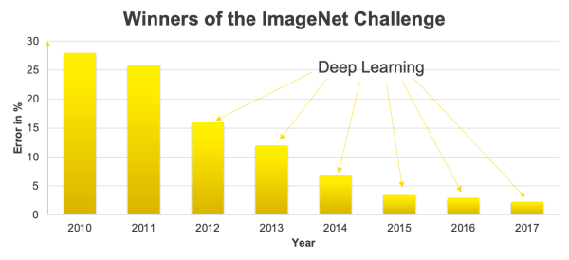
ImageNet Large Scale Visual Recognition Challenge (ILSVRC)
Alexnet 2012

Slide 8
Let’s see how machine sees

Slide 9
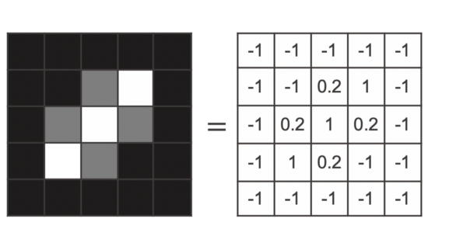
@Kathrin Melcher

Slide 10
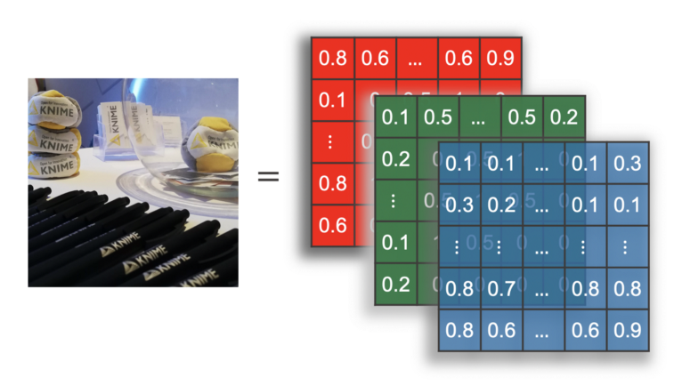
@Kathrin Melcher

Slide 11
Features in CV

Slide 12
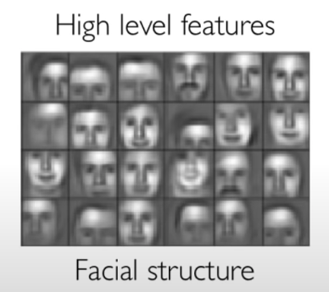
@Kathrin Melcher

Slide 13
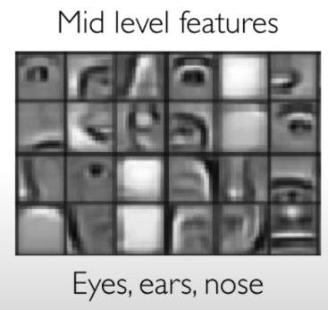
@Kathrin Melcher

Slide 14
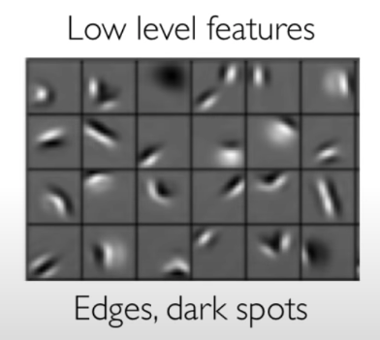
@Kathrin Melcher

Slide 15
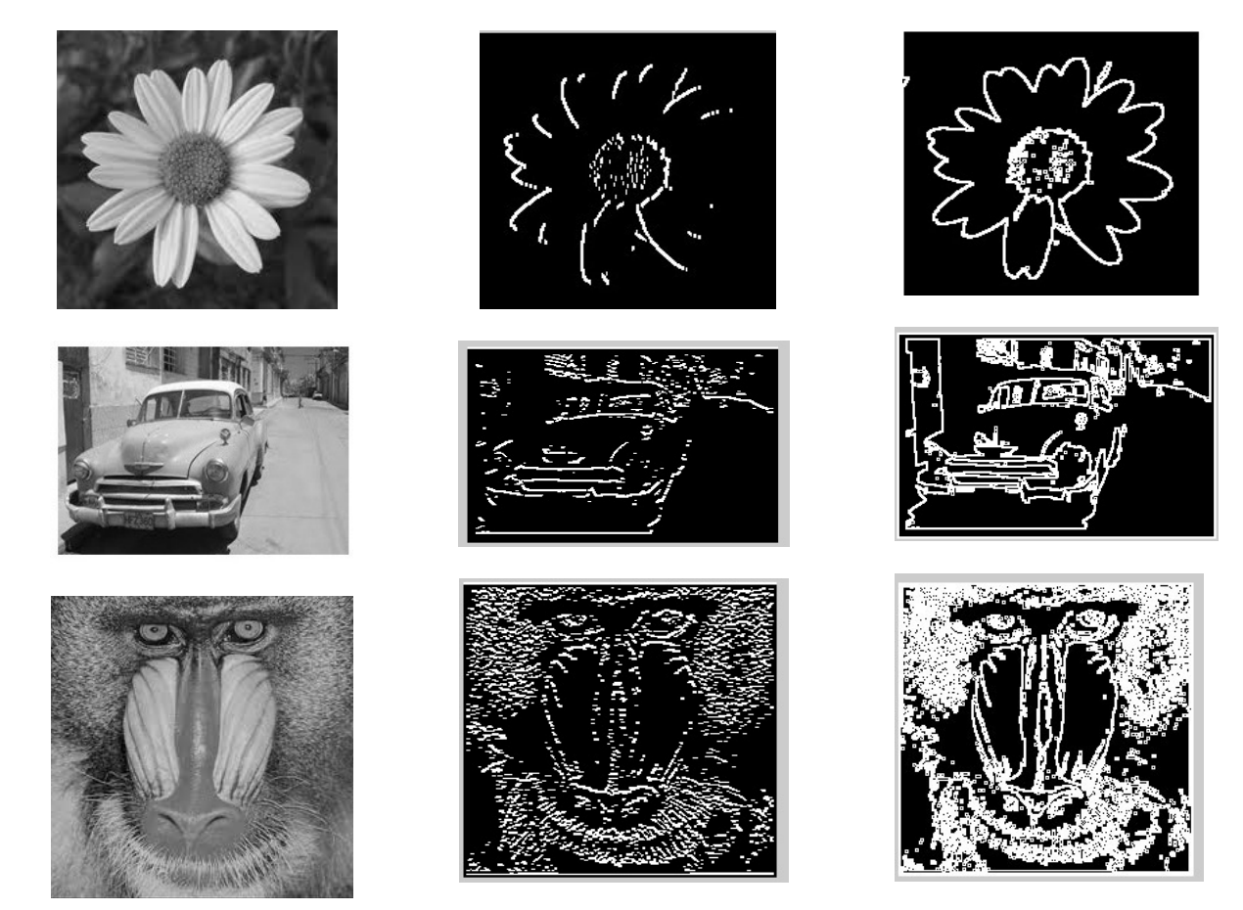
@Aryaman Sharda

Slide 16
CV tasks

Slide 17
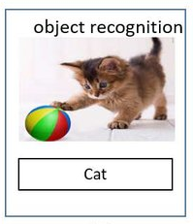

Slide 18
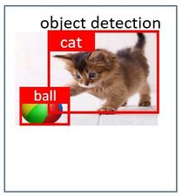

Slide 19
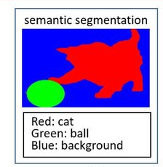

Slide 20
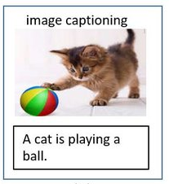

Slide 21
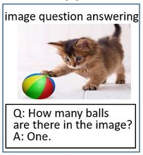

Slide 22
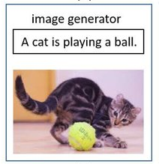

Slide 23



Slide 24
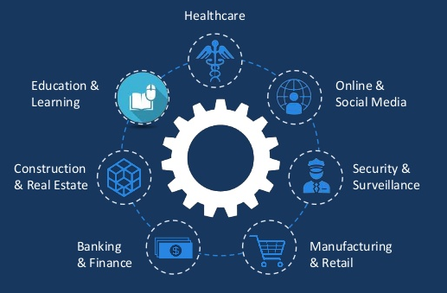
Application areas

Slide 25
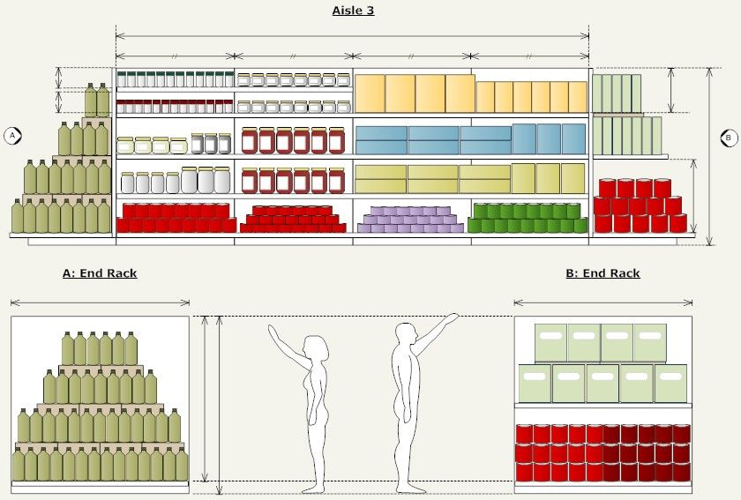

Slide 26
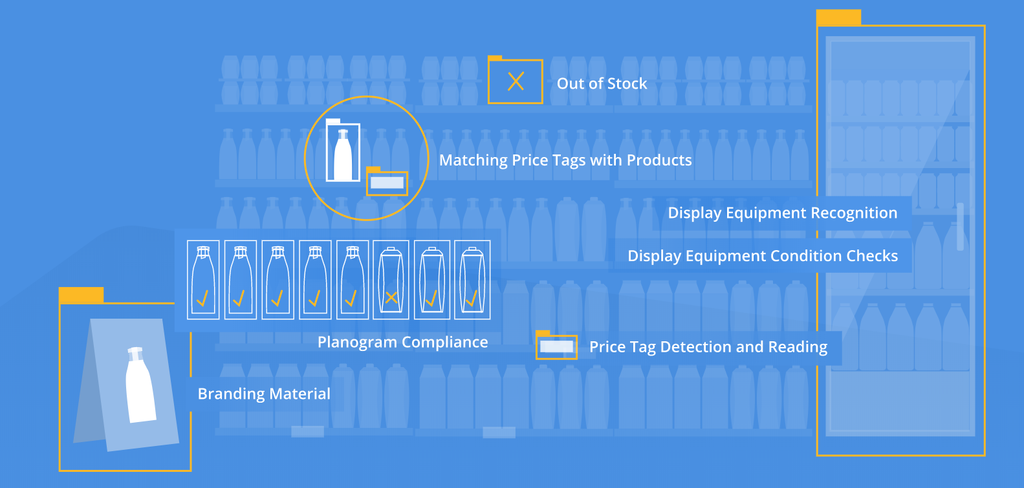
Computer vision in planogram
https://vispera.co/technology

