Slide 1


Cyber Security Risk Management
Online Executive Development Program,
offered by Indian Institute of Management Raipur in partnership with UPTOP
Session 7: Privacy Policies
Sourya Joyee De

Slide 2
Fun Facts
In an informal canvas of 191 online privacy policies, it was found that:
Longest privacy policy was 9965 words and took 20 seconds of continuous scrolling to reach the end
The shortest privacy policy was 248 words
“We will never sell your email address to any third parties, ever. If we ever sell your email address to anybody, we agree that you can beat us with a large metal object. The object must be at least 4 feet long and weigh more than 20lbs.”
Source: Waldman, A. E. (2018). Privacy, notice, and design. Stan. Tech. L. Rev., 21, 74.

Slide 3
On a serious note…
Just two policies used images, icons, and other graphics as part of the privacy policy
A user friendly, icon rich explanation of data use practices specifically geared towards average users
https://www.fitbit.com/legal/privacy
Source: Waldman, A. E. (2018). Privacy, notice, and design. Stan. Tech. L. Rev., 21, 74.

Slide 4
Notice and Choice/Consent
Inform users about data use practices
Provide them the opportunity to rectify their data
Enable them to give consent to any secondary use of information

Slide 5

Privacy Policy
Mechanism for companies to disclose their privacy practices
Notice:
What information is collected?
How is the information collected?
For what purpose?
With whom is it shared?
Choice:
Opportunity to opt out

Slide 6
Challenges
Average reading time: 10 minutes/policy
Opportunity cost to read privacy policies: approx. $781 billion
Additional time required for comparison
Source: McDonald, A. M., & Cranor, L. F. (2008). The cost of reading privacy policies. Isjlp, 4, 543.

Slide 7
Challenges
Hard to read and understand
  Confusing, long, difficult jargons
Read infrequently
  Inconspicuous
Often misleading
Do not support rational decision making

Slide 8
Primary Purposes
Transparency requirements
Right to be informed
Control over information
Enable comparison
Accountability
Developing trust
Competitive advantage
Compliance

Slide 9
Compliance
Fairness
Purpose limitation
Consent

Slide 10
When should privacy information be provided?
When data is obtained from data subject
  At the time of obtaining data
When data is obtained from other sources
  Within a reasonable period of time
  Latest by one month

Slide 11
Example I
A bank collects personal data from an individual in branch when they fill in a form to apply for a current account. The bank provides information to the individual on the application form to let them know why they need the data and what they do with it. The individual can review this information as they fill in the form.
Source: https://ico.org.uk/for-organisations/guide-to-data-protection/guide-to-the-general-data-protection-regulation-gdpr/the-right-to-be-informed/

Slide 12
Example II
A council obtains the names and contact details of the members of several voluntary groups in its area, from each group’s secretary. It intends to send letters to the members to invite them to a training event it is running on child safeguarding. The council assesses that the voluntary group members are unlikely to be significantly affected by, or object to, this use of their data. As such, it provides the members with the appropriate privacy information at the point at which it first communicates with them about the training event, two weeks after obtaining their data.
Source: https://ico.org.uk/for-organisations/guide-to-data-protection/guide-to-the-general-data-protection-regulation-gdpr/the-right-to-be-informed/

Slide 13
Questions
Does your organization collect and process personal data?
When does it provide the privacy information related to these data?

Slide 14
Where to deliver privacy information
Easily accessible form
  Putting privacy information on website
Make individuals aware of this information

Slide 15
Two Aspects of a Privacy Policy
Content: what information must be provided?
Design: how information must be provided?

Slide 16
Regulations and Privacy Policies
Primary focus is content
Design has also received some attention

Slide 17
Question
What information do you think should be included in a privacy policy?

Slide 18
Contents of a Privacy Policy
The identity and contact details of the data controller or their representative
Contact details of the data protection officer

Slide 19
Contents of a Privacy Policy
The purposes, legal basis and legitimate interest of data processing
Categories of personal data concerned
Source of data collection

Slide 20
Contents of a Privacy Policy
Recipients of the personal data
Information regarding cross-border transfer of data
The storage period or if not possible, the criteria used to determine that period

Slide 21
Content
The rights of the data subject, the procedure to exercise such rights and relevant contact details
The right to withdraw consent
The right to lodge a complaint with a supervisory authority

Slide 22
Content
The details of whether users are under statutory or contractual obligations to provide data
The procedure for grievance redressal
The security practices and safeguards used for the collected personal data
The existence of automated decision-making

Slide 23
Design
Presentation
Language clarity
Mode of expression

Slide 24
Challenges of Design
Discourage users from reading privacy policies
Coerce users into mismanaging privacy
Seemingly user-friendly design can be manipulative

Slide 25
About the Audience
A wide range of individuals
Vulnerable individuals
Dealing with people whose first language is not English

Slide 26
Example
An insurance company provides business travel insurance to large multi-national organizations and travel insurance to members of the public. It tailors the privacy information it provides to these different customers to cater for the differing levels of understanding and uses of personal data.
Source: https://ico.org.uk/for-organisations/guide-to-data-protection/guide-to-the-general-data-protection-regulation-gdpr/the-right-to-be-informed/

Slide 27
Presentation: Key Points to Remember
Conciseness
Transparency
Intelligibility
Ease of access
Clear and plain language

Slide 28
Exercise: Are these phrases sufficiently clear?
1. “We may use your personal data to develop new services”
2. “We may use your personal data for research purposes”
Source: Article 29 Working Party Guidelines on Transparency

Slide 29
Exercise
Compare the ease of access of the privacy policies of different websites.

Slide 30
Media
Orally
In writing
Through signage
Electronically

Slide 31
Techniques
Layered approach
Dashboards
Just-in-time notices

Slide 32
Layered Approach
Short notice containing key information
Link(s) to more detailed information

Slide 33
Benefits
Key information available immediately
Details available for those interested
Suitable for online context

Slide 34
Example
https://policies.google.com/privacy?hl=en-US#intro

Slide 35
Dashboards
Preference management tool
Provide and revoke consent over time
Link from where privacy information is made available

Slide 36
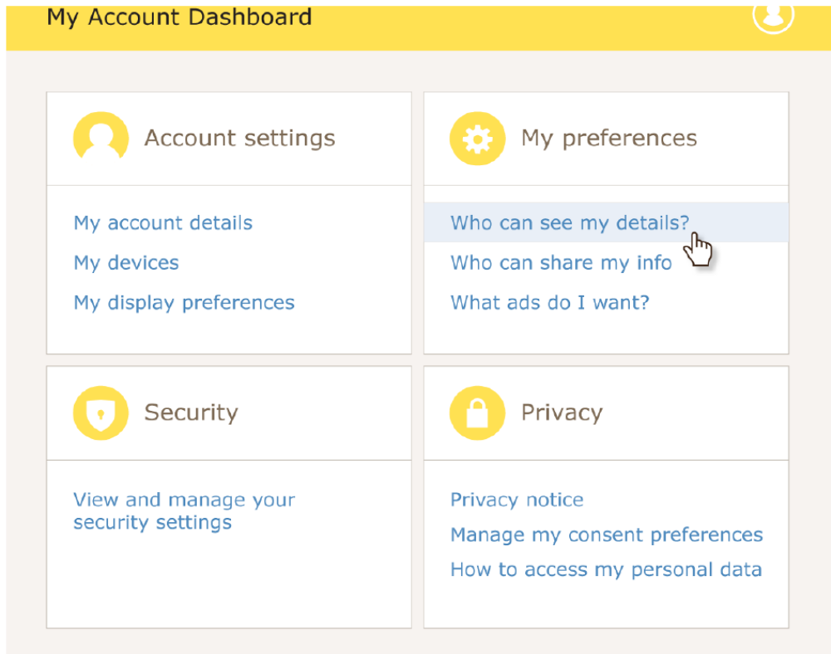
Example
Source: https://ico.org.uk/for-organisations/guide-to-data-protection/guide-to-the-general-data-protection-regulation-gdpr/the-right-to-be-informed/

Slide 37
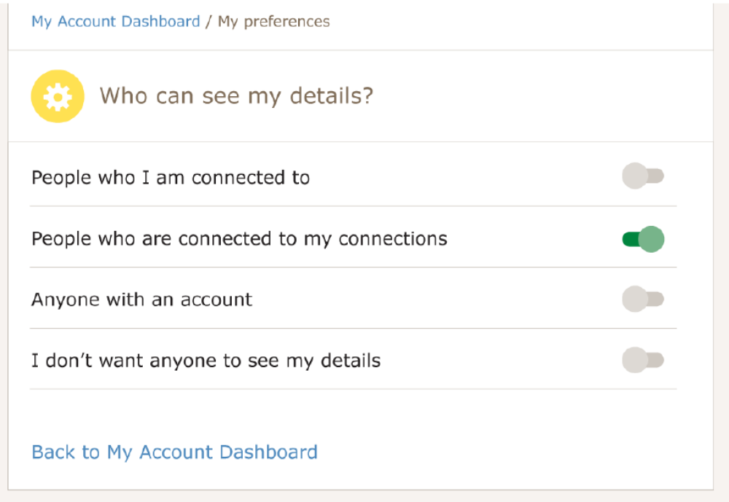
Example
Source: https://ico.org.uk/for-organisations/guide-to-data-protection/guide-to-the-general-data-protection-regulation-gdpr/the-right-to-be-informed/

Slide 38
Just-in-time Notice
Appears when an individual must provide the data controller some information
Explains how this information will be used
Relevant and focused privacy information

Slide 39
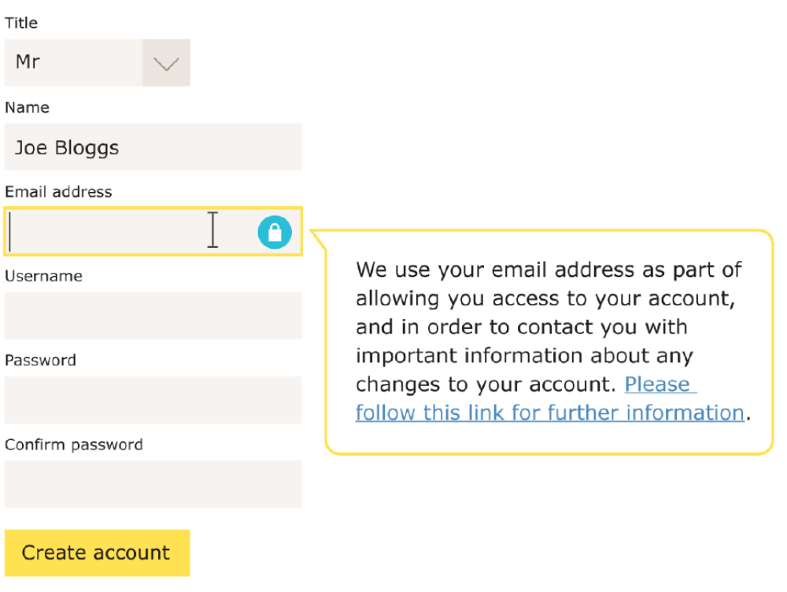
Example
Source: https://ico.org.uk/for-organisations/guide-to-data-protection/guide-to-the-general-data-protection-regulation-gdpr/the-right-to-be-informed/

Slide 40
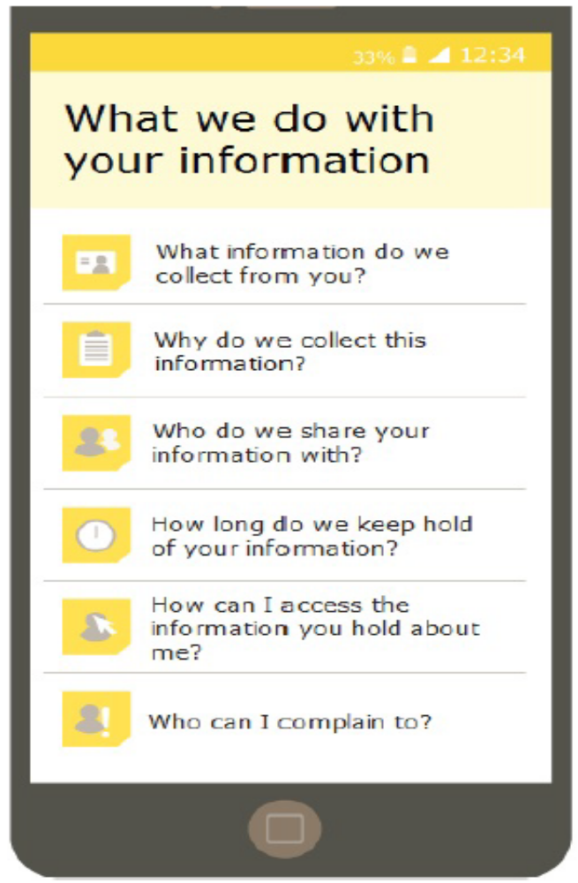
In mobile devices
Source: https://ico.org.uk/for-organisations/guide-to-data-protection/guide-to-the-general-data-protection-regulation-gdpr/the-right-to-be-informed/

Slide 41
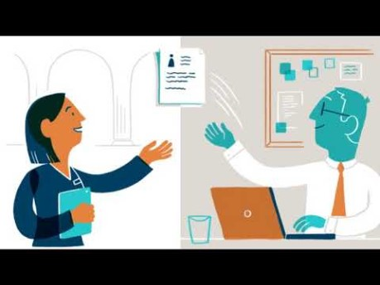
Video Privacy Notices

Slide 42
Further Responsibilities
User testing
Regular review
Update with new uses of data

