Slide 1


Cyber Security Risk Management
Online Executive Development Program,
offered by Indian Institute of Management Raipur in partnership with UPTOP
Session 6: Threat Finding
Sourya Joyee De

Slide 2
Overview

Slide 3
Key Questions
What are you building?
What can go wrong?
What should you do about things that can go wrong?
Did you do a decent job of the analysis?

Slide 4
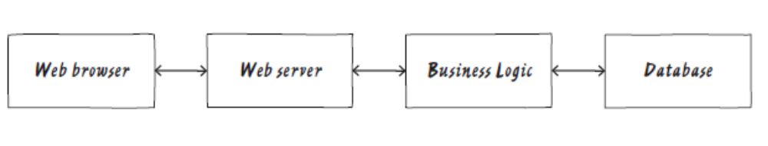
What are you building?
Source: Adam Shostack. Threat Modeling: Designing for Security. Wiley.

Slide 5
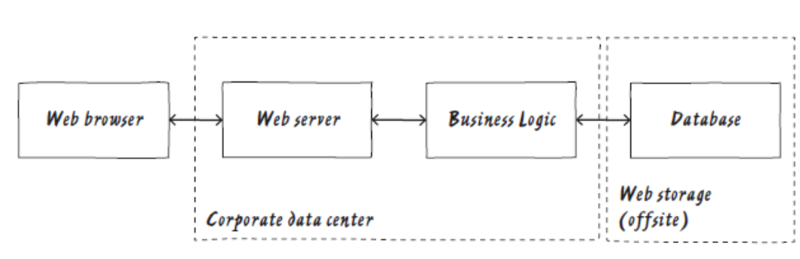
Adding trust boundaries
Source: Adam Shostack. Threat Modeling: Designing for Security. Wiley.
Who controls what?

Slide 6
What can go wrong?
Using the STRIDE mnemonic:
Spoofing
Tampering
Repudiation
Denial of Service
Information Disclosure
Elevation of Privilege

Slide 7

Examples
Spoofing:
Someone might pretend to be another customer
Someone might pretend to be your website
Tampering:
Someone might tamper with the data in your back end
Someone might tamper with the data as it flows back and forth

Slide 8
Examples
Repudiation:
Are there system logs?
Is the right information being logged?
Information Disclosure:
Can anyone connect to the database and read or write information?

Slide 9
Examples
DoS:
What happens if a thousand customers show up at once at the website?
Elevation of Privilege:
What prevents customers from connecting directly to the business logic server?

Slide 10
Threat Identification Tips
Start with external entities
Never ignore a threat because it’s not what you are looking for
Focus on feasible threats

Slide 11
What should you do about things that can go wrong?
Mitigate threats
Eliminate threats
Transferring threats
Accepting the risk

Slide 12
Did you do a decent job of the analysis?
Checking the model
Checking each threat
Checking your tests

Slide 13
Getting Started

Slide 14
Data Flow Diagrams
Used to clearly communicate how the system works
Develop shared understanding

Slide 15
Elements in a DFD
Process
Data flow
Data store
External entity

Slide 16
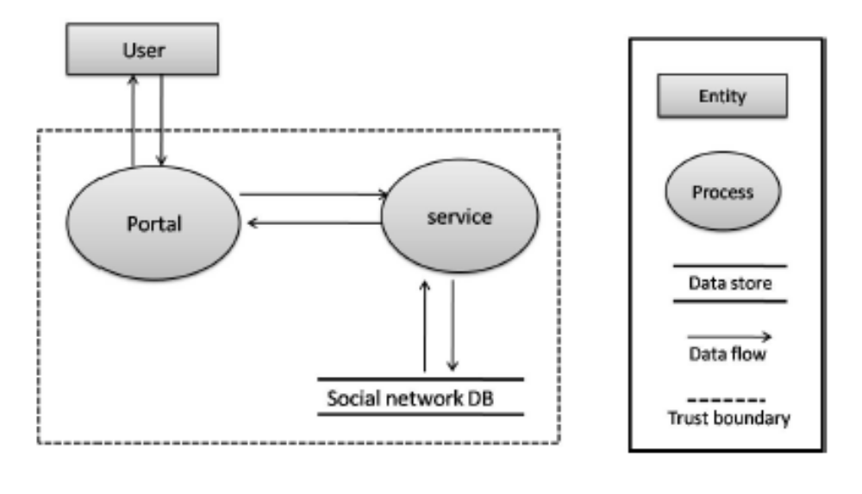
Example DFD
Source: Deng, M., Wuyts, K., Scandariato, R., Preneel, B., & Joosen, W. LINDDUN: running example-social network 2.0.

Slide 17
Question
What are the elements of the DFD of a system that you are developing?

Slide 18
Threat Finding

Slide 19
Different approaches to threat finding
STRIDE
Attack trees
Attack Libraries
Privacy tools

Slide 20
STRIDE
Framework designed to help people developing software identify the types of attacks that software tends to experience

Slide 21
Desirable properties vs.
STRIDE
Authenticity – Spoofing
Integrity – Tampering
Non-repudiation – Repudiation
Confidentiality – Information Disclosure
Availability – DoS
Authorization – Elevation of Privilege

Slide 22
Examples
Threat | Property violated | Threat definition | Typical Victims | Examples
Spoofing | Authentication | Pretending to be something or someone other than yourself | Processes, external entities, people | Falsely claiming to be Google.com, Barack Obama
Tampering | Integrity | Modifying something in storage or in flow | Data stores, data flows, processes | Changing a spreadsheet, adding or removing packets over a network
Repudiation | Non-repudiation | Claiming that you didn’t do something or weren’t responsible | Process | “I didn’t make that transaction”

Slide 23
Question
Can you state the property violated, threat definition and typical victims and give examples for the remaining STRIDE threats?

Slide 24
Exit Criteria
A threat of each type
One threat per element of the diagram

Slide 25
Attack Trees
“Attack trees provide a formal, methodical way of describing the security of systems, based on varying attacks. Basically, you represent attacks against a system in a tree structure, with the goal as the root node and different ways of achieving the goal as leaf nodes.”
Source: Bruce Schneier. Dr. Dobb's Journal, December 1999.

Slide 26
Building attack trees
Decide on representation
Create a root node
Create sub-nodes
Consider completeness
Prune the tree
Check the presentation

Slide 27
Open safe
Pick Lock
Install improperly
Learn combo
Cut open safe
Find written combo
Get combo from target
Threaten
Blackmail
Eavesdrop
Bribe
and
Listen to conversation
Get target to state combo
Source: Bruce Schneier. Dr. Dobb's Journal, December 1999.

Slide 28
Open safe
$10K
Pick Lock
($30K)
Learn combo
($20K)
Cut open safe
($10K)
Install improperly
($100K)
Find written combo ($75K)
Get combo from target ($20K)
Threaten
($60K)
Blackmail
($100K)
Eavesdrop
($60K)
Bribe
($20K)
and
Listen to conversation ($20K)
Get target to state combo ($40K)
Source: Bruce Schneier. Dr. Dobb's Journal, December 1999.

Slide 29
Question
Can you identify the root and sub-nodes of an attack?

Slide 30
Attack Libraries
A detailed list of common problems
CAPEC

Slide 31
CAPEC
Typical severity
A description
Pre-requisites
Method(s) of attack
Examples
Attacker skills or knowledge required
Resources required
Warnings of attack
Solutions and mitigations

Slide 32
Privacy Tools
Solove’s taxonomy
Privacy Considerations for Internet Protocols
Nymity Slider

Slide 33
Solove’s Taxonomy
Information collection: surveillance, interrogation
Information processing: aggregation, secondary use
Information dissemination: breach of confidentiality, increased accessibility
Invasion: intrusion

Slide 34
Privacy Considerations for Internet Protocol
Surveillance
Storage data compromise
Intrusion
Secondary use
Exclusion

Slide 35
Nymity
Amount of information about the identity of the participants that is revealed in a transaction

Slide 36
Linkability
Ability to bring two records together, combining the data in each into a single records or virtual record

Slide 37
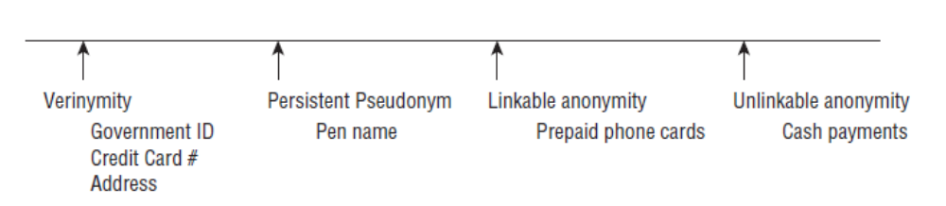
Nymity Slider
Source: Adam Shostack. Threat Modeling: Designing for Security. Wiley.

