Slide 1


Cyber Security Risk Management
Online Executive Development Program,
offered by Indian Institute of Management Raipur in partnership with UPTOP
Session 2: What is privacy? Why does privacy matter? Personal data, Common privacy risks
Sourya Joyee De

Slide 2
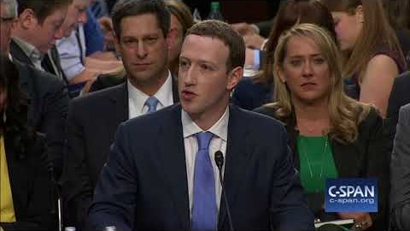
Why Should We Talk About Privacy?
Facebook CEO, Mark Zuckerberg’s replies to questions raised by Sen. Dick Durbin during his testimony at the U.S. Congress

Slide 3
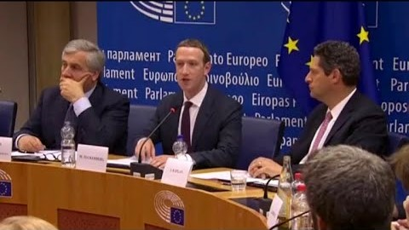
Why Should We Talk About Privacy?
Facebook CEO, Mark Zuckerberg’s apologizes to EU lawmakers

Slide 4

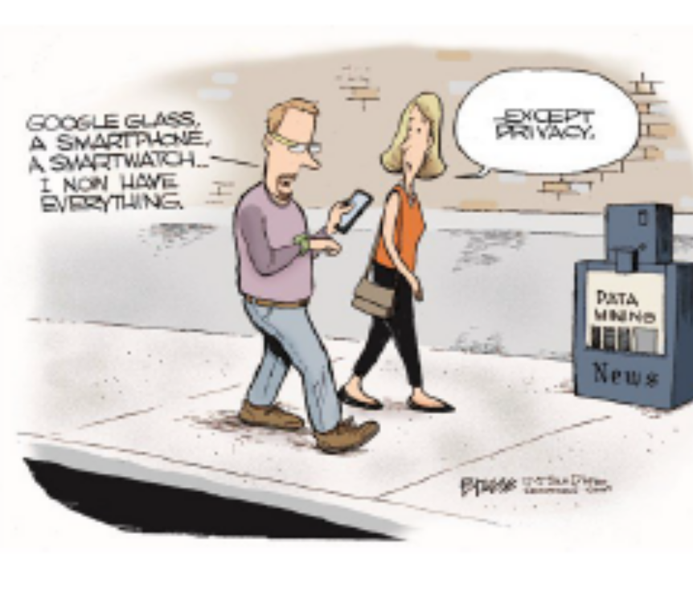
“Data is the new oil”
Personal data processing is at the core of business strategy and operations
Too much data collection
Too many ways to exploit

Slide 5
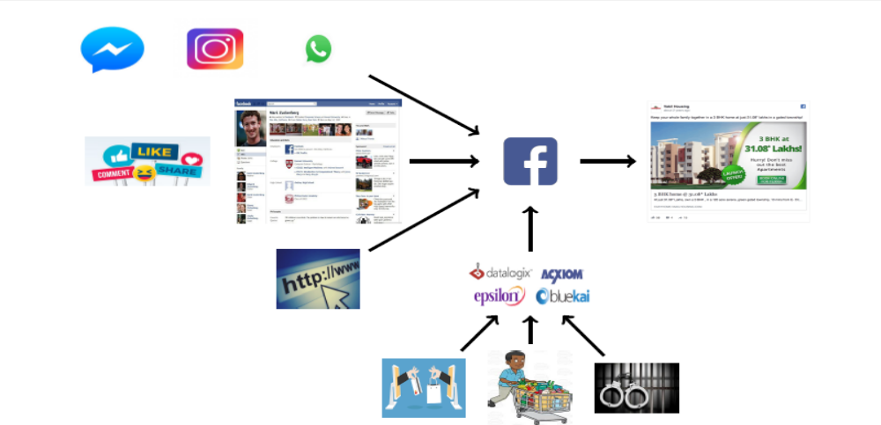
Your Data is My Business

Slide 6
What do data controllers know about you?
Behavioral data
Purchase behavior
Spending methods
Multicultural affinity
Consumer classification
Energy consumption
Demographic data
Education
Liquid assets
Politics
Relationship
Interest data
Entertainment
Fitness
Food and drink
Hobbies and activities
Shopping and fashion
Sports and outdoor activities

Slide 7
Potential Privacy Breaches
What health insurance premium should you be charged?
Will you be a good employee?
Are you a potential law-breaker?
Are you credit worthy?
Are you a trustworthy driver?

Slide 8
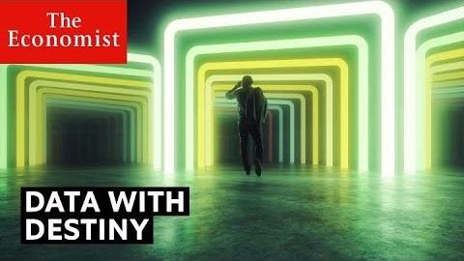
Owes of predictive policing

Slide 9
Why Should We Talk About Privacy?
Harmful consequences for users
Harmful consequences for the society at large
Harmful consequences for the business
Consumer backlash
Harsher regulations

Slide 10
Benefits of pro-actively tackling privacy issues
Protect your brand
Gaining competitive advantage
Creating new products and services

Slide 11
Basic Concepts

Slide 12
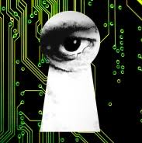
What is Privacy?
Abstract, subjective and hard-to-define concept
Some popular definitions:
  Right to be let alone
  Limited access to self
  Secrecy
  Control over personal data
  Personhood

Slide 13
Personal Data
Any information relating to an identified or an identifiable natural person that allows such a person to be singled out or treated differently

Slide 14
Examples of Personal Data
Identification and contact information
Health data
Genetic data
Data about personal life and relationships
Data about personal beliefs
Behavioral data
Location data
Financial data

Slide 15

The Data Life-Cycle
Data Dissemination
Data Collection
Data Processing
Data Collector/Data Processor
Data Subject

Slide 16
Privacy Weaknesses
A weakness in the data protection mechanism of a system or lack thereof that could lead to a privacy breach

Slide 17
Examples of Privacy Weaknesses
Storage of data in un-encrypted form
Non-enforcement of strong passwords for account access
Not prohibiting re-identification through contracts with third parties
Not binding third parties to maintain appropriate level of data protection
Default privacy setting is “public” for all data

Slide 18
Risk Sources
Any entity that may process, legally or illegally, data belonging to a data subject and whose actions may directly or indirectly, intentionally or unintentionally lead to privacy harms

Slide 19
Feared Events
Event occurring as a result of the exploitation of one or more privacy weaknesses by risk sources, leading to privacy harms

Slide 20
Examples of Feared Events
Excessive/ unauthorized collection of data
Unauthorized access to data
Unauthorized modification of data
Use of data for unauthorized purposes
Unjustified data inference or re-identification
Storage or use of inaccurate data
Disclosure of data to unauthorized actors or unauthorized publication
Retaining data more than necessary

Slide 21
Privacy Harms
Negative impact on the data subject or a group of data subjects or the society as a result of a feared event

Slide 22
Examples of Privacy Harms
Physical harms
Financial harms
Psychological harms
Harms to reputation/dignity
Societal harms

Slide 23
Summing up…
Risk sources exploit privacy weaknesses of a system processing personal data leading to feared events and hence breaches of privacy
A privacy breach results in privacy harm for an individual or groups of individuals or the society as a whole

Slide 24
What Was Privacy?
What is the definition of privacy used in the article?
What would happen if businesses remain complacent?
Give an example of a privacy harm.
What are people’s attitude towards privacy?
Why does privacy matter?

