Slide 1


Cyber Security Risk Management
Online Executive Development Program,
offered by Indian Institute of Management Raipur in partnership with UPTOP
Session 1: Why study security, basic concepts, common breaches
Sourya Joyee De

Slide 2
Why Should We Talk About Security?

Slide 3
Digital Transformation and security
Growth of automation, IoT, AI and ML, cloud processing and storage
High reliance on digital technologies in critical areas such as banking, aviation, healthcare, power grids and other industrial control systems
Gathering of customer data is at the center of business operations and strategy
Increasing cost of cybercrimes for global companies
Cyberattacks could nearly wipe out businesses, cripple critical services such as hospitals and power grids and destabilize nations
Advancements in AI and quantum computing could render current cybersecurity efforts obsolete

Slide 4
Benefits of pro-actively tackling security issues
Protect your brand
Gaining competitive advantage
Creating new products and services

Slide 5
Consumer Expectation
95% of consumers expect their bank to have the latest technologies to keep their financial information safe and secure
89% expect stores they shop at to stay up-to-date with the latest financial safety technologies
88% trust that their payment network is arming them with new, secure technologies that protect them from fraud
83% are excited about the emerging new technologies that will help secure and protect their financial information
Source: PSFK Lab + MasterCard research, https://www.slideshare.net/PSFK/psfk-presents-the-future-of-digital-safety-security

Slide 6
Security is a Business Problem
Cyber risks are business risks
Focus on a threat’s potential impact on business activities
How can a cyber attack disrupt the supply chain?
How can it expose trade secrets?
How can it lead to failure in meeting contractual obligations?
How can it be a threat to humanity?

Slide 7
The Broader Context

Slide 8
What can you do?
Know your risks
1
Establish suitable controls for high-priority risks
3
Accept residual risks
4
Prioritize your risks
2

Slide 9
Identifying Cyber Risks
A key business activity and the risks to it
Systems that support this activity
Potential types of attacks and possible consequences
Adversaries most likely to carry out the attack

Slide 10
What is Security?
“A condition that results from the establishment and maintenance of protective measures that enable an enterprise to perform its mission or critical functions despite risks posed by threats to its use of information systems. Protective measures may involve a combination of deterrence, avoidance, prevention, detection, recovery, and correction that should form part of the enterprise’s risk management approach.” - NIST

Slide 11
Information System Components
Data
Hardware
Software
Network
People
Procedures

Slide 12

From whom are we trying to protect?
Perpetrators have different motivations and capabilities
What does your company have that could be of value to someone else?
Adversaries’ wider commercial context is important

Slide 13

From whom are we trying to protect?
Individuals
Organized worldwide groups
Organized criminals
Terrorists
Nation states

Slide 14
They Burned the House Down
What were the key business activities that were affected?
What supporting systems were affected?
What were the consequences?
Who was the adversary?
What role did Lynton play in the aftermath of the attack?
How was the crisis managed?

Slide 15
Key Security Concepts

Slide 16



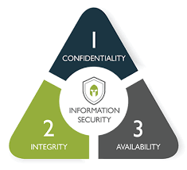
The CIA Triad and More
Basic characteristics:
  Confidentiality (C)
  Integrity (I)
  Availability (A)
Add-ons:
  Identification
  Authentication
  Authorization
  Non-repudiation
Calvin
Susie
Hobbes

Slide 17
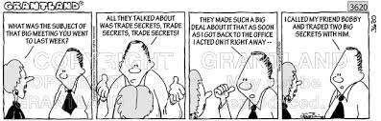
Confidentiality
Information should not be disclosed to unauthorized parties

Slide 18
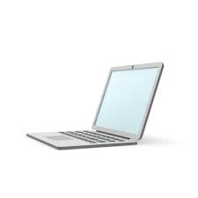
Message M
Hobbes reads the message M that Calvin stored in his system

Slide 19
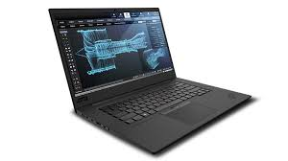
Message M
Hobbes reads the message M that Calvin was sending to Susie

Slide 20
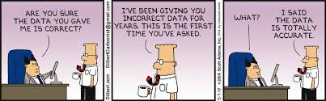
Integrity
Information should be untampered

Slide 21
Message M’
Hobbes changes the message M that Calvin stored in his system to another message M’

Slide 22
Message M
Message M’
Hobbes changes the message M that Calvin was sending to Susie to another message M’

Slide 23
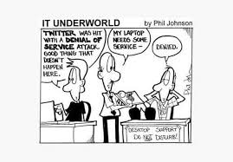
Availability
Accessibility of information assets to authorized users

Slide 24

Identification

Slide 25
Who are you?
I am Susie

Slide 26
Who are you?
I am Susie

Slide 27
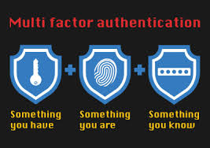
Authentication
Are you who you claim to be?

Slide 28
Who are you?
I am Susie
Prove it!
My password is
X4$%6bn

Slide 29
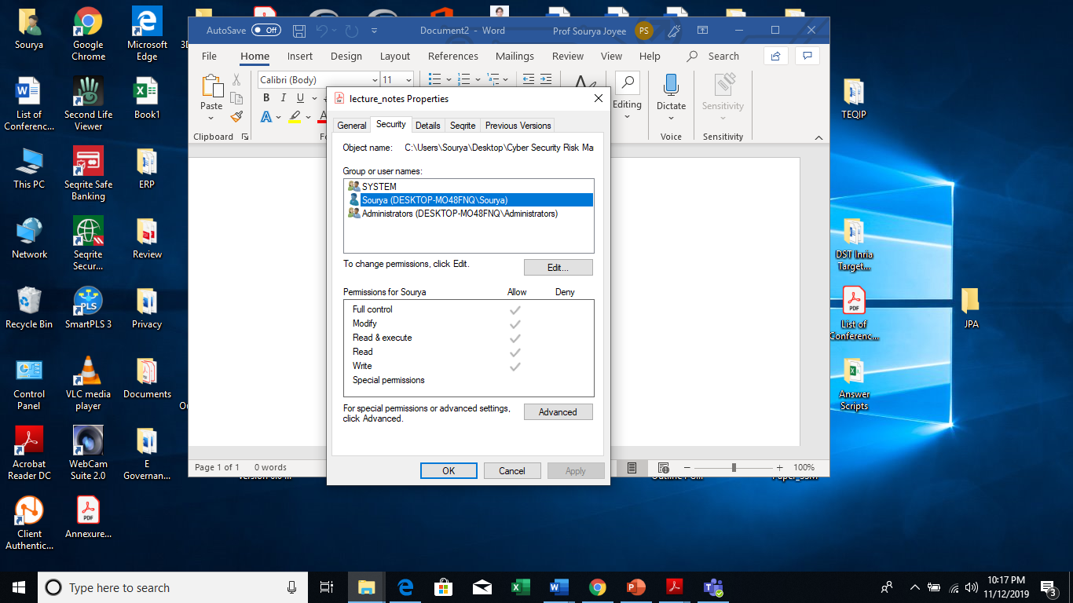
Authorization
What can you do?

Slide 30
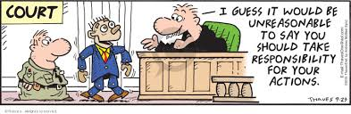
Non-repudiation
You cannot deny your actions

Slide 31
Common Security Breaches

Slide 32
Who is the weakest link?
Employee
Suppliers
Consumers

Slide 33
Malware
Malicious applications and codes
Damages and disrupts normal usage of devices
May allow unauthorized access, use system resources, steal passwords, etc.
Many existing types based on what it does to the system, the affected platforms etc.

Slide 34

Phishing
From: "HR@berkeley.edu (link sends e-mail)" <HR@berkeley.edu (link sends e-mail)>
Subject: Message from human resources
Date: April 13, 2017 at 9:29:54 PM PDT
To: XXXXX@berkeley.edu (link sends e-mail)
Dear XXXXX@berkeley.edu (link sends e-mail)
An information document has been sent to you by the Human Resources Department.
Click here to Login to view the document.
Thank you!
Berkeley University Of California HR Department
© 2017 The Regents of the University of California. All rights reserved.
-----------------------------------------------------------------------------------------------------------------------------------------------------------
CONFIDENTIALITY NOTICE: This email and any attachments may contain confidential information that is protected by law and is for the sole use of the individuals or entities to which it is addressed. If you are not the intended recipient, please destroying all copies of the communication and attachments. Further use, disclosure, copying, distribution of, or reliance upon the contents of this email and attachments is strictly prohibited.
Source: https://security.berkeley.edu/education-awareness/phishing/phishing-examples-archive

Slide 35
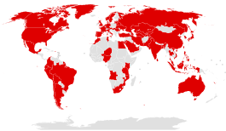
Ransomware
According to FBI estimates, costs of ransomware could exceed $1 bn
There were more than 4000 cases of ransomware daily in 2016
Nearly half of US organizations reported ransomware attacks in recent years
43% affected middle managers, 25% affected senior and C-level executives
Financial services and healthcare most affected

Slide 36
Ransomware
Prevent users from accessing their systems until a certain ransom is paid
Cyber criminals trick users to activate malware disguised in e-mails as HTML links or attachments
Encrypts user data using private key available only to the attackers
Use of anonymous payment methods such as Bitcoin to obtain ransom
Ransomware-as-a-service
Examples: Locky, WannaCry, NotPetya

Slide 37
An e-mail that contained the Locky ransomware
From: Curtis.8271@brasiltelecom.net.br (link sends e-mail) Date: Wed, 24 Aug 2016 20:29:58 -0700 Hello, Please sign the attached contract with our technical service company for 2016 � 2017. We would appreciate your quick response. King regards, Cynthia Curtis (Digital-Signature: f0a0e01386d19b03736165288026cc97e325560c78700e95)
Source: https://security.berkeley.edu/education-awareness/phishing/phishing-examples-archive

Slide 38
An e-mail that contained the Locky ransomware
From: Richmond.87413@ontheriverwoodstock.com (link sends e-mail) Date: Wed, 24 Aug 2016 08:44:09 -0700 Hi, The monthly financial statement is attached within the email. Please review it before processing. King regards, Pete Richmond (Topic-ID: b0b82053c611db43b3a1a568c0660cd72365964cb8b04ed5)
Source: https://security.berkeley.edu/education-awareness/phishing/phishing-examples-archive

Slide 39
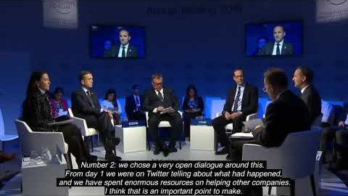
Maersk Global Supply Chain Meltdown
Jim Hagemann Snabe, Chairman, AP Moller-Maersk, on NotPetya attack on Maersk, in a panel discussion on “Securing a Common Future in Cyberspace” at World Economic Forum, 2018.

Slide 40
Distributed Denial-of-Service
Prevents legitimate users from accessing network resources
Legitimate servers overloaded with thousands of connection requests from botnets
Often used as a distraction from another cybercrime
Cheap, easy to organize, highly effective
More than 20% of enterprises in the world saw at least one DDoS attack on their infrastructure in recent years (source: Kaspersky)
Cloud and SaaS have been prominent targets of DDoS attacks in recent years
Heavy downtime and business losses

Slide 41
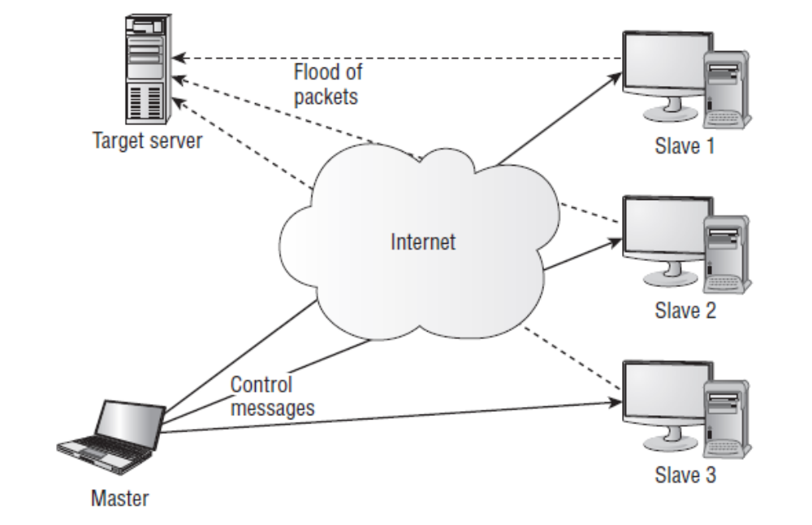
A DDoS Attack
(Source: CEH Study Guide, Kimberley Graves)

Slide 42

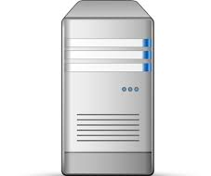
SYN
SYN
SYN-ACK
SYN-ACK
ACK
TCP Three-way Handshake
SYN Flooding

Slide 43
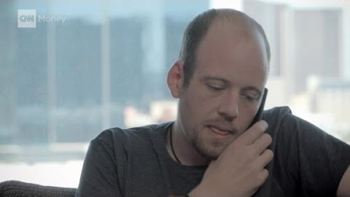
Social Engineering
Requires limited technical expertise
Open source intelligence gathering
Forces victim to take a decision on-the-spot
Difficult for victim to resist or say “no” for fear of violating social norms
Unsuccessful attempts often help attacker to refine attack

Slide 44
IT Department calling…
Obtained credentials
Pretend to be from IT dept.
Pretend to check for a patch
New Call
Target complies
Actions of the non-complying target
Don’t you want to just remote into my computer?
Expresses confusion.
What is your last name?
Looks up the last name in the directory.
Offers to call back.
Asks for a phone number to call back.
Ask target for user ID, pwd and promise to send pwd reset link to install patch
Pretend that the patch has failed to install
Pretend to check for a patch
Get Credentials
Failed attack, look for more information
Target does not comply, asks questions
Source: Talk by Jen Fox, Cyber Security Consultant at All Covered, at SANS Security Awareness Summit, 2018

Slide 45
Looking for more information
Found new name
Company Directory
New Call
Log into Intranet
Dept. names,
UID, extensions
Internal Newsletter
Monthly birthdays
Get Credentials
Phish
Source: Talk by Jen Fox, Cyber Security Consultant at All Covered, at SANS Security Awareness Summit, 2018

Slide 46
Man-in-the-Middle
Important meeting on Monday
Important meeting on Tuesday
Important meeting on Monday
Hobbes intercepts the channel between Calvin and Susie, reads the message and replaces it with another message.

Slide 47
Crypto-jacking
Mining cryptocurrencies through unauthorized use of computing resources
Attackers use phishing to distribute mining malwares
Victim bears the cost of mining operations
Victim suffers from slow response times of their devices

Slide 48
Supply Chain Attacks
Less well-defended supply chains of the actual target are targeted first
Most effective when targets with broadest reach have been identified

Slide 49
Questions?
E-mail: souryajoyee@iimraipur to ac.in

