Slide 1

Branding in the Digital Age
PRESENTED BY
Dr. Ankit Kesharwani
Assistant Professor, IIM Rohtak

Slide 2


Slide 3
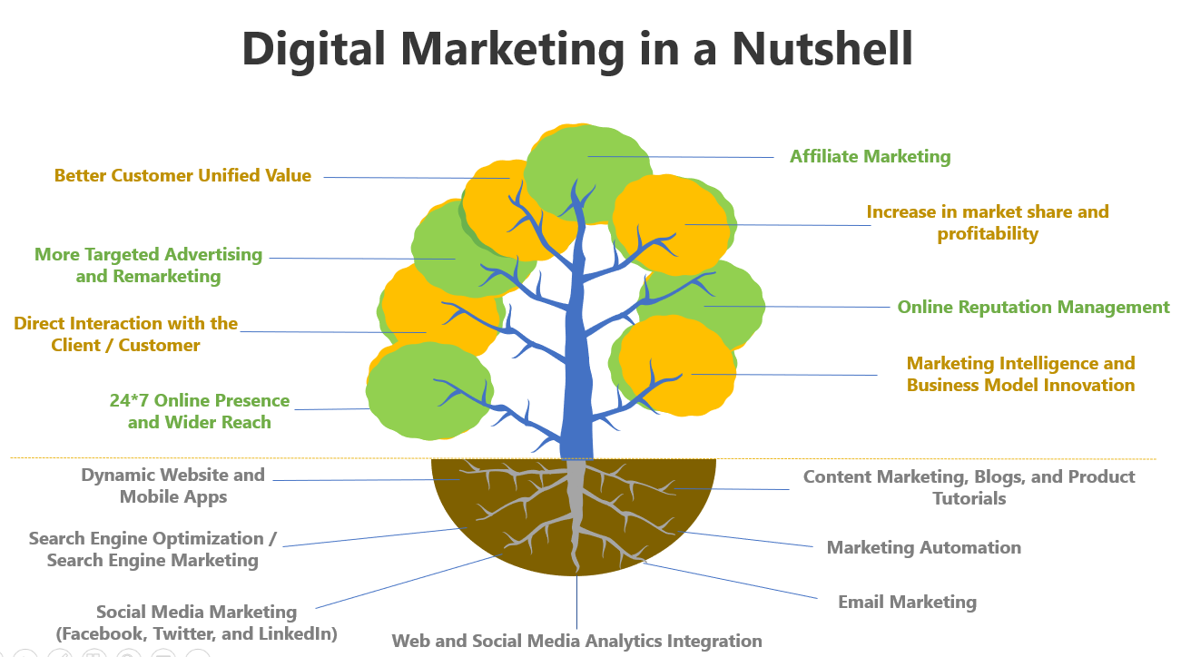
Digital Marketing in a Nutshell

Slide 4
Do All Industry Have Similar Setup?

Slide 5
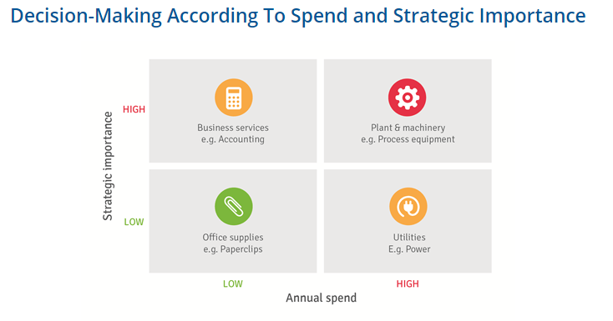
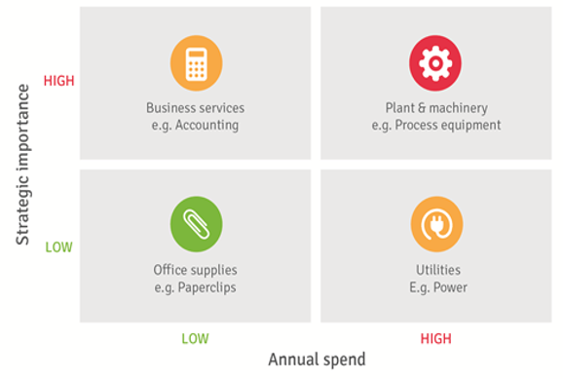

Slide 6
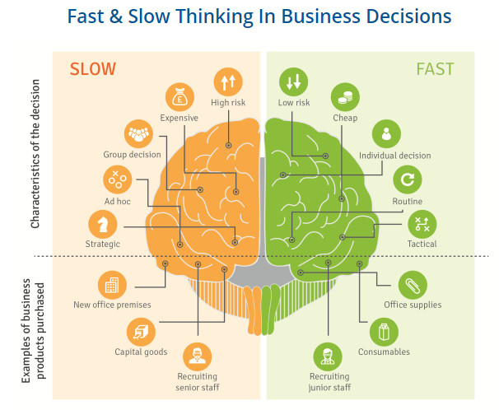

Slide 7
Should a single-use pen manufacturing firm with a margin of 2% invest in expansive CRM software?

Slide 8
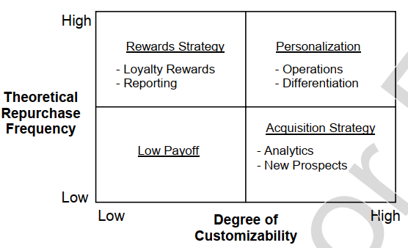

Slide 9
Blue Stationary Pens
Budget Homes / Apartments
Customized Stationary Pens
Premium Apartments
Green / Red Stationary Pens
Pradhan Mantri Awas Yojana
Customized Limited-edition Pens
Luxury Villas

Slide 14
Phases
Need recognition
Discovery
Consideration
Action
Advocacy
Customer thoughts & feelings
Customer actions
Touchpoints and platforms
Role of commn.
KPIs

Slide 15







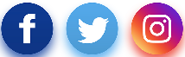

Phases
Need recognition
Discovery
Consideration
Action
Advocacy
If I subscribe, I am not bound by anything. I can let it go anytime?
Second hand cars is a risk. God knows in what condition the car is. But I can save money.
If I have to buy a new car, the down payment is going to take a toll on me. Then the EMIs.
Subscription? How can I subscribe to a car. Complicated.
I will give subscription a shot. Let me see how it goes.
I have friends who think buying a car is the only option.
Having a car is convenient for long drives and weekend trips
But an owned car says a lot about the person.
I may save money through sharing. But is it safe?
Subscription is a new cool thing. Why own a car?
Customer thoughts & feelings
I can even look at pre-owned cars. My friend bought one.
Subscription looks expensive
How do I share if I want to?
I need a car in this city.
My wife can also use it
Check out specs like mileage, power
Make a booking on the app
Extending subscription
Refer friends
Online search for the latest models
Driving classes, refresher courses
Online search for subscription, reviews
Visit the XXX website, download the app
Explore the sharing option on the app
Customer actions
Journey
starts
Look at pre-owned car websites
EMI calculation online, talk to the bank for loan
Read reviews
Visit second hand outlets like True Value
Comparing subscription charges with EMI
Test drive a preferred model
Touchpoints and platforms
Online test drive booking, car dealer outlets
Blogs on subscription, influencers on social
Referral
Customer care
Customer care
Role of commn.
Build emotional brand associations
Make XXX an option that’s more rewarding than ownership
Support and guidance
Promote referrals
KPIs
Brand awareness, search volume, website visits, fun and progressive brand imagery
Search volume, website visits, app download, conversion rate
Net Promoter Scores,
positive sentiment online
Number of referrals, conversion rate

Slide 16
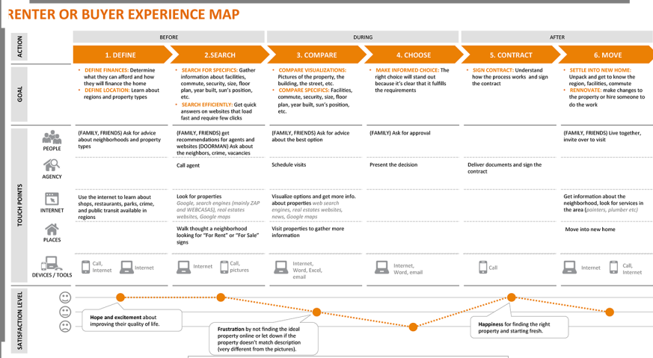

Slide 17
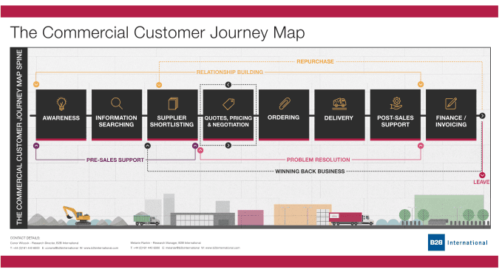

Slide 18
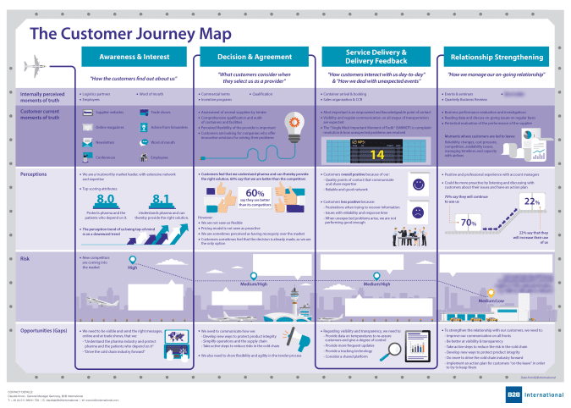

Slide 19
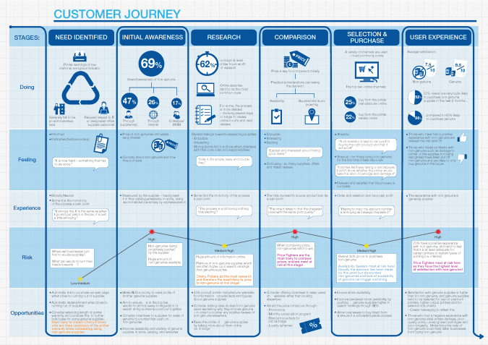

Slide 20
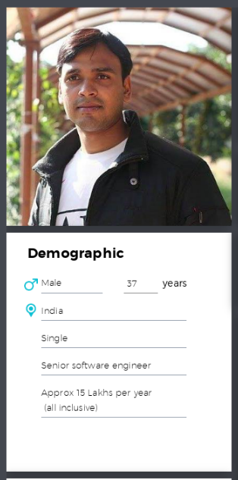
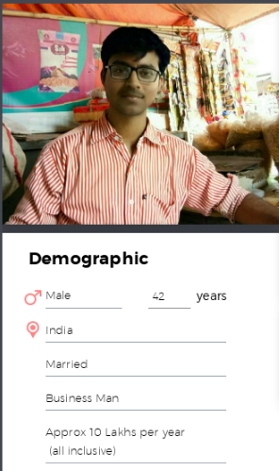
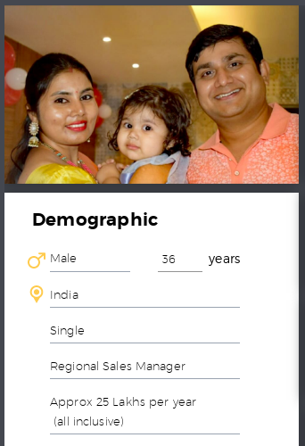

Ritesh Tiwari
Anand Keshri
Ajay Mishra

Slide 21
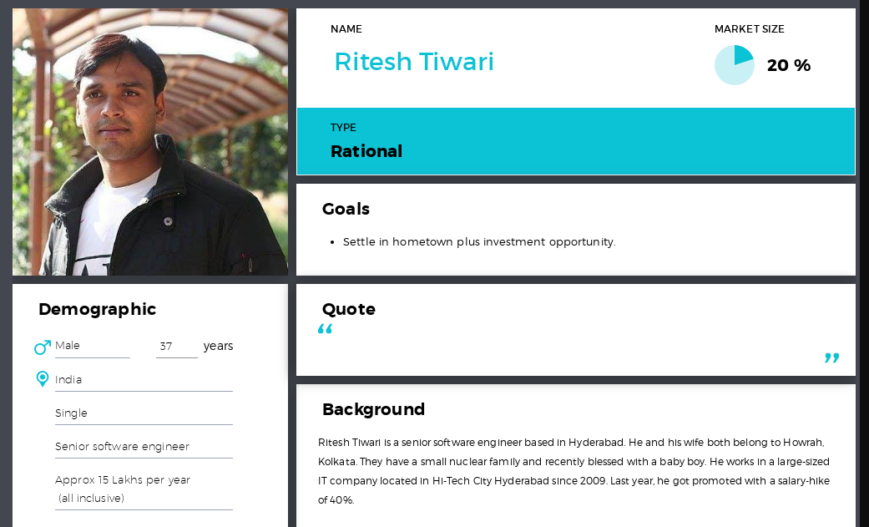
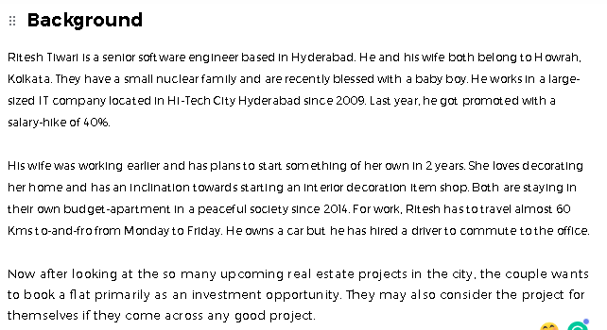

Slide 22
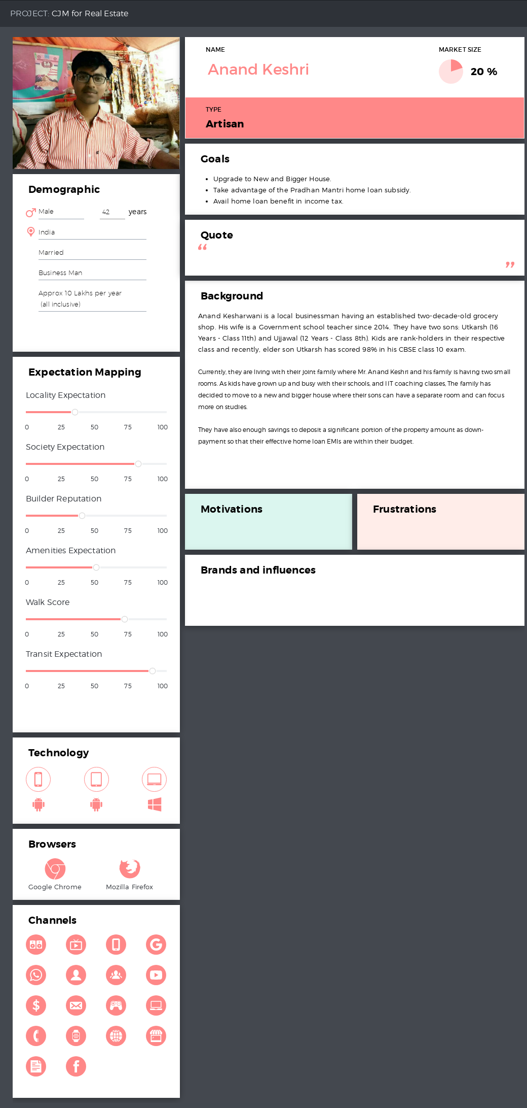

Slide 23
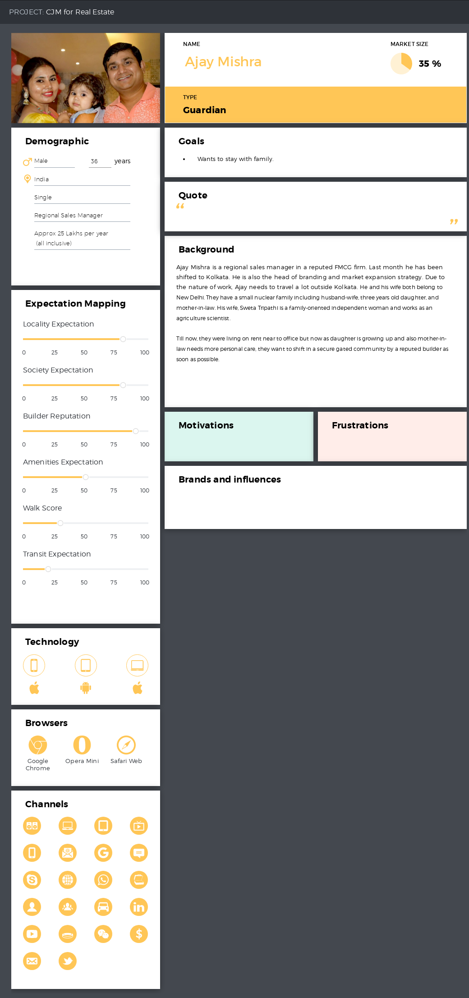

Slide 25
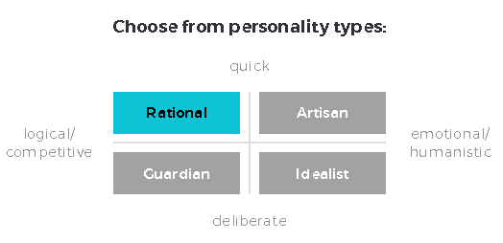

Slide 27
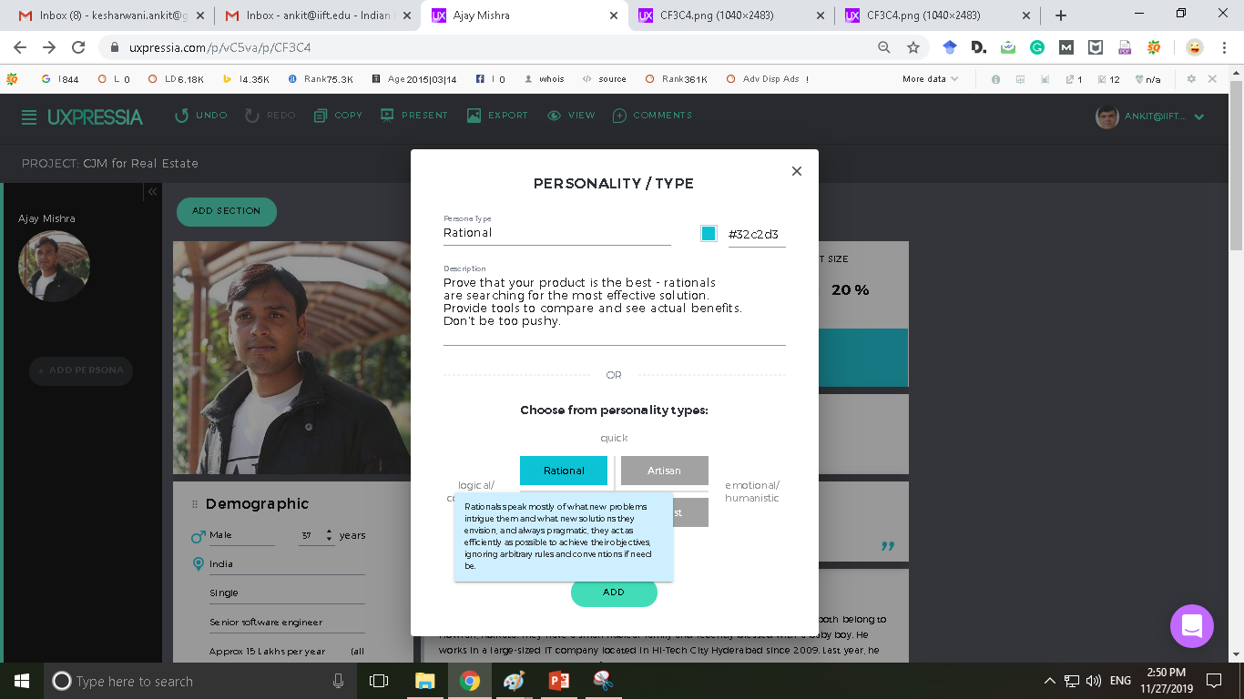
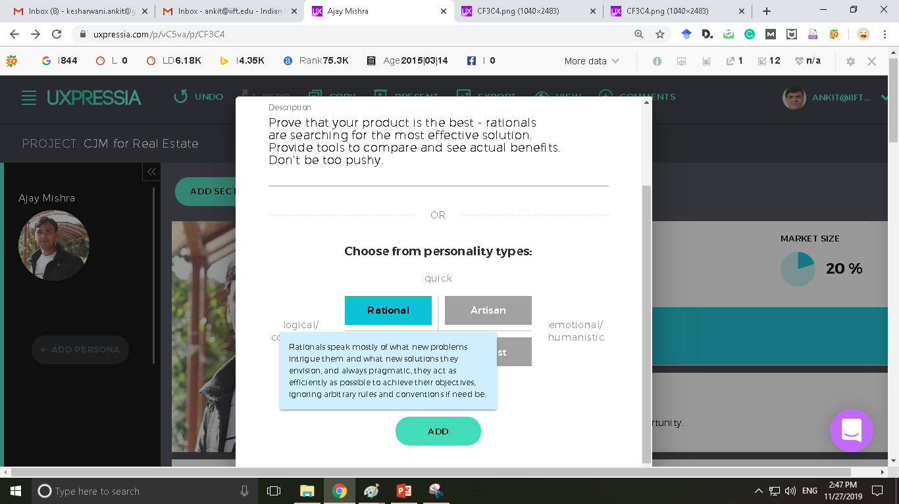

Slide 28
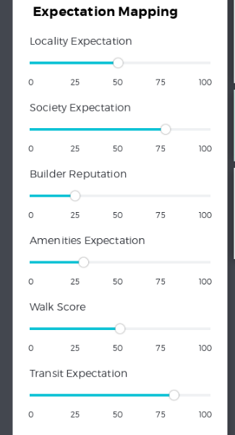
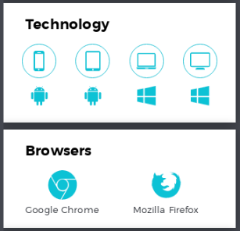

Slide 29
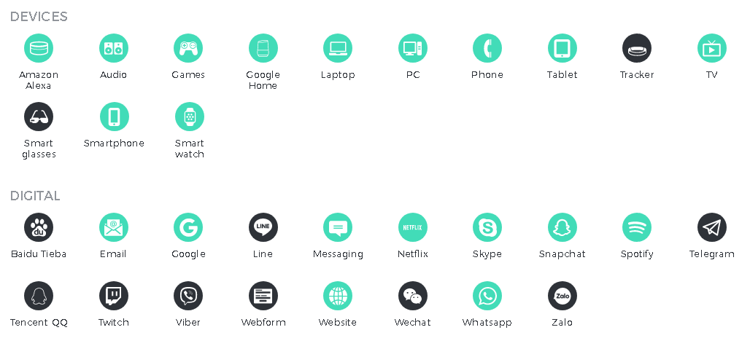
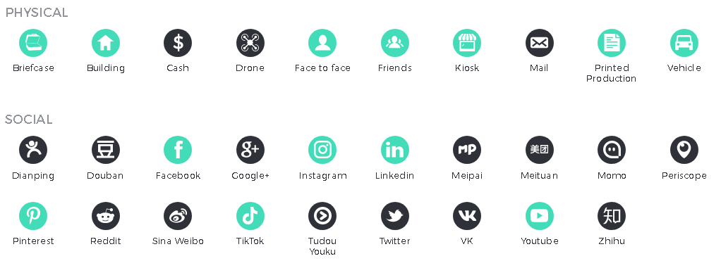

Slide 31
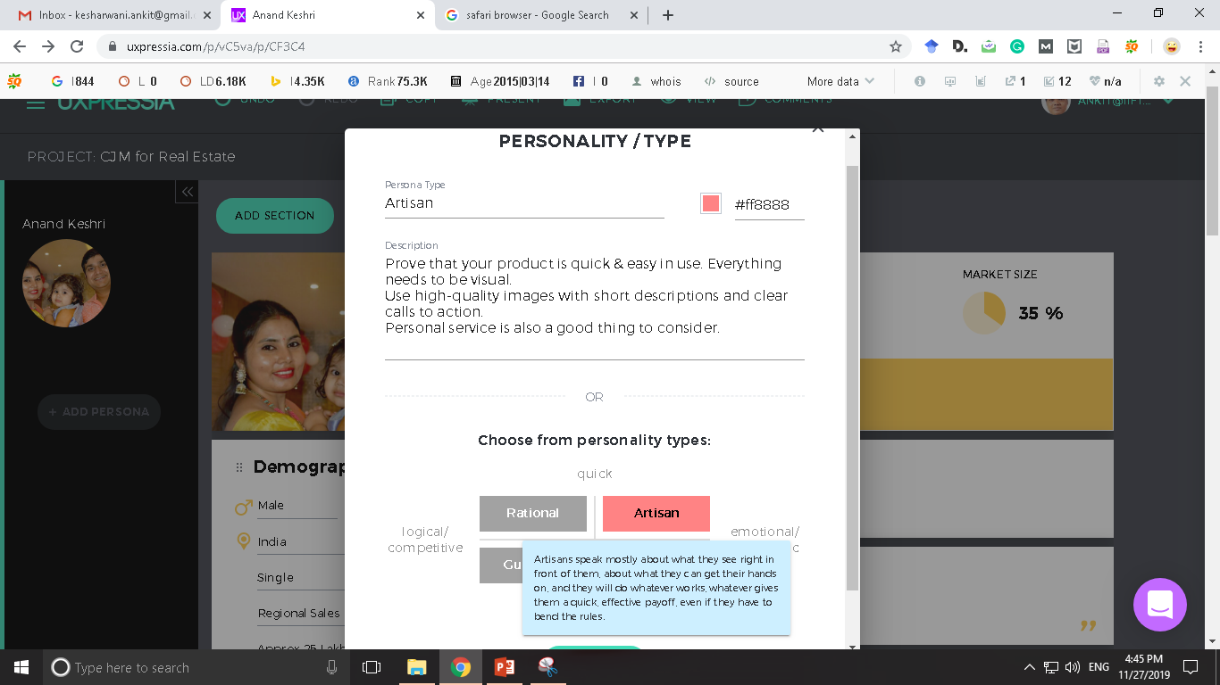

Slide 32
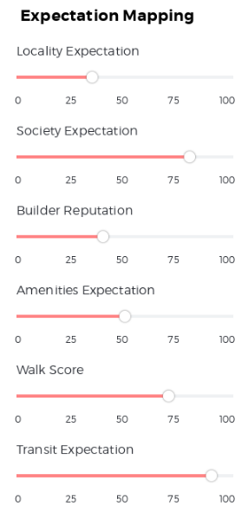
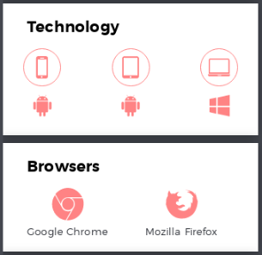

Slide 33
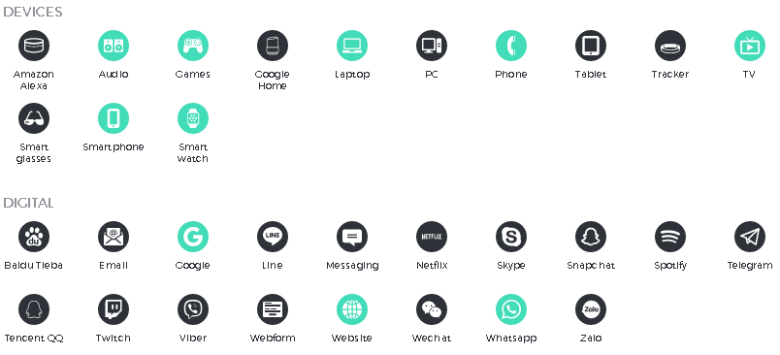
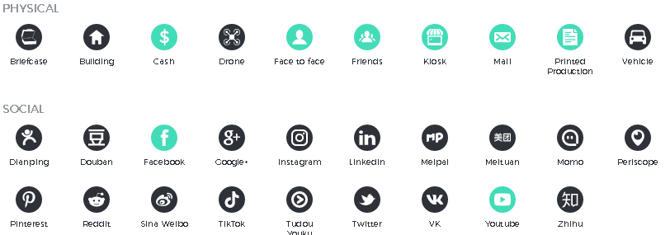

Slide 35
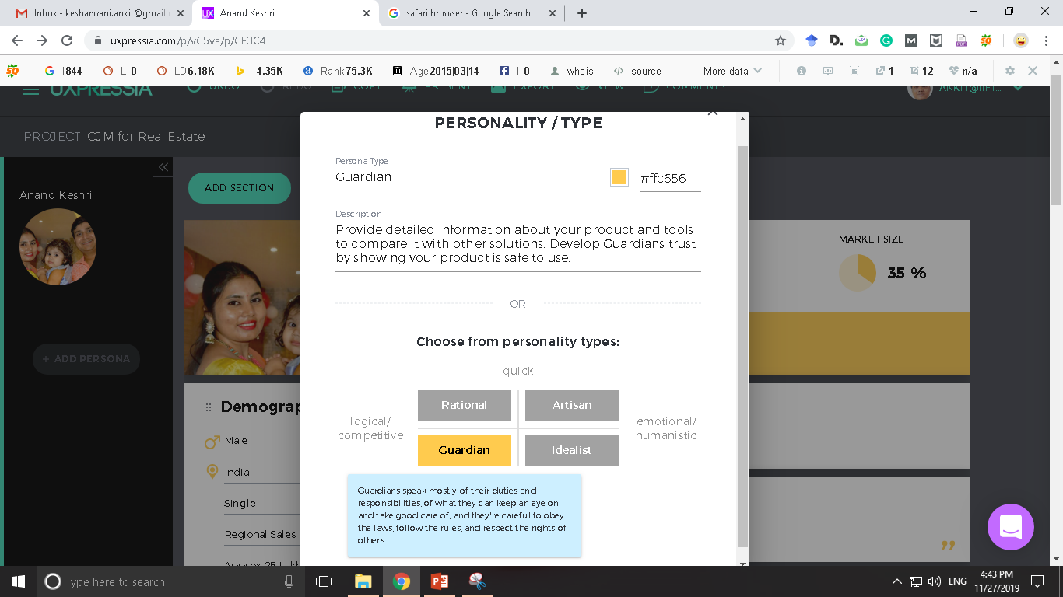

Slide 36
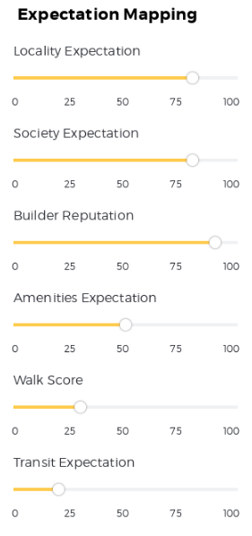
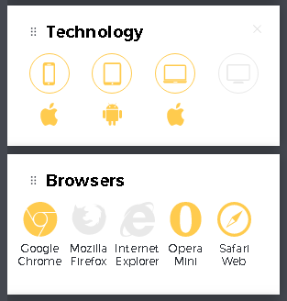

Slide 37
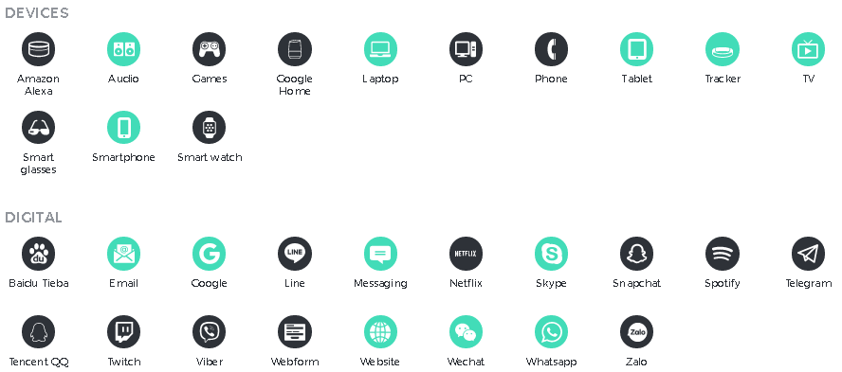
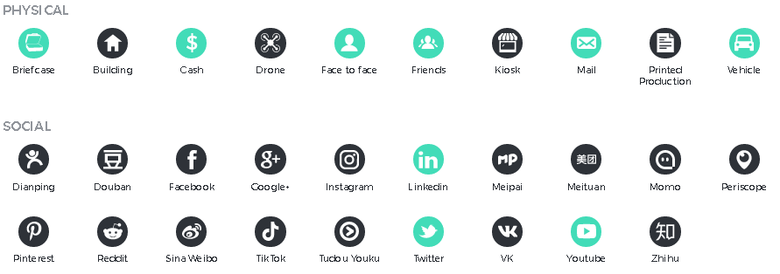

Slide 38


Slide 39
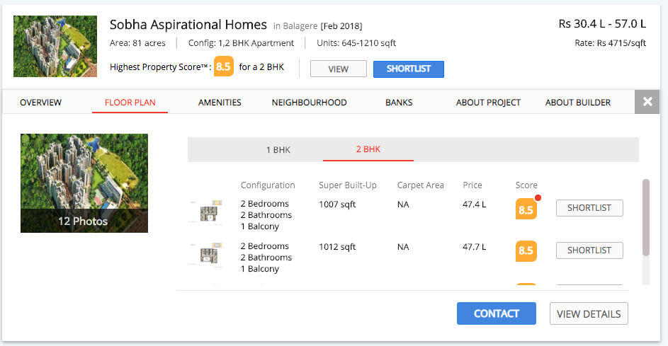

Slide 40
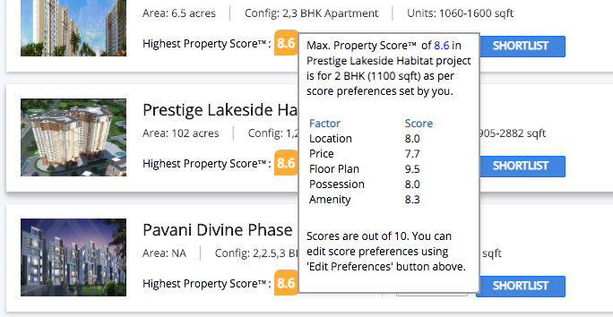

Slide 41
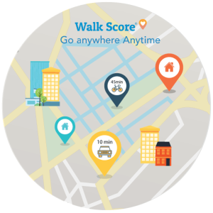
https://www.usabilitydynamics.com/product/wp-property-walkscore

Slide 42
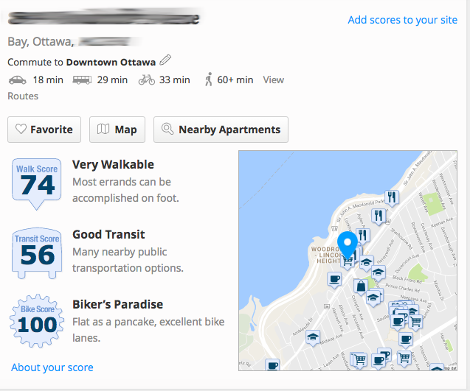

Slide 43
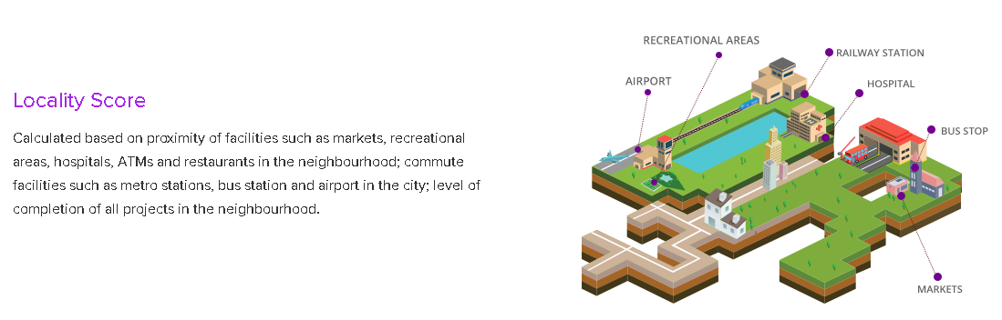
https://www.proptiger.com/buzz/livability-score

Slide 44
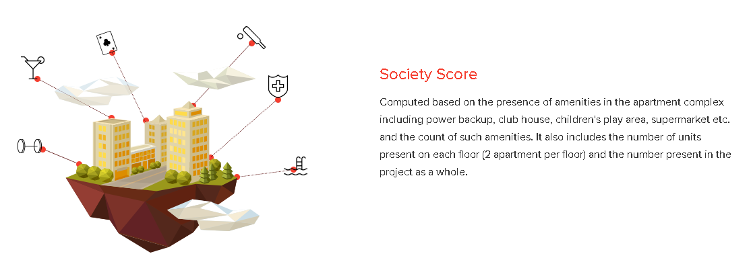
https://www.proptiger.com/buzz/livability-score

Slide 45
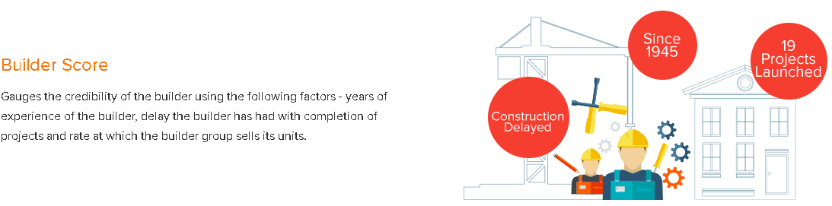
https://www.proptiger.com/buzz/livability-score

Slide 46

https://www.proptiger.com/buzz/livability-score

Slide 47


Slide 48
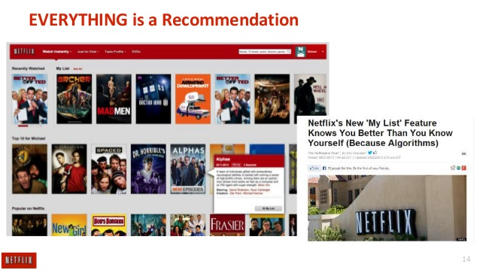

Slide 49
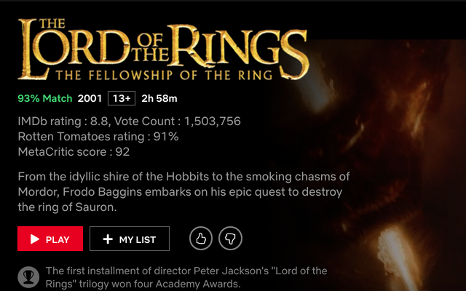

Slide 50
Lessons from Netflix
Just like “NETFLIX RECOMMENDATION ALGORITHM”, serve customized results based on “LIFESTYLE MATCH SCORE”.
This score should reflect the potential property types that potential buyer is ACTUALLY looking for.
Even the IMAGES being served along with the search result should be guided by the ALGORITHM which matches with the buyer’s decision-making criteria.

Slide 51
Ajay Mishra
Anand Keshri
Ritesh Tiwari

Slide 52
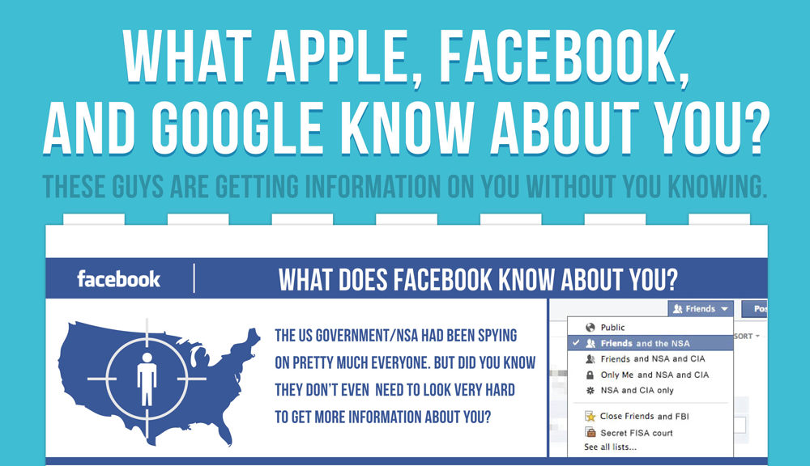

Slide 53
Are you ready? Here is all the data Facebook and Google have on you
https://www.theguardian.com/commentisfree/2018/mar/28/all-the-data-facebook-google-has-on-you-privacy
https://tinyurl.com/GoogleMyActivities

Slide 54
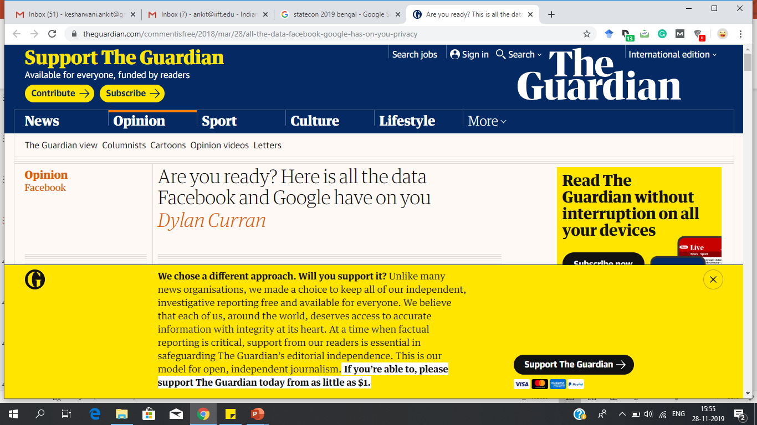

Slide 55
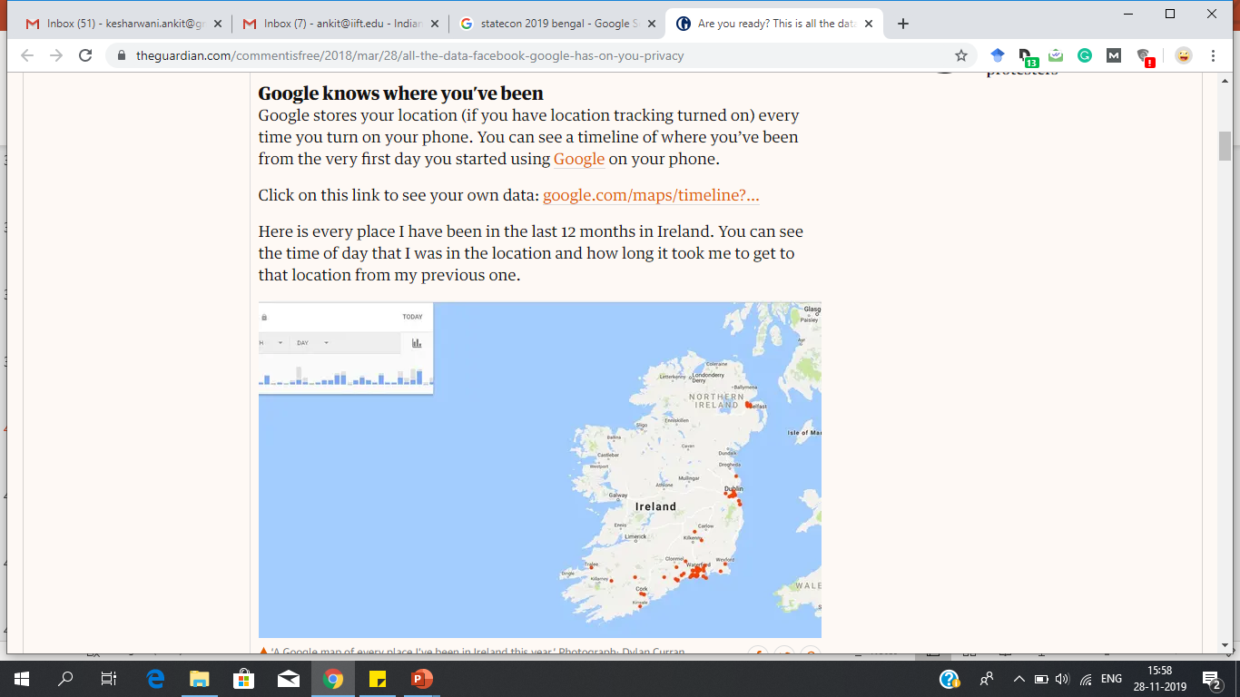

Slide 56
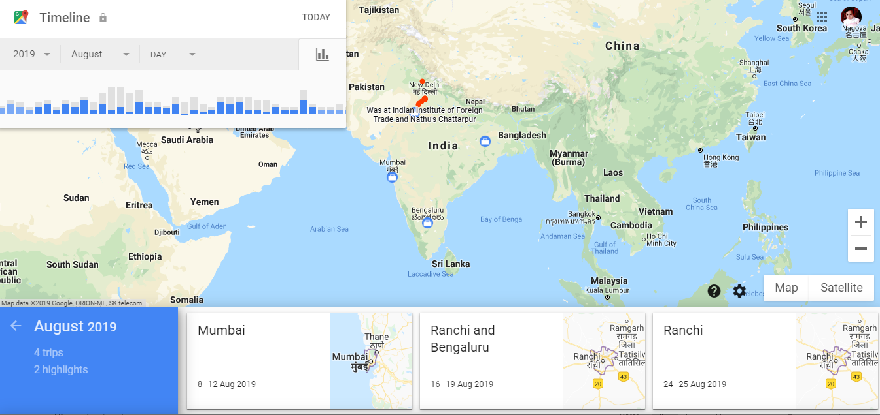

Slide 57
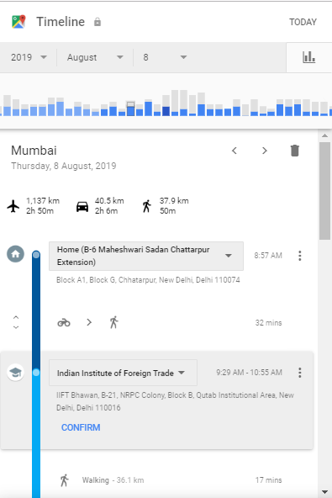
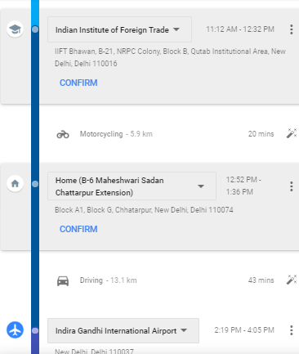
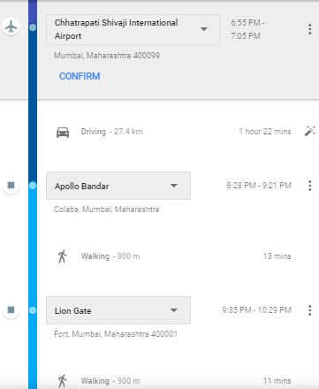

Slide 58


Slide 59


Slide 60


Slide 61


Slide 62


Slide 63


Slide 64


Slide 65


Slide 66


Slide 67



Slide 68


Heat Maps – All Touch Points

Slide 69


Slide 70


Slide 71


Slide 72


Slide 73


Slide 74


Slide 75


Slide 76


Slide 77



Suggestions
Make short-movies which revolves around your core product / brands.
Make series of videos to bust the myths of the real estate industry. E.g. How to identify a RERA certified builder? How to approach concerned authorities about any help?
Can also used as a platform to address various issues which may delay / defer their buying decision.

Slide 78


Slide 79


Slide 80

Tools for Customer Engagement

Slide 81


Slide 82


Slide 83


Slide 84


Slide 85


Slide 86


Slide 87


Slide 88
Top Management Dilemma?
Is the number of social media followers has an effect on stock prices of publicly traded companies?
Do social media followers have a positive association with shares prices?

Slide 89


Slide 90


Slide 91


Slide 92


Slide 93


Slide 94


Slide 95


Slide 97


Slide 102


