Slide 1
CNN

Slide 2
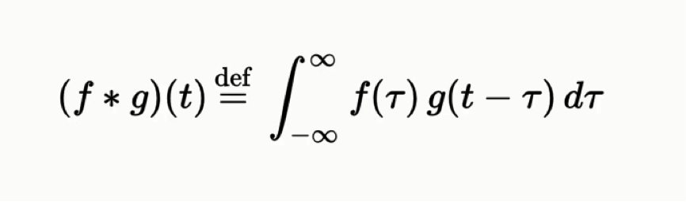
Convolutional Neural Network (CNN or ConvNet)
convolution is a function derived from two given functions by integration which expresses how the shape of one is modified by the other.
It is both the result function and to the process of computing it.

Slide 3
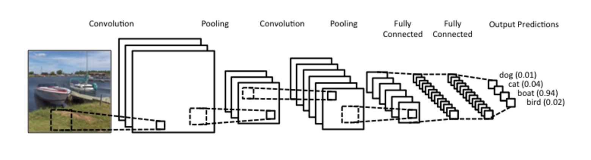

Slide 4
Convolution process
There is a feature detector or filter.
This filter detects edges or specific shapes.
Filter is placed top left of image and multiplied with value on same indices.
After that all results are summed and this result is written to output matrix.
Then filter slips to right to do this whole processes again and again.
Usually filter slips one by one but it can be change according to your model and this slipping process is called ‘stride’. Bigger stride means smaller output. Sometimes stride value is increased to decrease output size and time.

Slide 5
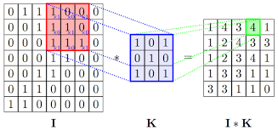

Slide 6
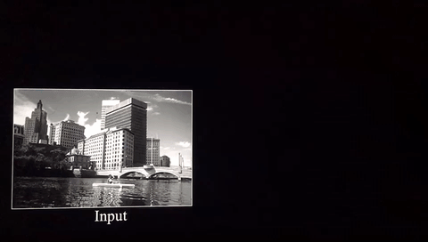

Slide 7
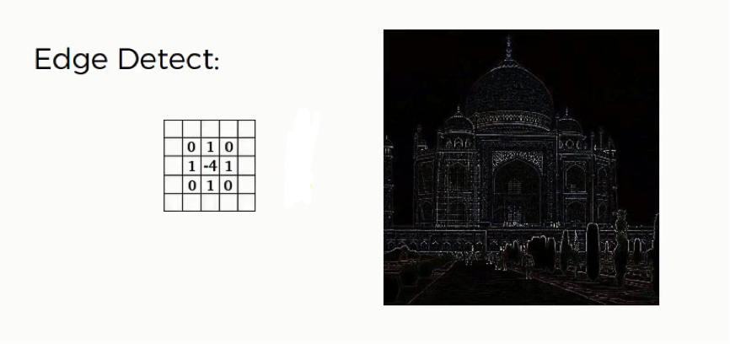
@SuperDataScience Team

Slide 8
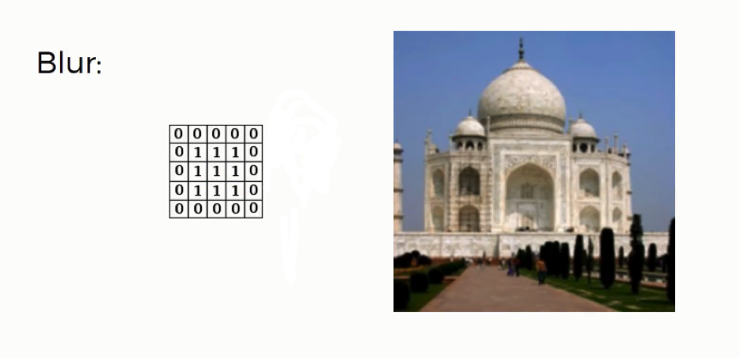
@SuperDataScience Team

Slide 9
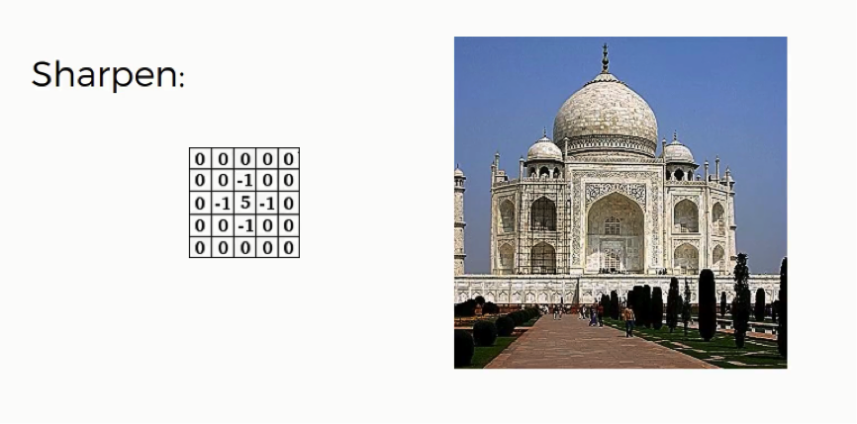
@SuperDataScience Team

Slide 10
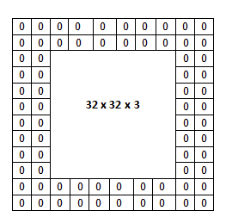
Padding is done to preserve input size.

Slide 11
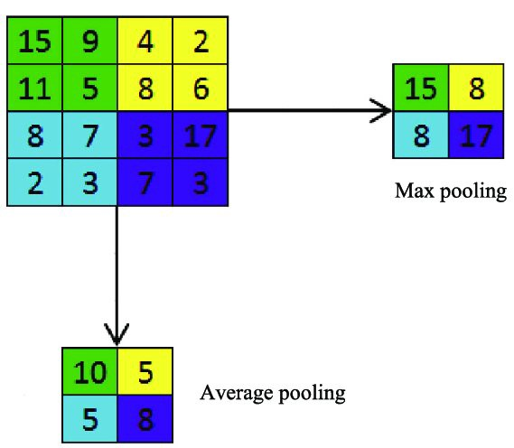
Pooling
This layer is used for reducing parameters and computing process.
summarizes the features present in a region of the feature map generated by a convolution layer.
adds a small amount of translation invariance

Slide 12
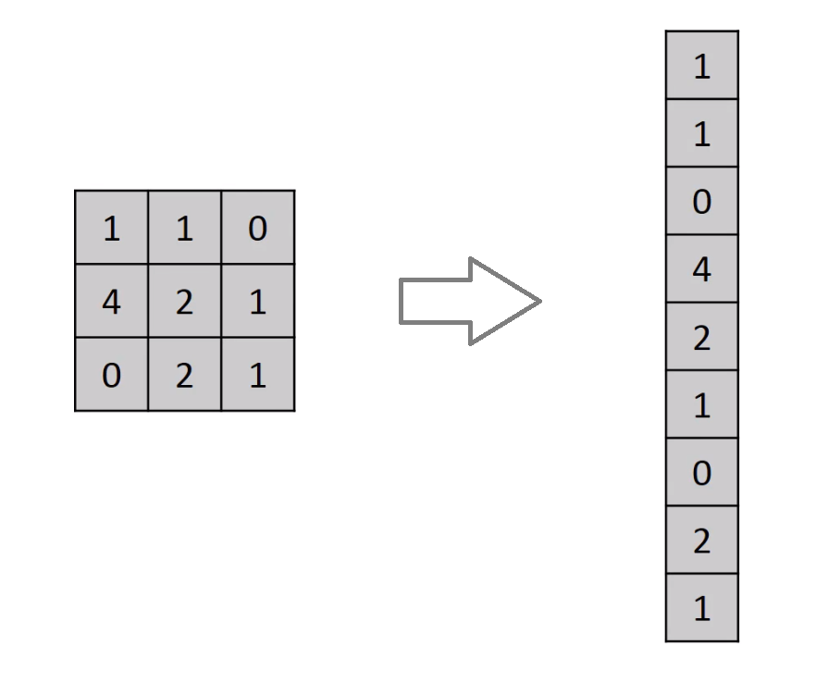
Flattening
flattening is taking matrix that came from convolutional and pooling processes and turn it into one dimensional array
because input of fully-connected layer of ANN
consist of one dimensional array

Slide 13
Let’s build our first CNN based classification

Slide 14
# explore image as series of numbers
CV_0

