Slide 1
The Capital Asset Pricing Model

Slide 2
Capital Asset Pricing Model (CAPM)
It is the equilibrium model that underlies all modern financial theory
The model gives us a precise prediction of the relationship that we should observe between the risk of an asset and its expected return.
Derived using principles of diversification with simplified assumptions
Markowitz, Sharpe, Lintner and Mossin are researchers credited with its development

Slide 3
Assumptions
Investors optimize portfolios a la Markowitz
Investors use identical input list for efficient frontier
Same risk-free rate, tangent CAL and risky portfolio
Market portfolio is aggregation of all risky portfolios and has same weights

Slide 4
Resulting Equilibrium Conditions
All investors will hold the same portfolio for risky assets – market portfolio
Market portfolio contains all securities and the proportion of each security is its market value as a percentage of total market value

Slide 5
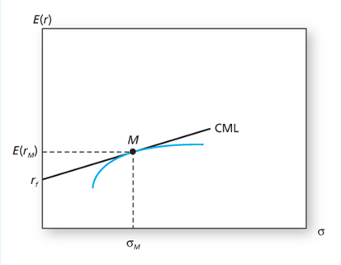
The Efficient Frontier and the Capital Market Line

Slide 6
Market Portfolio
When we aggregate, the portfolios of all individual investors, lending and borrowing will cancel out (because each lender has a corresponding borrower), and the value of the aggregate risky portfolio will equal the entire wealth of the economy.
This is the market portfolio, M.
The proportion of each stock in this portfolio equals the market value of the stock divided by the sum of market value of all stocks.
If the weight of GE stock, in each common risky portfolio is 1%, then GE also will constitute 1% of the market portfolio.

Slide 7
Return and Risk For Individual Securities
The risk premium on individual securities is a function of the individual security’s contribution to the risk of the market portfolio.
An individual security’s risk premium is a function of the covariance of returns with the assets that make up the market portfolio.

Slide 8

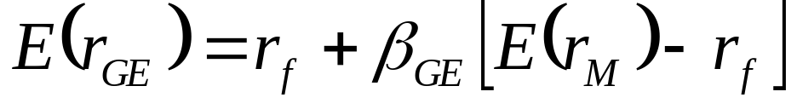
GE Example
The risk premium for GE:
Restating, we obtain:

Slide 9
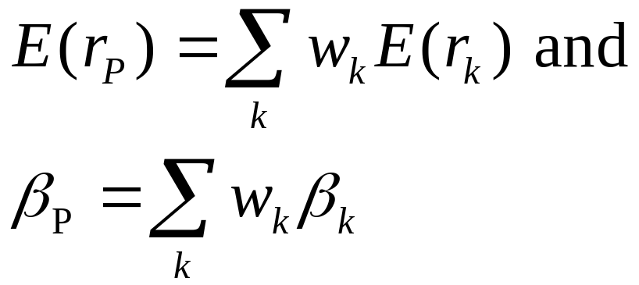
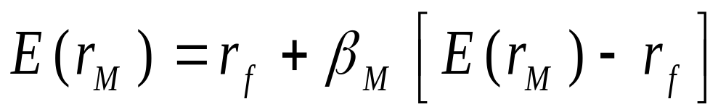
Expected Return-Beta Relationship
CAPM holds for the overall portfolio because:
This also holds for the market portfolio:

Slide 10
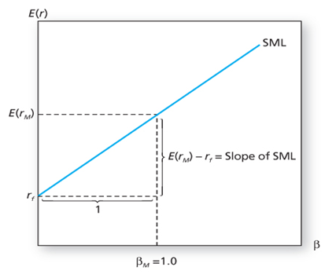
The Security Market Line

Slide 11
The Security Market Line
SML provides a benchmark for the evaluation of the investment performance.
Given the risk of an investment, as measured by its beta, the SML provides the required rate of return necessary to compensate investors
“Fairly priced” assets plot exactly on the SML – their expected returns are commensurate with their risk
All securities must lie on the SML in market equilibrium
If a stock is perceived to be a good buy, or under-priced, it will provide an expected return in excess of the fair return stipulated by the SML.

Slide 12
Example
The difference between the fair and actually expected rates of return on a stock is called the stock’s alpha
If the market return is expected to be 14%, a stock has a beta of 1.2 and the T-bill rate is 6%, the SML would predict an expected return on the stock of
6 + 1.2 (14-6) = 15.6%
If one believed the stock would provide an expected return of 17%, the implied alpha would be 1.4%

Slide 13
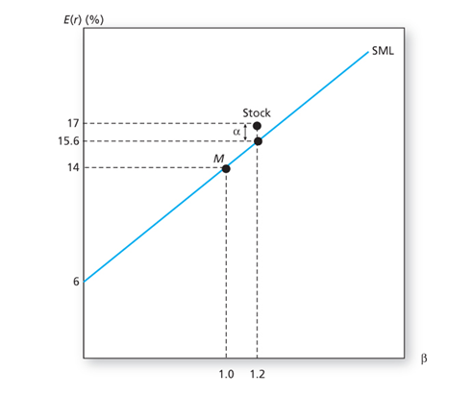
The SML and a Positive-Alpha Stock

Slide 14
The key implications of CAPM
1. The market portfolio is efficient
2. The risk premium on a risky asset is proportional to its beta

Slide 15
Assumptions of the CAPM
Individuals
  Investors are rational, mean-variance optimizers
  Their planning horizon is a single period
  Investors have homogeneous expectations (identical input lists)
Markets
  All assets are publicly held and trade on public exchanges, short positions are allowed, and investors can borrow or lend at a common risk-free rate
  All information is available
  No taxes
  No transaction costs

Slide 16
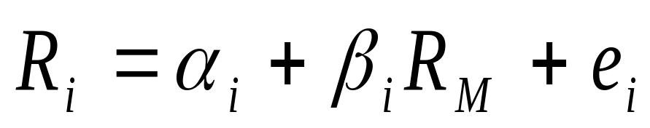
Single-Index Model and Realized Returns
To move from expected to realized returns, use the index model in excess return form:
The index model beta coefficient is the same as the beta of the CAPM expected return-beta relationship

Slide 17
CAPM and World
Academic world
  Cannot observe all tradable assets
  Impossible to pin down market portfolio
  Attempts to validate using regression analysis
Investment Industry
  Relies on the single-index CAPM model
  Most investors don’t beat the index portfolio

Slide 18
Fama-French Three-Factor Model
SMB = Small Minus Big (firm size)
HML = High Minus Low (book-to-market ratio)

Slide 19
Factor Investing
An investment approach that involves targeting specific drivers of return across asset classes.
There are two main types of factors
Macroeconomic factors
  capture broad risks across asset classes
Style factors
  explain returns and risk within asset classes
Investing in factors can help improve portfolio outcomes, reduce volatility and enhance diversification.

Slide 20
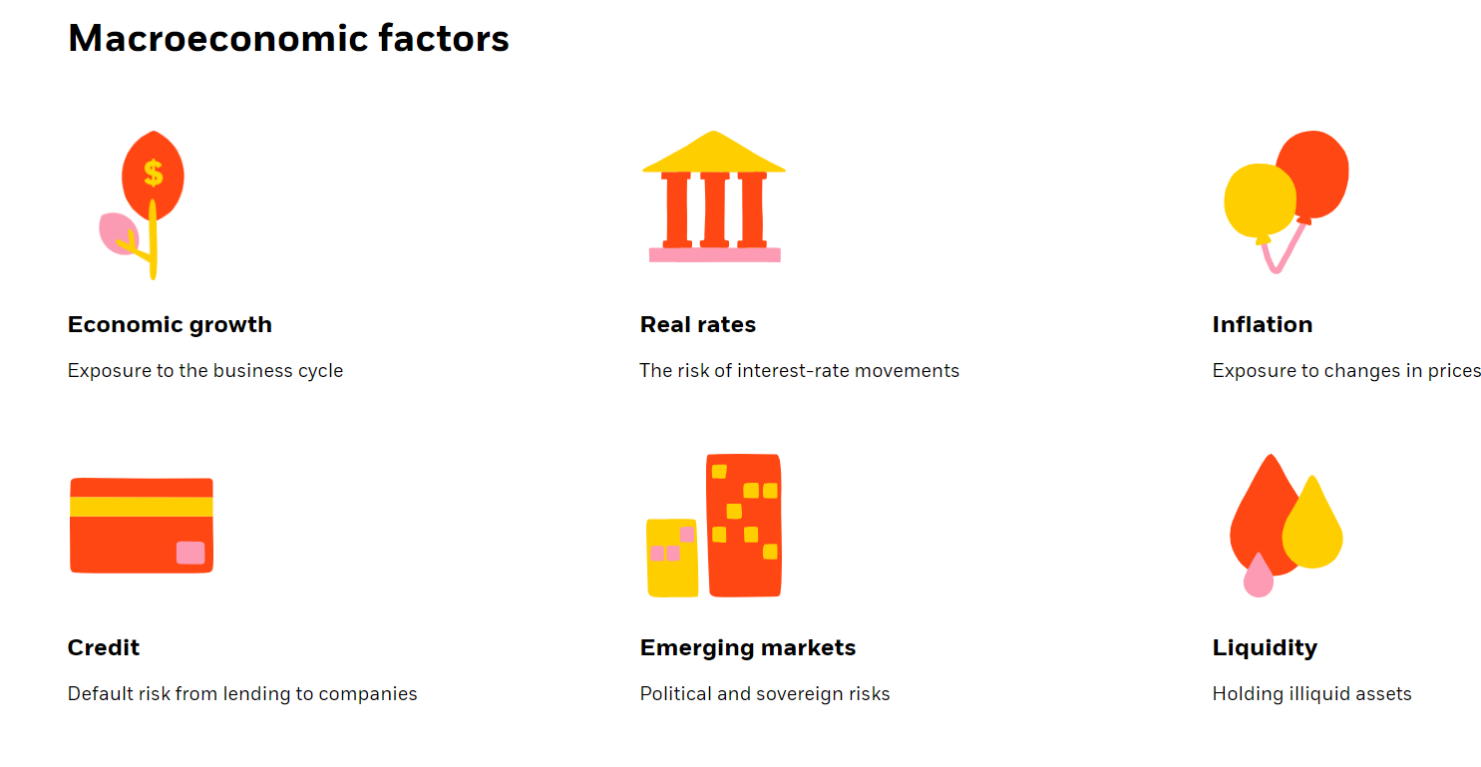

Slide 21
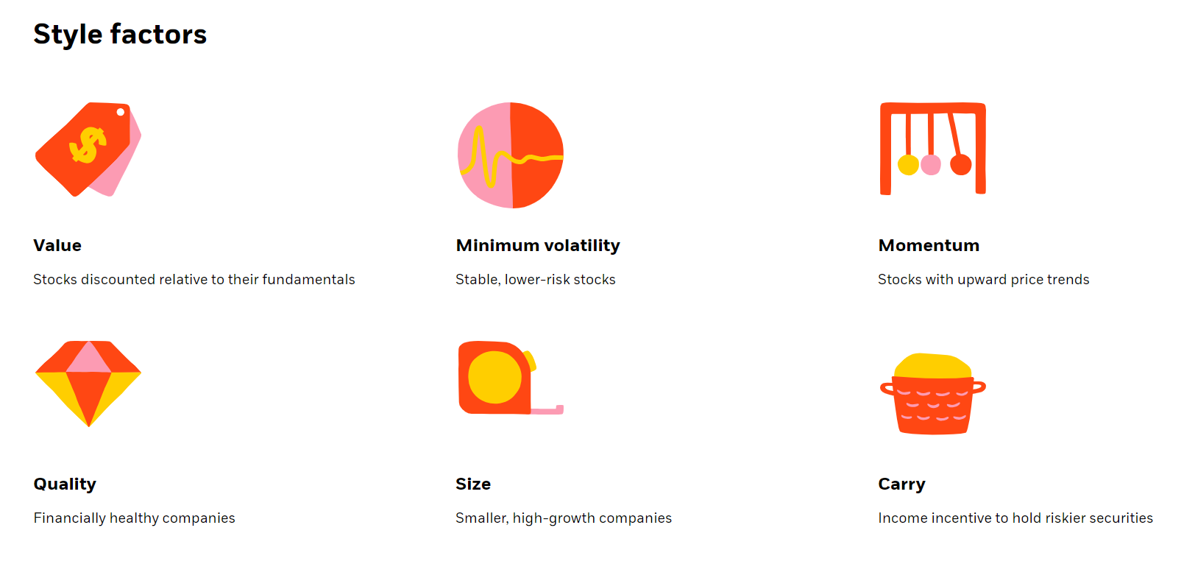

Slide 22
Problems
1. What must be the beta of a portfolio with expected return of 18%, if risk-free rate is 6% and expected market return is 14%?
2. The data on two companies are given below. The T-bill rate is 4% and market risk premium is 6%
What would be the fair return for each company, according to CAPM?
Company | A | B
Forecasted return | 12% | 11%
Std Deviation | 8% | 10%
Beta | 1.5 | 1

