Slide 1
BUSINESS LEADERSHIP VII
SPHRi

Slide 2
Strategic Human Resources
HR Roles and Responsibilities
HR Organization
HR in M&A
HR in Merging Culture
HR Competencies

Slide 3
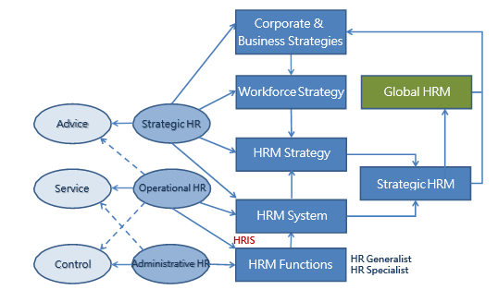
HR Roles and Responsibilities

Slide 4
Modern HR roles
Strategic partners – we are thinking long term business goals
Operational – We cannot be strategic unless we understand the operational side of HR
Administrative – We still do paper work. We monitor payroll, employee records
We are part of business plan and try to achieve the organisation’s operational goals

Slide 5
HR Roles
Strategic Partner with Functional Management
  Advisory, Service and Control (Traditional)
  Strategic, Operational, Administrative (Modern)
Performance Support
Ethics Officer/Ombudsman
Communication Officer
“Keeper of the files”

Slide 6
HR as Advisory role
HR gives advice about :
  How to train
  How to lead
  How to hire
  How to follow company procedure

Slide 7
Service
We serve the needs of workers and company
We help operations in terms of what they need to accomplish
We are support function
We are cost centers

Slide 8
Control
We enforce policy procedure
We are controlling in the past

Slide 9
Performance Support
It is getting done more with less.
Performance Management
  Discipline
  Counselling
  Training
  Professional Development

Slide 10
Performance Management
Communicate our expectations to work
Prepare them with training to do the job
Follow up through – to ensure they are doing what they are told to do.
We train managers and supervisors on how to get more out of people.

Slide 11
Ethics officer /Ombudsman
HR is in charge of ethics in the organisation
Ethical practices is different from culture to culture
Code of ethics -
You do not act in a selfish manner or do things to enrich yourself
Ethics when applied for organisation depends on organisation

Slide 12
Ombudsman
It is a neutral third party
Investigations of any wrong doing
Impartial and evaluates the situation based in merits

Slide 13
Compliance Officer
Knowing local rules
If the company has any problems work with government officials
Working with lawyers and government officials to solve the issue.

Slide 14
Communications
Communicate “what's going on”
HR delivers the news

Slide 15
Strategic Human Resources
HR Roles and Responsibilities
HR Organization
HR in M&A
HR in Merging Culture
HR Competencies

Slide 16
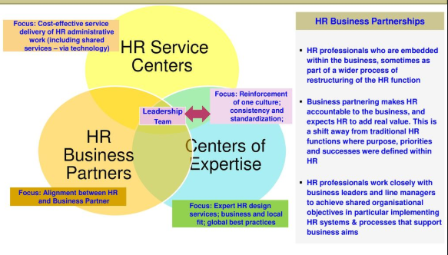
HR models

Slide 17
HR models
Centers of expertise or excellence. HR specialists in areas such as staffing, compensation, training, benefits and labor relations, all offering services companywide to executives in business units on request.
Service centers. A central unit for HR-related administrative and transactional tasks that employees, retirees and business-unit managers access through online portals and phones.

Slide 18
HR models
Business partners. HR staff members who work directly with business-unit managers in strategic roles. For example, they might discuss and create succession plans and compensation programs with business unit leaders.

Slide 19
Strategic Human Resources
HR Roles and Responsibilities
HR Organization
HR in M&A
HR in Merging Culture
HR Competencies

Slide 20
Mergers and Acquisitions
Mergers and acquisitions (M&A) is the dominant mode of growth for firms seeking competitive advantage in an increasingly complex and global business economy.

Slide 21

Global M&A

Slide 22
Overcapacity M&A
It occurs when an acquiring company seeks to eliminate excess capacity to create a more efficient corporation. In effect, the acquiring company’s strategic goal is to achieve economies of scale in order to gain market share, doing so in part by eliminating human resources
For example :
1. British Petroleum’s acquisition of Amoco
2. Daimler’s acquisition of Chrysler

Slide 23
Geographic roll-up M&A
It takes place when companies seek to expand geographically, often with operating units remaining at the local level.
In many instances, large companies acquire smaller companies that they try to keep intact and therefore these firms tend to retain local managers.
These types of M&As are common in the banking sector

Slide 24
Product or market extension M&A
It involves expanding product lines or expanding geographically across borders. This type of M&A occurs
  when the acquiring and acquired companies are functionally related in production and/or distribution but sell products that do not compete directly with one another
  when a company seeks to diversify geographically, such as when two companies manufacture the same product, yet sell it in different markets.
In effect, in this type of M&A, firms seek to achieve long-term strategic goals by investing in less saturated markets – often doing so to obtain economies of scale necessary for global competition.

Slide 25
M&A as a substitute for R&D
It occurs when acquisitions are used as a means of gaining access to new R&D knowledge or technological capabilities by acquiring innovative firms rather than producing the knowledge in-house. Acquiring firms in this type of M&A tend to be larger than the acquired firm, and sometimes have significant practical merger.

Slide 26

M&A Process

Slide 27

Phases of Merger

Slide 28

HR Due Diligence

Slide 29
Strategic Human Resources
HR Roles and Responsibilities
HR Organization
HR in M&A
HR in Merging Culture
HR Transformation

Slide 30

Merging Cultures

Slide 31
Hostile Takeover
When one company takes over another company and the second company which was acquired is fighting and resisting the first company.
Example : AOL and Time Warner,
L&T and Mindtree

Slide 32
Joint Ventures
The companies decide to partner up together or work together on a project
Neither of them are selling stock to one another.
They are not permanent partners owning each other like M&A.
They may share revenue, they may share costs for that project.
They are not losing their individual corporate identities

Slide 33
Strategic Human Resources
HR Roles and Responsibilities
HR Organization
HR in M&A
HR in Merging Culture
HR Competencies

Slide 34
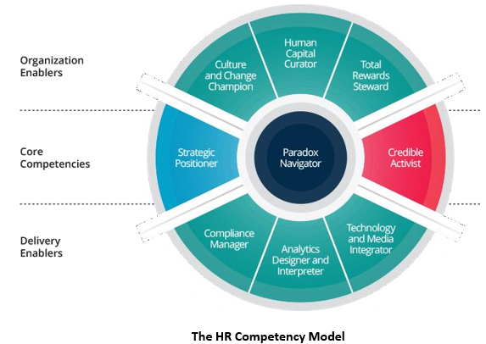
HR competency model

Slide 35
Questions

