Slide 1
BUSINESS LEADERSHIP VI
SPHRi

Slide 2
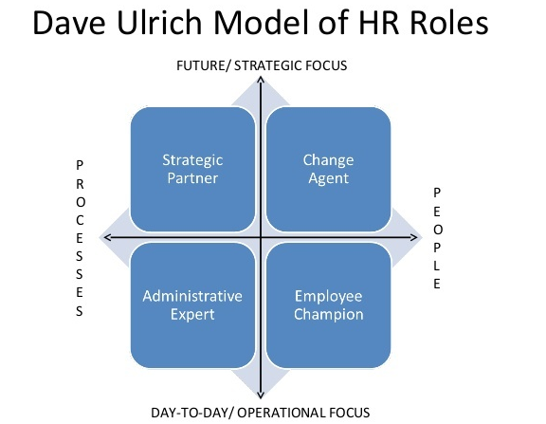
HR Competency Model

Slide 3

2012 HR competency model

Slide 4
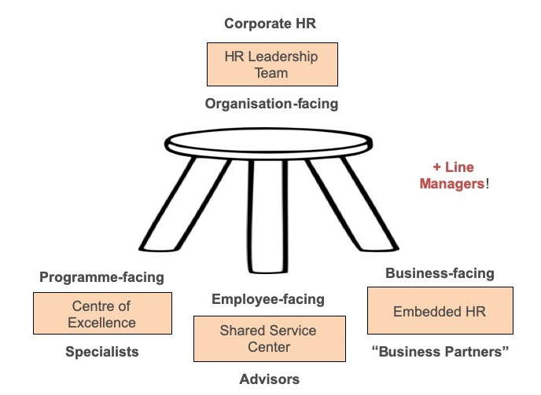
Ulrich Three legged model

Slide 5
Ulrich Three Legged Model
David Ulrich suggested that in large organizations, the (previously integrated) HR function should be divided into three segments.
Shared service activities should be concentrated in a call-centre with supporting intranet to provide administrative and basic support functions to the remainder of the business.
Business partners, in contrast, are individuals or small teams who work closely with the managers of business units on key initiatives and change management.
Centres of expertise exist as repositories of key technical knowledge on resourcing, reward, employment relations, etc. and can develop policy while providing support to business units and to shared services. At the apex of the three-legged model, according to Ulrich, should be a small, corporate HR team that is responsible for the function as a whole and provides strategic direction

Slide 6

Global M&A

Slide 7
Overcapacity M&A
Overcapacity M&A : It occurs when an acquiring company seeks to eliminate excess capacity to create a more efficient corporation. In effect, the acquiring company’s strategic goal is to achieve economies of scale in order to gain market share, doing so in part by eliminating human resources
For example :
1. British Petroleum’s acquisition of Amoco
2. Daimler’s acquisition of Chrysler

Slide 8
Geographic roll-up M&A
It takes place when companies seek to expand geographically, often with operating units remaining at the local level. In many instances, large companies acquire smaller companies that they try to keep intact and therefore these firms tend to retain local managers. These types of M&As are common in the banking sector

Slide 9
Product or market extension M&A
It involves expanding product lines or expanding geographically across borders. This type of M&A occurs when the acquiring and acquired companies are functionally related in production and/or distribution but sell products that do not compete directly with one another, or when a company seeks to diversify geographically, such as when two companies manufacture the same product, yet sell it in different markets. In effect, in this type of M&A, firms seek to achieve long-term strategic goals by investing in less saturated markets – often doing so to obtain economies of scale necessary for global competition.

Slide 10
M&A as a substitute for R&D
It occurs when acquisitions are used as a means of gaining access to new R&D knowledge or technological capabilities by acquiring innovative firms rather than producing the knowledge in-house. Acquiring firms in this type of M&A tend to be larger than the acquired firm, and sometimes have significant practical merger
Eg : Microsoft and Cisco Systems

Slide 11

M&A Process

Slide 12

Phases of Merger

Slide 13

HR Due Diligence

Slide 14

Merging Cultures

Slide 15

Merger, Acquistion and Takeover

Slide 16

Difference Merger and Acquisition

Slide 17
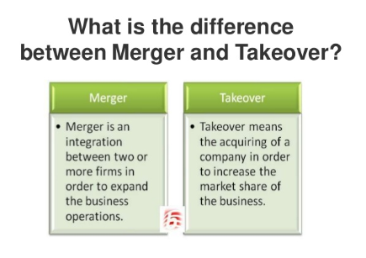
Difference Merger and Takeover

Slide 18

Motives of Mergers and Acquisition

Slide 19
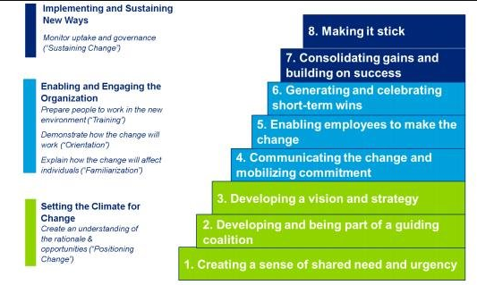
The 8-Step Process for Leading change – Dr. John Kotter

Slide 20

Star Technique

Slide 21

Star Method

Slide 22
Questions

