Slide 1
BUSINESS LEADERSHIP V
SPHRi

Slide 2
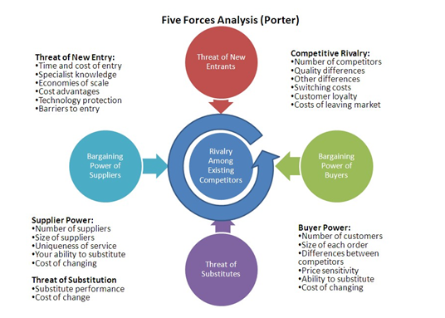
Porter’s Five Force Analysis

Slide 3

Five Force Model

Slide 4

Example of Five Forces

Slide 5
BCG Matrix
The BCG matrix also known as growth–share matrix ,the product portfolio matrix,Boston Box, Boston matrix, Boston Consulting Group analysis, portfolio diagram.
It was created by Bruce D. Henderson for the Boston Consulting Group in 1970 to help corporations to analyze their business units, that is, their product lines.
It helps the company allocate resources and is used as an analytical tool in brand marketing, product management, strategic management, and portfolio analysis
To be successful, a company should have a portfolio of products with different growth rates and different market shares. The portfolio composition is a function of the balance between cash flows. High growth products require cash inputs to grow. Low growth products should generate excess cash. Both kinds are needed simultaneously.—Bruce Henderson

Slide 6

BCG Matrix Grid

Slide 7

BCG Matrix table

Slide 8

BCG Matrix through Product Life cycle

Slide 9

BCG Matrix Example - Apple

Slide 10
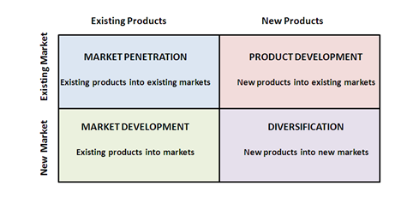
Ansoff Matrix Grid

Slide 11
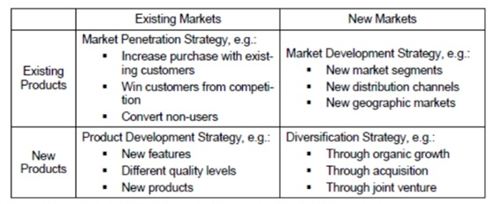
Ansoff Matrix Grid

Slide 12
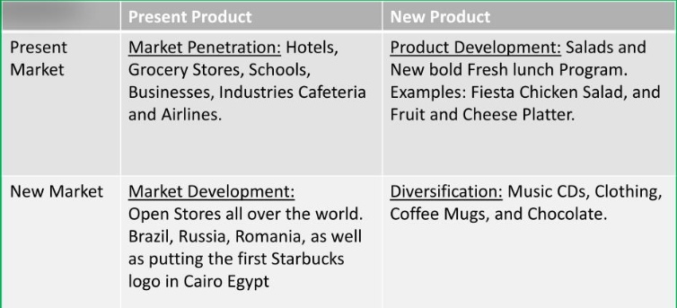
Ansoff Matrix Example
Starbucks

Slide 13
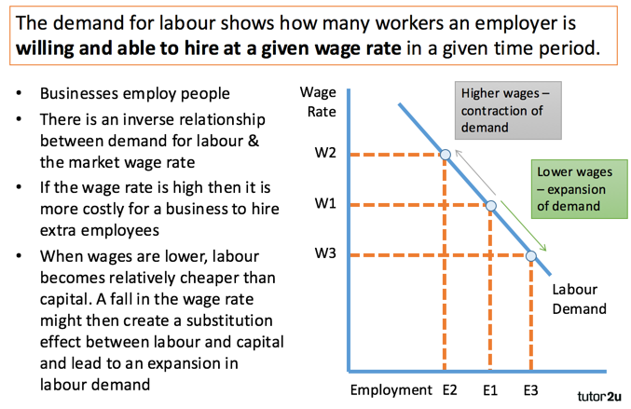
Demand Curve of Labour

Slide 14
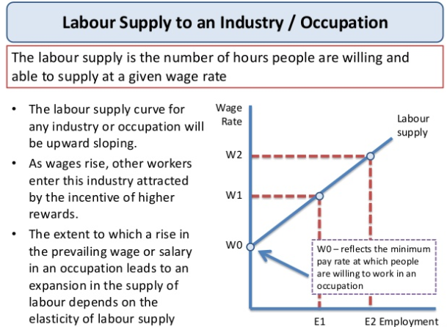
Supply Curve of Labour

Slide 15
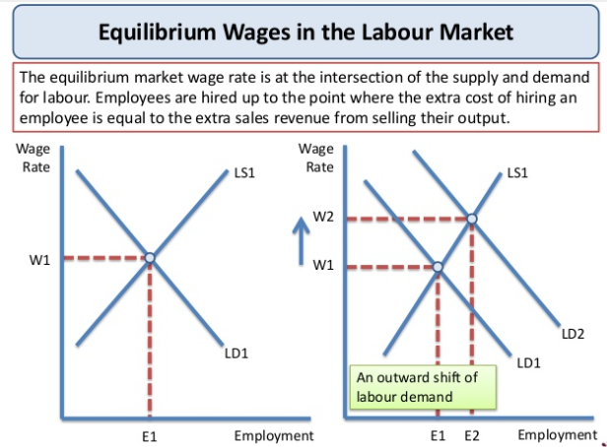
Equilibrium

Slide 16
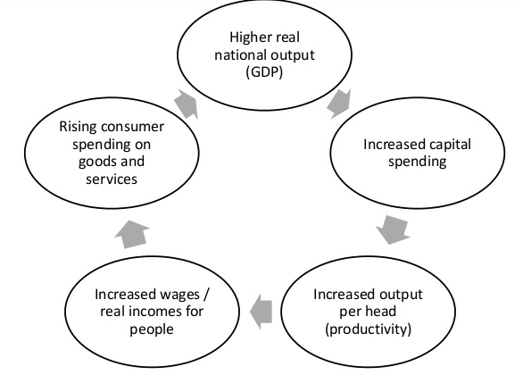
Economic Growth

Slide 17
HR Roles and Responsibilities
Micro HRM :covers the functions of HR policy and practice and consists of two main categories: one with managing individuals and small groups (e.g., staffing, training and development, performance management, and total rewards) and the other with managing work organization and employee voice systems (including union-management relations).
Strategic human resource management (strategic HRM, or SHRM) may be regarded as an approach to the management of human resources that provides a strategic framework to support long-term business goals and outcomes.
International Human Resource Management (IHRM), called Global HRM, covers HRM in companies operating across national boundaries

Slide 18
Questions

