Slide 1
BUSINESS LEADERSHIP IV
SPHRi

Slide 2

Income Statement
An income statement is one of the financial statements shown the company’s revenues and expenses during a particular period. It indicates how the revenues are transformed into the net income

Slide 3

Balance Sheet
The statement of financial position (balance sheet) “provides information about an entity’s assets, liabilities, and equity and their relationships to each other at a moment in time.”

Slide 4
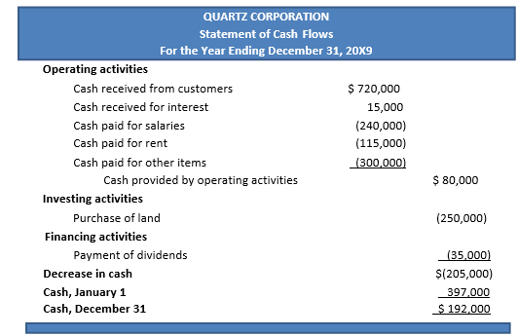
Cash Flow Statement
Cash flow statements assess the amount, timing, and predictability of cash-inflows and cash-outflows, and are used as the basis for budgeting and business-planning. The accounting data is presented usually in three main sections:
    Operating-activities (sales of goods or services),
    Investing-activities (sale or purchase of an asset, for example), and
    Financing-activities (borrowings, or sale of common stock, for example).

Slide 5

Marketing Mix
Satisfying needs and wants through an exchange process
Marketing is the process of planning, pricing, promoting, and distributing goods and services to satisfy organizational objectives

Slide 6
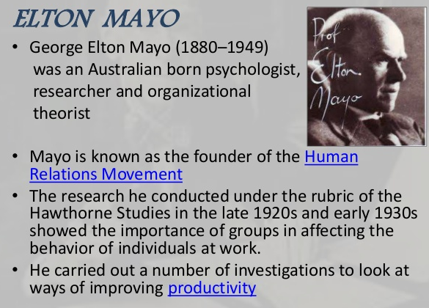
Human Relations Movement

Slide 7
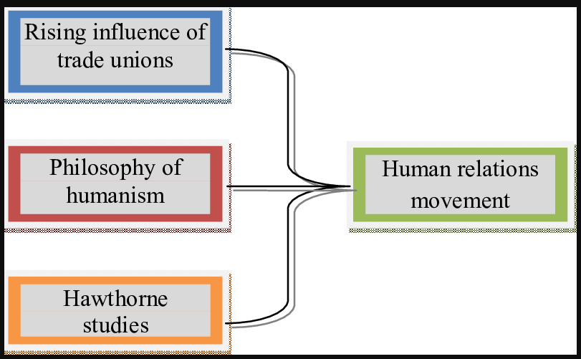
Rise of Human Relations Movement

Slide 8
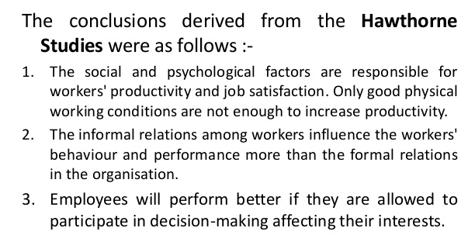
Implications of Hawthrone Studies

Slide 9
Human Capital Management
Human Capital - The sum of workforce skills, Knowledge and experience
Human Capital Management, or HCM, is the effective acquisition, employment, and development of a company’s employees through strategic and tactical practices, processes, and applications in order to maximize their economic value.

Slide 10
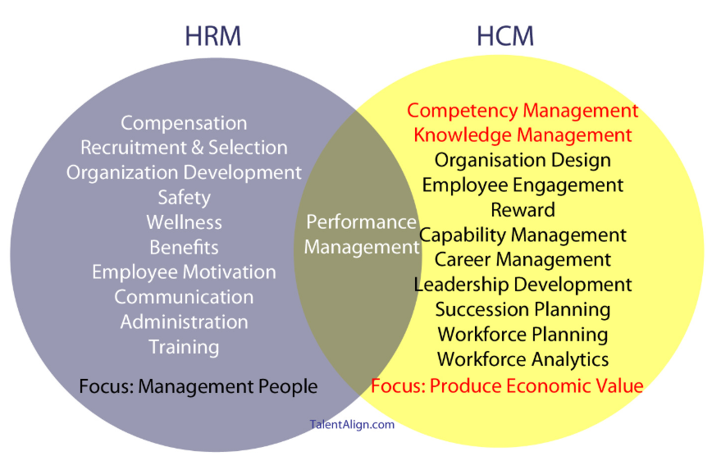
HRM vs HCM

Slide 11
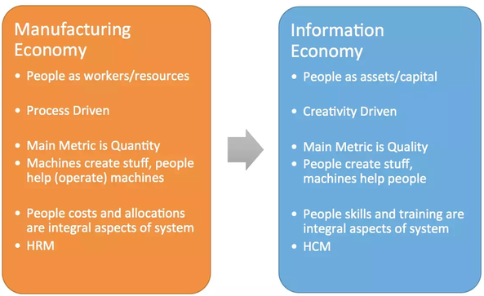
Shift from HRM to HCM

Slide 12
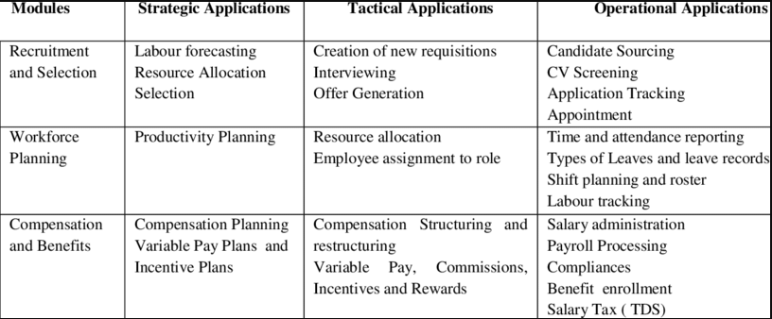
Strategic, Operational, Tactical

Slide 13
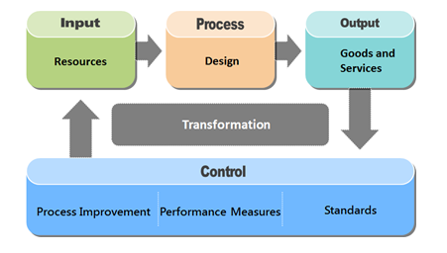
Operations Management

Slide 14
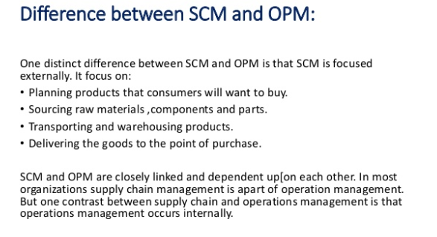
Difference between SCM and OPM

Slide 15
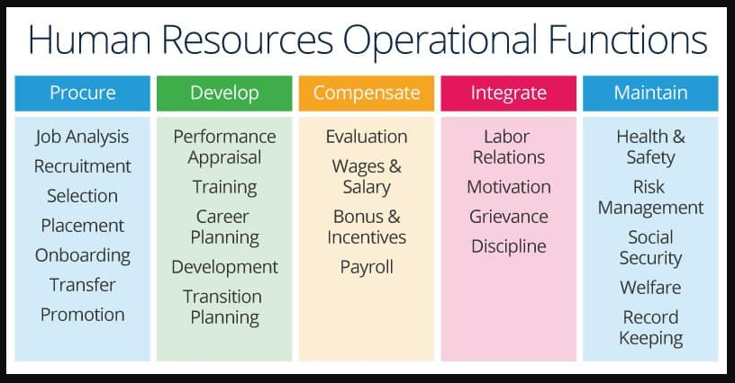
HR Operations Management

Slide 16
HRIS
HRIS stands for Human Resources Information System. The HRIS is a system that is used to collect and store data on an organization’s employees.
In most cases, an HRIS encompasses the basic functionalities needed for end-to-end Human Resources Management (HRM). It has a system for recruitment, performance management, learning & development, and more.
An HRIS is also known as HRIS software. This is a bit confusing as it implies that different systems can have different software running on them. However, this is not the case. The HRIS is, in essence, a software package.
The HRIS can either run on the company’s own technical infrastructure, or, what’s more common nowadays, be cloud-based. This means that the software is running outside of the company’s premises, making it much easier to update

Slide 17
Benefits of HRIS
Record-keeping. An HRIS is a record-keeping system that keeps track of changes to anything related to employees. The HRIS can be seen as the one source of truth when it comes to personnel data.
Compliance. Some data is collected and stored for compliance reasons. This includes material for the identification for employees in case of theft, fraud, or other misbehaviors, first contact information in case of accidents, citizens identification information for the tax office, and expiration dates for mandatory certification. All this information can be stored in the HRIS.
Efficiency. Having all this information in one place not only benefits accuracy but also saves time.
HR strategy. The HRIS enables the tracking of data required to advance the HR and business strategy. Depending on the priorities of the organization, different data will be essential to track. This is where the HRIS comes in.
Self-Service HR. A final benefit is the ability to offer self-service HR to employees and managers. This enables employees to manage their own affairs. When done right, the HRIS can offer a good employee experience. Keep in mind that not all HRIS systems offer this in a user-friendly manner!

Slide 18
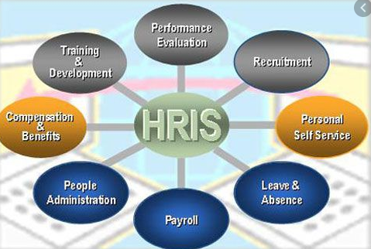
HRIS SYSTEM

Slide 19
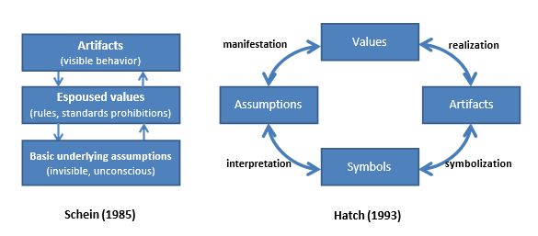
Organisational Culture

Slide 20

Trompenaars and Hampden-Turner's Seven Dimensions of Culture

Slide 21

Hofstede’s Cultural Dimensions

Slide 22
Questions

