Slide 1
BUSINESS LEADERSHIP IV
SPHRi

Slide 2
STRATEGIC MANAGEMENT

Slide 3
Strategy
Strategy is a term that comes from the Greek word strategos meaning “Army Leader”.
Strategy is a plan, a "how," a means of getting from here to there.
Strategy is a pattern in actions over time; for example, a company that regularly markets very expensive products is using a "high end" strategy.
Strategy is position; that is, it reflects decisions to offer particular products or services in particular markets.
Strategy is perspective, that is, vision and direction
Henry Mintzberg, The Rise and Fall of Strategic Planning

Slide 4
Strategy
Strategy is a plan, pattern, position, perspective
It basically answers –
Where we are now?
Where do we want to be?
How will we get there?
Strategy is about competitive position, about differentiating yourself in the eyes of the customer, about adding value through a mix of activities different from those used by competitors
Michael Porter, Competitive Advantage

Slide 5

Strategy

Slide 6
Tactics
A tactic is a conceptual action or short series of actions with the aim of achieving of a short-term goal.
Difference between Tactics and Strategy
A strategy is a set of guidelines used to achieve an overall objective, whereas tactics are the specific actions aimed at adhering to those guidelines
Tactics are the actual means used to gain an objective, while strategy is the overall plan

Slide 7
Strategy in Business
Strategy is about positioning an organization to have a competitive advantage by making choices about:
which countries/industries to participate in;
what products/services to offer;
how to allocate corporate resources.

Slide 8
Strategic Planning
Strategic planning is a function of strategic management, which is the continuing process of pursuing a favourable competitive fit between the firm and its dynamic environment.
A strategic plan is a document used to communicate with the organization the organizations goals, the actions needed to achieve those goals and all of the other critical elements developed during the planning exercise.

Slide 9

Strategic Planning

Slide 10
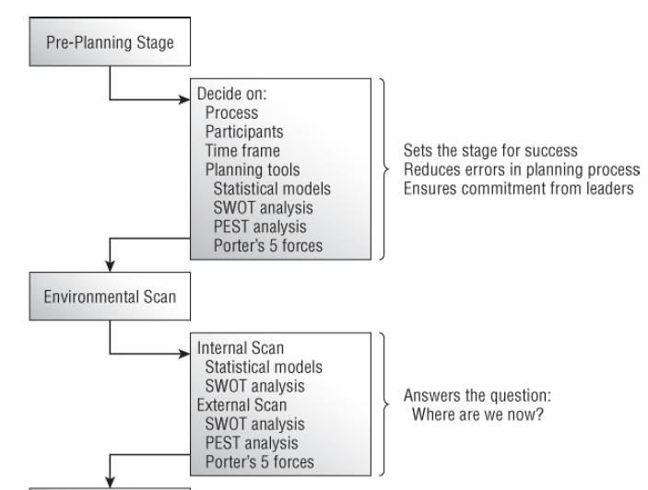
Elements of Strategic Planning Process

Slide 11
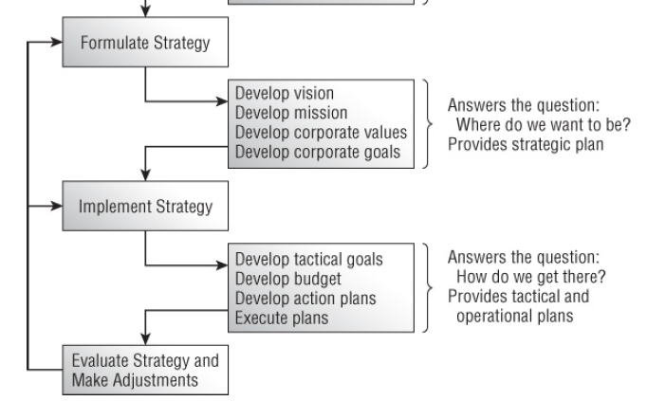
Elements of Strategic Planning Process

Slide 12
Vision Statement
A vision statement is a company's road map, indicating what the company wants to become by setting a defined direction for the company's growth
Big picture idea of what you want to achieve
Concise: able to be easily remembered and repeated
Clear: defines a prime goal
Time horizon: defines a time horizon
Future-oriented: describes where the company is going
Stable: offers a long-term perspective
Challenging: not something that can be easily met and discarded
Abstract: encompass all of the organization's interests and direction
Inspiring: motivates employees

Slide 13
Examples of Vision Statement
Bring inspiration and innovation to every athlete in the world ~ Nike
Our vision is to create a better everyday life for many people ~ IKEA
To be the best quick service restaurant experience. Being the best means providing outstanding quality, service, cleanliness and value, so that we make every customer in every restaurant smile ~ McDonald
Connect with friends and the world around you on Facebook
Create economic opportunity for every member of the global workforce ~ Linkedin

Slide 14
Mission Statement
A mission statement is a short statement of why an organization exists, what its overall goal is, identifying the goal of its operations: what kind of product or service it provides, its primary customers or market, and its geographical region of operation
“What do we do?” — The main purpose of the organisation
“How do we do it?” — Achieving the mission statement.
“Whom do we do it for?” — Target audience.
“What value are we bringing?” — The benefits and values

Slide 15
Examples of Mission Statement
To give people the power to share and make the world more open and connected ~ Facebook
“To connect the world’s professionals to make them more productive and successful” ~ Linkedin
“To be one of the world’s leading producers and providers of entertainment and information, using its portfolio of brands to differentiate its content, services and consumer products.” ~ Walt Disney
“To be a company that inspires and fulfils your curiosity.” ~ Sony

Slide 16


Differences in terms

Slide 17
Values
Organisational values describe the core ethics or principles which the company will abide by.
How you will behave during the process
Example : Google –
Focus on the user and all else will follow.
It’s best to do one thing really, really well.
Fast is better than slow.
Democracy on the web works.
There’s always more information out there.
The need for information crosses all borders.
You can be serious without a suit.
Great just isn’t good enough.

Slide 18
Goals
Organizational goals are strategically set objectives that outline expected results and guide employees’ efforts
There are three types of organizational goals are strategic, tactical, and operational goals.
Example :
Enter X, Y, Z markets by date.
20 total regional markets by date.
20% market share in each new market by date.

Slide 19
Objective
Organizational objectives are short-term and medium-term goals that an organization seeks to accomplish. An organization's objectives will play a large part in developing organizational policies and determining the allocation of organizational resources. Achievement of objectives helps an organization reach its overall strategic goals.

Slide 20
Summary
Vision – Big picture of what you want to achieve.
Mission – General statement of how you will achieve the vision.
Core Values – How you will behave during the process.
Strategies – Strategies are one or more ways to use the mission statement in order to achieve the vision statement. Although an organization will have just one vision statement and one mission statement, it may have several strategies.
Goals – These are general statements of what needs to be accomplished to implement a strategy.
Objectives – Objectives provide specific milestones with a specific timeline for achieving a goal.
Action Plans – These are specific implementation plans of how you will achieve an objective.

Slide 21

Different Terms

Slide 22
SWOT
The primary aim of strategic planning is to bring an organization into balance with the external environment and to maintain that balance over time. Organizations accomplish this balance by evaluating new programs and services with the intent of maximizing organizational performance. SWOT analysis is a preliminary decision-making tool that sets the stage for this work.

Slide 23

SWOT Analysis

Slide 24
Strengths
They are characteristics of the business or team that give it an advantage over others in the industry. Strengths must focus upon what the firm can do with its internal resources.
Any asset that the firm owns could certainly be classified as strength,
State-of-the-art production line machinery
A strong brand-name presence
Recognized customer service excellence,
Exclusive access to a strong supply chain network

Slide 25
Weaknesses
Characteristics that place the firm at a disadvantage relative to others.
Poor product positioning
Deteriorating physical assets
Out-of-date production equipment
Poor customer service
High employee turnover that causes the firm to lose talented people can be a major weakness of the firm

Slide 26
Opportunities
In general, any changes in the external environment can be an opportunity to the firm
Changes in tax structure
Improvements in economic trends
The passage of favourable laws
Market positioning
New technologies
International trade agreements

Slide 27
Threats
They are external elements in the environment that could cause trouble for the business.
Changes in consumer preferences
New competitor innovations
Restrictive regulations
Unfavourable trade barriers
Loss of favorable distribution networks
Restrictions on the firm’s cash flows
Anything that can threaten the firm’s market position

Slide 28

Michael Porter
Degree in aerospace and mechanical engineering from Princeton University in 1969
MBA in 1971 from Harvard Business School
PhD in business economics from Harvard University in 1973
Five forces framework was first published in Harvard Business Review in 1979

Slide 29
Strategy Formulation
As the Company’s vision, mission, core value statements, and SWOTs are defined. Businesses can secure a sustainable competitive advantage by adopting one of three generic strategies as follows:
Cost leadership Strategy
Differentiation Strategy
Focus (Niche) Strategy
"Middle of the road" strategy

Slide 30
Cost Leadership Strategy
Cost leadership is to drive cost down through all the elements of the production of the product from sourcing, to labor costs.
This strategy involves the organization aiming to be the lowest cost producer and/or distributor within their industry.
To achieve cost leadership a business will usually need large scale production so that they can benefit from "economies of scale".
Large scale production means that the business will need to appeal to a broad part of the market

Slide 31
Cost Leadership Strategy
A cost leadership business can create a competitive advantage:
by reducing production costs and therefore increasing the amount of profit made on each sale as the business believes that its brand can command a premium price or
by reducing production costs and passing on the cost saving to customers in the hope that it will increase sales and market share

Slide 32
Differentiation Strategy
Differentiation is to focus its effort on particular segments and charge for the added differentiated value.
To be different, is what organization striving for; companies and product ranges that appeal to customers and "stand out from the crowd" have a competitive advantage.
Porter asserts that businesses can stand out from their competitors by developing a differentiation strategy.

Slide 33
Differentiation Strategy
With a differentiation strategy the business develops product or service features which are different from competitors and appeal to customers including functionality, customer support and product quality.
New concepts which allow for differentiation can be protected through patents and other intellectual property rights.

Slide 34
Focus (Niche) Strategy
Focus or Niche is to form a competitive advantage for this niche market and either succeeds by being a low cost producer or differentiator within that particular segment.
Under a focus strategy a business focuses its effort on one particular segment of the market and aims to become well known for providing products/services for that segment.
They form a competitive advantage by catering for the specific needs and wants of their niche market.
A focus strategy is known as a narrow scope strategy because the business is focusing on a narrow (specific) segment of the market

Slide 35
"Middle of the road" strategy
Some businesses will attempt to adopt all three strategies; cost leadership, differentiation and niche (focus).
A business adopting all three strategies is known as "stuck in the middle".
They have no clear business strategy and are attempting to be everything to everyone.
This is likely to increase running costs and cause confusion, as it is difficult to please all sectors of the market.
Middle of the road businesses usually do the worst in their industry because they are not concentrating on one business strength.
In other word, try to do all three would become stuck in the middle and danger.

Slide 36

Competitive Advantage

