Slide 1
BUSINESS LEADERSHIP - III
SPHRi

Slide 2

Phases of Strategy Management Process

Slide 3
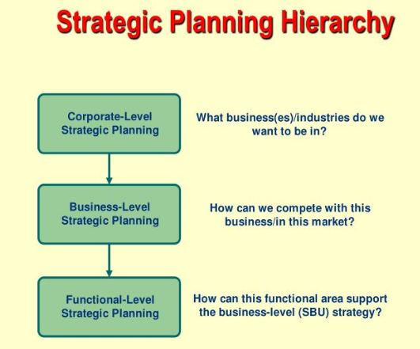
Hierarchical level of Strategy

Slide 4

Difference Strategy Formulation vs Implementation

Slide 5

Managing Strategy : Four Processes

Slide 6

Strategy Evaluation

Slide 7
Strategy Implementation Activities
Establish short-term organizational objectives
Formulation of policies for execution of strategies
Allocation of resources
Communicate and train employees

Slide 8

Strategy Evaluation Methods

Slide 9

HR in Strategy Planning

Slide 10

Porter Value Chain

Slide 11

Business Model Framework

Slide 12

Business Model Framework

Slide 13

Supply Chain

Slide 14
HR in Supply Chain
  Considering supply chain strategy, characteristics and partners when developing the HR strategy.
  Using HR systems (e.g. incentives, performance management, long-term relationships) to manage supply chain partners.
  Collaborating with the supply chain partners to develop and coordinate HR systems for the supply chain as a whole.
  Aligning recruitment practices among the supply chain firms.
  Sharing applicant pools.
  Forecasting labor demand and supply across the entire supply chain.
  Identifying training needs and objectives specifically for supply chain positions, and designing training to meet those needs.

Slide 15
HR in Supply Chain
Identifying the training needs of the supply chain partners, and training those partners (or vice versa).
Joint training and cross-organizational training of workers across the supply chain.
Developing performance metrics for the supply chain.
Aligning performance appraisal dimensions across supply chain partners.
Learning from supply-chain partner feedback on individual and group performance

Slide 16
Questions

