Slide 1
BUSINESS LEADERSHIP - II
SPHRi

Slide 2
Strategy
Strategy is a term that comes from the Greek word strategos meaning “Army Leader”.
Strategy is a plan, a "how," a means of getting from here to there.
Strategy is a pattern in actions over time; for example, a company that regularly markets very expensive products is using a "high end" strategy.
Strategy is position; that is, it reflects decisions to offer particular products or services in particular markets.
Strategy is perspective, that is, vision and direction
Henry Mintzberg, The Rise and Fall of Strategic

Slide 3
Strategy
Strategy is a plan, pattern, position, perspective
It basically answers –
Where we are now?
Where do we want to be?
How will we get there?
Strategy is about competitive position, about differentiating yourself in the eyes of the customer, about adding value through a mix of activities different from those used by competitors
Michael Porter, Competitive Advantage

Slide 4

Strategy

Slide 5
Vision Statement
A vision statement is a company's road map, indicating what the company wants to become by setting a defined direction for the company's growth
Big picture idea of what you want to achieve
Concise: able to be easily remembered and repeated
Clear: defines a prime goal
Time horizon: defines a time horizon
Future-oriented: describes where the company is going
Stable: offers a long-term perspective
Challenging: not something that can be easily met and discarded
Abstract: encompass all of the organization's interests and direction
Inspiring: motivates employees

Slide 6
Examples of Vision Statement
Bring inspiration and innovation to every athlete in the world ~ Nike
Our vision is to create a better everyday life for many people ~ IKEA
To be the best quick service restaurant experience. Being the best means providing outstanding quality, service, cleanliness and value, so that we make every customer in every restaurant smile ~ McDonald
Connect with friends and the world around you on Facebook
Create economic opportunity for every member of the global workforce ~ Linkedin

Slide 7
Mission Statement
A mission statement is a short statement of why an organization exists, what its overall goal is, identifying the goal of its operations: what kind of product or service it provides, its primary customers or market, and its geographical region of operation
“What do we do?” — The main purpose of the organisation
“How do we do it?” — Achieving the mission statement.
“Whom do we do it for?” — Target audience.
“What value are we bringing?” — The benefits and values

Slide 8
Examples of Mission Statement
To give people the power to share and make the world more open and connected ~ Facebook
“To connect the world’s professionals to make them more productive and successful” ~ Linkedin
“To be one of the world’s leading producers and providers of entertainment and information, using its portfolio of brands to differentiate its content, services and consumer products.” ~ Walt Disney
“To be a company that inspires and fulfils your curiosity.” ~ Sony

Slide 9
Values
Organisational values describe the core ethics or principles which the company will abide by.
How you will behave during the process
Example : Google –
Focus on the user and all else will follow.
It’s best to do one thing really, really well.
Fast is better than slow.
Democracy on the web works.
There’s always more information out there.
The need for information crosses all borders.
You can be serious without a suit.
Great just isn’t good enough.

Slide 10
Goals
Organizational goals are strategically set objectives that outline expected results and guide employees’ efforts
There are three types of organizational goals are strategic, tactical, and operational goals.
Example :
Enter X, Y, Z markets by date.
20 total regional markets by date.
20% market share in each new market by date.

Slide 11


Differences in terms

Slide 12
Objective
Organizational objectives are short-term and medium-term goals that an organization seeks to accomplish. An organization's objectives will play a large part in developing organizational policies and determining the allocation of organizational resources. Achievement of objectives helps an organization reach its overall strategic goals.

Slide 13
Tactics
A tactic is a conceptual action or short series of actions with the aim of achieving of a short-term goal.
Difference between Tactics and Strategy
A strategy is a set of guidelines used to achieve an overall objective, whereas tactics are the specific actions aimed at adhering to those guidelines
Tactics are the actual means used to gain an objective, while strategy is the overall plan

Slide 14
Summary
Vision – Big picture of what you want to achieve.
Mission – General statement of how you will achieve the vision.
Core Values – How you will behave during the process.
Strategies – Strategies are one or more ways to use the mission statement in order to achieve the vision statement. Although an organization will have just one vision statement and one mission statement, it may have several strategies.
Goals – These are general statements of what needs to be accomplished to implement a strategy.
Objectives – Objectives provide specific milestones with a specific timeline for achieving a goal.
Action Plans – These are specific implementation plans of how you will achieve an objective.

Slide 15

Different Terms

Slide 16
Strategic Planning
Strategic planning is a function of strategic management, which is the continuing process of pursuing a favorable competitive fit between the firm and its dynamic environment. A strategic plan is a document used to communicate with the organization the organizations goals, the actions needed to achieve those goals and all of the other critical elements developed during the planning exercise.

Slide 17

Strategic Planning

Slide 18

SWOT Analysis

Slide 19
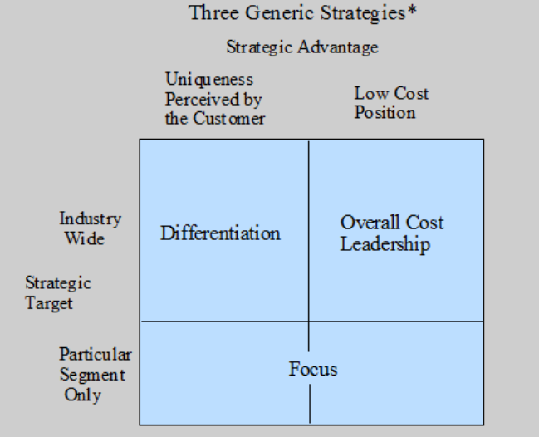
Competitive Advantage

Slide 20
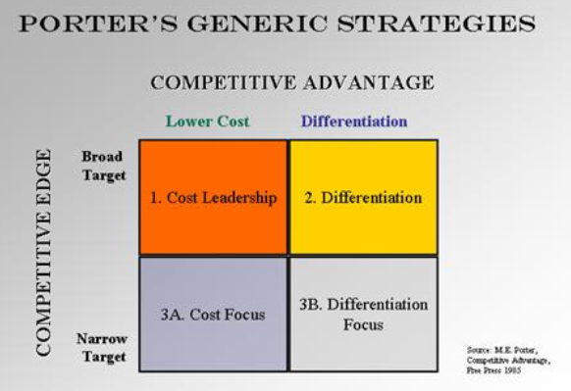
Porters Competitive Advantage

Slide 21

Balanced Scorecard

Slide 22

Management by Objectives

Slide 23

SMART Goals

Slide 24

Budgeting

Slide 25

McKinsey 7S Framework

Slide 26
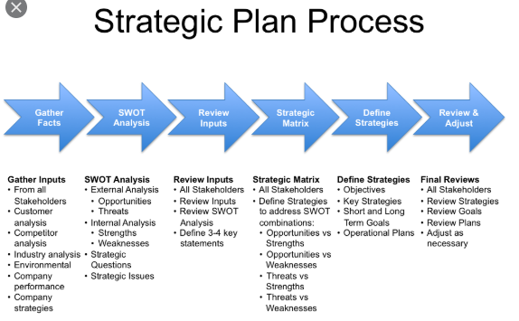
Strategic Plan Process

Slide 27
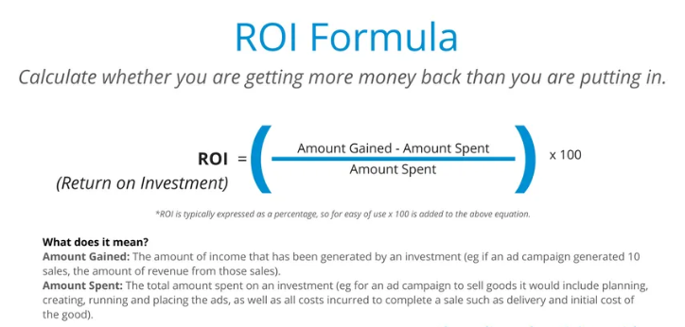
Return on Investment (ROI)

Slide 28
Questions

