Slide 1
BUSINESS LEADERSHIP - II
SPHRi

Slide 2
Globalisation
Globalization is the free movement of goods, services and people across the world in a seamless and integrated manner.
Globalization is grounded in the theory of comparative advantage which states that countries that are good at producing a particular good are better off exporting it to countries that are less efficient at producing that good

Slide 3

Stages of Globalisation

Slide 4
Stage 1: Domestic
The product or service is developed in the home country and produced and sold there. The strategy focuses only on the home market; the organization is mono-cultural (as defined by the home country).

Slide 5
Stage 2: International
A company begins to export a product or service to foreign countries, call International Corporation. The company may open production facilities or service centers, but the product/service, processes, and strategy are developed in the home country.

Slide 6
Stage 3: Multinational
The Multinational Corporations (MNCs) has its facilities and other assets in at least one country other than its home country. Gradually, perhaps in response to the needs of local markets, operations in host countries become more autonomous. The organization is a decentralized portfolio of subsidiaries. Knowledge is developed within the subsidiary and remains there. Many MNCs are staffed by host-country nationals, but key managers come from headquarters. Key decisions are made at headquarters as well.

Slide 7
Stage 4: Global
The global corporation views the world as a single, global market and offers global products that have little or no national variation or that have been designed with customizable elements. Strategy, ideas, and processes emanate from headquarters.

Slide 8
Global Orientations
Global integration refers to the coordination of the firm’s value-chain activities across
countries to achieve worldwide efficiency, synergy, and cross-fertilization in order to take
maximum advantage of similarities between countries. The flexibility objective is also
called local responsiveness. Local responsiveness refers to meeting the specific needs of buyers in individual countries.

Slide 9
Global Integration vs. Local Responsiveness
Globalized company achieves greater business efficiency, uniformity, and control of its brand and image. Localized company has more ability to be customer-focused and meet legal and cultural requirements. When the company becomes part of local networks, it is more likely to enjoy the support of authorities and public opinion, becomes active in local workforce development, and benefits from lower cost of operations. Moreover, the use of a local workforce is less expensive than use of a large expatriate workforce, and it reduces tensions between different workforces.

Slide 10

Global Integration & Local Responsiveness
Notes:
Bartlett & Ghoshal

Slide 11

Bartlett and Ghoshal Matrix

Slide 12
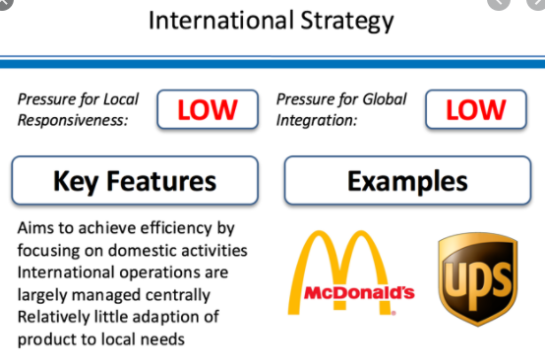
International Strategy

Slide 13
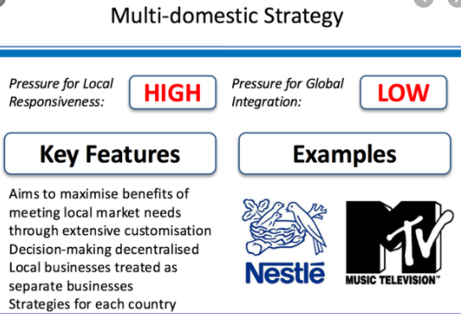
Multi Domestic Strategy

Slide 14
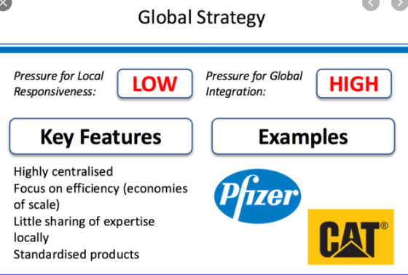
Global Strategy

Slide 15
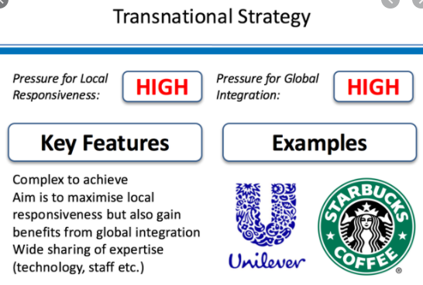
Transnational Strategy

Slide 16
Culture
Culture may be defined as a shared system of values, beliefs, and attitudes. It affects our own actions and the way we perceive the actions of others.
National Culture
Subculture
Organisational/Corporate Culture

Slide 17
Organisational Culture
Organizational Culture is a system of shared meaning. Just as tribal cultures have rules and taboos that dictate how members will act toward each other and outsiders, organizations have cultures that govern how its members should behave. A strong organizational culture usually provides a sense of identity for employees and a commonality of values and goals that leads to effective change management and problem solving.

Slide 18

Edgar Schein’s Model

Slide 19

Organisational Culture
    Artefacts
    Espoused Values
    Shared Tacit Assumptions

Slide 20
National Culture
The values that distinguished countries (rather than individuals) from each other grouped themselves statistically into four clusters. They dealt with four anthropological problem areas that different national societies handle differently:
ways of coping with inequality
ways of coping with uncertainty
the relationship of the individual with her or his primary group
the emotional implications of having been born as a girl or as a boy.

Slide 21
Hofstede Six Dimensions
Geert Hofstede dimensions of national culture:
Power Distance
Uncertainty Avoidance
Individualism versus Collectivism
Masculinity versus Femininity
Time Perspective
Indulgence/Restraint

Slide 22

Hofstede’s Cultural Dimensions

Slide 23
Individualism vs. Collectivism
Individualism is the tendency of people to look after themselves and their immediate family only; Individualism is the preference of people to belong to a loosely knit society where importance is placed on the self and autonomy.
In opposition, collectivism is the tendency of people to belong to groups or collectives and to look after each other in exchange for loyalty. Collectivist structures place importance on interdependent social units such as the family, rather than on the self. In individualist societies, employees require the freedom to work independently and desire challenging work (which is more important than personal relationships) that will help them reach self-actualization. In collectivist cultures, unquestioned management structures are responsible for the organization of teams of employees and the cohesion of the collective.

Slide 24
Masculinity vs. Femininity
Masculinity is a culture in which the dominant values in society are success, money, and that score high on masculinity; masculinity represents cultures with distinct gender roles where men focus on success, competition and rewards while women focus on tender values such as quality of life and modesty. Femininity represents cultures where gender roles overlap. Femininity is a culture in which the dominant values in society are caring for others and quality of life scores high on femininity. In masculine cultures managers are defined as more assertive and decisive, whereas feminine cultures breed more intuitive managers who negotiate disputes and encourage participation in decisions.

Slide 25
Uncertainty Avoidance
Uncertainty avoidance is the degree to which members of a culture feel threatened or uncertain in unfamiliar situations. Thus in high uncertainty avoidance cultures, people prefer a structured environment with rules and policies in place. Hard work is embraced, and there is a greater sense of anxiety amongst the workforce. In contrast, in weak uncertainty avoidance cultures rules create discomfort, almost fear, and exist only where absolutely necessary. People tend to be more relaxed in these cultures, and work at a slower pace. High uncertainty avoidance favors precise rules, teachers who are always right and superiors who should be obeyed without question. Low uncertainty avoidance favors flexibility, discussion and delegation of decision making

Slide 26
Power distance
Power distance is the extent to which less powerful members of institutions and organizations accept that power is distributed unequally. In high power distance cultures, children are raised with a great emphasis on respecting elders, which is carried through to adulthood. Therefore organizations are more centralized, employees prefer a more autocratic leadership style where subordinates are expected to be told what to do and there are wide wage gaps in the hierarchical structure. On the other hand, in low power distance cultures inequality is not desired, employees prefer to be consulted with regards to decision making and thus prefer a more resourceful and democratic leader.

Slide 27
Time Perspective
Following Hofstede, a subsequent study based on Chinese Confucian Theory revealed a fifth dimension referred to as long-term orientation. This describes the extent to which people have a dynamic, future-oriented perspective. It describes societies' time horizon. Long-term oriented societies attach more importance to the future. They foster pragmatic values oriented towards rewards, including persistence, saving and capacity for adaptation. In short term oriented societies, values promoted are related to the past and the present, including steadiness, respect for tradition, preservation of one's face, reciprocation and fulfilling social obligations.

Slide 28
Indulgence/Restraint
Indulgence societies tend to allow relatively free gratification of natural human desires related to enjoying life and having fun whereas Restraint societies are more likely to believe that such gratification needs to be curbed and regulated by strict norms.
Indulgent cultures will tend to focus more on individual happiness and well-being, leisure time is more important and there is greater freedom and personal control. This is in contrast with restrained cultures where positive emotions are less freely expressed and happiness, freedom and leisure are not given the same importance.

Slide 29

Cultural Dimensions

Slide 30

Trompenaars and Hampden-Turner's Seven Dimensions of Culture

Slide 31
Universalism vs. Particularism (Rules Versus Relationships)
Universalism implies that correct behaviour can be defined and always applies, while particularism suggests that relationships are more important than abstract social codes.
In universalistic cultures, people place a high importance on laws, rules, values, and obligations. On the contrary, in a particularistic culture, People believe that each circumstance, and each relationship, dictates the rules that they live by.
Typical universalistic cultures include the U.S., Canada, the U.K, the Netherlands, Germany, Scandinavia, New Zealand, Australia, and Switzerland. Typical particularistic cultures include Russia, Latin-America, and China.

Slide 32
Individualism vs. Communitarianism (The Individual Versus The Group)
Individualism refers to people as individuals; Communitarianism (Collectivism) refers to people regard themselves as part of a group. In individualistic cultures, People believe in personal freedom and achievement. They believe that you make your own decisions, and that you must take care of yourself. In the second case, people believe that the group is more important than the individual. The group provides help and safety, in exchange for loyalty. The group always comes before the individual.
Typical individualist cultures include the U.S., Canada, the U.K, Scandinavia, New Zealand, Australia, and Switzerland. Typical communitarian cultures include countries in Latin-America, Africa, and Japan.

Slide 33
Neutral vs. Emotional (How People Express Emotions)
Neutral refers to culture in which emotions are not shown; Emotional refers to emotions are expressed openly and naturally. In neutral culture, people make a great effort to control their emotions. Reason influences their actions far more than their feelings. People don't reveal what they're thinking or how they're feeling. In emotional culture, people want to find ways to express their emotions, even spontaneously, at work. In these cultures, it's welcome and accepted to show emotion.
Typical neutral cultures include the U.K., Sweden, the Netherlands, Finland, and Germany. Typical emotional cultures include Italy, France, Spain, and countries in Latin-America.

Slide 34
Specific vs. Diffuse (How Far People Get Involved)
Specific refers to large public space shared with others and small private space guarded closely. In specific culture, people keep work and personal lives separate. As a result, they believe that relationships don't have much of an impact on work objectives, and, although good relationships are important, they believe that people can work together without having a good relationship. In diffuse culture, people see an overlap between their work and personal life.
Typical specific cultures include the U.S., the U.K., Switzerland, Germany, Scandinavia, and the Netherlands. Typical diffuse cultures include Argentina, Spain, Russia, India, and China.

Slide 35
Achievement vs. Ascription (How People View Status)
Achievement culture refers to people are accorded status based on how well perform functions; Ascription culture refers to status based on who or what person is. In achievement culture, people believe that you are what you do, and they base your worth accordingly. These cultures value performance, no matter who you are. In ascription culture, people believe that you should be valued for who you are. Power, title, and position matter in these cultures, and these roles define behavior.
Typical achievement cultures include the U.S., Canada, Australia, and Scandinavia. Typical ascription cultures include France, Italy, Japan, and Saudi Arabia.

Slide 36
Sequential Time vs. Synchronous Time (How People Manage Time)
In sequential time oriented culture, people like events to happen in order. They place a high value on punctuality, planning (and sticking to your plans), and staying on schedule. In this culture, "time is money," and people don't appreciate it when their schedule is thrown off. In synchronous time oriented culture, people see the past, present, and future as interwoven periods. They often work on several projects at once, and view plans and commitments as flexible.
Typical sequential-time cultures include Germany, the U.K., and the U.S. Typical synchronous-time cultures include Japan, Argentina, and Mexico.

Slide 37
Inner-directed vs. Outer-directed (How People Relate to Their Environment)
Inner-directed refers to people believe in control of outcomes; Outer-directed refers to people believe in letting things take own course. In inner-directed culture, people believe that they can control nature or their environment to achieve goals. This includes how they work with teams and within organizations. In outer-directed culture, people believe that nature, or their environment controls them; they must work with their environment to achieve goals. At work or in relationships, they focus their actions on others, and they avoid conflict where possible. People often need reassurance that they're doing a good job.

Slide 38

Diversity Cultures

Slide 39
Family
The Family organizational culture is marked by a parent-child dynamic in which personal relationships and getting along together are extremely important. Power rests in key leaders, who guard it carefully. Success often depends on one's ability to manipulate and build on relationships. This culture occurs most frequently in countries like Japan, France, and Spain.

Slide 40
Eiffel Tower
The Eiffel Tower concept refers to a hierarchical structuring of relationships. Power and decision-making responsibility increase as one move toward the top of the organization. There may be elaborate rules, strictly respected job definitions and responsibilities, and a reliance on planning. These kinds of organizations are generally found in Germany, Denmark, and the Netherlands.

Slide 41
Incubator
The Incubator describes organizations that are relatively flat, in which individuals can exert power and gain recognition. From a national perspective, Sweden tends to produce Incubators; from an industrial perspective, Incubators are often software companies

Slide 42
Guided Missile
The Guided Missile organization is highly focused on the achievement of specific objectives, often those that deliver value in a short time frame. Power is gained through expertise. Value to the organization is measured by results and is rewarded. This type of corporate culture characterizes many organizations in the United Kingdom, the United States, and Canada.

Slide 43

High vs Low Context Culture

Slide 44
High context Culture
High context refers to societies or groups where people have close connections over a long period of time. Many aspects of cultural behavior are, not made explicit, because most members know what to do and what to think from years of interaction with each other. High context is more common in Eastern cultures than in Western cultures.

Slide 45
Low context Culture
Low context refers to societies where people tend to have many connections but of shorter duration or for some specific reason. In these societies, cultural behavior and beliefs may need to be spelled out explicitly so that those coming into the cultural environment know how to behave.

Slide 46

Organisational Climate
Organizational climate is often defined as the recurring patterns of behavior, attitudes and feelings that characterize life in the organization

Slide 47
Climate vs Culture
Climate describes the shared perceptions of the people in a group or organization, while culture includes how people feel about the organization and the beliefs, values, and assumptions that provide the identity and set the standards of behaviour

Slide 48
Corporate Governance
Corporate governance is regarded as a means to ensure that companies are run properly and at the same time, minimising the risk of corporate failure
The need for corporate governance arises because of the separation of management and ownership in modern Corporation
There is an inherent conflict of interest between managers and shareholders. If managers are to act in the best interest of owners, the managers must be monitored and rewarded with appropriate incentives.
Well governed companies are better contributors to the national economy and society

Slide 49
Corporate Governance
The efficiency of this stakeholder approach draws on Japan and Germany as examples of successful industrial societies in which stakeholders are given importance while setting corporate goals so as to maximise the interests of the various groups of stakeholders
In 2001-2002 saw the collapse of two big corporations namely Enron and WorldCom and the ensuing scandals and collapses like Arthur Andersen, Global Crossing and Tyco.

Slide 50

Models of Corporate Governance

Slide 51

Models of Corporate Governance

Slide 52
Questions

