Slide 1
BUSINESS LEADERSHIP - II
SPHRi

Slide 2
Group vs Team
Organisational Structure
Globalisation
Global Integration vs Local Response
Organisational Culture
Corporate Governance
Organisational Life Cycle

Slide 3
Type of Structures
Developing an organizational structure involves defining the framework around which the business operates and provides guidance to all employees by laying out the official reporting relationships that govern the workflow of the company. A well-structured organization chart indicates :
How an organization functions
How it is managed
How information flows and is processed within an organization
How flexible or responsive the organization is.

Slide 4
Structure affects how strategic decisions are made
As the structure becomes more centralized there is a stronger probability that the strategic decision making process will be initiated by only those few dominant individuals who run the company, and that it will be the result of their proactive seeking for business opportunities
As the structure becomes more formalized the strategic decision making process is likely to become reactive rather than proactive
As the level of complexity of the structure grows, so does the probability that members will either not recognize the strategic impacts of a policy or will ignore these impacts in favor of the interests of the immediate unit in which they work

Slide 5
Boundaryless Structure
A boundaryless organization, coined by former GE CEO Jack Welch, is not defined or limited by boundaries or categories imposed by traditional structuresThere are two types of boundaries:
Internal—the horizontal ones imposed by work specialization and departmentalization and the vertical ones that separate employees into organizational levels and hierarchies.
External—the boundaries that separate the organization from its customers, suppliers, and other stakeholders.

Slide 6
Boundaryless Structure
A virtual organization or company is one whose members are geographically apart, usually working by computer e-mail and groupware while appearing to others to be a single, unified organization with a real physical location.
A network organization is one that uses its own employees to do some work activities and networks of outside suppliers to provide other needed product components or work processes. Also called a modular organization by manufacturing firms.

Slide 7
Group vs Team
Organisational Structure
Globalisation
Global Integration vs Local Response
Organisational Culture
Corporate Governance
Organisational Life Cycle

Slide 8
Group vs. Team
Groups differ from teams in several ways:
Task orientation : Teams require coordination of tasks and activities to achieve a shared aim. Groups do not need to focus on specific outcomes or a common purpose.
Degree of interdependence : Team members are interdependent since they bring to bear a set of resources to produce a common outcome. Individuals in a group can be entirely disconnected from one another and not rely on fellow members at all.

Slide 9
Group vs. Team
3. Purpose : Teams are formed for a particular reason and can be short- or long-lived. Groups can exist as a matter of fact; for example, a group can be comprised of people of the same race or ethnic background.
4. Degree of formal structure : Team members' individual roles and duties are specified and their ways of working together are defined. Groups are generally much more informal; roles do not need to be assigned and norms of behavior do not need to develop.

Slide 10
Group vs. Team
5. Familiarity among members : Team members are aware of the set of people they collaborate with, since they interact to complete tasks and activities. Members of a group may have personal relationships or they may have little knowledge of each other and no interactions whatsoever.

Slide 11
Group vs Team
Organisational Structure
Globalisation
Global Integration vs Local Response
Organisational Culture
Corporate Governance
Organisational Life Cycle

Slide 12

Organisational Life Cycle
Start-up
Growth
Maturity
Revival
Decline

Slide 13
Start-Up Stage
A startup is a company that's in the initial stages of business.
Until the business gets off the ground, a startup is often financed by its founders and may attempt to attract outside investment.
The many funding sources for startups include family and friends, venture capitalists, crowdfunding and loans

Slide 14
Growth Stage
In the growth phase, companies experience rapid sales growth. As sales increase rapidly, businesses start seeing profit once they pass the break-even point.

Slide 15
Maturity Stage
Sales continue to increase, but at a slower rate, usually due to either approaching market saturation or the entry of new competitors in the market

Slide 16
Decline Stage
In the final stage of the business life cycle, sales, profit, and cash flow all decline. During this phase, companies accept their failure to extend their business life cycle by adapting to the changing business environment. Firms lose their competitive advantage and finally exit the market.

Slide 17
Revival Stage
Businesses extend their business life cycle during this phase by reinventing themselves and investing in new technologies and emerging markets. This allows for companies to reposition themselves in their dynamic industries, and hence refresh their growth in the marketplace

Slide 18
Group vs Team
Organisational Structure
Globalisation
Global Integration vs Local Response
Organisational Culture
Corporate Governance
Organisational Life Cycle

Slide 19
Globalisation
Globalization is the free movement of goods, services and people across the world in a seamless and integrated manner.
Globalization is grounded in the theory of comparative advantage which states that countries that are good at producing a particular good are better off exporting it to countries that are less efficient at producing that good

Slide 20

Stages of Globalisation

Slide 21
Stage 1: Domestic
The product or service is developed in the home country and produced and sold there. The strategy focuses only on the home market; the organization is mono-cultural (as defined by the home country).

Slide 22
Stage 2: International
A company begins to export a product or service to foreign countries, call International Corporation. The company may open production facilities or service centers, but the product/service, processes, and strategy are developed in the home country.

Slide 23
Stage 3: Multinational
The Multinational Corporations (MNCs) has its facilities and other assets in at least one country other than its home country. Gradually, perhaps in response to the needs of local markets, operations in host countries become more autonomous. The organization is a decentralized portfolio of subsidiaries. Knowledge is developed within the subsidiary and remains there. Many MNCs are staffed by host-country nationals, but key managers come from headquarters. Key decisions are made at headquarters as well.

Slide 24
Stage 4: Global
The global corporation views the world as a single, global market and offers global products that have little or no national variation or that have been designed with customizable elements. Strategy, ideas, and processes emanate from headquarters.

Slide 25
Group vs Team
Organisational Structure
Globalisation
Global Integration vs Local Response
Organisational Culture
Corporate Governance
Organisational Life Cycle

Slide 26
Global Orientations
Global integration refers to the coordination of the firm’s value-chain activities across
countries to achieve worldwide efficiency, synergy, and cross-fertilization in order to take
maximum advantage of similarities between countries. The flexibility objective is also
called local responsiveness. Local responsiveness refers to meeting the specific needs of buyers in individual countries.

Slide 27
Global Integration vs. Local Responsiveness
Globalized company achieves greater business efficiency, uniformity, and control of its brand and image. Localized company has more ability to be customer-focused and meet legal and cultural requirements. When the company becomes part of local networks, it is more likely to enjoy the support of authorities and public opinion, becomes active in local workforce development, and benefits from lower cost of operations. Moreover, the use of a local workforce is less expensive than use of a large expatriate workforce, and it reduces tensions between different workforces.

Slide 28

Global Integration & Local Responsiveness
Notes:
Bartlett & Ghoshal

Slide 29

Bartlett and Ghoshal Matrix

Slide 30
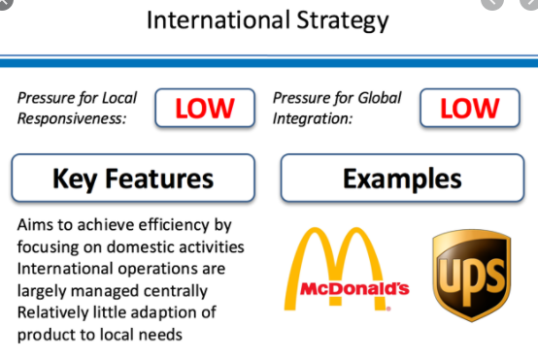
International Strategy

Slide 31
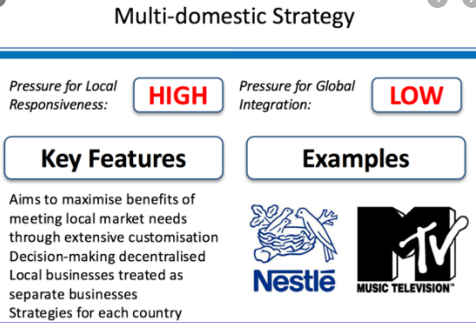
Multi Domestic Strategy

Slide 32
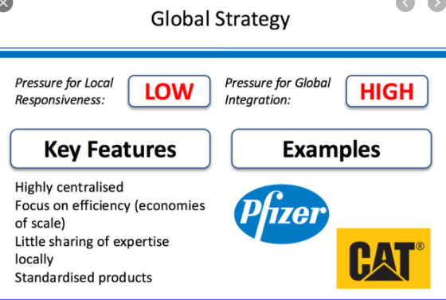
Global Strategy

Slide 33
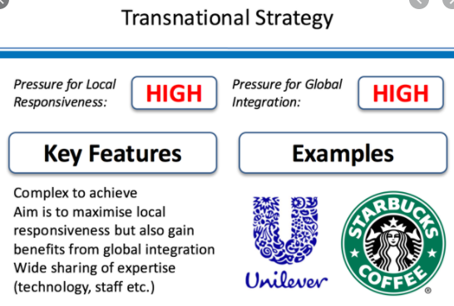
Transnational Strategy

Slide 34
Questions

